Slide 1
S2E Meeting on 07.04.2013
Yauhen Kot

Slide 2
Plans for March 2013 and Achieved Progress
Track 250pC and 500pC within the same optics and RF parameters.
establish suitable bunch distributions for lasing: 25% → 100%
2. Check Lasing of these Bunches: 0% → 50%
3. Internal report about S2E Simulations for XFEL
for pair 250/500pC: 0% → 20%

Slide 3
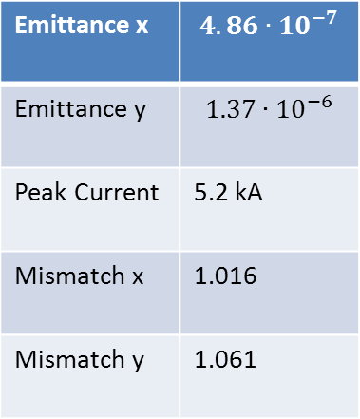
500pC. Combined WP with 250pC. Summary After S2E
Emittance x | $$4.86∙{10}^{−7}$$
Emittance y | $$1.37∙{10}^{−6}$$
Peak Current | 5.2 kA
Mismatch x | 1.016
Mismatch y | 1.061

Slide 4
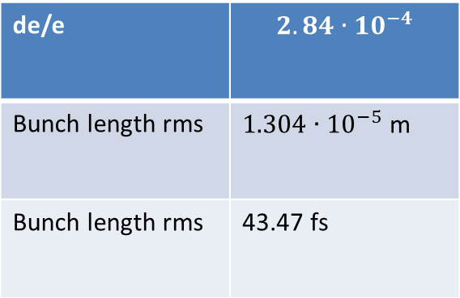
500pC. Combined WP with 250pC. Longitudinal Phase Space After S2E
de/e | $$2.84∙{10}^{−4}$$
Bunch length rms | $1.304∙{10}^{−5}$ m
Bunch length rms | 43.47 fs

Slide 5
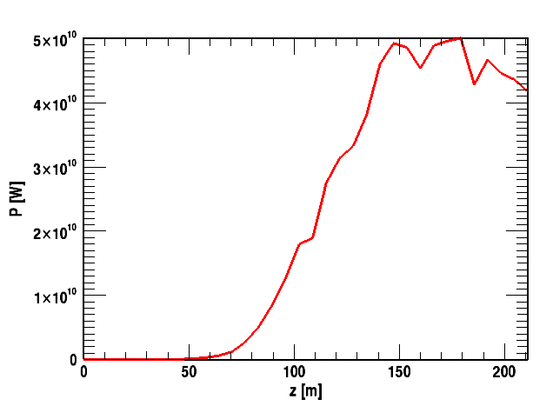
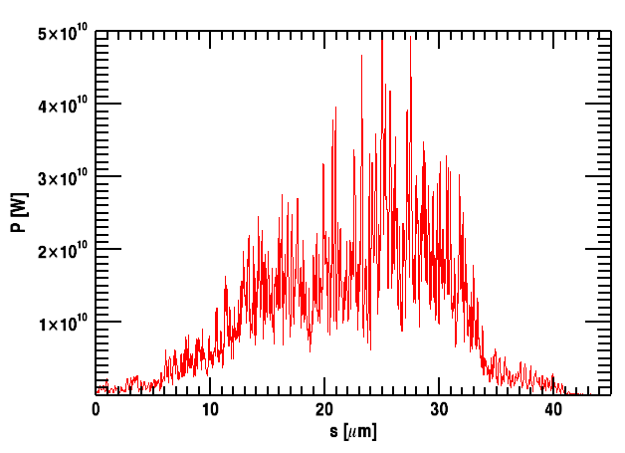
500pC. Combined WP with 250pC. SASE Simulations
45 μm of bunch simulated
beginning after first 11μm
Maximum Power along Undulators
Maximum Power along Bunch

Slide 6
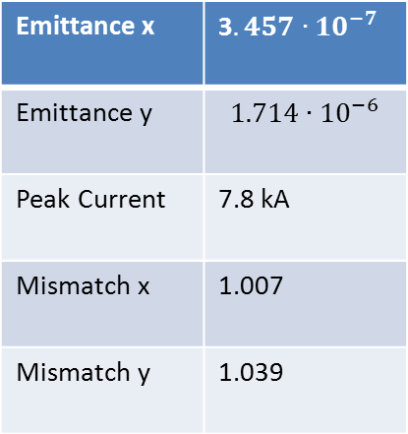
250pC. Combined WP with 500pC. Summary After BC2
Emittance x | 3$.457∙{10}^{−7}$
Emittance y | $$1.714∙{10}^{−6}$$
Peak Current | 7.8 kA
Mismatch x | 1.007
Mismatch y | 1.039

Slide 7
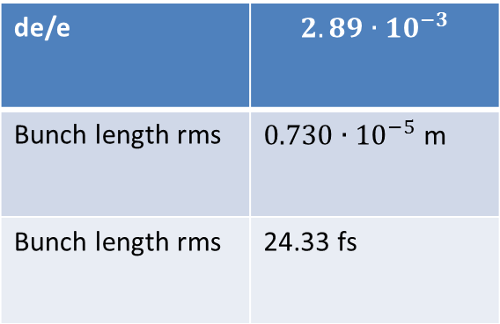
250pC. Combined WP with 500pC. Longitudinal Phase Space After BC2
de/e | $$2.89∙{10}^{−3}$$
Bunch length rms | $0.730∙{10}^{−5}$ m
Bunch length rms | 24.33 fs

Slide 8
Difficulties
- Different chirp for 250pC and 500pC at entrance BC2

Slide 9
Plans for the Next Month
A. Finish this work:
1. Track 250pC and 500pC within the same optics and RF parameters.
establish suitable bunch distributions for lasing: 25% → 100%
2. Check Lasing of these Bunches: 0% → 50%
3. Internal report about S2E Simulations for XFEL
for pair 250/500pC: 0% → 20%
B. To be discussed
- implement back the gaussian laser
…

