Slide 1
Bunch Emission Simulation for the PITZ* Electron Gun Using CST Particle StudioTM
DESY-TUD Meeting 09.08.2013
Ye Chen, Erion Gjonaj, Wolfgang Müller,Thomas Weiland
Notes:
“The European XFEL is more than three kilometers long. It will begin at the DESY site in Hamburg-Bahrenfeld and run to the town of Schenefeld, where the main building with its underground experiment hall will be located.”

Slide 2
Contents
Introduction
CST field simulation
  Eigenmode simulation for Gun 4.3 cavity
  Solenoids simulation
CST PIC simulation
  Modified simulation model
  ASTRA particles import
  Simulation results
Discussion
  Cathode studies
Next steps

Slide 3
Introduction
Motivation
Main tasks
  3D CST field simulations (Gun 4.1/4.3 cavity, Solenoids)
  3D CST beam dynamic simulations
      for different bunch charges
      with homogeneous/inhomogeneous particle distributions
      convergence study and comparisons to ASTRA
  Cathode studies
      Influences from materials, non-uniformities, ……on beam qualities
  Emittance study

Slide 4
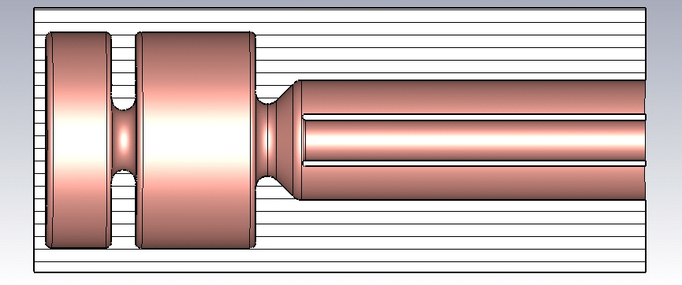
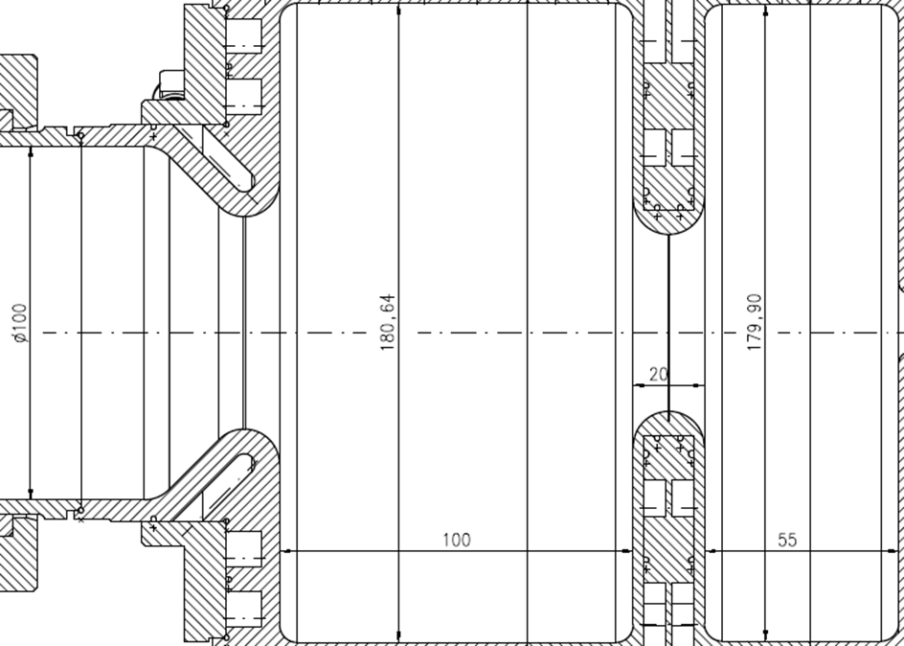
CST Field Simulation
Simulation Model for Gun 4.3
Eigenmode Calculations
Simulation results
Mode | π mode
Field Ratio | 1.04
Frequency | 1.3019 GHz
55
100
Geometry Settings/mm
Ez
179.90
20
100
180.64
Accelerating Ez field along z-axis
z

Slide 5
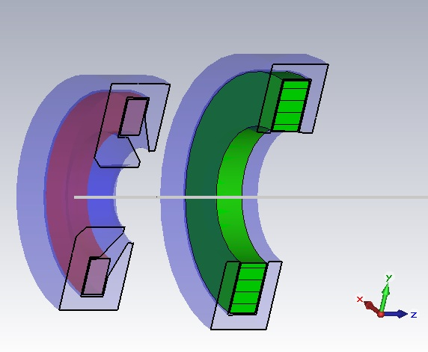
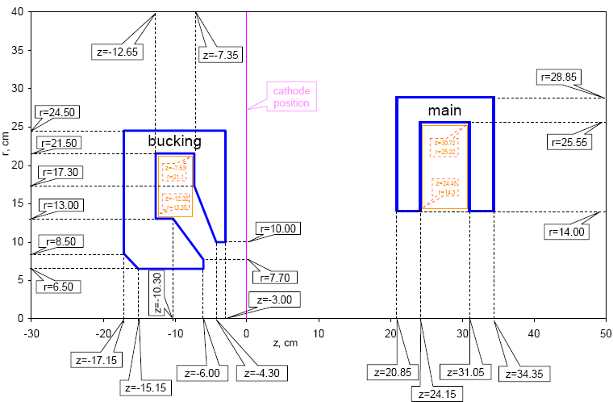
CST Field (Solenoids)
Simulation
Simulation Model
for Solenoids
Pos. of Main = 276 mm
Pos. of Bucking = -172 mm
Curr. of Main = 375 A
Curr. of Bucking = -31 A
B_{zmax} ≈ 0.2279 T
B_{z}(0,0,0) ≈10⁻⁷ T
Geometrical Settings/cm
Longitudinal B field
along z-axis
Bz
z

Slide 6
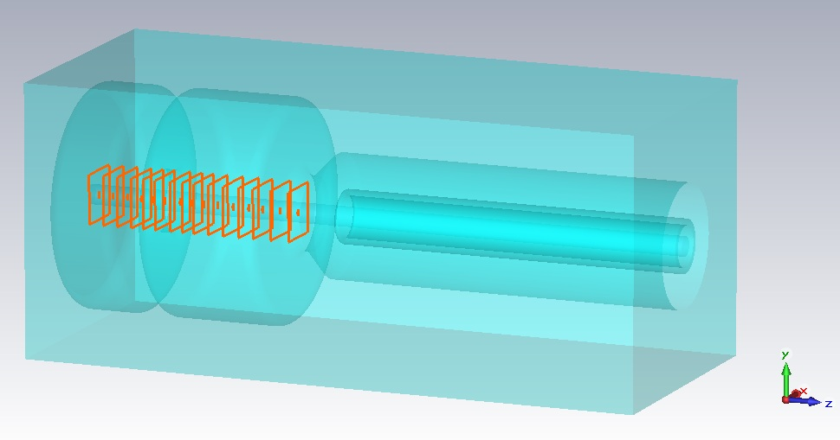
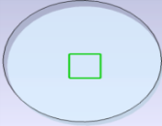
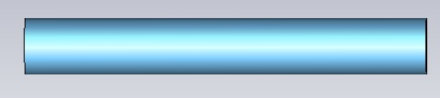
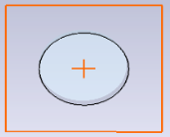
CST PIC Simulation
PIC Simulation Model
Bunch Parameters
& Fields Data
Local Mesh Refinement
Bunch radius = 0.4 mm
Bunch charge = -1 nC
Bunch length = 21.5 ps
Rise/Fall time = 2 ps
Macro particles = 500 k
Cavity frequency = 1.30 GHz
E_{z} at cathode = 60.58 MV/m
Field ratio = 1.04
B_{zmax} = 0.2279 T
Particle Import Interface
electron bunch
2D Particle Monitors: transversal/longitudinal
Min. mesh step= 0.01mm
Meshcell numbers: up to 1000M
Including PIC position monitor, phase-space monitors for momentum, energy, velocity… , 2D particle monitors and particle import interfaces

Slide 7
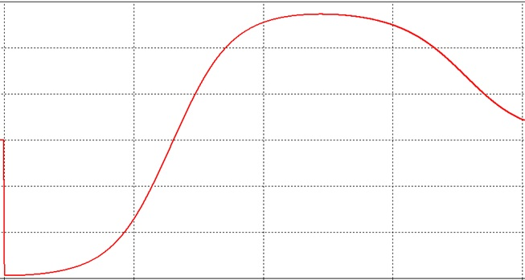
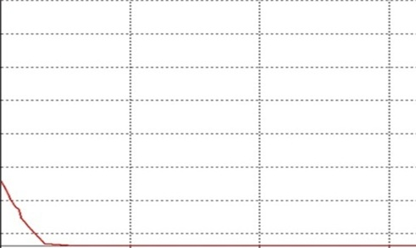
CST PIC Simulation
Problem description
    mesh resolution difference in the cathode region between eigenmode simulation and PIC simulation can lead to field interpolation at the cathode plane
    field interpolation within the first meshcell between PEC and vacuum
  Solutions
    keep the mesh resolution same, but very mesh-consuming
    modify PIC simulation model
Amplitude of E_{z}
Imported longitudinal electric field
along z-axis for PIC simullation
field interpolation at the cathode plane
z

Slide 8
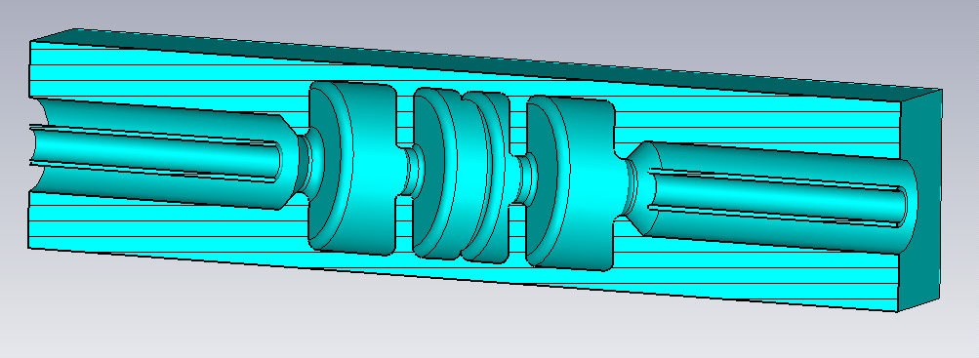
CST PIC Simulation
Mirrored gun model for PIC
  Goal
    to improve the accuracy of the field solution within a short distance from the cathode plane at z = 0
  Implementation
    send positrons & electrons at the same time
    all velocity directions reversed
    keep field ratio same
positron bunch
electron bunch
Longitudinal E field in
the mirrored cavity
E_{z}
z

Slide 9
CST PIC Simulation
4
3.5
3
2.5
2
1.5
1
0.5
0
40
35
30
25
20
15
10
5
0
horizontal rms size of the beam along z-axis (Gun4.1)
CST-1
ASTRA
CST-2
CST-3
X_{rms} /mm
CST-5
Discrepancy /%
CST-4
CST-1, ∆z≈0.075mm
CST-2, ∆z≈0.05mm
CST-3, ∆z≈0.03mm, with original model
CST-4, ∆z≈0.03mm, with mirrored model
Discrepancy
for CST-3
CST-5, ∆z≈0.015mm
ASTRA Simulation
Discrepancy with ASTRA for CST-3
Discrepancy with ASTRA for CST-5
Discrepancy
for CST-5
z /mm
0 250 500 750 1000 1250 1500
  Note that,
  simulations with both of the models showed trends of convergence
  better convergence rate with the mirrored model

Slide 10
CST PIC Simulation
ASTRA Particle Import
Astra2CST
Particles
z=z₀, tє(t₀,t₁)
Particles
t=t₀, zє(z₀,z₁)
Particle Import Interface
(CST-PS)
Input Data for ASTRA:
Lt=21.5E-3ns
rt=2E-3ns
LE=0.00055keV
sig_x=sig_y=0.4mm
Q =1nC
Ipart=500,000
Species=‘electrons’
Dist_z=‘p’
Dist_pz=‘i’
Dist_y=Dist_x=‘r’
Dist_px=Dist_py=‘r’
Ref_zpos=0.0m

Slide 11
CST PIC Simulation
average energy of the beam along z-axis

Slide 12
CST PIC Simulation
horizontal rms size of the beam along z-axis
beam energy spread along z-axis

Slide 13
CST PIC Simulation
bunch length of the beam along z-axis
horizontal normalized emittance of the beam along z-axis

Slide 14
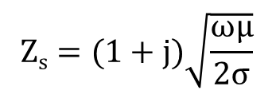
Discussion
Cathode Studies
Frequency-dependent isotropic
surface impedance model
Surface impedance:
$$Zs=(1+j)\sqrt{\frac{ωμ}{2σ}}$$
y
z
σ : conductivity, ω: angular frequency
Gun cavity material
Cathode material
Gun 4.3 Cavity
cathode plane at z = 0

Slide 15
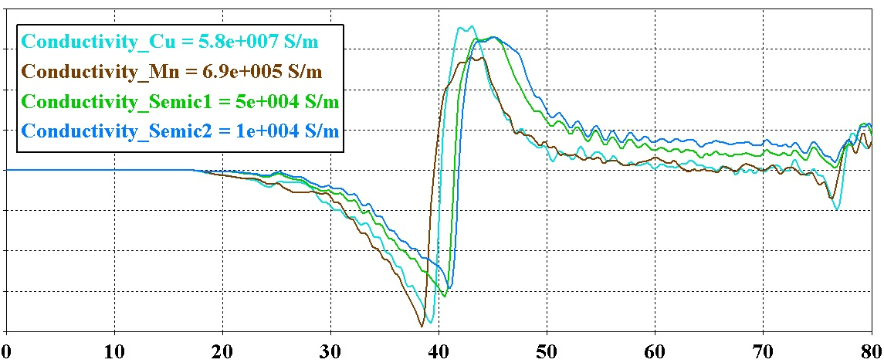
Cathode Studies
Simulation performed
with bunch parameters: -1nC, 0.4mm(radius), 500k(particle numbers), 2ps/21.5ps\2ps
by using the same mesh resolution
during propagation time up to 80ps
at the same location, z=5mm
Space charge field vs. time
in correspondence to various conductivities of cathode material
SPCH Field
Time /ps

Slide 16
Summary & Plans
Summary
Field simulations for gun 4.1 & 4.3 done, desired fields produced
CST PIC results (1nC) on beam energy and spread, beam size, bunch length and beam emittance obtained, compared to ASTRA. The discrepancy with ASTRA is about 10%, 5%, 9% and 20%, respectively.
Simulations on cathode study showed the influence of the cathode material on the space charge field.
Plans
Perform PIC simulations
    for various bunch charges
    with inhomogeneous particle distributions
Further study on the influence of cathode material on the beam qualities

Slide 17
Thanks for
your attention!

