Slide 1
Injector Optimization for Simultaneous Operation with Different Bunch Charges
Yauhen Kot
BD Meeting 23.04.2012

Slide 2
Contents
How it theoretically can work, technical constraints
WP for 20pC
WP for 100pC
Operation 20-100pC
WP for 250pC
Operation 100-250pC
WP for 500pC
Operation 250-500pC
WP for 1000pC
Operation 500-1000pC
Conclusions: operation with single bunch charge
Conclusions: simultaneous operation with two bunch charges
Simultaneous operation with two laser systems and single solenoid
Simultaneous operation with two laser systems and two solenoids

Slide 3
Operation with two different bunch charges within the same system.
How can it theoretically work?
Remarks…
- The problem of the operation with two different bunch charges at the same time is a question whether it is possible to achieve the same optics functions at the first quadrupole for both charges
- Generally bunch charge affects the optics functions → similar optics for different charges at the same settings of the solenoid and laser can occur only in the exceptional cases.

Slide 4
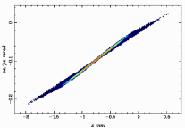
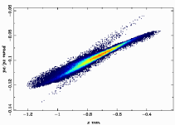
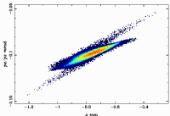
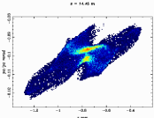
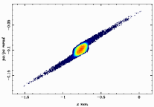
Typical beta development over the laser spot size.
(seen at the end of the ACC1)
Small beta for transmission under 100%
Local maximum at the point of 100% transmission
Shortly after the 100% transmission emittance minimum
And much later the beta function minimum
100% transmission
from the cathode
Beta minimum
For higher charges the whole curve shifts to the right
Emittance minimum

Slide 5
Operation with two different bunch charges within the same system.
How can it theoreticaly work?
The problem of the operation with two different bunch charges at the same time is a question whether it is possible to achieve
the same optics functions at the first quadrupole for both charges
Generally bunch charge affects the optics functions → similar optics for different charges at the same settings of the solenoid and laser can occur only in the exceptional cases.
Operation within the same system but with two different charges is only possible
If we “catch” the beta for higher charge on the falling arm and the other one on the rising arm
…and hope that alfas also coincide

Slide 6
Technical and Theoretical Constraints
Max K1 of the quadrupoles in the injector < 10.0
Generally it is not guaranteed that a theoretical match is possible for any
initial betas

Slide 7
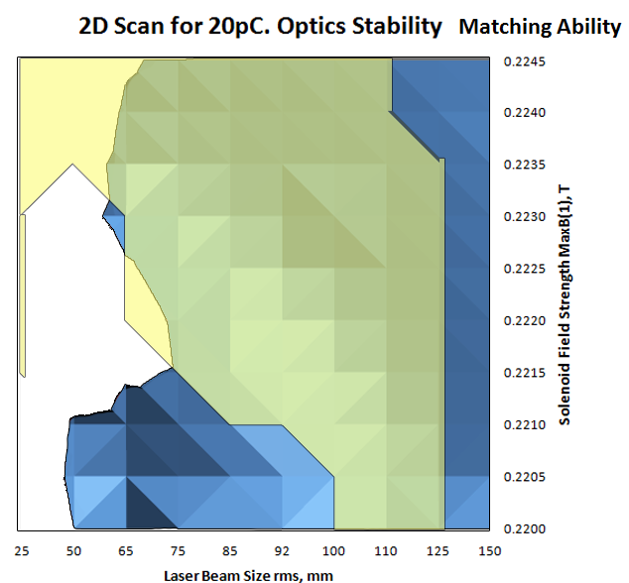
2D Scan for XFEL Injector. 20pC
Comfortable Optics Conditions
Working points for 20pC. Emittance Point of View
Best Emittance
Match possible
MaxB(1) | XYrms | ε | Opt. sensitivity Ξ
0.2216 | 67 | 0.0785 | 1.110
100% transmission beginning at XY=40μm
Stable optics solutions with the emittance > 0,10 mm mrad possible
Operation reasonable with XYrms between 50-125μm
and MaxB(1) range of 0.2200-0.2245T
Mismatch after the change of solenoid field by 0.0005T

Slide 8
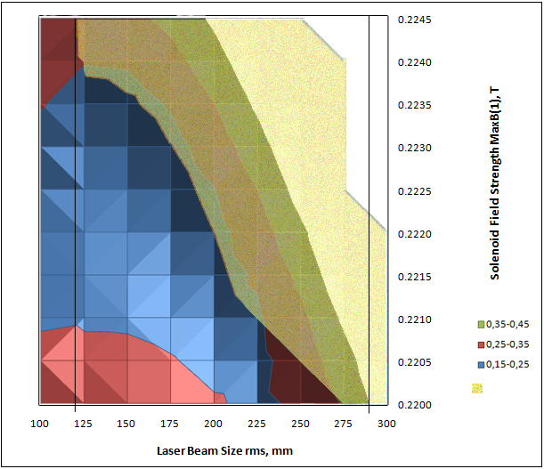
2D Scan for XFEL Injector. 100pC
Stable optics match is possible
Emittance minimum
MaxB(1) | XYrms | ε | Ξ
0.2230 | 125 | 0.1716 | 1.310
Possible to match
with the current configuration
Working Point with respect to the emittance minimum at
0.2230 T x 125 mm
Best emittance: 0,1716 mm mrad
Stable optics solutions with the emittance > 0,24 possible
100% transmission beginning at XY=75mm
Operation reasonable with XYrms between 120-290μm
and MaxB(1) range of 0.2205-0.2245T

Slide 9
Simultaneous Operation with 20pC and 100pC
Charge | 100% Transmission at XYrms, μm | XY operation window | MaxB1 operation window | Working Point for best ε |  | ε_min, mm mrad
 |  |  |  | Xyrms, μm | MaxB1, T
20 | 40 | 50-125 | 0.2200-0.2245 | 67 | 0.2216 | 0.0785
100 | 75 | 125-275 | 0.2205-0.2245 | 125 | 0.2230 | 0.1716
250 | 170 | 175-400 | 0.2210-0.2255 | 200 | 0.2235 | 0.2835
500 | 225 | 250-475 | 0.2225-0.2260 | 300 | 0.2235 | 0.4302
1000 | 365 | 365-600 | 0.2230-0.2265 | 450 | 0.2240 | 0.745
Match possible
Match possible
Obviously no common areas → simultaneous operation of the bunch of 20pC with the bunch charge over 100pC
is not possible.
The situation cannot be cured by means of the additional solenoid only. Another laser system is needed.

Slide 10
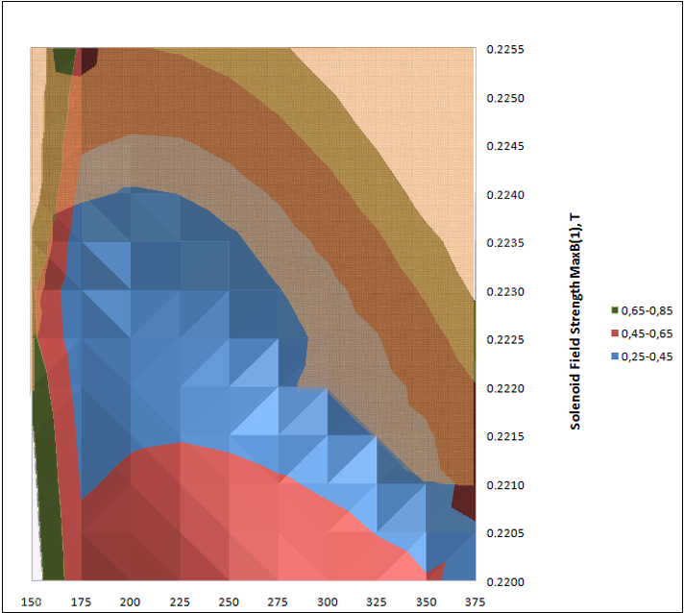
2D Scan for XFEL Injector. 250pC
Transmission below 100%
MaxB(1) | XYrms | ε | Ξ
0.2235 | 200 | 0.2832 | 1.3899
Working Point with respect to the emittance minimum at
0.2235 T x 200 mm
Best emittance: 0,2832 mm mrad
Stable optics solutions with the emittance > 0,32 possible
Operation reasonable with XYrms above 170mm
and MaxB(1) range of 0.2210-0.2255T

Slide 11
Simultaneous Operation with 100pC and 250pC
Playable range for both charges
Playable range for both charges
Operation with both charges simultaneously is imaginable
for MaxB(1)=0.2230 and 0.2235

Slide 12
Simultaneous Operation with 100pC and 250pC. MaxB(1)=0.2230 and 0.2235
MaxB(1)=0.2230
MaxB(1)=0.2235
Both twiss functions coincide for both bunch charges at almost the same settings of the laser.
Combined working point at
MaxB(1)=0.2235 XYrms=225
Combined working point is almost the same as the working point for 250pC
Generally: the emittance of the smaller bunch charge could be more effective reduced by means of the laser beam size.
On the other hand it grows even faster for larger laser beam sizes
Operation of the both bunch charges (150 and 250pC) at the same settings of the laser and the solenoid field is possible.
In that case we get the best possible emittance and somehow unstable optics for 250pC on the one hand and very stable optics solution but blowed up emittance for 100pC.

Slide 13
WP for Simultaneous Operation with 100pC and 250pC
Settings |  | Emittance |  | Optics Sensitivity
MaxB(1), T | XYrms, μm | ε_250 | ε_100 | Ξ_250 | Ξ_100 | Ξ_250◊100
0.2230 | 200 | 0.2839 | 0.2939 | 1.3365 | 1.0307 | 1,57
0.2230 | 225 | 0.295 | 0.4088 | 1.3178 | 1.0034 | 1,385
0.2230 | 250 | 0.3088 | 0.5569 | 1.2824 | 1.0010 | 1,106
0.2230 | 275 | 0.3402 | 0.7151 | 1.208 | 1.0072 | 1,012
MaxB(1) | XY | ε_250 | ε_100 | Ξ_250 | Ξ_100 | Ξ_250◊100
0.2235 | 200 | 0.2832 | 0.347 | 1.3899 | 1.0103 | 1.195
0.2235 | 225 | 0.2966 | 0.471 | 1.3145 | 1.0004 | 1.055
0.2235 | 250 | 0.3275 | 0.6176 | 1.2319 | 1.0041 | 1.078
0.2235 | 275 | 0.3859 | 0.7683 | 1.1395 | 1.0121 | 1.369

Slide 14
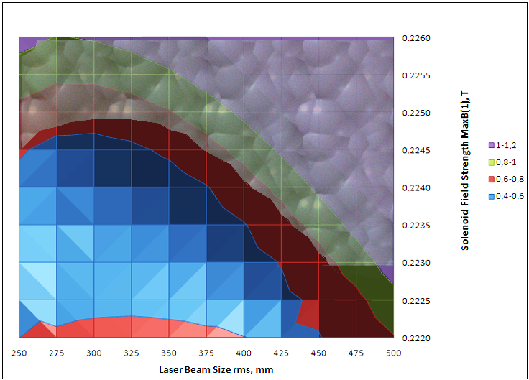
2D Scan for XFEL Injector. 500pC
500pC Emittance
Match possible, stable optics solution
No match possible
Emittance minimum
MaxB(1) | XYrms | ε | Ξ
0.2235 | 300 | 0.4302 | 1.4363
Working Point with respect to the emittance minimum at
0.2235 T x 300 μm
Best emittance: 0,4302 mm mrad
Stable optics solutions with the emittance > 0,60 mm mrad possible
Operation reasonable with XYrms between 250μm and 475μm
and MaxB(1) range of 0.2225-0.2260T

Slide 15
Simultaneous Operation with 250pC and 500pC
Playable range for both charges
Playable range for both charges
Imaginable for MaxB(1)=0.2240 and 0.2235

Slide 16
Simultaneous Operation with 250pC and 500pC. MaxB(1)=0.2235 and 0.2240
MaxB(1)=0.2235
MaxB(1)=0.2240
Operation at MaxB(1)=0.2235 gives similar but not equal optics
Operation at MaxB(1)=0.2240 provides a long range of laser beam size (275 to 375mm) with almost equal optics
for 250pC and 500pC.

Slide 17
WP for Simultaneous Operation with 250pC and 500pC
Settings |  | Emittance |  | Optics Sensitivity
MaxB(1), T | XYrms, μm | ε_500 | ε_250 | Ξ_500 | Ξ_250 | Ξ_500◊250
0.2235 | 275 | 0.472 | 0.468 | 1.391 | 1.070 | 1.236
0.2235 | 300 | 0.451 | 0.584 | 1.379 | 1.029 | 1.035
0.2235 | 325 | 0.470 | 0.738 | 1.327 | 1.008 | 1.001
0.2235 | 350 | 0.517 | 0.931 | 1.257 | 1.001 | 1.014
0.2235 | 375 | 0.592 | 1.155 | 1.178 | 1.001 | 1.056
MaxB(1) | XY | ε_500 | ε_250 | Ξ_500 | Ξ_250 | Ξ_500◊250
0.2240 | 275 | 0.439 | 0.386 | 1.391 | 1.070 | 1.220
0.2240 | 300 | 0.430 | 0.482 | 1.379 | 1.029 | 1.228
0.2240 | 325 | 0.445 | 0.619 | 1.327 | 1.008 | 1.221
0.2240 | 350 | 0.470 | 0.801 | 1.257 | 1.001 | 1.160
0.2240 | 375 | 0.516 | 1.017 | 1.178 | 1.001 | 1.082

Slide 18
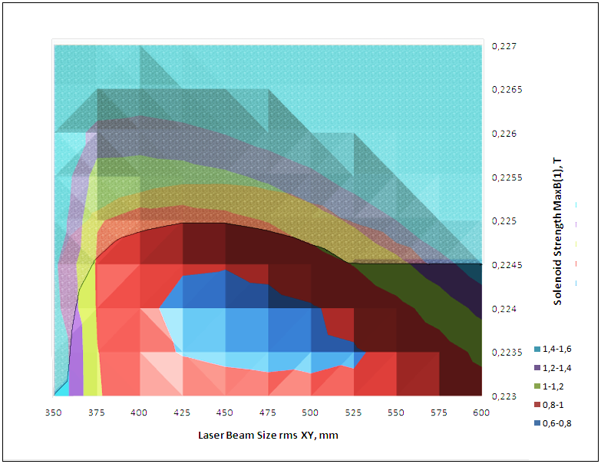
2D Scan for XFEL Injector. 1000pC
Match possible, stable optics solution
No match possible
Emittance minimum
Emittance minimum is feasible but may have
an unstable optics
Working point for the emittance minimum:
MaxB(1) | XYrms | ε | Ξ
0.2240 | 450 | 0.745 | 1.452
100% transmission beginning at XY=365μm
Stable optics solutions with the emittance > 1,00 mm mrad possible
Operation reasonable with XYrms between 365μm and 600μm
and MaxB(1) range of 0.2230-0.2265T

Slide 19
Simultaneous Operation with 500pC and 1000pC
Playable range for both charges
Playable range for both charges
→Imaginable for MaxB(1)=0.2240 and 0.2245T

Slide 20
Simultaneous Operation with 500pC and 1000pC. MaxB(1)=0.2240 and 0.2245
MaxB(1)=0.2240
MaxB(1)=0.2245
Operation at MaxB(1)=0.2240 T: same optics and same emittance for XY=400. Only different charges
Operation at MaxB(1)=0.2245 T: equal optics for XY=500mm. At this point is 500pC bunch significantly larger
than the one with 1000pC!

Slide 21
WP for Simultaneous Operation with 500pC and 1000pC
Settings |  | Emittance |  | Optics Sensitivity
MaxB(1), T | XYrms, μm | ε_1000 | ε_500 | Ξ_1000 | Ξ_500 | Ξ_1000◊500
0.2240 | 375 | 0.9825 | 0.5921 | 1,2792 | 1,178 | 1.400
0.2240 | 400 | 0.8284 | 0.703 | 1,3712 | 1,1085 | 1.118
0.2240 | 425 | 0.7645 | 0.852 | 1,425 | 1,0586 | 1.118
0.2240 | 450 | 0.7453 | 1.041 | 1,4518 | 1,0276 | 1.104
0.2240 | 475 | 0.7528 | 1.269 | 1,4382 | 1,0099 | 1.130
MaxB(1) | XY | ε_1000 | ε_500 | Ξ_1000 | Ξ_500 | Ξ_1000◊500
0.2245 | 375 | 0.9761 | 0.7265 | 1.2095 | 1.0933 | 1.599
0.2245 | 400 | 0.8645 | 0.8612 | 1.2951 | 1.0513 | 1.232
0.2245 | 425 | 0.8125 | 1.032 | 1.3300 | 1.0240 | 1.064
0.2245 | 450 | 0.8073 | 1.239 | 1.3294 | 1.0087 | 1.026
0.2245 | 475 | 0.8397 | 1.485 | 1.3011 | 1.0023 | 1.045

Slide 22
Conclusions – I. Working Points for the Operation with Different Bunch Charges
Charge | 100% Transmission at XYrms, μm | XY operation window | MaxB1 operation window | Working Point for best ε |  | ε_min, mm mrad | Sensitivity of the optics solution Ξ
 |  |  |  | XYrms, μm | MaxB1, T
20 | 40 | 50-125 | 0.2200-0.2245 | 67 | 0.2216 | 0.0785 | 1.110
100 | 75 | 125-275 | 0.2205-0.2245 | 125 | 0.2230 | 0.1716 | 1.310
250 | 170 | 175-400 | 0.2210-0.2255 | 200 | 0.2235 | 0.2835 | 1.390
500 | 225 | 250-475 | 0.2225-0.2260 | 300 | 0.2235 | 0.4302 | 1.436
1000 | 365 | 365-600 | 0.2230-0.2265 | 450 | 0.2240 | 0.745 | 1.452
Charge | 100% Transmission at XYrms, μm | XY operation window | MaxB1 operation window | Working Point for best ε |  | ε_min, mm mrad
 |  |  |  | Xyrms, μm | MaxB1, T
20 | 40 | 50-125 | 0.2200-0.2245 | 67 | 0.2216 | 0.0785
100 | 75 | 125-275 | 0.2205-0.2245 | 125 | 0.2230 | 0.1716
250 | 170 | 175-400 | 0.2210-0.2255 | 200 | 0.2235 | 0.2835
500 | 225 | 250-475 | 0.2225-0.2260 | 300 | 0.2235 | 0.4302
1000 | 365 | 365-600 | 0.2230-0.2265 | 450 | 0.2240 | 0.745
Relaxed optics for the bunch charge of 20pC
Tough optics conditions for the bunch charge over 100pC

Slide 23
Conclusions – II. Operation with Two Different Bunch Charges
Bunch Pair | MaxB(1) | XY | Δε_higher charge, % | Δε_smaller charge, % | Ξ_higher charge | Ξ_smaller charge | Ξ_Charge1◊Charge2
100-250pC | 0.2235 | 200 | 0 | 102 | 1.3899 | 1.0103 | 1.195
250-500pC | 0.2240 | 275 | 2.0 | 36.3 | 1.391 | 1.070 | 1.220
500-1000pC | 0.2240 | 400 | 11.2 | 63.4 | 1.3712 | 1.1085 | 1.118
→ WP is to be chosen at the smallest laser beam size which still provides the 100% transmission of the
bunch with the higher charge.
WP could be mostly found in the near of the emittance optimum for the higher charge
Lower bunch charge will necessarily suffer a big emittance increase
Relaxed optics for the lower bunch at the combined WP

Slide 24
Operation with Two Laser Systems and Single Solenoid
That means:
→ Fixed solenoid field for each WP
→ But variable laser beam sizes for each bunch charge
Scan over all possible laser beam sizes for each solenoid field
and look for

Slide 25
Operation with Two Laser Systems and Single Solenoid
Table: Max Solenoid Field Strength for different operation modes, T
 | Charge of the Partner Bunch, pC
Bunch Charge, pC | 20 | 100 | 250 | 500 | 1000
20 | 0.2216 | 0.2233 | 0.2238 | 0.2240 | 0.2245
100 |  | 0.2230 | 0.2232 | 0.2237 | 0.2240
250 |  |  | 0.2235 | 0.2235 | 0.2240
500 |  |  |  | 0.2235 | 0.2236
1000 |  |  |  |  | 0.2235
Table: Laser Beam Size rms for different operation modes, μm
 | Charge of the Partner Bunch, pC
Bunch Charge, pC | 20 | 100 | 250 | 500 | 1000
20 | 67 | 73 | 72 | 75 | 76
100 | 143 | 125 | 125 | 145 | 195
250 | 200 | 175 | 200 | 210 | 240
500 | 275 | 250 | 260 | 300 | 290
1000 | 393 | 375 | 375 | 375 | 365

Slide 26
Operation with Two Laser Systems. Emittance
Table: Emittance for different operational modes, mm mrad
 | Charge of the Partner Bunch, pC
Bunch Charge, pC | 20 | 100 | 250 | 500 | 1000
20 | 0.0786 | 0.1107 | 0.1203 | 0.1279 | 0.1394
100 | 0.2004 | 0.1761 | 0.1864 | 0.2245 | 0.3900
250 | 0.3080 | 0.2962 | 0.2832 | 0.2886 | 0.3714
500 | 0.4716 | 0.5439 | 0.4783 | 0.4302 | 0.4387
1000 | 0.8980 | 0.9830 | 0.9825 | 0.9997 | 0.745
Table: Emittance change in % for different operational modes
 | Charge of the Partner Bunch, pC
Bunch Charge, pC | 20 | 100 | 250 | 500 | 1000
20 | 0 | 40.8 | 53.0 | 62.7 | 77.4
100 | 13.8 | 0 | 5.86 | 27.5 | 121
250 | 8.77 | 4.60 | 0 | 1.89 | 31.1
500 | 9.62 | 26.4 | 11.19 | 0 | 1.97
1000 | 13.8 | 31.9 | 31.8 | 34.1 | 0

Slide 27
Operation with Two Laser Systems and Two Solenoids
That means:
→ Variable solenoid field for each bunch charge
→ Variable laser beam sizes for each bunch charge
Scan for each WP of bunch 1 the whole area of WPs of bunch 2
and look for

Slide 28
Operation with two laser systems and additional solenoid
Table: Max Solenoid Field Strength for different operation modes, T
 | Charge of the Partner Bunch, pC
Bunch Charge, pC | 20 | 100 | 250 | 500 | 1000
20 | 0.2216 | 0.2213 | 0.2215 | 0.2215 | 0.2210
100 | 0.2225 | 0.2230 | 0.2228 | 0.2225 | 0.2225
250 | 0.2230 | 0.2230 | 0.2235 | 0.2233 | 0.2230
500 | 0.2237 | 0.2235 | 0.2235 | 0.2235 | 0.2235
1000 | 0.2238 | 0.2239 | 0.2238 | 0.2239 | 0.2235
Table: Laser Beam Size rms for different operation modes, μm
 | Charge of the Partner Bunch, pC
Bunch Charge, pC | 20 | 100 | 250 | 500 | 1000
20 | 67 | 75 | 75 | 85 | 99
100 | 128 | 125 | 128 | 165 | 175
250 | 182 | 175 | 200 | 223 | 250
500 | 275 | 275 | 275 | 300 | 320
1000 | 375 | 393 | 418 | 425 | 365

Slide 29
Operation with two laser systems and additional solenoid
Table: Emittance for different operational modes, mm mrad
 | Charge of the Partner Bunch, pC
Bunch Charge, pC | 20 | 100 | 250 | 500 | 1000
20 | 0.0786 | 0.0804 | 0.0798 | 0.0867 | 0.1003
100 | 0.1812 | 0.1761 | 0.1779 | 0.1899 | 0.1957
250 | 0.2852 | 0.2857 | 0.2832 | 0.2947 | 0.3088
500 | 0.4486 | 0.4420 | 0.4387 | 0.4302 | 0.4419
1000 | 0.9911 | 0.8777 | 0.7906 | 0.7700 | 0.7453
Table: Emittance change in % for different operational modes
 | Charge of the Partner Bunch, pC
Bunch Charge, pC | 20 | 100 | 250 | 500 | 1000
20 | 0 | 2.29 | 1.53 | 10.3 | 27.7
100 | 2.90 | 0 | 1.02 | 7.86 | 11.1
250 | 0.74 | 0.88 | 0 | 4.06 | 9.04
500 | 4.27 | 2.73 | 1.98 | 0 | 2.72
1000 | 33.0 | 17.8 | 6.08 | 3.32 | 0

