Slide 1


XFEL Bunch Compressor Chicane Layout
W. Decking, M. Dohlus, C. Gerth, A. Krasnov, S. Lederer, T. Limberg, N. Mildner, D. Noelle
FEL Beam Dynamics Meeting, 27.06.2011
Notes:
How to edit the title slide
Upper area: Title of your talk, max. 2 rows of the defined size (55 pt)
Lower area (subtitle): Conference/meeting/workshop, location, date,
your name and affiliation,
max. 4 rows of the defined size (32 pt)
Change the partner logos or add others in the last row.

Slide 2
Introduction
Bunch Compressor Chicane Specifications: EDMS D*1658531
Basic Requirements:
Magnetic Field Limits:
BC0: 160 MeV
BC1: 700 MeV
BC2: 2.5 GeV (dump magnet)

Slide 3
Chicane Layout
Beam
Size
15 deg
RF scan
Beam offsets

Slide 4
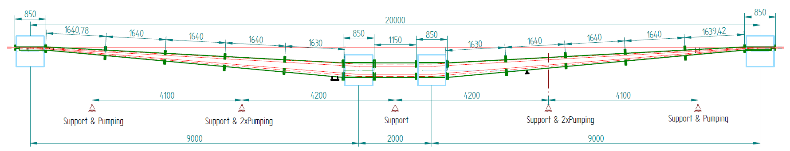
BC1 Layout

Slide 5
Intersection Layout
Energy BPM: Measure relative and absolute beam energy
OTR-Screen: Measure dispersive beam profile
Spoiler: Intercept off-energy tails
SR port: Online measurement of dispersive beam profile
BAM before and after chicane: Measure relative and absolute beam energy

Slide 6
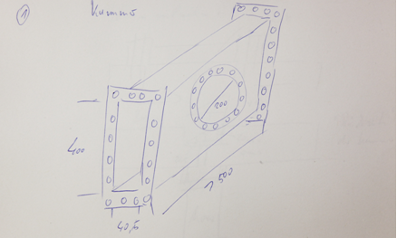
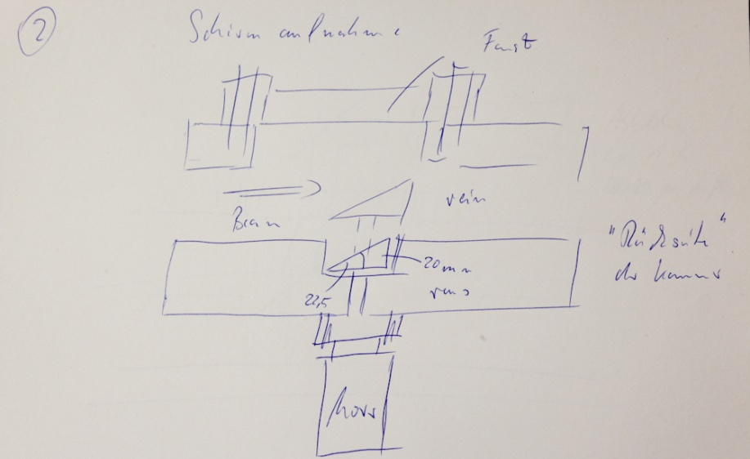
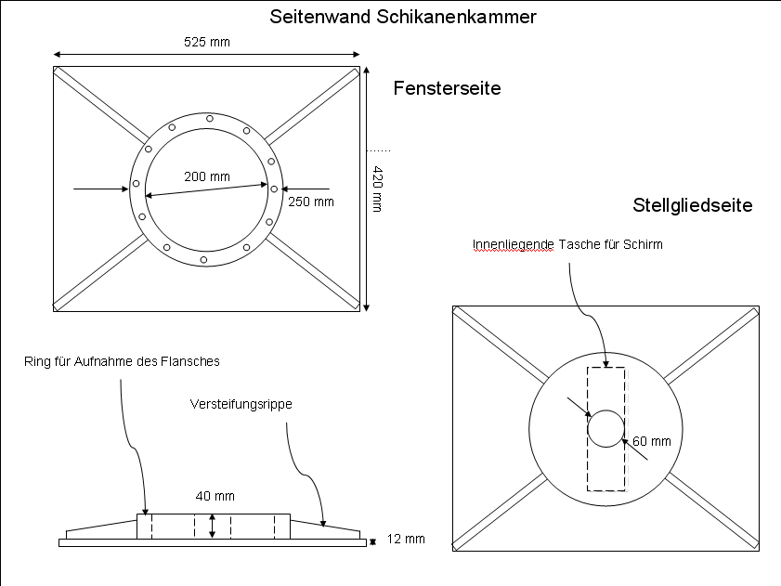
OTR Screen Concept: D. Noelle et. al.
Avoid long motion and thus extensive bellow units:
  Move in OTR from the wide side of chamber
  Visibility range given by maximum size of window flange

Slide 7
Other parts
Spoiler:
  No concept yet
  Might be combined with OTR chamber
  Long bellows are back because spoiler has to cover complete transverse space (400 mm)
E BPM:
  Design missing
  Mechanics will get challenging

Slide 8
Open questions
What else ?
Are 1150 mm space between dipoles sufficient?
  If not, chicane length cannot be changed anymore
  Angle has to be increased instead
Is the offset and R56 range correct ?
Chicane geometry changes are possible till September 2011

