Slide 1
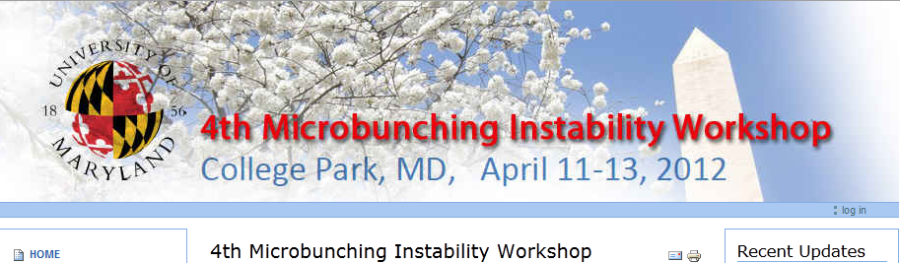
Overview of Microbunching Instability Research
Chairs: Alexander Zholents (ANL) and Bruce Carlsten (LANL)
Theoretical Studies of Microbunching Instability
Chairs: Gennady Stupakov (SLAC) and Avi Gover (Tel Aviv U.)
Experimental Observations
Chairs: Simone DiMitri (S. Trieste) and Torsten Limberg (DESY)
Code Development and Simulations
Chairs: Bill Fawley (LBNL) and Max Cornacchia (UMD)
Diagnostics
Chairs: Ralph Fiorito (UMD) and Dave Douglas (J-Lab)

Slide 2
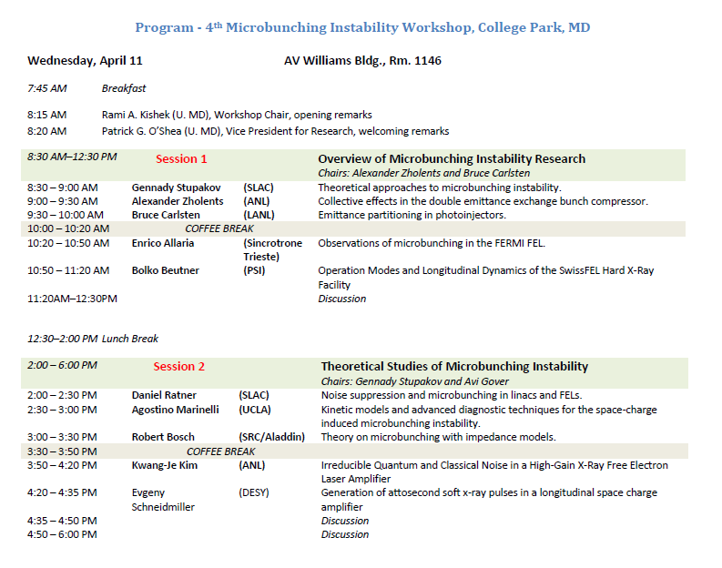

Slide 3
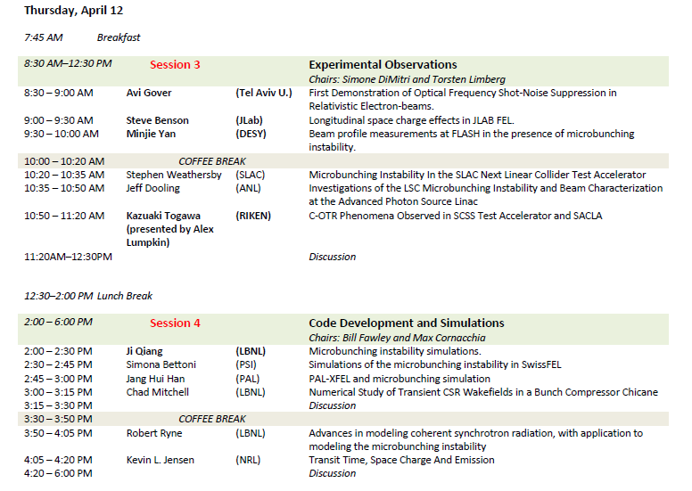

Slide 4
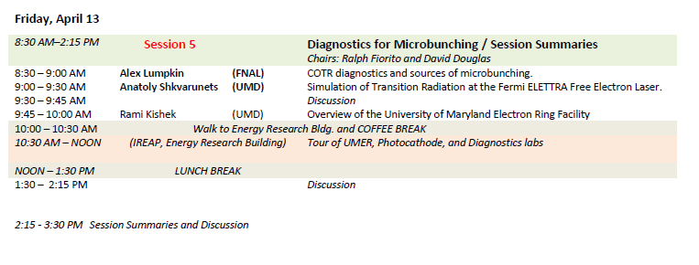

Slide 5
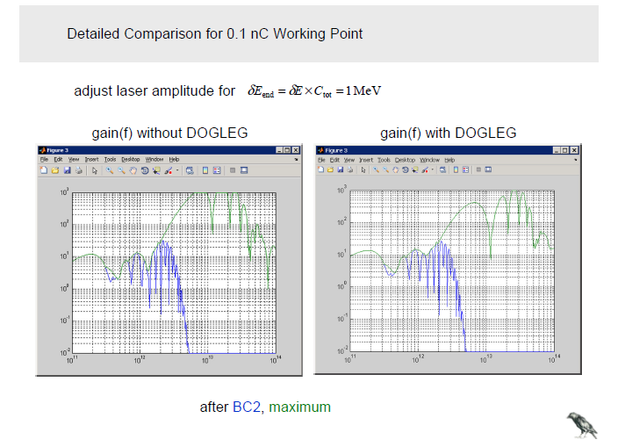

Slide 6
Micro Bunching Instability Damage
COTR effects at OTR screens (unusable?)
Energy spectrum at undulator entry broadens (seeding!)
Possible cures:
  Laser heater (proposed by SSY, operated at LCLS)
  Rf heater (later this talk)
  Shot noise reduction (later this talk)

Slide 7
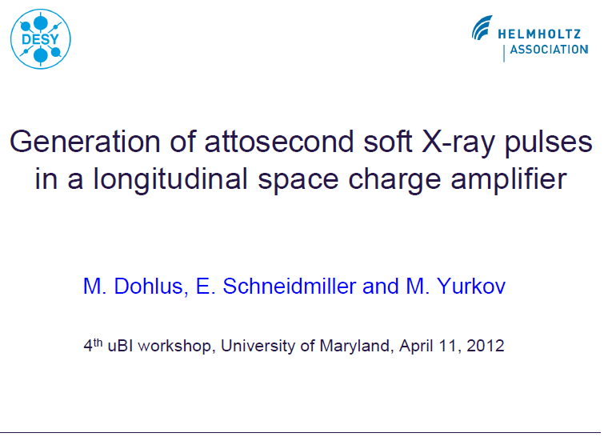

Slide 8
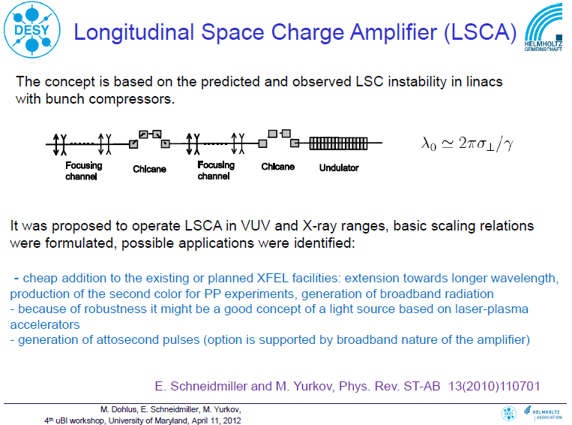

Slide 9
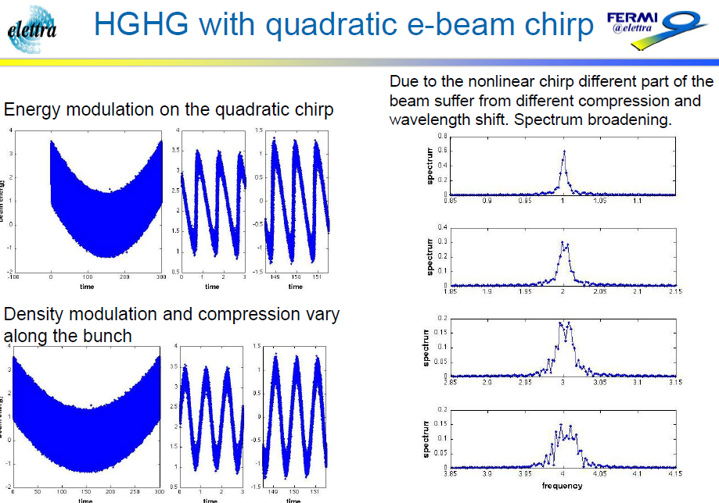

Slide 10
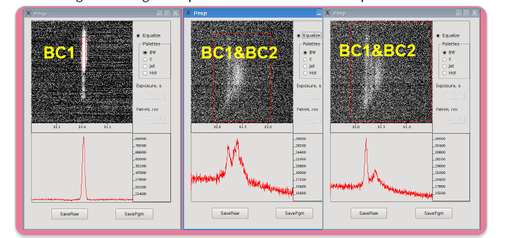
FEL results seems to suggest that the microbunching is stronger for the beam compressed with BC1 and BC2 than with only BC1. More studies are needed.

Slide 11
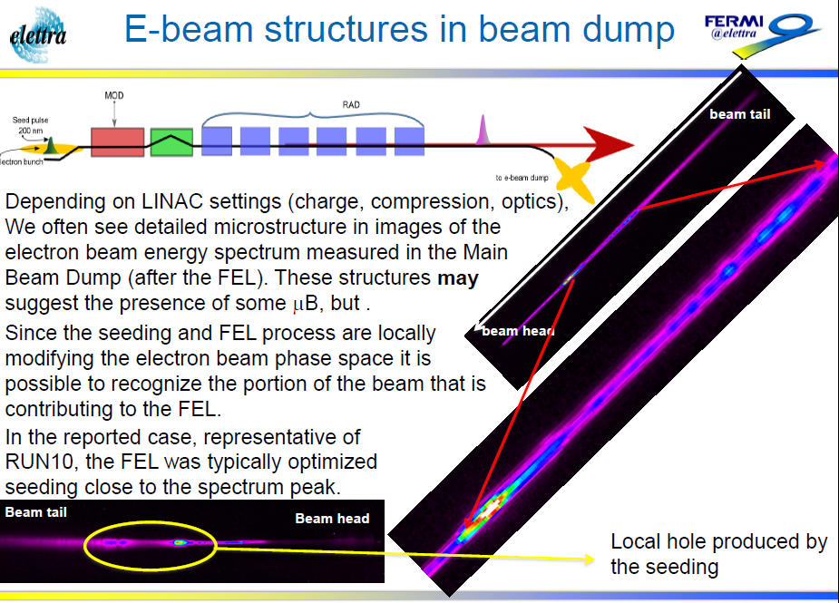

Slide 12
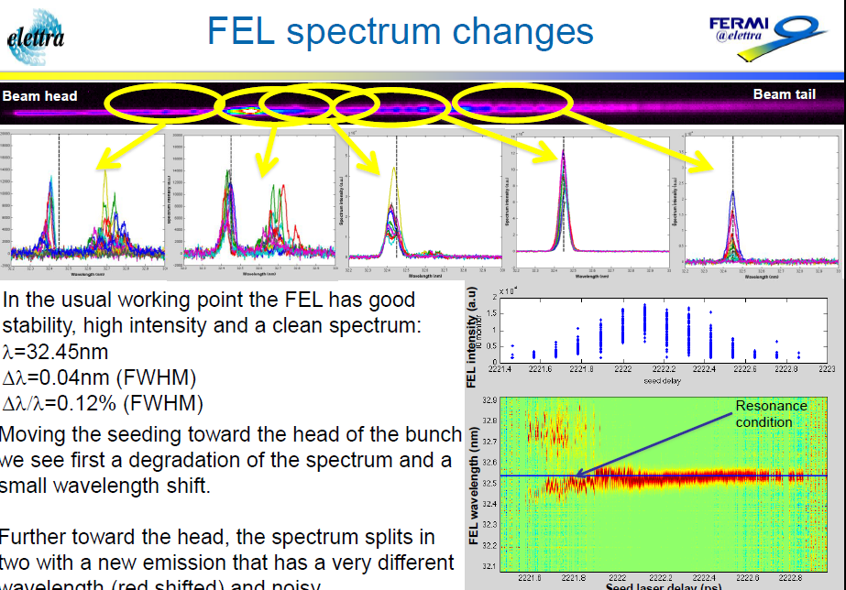

Slide 13
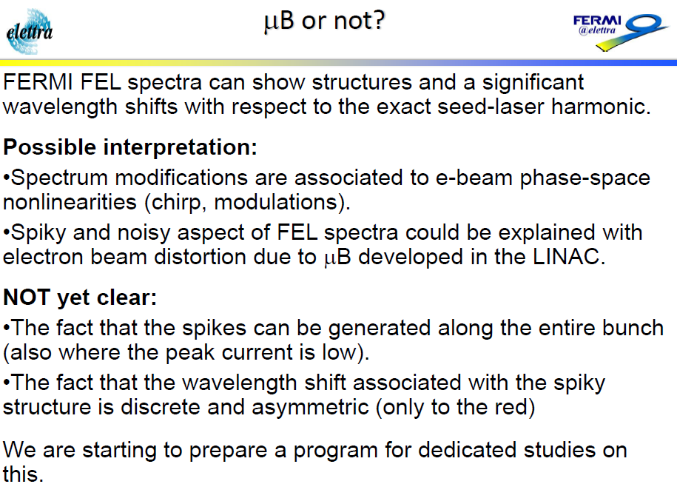

Slide 14
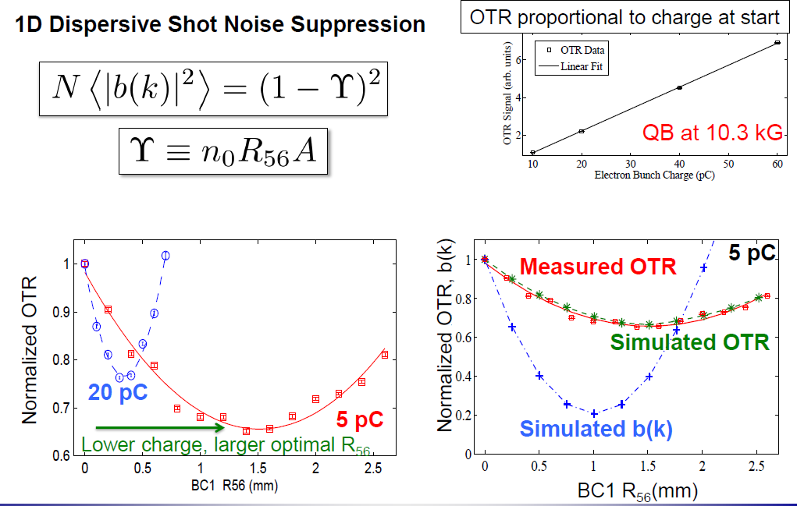

Slide 15
First Demonstration of Optical Frequency Shot-Noise Suppression in Relativistic Electron-beams
A. Gover, A.Nause, E. Dyunin
Tel-Aviv University Fac. Of Engin.,
Dept. of Physical Electronics, Tel-Aviv, Israel
UMD – April 15, 2012

Slide 16
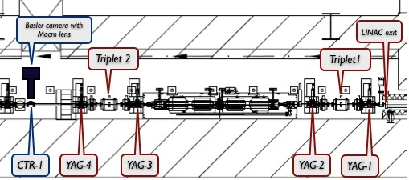
EXPERIMENTAL SETUP

Slide 17
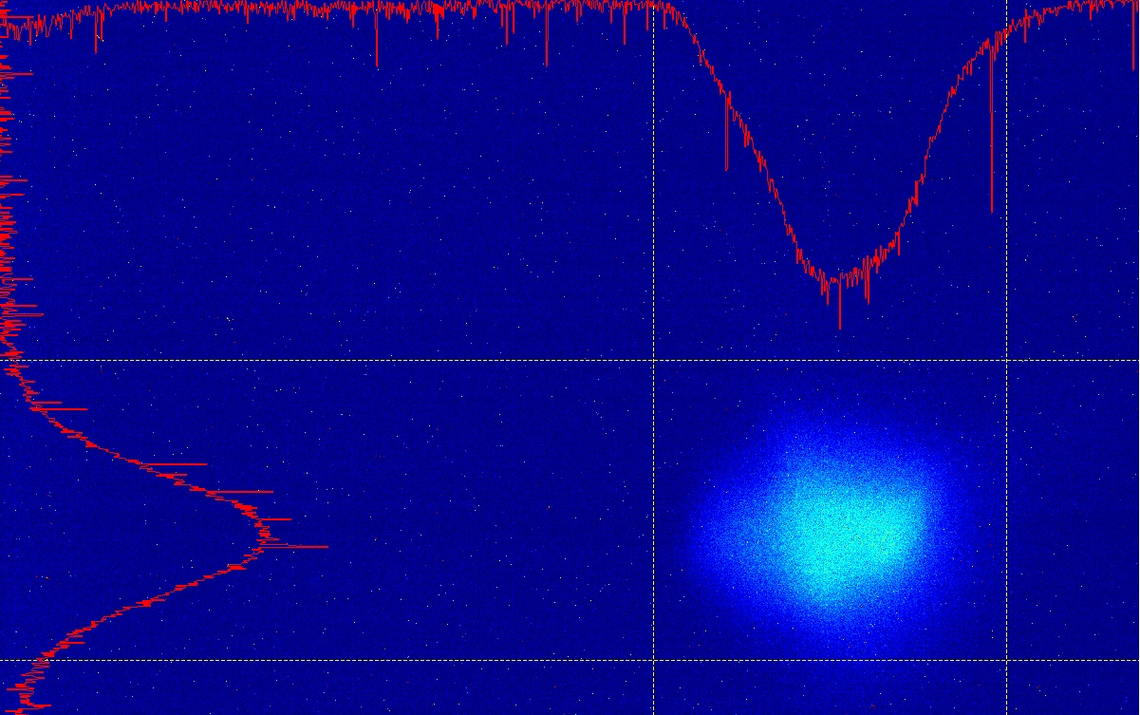
OTR-beam profile
(expanded dynamic range of the frame grabber record M. Fedurin - ATF)

Slide 18
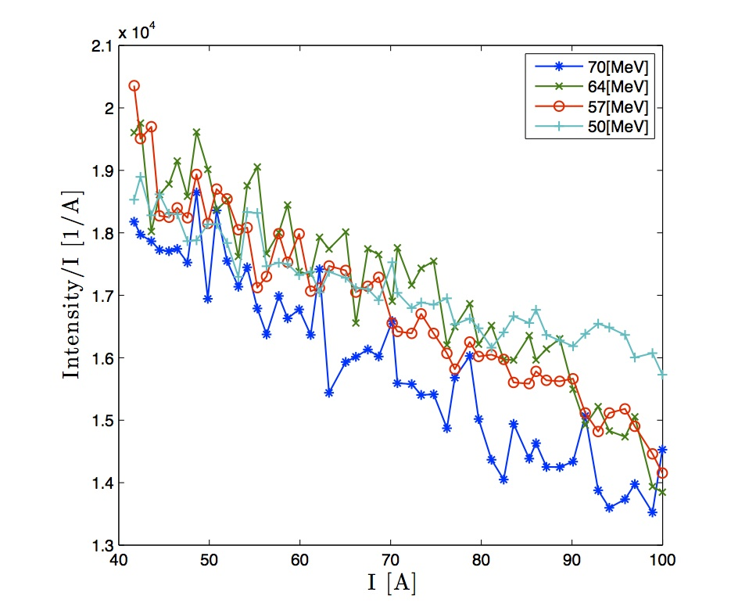
Experimental Results
(ATF/BNL OCT 2011)
OTR of an uncorrelated e-beam ~ N ~ Q
OTR Intensity/Q [1/pC]
200
Q [pC]
500

Slide 19
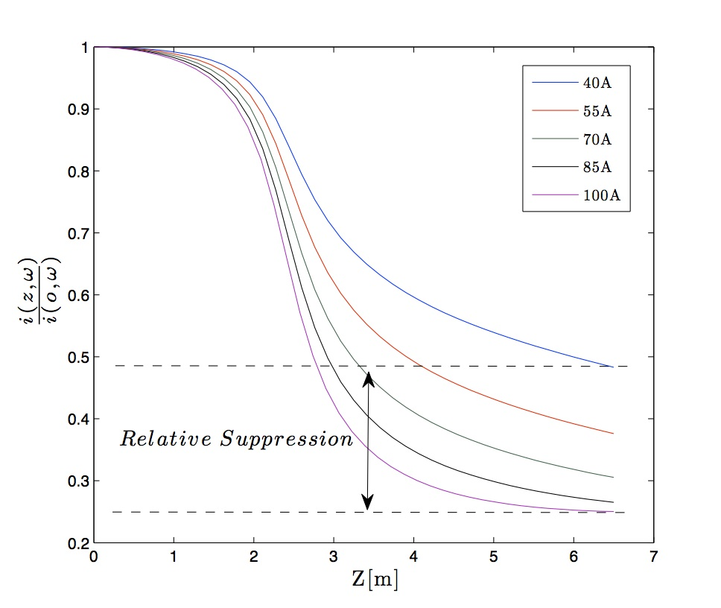
COMPUTATION OF NOISE SUPPRESSION WITH BEAM ANGULAR SPREAD – modelling 30% suppression measure in the experiment at z-6.5m a charge was varied 200-500pC

Slide 20
CONCLUSION
It is possible to adjust the e-beam current shot- noise level by controlling the longitudinal plasma oscillation dynamics.
We have demonstrated for the first time such noise suppression at optical frequencies.
This can be used to enhance FEL coherence and relax seeding power requirement.
After elimination of shot noise, IR/XUV FEL coherence is ultimately limited by the quantum input noise

Slide 21
Longitudinal Space Charge at Jefferson Lab
Stephen Benson for the Jlab FEL team
Microbunching Workshop
College Park MD
April 11, 2012

Slide 22
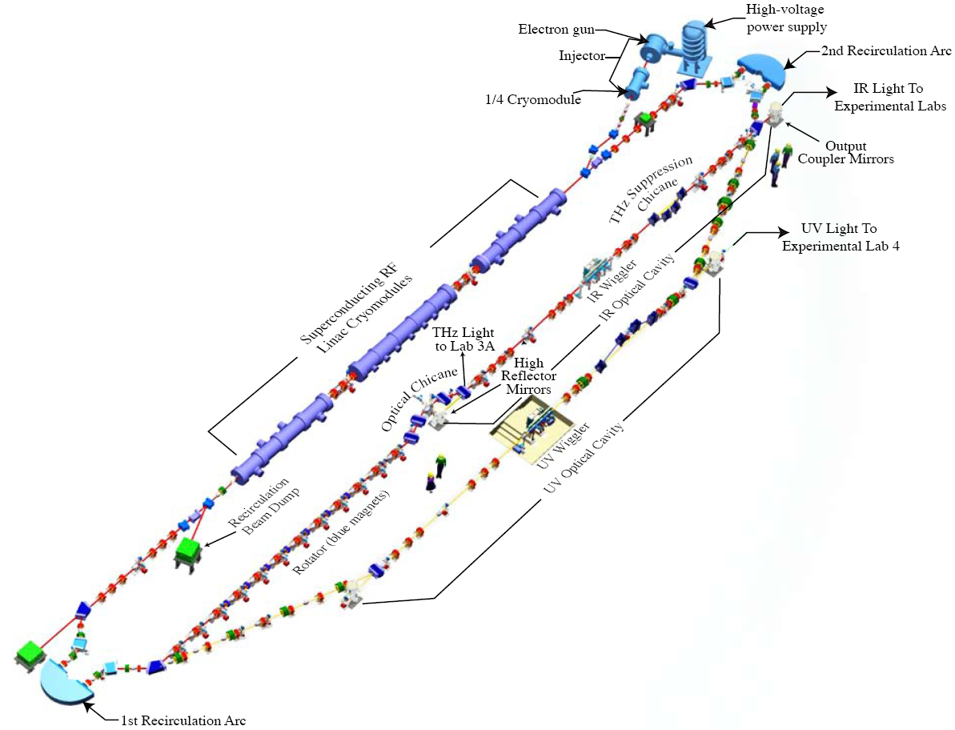
JLab IR/UV ERL Light Source
E_{beam} 135 MeV
Bunch charge: 60 pC – UV FEL
135 pC – IR FEL
Rep. rate up to 74.85 MHz
25 μJ/pulse in 250–700 nm UV-VIS
120 μJ/pulse in 1-10 μm IR

Slide 23
Space-Charge Induced Momentum Spread Mechanism*
AHEAD of crest: (head driven to low energy, tail to high) observed momentum spread is REDUCED
BEHIND crest: (head driven to high energy, tail to low) observed momentum spread is INCREASED
Longitudinal space charge will cause correlated energy slew (head of bunch accelerated, tail of bunch decelerated)
ΔE
Δφ
* Courtesy of D. Douglas

Slide 24
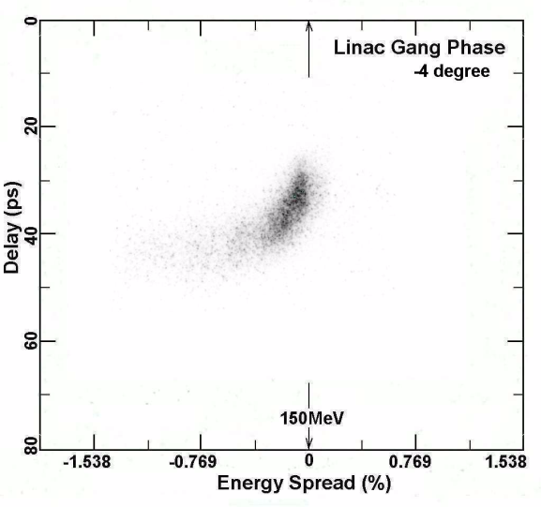
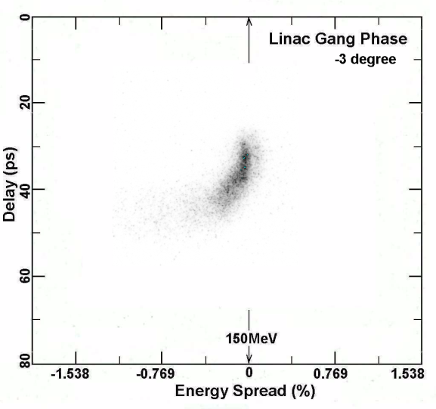
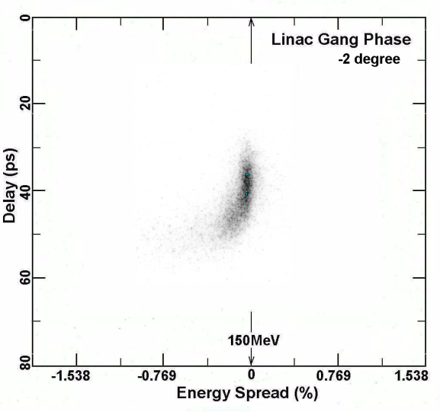
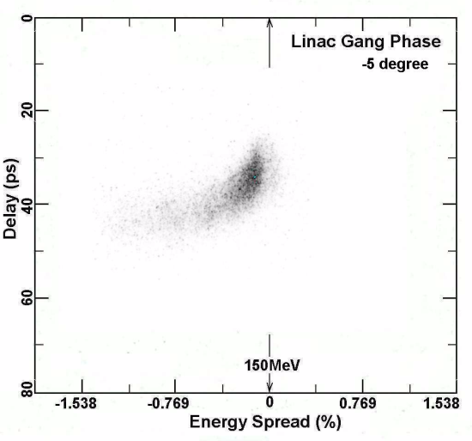
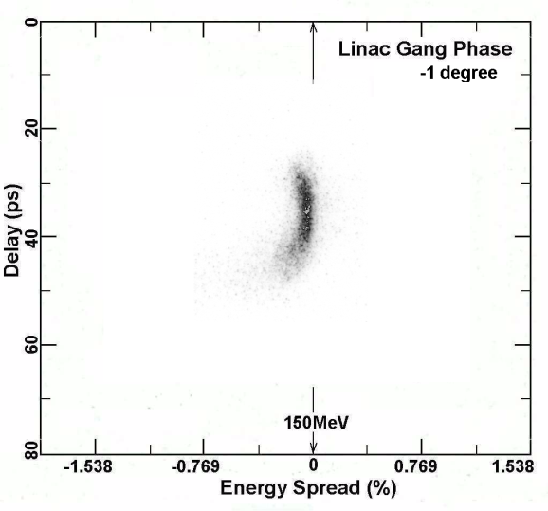
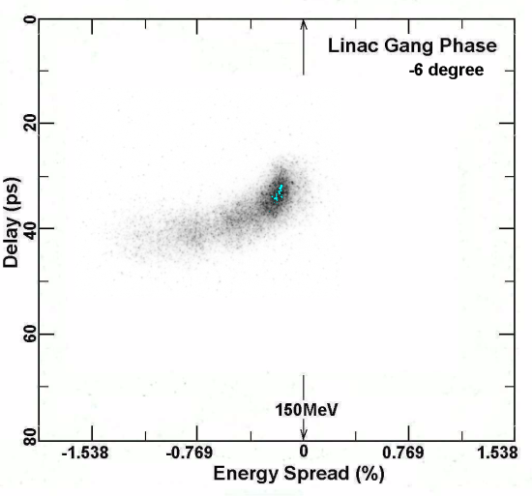
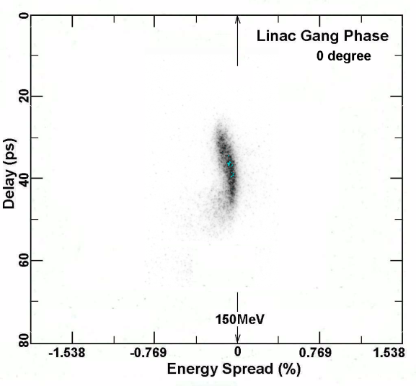
LSC: Streak Camera Data, IR Upgrade
-4º
-3º
-2º
(t,E) vs. linac phase after crest
-5º
-1º
-6º
(data by S. Zhang, v.g. from C. Tennant)
0º

Slide 25
Conclusions
We do not see microbunching COTR in the visible.
Parallel to point longitudinal focus means that the microbunching shows up only in the energy spectrum.
We do see growth in the instantaneous energy spread.
We also see an asymmetry in the energy slew on either side of crest that is worse for shorter bunches.
Shaping the charge distribution seems to help reduce the longitudinal emittance growth.

Slide 26
Beam Profile Measurements at FLASH in the presence of
Microbunching Instability.
Minjie Yan
Deutsches Elektronen-Synchrotron (DESY)
4th Microbunching Instability Workshop
College Park, MD, 12.Apr.2012

Slide 27
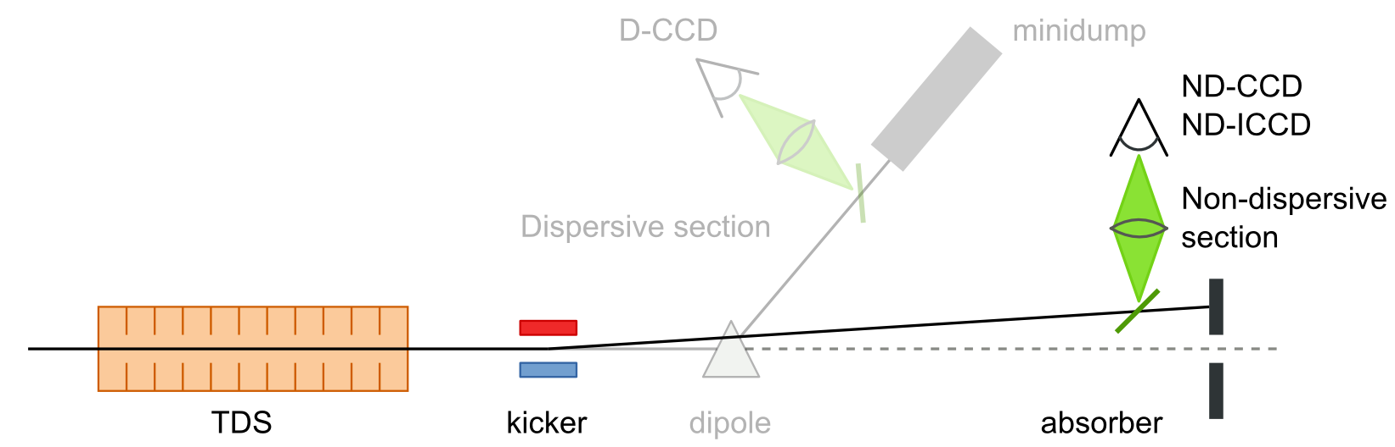
I. Experimental Setup
Longitudinal diagnostic with TDS
Courtesy S.Wesch (DESY)
Dispersive section
  In combination with a dipole magnet Longitudinal phase space measurements
  Record resolution: 7fs !
  + No observation of COTR
Non-Dispersive section:
  Longitudinal profile/ slice emittance measurements
  In combination with a fast kicker Designed as Online-Monitor during FEL operation
  - Disturbed by strong COTR

Slide 28
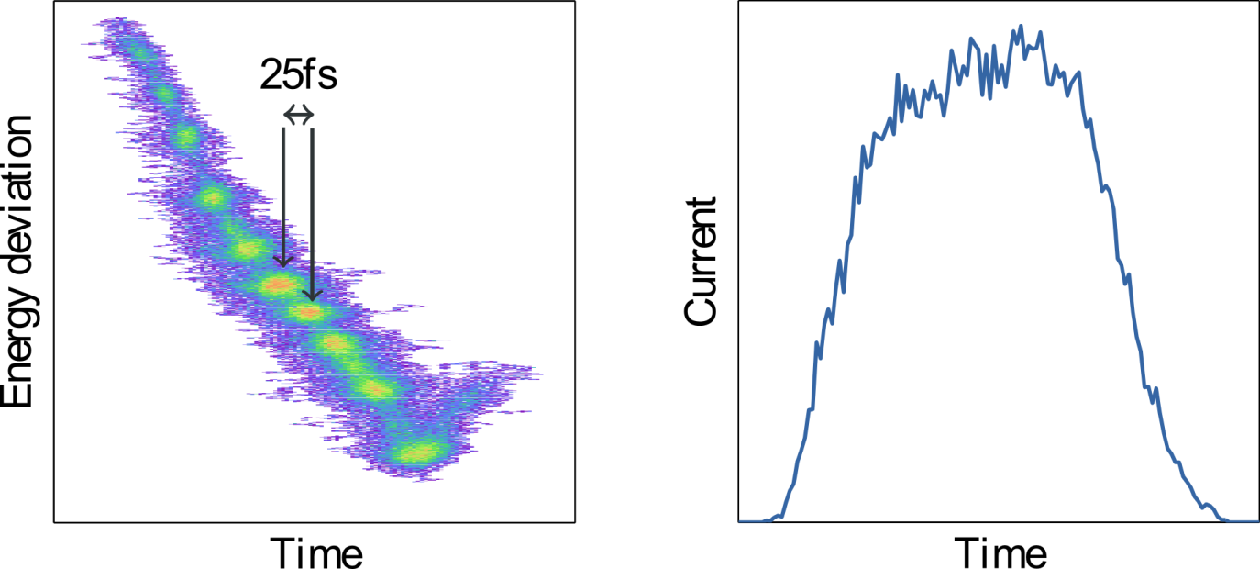
II. Observation of COTR and Microbunching @ FLASH
Micro bunching observation in longitudinal phase space
Ref.: C. Behrens, Ch. Gerth, G. Kube, B. Schmidt, S. Wesch, M. Yan,
submitted to Phys. Rev. ST Accel. Beams., 2012
Measured in the dispersive section with YAG:Ce screen
  Density modulation indicates microbunches
Notes:
Single shot. Typical FEL operation

Slide 29
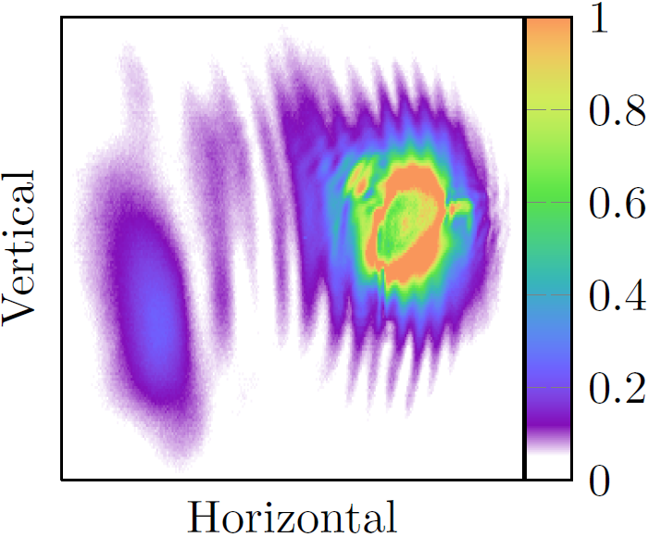
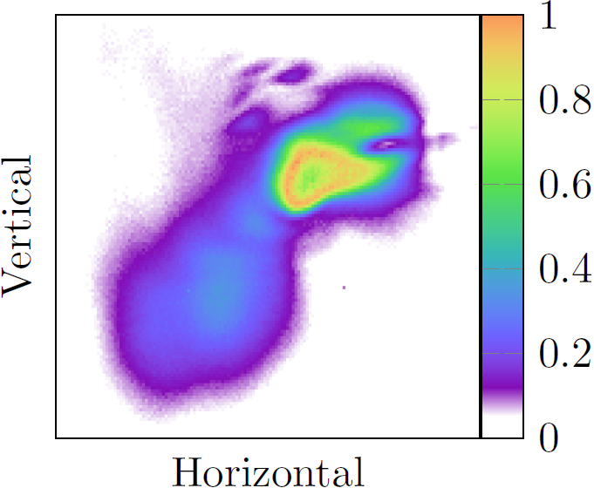
II. Observation of COTR and Micro-bunching @ FLASH
COTR observation
OTR + longpass filter
LuAG + longpass filter
Ref.: C. Behrens, Ch. Gerth, G. Kube, B. Schmidt, S. Wesch, M. Yan,
submitted to Phys. Rev. ST Accel. Beams., 2012
Measured in the non-dispersive section
  Typical characteristics of COTR:
  saturation, ring-structure, fluctuation
  Both the OTR and scintillation screen are impeded.
  (Strong COTR is still generated on the surface of scintillation screen.)
Notes:
Longpass filter: blocks wavelengh < 780nm
LuAG: 535nm

Slide 30
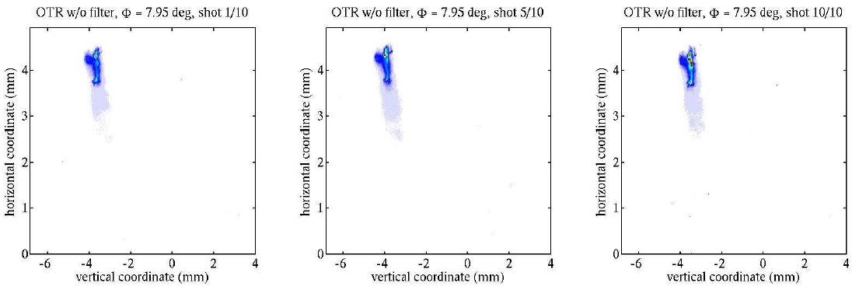
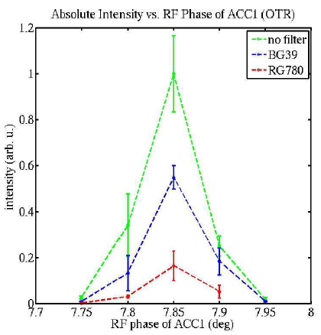
II. Observation of COTR and Microbunching @ FLASH
COTR observation
OTR without filter
ACC1 phase 7.95deg

Slide 31
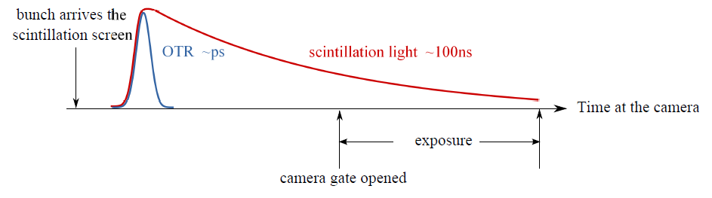
IV. Suppression of COTR in the non-dispersive section
Temporal separation of COTR
Scintillation light
insensitive to microstructures
delayed process
accompanied by OTR
OTR
could be coherent
instantaneous process
Scintillation screen + fast gated camera (ICCD)
Temporal separation of COTR from scintillation

Slide 32
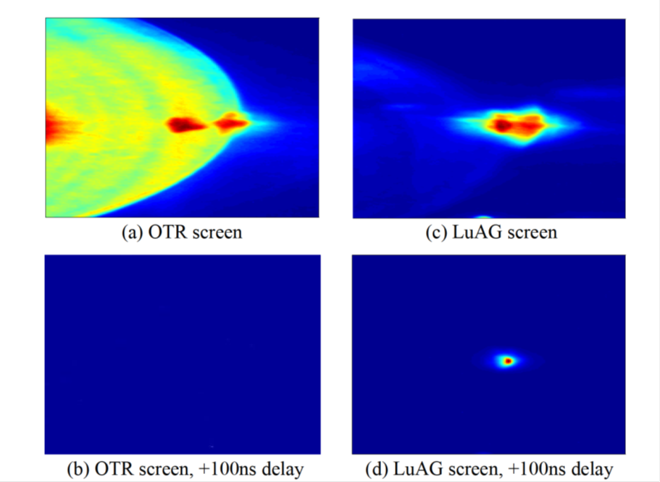
Temporal separation of COTR
Proof-of-principle experiment @FLASH
Ref.: M. Yan, C. Behrens, Ch. Gerth, G. Kube, B. Schmidt, S. Wesch,
in Proceedings of DIPAC2011, p. 440, 2011
no delay
OTR COTR+CSR
LuAG coherent radiation
with delay
OTR no signal
LuAG only scintillation light

Slide 33
Summary
Strong COTR observed at FLASH. Microstructures with modulation lengths of 25fs measured in the longitudinal phase space.
Longitudinal beam profile measurements carried out with the help of a transverse deflecting structure (TDS) in the dispersive and non-dispersive beamlines.
Suppression of COTR emission in the dispersive section (energy spectrometer) due to R51.
Suppression of COTR detection in the non-dispersive section with the temporal separation technique (scintillation screen + gated camera). It is a definite method not requiring the knowledge of the spectrum.
Since the last shutdown of FLASH at the end of 2011, there is no COTR observed at any of the screen stations anymore. Many efforts have been paid to reproduce COTR, but still no sign of COTR at all. This has to be further investigated, etc. by taking spectrum… Maybe we will report something on the next uBI workshop.

Slide 34
Microbunching Instability In the SLAC Next Linear Collider Test Accelerator (NLCTA)
Stephen Weathersby
M. Dunning, C. Hast, E. Hemsing, K. Jobe,
D. McCormick, J. Nelson, D. Xiang
.

Slide 35
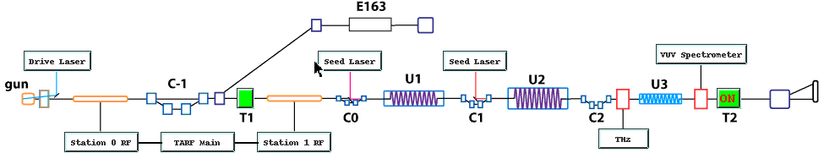
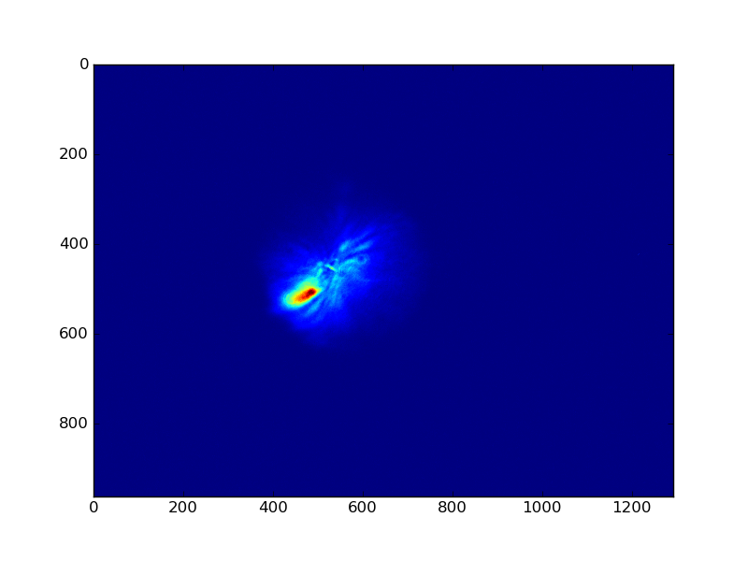
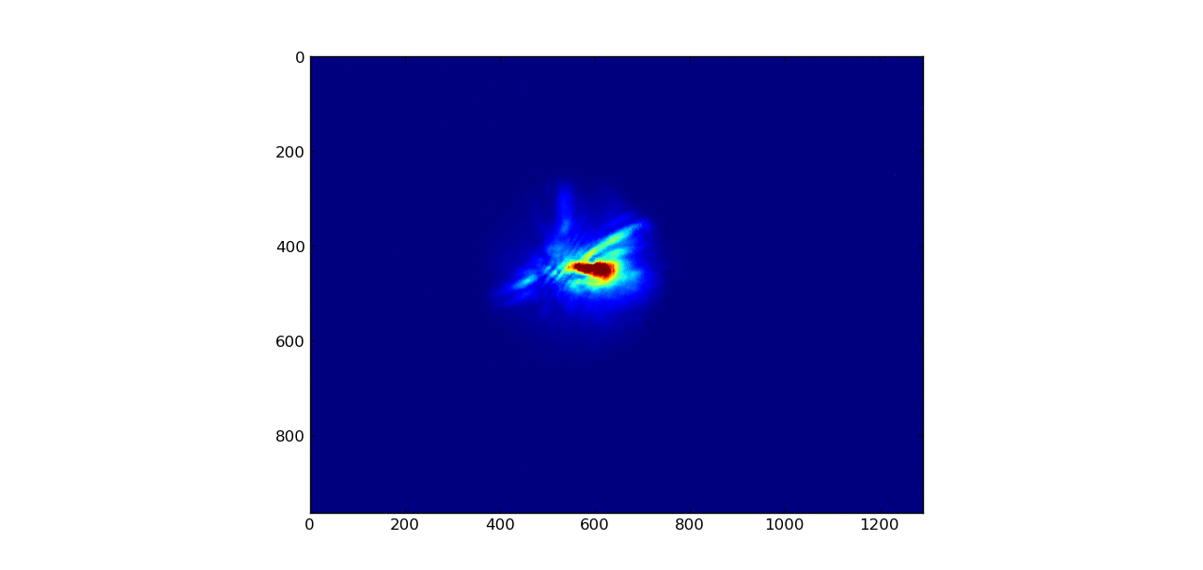
Microbunching from compression
CUR

Slide 36
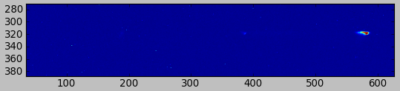
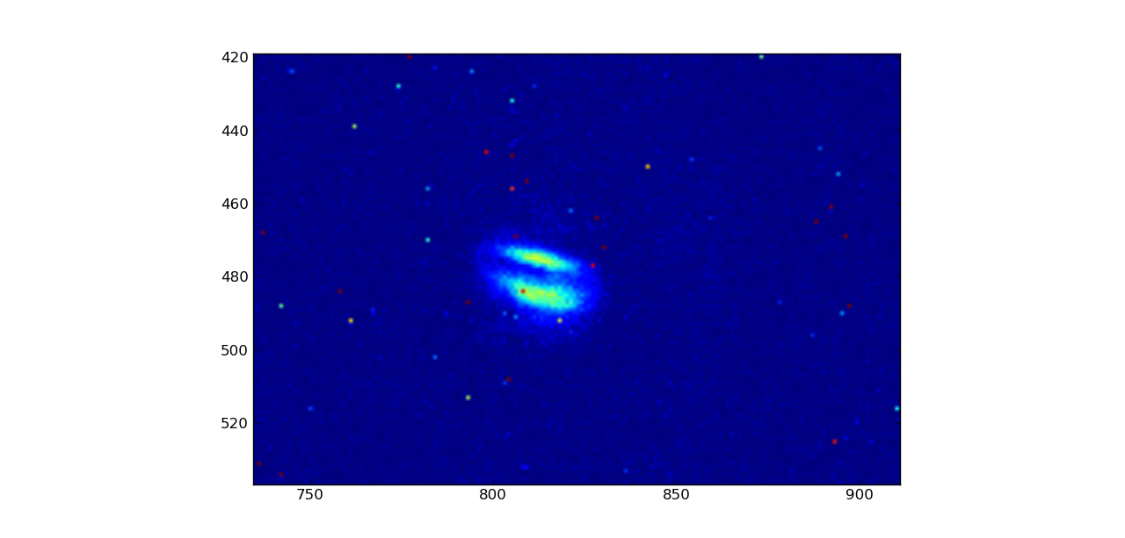
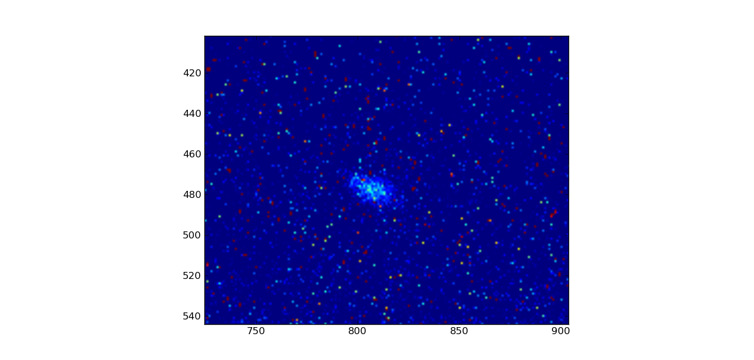
Microbunching – seeded
donut
800 nm
laser modulated cotr
incoherent otr

Slide 37
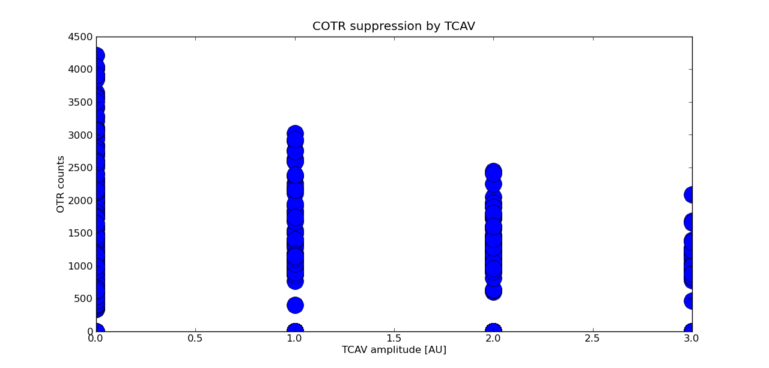
TCAV suppression
compressed case
essentiallly off
full power ~ 10kV

Slide 38
Summary
Microbunching – from compression
  shot to shot intensity and shape fluctuation
  COTR gain at longer wavelengths
Microbunching – seeded
  Interference rings have an energy dependent opening angle, and are visible at sub pC. Immense gain allows high sensitivity.
  donut does correlate with gradient of bunch charge density
TCAV suppression
  Tantalizing. Needs more quantification.

Slide 39
Jeff Dooling
My talk summary:
!. Suppression of microbunching instability demonstrated both spectrally
and temporally. (COTR?)
a) Spectrally, with blue narrow band interference (NBI) or BW
filters viewing an LSO: Ce scintillator.
b) Spectrally, with blue NBI filters viewing an OTR screen (this
was not as clear, since some of the MBI was still present)
c) Temporally, with a gated camera delayed after the prompt
radiation is gone but while the scintillator is still emitting
2. Need to pay attention to the rf phase. In our case, we turned off
the linac phase control law which tries to keep all accelerating
structures on-crest with the beam.
3. Started ASTRA simulations. Goal is to have start-to-end (STE)
simulations through the full linac with ASTRA and ELEGANT and eventually
IMPACT.
a) Good agreement with compressed measured bunch length
b) Good agreement for emittance with charge
c) So-so agreement for emittance and solenoid current
4. Laser upgrade, exchanging flashlamps with diode pumping in the regen
amplifier, improves laser reliability (Nd:Glass). Need to improve
transverse distribution uniformity.

Slide 40
3. Started ASTRA simulations. Goal is to have start-to-end (STE)
simulations through the full linac with ASTRA and ELEGANT and eventually
IMPACT.
a) Good agreement with compressed measured bunch length
b) Good agreement for emittance with charge
c) So-so agreement for emittance and solenoid current
4. Laser upgrade, exchanging flashlamps with diode pumping in the regen
amplifier, improves laser reliability (Nd:Glass). Need to improve
transverse distribution uniformity.

Slide 41

COTR Phenomena Observed in SCSS* Test Accelerator and SACLA**
*SPring-8 Compact SASE Source
**SPring-8 Angstrom Compact free electron LAser
Kazuaki Togawa¹, Toru Hara¹, Hirokazu Maesaka¹, Shinichi Matsubara², Shinobu Inoue³, Yuji Otake¹, Hitoshi Tanaka¹
¹ XFEL Research and Development Division, RIKEN SPring-8 Center
² XFEL Division, Japan Synchrotron Radiation Research Institute
³ SPring-8 Service Co., Ltd.
4th Microbunching Instability WS, Univ. of Maryland April 11-13, 2012

Slide 42

Introduction
Through the operation experiences of the test accelerator, we believed that we could not see any COTR phenomenon at SACLA. However, reality differs from what we expected.
In the SACLA commissioning, we encountered the strong COTR and tried to suppress COTR by optimizing the tuning parameters. We have not succeeded in cure yet. To tune accelerator parameters we introduced temporarily several profile-monitor systems each of which has a Ce:YAG screen and a spatial mask.
4th Microbunching Instability WS, Univ. of Maryland April 11-13, 2012

Slide 43
Introduction
SACLA and test accelerator use the same injectors basically. Slight differences between the two are as follows:
Beam energy at compression: 45 MeV vs 400 MeV(BC2)~1400(BC3) MeV
Peak Current: 300 A vs 600A (BC2)~3000A (BC3)
BC factor by velocity bunching: 100 vs 20~25
Buncher RF frequency: S-band vs L-band
Correction Cavities: without vs with
Earth-field cancelling coil: without vs with
Red: test accel. Blue: SACLA
4th Microbunching Instability WS, Univ. of Maryland April 11-13, 2012

Slide 44
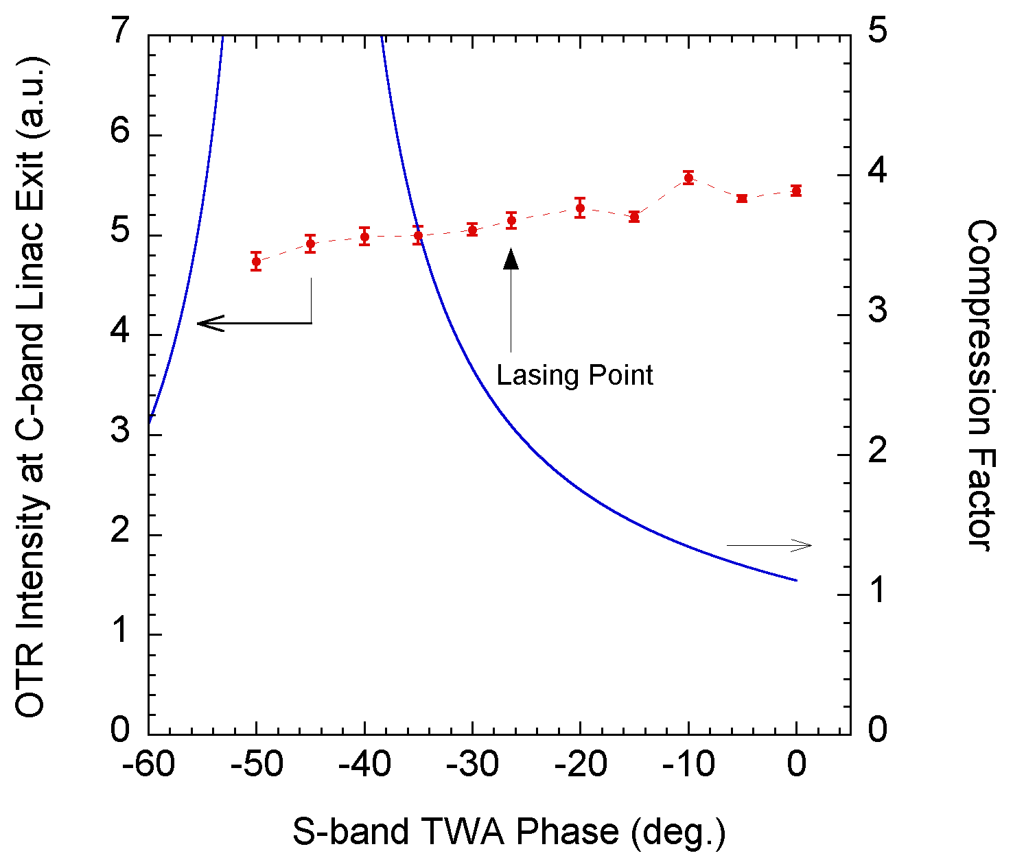
SCSS Test Accelerator
Compression Dependence of OTR Intensity
*OTR intensity was constant even at high-compression.
*Thermionic injector did not generate coherent OTR. *However…..
4th Microbunching Instability WS, Univ. of Maryland April 11-13, 2012

Slide 45
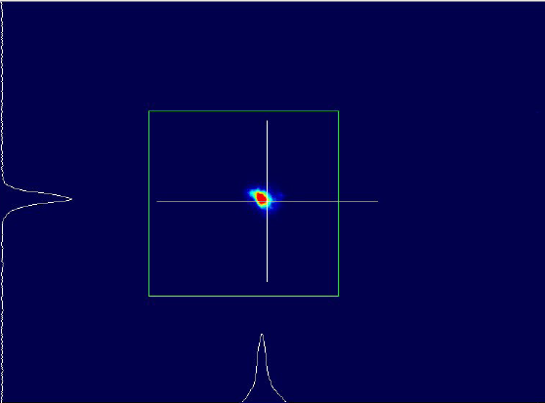
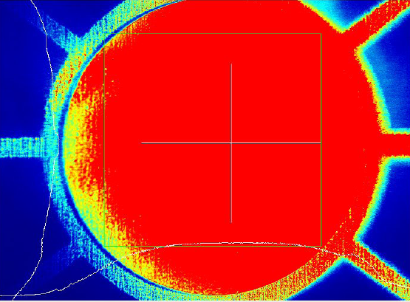
SACLA
Entrance of BC3 (1.4 GeV, ~600 A)
Exit of BC3 (1.4 GeV, ~3 kA)
4th Microbunching Instability WS, Univ. of Maryland April 11-13, 2012

Slide 46
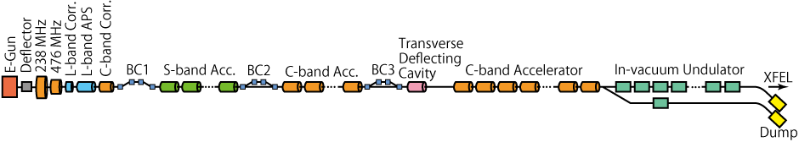
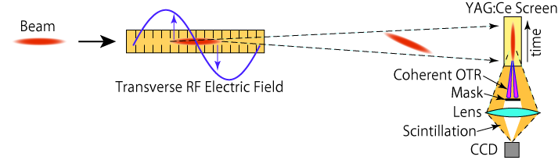
Temporal Profile Measurement at SACLA under COTR
Screen Monitor
5712 MHz
HEM11
< 10 μm resolution
Temporal profile measurement
20 fs resolution
46
FEL'11@Shanghai
On courtesy of the SACLA Team
4th Microbunching Instability WS, Univ. of Maryland April 11-13, 2012

Slide 47
SACLA Team Offer
During exchange of e-mail with AHL, the SACLA team made an offer for a window of time for a COTR- microbunching studies program.
SCSS studies this Fall, winter and next spring prior to the move of SCSS to SACLA tunnel.
Invite WS to suggest studies and they are open for collaborations. (I suggest theory guidance.)
One key aspect is the difference between SCSS and SACLA observed COTR effects.
Propose this is topic for discussion uBI-4.

Slide 48
Some Initial Thoughts (AHL)
SCSS: use the second chicane as a bunch compressor and measure OTR signal vs. compression. They have not done this, but are now considering it. Use chirp in C-band accelerators instead of running on crest for FEL.
Ask for theory to predict results. See COTR?
SACLA: Evaluate magnitude of COTR gain with neutral density filters after BC2 and BC3. vary all
Check for energy modulation at 1.4 GeV, FEL
Use TDS for studies of long. distr. of COTR.

