Slide 1
Short Bunches at FLASH
T. Limberg

Slide 2
Outline
Start-2-End Simulations and a fast Model for Longitudinal Phase Space Simulations
Dedicated Benchmark Studies Analysis
Machine Set Up for Short Bunches with Subsequent Photon Pulse Length Measurements

Slide 3
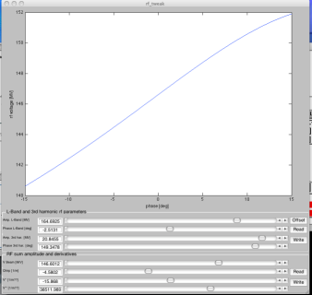
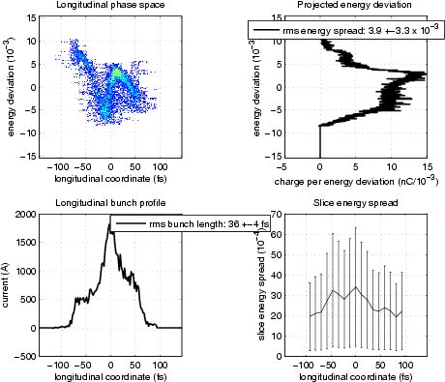
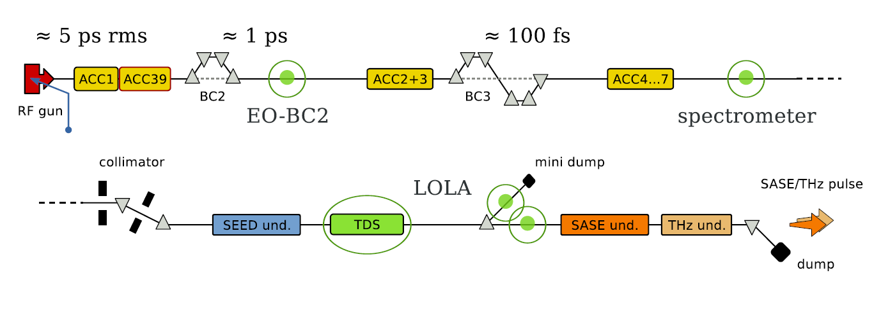
FLASH Bunch Compression Scheme
A_{ACC2/3} , φ_{ACC2/3}
35 fs
150 MeV
450 MeV

Slide 4
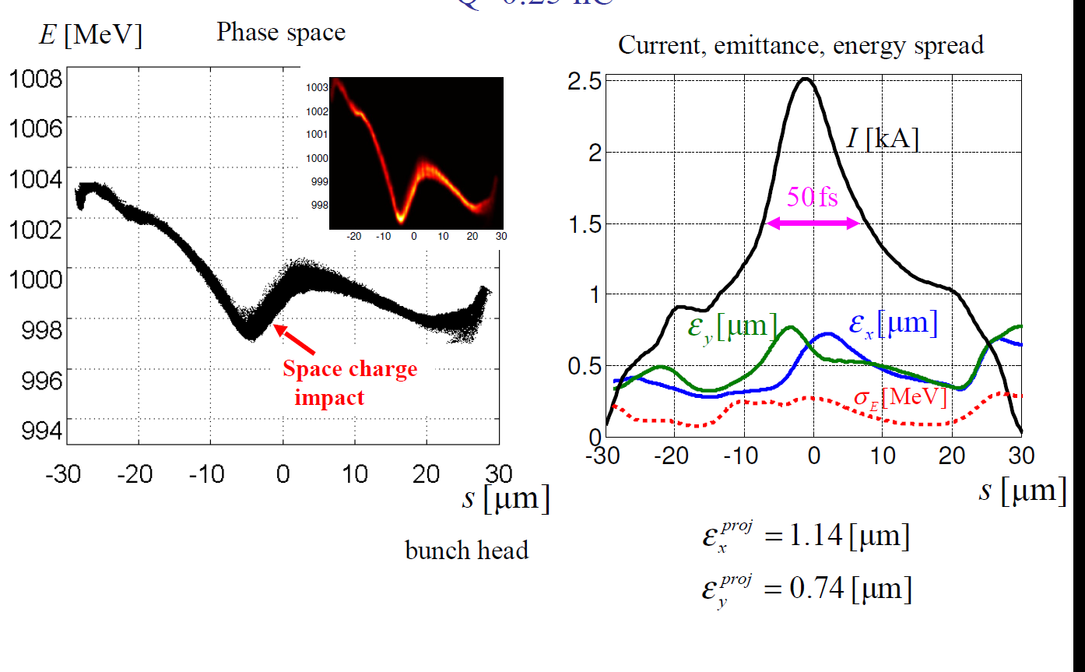
S2E with 250 pC Bunch Charge (I. Zagorodnov)
Numerically expensive,
optimized parameter set
Photon Pulse Length (FWHM) : 17 fs

Slide 5
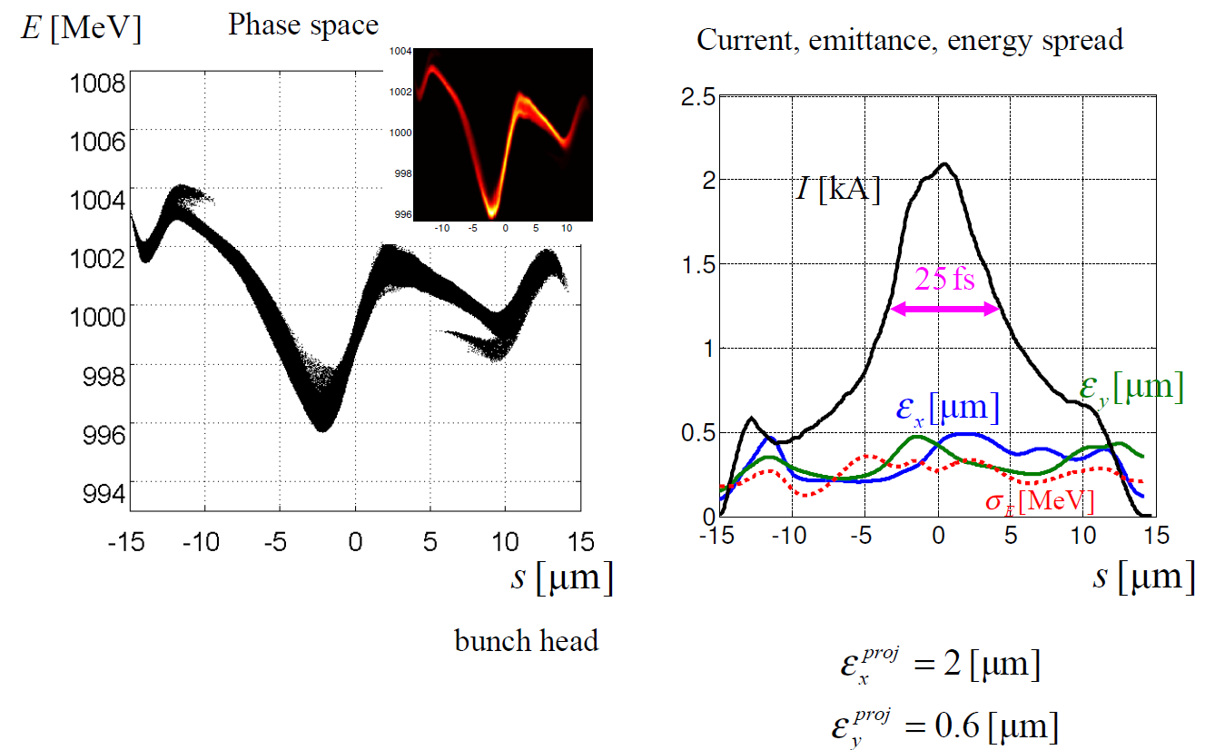
S2E with 100 pC Bunch Charge
Photon Pulse Length (FWHM) : 7 fs

Slide 6
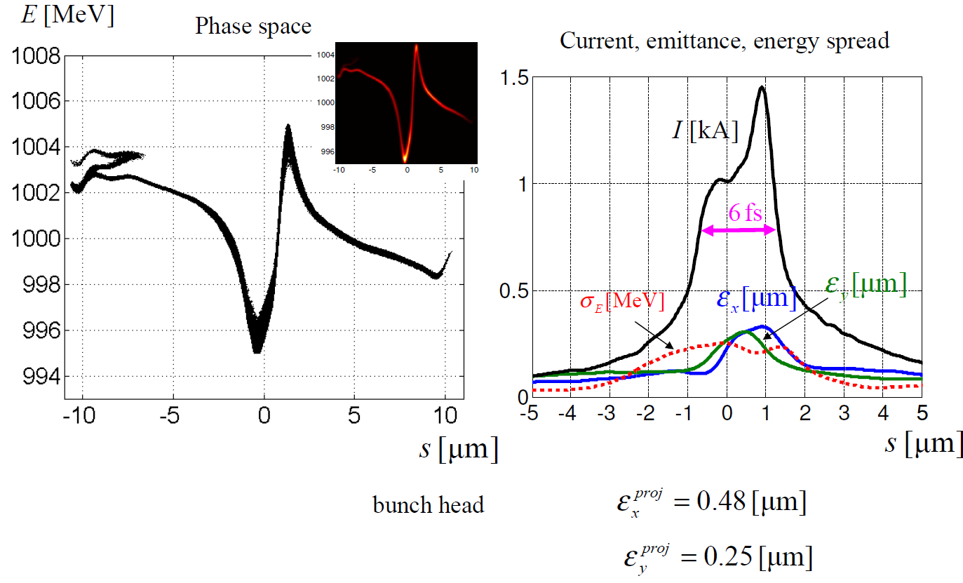
S2E with 20 pC Bunch Charge
Photon Pulse Length (FWHM) : 2 fs

Slide 7
E-Bunch Length and Photon Pulse Length
100 pC
Photon pulse length can be reduced by:
transverse offsets
energy offsets
local emittance blow-up
…

Slide 8
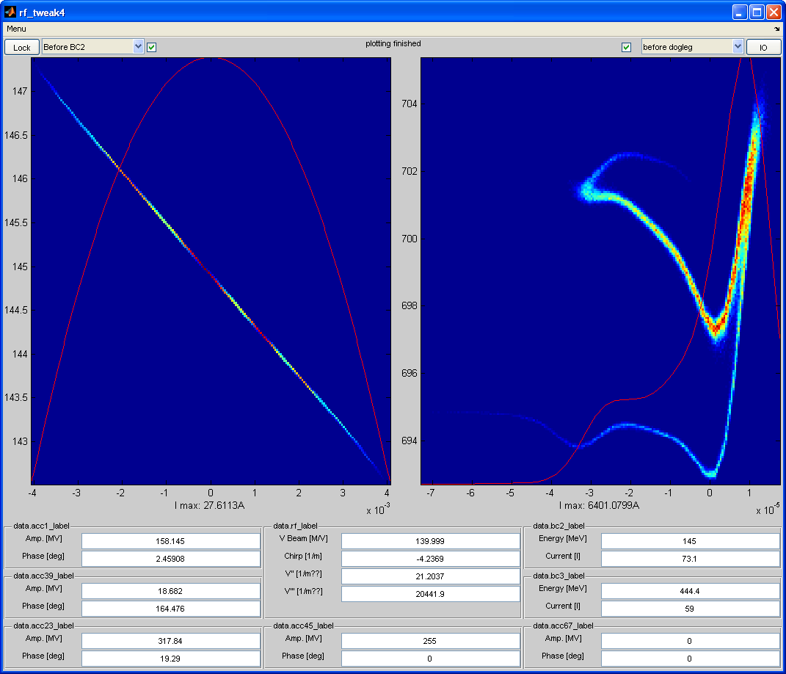
Fast Model for longitudinal Phase Space

Slide 9
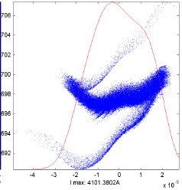
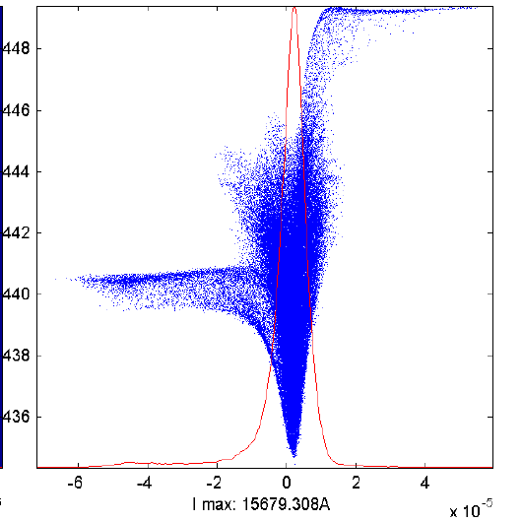
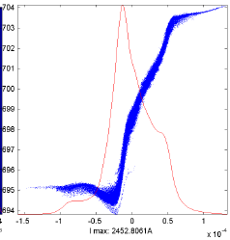
Bunch Shape after Compression vs. First Linac Section Chirp (500 pC)
Minimum bunch length limited by non-linearities
120 fs
30 fs
180 fs
ACC1-Phase: 2.51 deg
ACC1-Phase: 2.6 deg
ACC1-Phase: 2.8 deg
Stability and Tuning Issue

Slide 10
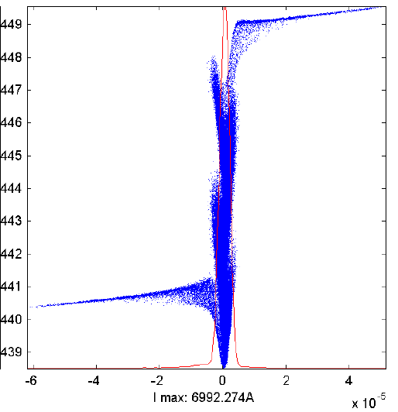
Bunch Shape after Compression (100 pC)
15 fs

Slide 11
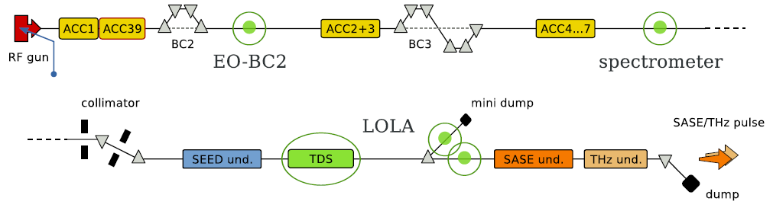
Study by Helen Edwards et al.
  Only BC-2 is on
  Bunch shape and length as measured with transverse deflecting cavity (LOLA) vs. ACC1/ACC39 phase

Slide 12
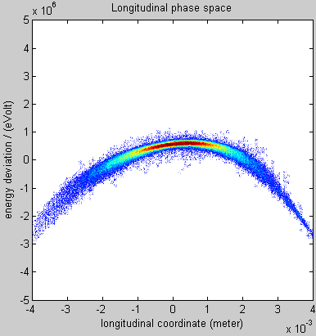
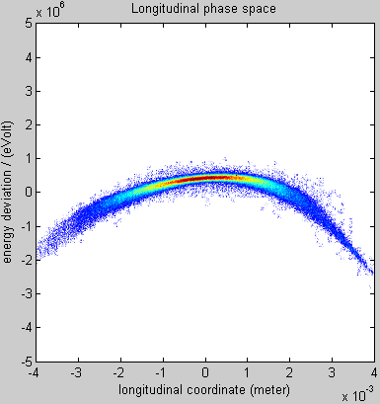
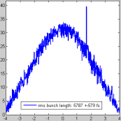
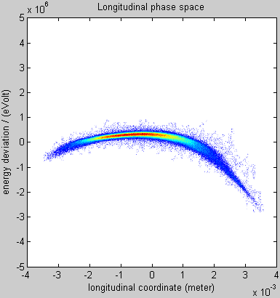
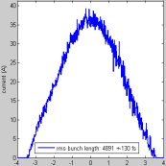
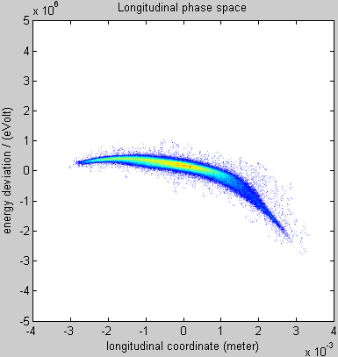
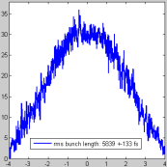
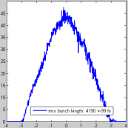
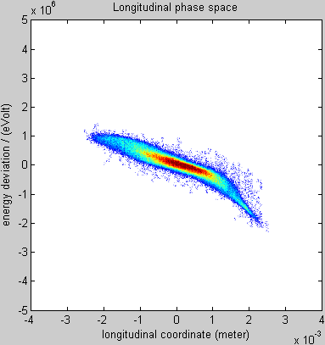
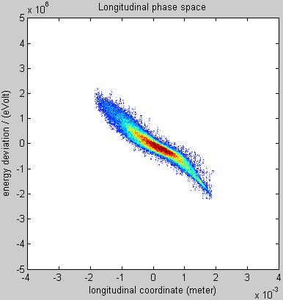
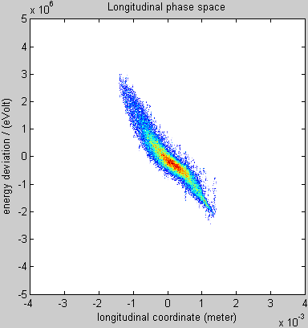
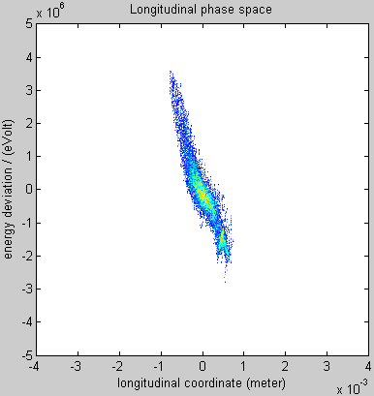
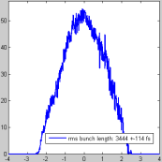
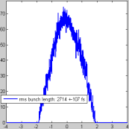
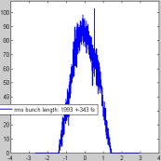
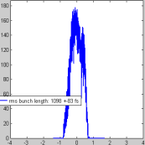
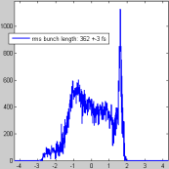
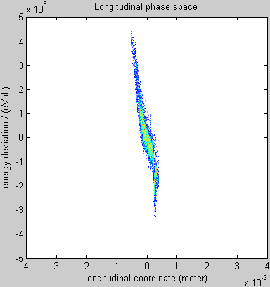
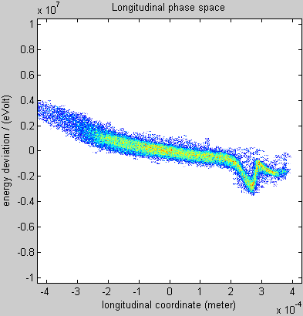
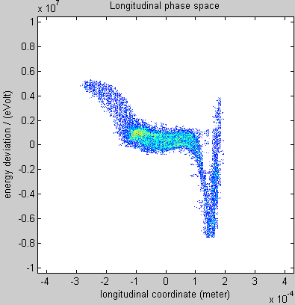
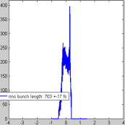
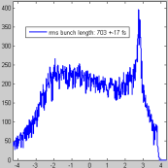
Longitudinal Phase Space and Profile vs. Energy Chirp
(ACC1 phase monitored)
0 deg
1 deg
2 deg
3 deg)
4 deg
5 deg
6 deg
7 deg
7.5 deg
7.5 deg
7.9 deg

Slide 13
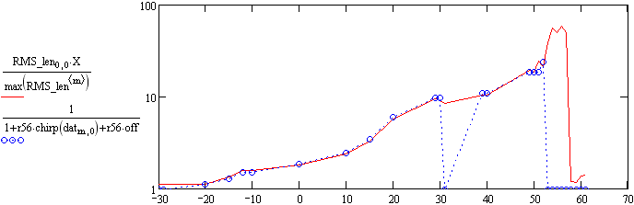
Measured and calculated compression factor
(without self-effects)
Small additional chirp and 10% correction of LOLA energy calibration:
M. Dohlus
C
r56_{nom} = 178.4 mm
off = 0.18
number of measurement
(increasing chirp)

Slide 14
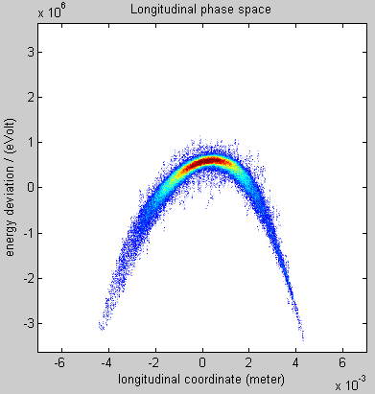
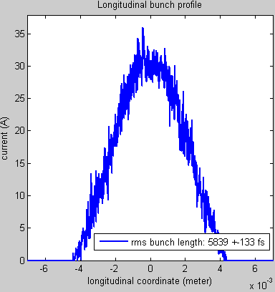
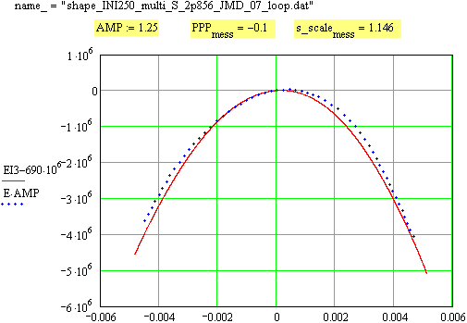
On crest

Slide 15
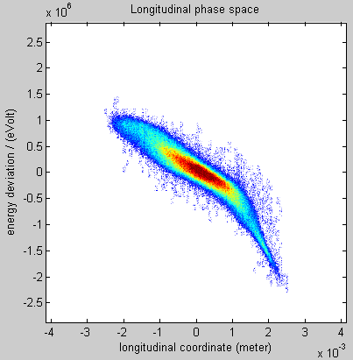
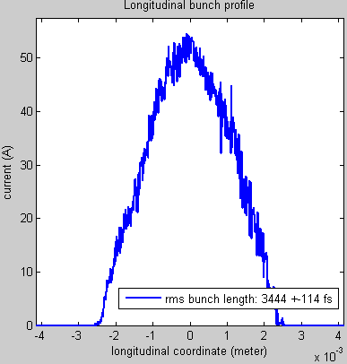
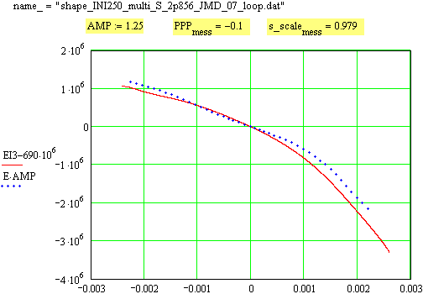
Compressed to ca. 50 A
No self-effects

Slide 16
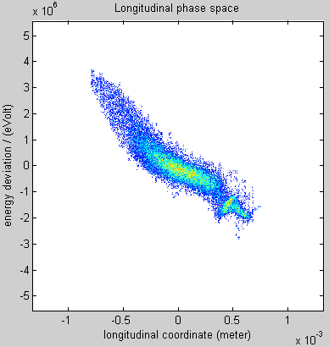
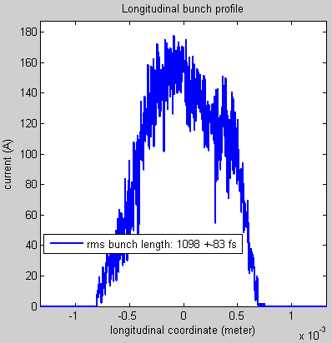
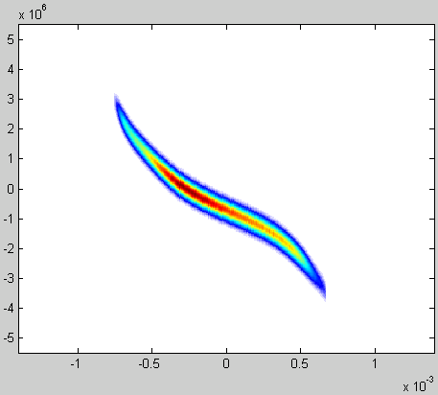
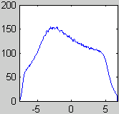
Compressed to ca. 150 A
With self-effects

Slide 17
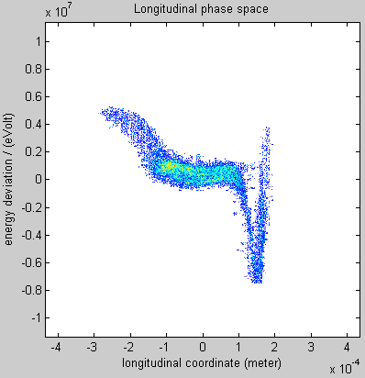
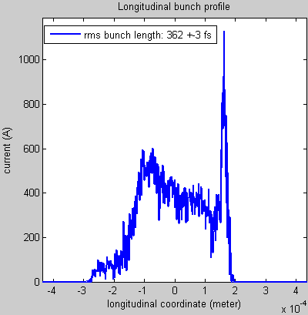
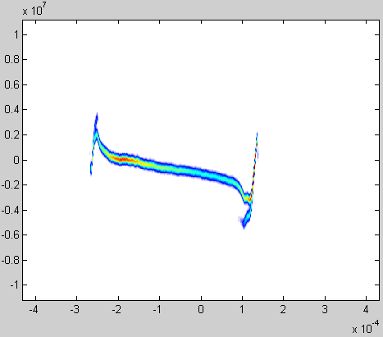
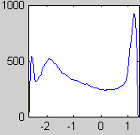
1kA Spike
Slope doesn‘t fit

Slide 18
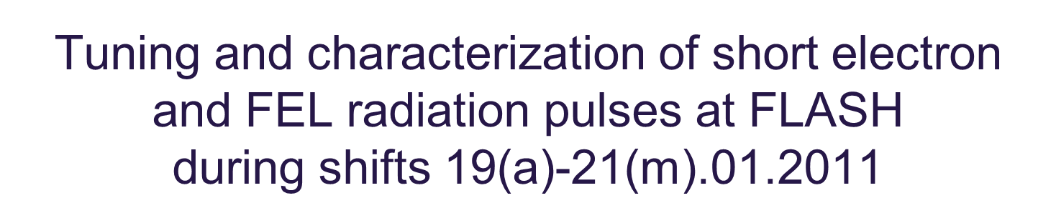

Bunch-Length-Tuning

Slide 19
Bunch-Length-Tuning (differential): 150 pC

Slide 20

Bunch-Length-Tuning: Spectra and Statistics

Slide 21

Results from another shift block
(compiled by S. Schreiber (still preliminary))
In general good agreement for the short pulses - within a factor of 2
Larger uncertainties for longer pulses

Slide 22
Tuning Issues
Longitudinal bunch shape changes with pulse train length, but LOLA can take only one bunch
  Under study/development: UV Pockels cell
Uncertainty in absolute rf phases
  Beam Arrival-time Monitors help
rf drifts
  LLRF hardware and software upgrades improved situation significantly
Instrumentation specified and designed for the original design charge of 1 nC

Slide 23
Peak Current for Short Pulses (Gaussian like)
Charge [pC] | Peak Current [kA] E-Bunch <100 fs FWHM | Peak Current [kA] E-Bunch <50 fs FWHM
1000 | 8.4 | 16.8
500 | 4.2 | 8.4
250 | 2.1 | 4.2
100 | 0.8 | 1.6
From S2E: At short bunches, peak currents of 2 kA already increase slice emittance.
From SASE Simulations: Peak currents of 1.5 - 2 kA needed for saturation (at least for the shorter wave lengths)
In the charge regime below 250 pC, SASE intensity and very short bunch length should go together

Slide 24
Summary and Remarks
The tools and methods to tune bunch length exist and have passed first tests
Extensive feedback from users about photon beam quality is important
An on-line photon pulse length and pulse shape measurement would be of great help

