Slide 1
Beam Dynamic Shifts 2011
C. Behrens, W. Decking, M. Dohlus, H. & D. Edwards,
C. Gerth, T. Hellert, T. Limberg, P. Piot, E. Schneidmiller,
M. Scholz, M. Vogt, S. Wesch, M. Yurkov, I. Zagorodnov

Slide 2
Schedule
Shift | Person in Schedule | Subject | Comments
Sun Jan 16 n | P. Piot (12h) | Linearly ramped current profile | done
Mon Jan 17 n | P. Piot (12h) | Linearly ramped current profile | done
Tue Jan 18 n | P. Piot (12h) | Linearly ramped current profile
Wed Jan 19 a | B. Faatz | SASE tuning | E. Schneidmiller: Set-up for different charges
Wed Jan 19 n | C. Behrens | Long. Phase space vs. SASE | LOLA studies, SASE vs. bunch length @ given charge

Slide 3
Shift | Person in Schedule | Subject | Comments
Thu Jan 20 m 7-11 |  | SASE Characterization (Bunch length etc.) | M. Yurkov
Thu Jan 20 m 11-3 | TL/WD (4 h) | Optics and Beam-D | Emittance and optics measurement, Dog-leg dispersion measurement and adjustment
Thu Jan 20 a | TL | BC Studies | Impact of dog-leg on LOLA profile and SASE
Thu Jan 20 n | C. Behrens | Long. Phase space vs. SASE
Fri Jan 21 m |  | SASE Characterization (Bunch length etc.) | M. Yurkov

Slide 4
Shift | Person in Schedule | Subject | Comments
Fri Jan 21 m | TL/WD (4 h) | Optics and Beam-D | Orbit response, ACC1 beam dynamic
Fri Jan 21 a | TL | BC Studies | Vary ACC567 energy, observe LOLA
Fri Jan 21 n | C. Behrens | Long. Phase space vs. SASE
Sat Jan 22 m 7-11 |  | Contingency SASE characterization | M. Yurkov
Sat Jan 22 n | C. Behrens | Long. Phase space vs. SASE

Slide 5
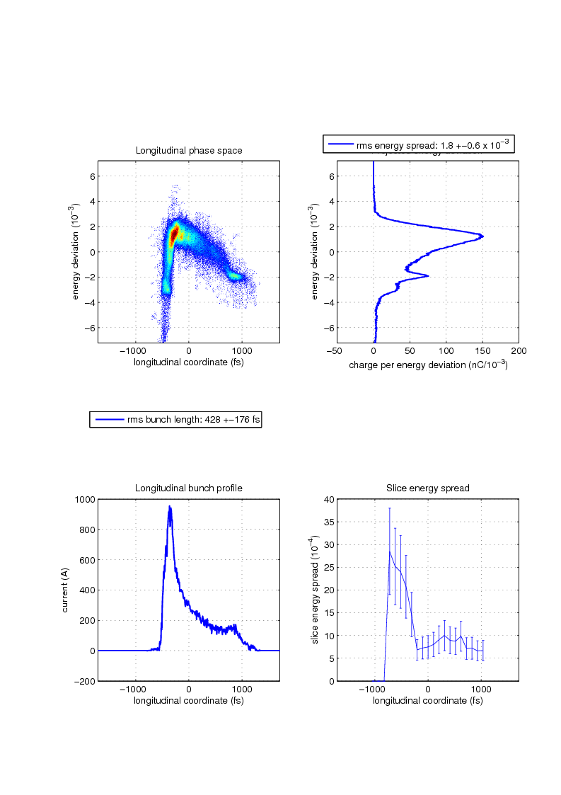
Generation of electron bunches with linearly-ramped current profile
ACC39 gradient limit was increased to ~21-22 MV; we decrease the BC2 energy to 140 MeV With this setup could produce linearly-ramped bunches with two type of slopes (rising and falling) starting from setup devised from rftweak and a tracking code from M. Dohlus. We demonstrated the tunability of the ramp steepness and associated peak current (max peak current was of the order of 1 kA). We collected data for compression in BC2 only (BC3 R56 decreased to 15 mm) and with some compression in BC3 (BC3 `R56~32 mm)

Slide 6
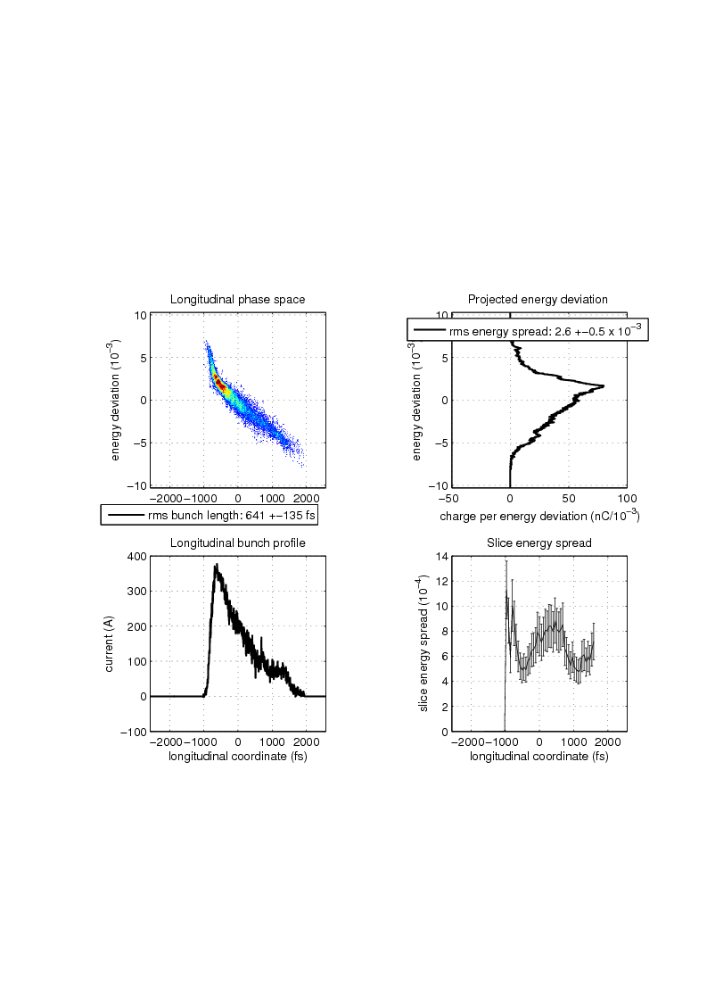
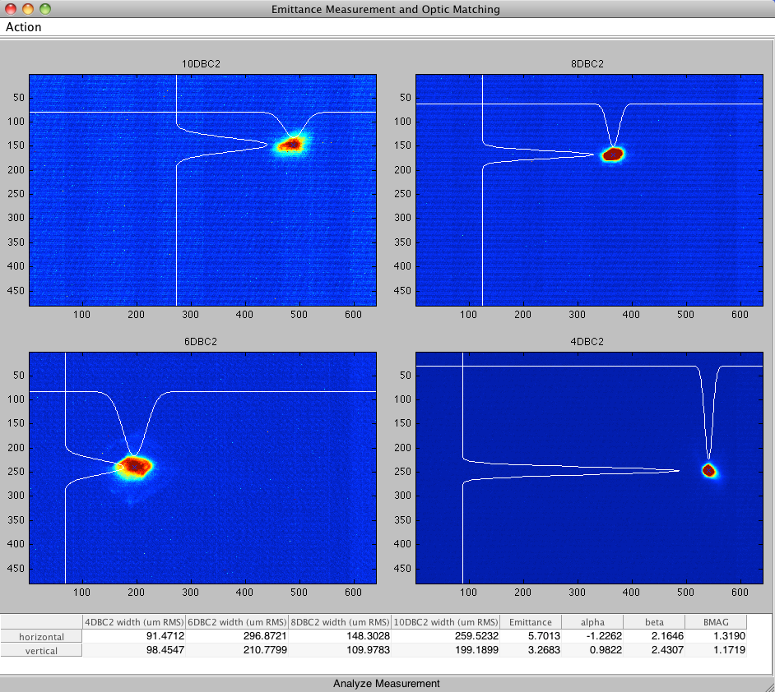
Peak current vs. emittance

Slide 7
3rd Shift
* CTR bunch spectra were taken for different bunch profiles. Thanks for parasitic measurements! (S.Wesch) * Linearly-ramped current profile for different charges and iris settings taken
* Laser attenuator was broken => temporarily 2-nd installed (taken from Laser 1) by Sebastian Schulz (one of the few down times)

Slide 8
SASE tuning (E. Schneidmiller)
Set on crest phases for ACC23, ACC45 to zero
225 uJ (GMD-B, 10/10 mm) at 14.6 nm for 5 bunches, 1 MHz, 1 nC
210 uJ for 0.5 nC
35 uJ for 0.25 nC
1 uJ for 0.1 nC
Change between these 4 regimes is done with the help of very few knobs (pyro BC2 target, solenoid, launch steerers)

Slide 9
Electron bunch characterization
We recovered all of Evgeny's SASE WP with the same level of SASE. In two directions, going from 1nC to 0.1nC and back again from 0.1nC to 1nC.!
We measured long . phase space and THz spectra for all SASE WP and took a lot of data for post-analysis.
The rms values for bunch lenghts are between 60 and 110fs, but looking into the long. phase space, much shorter lasing parts can be expected!
As expected the long. phase space and finally SASE is pretty sensitive to phase variations of the order of 0.1deg.
The measurements resp. the behavior of the long. phase on the 0.1deg phase variations match with first simple simulations we did in the control room.
3 x LOLA time resolution record: 11fs, 9fs, and finally 8fs.

Slide 10
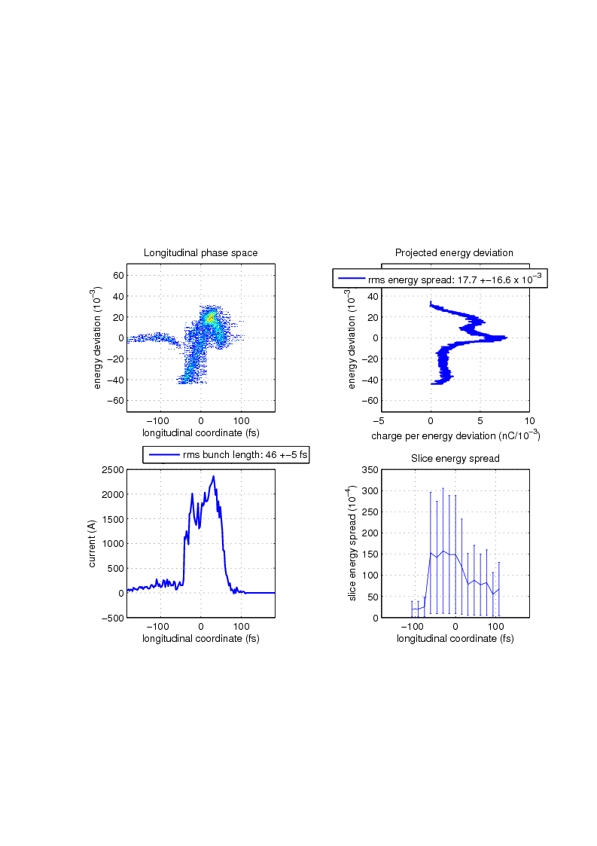
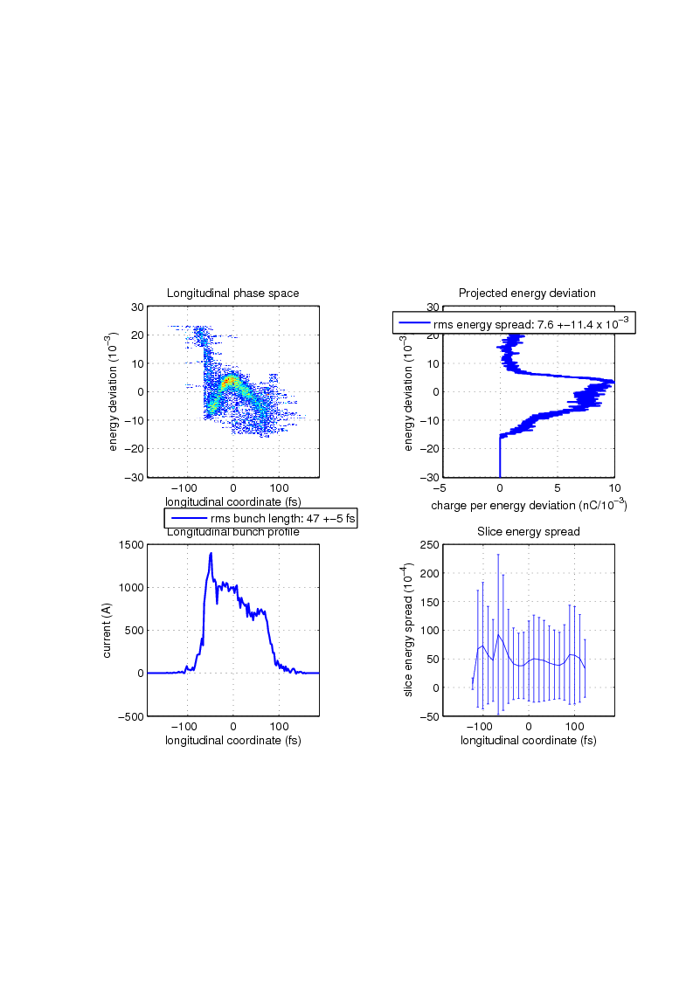
The other direction: Before and after SASE optimization

Slide 11
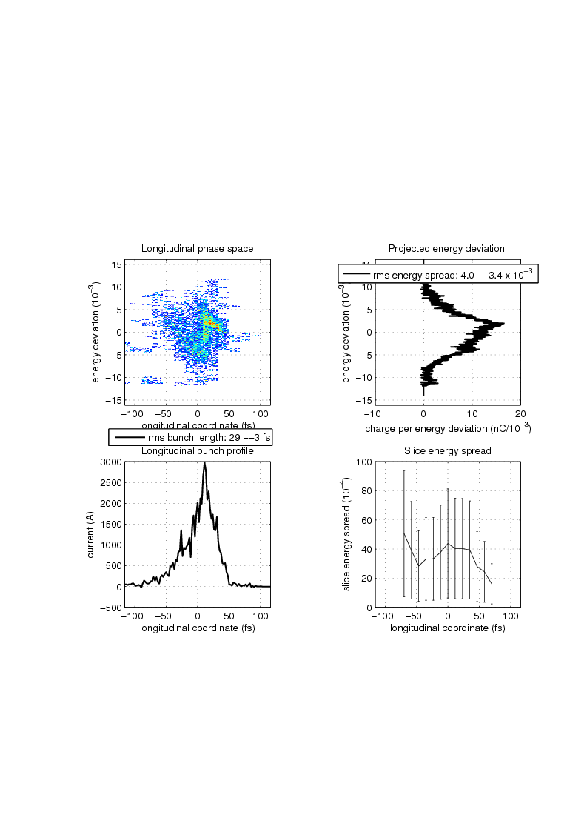

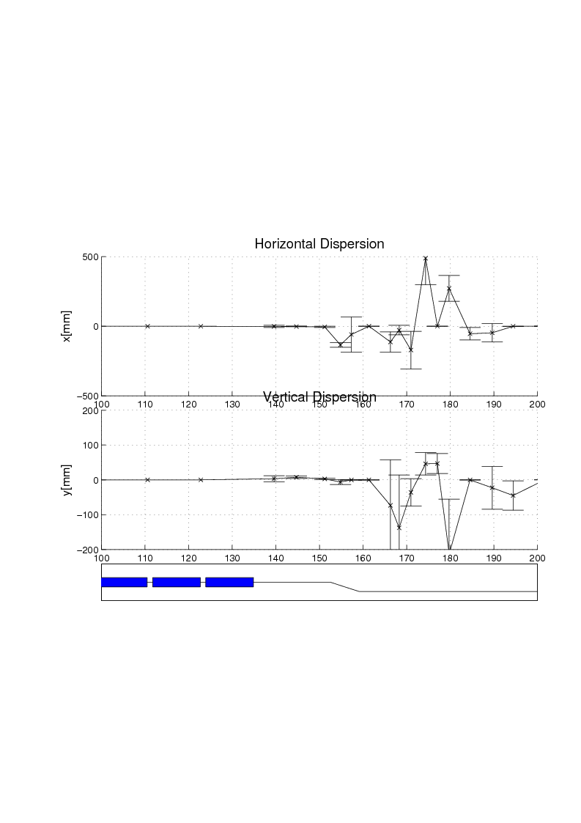
Q3ECOL Scan (here: 118 A and 121 A)

Slide 12
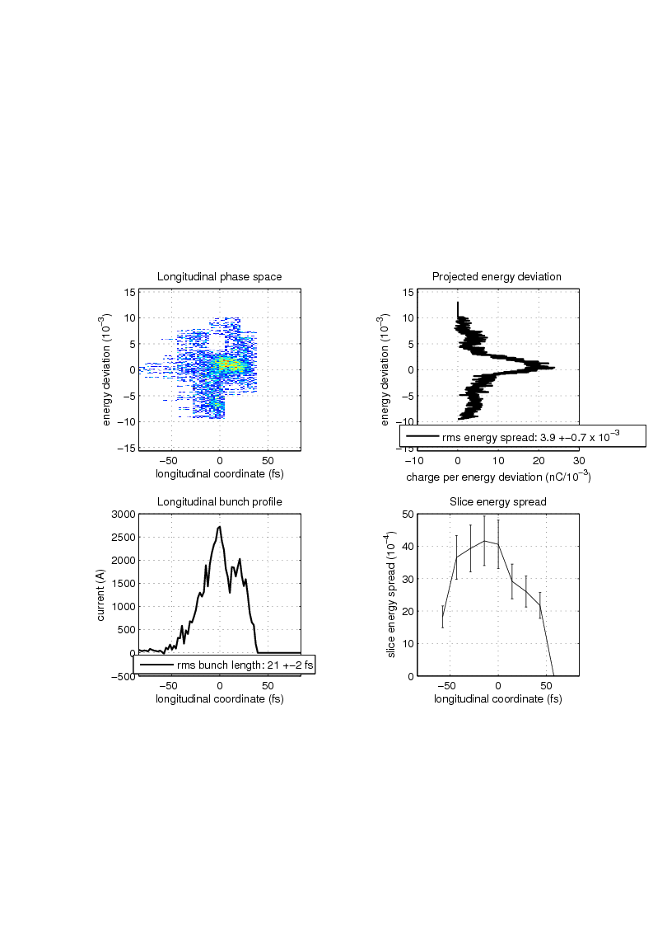
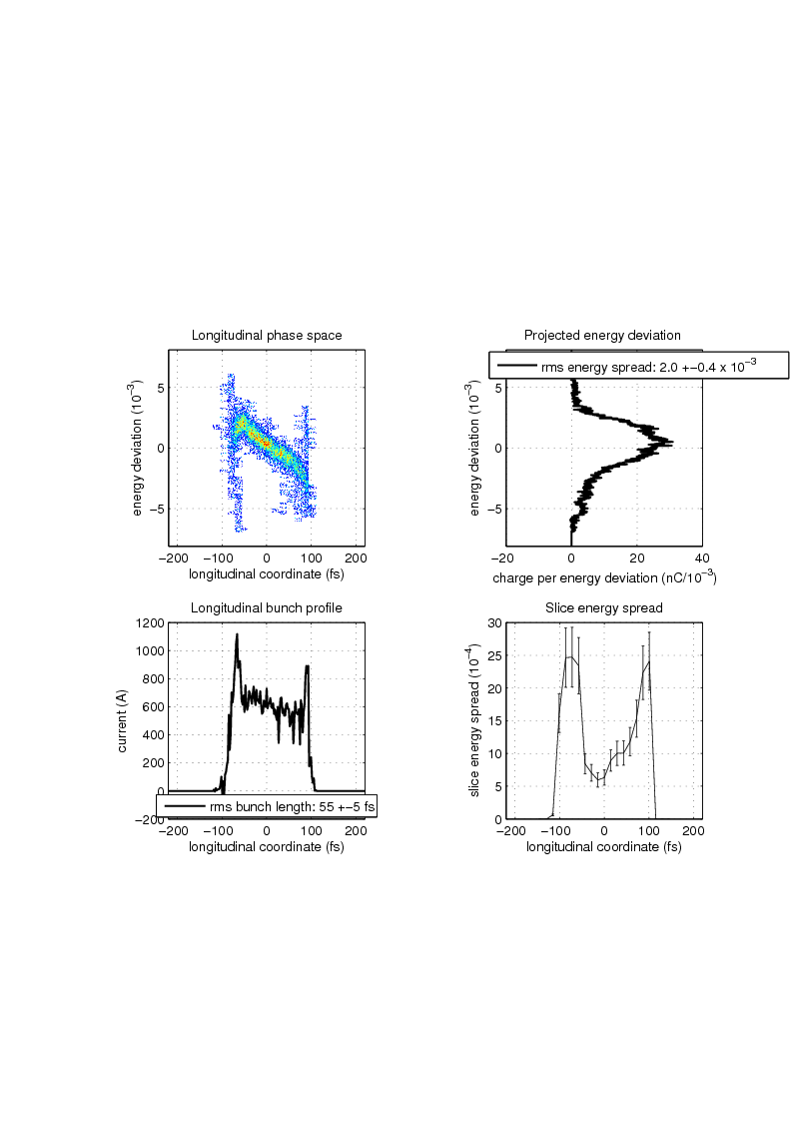
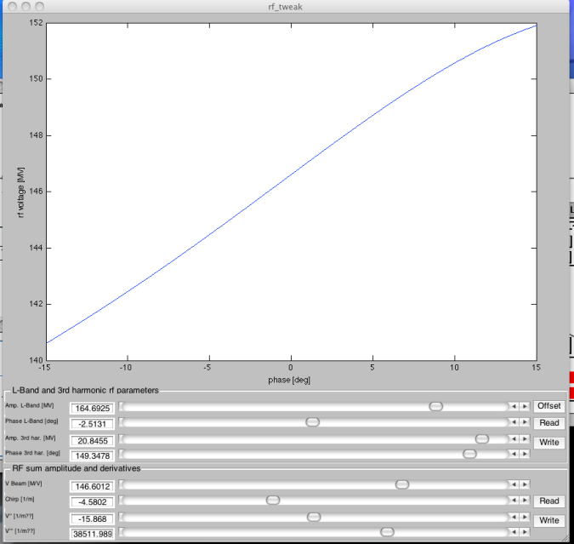
Performed studies of bunch shape vs. rf acc1/acc39 knob settings.

Slide 13
Optics and transverse beam dynamics
Response matrix data taking
Commissioned emittance measurement data taking for both ORS screen sections.

