Slide 1
Low Emittance RF Gun Developments for PAL-XFEL
Jang-Hui Han, Juho Hong,
Munsik Chae, Sung-Ju park
Pohang Accelerator Laboratory

Slide 2
Contents
PAL-XFEL project overview
Requirements of PAL-XFEL injector
Baseline Injector
Methods to further improve injector performance
Alternative (Low Emittance) Injector
PAL-XFEL injector test facility

Slide 3

PAL-XFEL Project
S-band 10 GeV linac + 1 hard & 1 soft X-ray undulator beamlines (space for two more hard and one more soft lines reserved)
60 Hz rep. rate with single or two bunches
The project started in 2011 aiming at construction by 2014
Building construction ongoing
Commissioning to start in 2015
PAL-XFEL
PLS II

Slide 4
Baseline Linac Layout
  Injector to 139 MeV + Laser heater
  S-Band cavities for beam acceleration
  X-band cavity for linearization in time-energy phase space
  BC1 (1st magnetic bunch compressor) at 0.33 GeV
  BC2 at 2.5 GeV
  Beam branch to soft X-ray beamlines at 3 GeV
  BC3 at 3.5 GeV
  Linac end at 10 GeV

Slide 5
Two Undulator Lines for Phase 1
Undulator Line | HX1 | SX1
Wavelength, nm | 0.1 | 3.0
Beam energy, GeV | 10 | 3.15
Undulator period, mm | 24.4 | 34.0
Undulator gap, mm | 7.2 | 8.3
Undulator module length, m | 5 | 5

Slide 6
How good Injector needed?
Electron beam quality for
  0.1 nm FEL using 10 GeV electron beam
  10¹² photons per pulse at 0.1 nm
  → 30 GW with 0.2 nC bunch
  Saturation within 120 m (24 x 5 m long undulators)
Thermally stable at 60 Hz +
Robust and reliable for user service

Slide 7
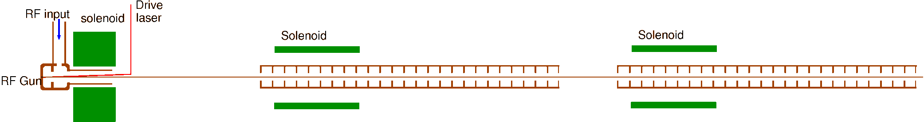
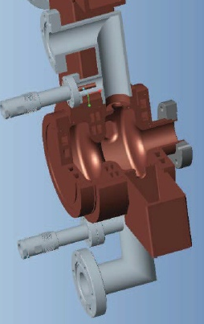
PAL ITF Gun1
e beam
Developed during last few years at PAL
1.6 cell, 2.856 GHz
2 RF coupler ports & 2 vacuum ports at the full cell for RF symmetry
  Gun solenoid at 205 mm from cathode (no magnetic field compensation solenoid)
Basic test done at GTF in 2011
Commissioning started at ITF

Slide 8
Baseline Injector Layout
2 accelerating sections with focusing solenoids
120 MV/m max field at cathode, 5.7 MeV beam energy at gun exit
20 MV/m & 25 MV/m gradients at 1st & 2nd accelerating tubes, 139 MeV beam energy at injector end
Drive laser beam size is minimized to reduce thermal emittance (0.12 mm rms for 200 pC beam → 0.11 mm mrad thermal emittance)
1st accelerating section starts at 2.2 m from the cathode (longer e-beam focal length due to the smaller laser beam at cathode)
Two linac solenoids for beta-function control at the entrance of the laser heater system

Slide 9
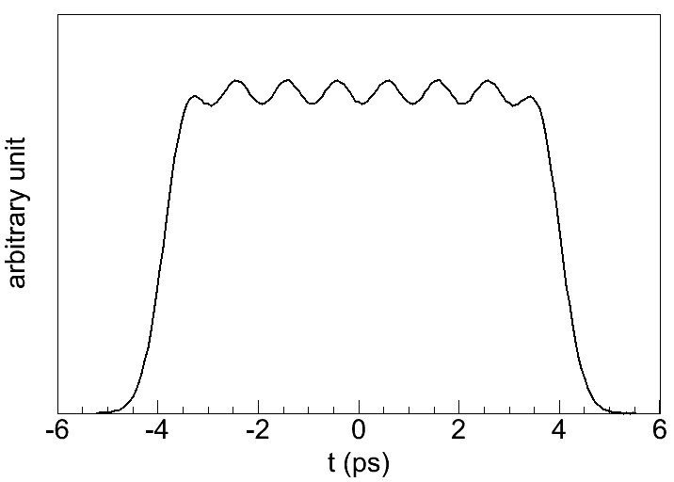
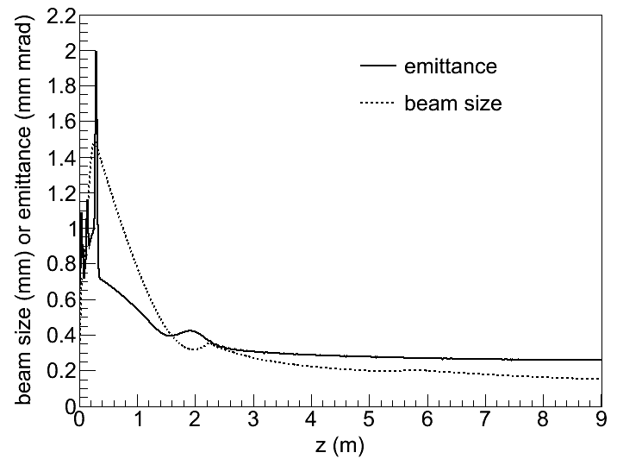
Beam Dynamics, Flat-top Laser – 1
Cathode laser
Longitudinal shape:
- 8 short Gaussian pulses stacked
- 8 ps fwhm
Transversely uniform
200 pC beam simulation at injector end
→ 0.26 mm mrad transverse projected emittance

Slide 10
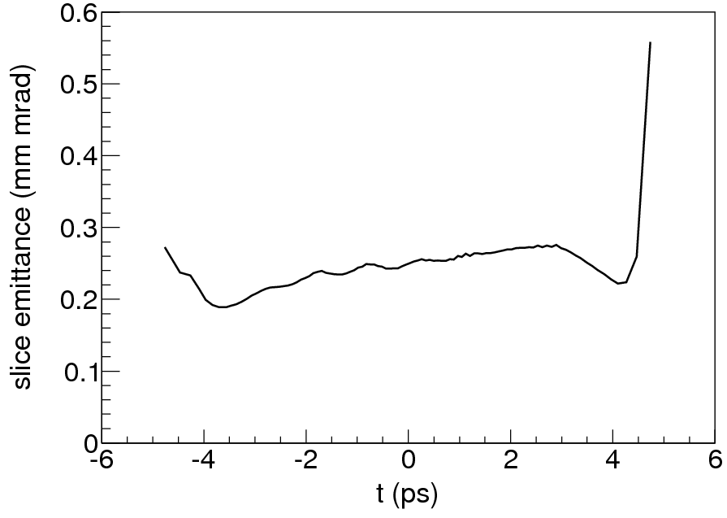
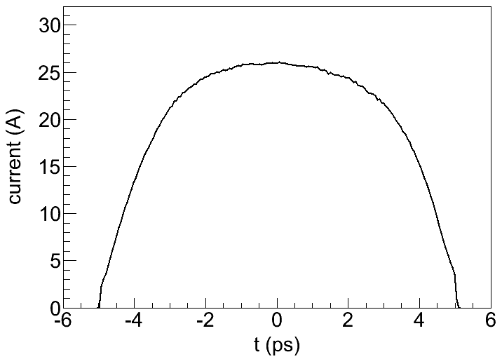
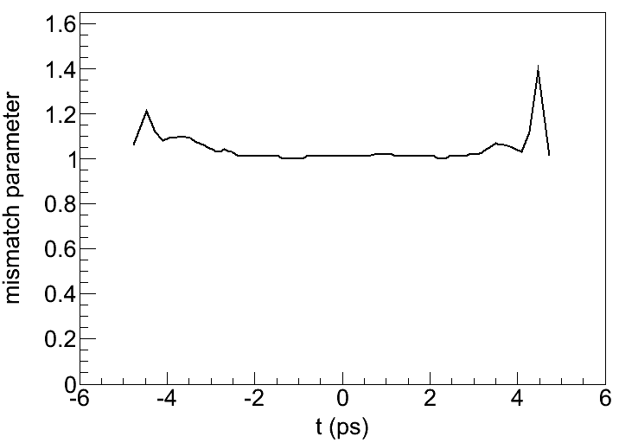
Beam Dynamics, Flat-top Laser – 2
Emittance at central slices below 0.3 mm mrad
200 pC
0.3 mm mrad
Peak current 26 A
Mismatch parameter close to 1

Slide 11
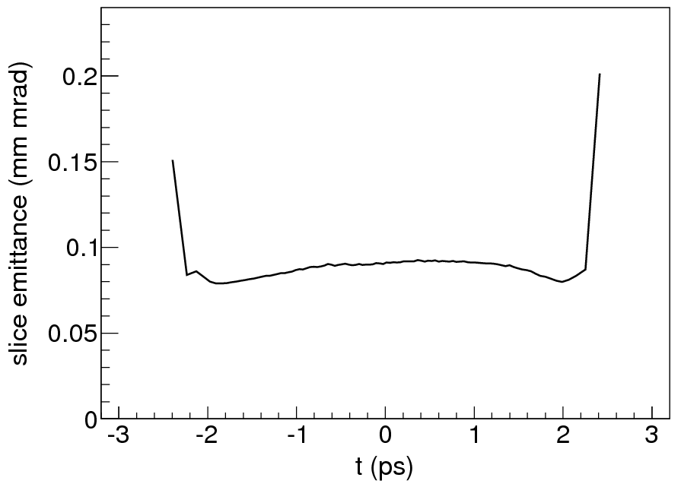
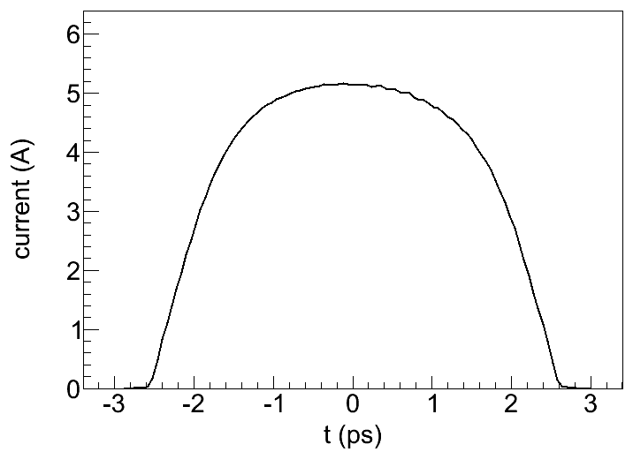
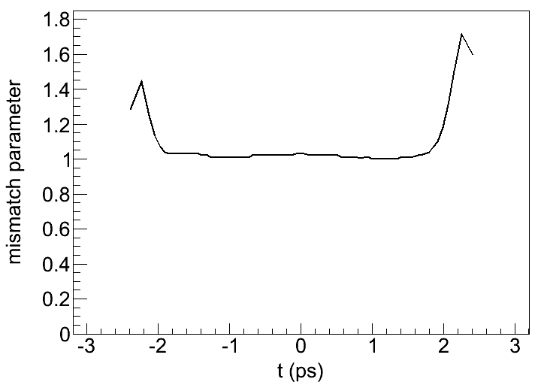
Beam Dynamics, Flat-top Laser 20 pC
Emittance at central slices below 0.1 mm mrad
4 ps flat-top laser pulse profile (4 Gaussian pulses stacked)
0.1 mm mrad
Peak current 5 A

Slide 12
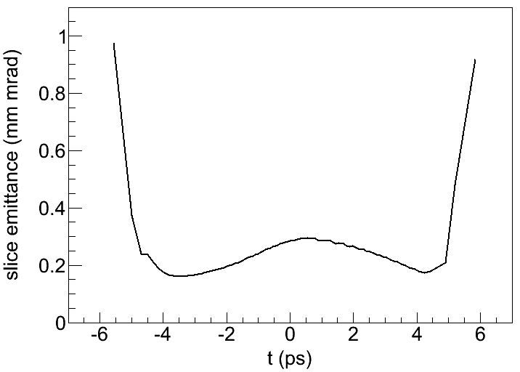
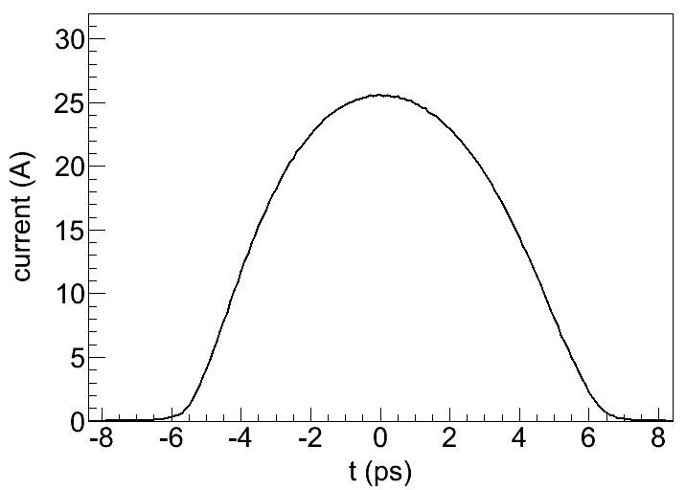
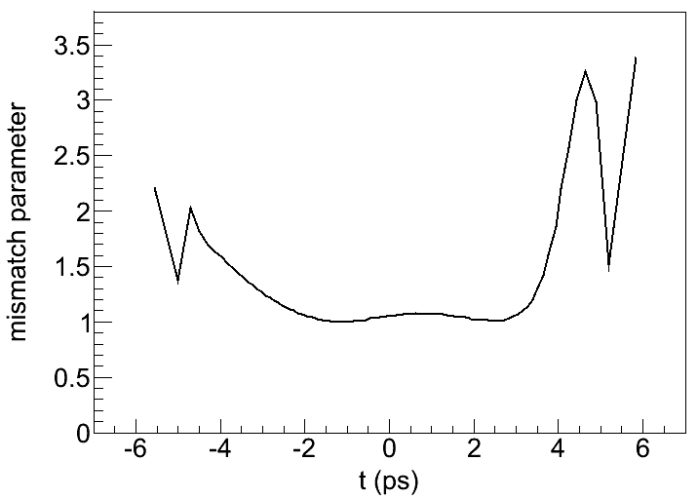
Beam Dynamics, Gaussian Laser
200 pC
Gaussian laser pulse profile instead of flat-top
0.3 mm mrad
Peak current 26 A

Slide 13
Can We further improve Injector?
Thermal emittance
Gun cavity geometry
Position of gun solenoid
Position of first accelerating section
– already done for the PAL-XFEL baseline injector

Slide 14
Low Thermal Emittance
Small drive-laser beam size
  Electron beam dynamics optimization
Small kinetic energy of emitted electrons from the cathode
  Longer wavelength of drive-laser
  Higher work function (and high quantum efficiency)
Need for R&D of drive-laser and photocathode
Photocathode plug enables using various photocathode material with different surface treatment

Slide 15
Keeping Beam Quality through Gun
Immediately after the beam emission, the beam is affected by space charge and mirror charge
→ Strong acceleration field required
On the other hand, strong surface field produces Schottky effect. The kinetic energy of emitted electrons increases.
120 MV/m peak field at the PAL-XFEL S-band gun
Fast acceleration as well as keeping the electron beam size through the gun cavity is crucial to generate a small emittance beam.

Slide 16
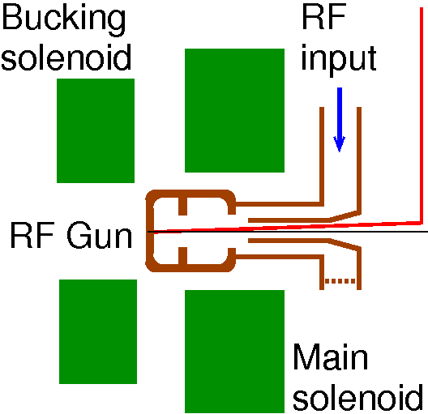
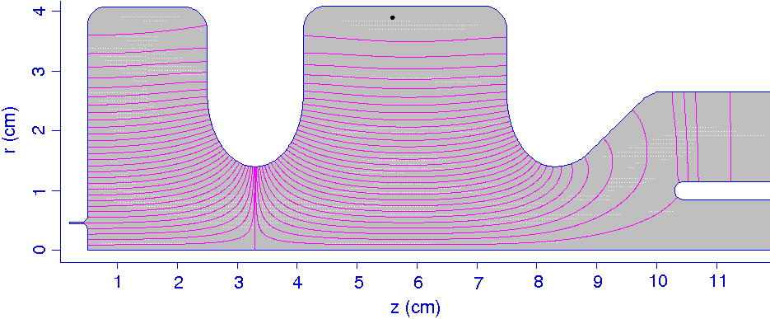
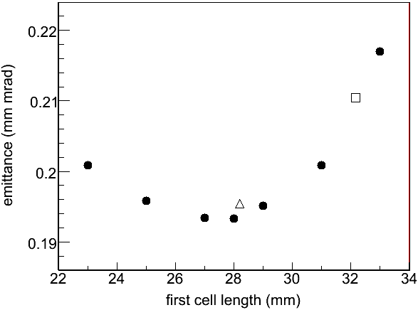
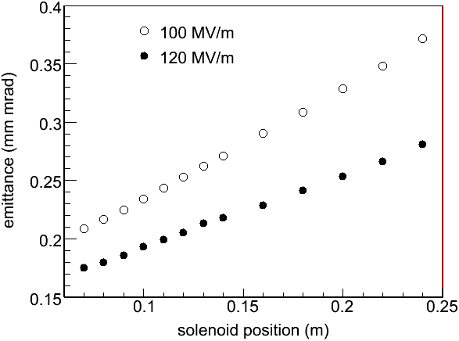
Optimization of a New Gun
1st cell
2nd cell
LCLS
2.856 GHz gun
Scaled DESY
1.3 GHz gun

Slide 17
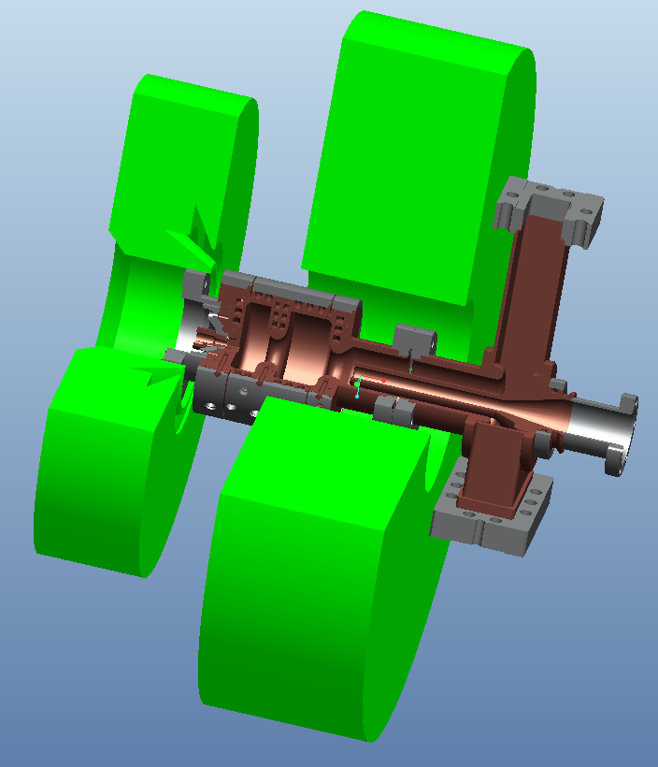
Low Emittance Gun (Alternative Gun)
In parallel with the baseline injector commissioning at ITF,
a new injector with an alternative gun is being developed.
Alternative gun (2.856 GHz):
A scaled down version of DESY L-band guns
Coaxial RF coupler
→ perfect RF symmetry
Optimum solenoid position
→ minimized transverse emittance
Cathode plug exchangeable under UHV
→ more reliable operation
→ possibility using other cathode materials
Improved water-cooling
→ more thermal stablility

Slide 18
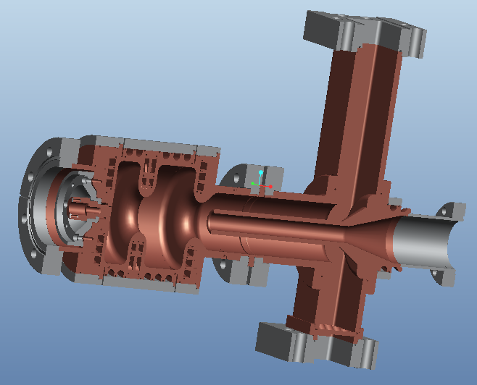
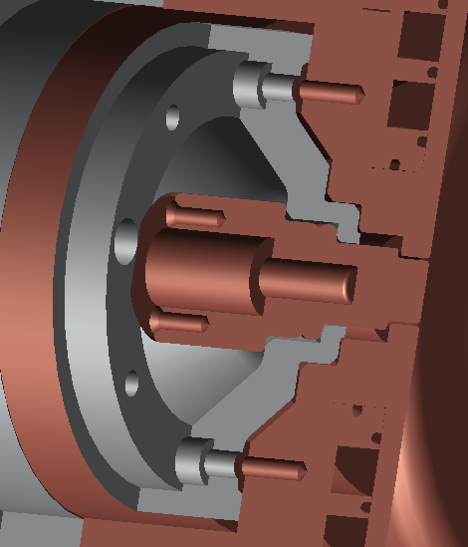
Gun + Coupler

Slide 19
Gun Development Status
Gun cavity & coupler
  First machining ongoing at a local machining company
  Vacuum brazing to be done at PAL
  Production to be ready January 2013
Gun solenoids
  Production ready at a local company
  Magnetic field measured
Gun test beamline
  Under design
  First operation planned summer 2013

Slide 20
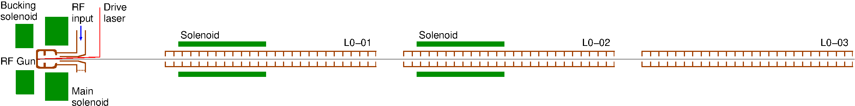
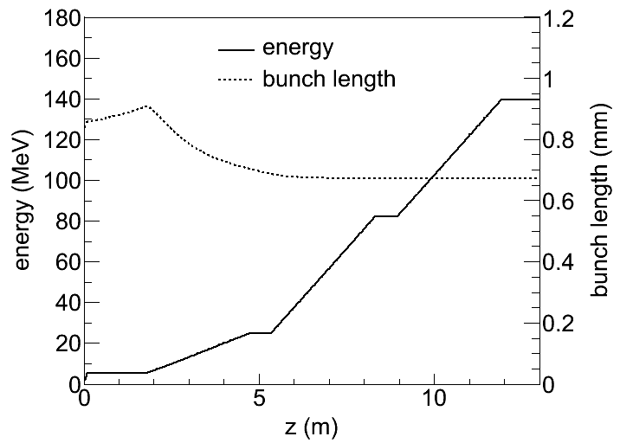
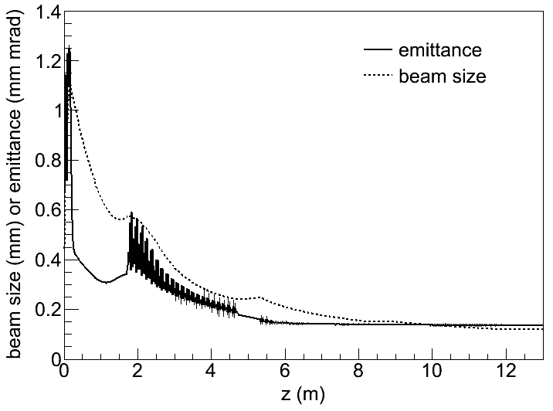
Low Emittance Injector
Alternative gun + three accelerating sections (focusing solenoids at the first two sections)
120 MV/m max field at gun, 14 MV/m gradient at 1st section, 20 MV/m at 2nd & 3rd sections
Mild velocity bunching at 1st section (−67°), energy chirp corrected by 2nd & 3rd sections (16°)

Slide 21
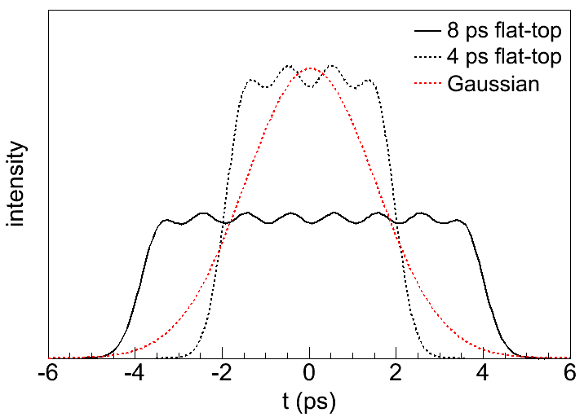
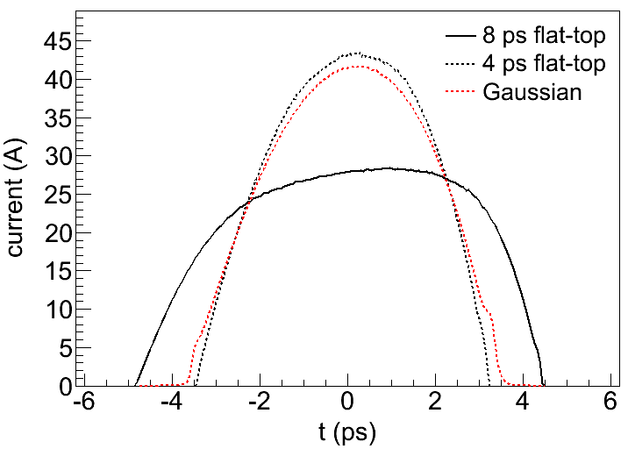
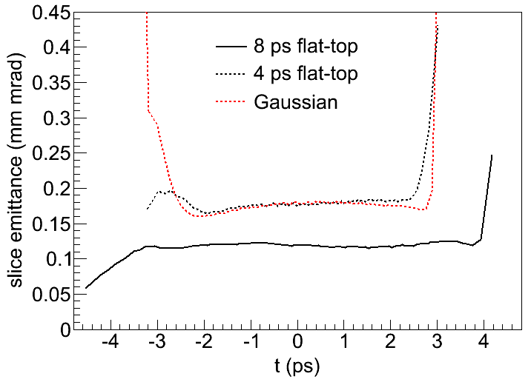
Nominal Bunch Charge, 200 pC
8 ps flat-top: eight Gaussian pulses stacked
4 ps flat-top: four Gaussian pulses stacked
Short Gaussian (no complicated pulse shaping)

Slide 22
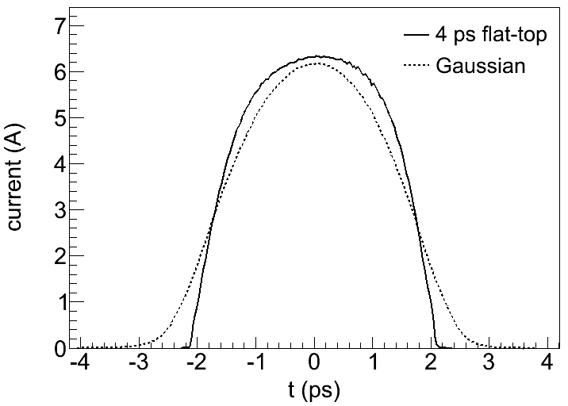
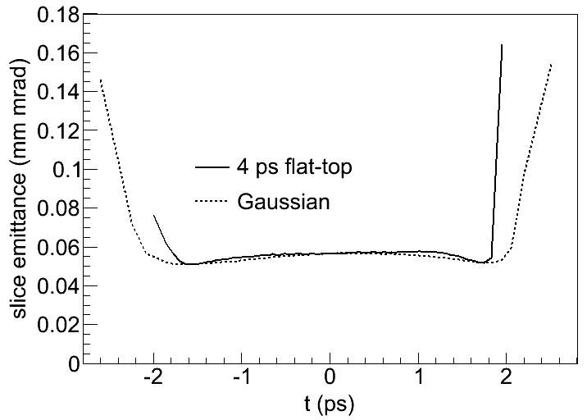
Low Bunch Charge, 20 pC
4 ps flat-top: four Gaussian pulses stacked
Short Gaussian (no complicated pulse shaping)

Slide 23
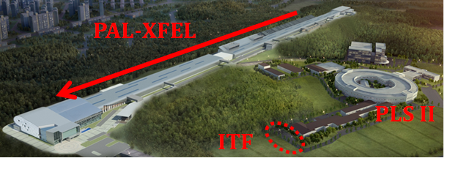
PAL Injector Test Facility
19.2 m
S. J. Park

Slide 24
Purpose of ITF
Commissioning of PAL-XFEL injector (one gun + two accelerating sections) including laser heater and RF deflector
Test of new guns, laser, diagnostics, control, cooling, …
Practice of beam operation, education of new operators

Slide 25
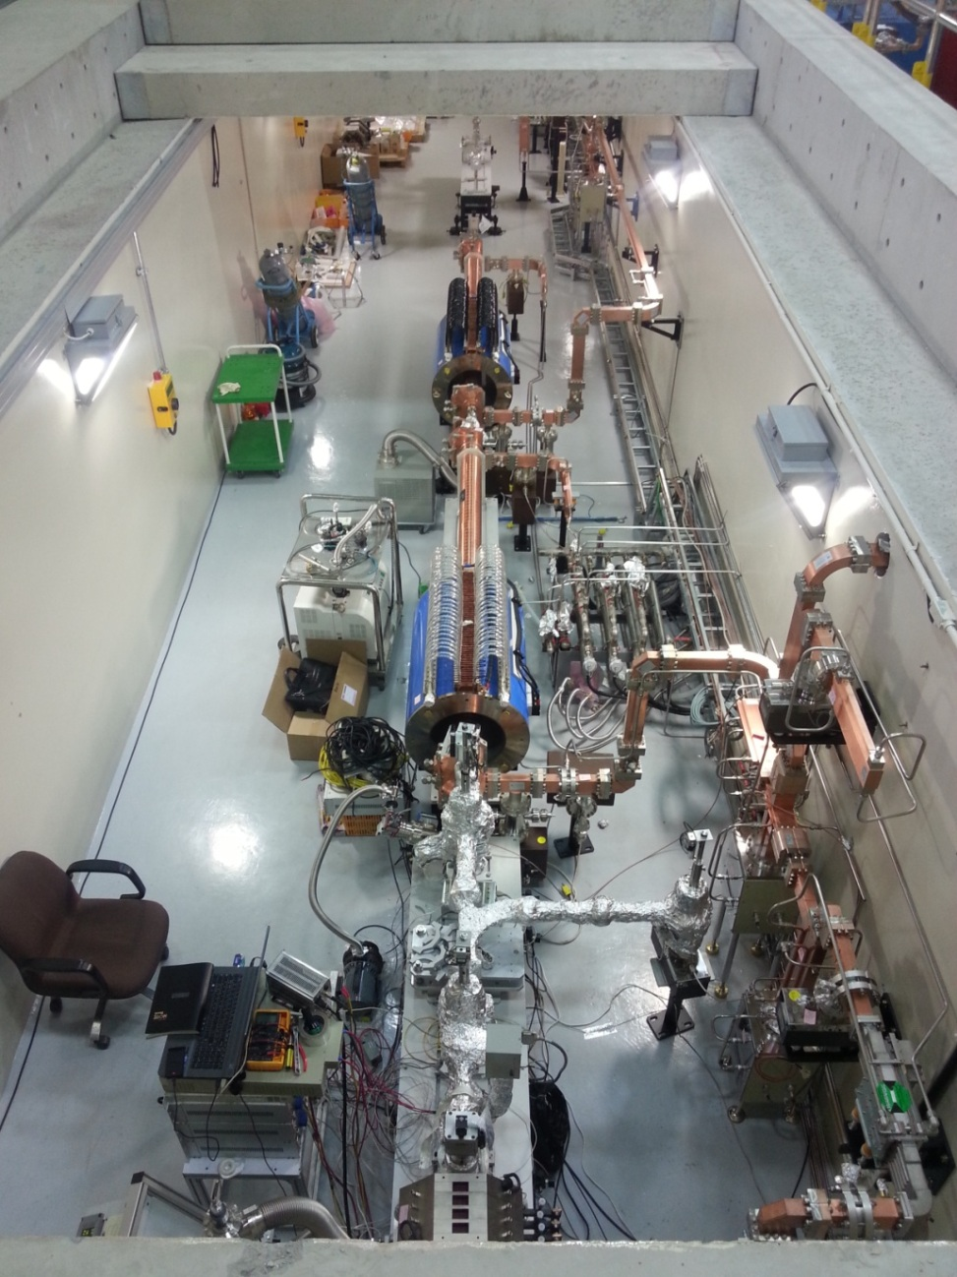
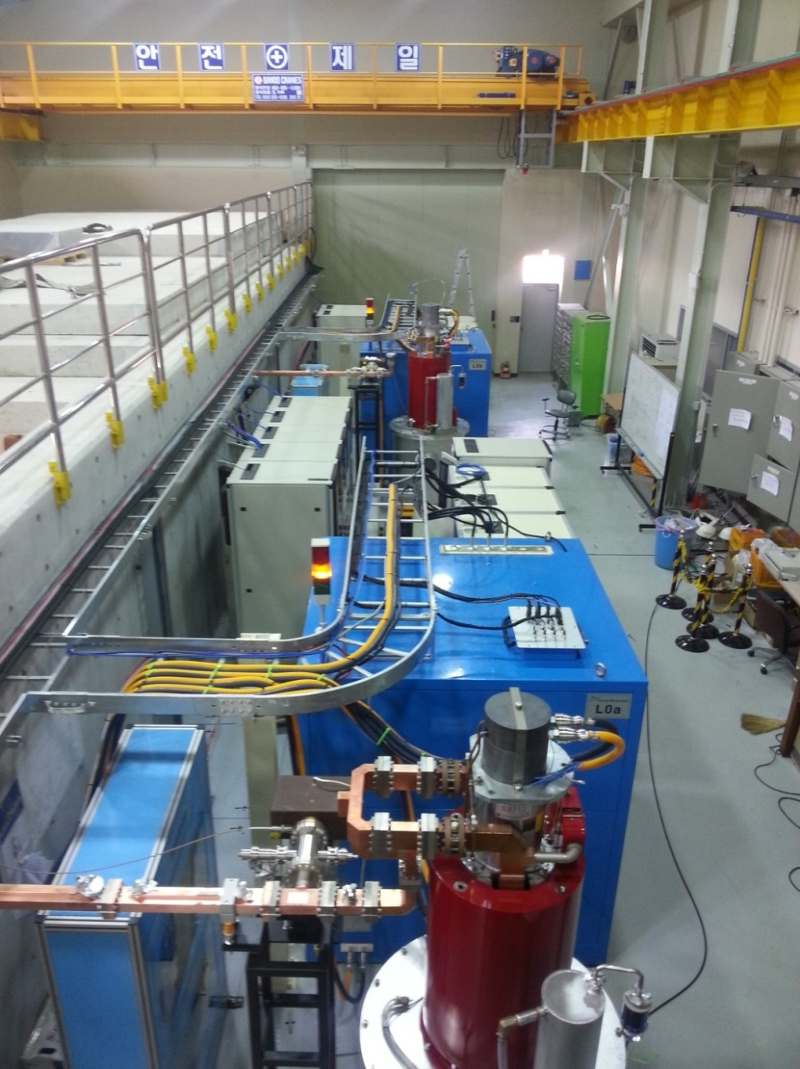
ITF Status I
ITF tunnel
Gallery

Slide 26
ITF Status II
RF station installed
GTF gun with solenoid installed
2 linac tubes with solenoids installed
Laser system installed in the laser room
Laser optics being installed in the tunnel
RF network being installed
RF conditioning being started
→ First beam foreseen in the next weeks

Slide 27
Summary
Baseline injector
  PAL ITF gun1 + two accelerating sections
  Fully satisfy PAL-XFEL basic requirement
  Installed at PAL-XFEL ITF, RF conditioning ongoing, first beam foreseen this month
Alternative injector
  Alternative gun + three accelerating sections
  Will provide further low emittance
  Thermally more stable, photocathode easily exchangeable
  Under production, first beam foreseen summer 2013

Slide 28

Thanks

