Slide 1
Flat Top Pulser for XFEL and FLASH II
W. Decking, B. Faatz, C. Gruen,
M. Hϋning, J. Kahl, J. Klute, K. Mϋller,
F. Obier, J. Wortmann
FEL Beam Dynamics Meeting, 27.06.2011
Notes:
How to edit the title slide
Upper area: Title of your talk, max. 2 rows of the defined size (55 pt)
Lower area (subtitle): Conference/meeting/workshop, location, date, your name and affiliation, max. 4 rows of the defined size (32 pt)
Change the partner logos or add others in the last row.

Slide 2
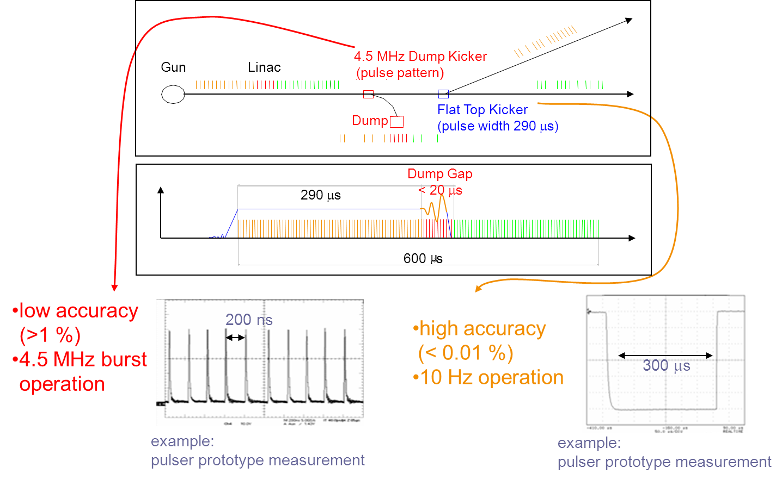
Introduction
Intra-Train Beam Switching requires ultra-stable pulser with up to 800 μs flat top
Satbility goal at undulator < 1/10 σ, typical kick 100-300 σ
=> rel. amplitude stability < 1e-3 to 1e-4

Slide 3
FLASH Measurements
Installed pulser (and new kicker) at feedback location before collimator
Correct kicker influence with nearby steerer
Observe trajectory and SASE level

Slide 4
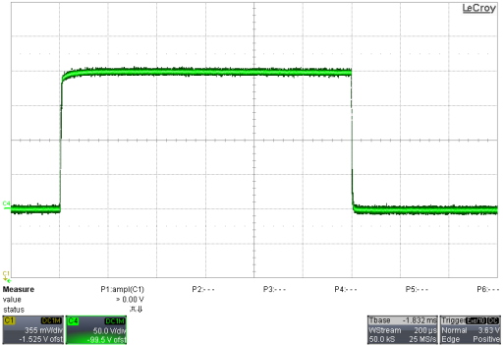
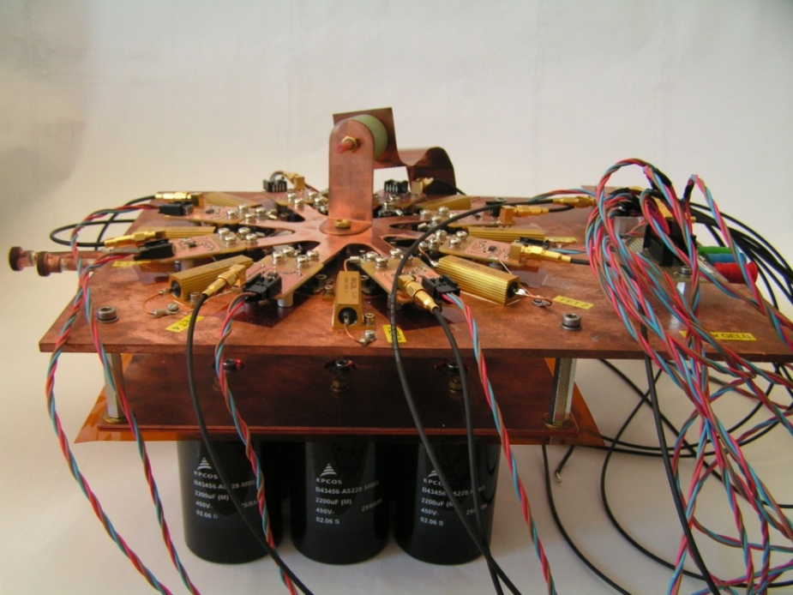
Principle layout of the pulser
200A
Power supply
Data:
Voltage U= 80V
Pulse current I_{max}=400A
Pulse length t= 1.8ms
Pulse current
C_{Lade}
200µs/div
50A/div
L _{Kicker}
+5V
pulse trigger
D
-5V
G
-
+
Op-amp AD817
S
S
R
8 Mosfet parallel
9 capacitor (450V 2200µF)
Constant current source

Slide 5
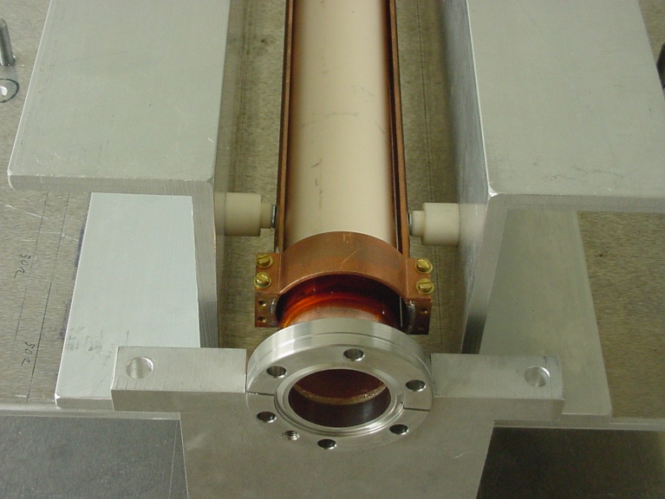
Feedbackkicker
strip line kicker outside of vacuum
the Kicker was built in a 50 Ω geometry
ceramic vacuum chamber
coating material is stainless steel 4.4541 (titan stabilised)
a small reduction of the magnetic field by the sputtered chamber.

Slide 6
Pulse Shape - Aluminum Housing

Slide 7
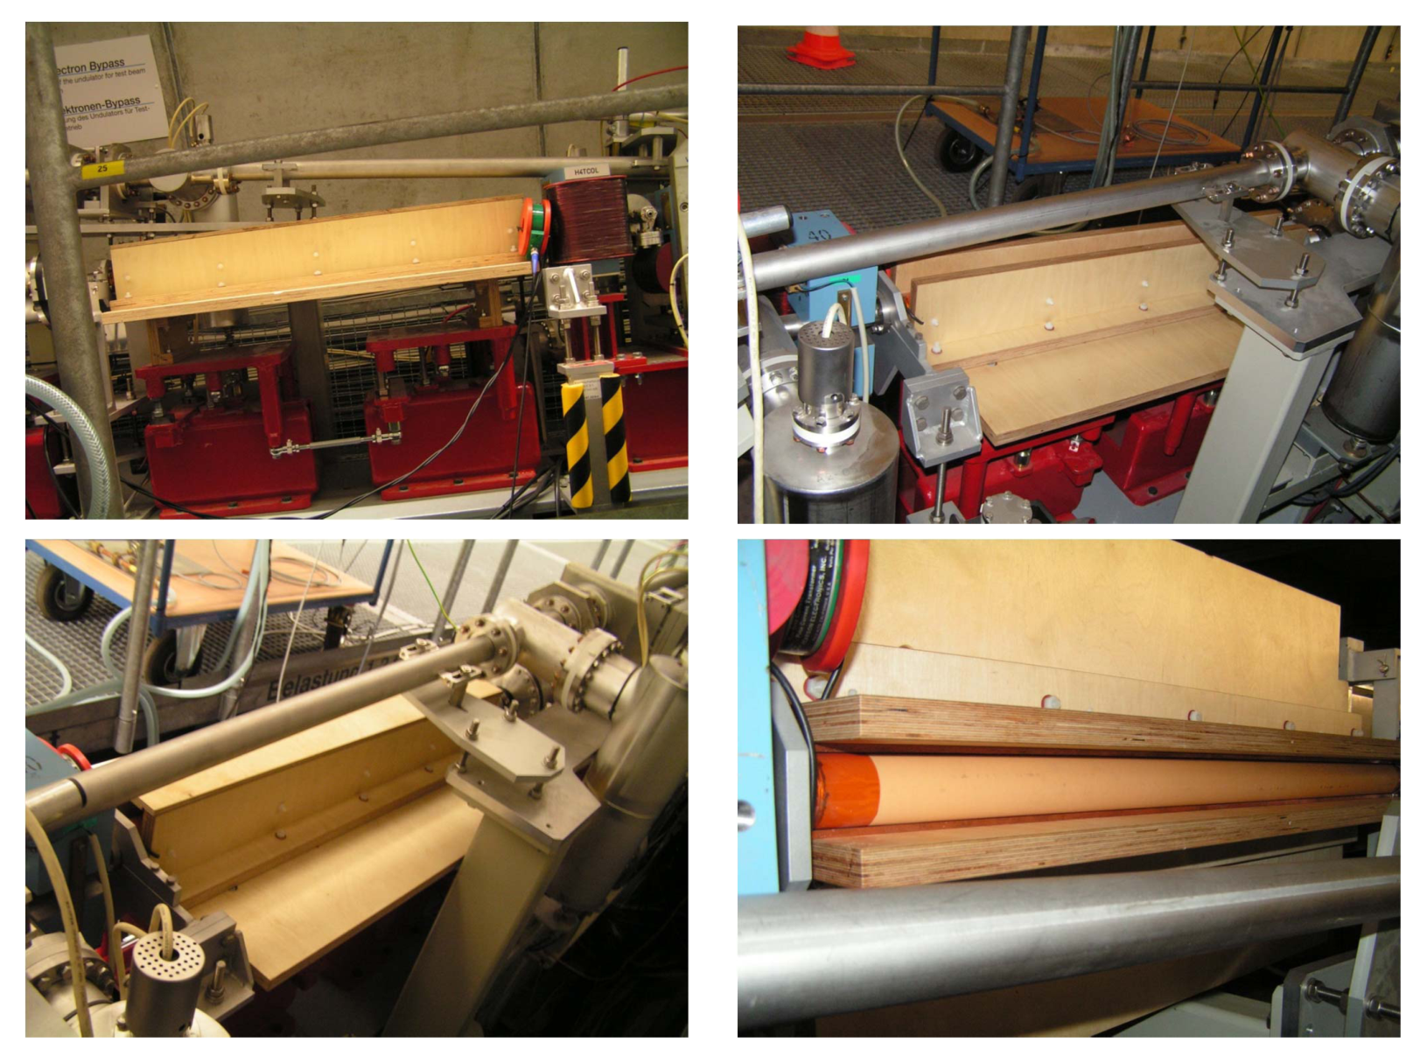
Wood Housing – H.J. Strahlendorf, Carpenter

Slide 8
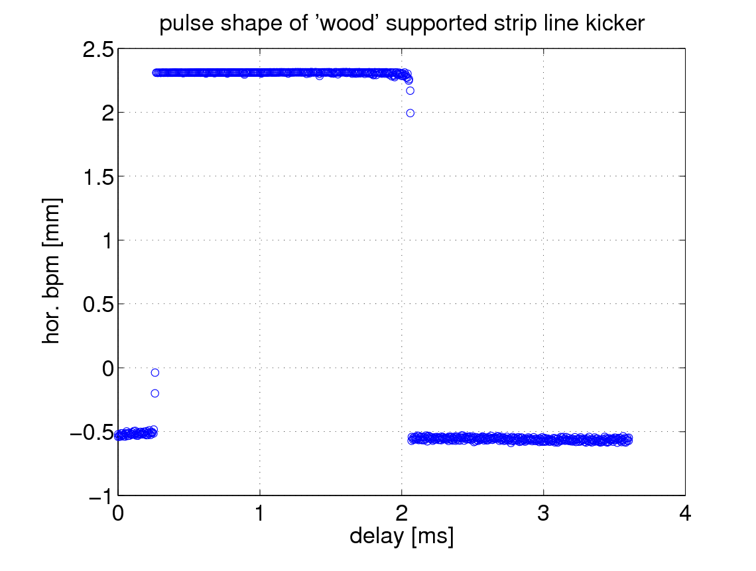
Pulse Shape – Wood Housing

Slide 9
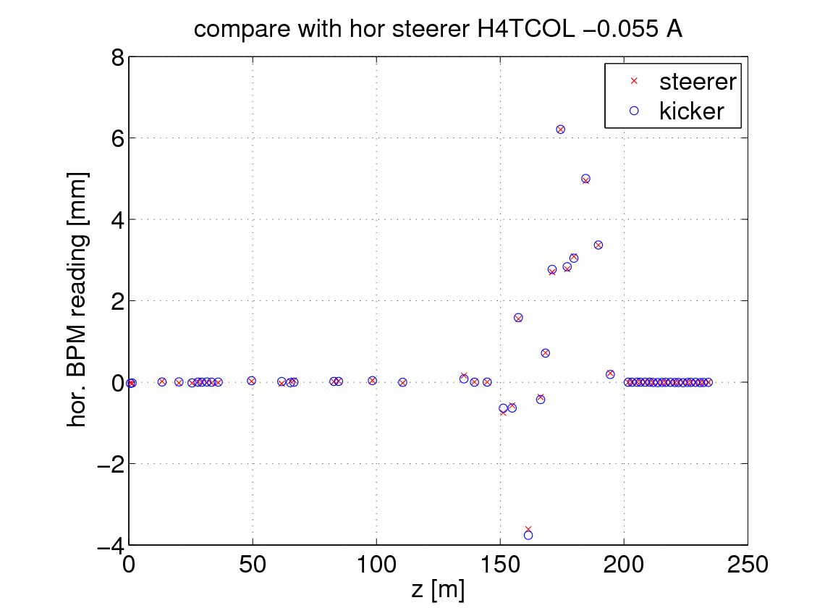
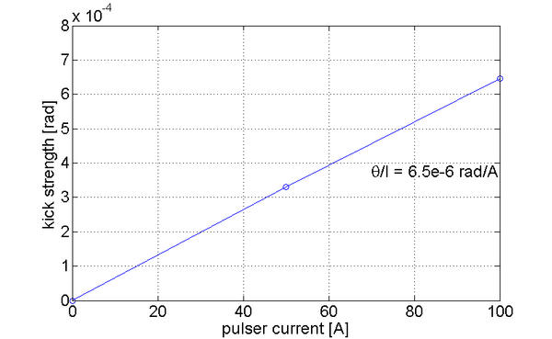
Kick Strength Calibration

Slide 10
Statistics – SASE at 4.8 nm, Trajectory
Stability beyond resolution of BPM system
estimated < 1e-4

Slide 11
Summary
Flat Top Pulser in good shape
Three to be built for FLASH II in 2013
Six to be built for XFEL in 2014
Open issue is the fast kicker for the XFEL …

Slide 12
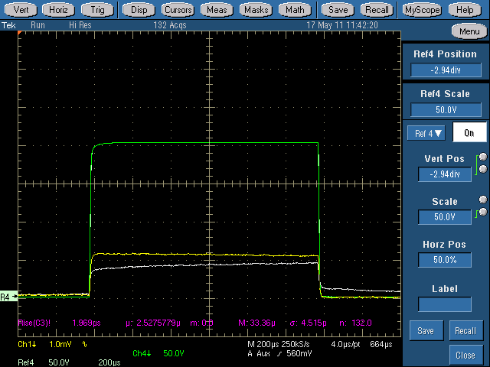
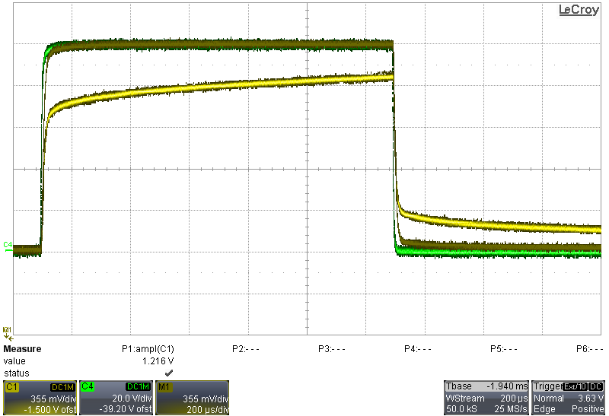
Result of the magnetic field measurement
Air-core coil (1 winding) with integrator
CMR Sensor
Feedbackkicker without cage
Current 100A
50A /div
Current 200A
200µs /div
Feedbackkicker with cage
Feedbackkicker without cage
20A /div
200µs /div
Feedbackkicker with cage
green curve: pulse current of 200A
white curve: field measurement with a Feedbackkicker without cage (with a droop and a very slow fall time of 1ms)
Yellow curve: field measurement with a Feedbackkicker with cage (no droop and a fast fall time)
green curve: pulse current of 100A
Yellow curve: field measurement with a Feedbackkicker with cage (with a droop and a very slow fall time of 1ms)
grey curve: field measurement with a Feedbachkicker without cage (no droop and a fast fall time)
Result: The eddy current on the kicker cage create the droop and a very slow fall time.

