Slide 1
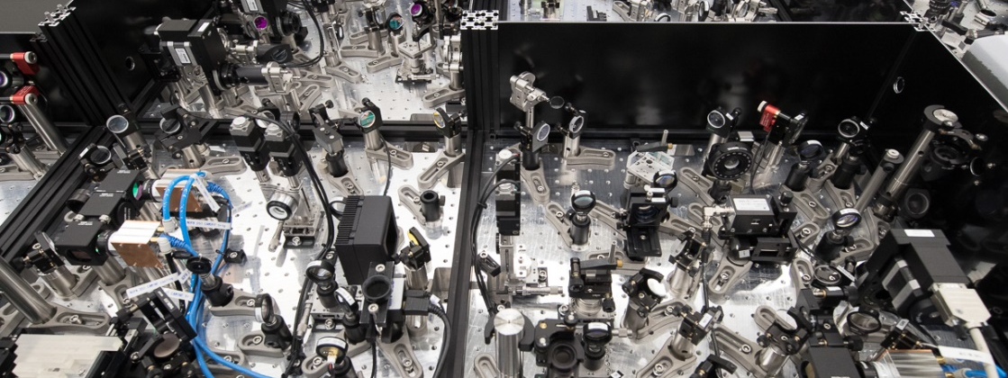
First FLASH2 FEL-pplaser experiment
FS-LA Laser Science and Technology Group, DESY
Bastian Manschwetus

Slide 2
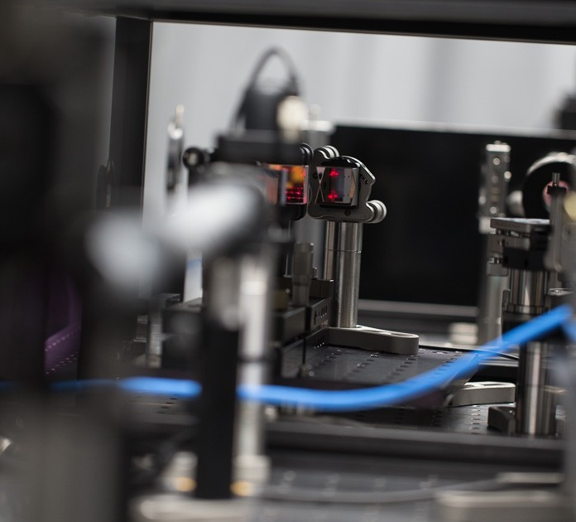
Outline
Motivation
  Pump probe experiments at FLASH
  FLASH2 pump probe laser
  Arrival time and synchronization
Experiment
  Xe photoionization
  Results
  Interpretation
Summary + Outlook
  Recent user experiments
  Upcoming timing experiments
  Improvements

Slide 3
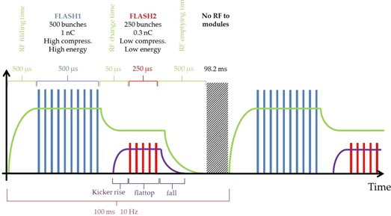
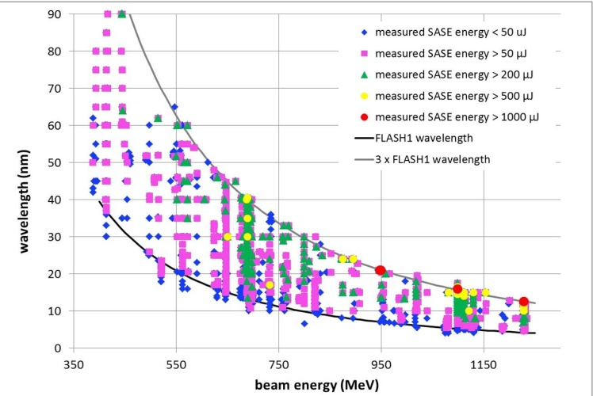
Soft X-ray FEL in Hamburg - FLASH
sFLASH
RF stations
1.3 GHz SC Accelerating Structures
FLASH1
Diagnostics
LOLA
Fixed Gap Undulators
Bunch Compressor
Bunch Compressor
FLASH2
RF Gun
FEL Experiments
5 MeV
150 MeV
450 MeV
1250 MeV
Variable Gap Undulators
315 m
FLASH2
  Photon pulse duration 10-200 fs
    10 Hz bursts (≤ 800 intra burst pulses)
  Fundamental photon energy 14 - 310 eV
  Beamlines 2 (up to 7)
90
FLASH1 wavelength
3 x FLASH1 wavelength
60
Wavelength / nm
> 1mJ / pulse
30
0
350
1150
750
Beam Energy / MeV

Slide 4
Science at FLASH
Average over last calls
The performance of FEL and optical laser is crucial for the success of a pump probe experiment
Control of:
Wavelength
Pulse energy
Pulse duration
Arrival time
Spatial overlap

Slide 5



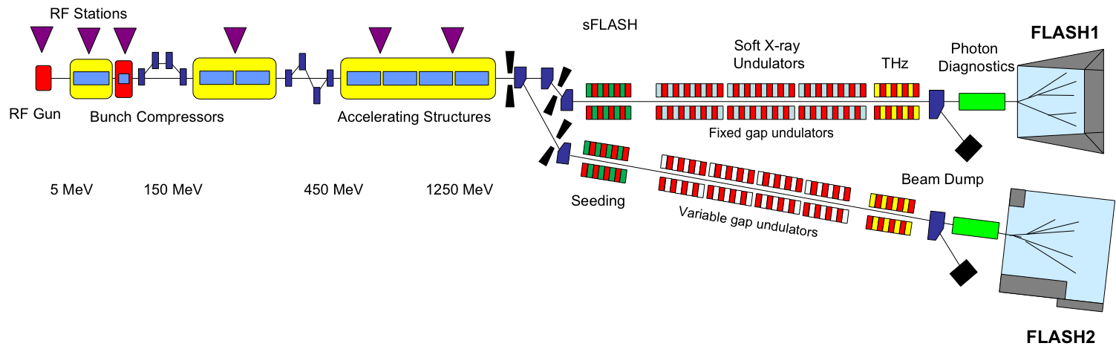
Optical lasers for FLASH
Pulsed Laser
Timing System

Slide 6
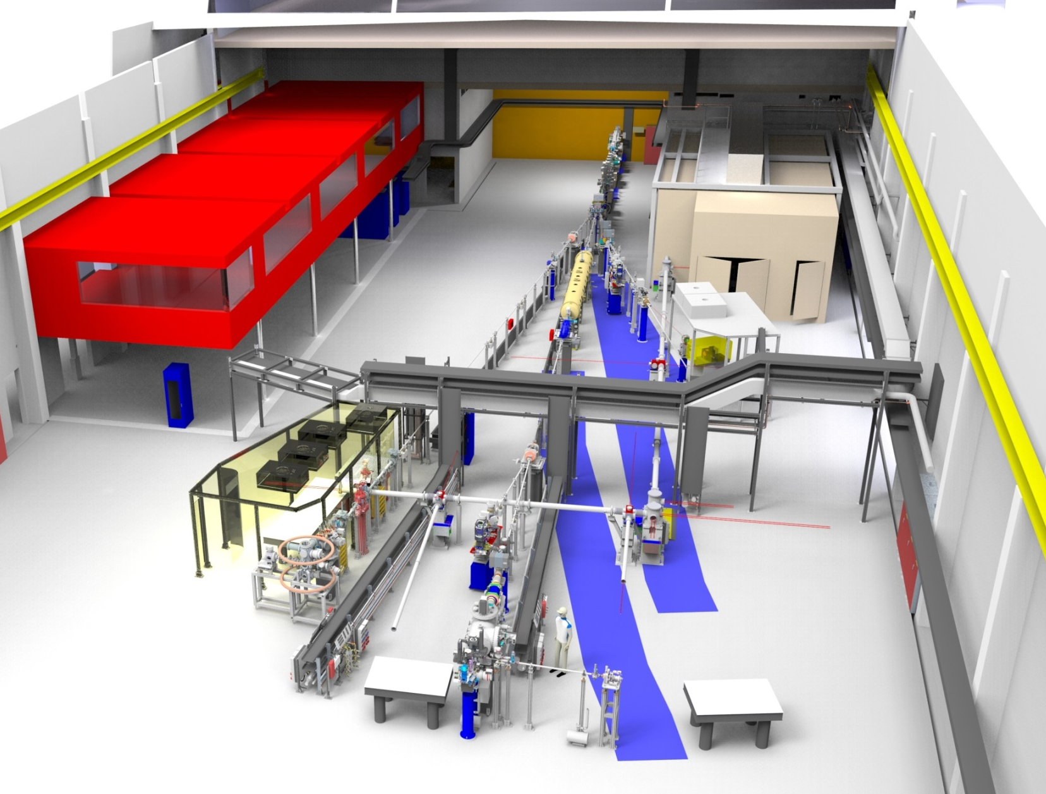
Looking into the FLASH2 hall “Kai Siegbahn”

Slide 7
Pump-probe Experiment @ FLASH2
Pulse arrival time stability
Free-Electron Laser
Experiments
Synchronization System
Pulsed Laser
Reference
Pump-Probe Laser
EXP 1
FL22
FLASH
FL23
Beam
Arrival Time
Monitor
EXP 2
FEL Beamline
Laser Beamline
EXP 3
< 10 fs
315 m
Required arrival time stability:
< 30 fs or 9 µm rms
Many effects:
Thermal expansion
Change of air refractive index
~80 m Laser system + 40 m Laser Beamline
Schulz et al. Nat. Commun. 6:5938 (2015)
Optical path length stability: <3 x 10⁻⁸

Slide 8
Arrival time stability
Main effects
Free electron laser
RF phases
Beam energy
Thermal expansion
SASE process
Optical laser
Refractive index of optical fibers
Thermal expansion
Refractive index of air
Vibrations
Golden Rules
Passive stability
Measure arrival time
Feedback loops
Minimize uncontrolled path

Slide 9
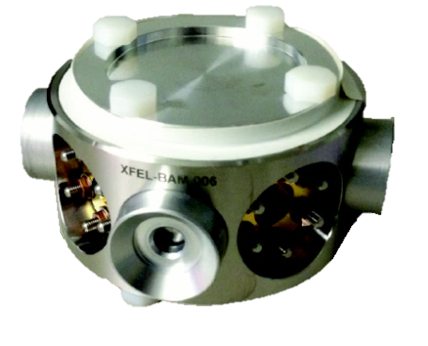
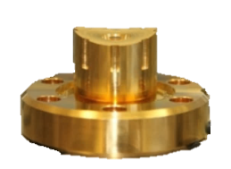

Electron Bunch Arrival Monitors (BAMs)
New Pickups, Electronics and Synchronization
RF Pickup
Temporal resolution: < 10fs
Even very low electron bunch charges used in short-pulse operation
All individual BAMs will be put into operation one by one 2018/2019
4 pickups in one vacuum-tight body
40GHz pickups (●) installed for all BAM locations at FLASH (07/2018)
1UBC2 | 3DBC2 | 4DBC3 | 15ACC7 | (FL2EXTR) | 1SFELC | 8FL2BURN | 7FLFMAFF
22m | 27m | 85m | 138m |  | 185m | 243m | 203m
FLASH1
A.Angelovski, M.Kuntzsch, M.K.Czwalinna, et al., Phys. Rev. STAB 18, 012801 (2015)
FLASH2
Albert Einstein
FLASH Forward
Kai Siegbahn

Slide 10
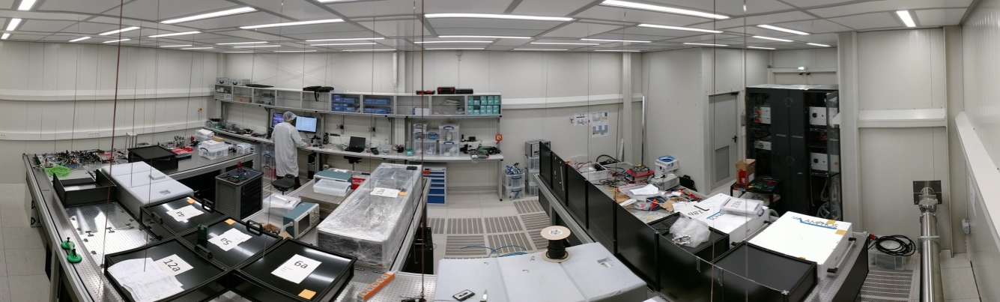
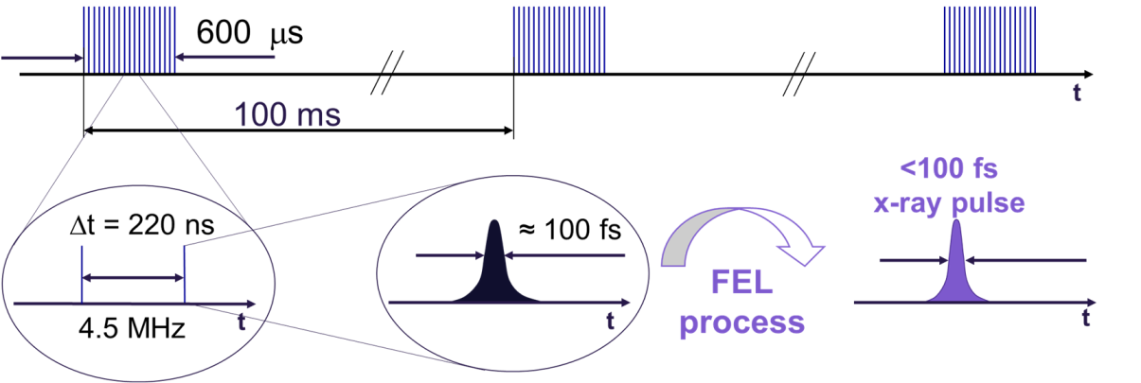
OPCPA Laser System
System Overview
CPA amplifier system
OPCPA
Master Laser Oscillator
Pump-probe Delay
OXC
Yb fiber amplifier
WLG
NOPA
Bulk-
Stretcher
OPCPA
Stage 1
OPCPA
Stage 2
Beamline
Pulse Compression
Experiment
Oscillators
Stretcher
Yb fiber
front-end
YbYAG Slab
Comp-ressor
SHG
    Laser parameters
    Rep.-Rate: 100 kHz in 800µs burst @ 10Hz
    Pulse energy: 400 µJ (before transport)
    Pulse duration: 15 fs - 50 fs
    Wavelength: 700nm – 900 nm
  CPA amplifier
    Pump for seed generation
    Pulse energy: 6 µJ
    Pulse duration: < 500 fs
    Pump for OPCPA
    Pulse energy: 8 mJ
    Pulse duration: < 1.5 ps
  OPCPA
    Laser parameters
    Rep.-Rate: 50 kHz in 10 Hz / 800µs burst
    Pulse energy: 500 µJ
    Pulse duration: < 15 fs | long pulse mode
    Wavelength: 800 nm | 700nm – 900 nm
800 µs
100 ms
50 kHz – 40 pulses intra-burst

Slide 11
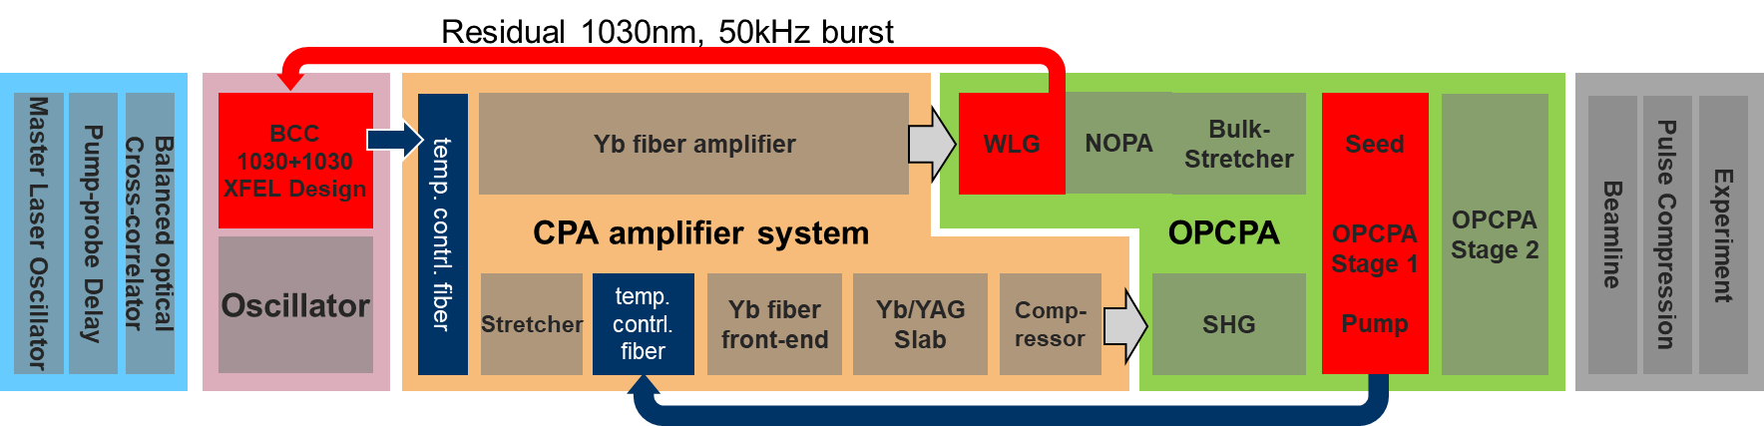
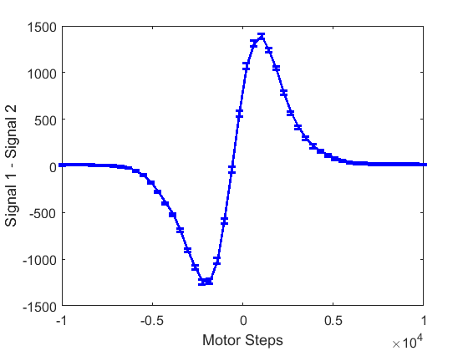
Drift compensation system laser system
Pump probe delay
  Shifts complete system
  No influence on triggers or drifts
Wavelength
  Relative seed/pump timing in OPCPA
  Slow control with spectral encoded drift correlator feedback
Timing at experiment
  Correlates with seed timing in OPCPA
  Slow control with balanced optical cross correlator (BCC)
0.2 fs /count
Signal 1 – Signal 2
1 ps
Delay

Slide 12
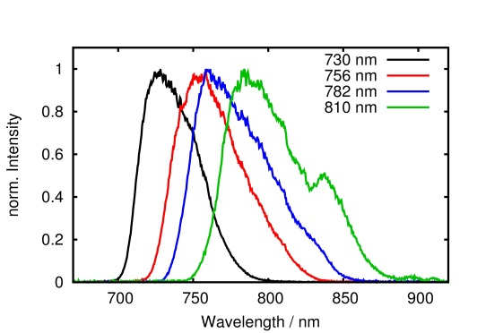
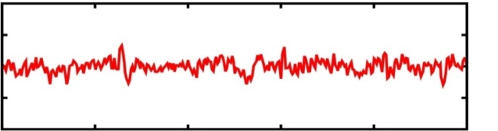
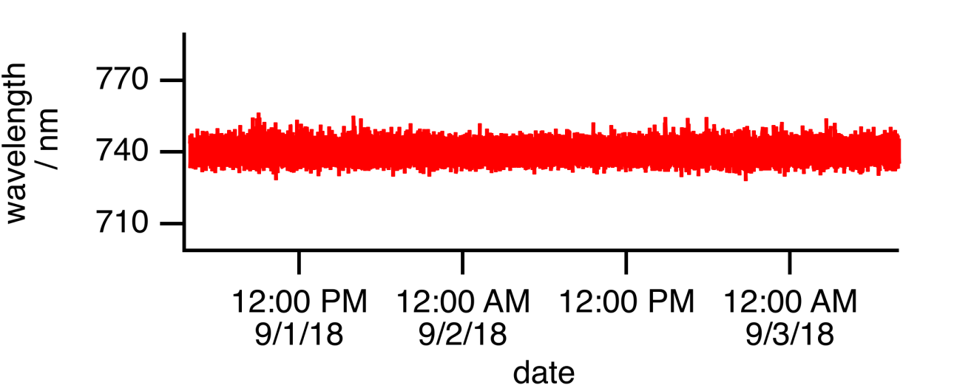
OPCPA - Pump vs. Seed
Wavelength Stabilization
770
Pump
750
10s
730
Intensity
Signal
Seed
Instability: 3.2 nm rms
Time
  Fast change of central wavelength
  drift control with temperature controlled fiber delay line

Slide 13
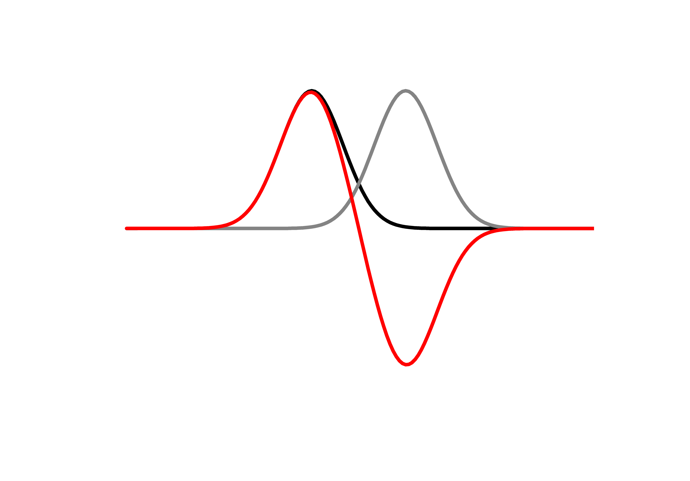
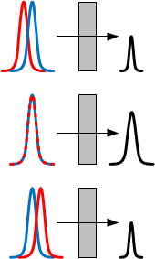
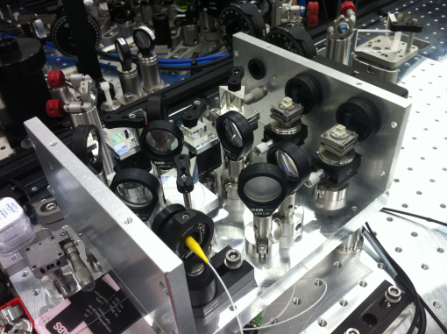
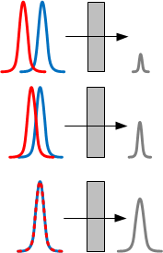

Timing drift stabilization
Balanced cross correlator
Signal
+T
Crosscorrelation of oscillator pulse and amplifier pulse
two cross correlations with small time delay
T_{opt} = ± $\sqrt{2(τ12+τ22)}$
Signal 1
Signal 2
Signal 1 – Signal 2
KTP
Δt
Photodiode 1
Photodiode 2
Schibli et al. Opt. Lett. 28, 947-949 (2003).

Slide 14

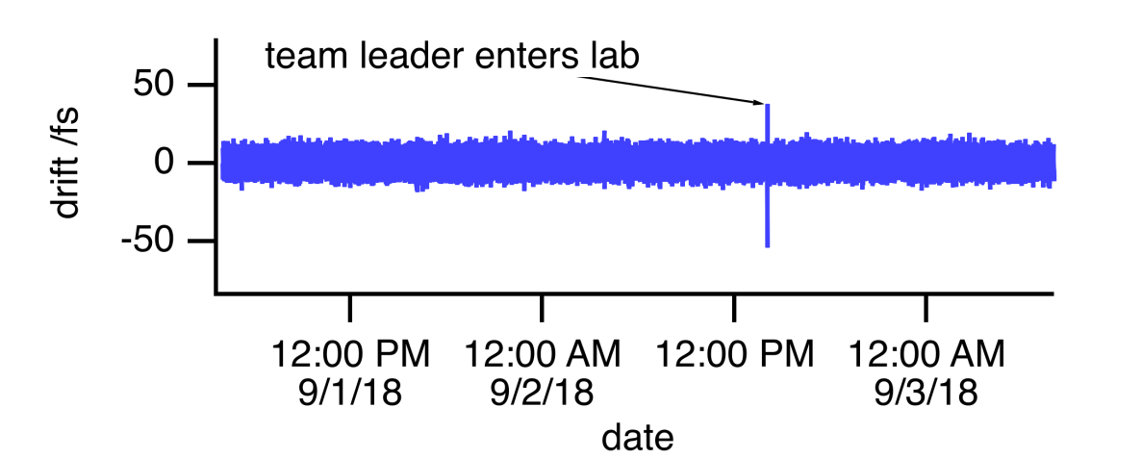
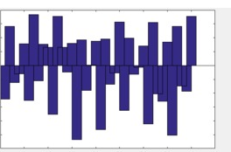
Timing drift stabilization
Performance
Full fiber amplifier is in feedback loop
OPCPA amplifier, beamtransport and pulse compresson is not controlled
  50 m out of loop beam path
Standard drift deviation: 5.7 fs rms
Oscillations of 30 s period
Single shot measurement in burst
  No slope over the pulse train visible
  But high noise
20
Drifts / fs
0
-20
10s
6
0
Delay / fs
-6
Number of intra-burst pulse

Slide 15
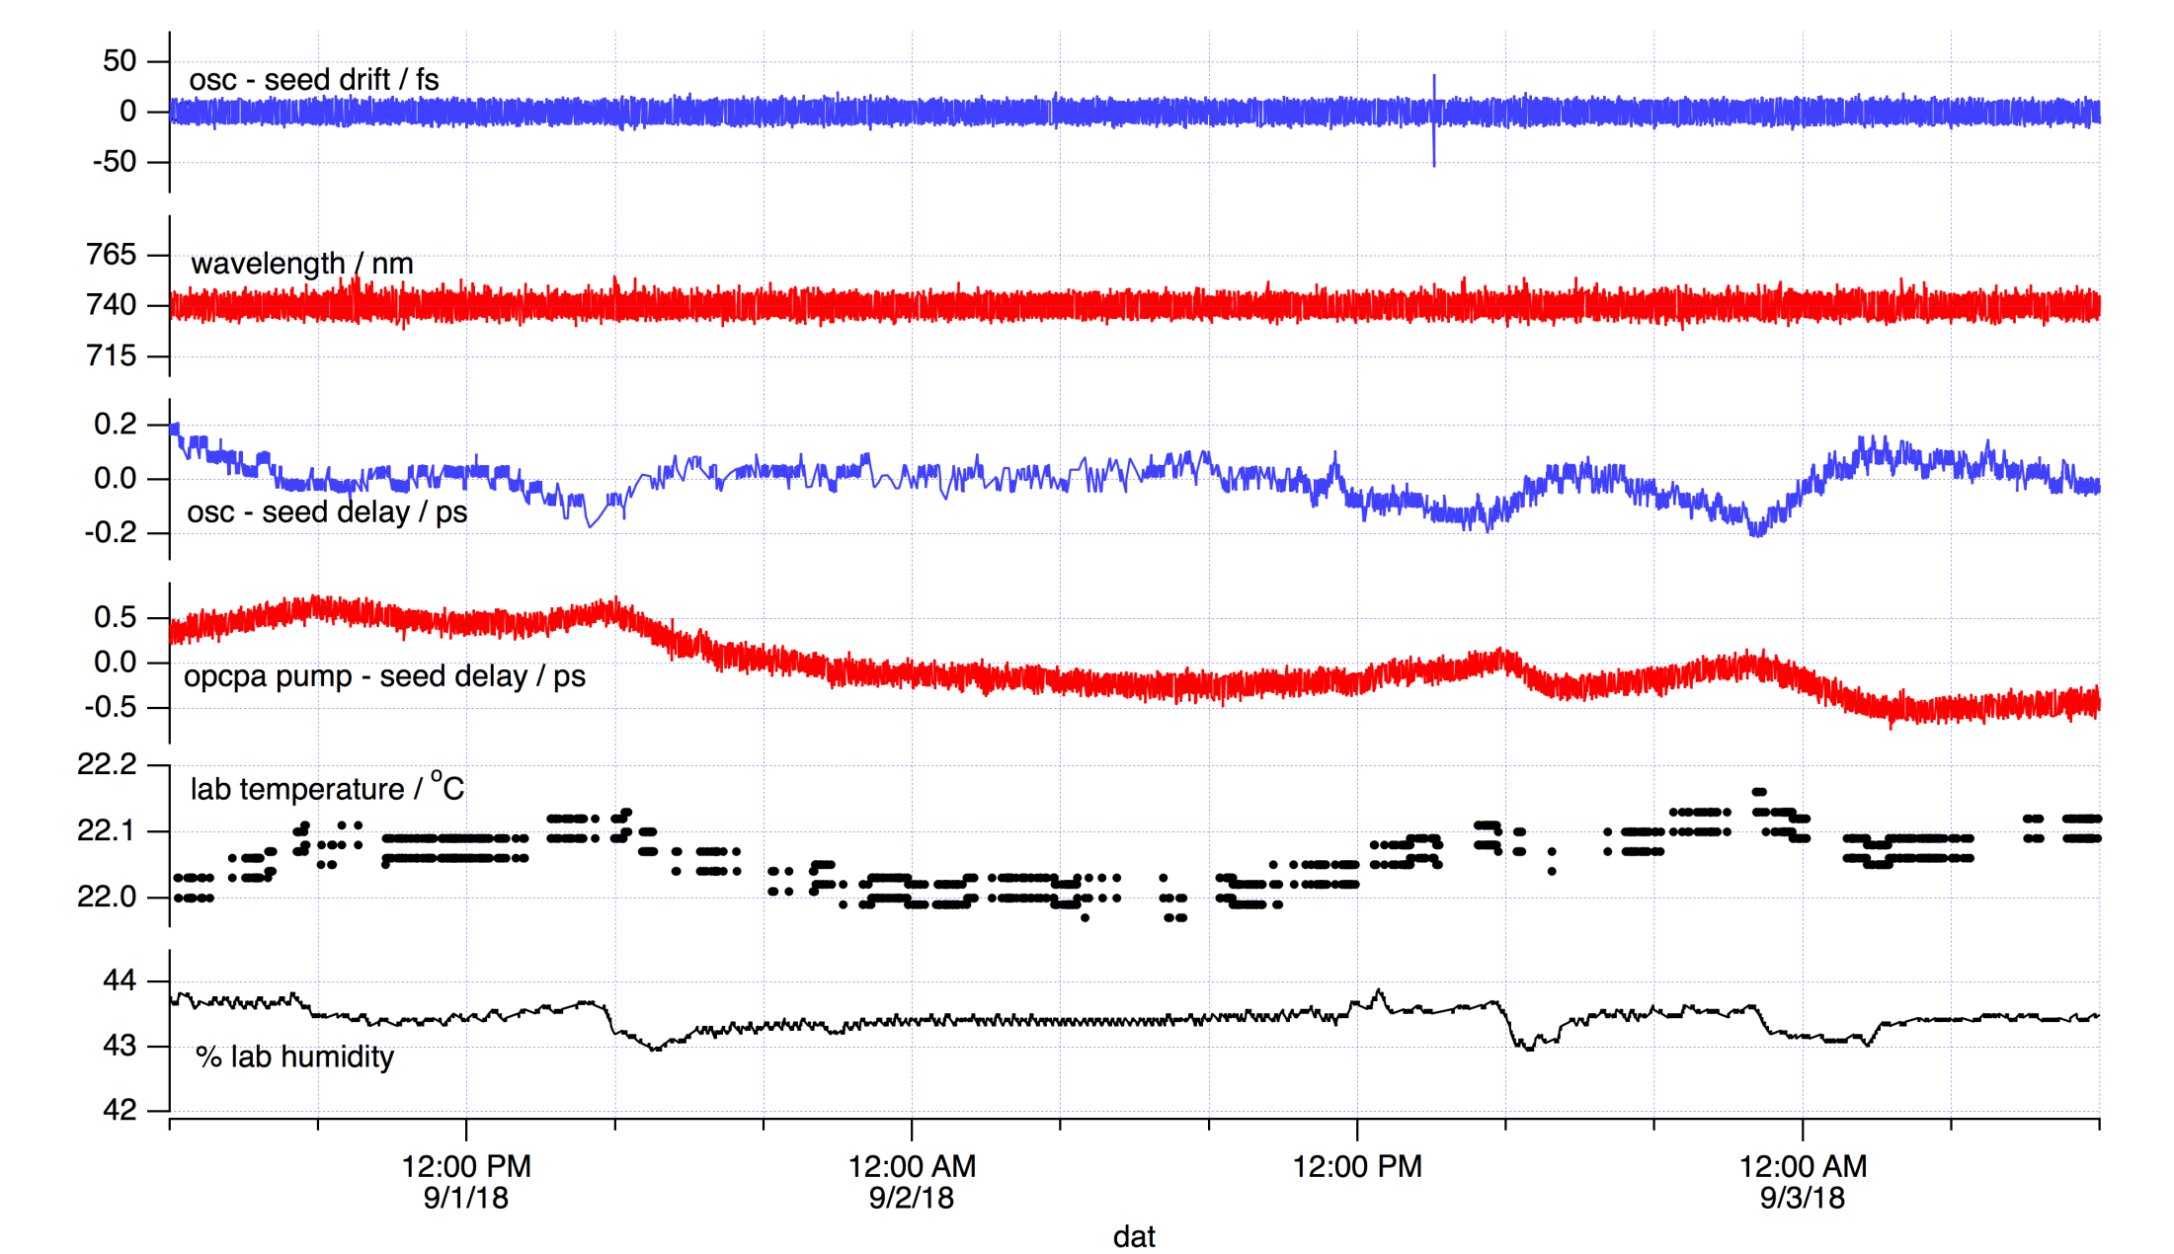
Wavelength and timing drift stability
Team leader enters lab
Standard drift deviation: 5.7 fs
Instability: 3.2 nm rms
Peak to peak delay 0.4 ps
Peak to peak delay 1.5 ps
Correlation to lab temperature
and humidity
  BCC Signal

Slide 16
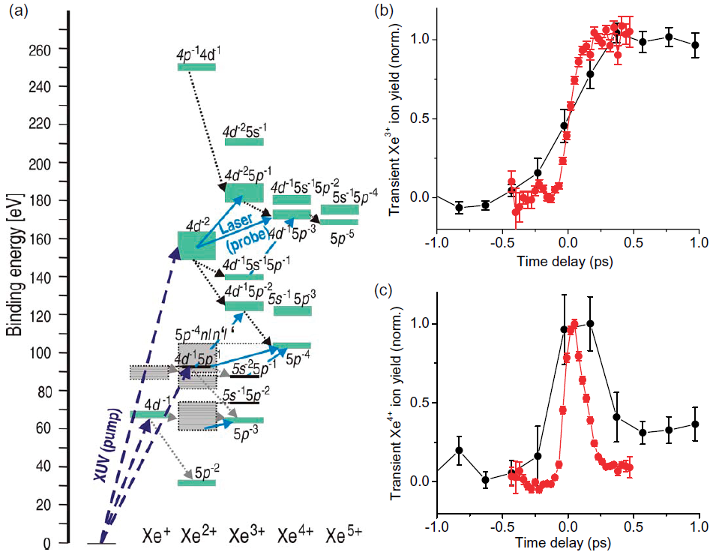
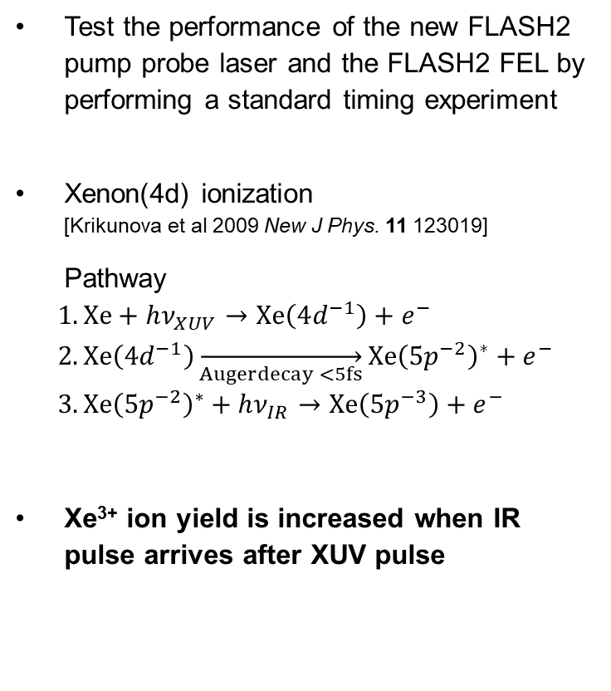
FLASH2 FEL-pump optical-probe experiment
Test the performance of the new FLASH2 pump probe laser and the FLASH2 FEL by performing a standard timing experiment
Xenon(4d) ionization
[Krikunova et al 2009 New J Phys. 11 123019]
Pathway
$$1.Xe+hν_{XUV}→Xe\left(4d^{−1}\right)+e^{−} \\ 2. Xe\left(4d^{−1}\right)\overset{→}{Augerdecay <5fs}Xe{\left(5p^{−2}\right)}^{∗}+e^{−} \\ 3. Xe{\left(5p^{−2}\right)}^{∗}+hν_{IR}→Xe\left(5p^{−3}\right)+e^{−}$$
Xe³⁺ ion yield is increased when IR pulse arrives after XUV pulse

Slide 17
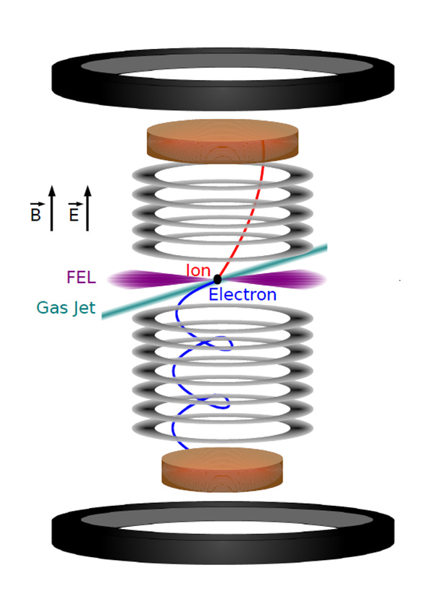
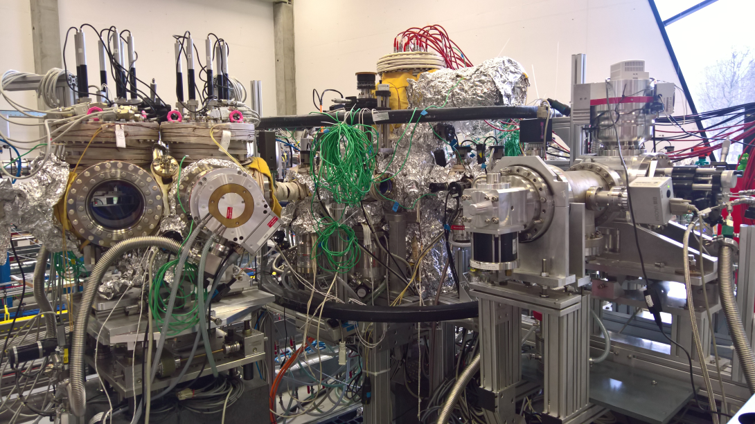
Experimental apparatus REMI@FL26
Reaction microscope
  Ions and electrons detectors
  coincidence detection
Added incoupling optics for the optical laser
Only ion TOF measurement required

Slide 18
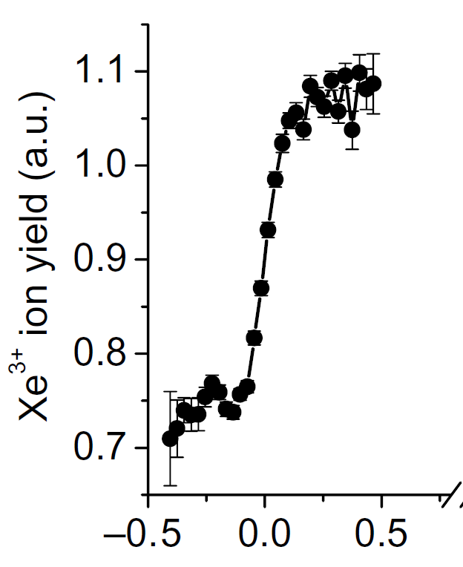
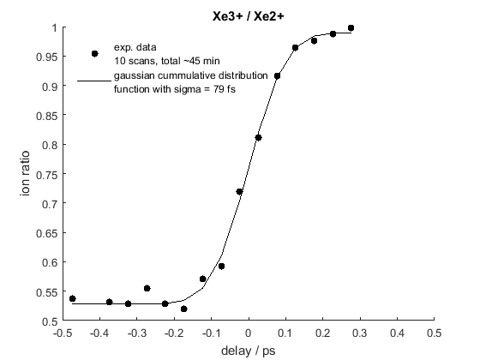
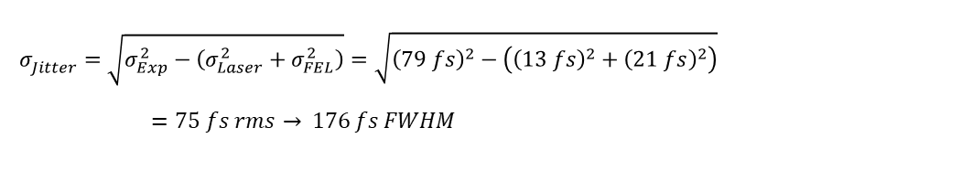
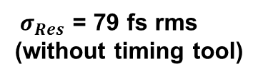
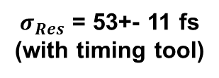
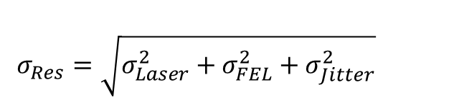
Experimental results
FLASH1
FLASH2
FEL: λ=13.4 nm/92 eV; T_{FWHM} = 35 fs
Laser: λ=400 nm/3.1 eV; T_{FWHM} = 120 fs
FEL: λ=12.7 nm/150 eV; T_{FWHM} = < 50 fs?
Laser: λ=800 nm/1.55 eV; T_{FWHM} = 26 fs?
[Krikunova et al 2009 New J Phys. 11 123019]
Limited by pplaser pulse duration
Limited by arrival time jitter?
$σ_{Res}$ = 79 fs rms
(without timing tool)
$σ_{Res}$ = 53+- 11 fs
(with timing tool)
$$σ_{Jitter}^{}=\sqrt{σ_{Exp}^{2}−\left(σ_{Laser}^{2}+σ_{FEL}^{2}\right)}=\sqrt{{\left(79 fs\right)}^{2}−\left({\left(13 fs\right)}^{2}+{\left(21 fs\right)}^{2}\right)}=75 fs rms \overset{→}{} 176 fs FWHM$$
$$σ_{Res}=\sqrt{{σ_{Laser}^{2}+σ_{FEL}^{2}+σ}_{Jitter}^{2}}$$
Tlaser=26 fs
TFEL=

Slide 19
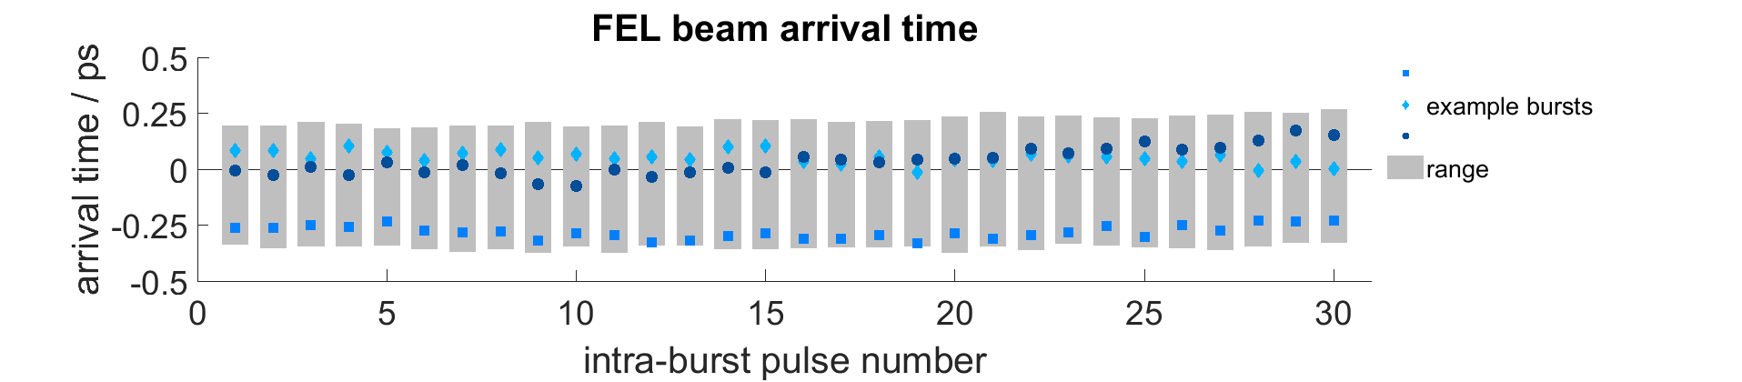
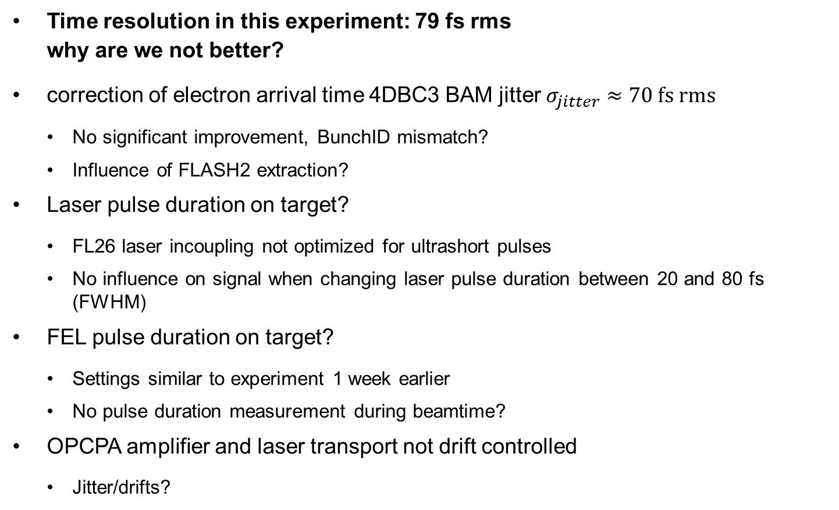
Discussion: many open questions
Time resolution in this experiment: 79 fs rms
why are we not better?
correction of electron arrival time 4DBC3 BAM jitter $σ_{jitter}≈70 fs rms$
  No significant improvement, BunchID mismatch?
  Influence of FLASH2 extraction?
Laser pulse duration on target?
  FL26 laser incoupling not optimized for ultrashort pulses
  No influence on signal when changing laser pulse duration between 20 and 80 fs (FWHM)
FEL pulse duration on target?
  Settings similar to experiment 1 week earlier
  No pulse duration measurement during beamtime?
OPCPA amplifier and laser transport not drift controlled
  Jitter/drifts?
4DBC3 FEL beam arrival time: ~70 fs rms

Slide 20
Summary
Importance of arrival time for pump probe experiments
Measured arrival time performance using Xe photoionization
  Achieved resolution 79fs rms/186 fs FWHM without BAM correction
Drift stabilization systems at FLASH
  Beam arrival monitors at FLASH
    Arrival time jitter 70fs rms / Resolution < 10fs (4DBC3)
  Drift stabilization of FLASH2 pump probe laser
    Wavelength stabilized with 3.2 nm instability for 80 nm FWHM
    Temporal drift stabilized to 5.7 fs rms

Slide 21
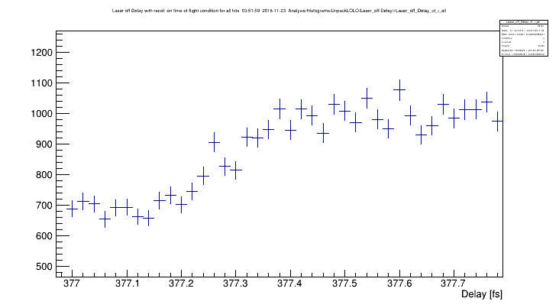
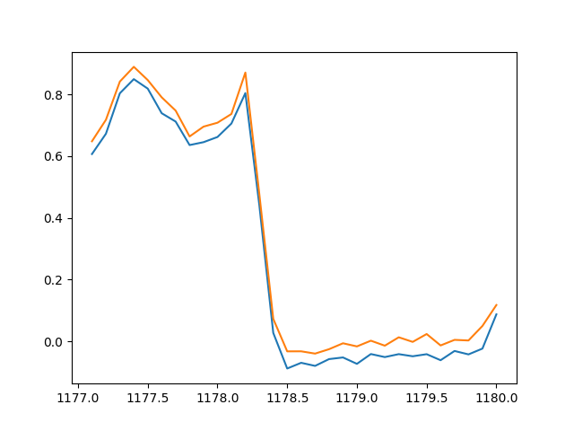
Outlook
So far two user beamtimes with FLASH2 pump probe laser
  Spatial and temporal overlap stable over several days without issues
  But no experiments with ultrashort pulses again, limited by laser pulse duration
Next dedicated beamtime April 2019
  Toleikis et al. using a timing tool
Influence of length drift in laser beam transport and at the endstation
  Is a free space length stabilization possible and practical?
  Measurement of laser arrival time at endstation with respect to MLO link
E-beam arrival feed back with new BAM 8FL2BURN
FEL beam arrival time and pulse duration measurements with THz streaking at FL21 (S. Düsterer and R. Ivanov)
Nov. 2018 FL26, Kr ionization
Laser pulse duration: 200 fs (FWHM)
Gisselbrecht et al.
~200fs slope
Position of molecular photoelectron line
March 2019
FL24, Gühr et al.
UV pulses ~ 80 fs (FWHM)
~200fs slope
Delay [ps]

Slide 22
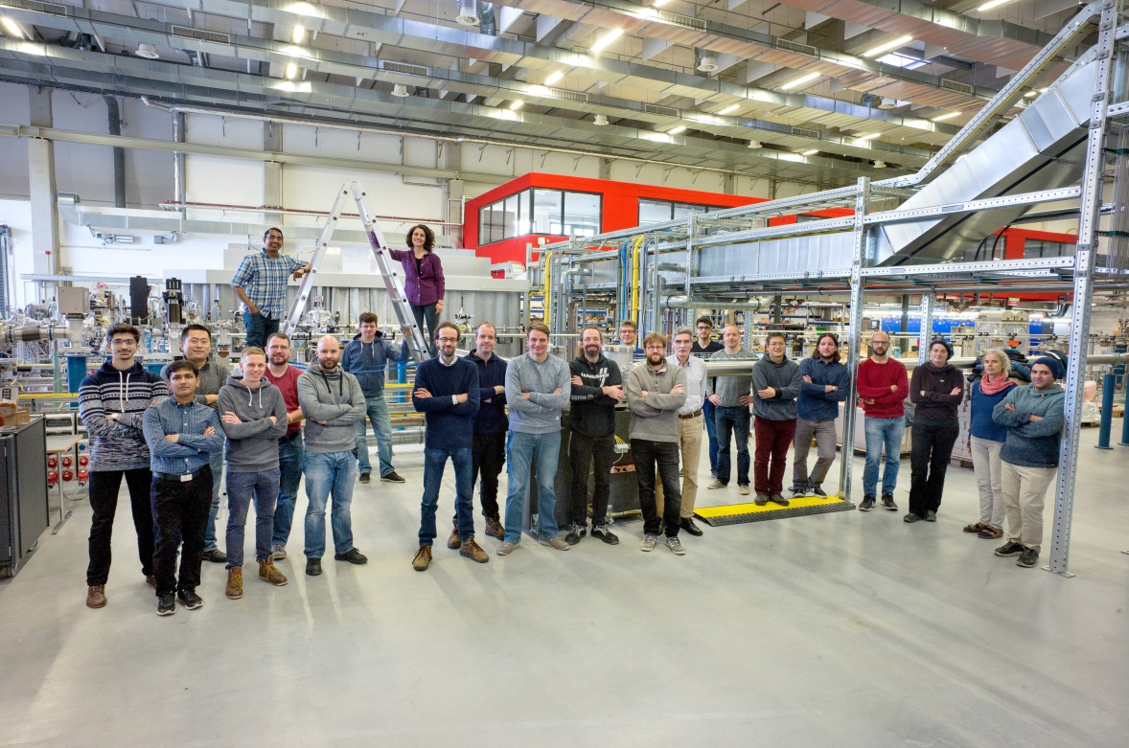
Acknowledgements
FS-LA Laser science and technology, DESY
Skirmantas Alisaukas, Uwe Große-Wortmann, Thomas Hülsenbusch, Bastian Manschwetus, Christian Mohr, Nora Schirmel, Angad Swiderski, Falko Peters, Lutz Winkelmann, Jiaan Zheng,
Tino Lang and Ingmar Hartl
Max-Planck-Institut für Kernphysik Heidelberg
Robert Moshammer, Kirsten Schnorr
FS-FLASH, DESY
Markus Braune
Thank you for your attention

Slide 23

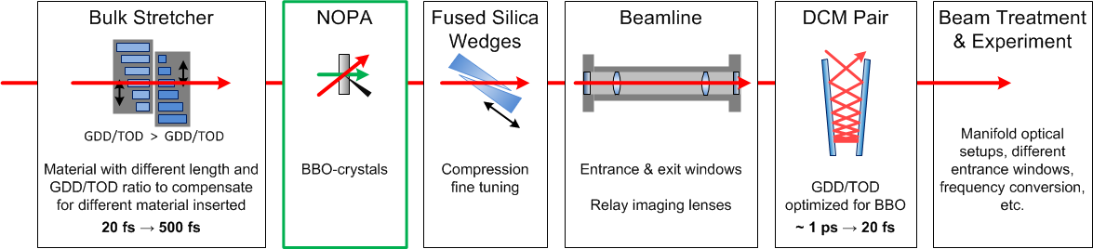

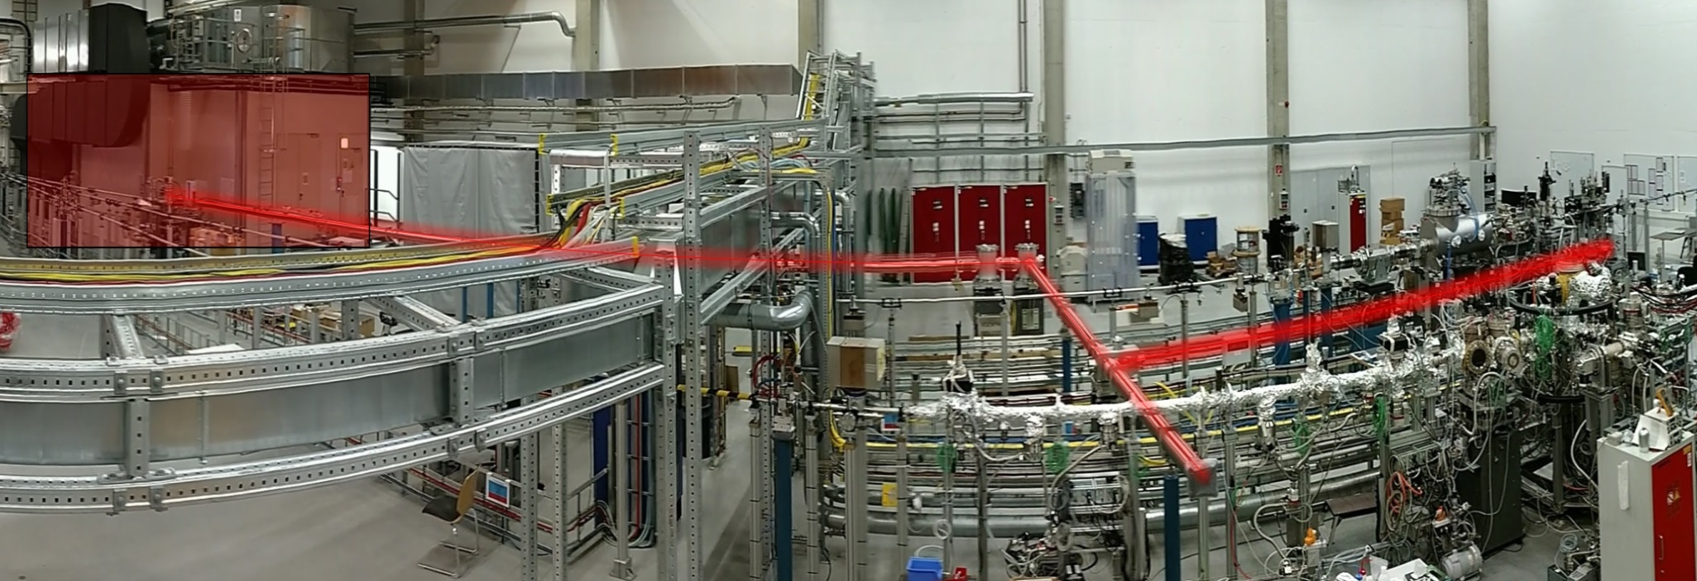
Expected drifts and their origins in the laser
expected slow drifts
Balanced Cross Correlator
~ 50 fs
~ 150 fs
~100 fs
Oscillator
CPA
Stretcher
OPCPA
Beamline
40m
Compression
10 m
Experiment
Seed preparation
AOM
DCM’s
FS
YAG
BBO
BBO
BBO
LBO
40m beam transport
Fiber drifts
Temperature 4 fs / (m * 0.1 K)
Humidity 5 fs / (%hum * m)
50 m fiber Oscillator to CPA
70 m fiber in CPA for pump
→ All fibers are compensated
Free space beam path drifts
  Aluminum Breadboard 7.7 fs / (m * 0.1 K)
  Steel Table 3.7 fs / (m * 0.1 K)
    Concrete Floor 4.0 fs / (m * 0.1 K)
    Invar pump-probe Delay Line 0.7 fs / (m * 0.1 K)
    Refraction index changes of air by changes in humidity, temperature and pressure
Reaction Microscope
Typical lab conditions: ± 0.2 K / h, ± 5 %hum / h

Slide 24
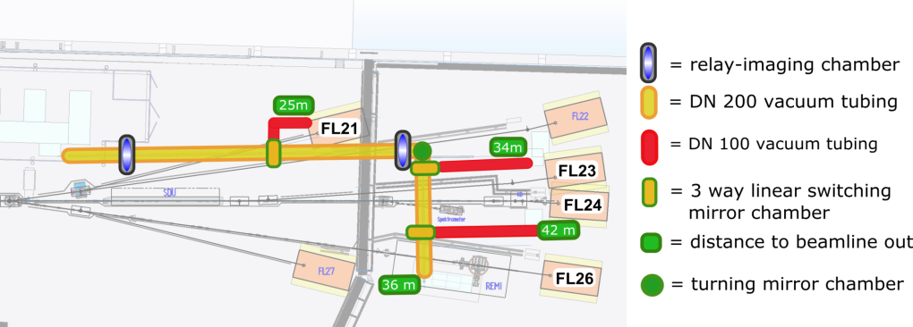
FLASH2 pump-probe laser
… available since second half of 2018
Initial laser parameters (Summer 2018)
Technology | Optical parametric chirped pulse amplification (OPCPA)
Wavelength | 700 nm – 900 nm
Repetition rate | 50 kHz (1 - 40 Pulses in Burst)
Pulse duration | < 20 fs (fwhm)
Pulse energy | > 250 µJ
Beam transport | Relay Imaging, 680 – 1050 nm 2 Experiments can be simultaneously served
Laser hutch
Beamline layout in FLASH2 hall
„Panorama view“ into the ~80 m² laser hutch

Slide 25
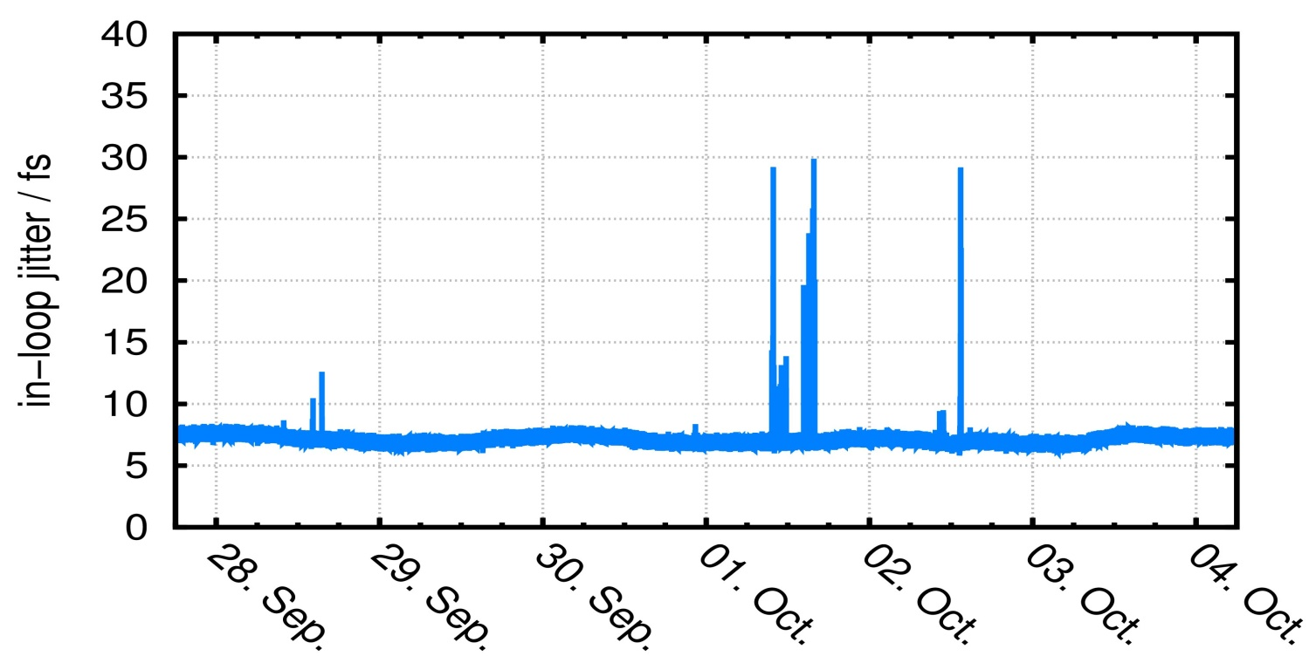
Optical laser synchronization
During September 2018
balanced optical cross-correlation with MLO
optical delay line for user delays scans
(4 ns, resolution 1 fs)
rms jitter < 10 fs
work in vicinity to oscillator and synchronization setup

