Slide 1
Relativity and Accelerator Engineering
Evgeni Saldin

Slide 2

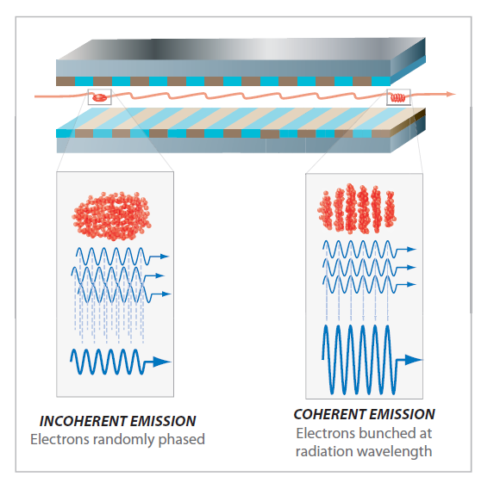


Relativistic kinematics effects are important for current and future XFEL operation

Slide 3
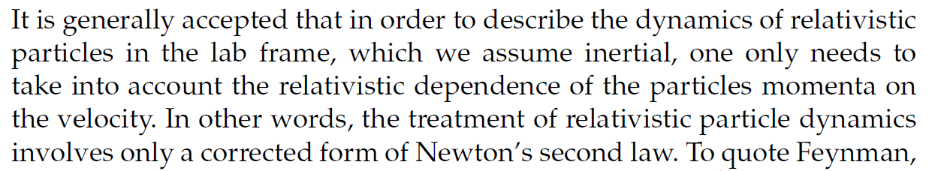

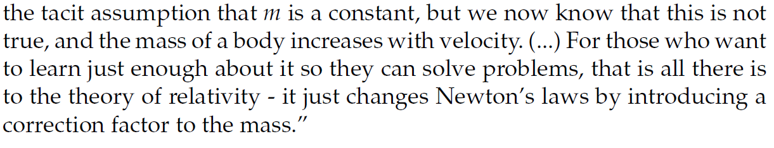
The dynamics of relativistic particles in the lab frame

Slide 4

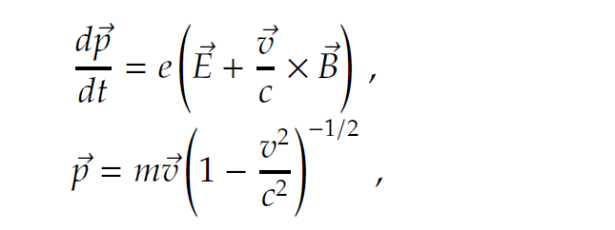

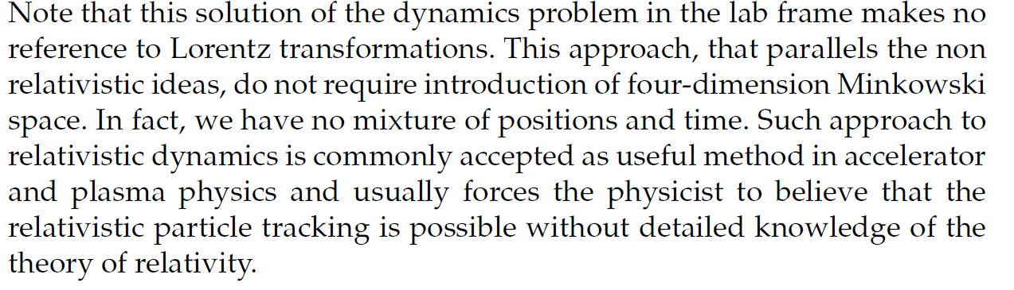
The dynamics of relativistic particles in the lab frame

Slide 5
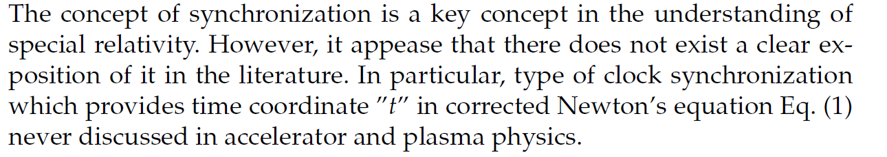

Conventional (non-covariant) particle tracking

Slide 6









Result of conventional particle tracking does not include relativistic kinematics effects

Slide 7





Conventional (non-covariant) particle tracking

Slide 8
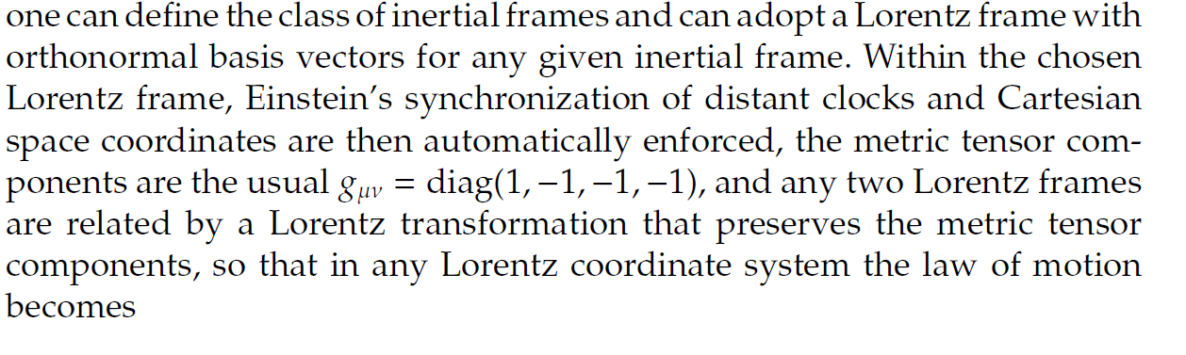
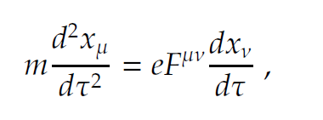

Covariant particle tracking

Slide 9




Covariant particle tracking

Slide 10
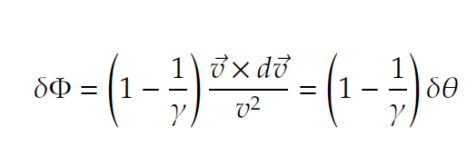


Covariant particle tracking

Slide 11

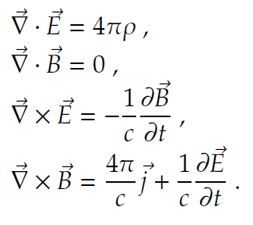

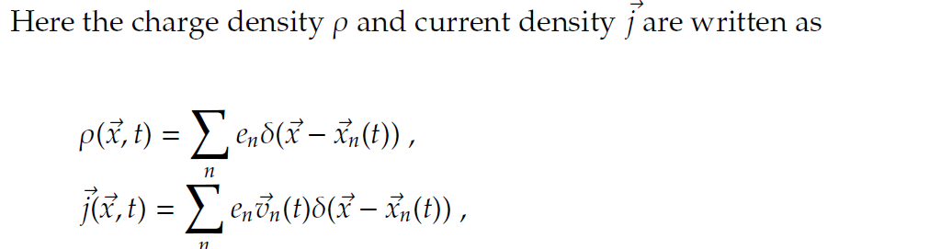
The electrodynamics problem

Slide 12
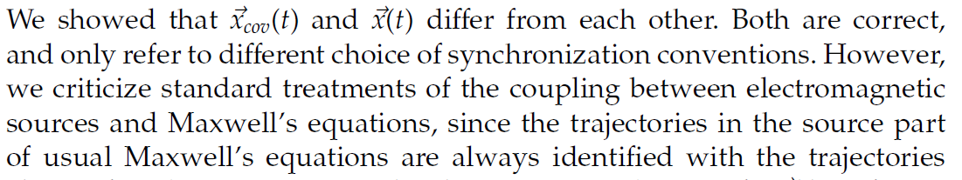
Error in coupling fields and particles

Slide 13
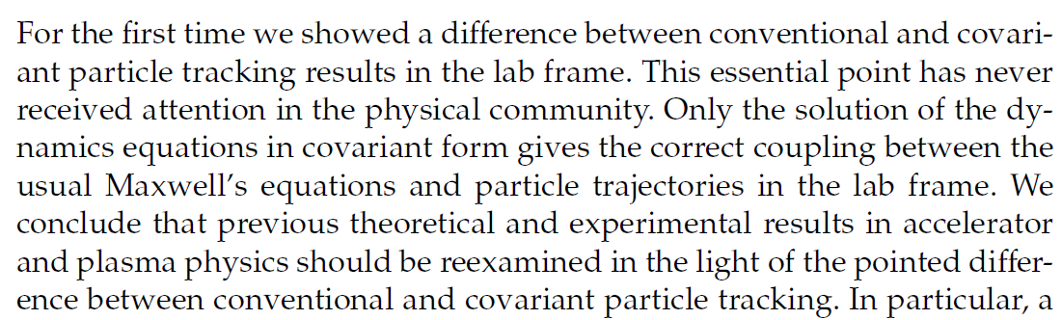
Error in coupling fields and particles

Slide 14
Thank you for your attention.
Any questions?

