Slide 1
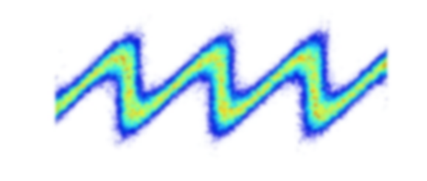






Seeding developments at FLASH
Jörn Bödewadt and Christoph Lechner on behalf of the seeding team
FLASH Seminar 18.04.2017
Introduction
Latest results
Outlook (Christoph)
Supported by BMBF under contract 05K13GU4 and 05K13PE3
DFG GrK 1355
Joachim Herz Stiftung
Helmholz Accelerator R&D
Notes:
Federal Ministry of Education and Research of Germany

Slide 2
Seeding Operations Team
Machine Operation
Laser Operation / Seed Source
FLASH operators
Nils Lockmann
Bastian Manschwetus
Matthias Vogt
Johann Zemella
Core Team
Velizar Miltchev
Jörn Bödewadt
Mehdi Kazemi
Christoph Lechner
Theo Maltezopoulos (left 01/17)
Tim Plath
(on leave to TUD)
Armin Azima
Leslie L. Lazzarino
Andreas Przystawik
Guangyao Feng
Sergey Usenko
Martin Dohlus
Simulation
FEL characterization
DESY
Uni HH
TU Dortmund

Slide 3
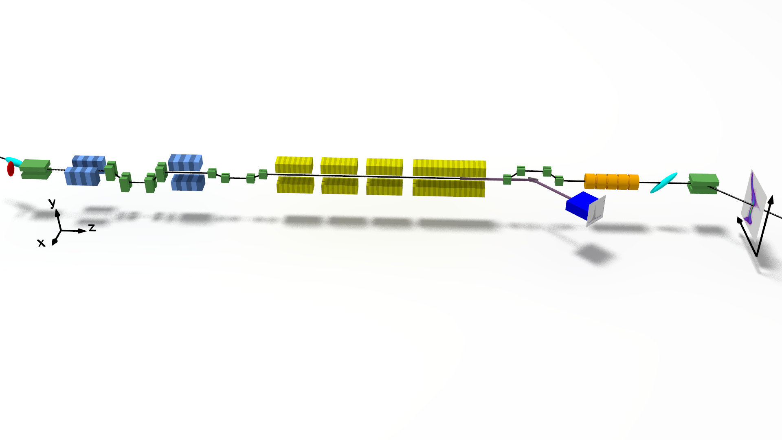
sFLASH layout and operation
UV laser
NI
FEL diagnostic
hutch 28h
Seed laser
lab. 28g
NIR beamline
sFLASH
RF stations
1.3 GHz SC Accelerating Structures
FLASH1
Diagnostics
LOLA
Fixed Gap Undulators
Bunch Compressor
Bunch Compressor
FLASH2
RF Gun
FEL Experiments
5 MeV
150 MeV
450 MeV
1250 MeV
Variable Gap Undulators
315 m

Slide 4
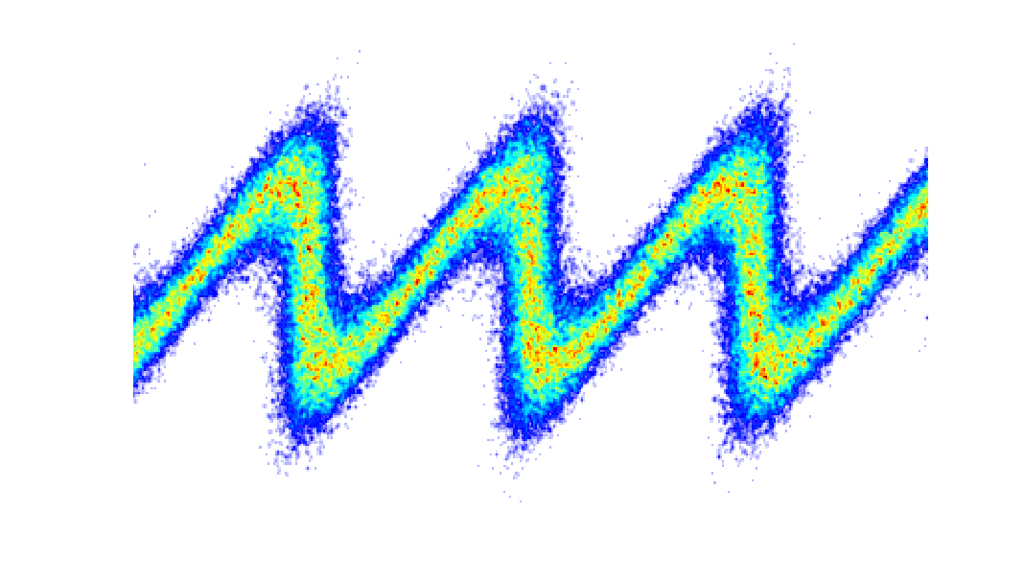
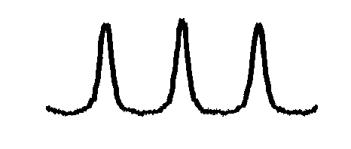
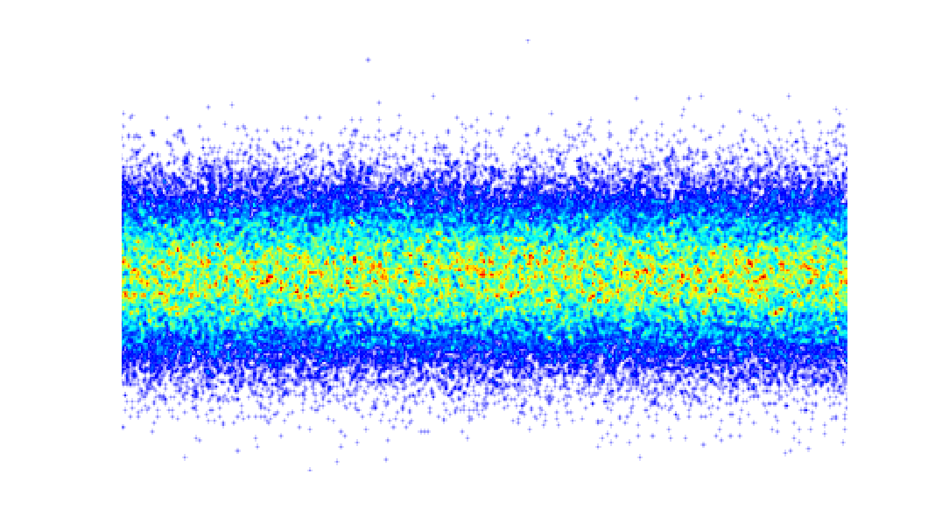
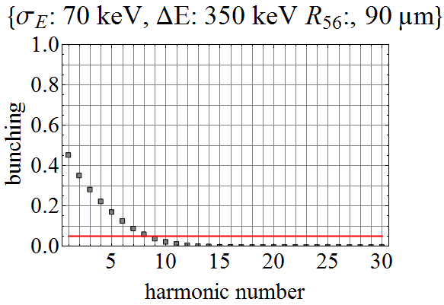
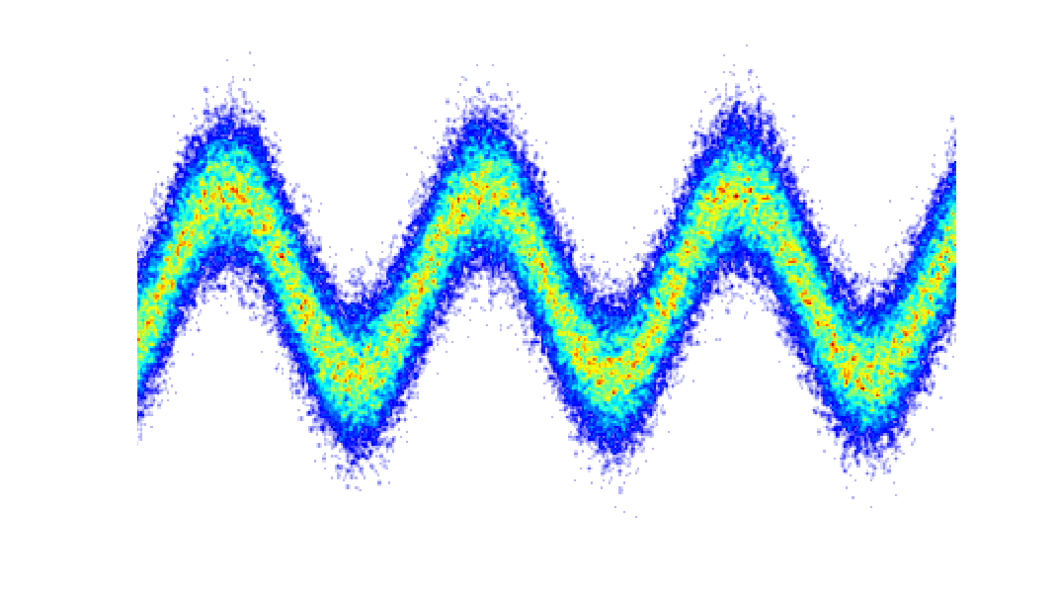
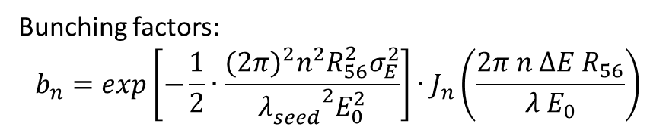
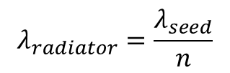
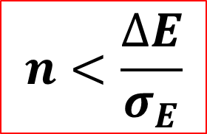




sFLASH layout and operation
E
rms e. spread: $σ_{E}$
I
s
s
$$R_{56}$$
$$λ_{radiator}=\frac{λ_{seed}}{n}$$
$$n<\frac{∆E}{σ_{E}}$$
mod amp. $∆E$
$$λ_{seed}$$
Bunching factors:
$$b_{n}=exp\left[−\frac{1}{2}∙\frac{{{(2π)}^{2}n}^{2}R_{56}^{2}σ_{E}^{2}}{{λ_{seed}^{}}^{2}E_{0}^{2}}\right]∙J_{n}\left(\frac{2π n ∆E R_{56}}{λ E_{0}}\right)$$
L.H. Yu, Phys.Rev. A 44, 5178 (2001)

Slide 5
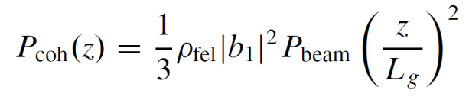
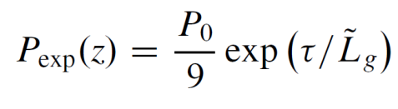
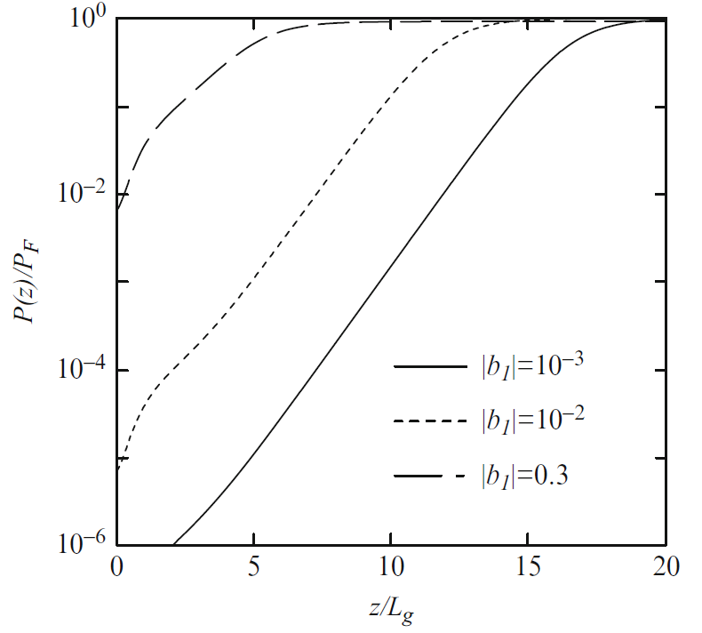


Coherent Harmonic Generation & High-Gain Harmonic Generation
CHG (quadratic)
HGHG (exponential)
Eberhard J. Jaeschke et al.
Synchrotron Light Sources and Free-Electron Lasers, Springer
International Publishing, 2016.

Slide 6
Improvement of UV seed beam quality (November 2016)
and characterization of the laser-induced energy modulation

Slide 7

FLASH1 Seed Laser System, UV Generation, & Transport (2016)
Synchronization
(RF/< 50 fs rms)
THz Streaking
(28h)
Optical Link
Nd:YAG Pump Laser
(InnoLas: SpitLight 600)
50 mJ/pulse
2% rms stab.
10 Hz rep. rate
uncompressed
> 20 m Beamline
Master Laser
Oscillator
Ti:Sapphire Amplifier (CPA, 2-stage)
(Coherent: HIDRA)
70%
Ti:Sapphire Oscillator
108.3 MHz, BW 60 nm (Femtolaser: Synergy)
Regen
Multipass
30 %
Pump Laser
(Coherent: Verdi G5)
PBS λ/2
Energy Attenuator
(x 1/100)
λ/2 (for polarization
rotation)
Grating
Compressor
Beam Expander
9 m
800 nm , 400 nm
Wavelength Separation
Alignment Diagnostics
Frequency Tripler
Alignment Diagnostics
FEL Machine Vacuum (10⁻¹² mbar)
267 nm Seed Injection
FEL Machine Vacuum (10⁻¹² mbar)
267 nm Seed Injection
FLASH Tunnel (restricted area/limited access)
High Vacuum (10⁻⁶ mbar)

Slide 8
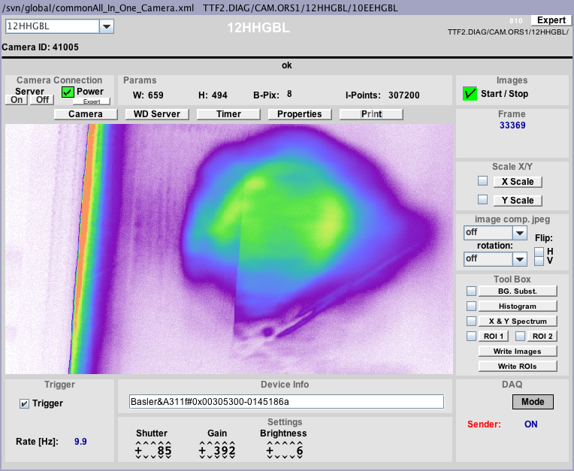
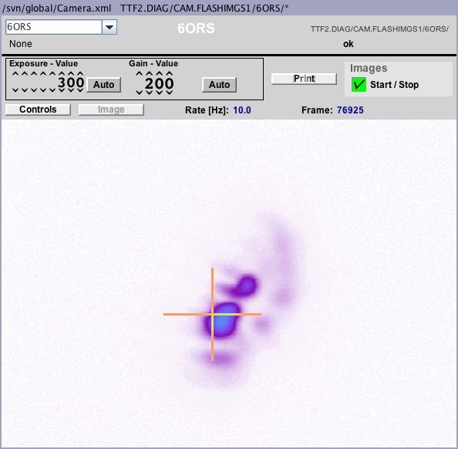
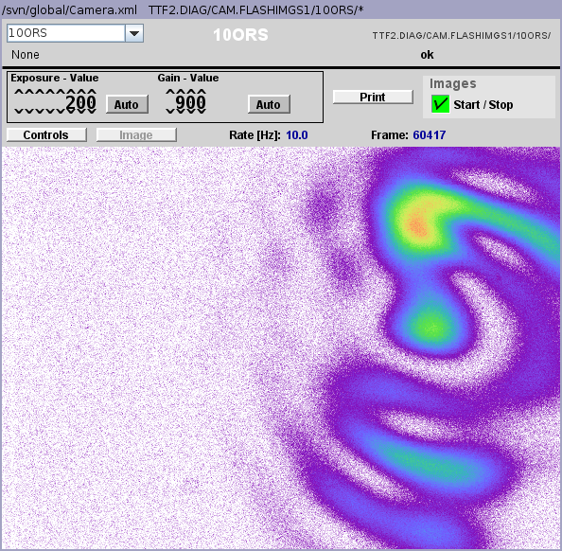
UV beam (before changing tripler)
before
modulator undulator
after
modulator undulator

Slide 9
FLASH1 Seed Laser System, UV Generation, & Transport (2016)
Synchronization
(RF/< 50 fs rms)
THz Streaking
(28h)
Optical Link
Nd:YAG Pump Laser
(InnoLas: SpitLight 600)
50 mJ/pulse
2% rms stab.
10 Hz rep. rate
uncompressed
> 20 m Beamline
Master Laser
Oscillator
Ti:Sapphire Amplifier (CPA, 2-stage)
(Coherent: HIDRA)
70%
Ti:Sapphire Oscillator
108.3 MHz, BW 60 nm (Femtolaser: Synergy)
Regen
Multipass
30 %
Pump Laser
(Coherent: Verdi G5)
PBS λ/2
Energy Attenuator
(x 1/100)
λ/2 (for polarization
rotation)
Grating
Compressor
Beam Expander
9 m
800 nm , 400 nm
Wavelength Separation
Alignment Diagnostics
Frequency Tripler
Alignment Diagnostics
FEL Machine Vacuum (10⁻¹² mbar)
267 nm Seed Injection
FEL Machine Vacuum (10⁻¹² mbar)
267 nm Seed Injection
FLASH Tunnel (restricted area/limited access)
High Vacuum (10⁻⁶ mbar)

Slide 10
FLASH1 Seed Laser System, UV Generation, & Transport (2017)
Synchronization
(RF/< 50 fs rms)
THz Streaking
(28h)
Optical Link
Nd:YAG Pump Laser
(InnoLas: SpitLight 600)
50 mJ/pulse
2% rms stab.
10 Hz rep. rate
uncompressed
> 20 m Beamline
Master Laser
Oscillator
Ti:Sapphire Amplifier (CPA, 2-stage)
(Coherent: HIDRA)
70%
Ti:Sapphire Oscillator
108.3 MHz, BW 60 nm (Femtolaser: Synergy)
Regen
Multipass
30 %
Pump Laser
(Coherent: Verdi G5)
PBS λ/2
Energy Attenuator
(x 1/100)
Wavelength Separation
λ/2 (for polarization
rotation)
Grating
Compressor
Frequency Tripler
Beam Expander
9 m
Alignment Diagnostics
267 nm Seed Injection
FEL Machine Vacuum (10⁻¹² mbar)
FLASH Tunnel (restricted area/limited access)
High Vacuum (10⁻⁶ mbar)

Slide 11
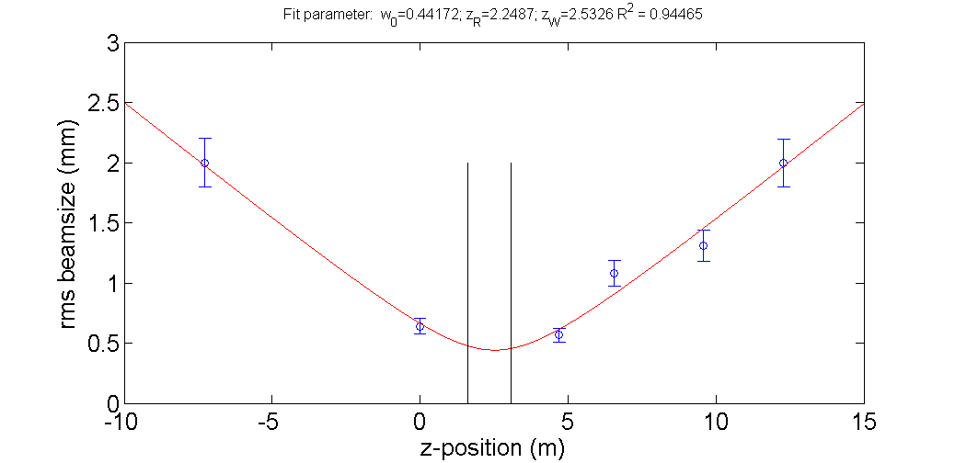
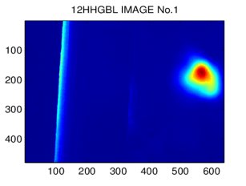
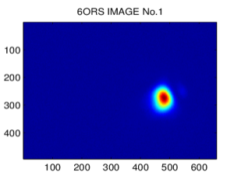
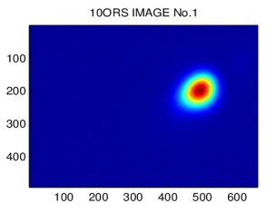
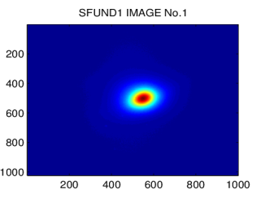
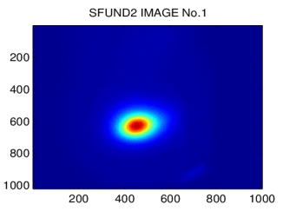
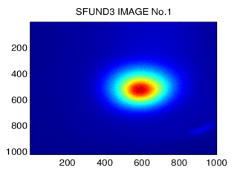
UV beam (after changing tripler)
Position of
modulator undulator

Slide 12
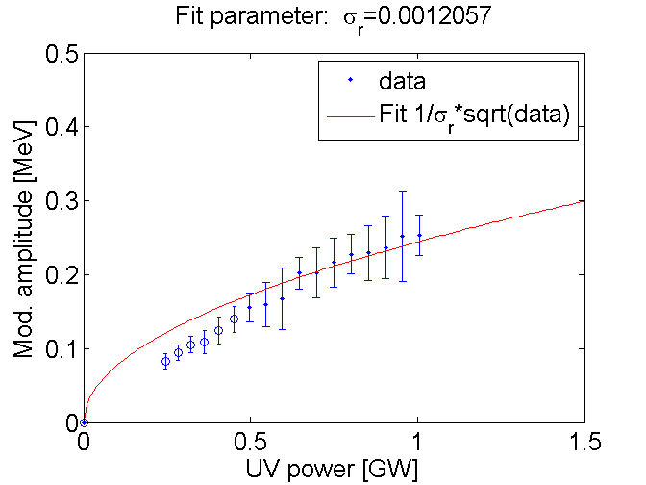
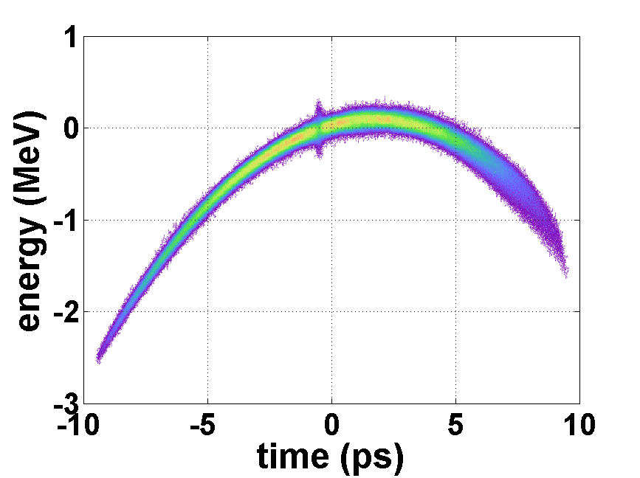
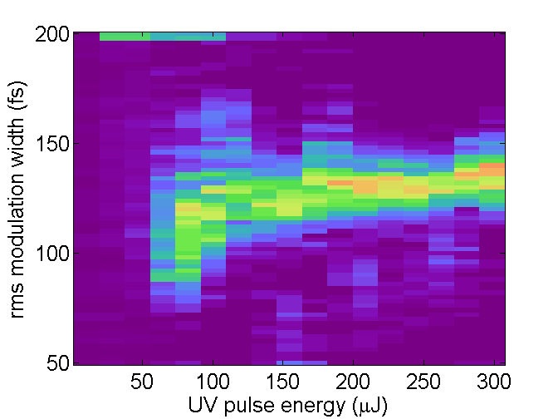
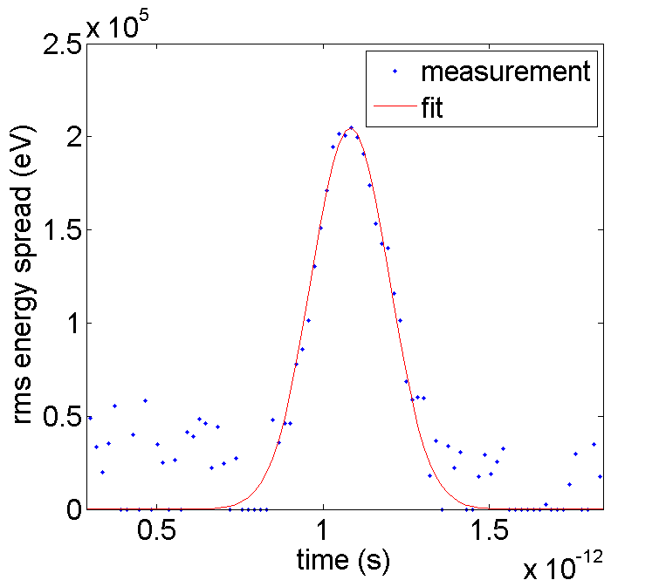
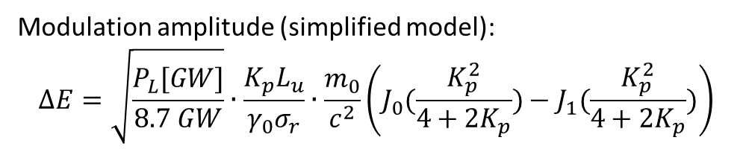
Characterization of laser-induced energy modulation $∆E$
Use TDS to measure the induced energy modulation
Modulation amplitude (simplified model):
$$∆E=\sqrt{\frac{P_{L}[GW]}{8.7 GW}}∙\frac{K_{p}L_{u}}{γ_{0}σ_{r}}∙\frac{m_{0}}{c^{2}}\left(J_{0}(\frac{K_{p}^{2}}{4+2K_{p}})−J_{1}(\frac{K_{p}^{2}}{4+2K_{p}})\right)$$

Slide 13
CHG Studies

Slide 14
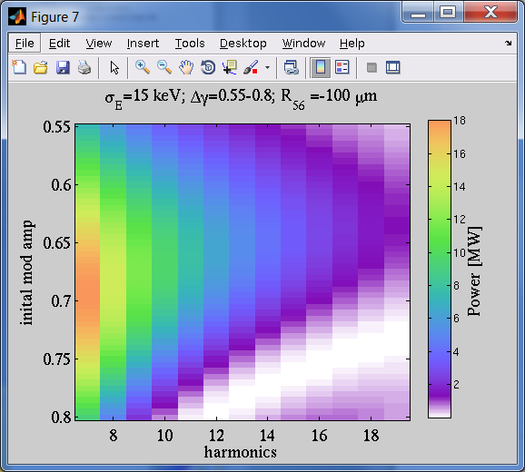

CHG experiments
Idea: use CHG to retrieve the electron beam’s energy spread
1st possibility:
2nd possibility:
$∆E$[keV]

Slide 15
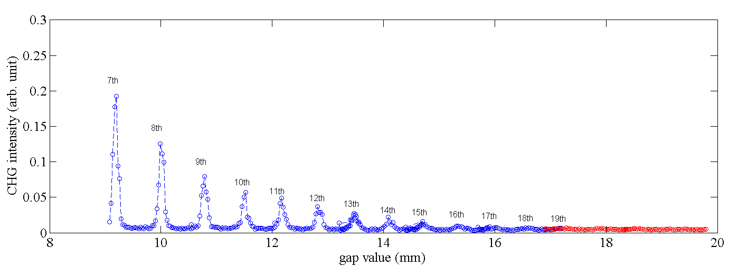
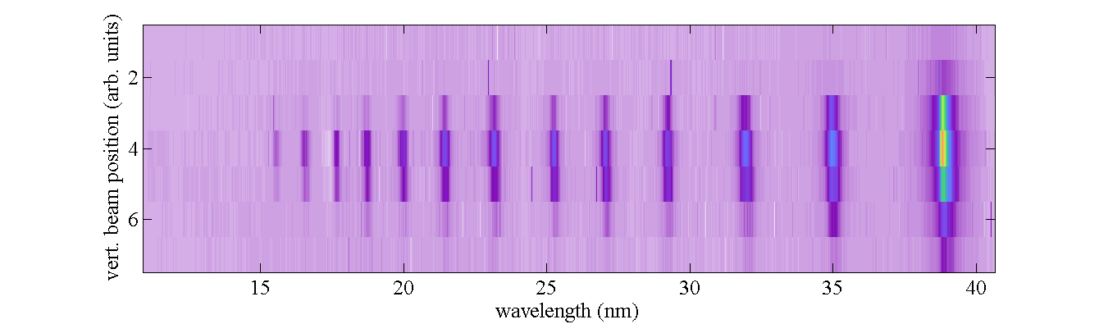
CHG experiments
January 2017: Scan of undulator gap of first radiator module

Slide 16
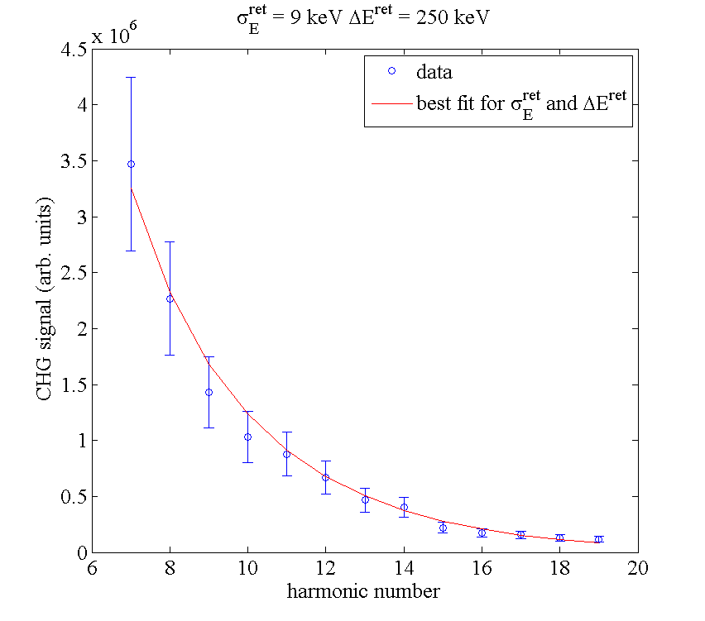


CHG experiments
Simulate CHG output power for varying initial energy spread and modulation amplitude and fit the results to the measurements

Slide 17
HGHG operation

Slide 18
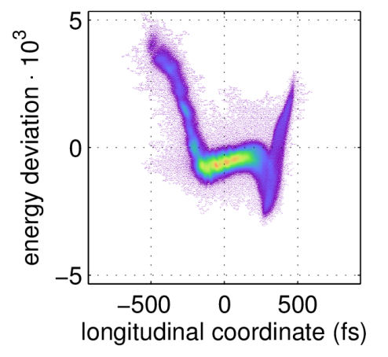
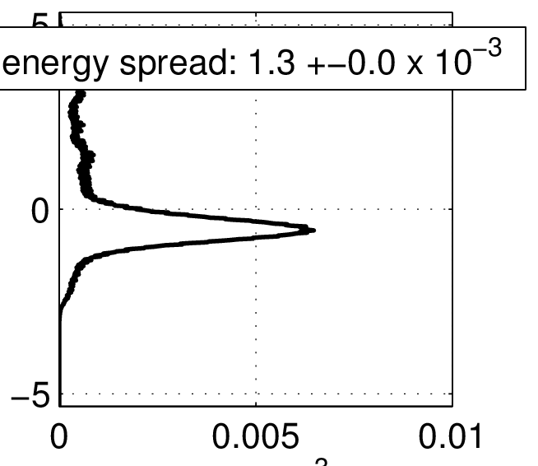



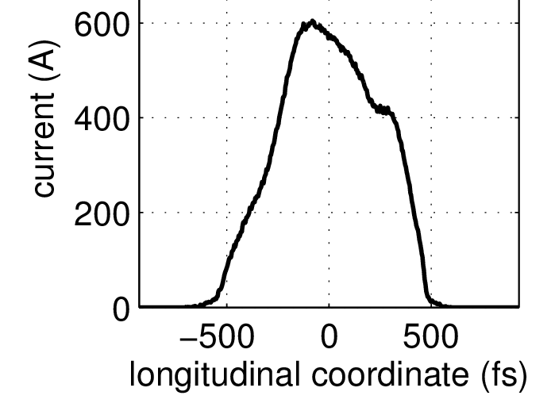

HGHG operation
Machine parameters:

Slide 19
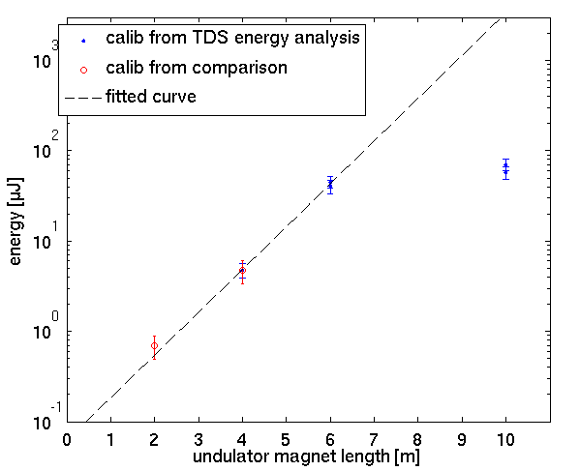


Gain Curve (maximum bunching)
Only taken best 50% of the shots.

Slide 20
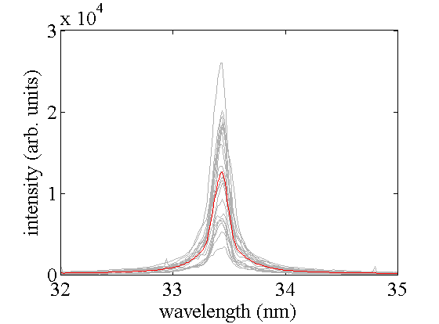
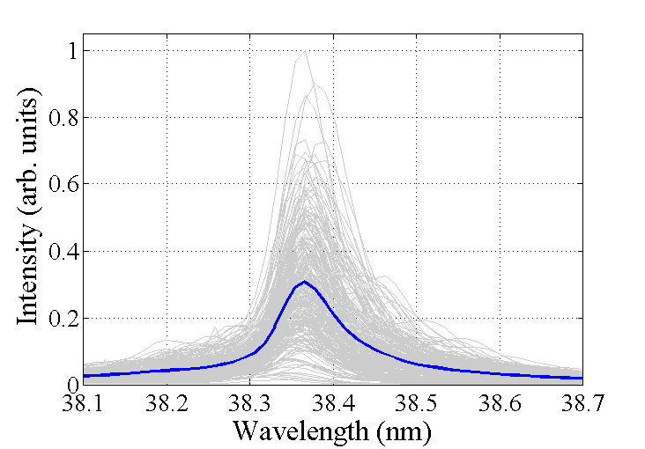
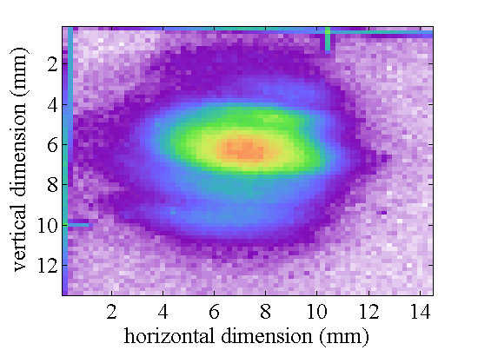
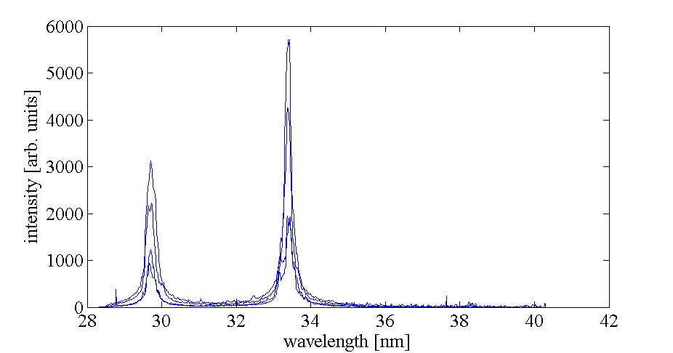
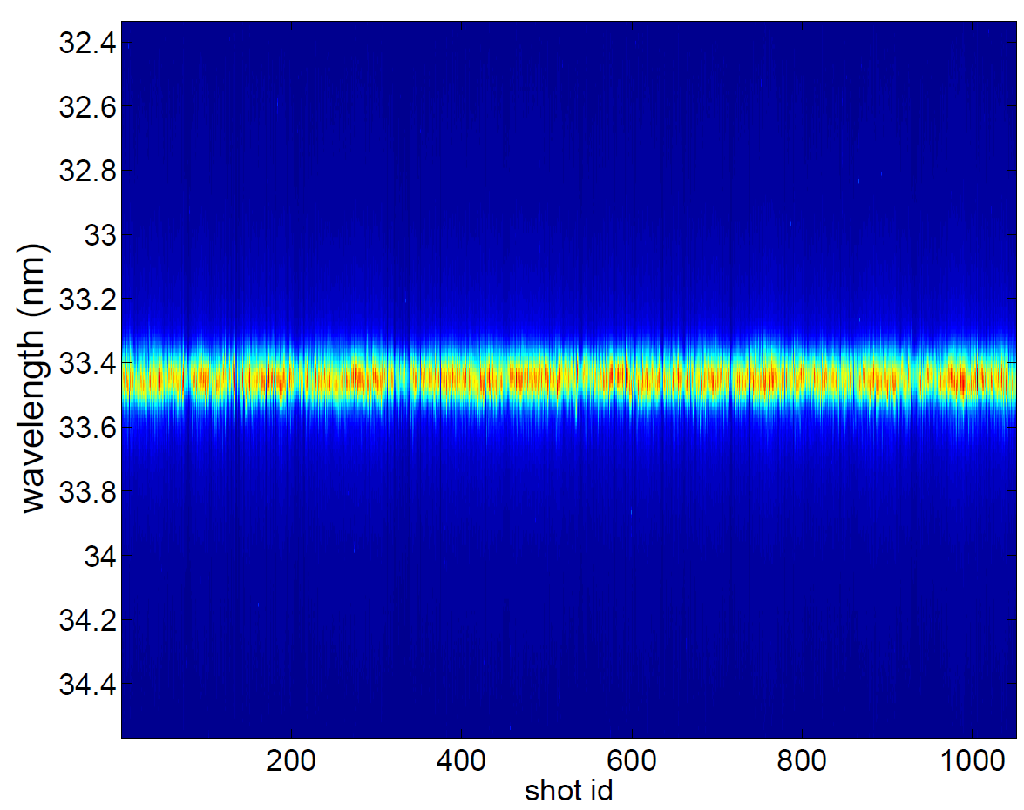
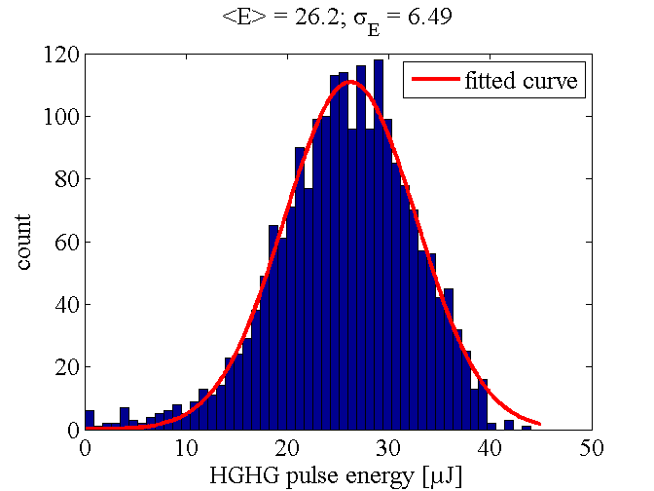

HGHG operation
^{8th}
7th
UV seed
Simultaneous
8th and 9th harmonic

Slide 21
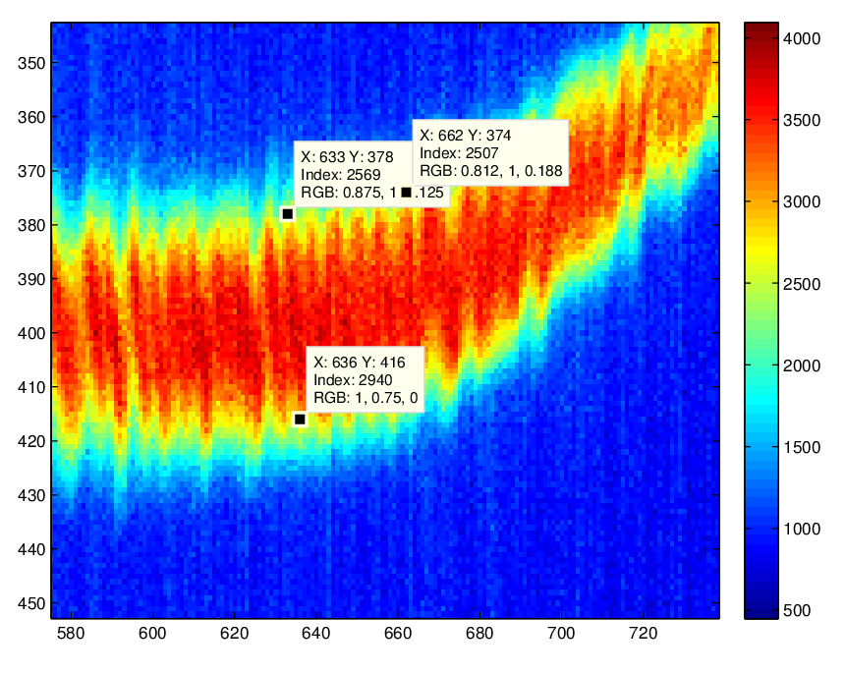
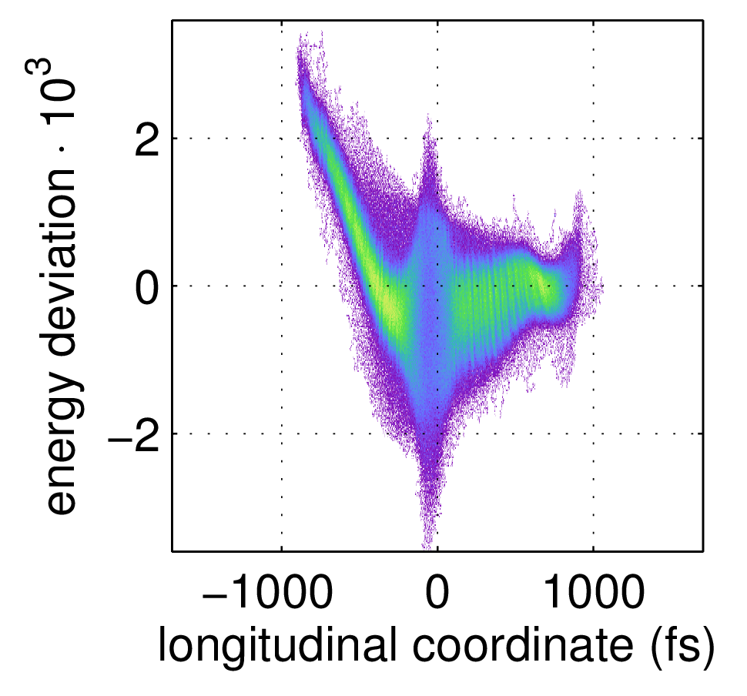
Microbunch instability
Very poor and instable HGHG operation (< 1µJ)

Slide 22
Temporal diagnostics

Slide 23
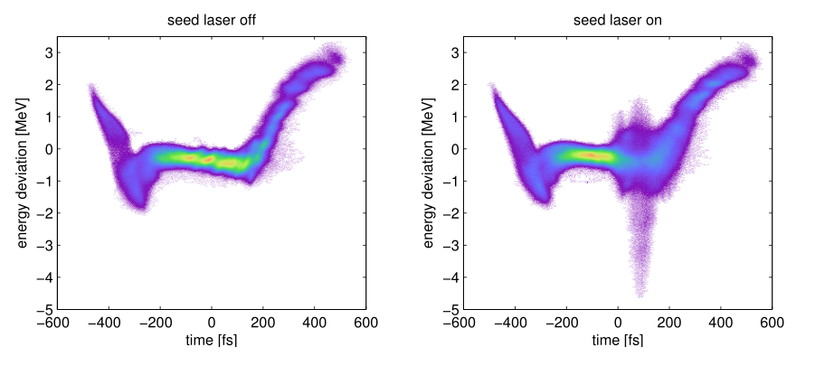
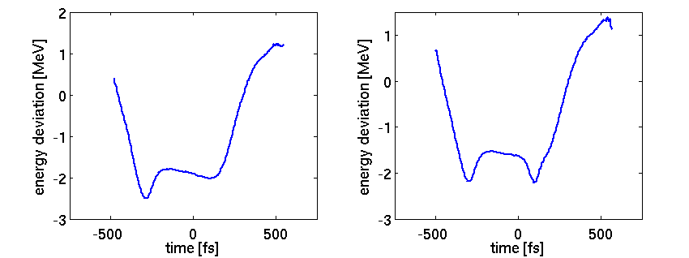

Transverse Deflecting Structure
Changes in LPS distribution allows for characterization of photon pulse power profile:
Energy Drop Method
C. Behrens et al., Nature Communications 5 (2014), 10.1038/ncomms4762.

Slide 24
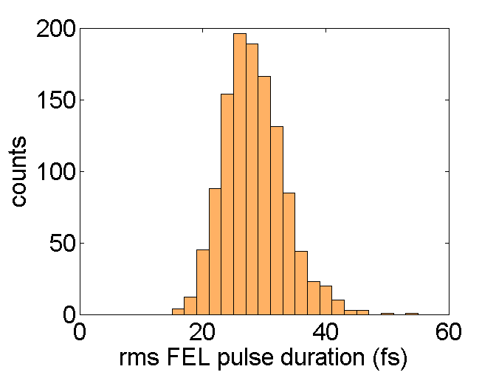
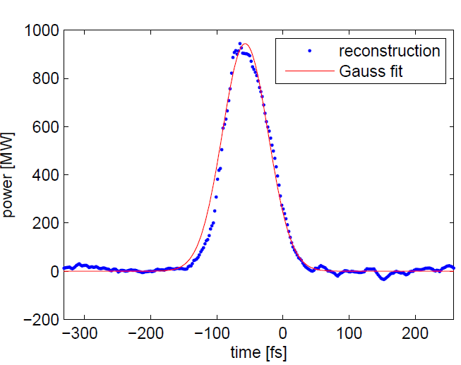

Transverse Deflecting Structure
More about TDS analysis in PhD defense by Tim Plath
From this calculate: Pulse duration, peak power and energy.
T. Plath et al. accepted at Scientific Reports

Slide 25
THz streaking
Time-of-flight electron detector
THz lens
Ag mirror
with hole
FEL xxx nm, 1-40µJ
Ar ~2e⁻⁶mbar
0.5mm
aperture
P43 screen +
ZnTe crystal
Gold mirror

Slide 26
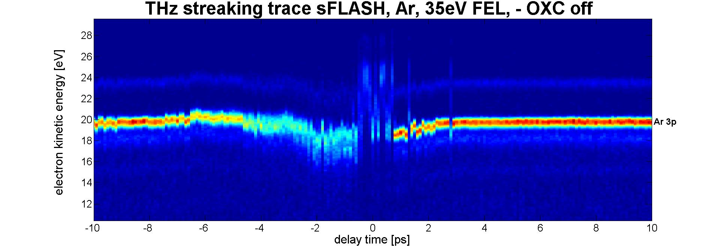
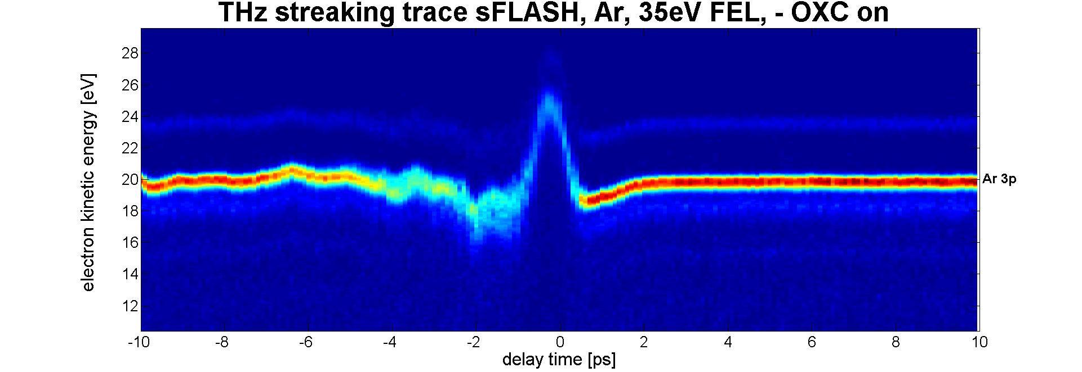

THz Streaking
sFLASH SASE operation
More about THz streaking with seeded FEL
beams next week by Armin Azima
$$FWHM_{s}=\text{230}\text{fs}$$
22.01.2017

Slide 27
Outlook: next steps towards EEHG operation (Christoph)

Slide 28
On behalf of the seeding team
Thank you for your attention

Slide 29


FLASH1 Seed Laser System
Synchronization
(RF/< 50 fs rms)
THz Streaking
(28h)
Optical Link
Nd:YAG Pump Laser
(InnoLas: SpitLight 600)
50 mJ/pulse
2% rms stab.
10 Hz rep. rate
uncompressed
> 20 m Beamline
Master Laser
Oscillator
Ti:Sapphire Amplifier (CPA, 2-stage)
(Coherent: HIDRA)
70%
Ti:Sapphire Oscillator
108.3 MHz, BW 60 nm (Femtolaser: Synergy)
Regen
Multipass
30 %
Pump Laser
(Coherent: Verdi G5)
PBS λ/2
Energy Attenuator
(x 1/100)
50 fs (FWHM)
10 mm (1/e²)
5 mJ/pulse (max injection)
(~ 35 mJ/pulse available)
λ/2 (for polarization
rotation)
Grating
Compressor
Purchased by Uni. of Hamburg
Now a shared property of DESY + Uni. of Hamburg
Used for HHG seeding experiment
Serves as HGHG seed laser

