Slide 1
FLASH RF gun developments.
Sven Pfeiffer for the LLRF team
FEL Seminar
Hamburg, 19.04.2016

Slide 2
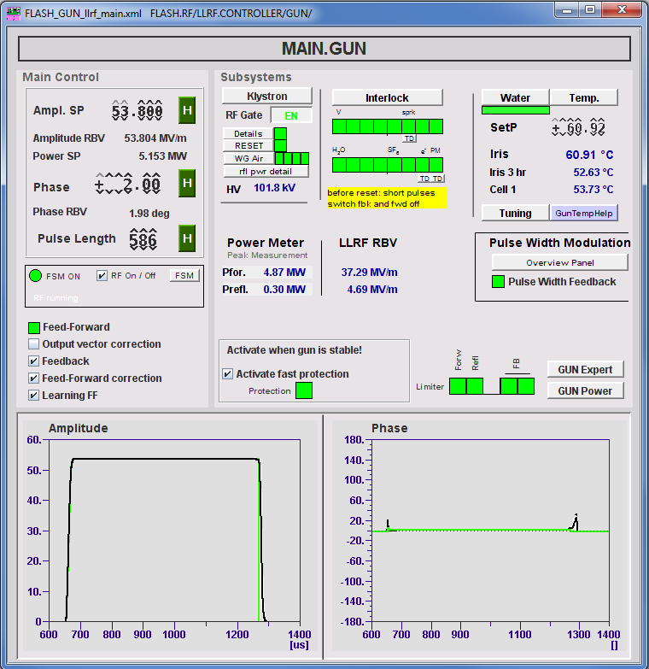
Outline
Introduction
LLRF
Feedback & Limitations
Learning Feedforward
Pulse Width Modulation
RF gun cooling system
Temperature estimation
Precision temperature control
Fast Protection
The why and wherefore
Current problems
After start-up

Slide 3
Outline
Introduction
LLRF
Feedback & Limitations
Learning Feedforward
Pulse Width Modulation
RF gun cooling system
Temperature estimation
Precision temperature control
Fast Protection
The why and wherefore
Current problems
After start-up

Slide 4
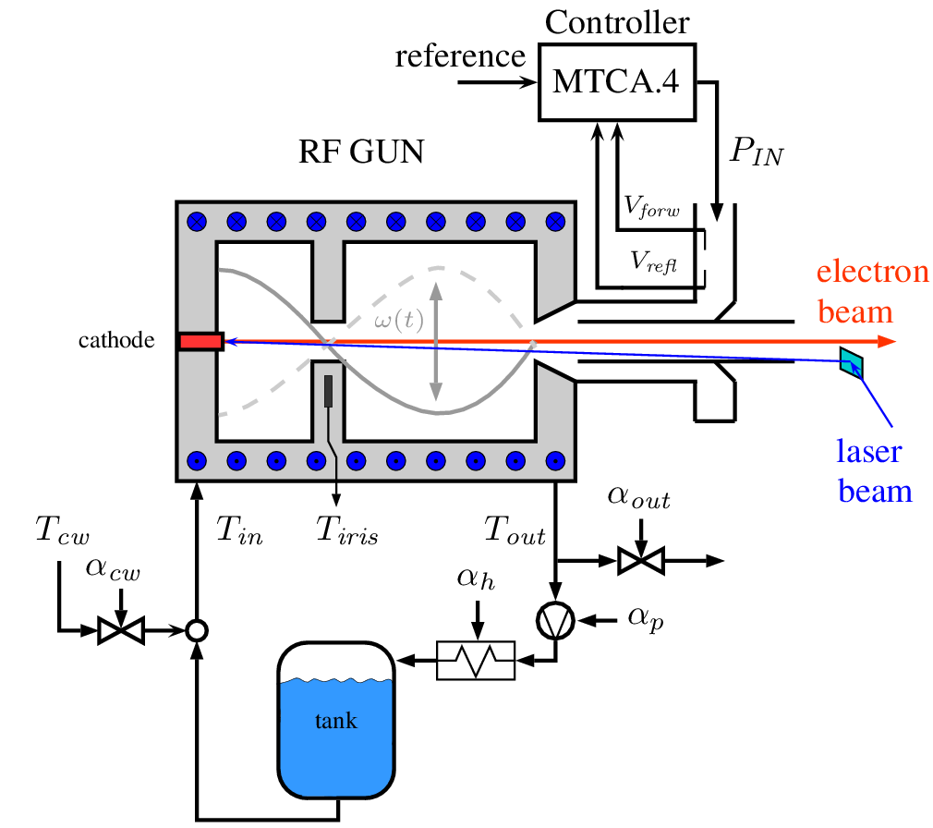
Introduction
1.3 GHz SWS, Pulsed mode @ 10 Hz,
Forward power ≈ 5 MW (average power ≈ 50 kW)
Pulse length up to 800 μs → 1% duty cycle
Since 01/2015 operated with MicroTCA.4
(1) Regulation - LLRF: Control the amplitude and phase of virtual probe signal
(2) Regulation - Water: Control the RF gun temperature → keep it on (slightly below) its resonance frequency
(3) Protection:
Limiter for Output, FB, LFF etc.
Switch off the power to RF gun if necessary, e.g. spark

Slide 5
Outline
Introduction
LLRF
Feedback Loop
Concepts & Achievement
Pulse Width Modulation
RF gun cooling system
Temperature estimation
Precision temperature control
Fast Protection
The why and wherefore
Current problems
After start-up

Slide 6
LLRF Regulation
Main.GUN Panel
LLRF
Ampl. SP [MV/m]
(new: before power SP [MW])
Phase SP [deg]
Pulse length [μs]
Feedforward
Feedback
OVC, LFF etc.

Slide 7
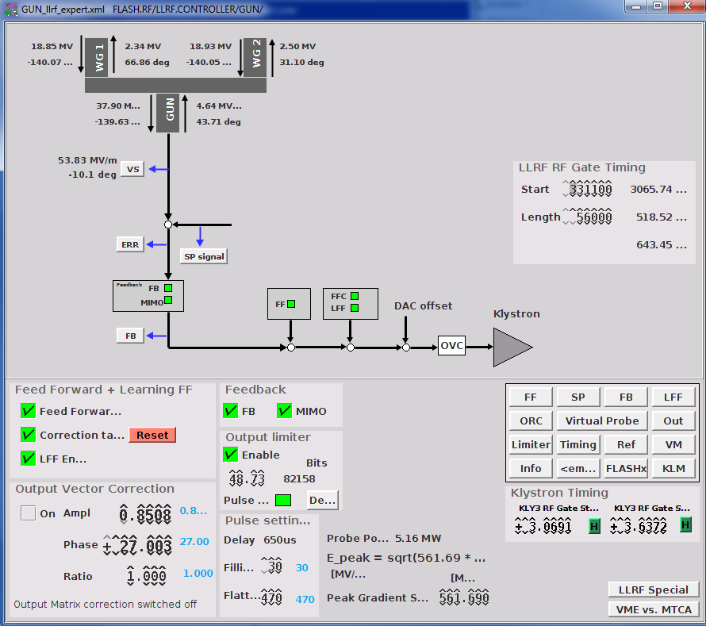
LLRF Regulation

Slide 8
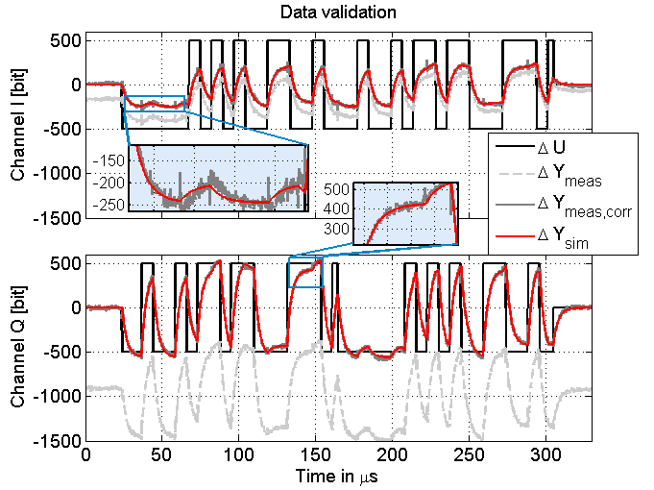
LLRF Regulation
System model
FPGA output to virtual probe
Small signal system model
Identified parameters:
I/Q gains as function of frequency
Cross-couplings
Bandwidth ~ 52 kHz
Loop delay ≈ 1.4 μs
Feedback loop
Model based optimization of
FB and LFF

Slide 9
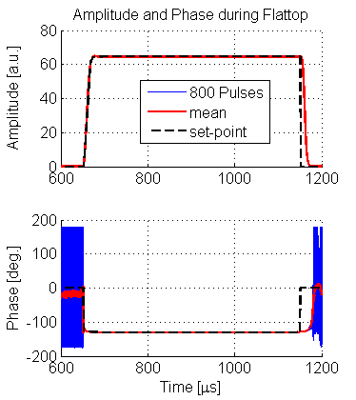
LLRF Regulation
Goal: dA/A<0.01%
d <0.01 deg (rms)
Feedback concepts
1) Output-Vector Correction (OVC - Server)
Drift compensation
2) Learning Feedforward (LFF - Server)
Minimize repetitive errors from pulse to pulse
3) MIMO feedback (FB - FPGA)
Intra-pulse feedback
Main limitation: Loop delay ≈ 1.4 μs
limits control gain
max. FB gain 2-3; SRF ≈ 20-40 (!)

Slide 10
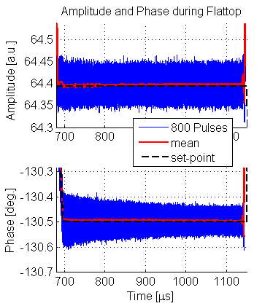
LLRF Regulation
Goal: dA/A<0.01%
d <0.01 deg (rms)
PI feedback

Slide 11
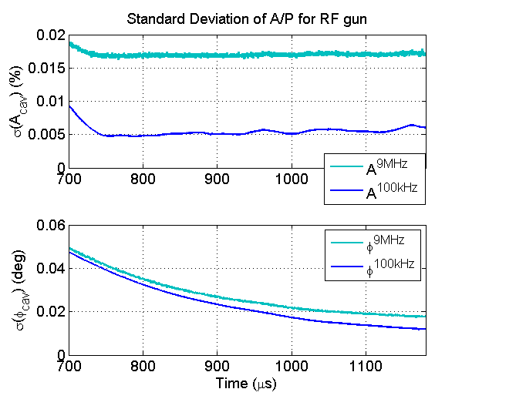
LLRF Regulation
Goal: dA/A<0.01%
d <0.01 deg (rms)
0.01%
9MHz → 100kHz
Factor 3-5 improvement necessary
0.01deg.
PI feedback

Slide 12
Outline
Introduction
LLRF
Feedback & Limitations
Learning Feedforward
Pulse Width Modulation
RF gun cooling system
Temperature estimation
Precision temperature control
Fast Protection
The why and wherefore
Current problems
After start-up
Outlook

Slide 13
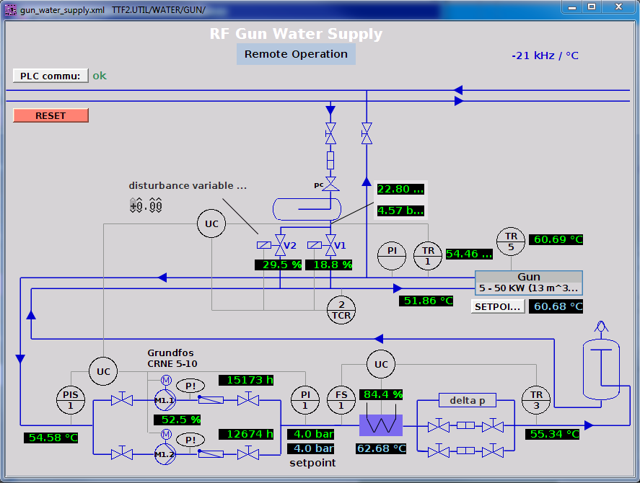
RF gun cooling system
Cold water
GUN Wasser
Temperatur
Wasserkreislauf
Valves
RF gun
Warm water
Tank
Heater

Slide 14
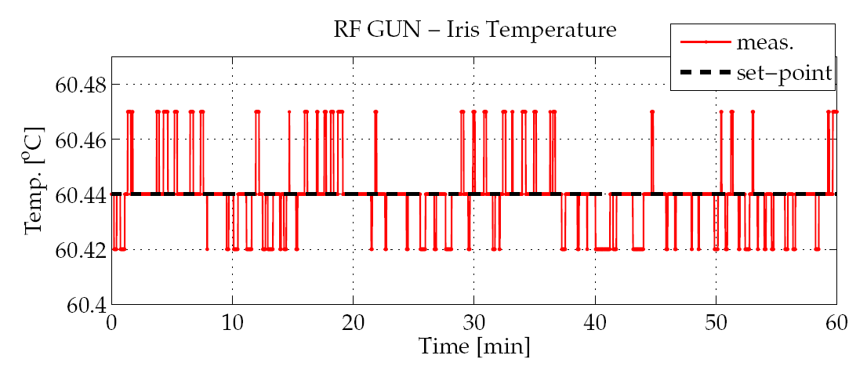
RF gun cooling system
Long term error ± 1 bit (about 14mK rms)
@Resolution (12 bit ADC)
of 0.02 K – 0.03 K
Required stability for d < 0.01 deg
without LLRF control:
$$ΔT= \frac{tan ψ⋅f}{2 Q_{L}K_{fT}}≈\frac{dφ⋅f}{2 Q_{L}K_{fT}}<0.45mK,$$
($f=1.3GHz, Q_{L}=12000, K_{fT}=−21kHz/K)$

Slide 15
RF gun cooling system
Pressure
+0.09bar
Long term error ± 1 bit (about 14mK rms)
@Resolution (12 bit ADC)
of 0.02 K – 0.03 K
T_{IRIS}
+100mK
Required stability for d < 0.01 deg
without LLRF control:
$$ΔT= \frac{tan ψ⋅f}{2 Q_{L}K_{fT}}≈\frac{dφ⋅f}{2 Q_{L}K_{fT}}<0.45mK,$$
($f=1.3GHz, Q_{L}=12000, K_{fT}=−21kHz/K)$
SASE
-35uJ

Slide 16
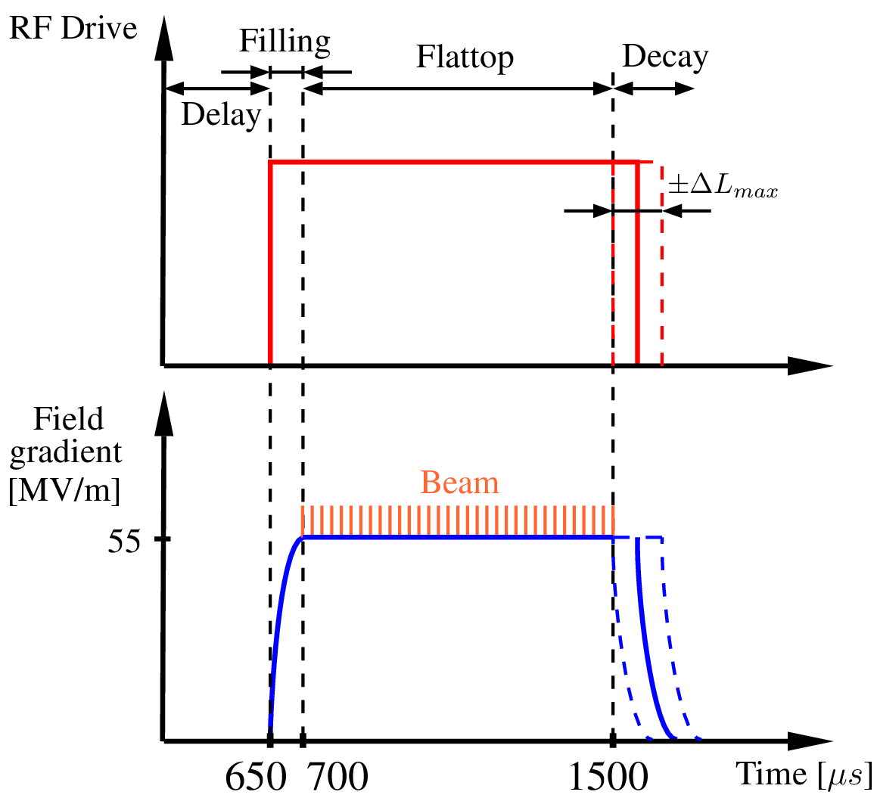
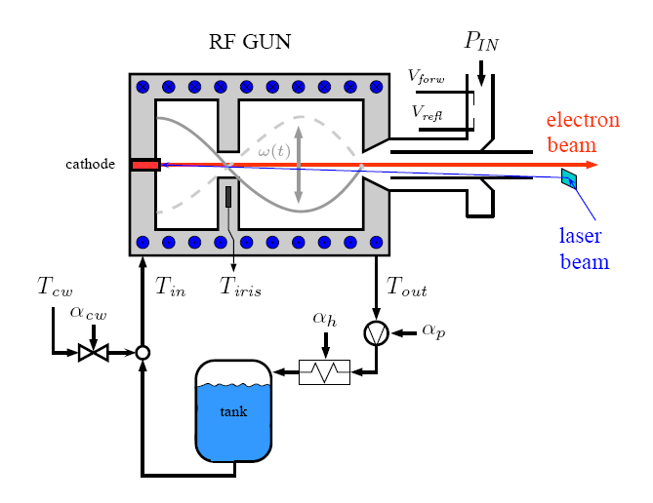
Pulse Width Modulation
Idea: Usage of LLRF Signals
Use pulse width modulation to control the dissipated power (heat balance) to the RF gun body within pre-defined limits
Needed is a high precision temperature estimation with no time delay for pulse to pulse feedback

Slide 17
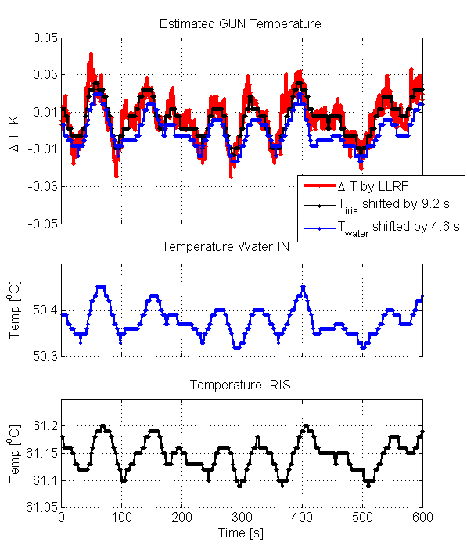
Pulse Width Modulation
Idea: Usage of LLRF Signals
Delayed T_{IRIS} (9s) and T_{IN} (5s) information
Transition from cavity body to sensor
Low pass behavior of temp. sensor
FLASH RF GUN data
Temp. sensor (12 bit ADC)

Slide 18
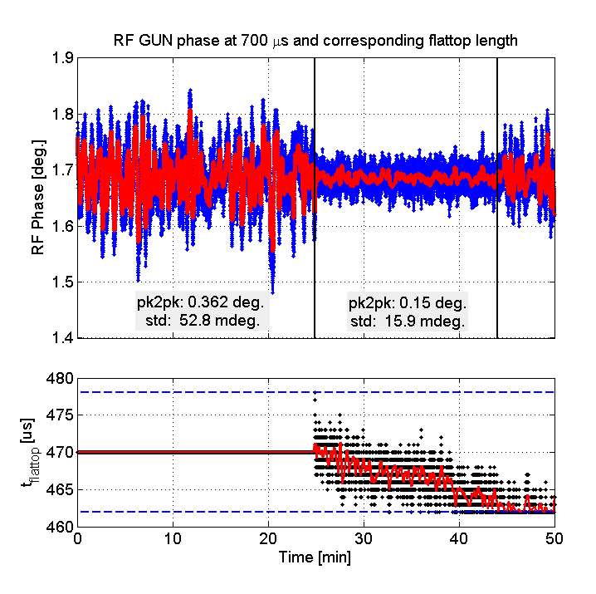
Pulse Width Modulation
Blue: single pulse, Red: mean 100 pulses (10s@10Hz)
RF GUN phase at 1st beam position (700μs) for 50 minutes
Without and with modulation to minimize disturbances from cooling water circuit Pulse to pulse compensation (10 Hz)
Improvement for phase x3 (dφ = 53 mdeg. → 16 mdeg.)
RF GUN temperature stabilized by x5 (from 14 mK → 3 mK)
Running @ FLASH, PITZ, (XFEL)
* Under review @ Physical Review Special Topics - Accelerators and Beams

Slide 19
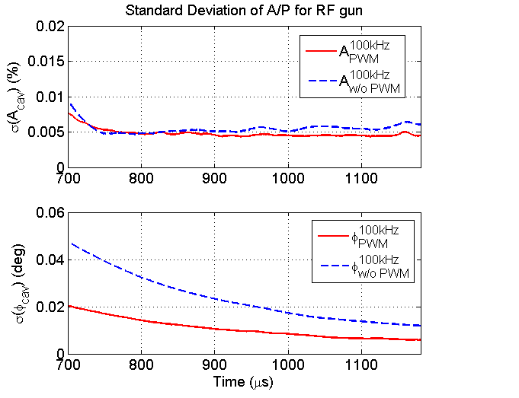
Pulse Width Modulation
Goal: dA/A<0.01%
d <0.01 deg (rms)
Remember:
Factor 3-5 improvement in phase is necessary using only LLRF control
Applying PWM:
No improvement of RF amplitude
Detuning affects mainly the RF phase
Great improvement in standard deviation of RF phase
Achieved by using disturbance minimization of detuning with precision temperature control
0.01%
0.01deg.

Slide 20
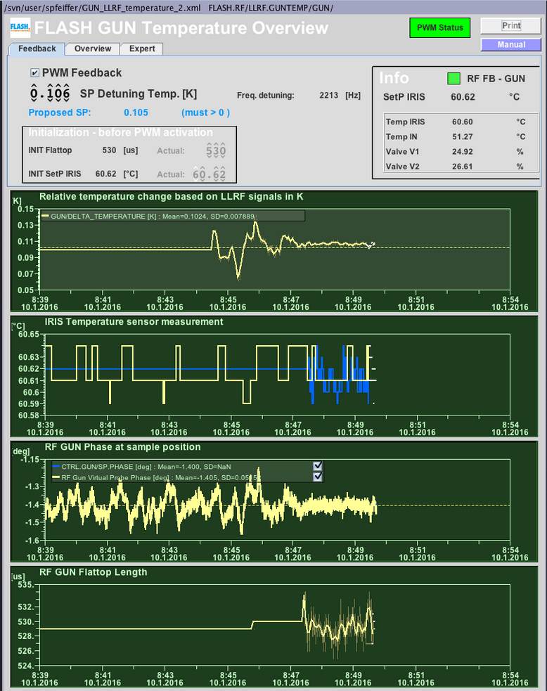
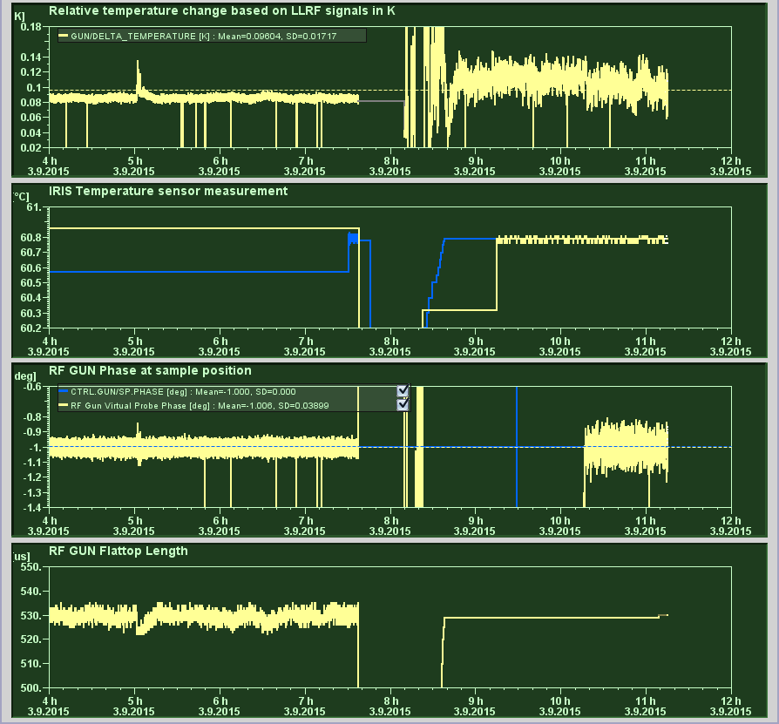
Pulse Width Modulation – Panel
PWM Feedback check box
Set-point (automatically computed)
Status indicator
Initialization (settings before PWM)
Manual (set-up, problem handling)
With Pulse Width Modulation
Start-up of RF gun → next slide
Without Pulse Width Modulation

Slide 21
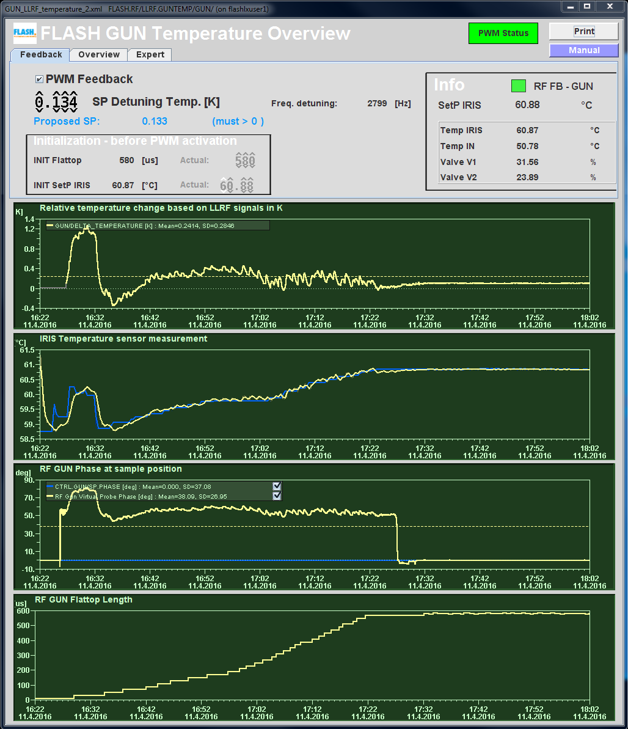
Additional Info
Using pulse width modulation – panel for start-up of RF gun
Direct response
RF gun is in resonance, to cold or to warm
Relative detuning / temperature information
What is the current optimal Iris set-point etc.
Δ Temperature
T_{IRIS} and set-point
Flattop length

Slide 22
Outline
Introduction
LLRF
Feedback & Limitations
Learning Feedforward
Pulse Width Modulation
RF gun cooling system
Temperature estimation
Precision temperature control
Fast Protection
The why and wherefore
Current problems
After start-up

Slide 23
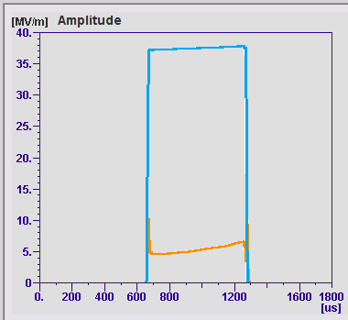
Fast Protection
Implementation in FPGA (L. Butkowski, C. Schmidt et al.)
Threshold for reflected signal is defined (scaled by forward signal)
Cut RF pulse if reflected signal is too high (sparks, detuning, etc.)

Slide 24
Fast Protection
6 Events since 01/2016 → no known false alarms
Test of
concept
Water pressure
RF-6
timing (?)
Water pressure
Reference phase jump
unknown

Slide 25
Outline
Introduction
LLRF
Feedback & Limitations
Learning Feedforward
Pulse Width Modulation
RF gun cooling system
Temperature estimation
Precision temperature control
Fast Protection
The why and wherefore
Current problems
After start-up

Slide 26
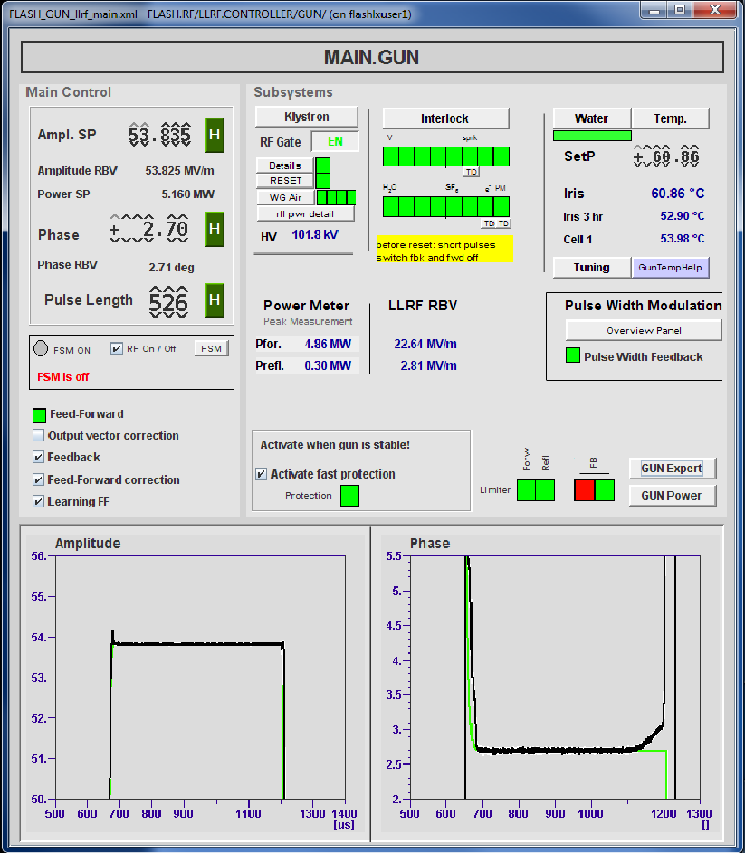
Current Problems
After RF gun start-up
Phase at end is not on set-point
How to check?
Look in LFF panel

Slide 27
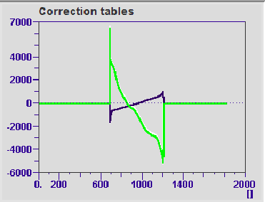
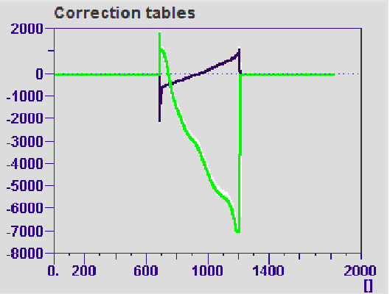
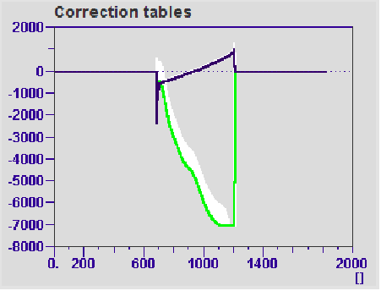
Current Problems
RF gun start-up without FB, LFF
(1) Adjust OVC before FB and LFF is enabled
(2) Enable FB, LFF
FF correction are centered after a while
FF correction limits: 7000 bits
→ t = 0
(3) FF correction tables 20 minutes later
(4) After 40 minutes
FF tables (Q channel) hits limit
→ readback ≠ set-point
t = 0
t = 20 min
Why?
Slowly waveguide heating (guess)
t = 40 min

Slide 28
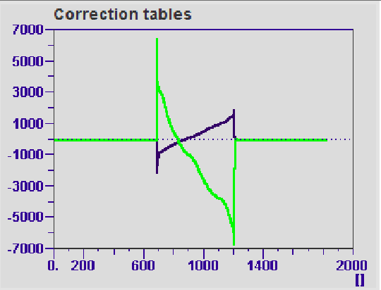
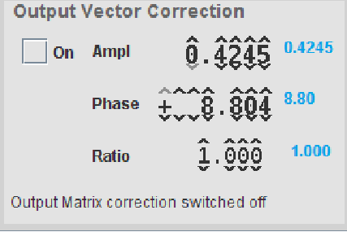
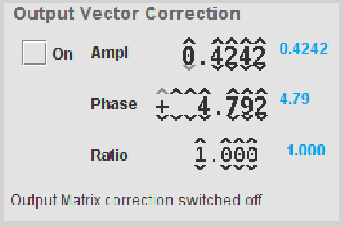
Current Problems
After RF gun start-up
Phase at end is not on set-point
Why?
Slowly waveguide heating (guess)
How to check?
Look in LFF panel
What can I do?
Adjust OVC phase by ~ -4 deg
t = 40 min
t = 40+x min

Slide 29
Current Problems
After RF gun start-up
Phase at end is not on set-point
Why?
Slowly waveguide heating (guess)
How to check?
Look in LFF panel
What can I do?
Adjust OVC phase by ~ -4 deg
Why is it not done automatically?
Most of the time OVC is OFF…
OVC ON does not mean that its active…
Active limiter deactivate OVC
t = 40 min
t = 40+x min

Slide 30
Outline
Introduction
LLRF
Feedback & Limitations
Learning Feedforward
Pulse Width Modulation
RF gun cooling system
Temperature estimation
Precision temperature control
Fast Protection
The why and wherefore
Current problems
After start-up
Thank you for your attention!

