Slide 1
RF Tweak 5 Tool for FLASH and XFEL
Bolko Beutner
FEL Seminar 17.2.2015
Notes:
How to edit the title slide
Upper area: Title of your talk, max. 2 rows of the defined size (55 pt)
Lower area (subtitle): Conference/meeting/workshop, location, date,
your name and affiliation, max. 4 rows of the defined size (32 pt)
Change the partner logos or add others in the last row.

Slide 2
Contents
Introduction
Program Overview
  RF Setup
  Particle Distributions
  LOLA Simulations
Demo
Summary and Outlook

Slide 3
Introduction
Demand for a fast longitudinal tracking code to assist in machine operation (e.g. compression setup, SASE tuning,…)
Self field effects should be included as much as possible
Code should be user friendly for control room operation
RF Tweak 5 developed by BB, M. Dohlus, C. Henning uses:
  Xcomm by S. Meykopff and J. Wilgen for machine controls comunication
  Datagui by S. Meykopff for GUI

Slide 4
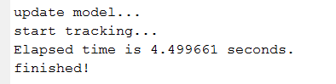
  RFTweak 5
Fast self field calculations are possible by precalculating wake kernel tables which are stored to disk
  energy independent CSR kernels (about 4GB for XFEL)
  Energy dependent tables for wakes and LSpCh (about 150MB each)
    Recalculation required if energy profile changes (ca. 2 minutes)
    Results are stored to disk so following tracking runs with the same energy do not require this preparation
Example:
Full XFEL 1D tracking with 1M particles,
wakes on, LSpCh on, no CSR in less than 5 seconds

Slide 5
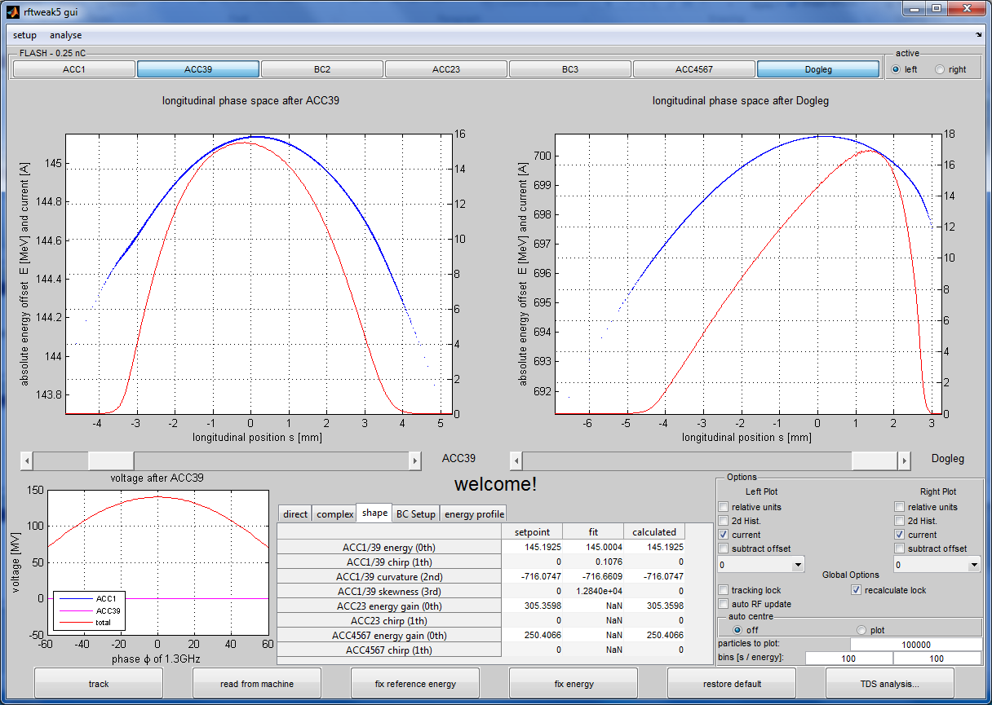
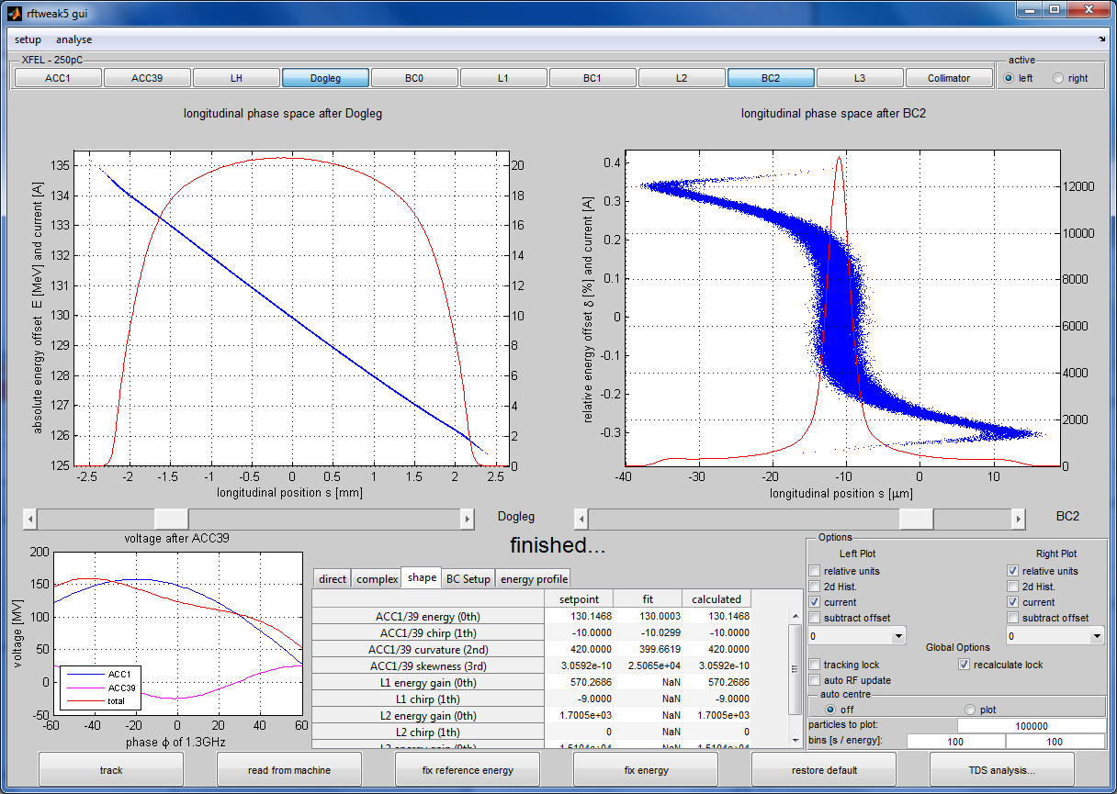
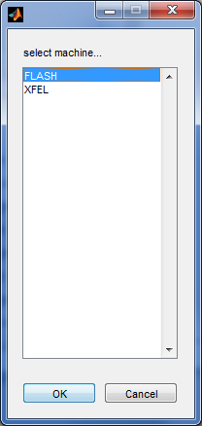
GUI Overview

Slide 6
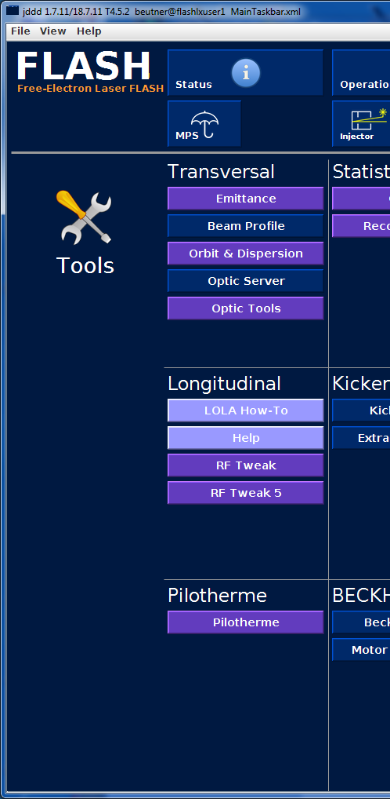
GUI Overview
Code is developed to deal with FLASH and XFEL
For FLASH the code can be found in the
standard jddd panel for FLASH Tools
In the moment the code is executed from
/home/ttflinac/beam_dynamics/Work_in_Progress/BB/rftweak5/
rf_tweak5_FLASH.m
rf_tweak5_XFEL.m
rf_tweak5_gui_bb.m
Subversion repository is available

Slide 7
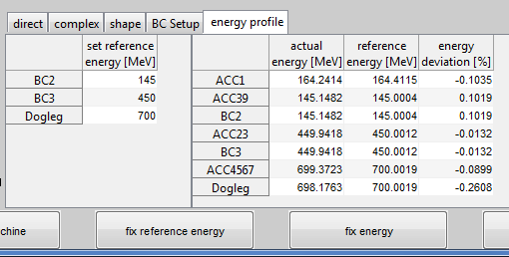
Reference Energy Management
Energy Profile correspond to the wake tables --deviations must not exceed percent level for accurate self-field calculations
Reference energy can be changed to actual energy profile (‘fix reference energy’) recalculating the tables,
or the RF can be automatically adjusted to match reference energy (‘fix energy’)

Slide 8
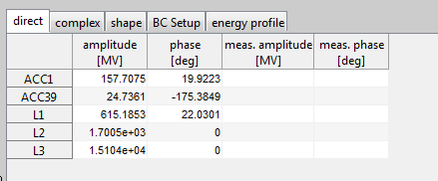
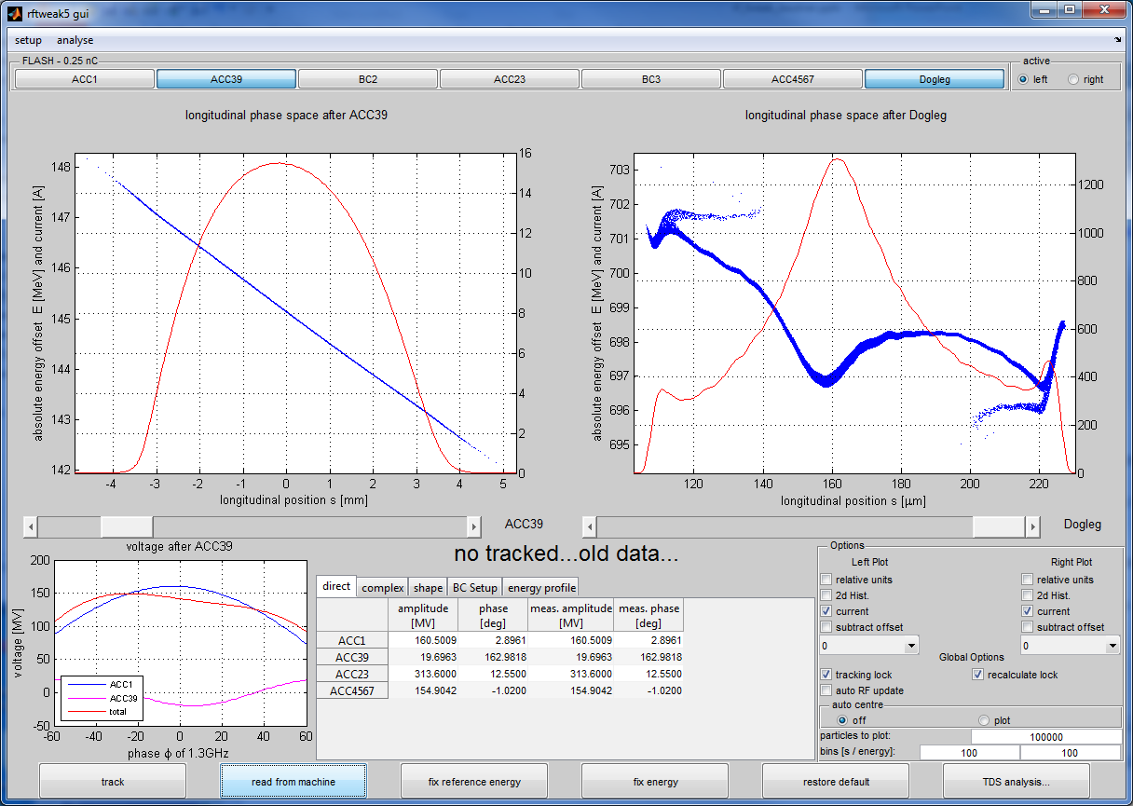
  RF Setup Methods
RF phase and voltage can be read from machine for analysis of present setup
Different options to modify RF
setup
Direct RF phase and amplitude adjustment
  Beam energy profile is not maintained
  - > beam energy for wake tables needs to be recalculated
Energy profile conserving methods (complex, shape)

Slide 9
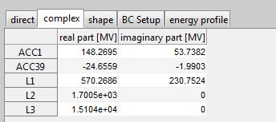
Complex RF Setup
Energy gain is given by the Real Part of the RF as the phase is relative to the beam (phi = 0)
Im
Chirp is controlled by the Imaginary part without changing energy gain
Each RF station is managed individually in contrast to the ACC1 / 39 multiknob
Re

Slide 10
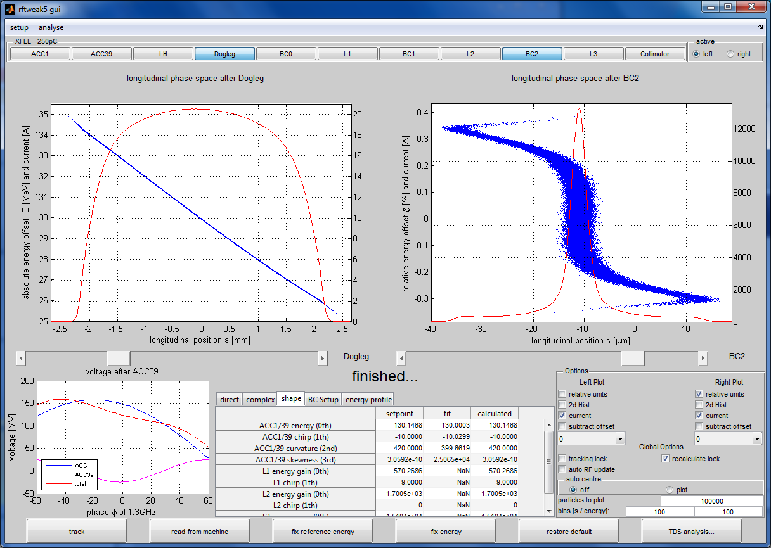
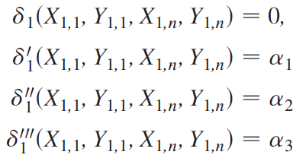

    Sum Voltage Multiknobs I
Interplay between ACC1 and ACC39 should be described by the required phase space downstream of ACC39
Before ACC1
Igor Zagorodnov and Martin Dohlus
Semianalytical modeling of multistage bunch compression with collective effects
Phys. Rev. ST Accel. Beams 14, 014403 (2011)
first BC

Slide 11
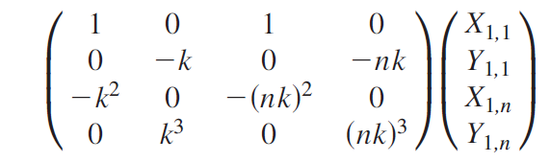
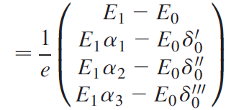
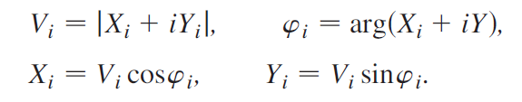
    Sum Voltage Multiknobs I
Problem:
ACC1
ACC39
Igor Zagorodnov and Martin Dohlus
Semianalytical modeling of multistage bunch compression with collective effects
Phys. Rev. ST Accel. Beams 14, 014403 (2011)

Slide 12
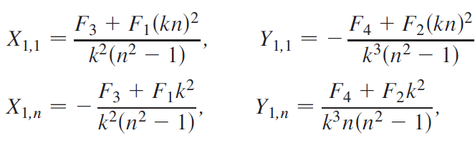
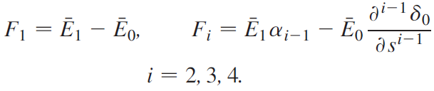
    Sum Voltage Multiknobs I
Solution:
Igor Zagorodnov and Martin Dohlus
Semianalytical modeling of multistage bunch compression with collective effects
Phys. Rev. ST Accel. Beams 14, 014403 (2011)

Slide 13
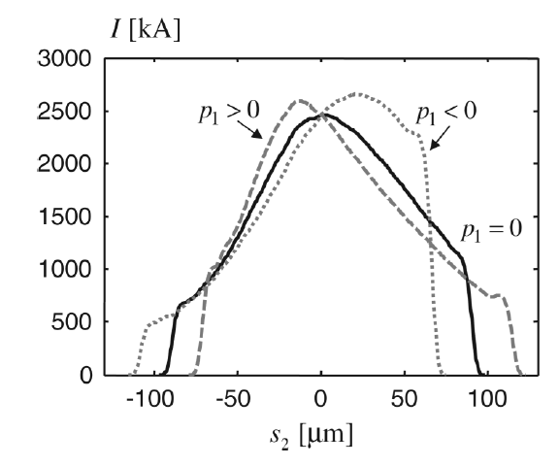
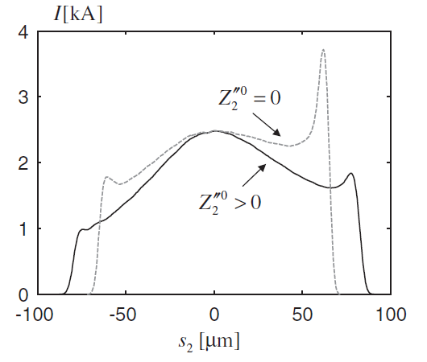
Sum Voltage Multiknobs I
skewness
3rd order
curvature
2nd order
Compression is affected by the first order
Changes in the second order shift the current peak
The third order bends
the spikes
Igor Zagorodnov and Martin Dohlus
Semianalytical modeling of multistage bunch compression with collective effects
Phys. Rev. ST Accel. Beams 14, 014403 (2011)

Slide 14
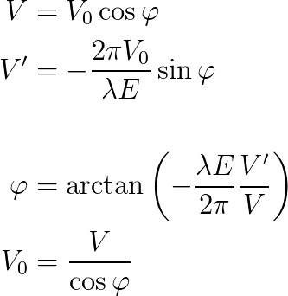
Sum Voltage Multiknobs II
Problem:
The energy gain and relative chirp generated per linac section can be treated in a similar fashion as the ACC1/39 problem
RF amplitude V₀ and phase is
obtained from the ”requested”
V and V’
Similar to the complex method
downstream of ACC39
Solution:

Slide 15
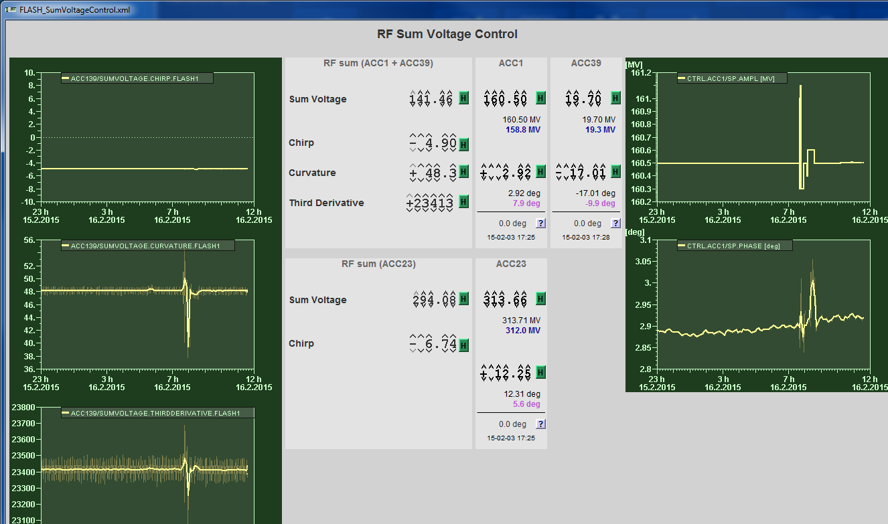
Sum Voltage Control as Doocs Server

Slide 16
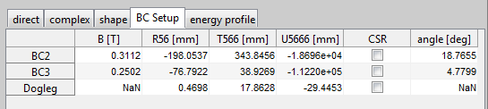
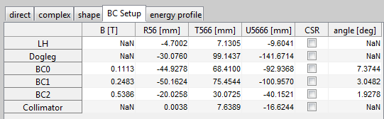
BC Setup
FLASH
Chicanes are either set manually or read from machine
Magnetic field B is adjustable while R₅₆,…, and bending angle are calculated based on the reference energy
Elements as Doglegs or Collimators are not adjustable
Individual CSR toggle per section
Example: switching CSR on for FLASH BC3 increases tracking time from 5s to about a minute
XFEL

Slide 17
Input Particle Distributions
ASTRA dumps downstream of ACC1 are accepted as input
Chirp generated by ACC1 is implemented by simple backtracking,
therefore ACC1 settings from ASTRA run are required
The information are either taken from an ASTRA input deck or from an .txt file which needs to be provided
2. Backtracking
1. Input Distribution
ACC1
ACC39
3. Tracking

Slide 18
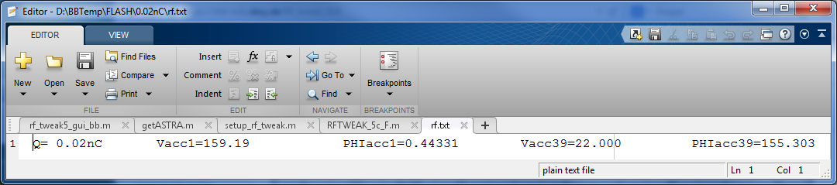
Input Particle Distributions
ASTRA dumps downstream of ACC1 are accepted as input
Chirp generated by ACC1 is implemented by simple backtracking,
therefore ACC1 settings from ASTRA run are required
The information are either taken from an ASTRA input deck or from a .txt file which needs to be provided
2. Backtracking
1. Input Distribution
ACC1
ACC39
3. Tracking

Slide 19
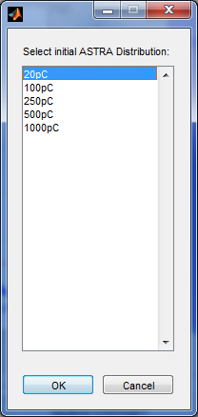
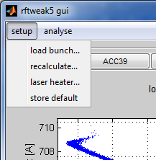
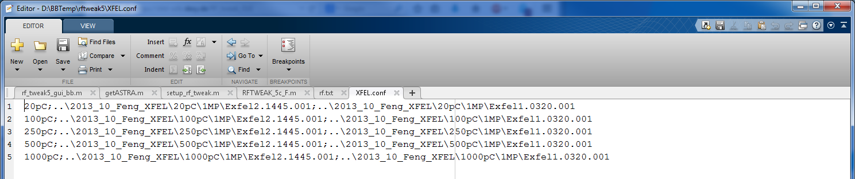
Input Particle Distributions
Input Distributions are selected in a Menu
A list of prepared Input Distributions is
configured in a config file
(‘FLASH.conf’ , ‘XFEL.conf’)
flexible inclusion of new
input distributions

Slide 20
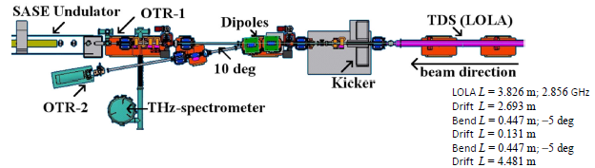
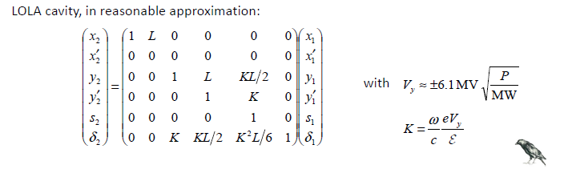
  LOLA
Longitudinal phase space distribution is transported to the LOLA screen with randomised transverse coordinates assuming some constant emittance along the bunch

Slide 21
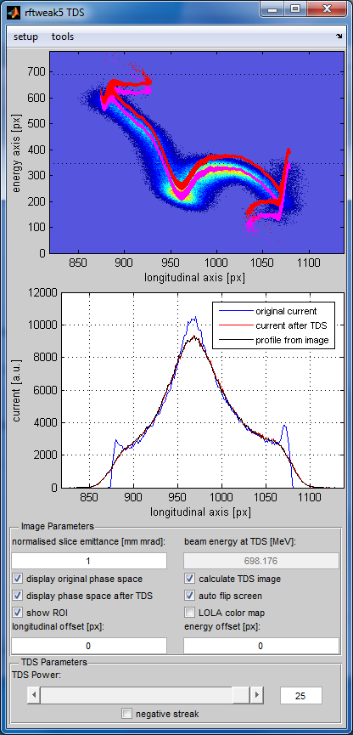
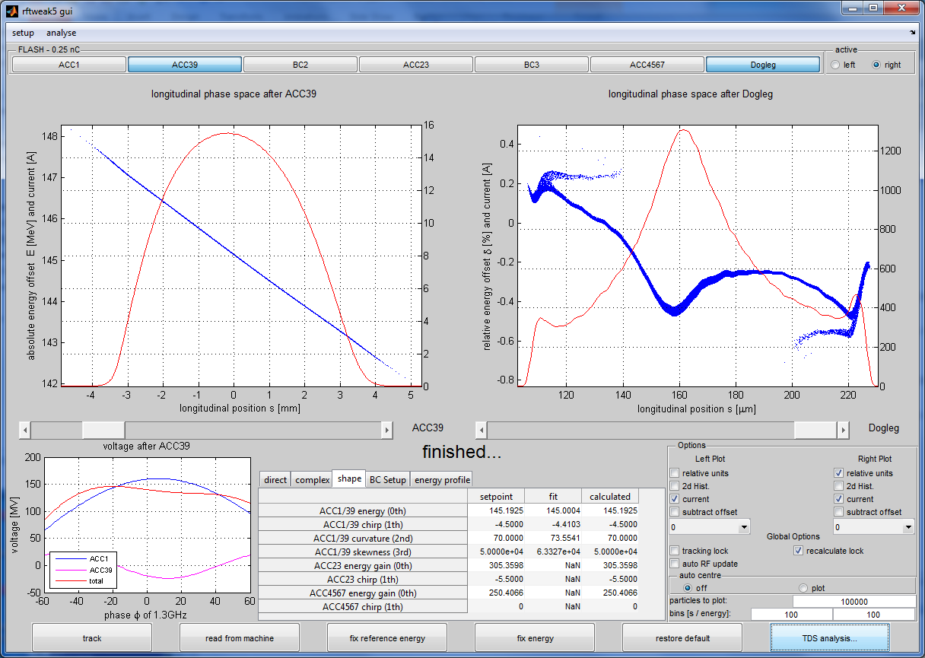
LOLA Simulation
Simulation of LOLA streak in spectrometer
Comparison between ‘real’ and LOLA phase spaces
Real Screen dimensions and resolution
Position offsets and different streak voltage
No transverse wakes implemented yet….

Slide 22
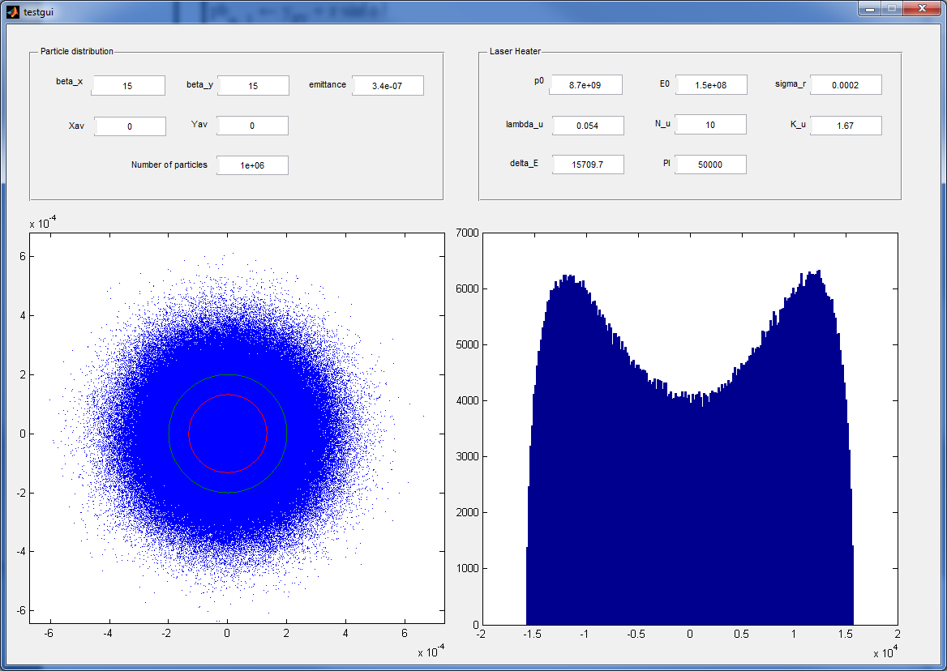
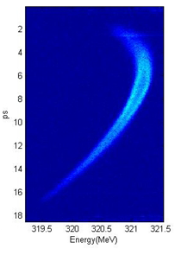
Laser Heater
For XFEL a laser heater element is included
A simple Gaussian heating can be replaced by a ‘proper’ spectrum based on transverse electron and laser beam dimensions
Simone Spampanati et. al.,
COMMISIONING OF THE FERMI@ELETTRA LASER HEATER,
Proceedings of FEL2012, Nara, Japan

Slide 23
Demo….

Slide 24
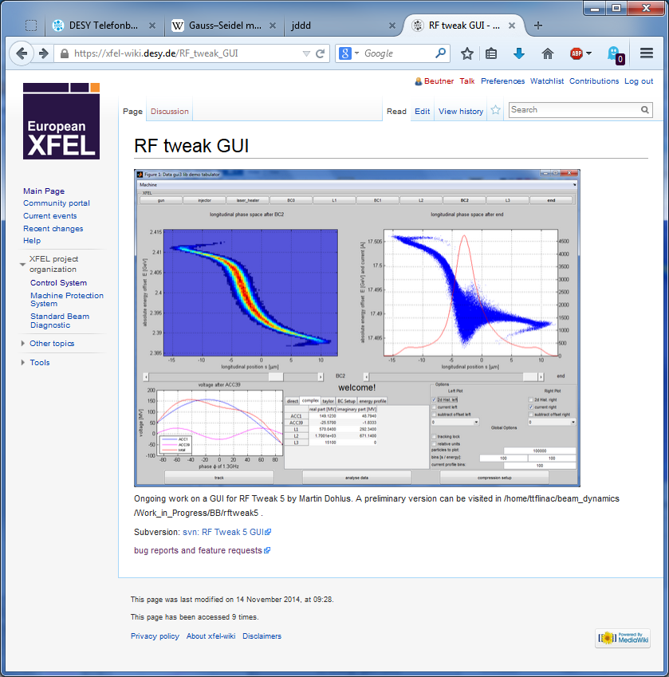
Wiki / Bug reports and feedback
https://xfel-wiki.desy.de/RF_tweak_GUI

Slide 25
Summary and Outlook
An efficient longitudinal tracking code for control room use was developed
CSR, wakes, LSpCh, and Laser Heater are included
LOLA images can be generated for the simulated results
Next Steps:
Include further longitudinal Diagnostics like Compression monitors
FLASH 2
GUI cleanup
Testing and comparison with beam real beam…
(no beam time requested yet)

