Slide 1
Time Domain Numerical Method for Resistive Wakefield Calculations of Ultra-Short Bunches
Andranik Tsakanian
TU Darmstadt, TEMF
TEMF – DESY Collaboration Meeting
12 February 2015
TEMF, Darmstadt

Slide 2
Motivation & Requirement on Numerical Method
Example:
X-Ray SASE FELs
Requirements on electron beam
Electron beam emittance
Relative energy spread (typical)
(Overlapping of electron and photon beams in phase space)
(To prevent widening of the spontaneous radiation line)
High peak current
Short bunches
European XFEL
ε_{n} ~ 1.4 μm E ~ 17.5 GeV σ_{b} ~ 25 μm λ_{r} ~ 0.1 nm
The wakefields of short bunches
Emittance growth
Extra induced energy spread
Degradation of FEL process
Requirements on Numerical Method
Wakefield Time Domain 3D Solver
Ultra-short bunches
Long structures
Resistive Walls with Freq. Dep. Conductivity
Surface Roughness & Metal Oxidation Effects
Numerical Method
Dispersion Free
SIBC-TD model
Moving Window
Parallel

Slide 3
Dispersion-Free Numerical Method
Staggered Finite Volume Time Domain Method
Volume Integral Form of Maxwell’s Equations
Time Continuous MGE
No Splitting
Space Discretization
Time Integration
Dispersion-free in longitudinal direction
E. Gjonaj, T. Lau, T. Weiland, Wakefield Computation with the PBCI Code using a Non-Split Finite Volume Method, Proceedings of PAC09, Vancouver, Canada, 2009, pp. 4516-4518

Slide 4
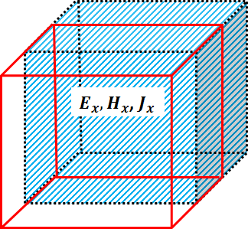
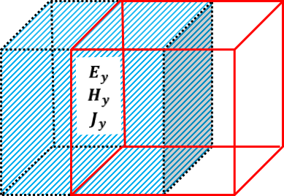
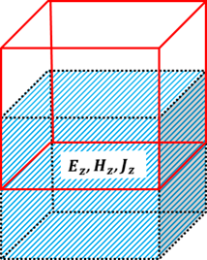


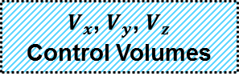







Finite Volume Time Domain Method
Allocations of E&M Field Components on Cartesian Grid
$$V_{x}$$
$$H_{z}$$
$$E_{z}$$
$$E_{x}$$
$$H_{y}$$
$$H_{x}$$
$$E_{y}$$
y
$$V_{y}$$
z
x
$V_{x}$, $V_{y}$, $V_{z}$
Control Volumes
$$V_{z}$$

Slide 5
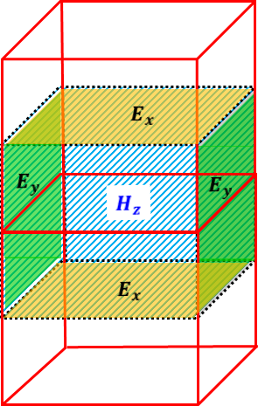









Finite Volume Time Domain Method
Faraday’s Law
$$E_{x}$$
$$E_{y}$$
4-Point Derivative Stencil
$$E_{y}$$
$$E_{x}$$
$$E_{y}$$
$$E_{x}$$
$$E_{x}$$
$$E_{y}$$
y
z
x

Slide 6
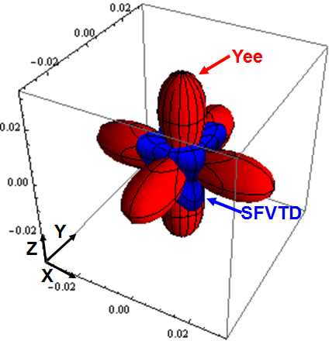
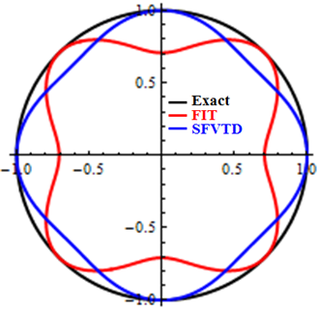

Dispersion Properties of Numerical Methods
Numerical phase velocity error vs propagation direction
Numerical phase velocity vs propagation direction
3D – Δ=λ/5
2D – Δ=λ/2
Stability Limits
$$\frac{{max⁡(∆V}_{Yee})}{max⁡({∆V}_{FVM})}>1,7$$

Slide 7
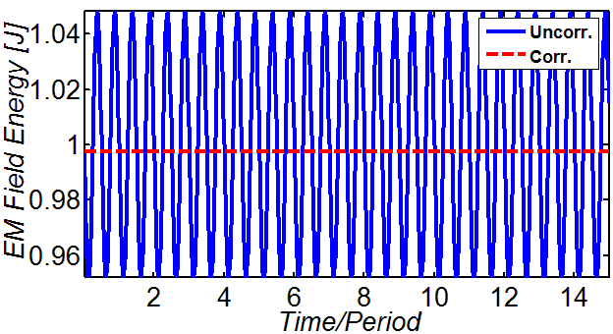
Numerical Field Energy
Numerical EM Field Energy
Cube Cavity
l=0.1 mm
Correction term
Mode -TM₂₁₁, f~3.5 THz

Slide 8
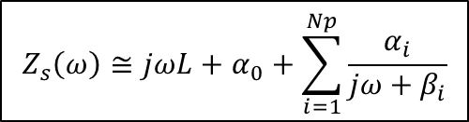

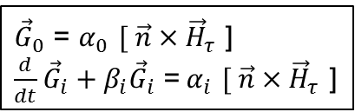
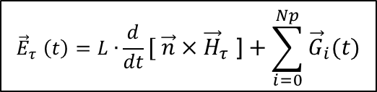
SIBC Time Domain Model
SIBC in Frequency Domain
SIBC in Time Domain
Transformation to TD
$${\vec{E}}_{τ} \left(t\right)=L∙\frac{d}{dt}{[ \vec{n}×\vec{H}}_{τ}\text{ ]}+\sum_{i=0}^{Np}{{\vec{G}}_{i}(t)}$$
${\vec{E}}_{τ}$ $\left(ω\right)$=${Z_{s}\left(ω\right) [\vec{ n}×\vec{H}}_{τ}\left(ω\right)$]
$$Z_{s}^{}\left(ω\right)≅jωL+α_{0}+\sum_{i=1}^{Np}{\frac{α_{i}}{jω+β_{i}}}$$
Auxiliary Differential Equations (ADE)
${\vec{G}}_{0}$ = $α_{0}$ ${[ \vec{n}×\vec{H}}_{τ}$ ]
$\frac{d}{dt}{\vec{G}}_{i}+β_{i}{\vec{G}}_{i}$ =${ α}_{i}$ ${[ \vec{n}×\vec{H}}_{τ}$ ]
Rational Function Approximation (RFA)
B. Gustavsen, Improving the pole relocating properties of vector fitting, IEEE Trans. on Power Delivery, vol. 21, pp. 1587–1592, 2006
J. Woyna, E. Gjonaj, and T. Weiland, Broadband surface impedance boundary conditions for higher order time domain discontinuous galerkin method, COMPEL, vol. 33, no. 4, pp. 1082–1096, 2014.

Slide 9
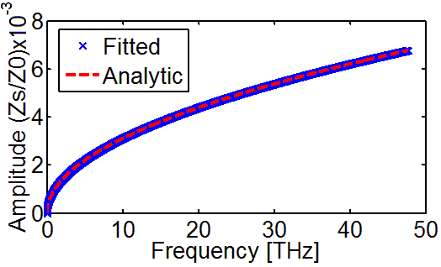
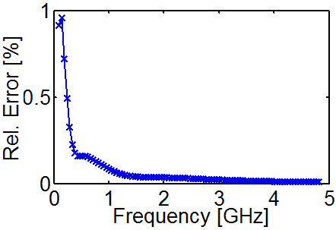
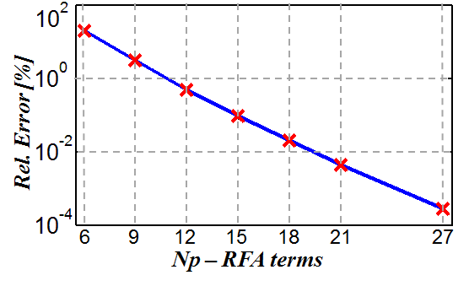
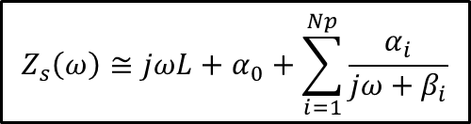
SIBC Time Domain Model
Accuracy of Vector-Fitting technique
Good Conductors
VF
$$Z_{s}^{}\left(ω\right)≅jωL+α_{0}+\sum_{i=1}^{Np}{\frac{α_{i}}{jω+β_{i}}}$$
Example : Cu – Np=21, Frequency range ~ 100MHz-50THz, Δf~50MHz
Sensitivity on RFA terms
Cu , f ~ 10GHz

Slide 10
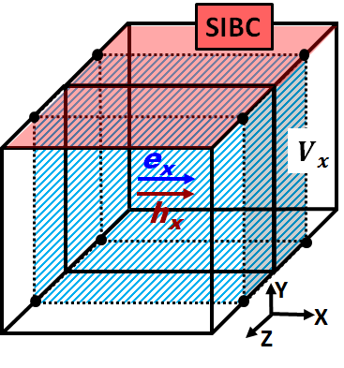
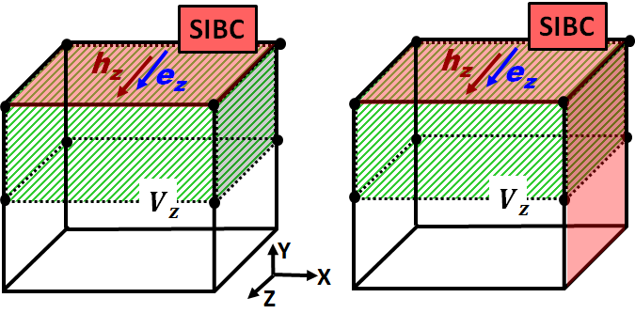
SFVTD Method with SIBC-TD
Boundary Cells with SIBC Surfaces
Case I
Case II
Case III
Control volumes (shaded) at SIBC boundaries (red) and associated DoFs with respect to a cell volume of primary grid (black).

Slide 11
SFVTD Method with SIBC-TD
Semi-Discrete ADE Formulation in Time Continuous MGE with SIBC
Time Integration
Faraday’s Law with SIBC - TD
Semi-Analytic
Semi-Implicit
Ampere’s Law with PEC
Mass Matrix at the Boundary

Slide 12
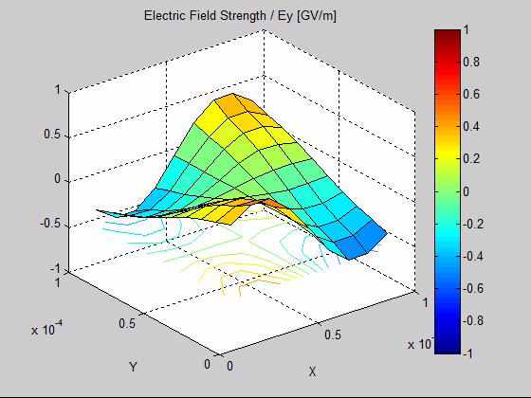
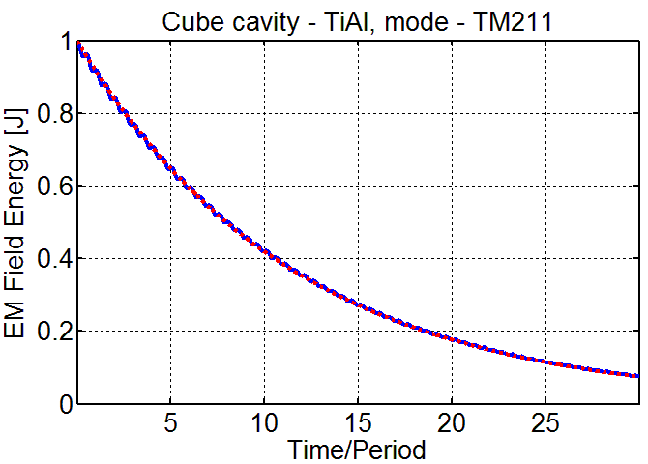
Numerical Example
Cube Cavity
l=0.1 mm
Np=21
P-Loss Method
Numerical

Slide 13
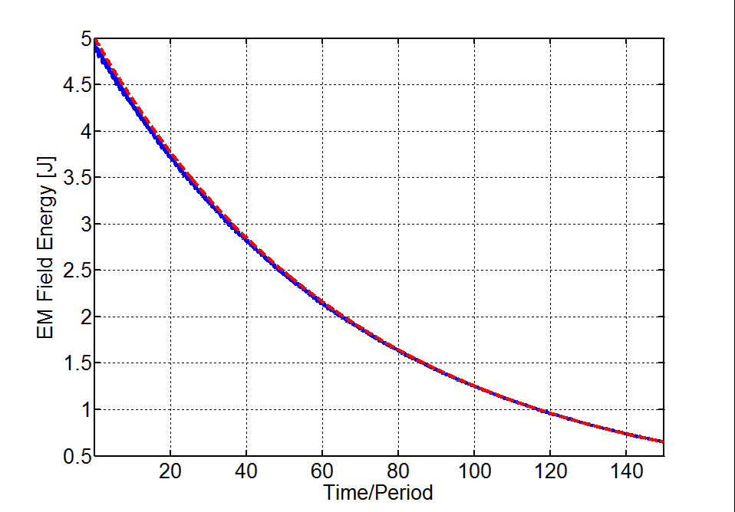
Numerical Example
Multi-Mode Example
Cube Cavity
l=1 cm
Mode | Frequency [GHz] | Filling Time c τ [m]
TM₁₁₁ | 25.9628 | 1.1202
TM₂₁₁ | 36.7169 | 0.9420
TM₃₁₁ | 49.7150 | 0.8095
TM₄₁₁ | 63.5956 | 0.7157
TM₅₁₁ | 77.8884 | 0.6468
Np=21
P-Loss Method
Numerical

Slide 14
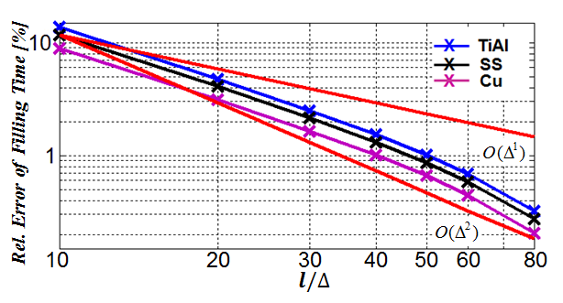
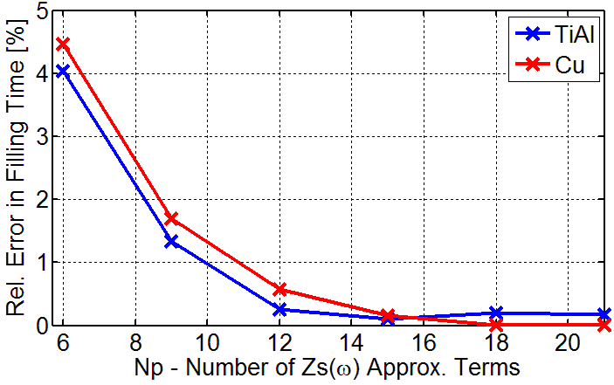
Convergence of the Scheme
Cube Cavity
l=0.1 mm
Reference Solution
Fine Mesh - l/Δ = 120
Np=21
Fixed Mesh - l/Δ = 60
Rel. Error of Filling Time [%]
Reference Solution
Np=27

Slide 15
Current Status & Further Steps
Summary
Time Domain SIBC model & RFA Accuracy
SIBC-TD Implementation in 3D SFVTD
Stability & Convergence Tests
Accuracy test on SIBC-RFA Terms
Further Steps
Implementation of SFVTD Method with PEC-BC in PBCI
  Moving Window
  Parallel
Add SIBC-TD model in PBCI
  Comparison with Analytics & Numerical Codes
Resistive Wakes Calculations for Real Cases
Thank You for Your Attention!

