Slide 1
Recent Progress on LLRF Developments at FLASH
Christian Schmidt
for the LLRF team
FLASH Seminar
2014/11/25

Slide 2
Overview
The LLRF system at FLASH
  Overview and structuring
  Performance evaluation
  Downtime statistics
Identified issues and solutions
  Phase jumps (sudden) and after system restarts
  Piezo failure, conclusions and recovering operation
Long term stability
  RF measurement in case of environmental changes
  Drift compensation module
Examples from special measurement setups
  Operation with XFEL conditions
  Multi beamline support (FLASH2)
Next steps
  RF Gun operation using MTCA.4 based LLRF system
Conclusion

Slide 3
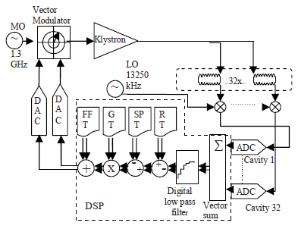
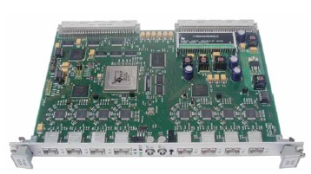
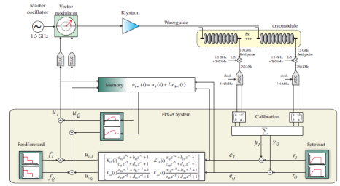
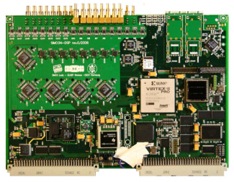
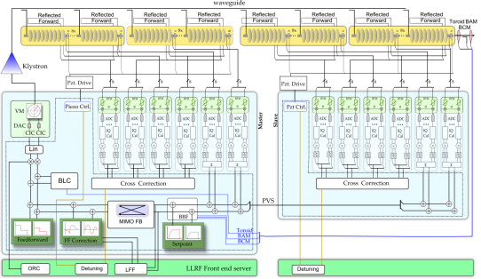
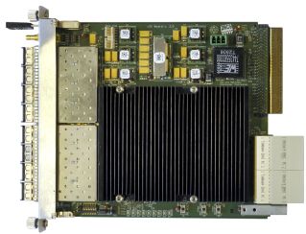
Evaluation of digital LLRF@DESY
DSP based LLRF → monitoring system
  Basic controller functionality
  Feedback and feed forward drive
  Main digital VS feedback concept
VME based LLRF → backup system
  Integration complex controller structure
  Beam based feedback system
  Restructuring server + firmware layout
Switching to MTCA.4
  Layout change (ADC + main controller)
  September 2011 → test setup ACC1
  Permanent FLASH operation since Aug. 2013
  Implementation of all commissioned software components from SIMCON
Known procedures, new features

Slide 4
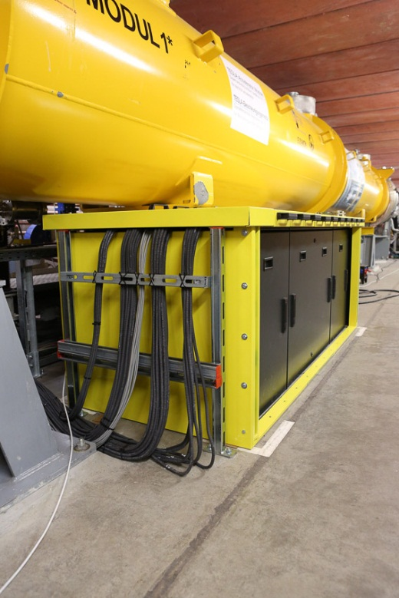
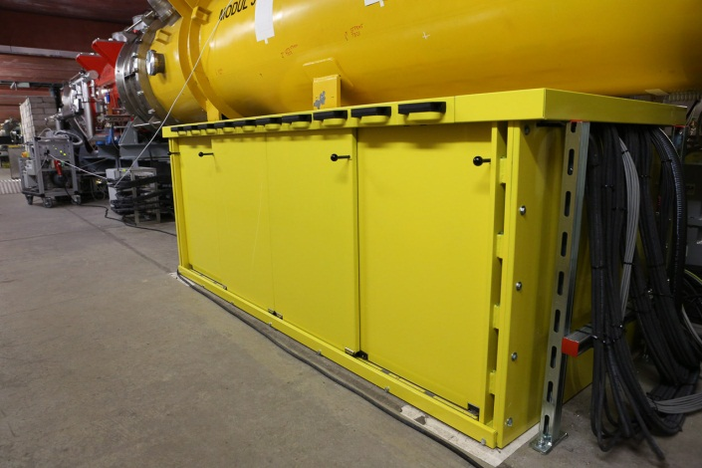
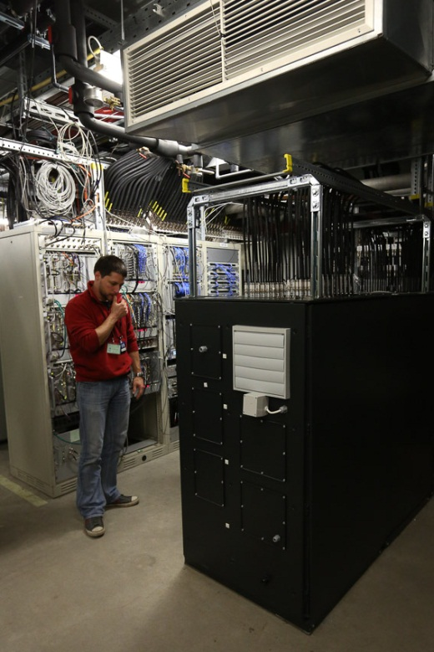
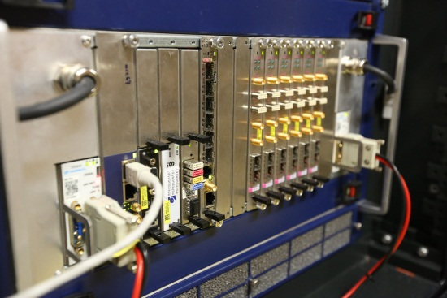
MTCA LLRF Installations at FLASH
ACC7
ACC6
ACC5
ACC4
ACC3
ACC2
ACC39
ACC1
GUN
ACC23
1-39-Gun
ACC67
ACC45
Hall 3 Annex

Slide 5
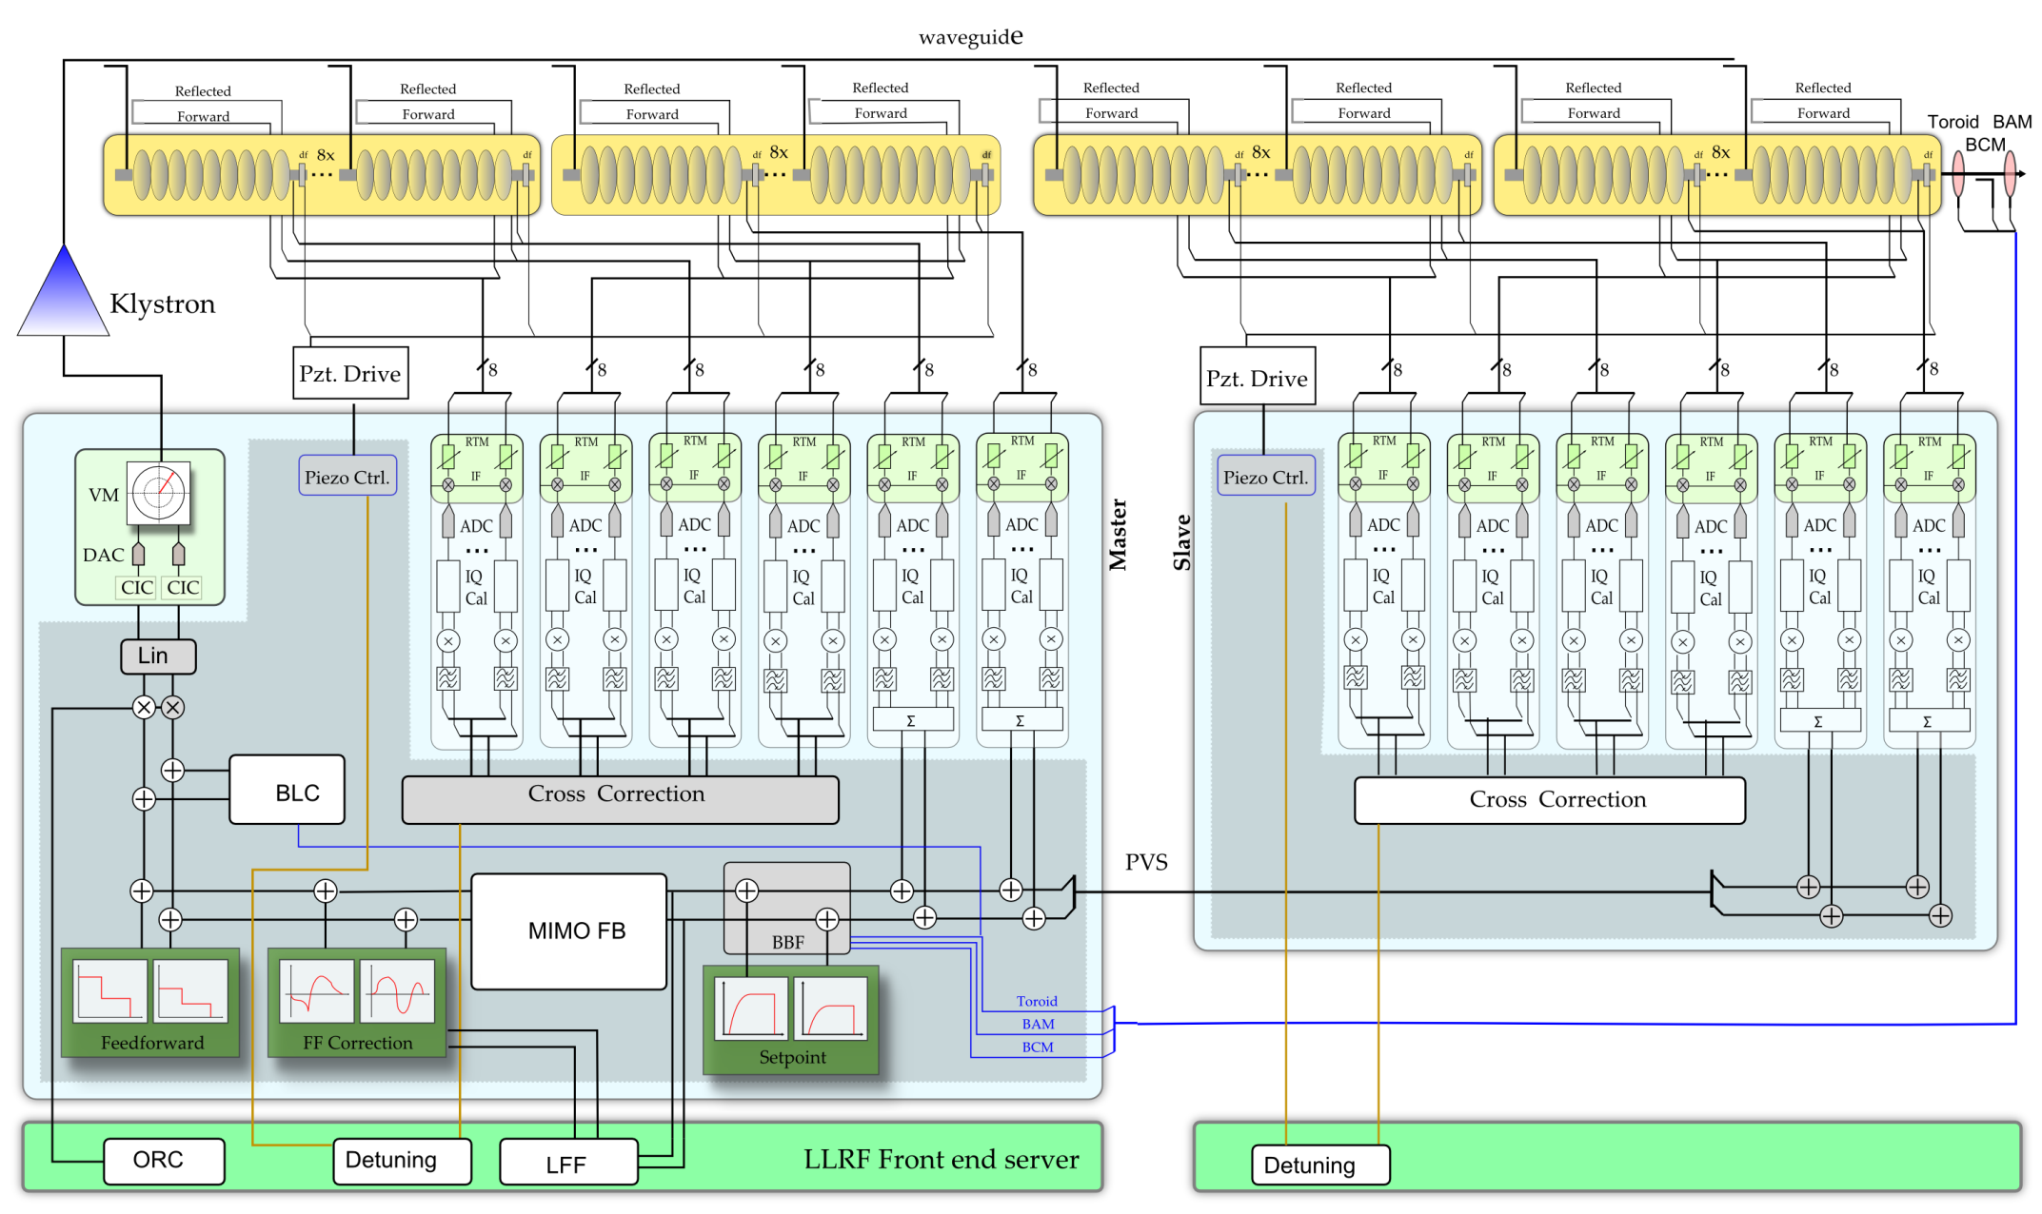
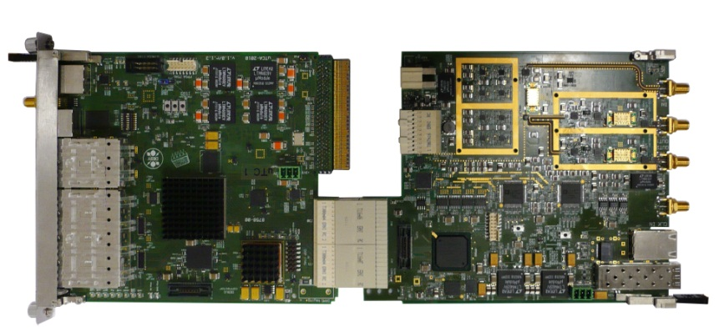
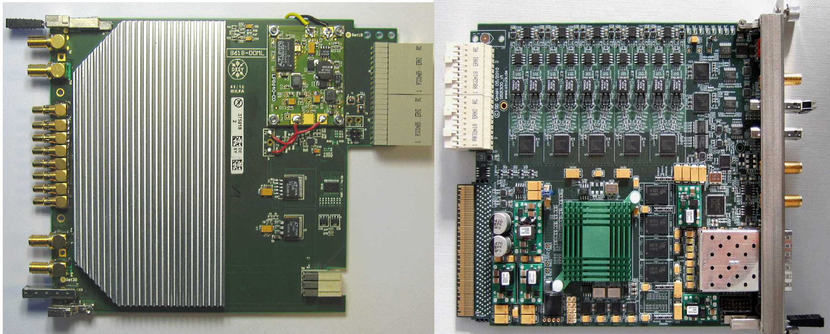
LLRF control loop
Vector Modulator (uVM)
LLRF Controller (uTC)
Down Converter (DWC)
Digitizer (uDAQ)

Slide 6
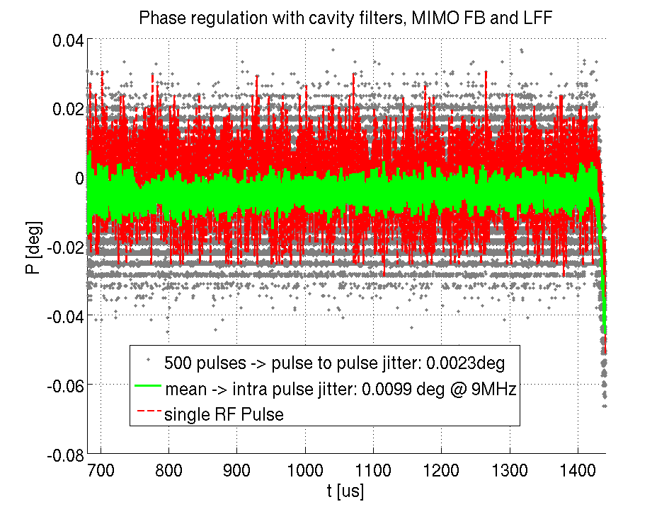
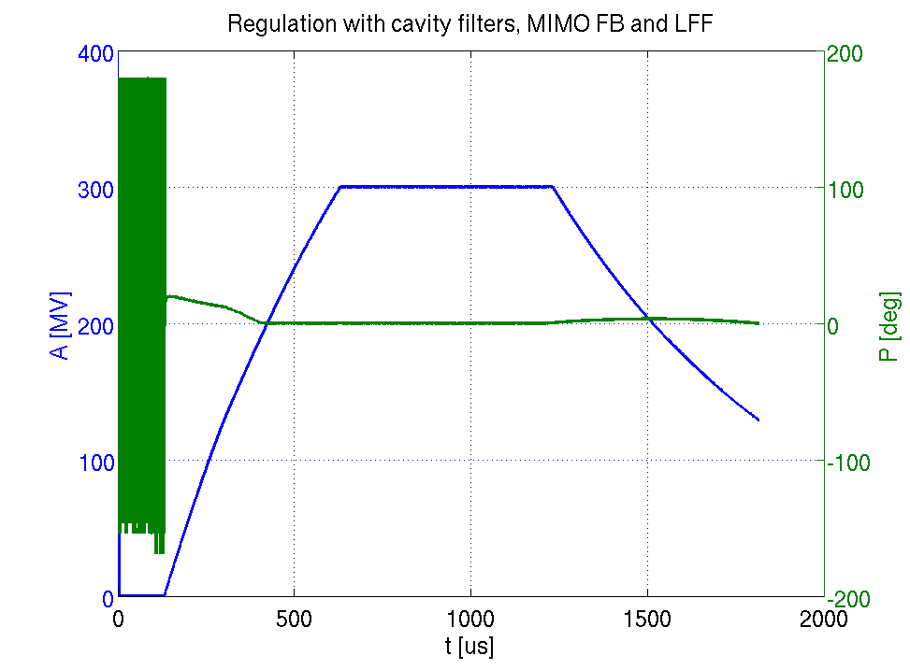
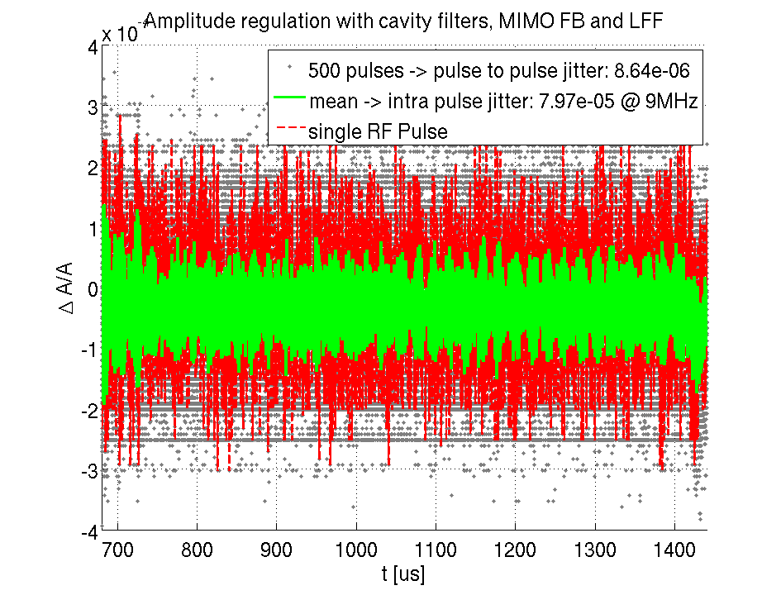
RF stability measurement results (in-loop regulation)
Stability (rms) @ 9MHz | ACC1 | ACC39 | ACC23 | ACC45 | ACC67
Ampl. Intra pulse [%] | 0.0067 | 0.0266 | 0.0055 | 0.0079 | 0.0069
Ampl. pulse to pulse [%] | 0.0017 | 0.0053 | 0.0012 | 0.0009 | 0.0019
Phase Intra pulse [deg] | 0.0100 | 0.0233 | 0.0074 | 0.0099 | 0.0089
Phase pulse to pulse [deg] | 0.0028 | 0.0108 | 0.0017 | 0.0023 | 0.0031
Goal: < 0.01% in amplitude and < 0.01deg in phase

Slide 7
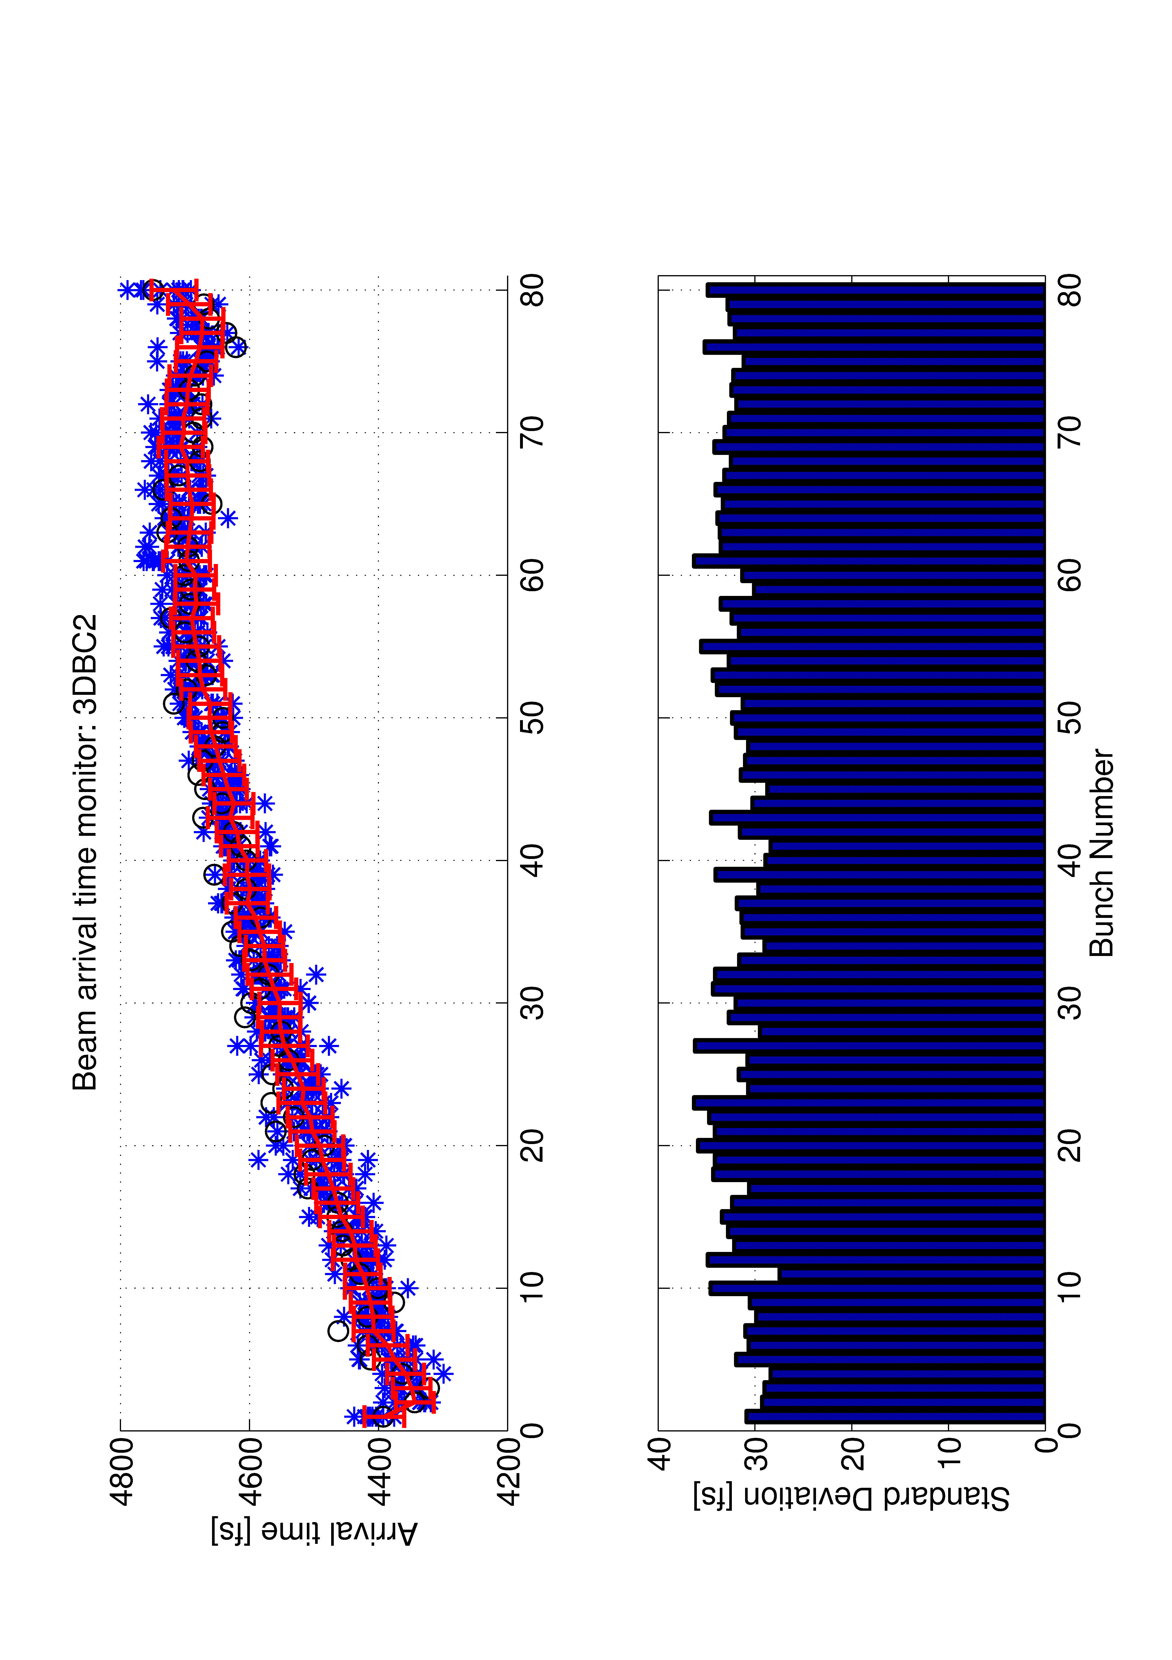
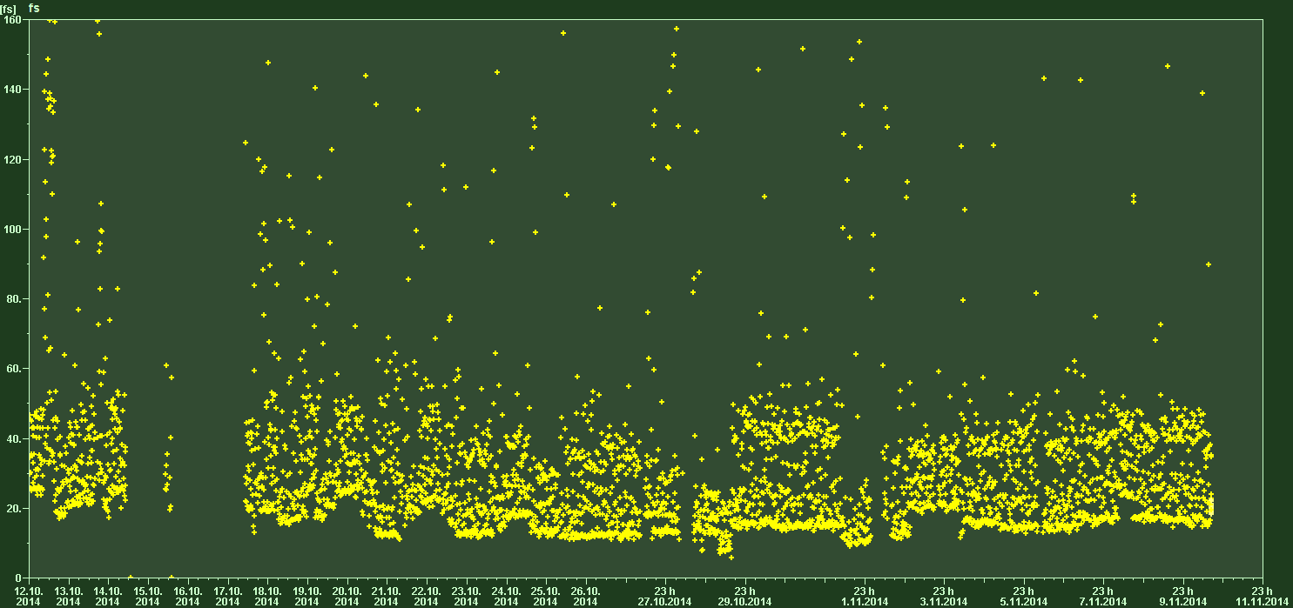
Performance measurement with BAM (3DBC2)
1 week
30 fs

Slide 8
Operation statistics since week 35 / for 2013
Firmware
  Jumping phases after initialization
  LLL communication lost
Operation
  Setting undesired values
  Rebooting wrong system MCH
Automation
  Malfunction of routines
  Limiter adjustments
Infrastructure
  Loosing Ethernet connection
  Inter crate communication
Server
  Crashes or malfunction

Slide 9
Internal LLRF downtime statistic for 2014 (till now)
Biggest issue was ACC39
  DWC failure (Hardware)

Slide 10
Review of the system issues
Started operating SC modules in 2013 summer
  Couple of quenches → cavity limiters did not work as expected
  Coupler interlocks → firmware malfunction, algorithm divergence
  Operational aspects → reboot with issues (crate management)
Switched back to VME system 3 times (in total)
  To minimize downtimes, will keep this backup system running
Network communication issues
  Upgraded Ethernet structure → DAQ system running now
Often observed after system restart 240deg phase jumps
  Synchronisation of the internal FIFO counter (firmware)
CPU hangs due to DMA read errors
  Firmware synchronisation issue, kills the CPU root complex → bugfix currently under test
Oscillations in regulation often observed
  Combination of Output vector correction and detuned cavities (OVC bug found, piezo automation)

Slide 11
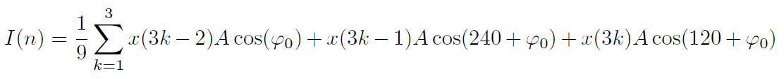
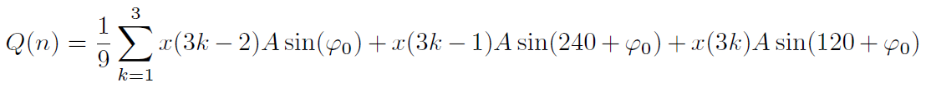
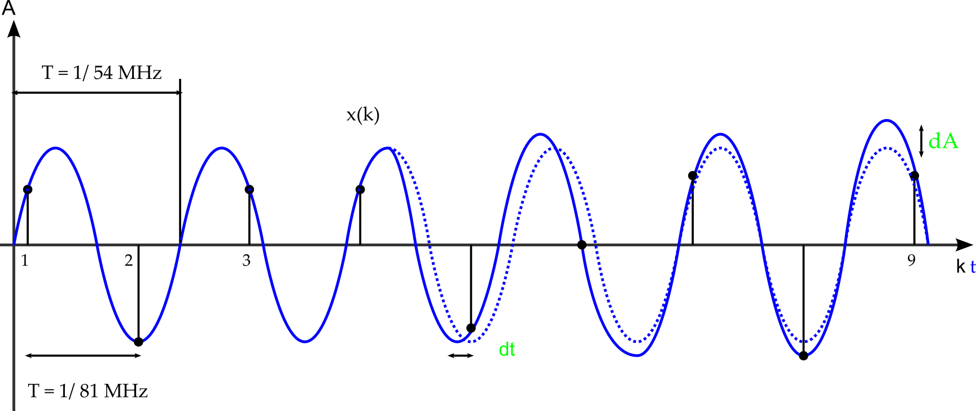
LLRF digitalization and data processing
LO
Clock 81 MHz
IQ detection + calibration + down-sampling
(3)
FIFO
(2)
(4)
RF
IF
I
ADC
Q
(1)
k ➔ 81 MHz
n ➔ 9 MHz
RF signals are down converted to an IF of 54 MHz
ADC sampling with 81 MHz + adjustable delay in steps of 1/81MHz
IQ detection and averaging over 9 sampling points
Further data processing with 9MHz

Slide 12
Procedure for system upgrade / test
Hardware design → internal tests and performance check
Implementation at FLASH test stand (injector hutch)
  Complete MTCA system is installed
  System is also used as a hot spare
  Usage of real cavity signals from ACC1 (split to 16 cavities)
  System can also be used as driving source for ACC1 for special tests
  Further out of loop performance measurements can be made
Software / Firmware development takes place here
  Same procedure as for hardware installation
If tests are passed → Integration and commissioning at FLASH

Slide 13
Piezo failure and conclusion
Incident which broke two Piezo’s at ACC67
Communication error between Piezo driver box and controller during Firmware upgrade
  Lead to fast switching of the driver → Overheating in box and piezo
  Thermal damage
Immediately stopped Piezo operation for investigation
  Identified error, corrected and build in additional security mechanism
Continue operation, starting with ACC3
As soon as allowed, other stations will follow
Automatic fine tuning of the cavities

Slide 14
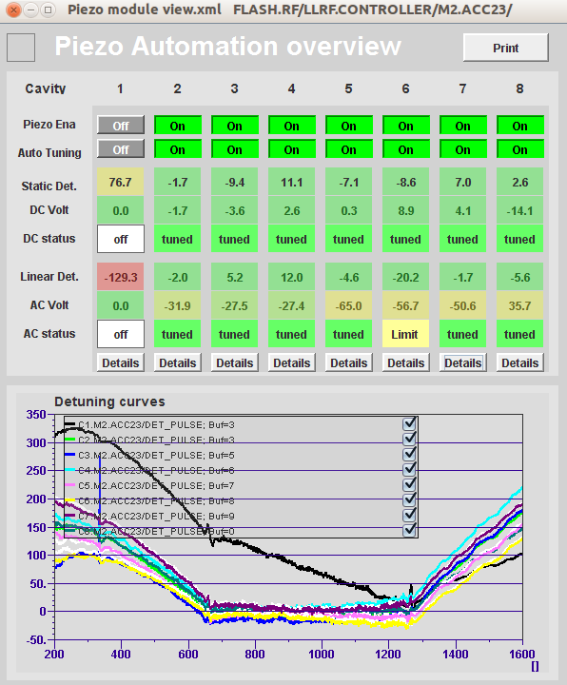
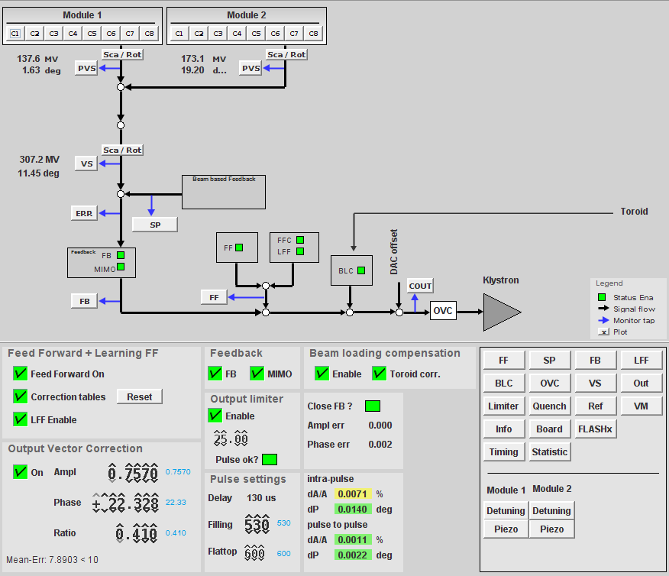
Piezo control and automation
Online detuning computation
Currently on server level
Should be done in firmware later
→ Next: piezo relaxation (cav. tuner)

Slide 15
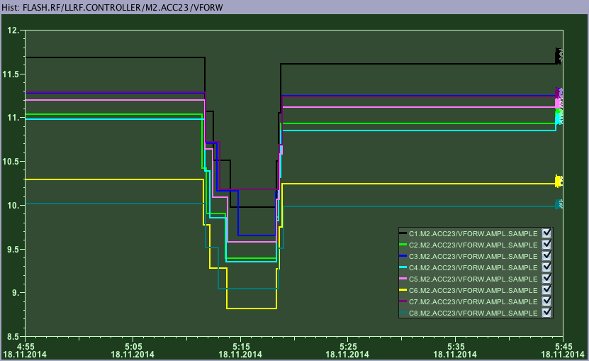
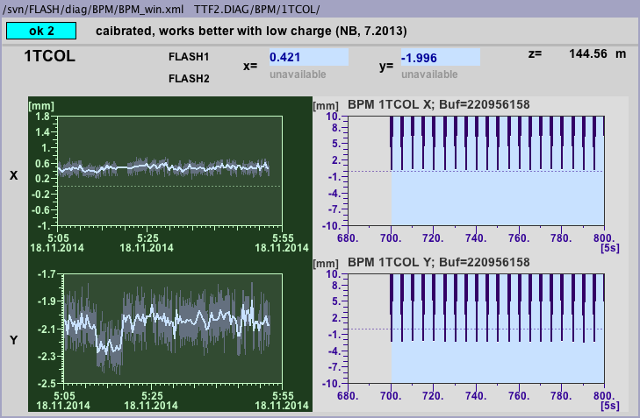
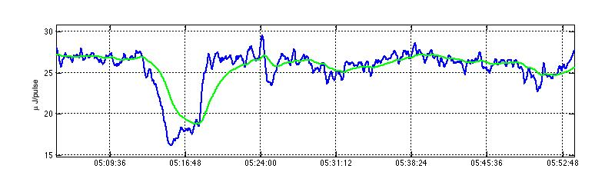
Impact of piezo activation during operation
1. Piezo activation → reduced detuning → less forward power
Forward Power
2. Strong impact on vertical orbit (reduced kicks from input coupler ? )
To be further investigated
Systematic scan needed

Slide 16

Long term stability and drifts
Known that the stability (long term) of the field detector is part of the machine reproducibility
  LLRF contributes → On-crest phase changes (assuming Laser arrival time is stable)
Temporal measurement setup to monitor environmental changes inside rack
  Tracking the reference frequency → stable source
  Outer rack errors are common mode → not detected
Ref. 1.3 GHz
LOGM
X
ADC
$$ΔA , ΔP$$
LO. 1.3GHz + 54 MHz
Inside crate
T, % RH
RF measurement setup

Slide 17
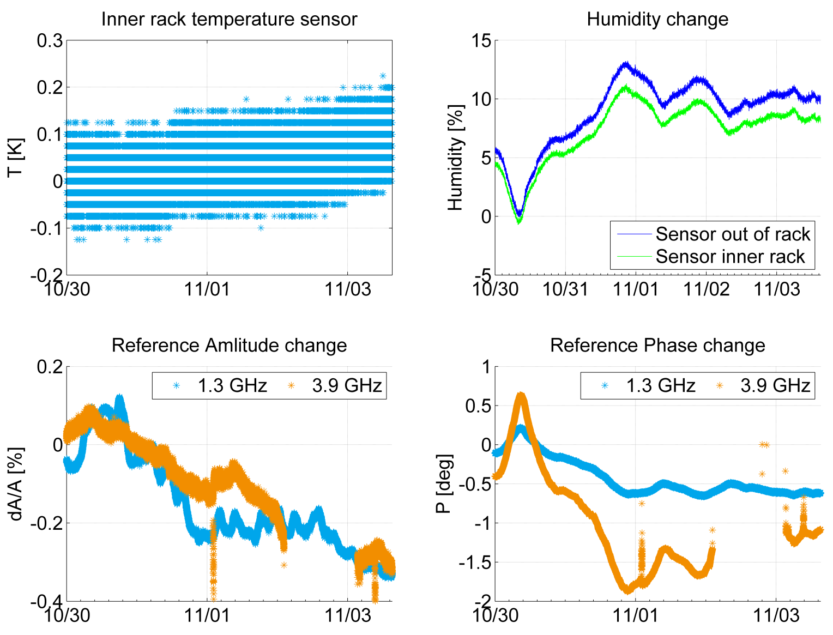
Reference tracking – long term measurement
ACC39 board failure
1.3 → 0.06 deg / %
3.9 → 0.18 deg / %

Slide 18
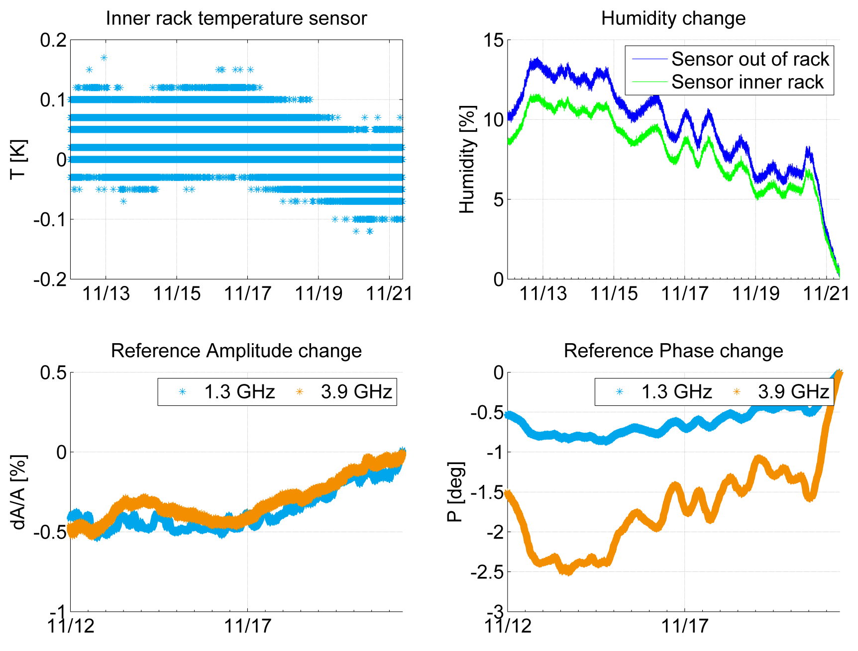
Reference tracking – long term measurement

Slide 19
Lesson learned
Even with very good temperature stabilization, long term drifts are dominated by humidity effects
  Requires compensation techniques (active, passive)
  Drift compensation module → next slide
When running slow RF feedback it should act on:
  Combination of ACC1 and ACC39 (about a factor of 3 difference)
  If one system only, operator must tune the other accordingly
Good and expected explanation for on-crest phase changes
  Reference monitoring gives a good indication how much the system has changes
  Does not include other factors like laser arrival time, arrival time in BC3 (dE in BC2)
Need to measure this also for ACC23, expect same result

Slide 20
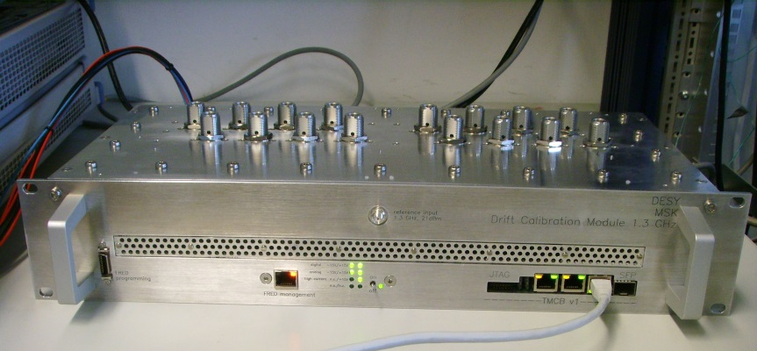
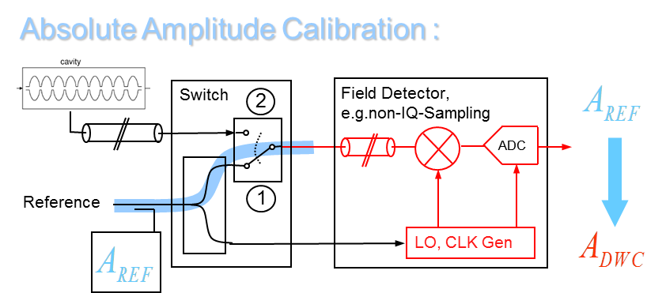
Drift compensation module (DCM)
Planned installation soon for ACC1
  Most sensitive system for FLASH operation
  Requires recalibration of the system
Benefit
  Reduced susceptibility to environmental changes
  Calibration of the detection chain, no calibration in between pickup and DCM box!
Risk
  Failure of the fast switches would compromise the RF field measurement
  Consequence: Regulation does not work, cavity max gradient limiters are not working properly
  Limitation is given from the driving chain only
Prototype → tested at FLASH LLRF teststand
A
Cavity „Flattop“
1
2
t
Beam pause

Slide 21
Measurements on XFEL conditions
Timing structure
  T (fill) = 750 us, t (flattop) = 550us (limited here due to klystron intended →600us)
Change of Ql -> study control performance of the system
  4e6 to fit to adapted filling time → reduced peak power
  Auto setup of QLs worked fine → AMTF development server
Will have to continue this topic:
  Need Piezo running for the test → not possible last time
  Require controller adaptation to new system dynamics (bandwidth change)
  Subsequent adjustment of beam loading compensation modules
  Require higher beam loading → more bunches, higher charge

Slide 22
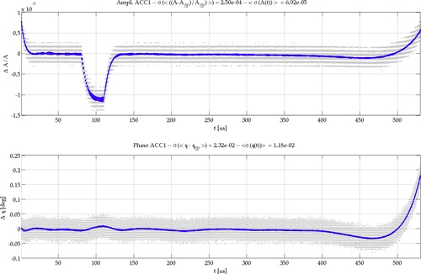
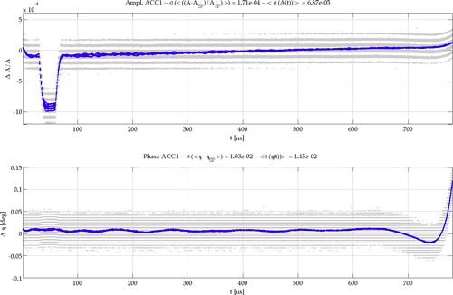
ACC1 operation with XFEL parameters
LLRF parameters adjusted and feedback closed, comparable performance
Recovered SASE within same level as with ACC1 nominal settings (~70uJ, 7.5nm)
RF stability measurement with single and 30 bunches (0.3nC & 0.57nC)
30 bunches, Ql 4.6e6 -> LFF and BLC off
30 bunches, Ql 3e6 -> LFF and BLC off

Slide 23
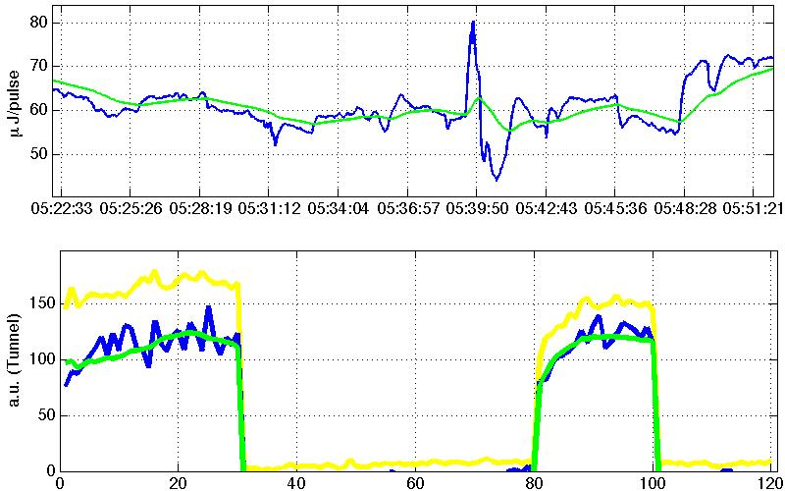
Multi beam line mode of operation (FLASH2)
Setup of LLRF flattop for two different modes
  RF amplitude and phase change within pulse (simultaneously)
  Different beam loading for FLASH1 and FLASH2
  Ability of independent LLRF parameter adjustment for FLASH1 and FLASH2
Implemented support for this operation mode
  Semi-automatic procedure → timing information is distributed from timing system
  Requires also some feedback about maximum variation → transition time
µJ/pulse
bunch number

Slide 24
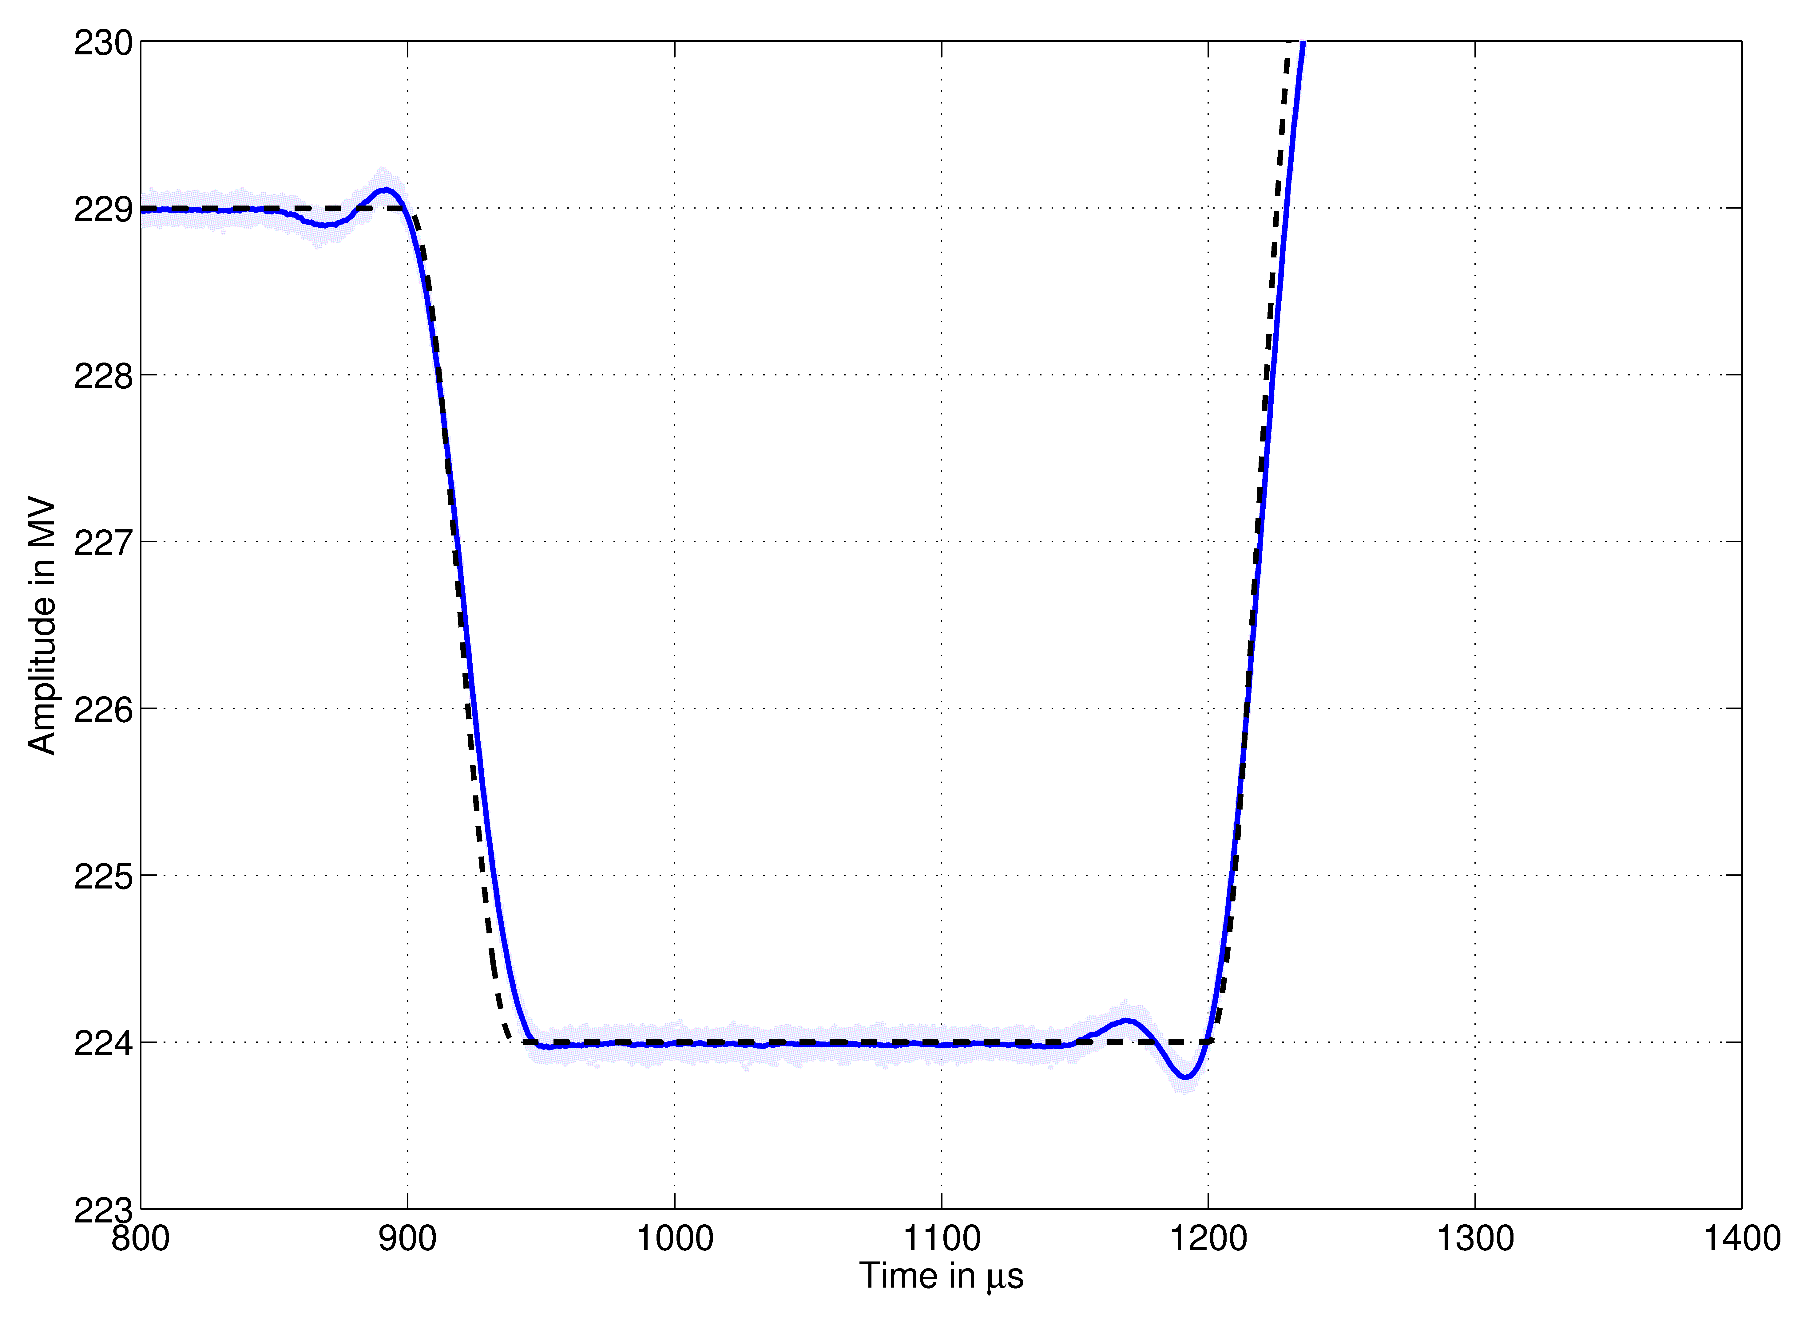
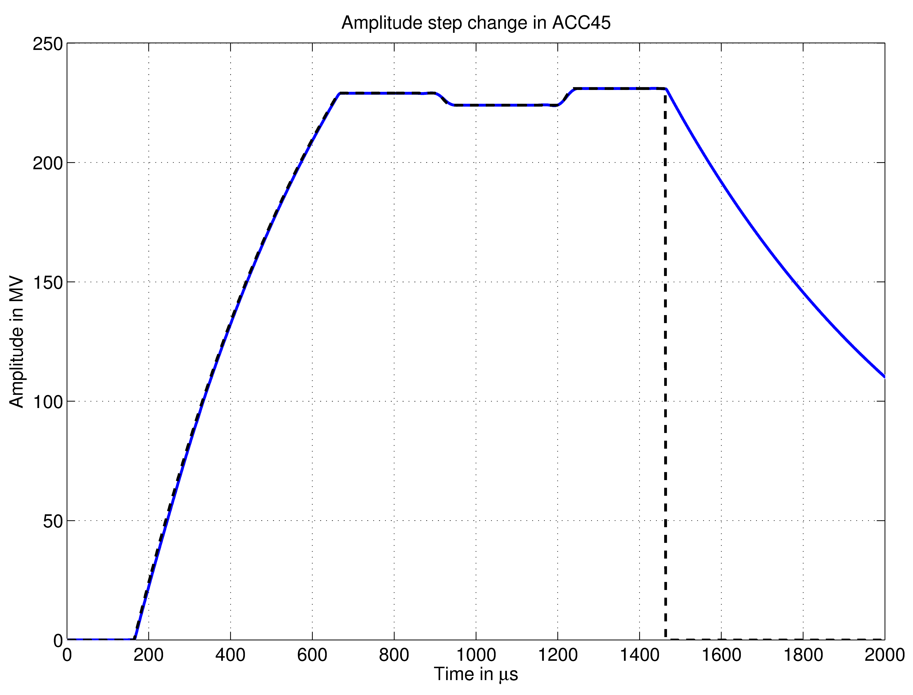
Gradient variation intra-pulse
Typical amplitude variation within one RF pulse
Min e für alle t
only FB (illustration!)
FB
LFF
Transition time is limited by given closed loop bandwidth
  Bigger variation → increased time
  In plot amplitude is shown, for phase same approach
Overshoot at transitions is an effect of regulation concept (LFF + FB)

Slide 25
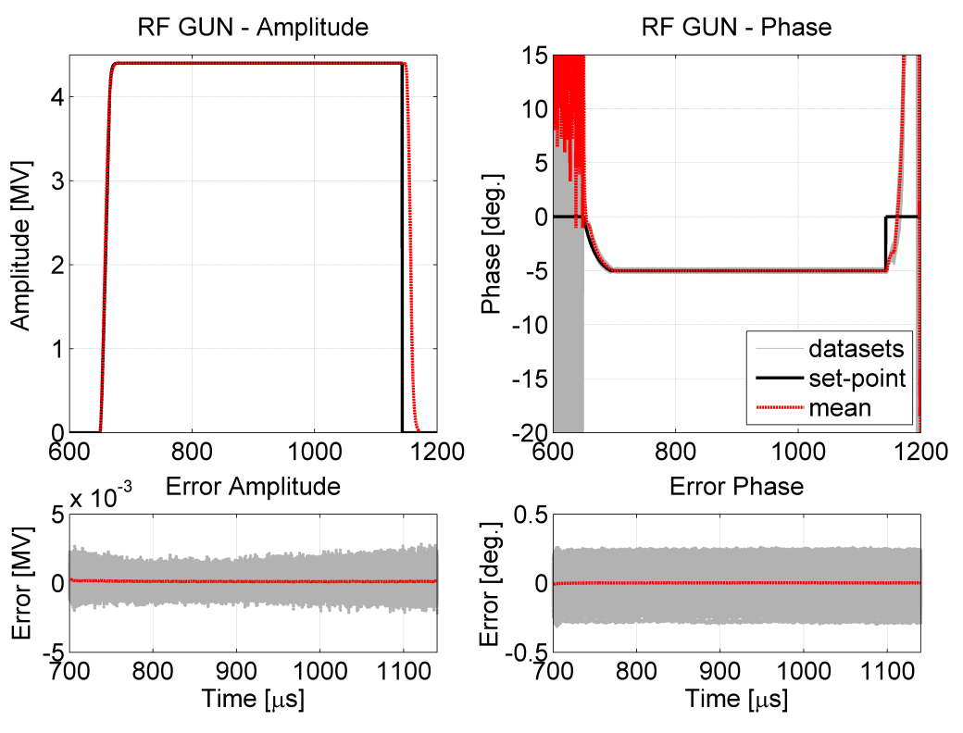
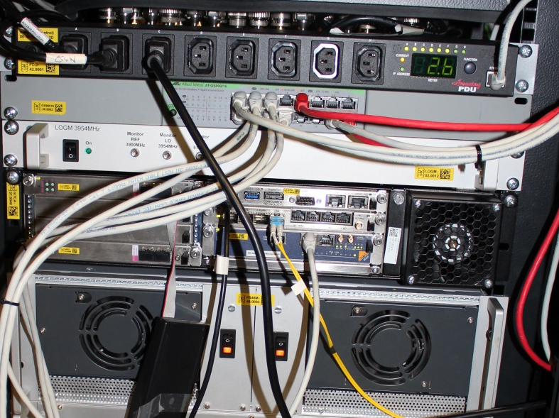
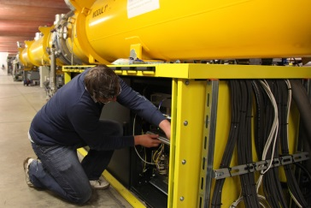
RF GUN regulation using MTCA.4 LLRF
Regulation performance(rms) | Intra pulse (flattop ) | Pulse to pulse (960 consecutive pulses)
Amplitude [%] | 0.008 | 0.008
Phase [deg] | 0.007 | 0.076
Pulse to pulse fluctuation
due to temperature changes
System identification performed (cross validated)
  Found model and designed controller
  Feedback gain not sufficient to achieve dP < 0.01 deg
  large loop latency compared to system bandwidth
Tested additional protection mechanism
Intended to run next friendly user period with this system
Integration in current operation panels/ tuning routines required
Used as a permanent monitoring system
  Additional waveguide pickups
Flash crate installation below Module ACC1

Slide 26
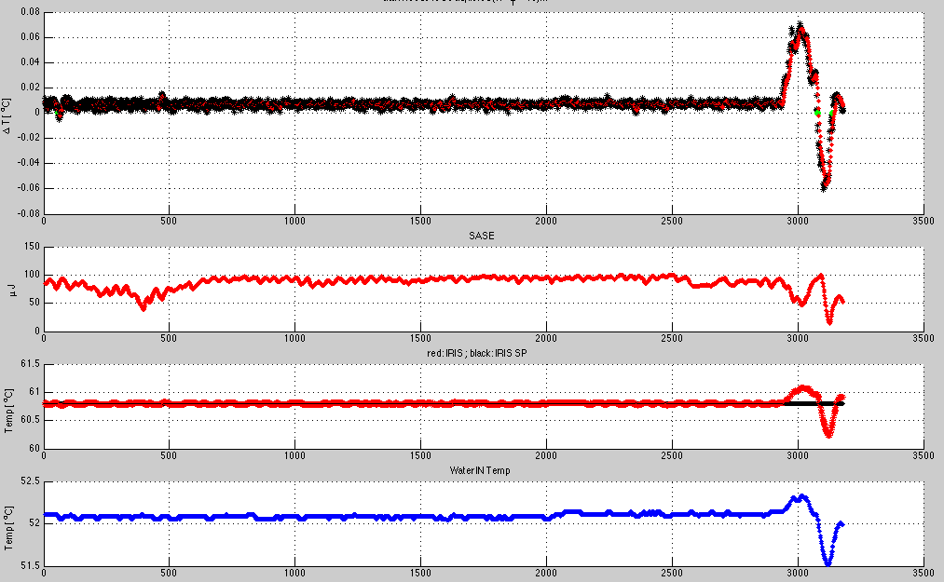

RF dependencies → Impact to other systems
Water regulation (strong coupling to RF performance)
  Detection in cavity detuning → fast compensation by HF pulse length variation
Fast startup using frequency modulation in combination with FSM
  Tools exist, but not used for long time → continue this approach
$ΔT$ (LLRF)
SASE [uJ]
T (Water)
T (Water inlet)

Slide 27
Planned upgrades
DCM installation for ACC1 and ACC23
Upgrade of the main controller card → higher processing power and increased resources
  Implementation of additional software features like corrected forward and reflected readout
  Improved beam loading compensation module
  Beam based feedback integration
  Online firmware failure detection
Installation of a reference stabilization box (REFM-opt)
  Long term stabilization using the optical synchronization system
Changing of property naming → effects large number of properties
  To be negotiated /communicated with other users of these properties
  As early as possible
Example: FLASH.RF/LLRF.CONTROLLER/C1.M1.ACC1/PROBE.AMPL
→ FLASH.RF/LLRF.CONTROLLER/C1.M1.ACC1/PROBE.AMPL.TD

Slide 28
Conclusion
1.5 years operation of FLASH SC modules with MTCA.4 LLRF system
  Short term performance achieved → Improvement in regulation performance
  System is operating stable (main issues found and bugfixed)
Continue further upgrade of the system
  Software development, further automation routines
  Upgrade of hardware components
  Integration of long term stability improving modules
Next milestone → Switching to RF gun operation with MTCA
  Performance improve expected
  Test have been made also at XFEL gun, operation of PITZ gun
Further reducing LLRF related downtime
Thanks for your attention

