Slide 1
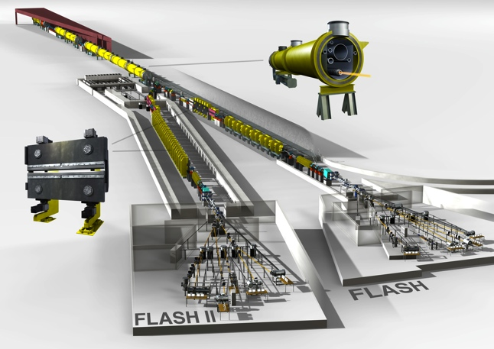
FLASH II.
The results from FLASH II tests
Sven Ackermann
FEL seminar
Hamburg, April 23th, 2013

Slide 2
Motivation for FLASH II.
Generate more photon user beam time by fast switching
Variable gap undulators offer flexible, fast and easy way for wavelength changes largely independent from electron beam energy
Seeding for better photon beam quality

Slide 3
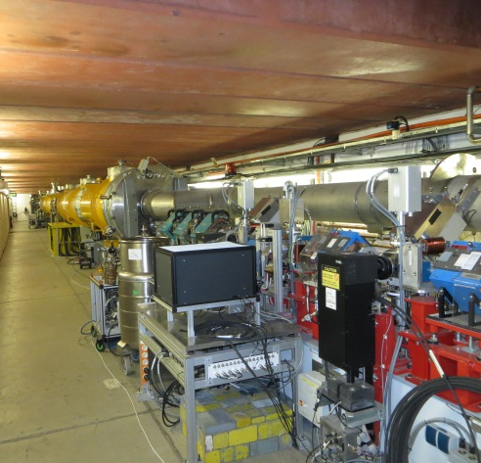
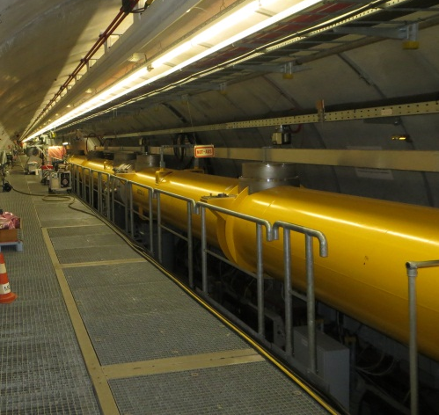
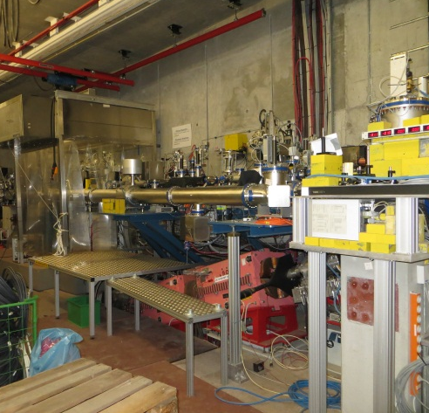
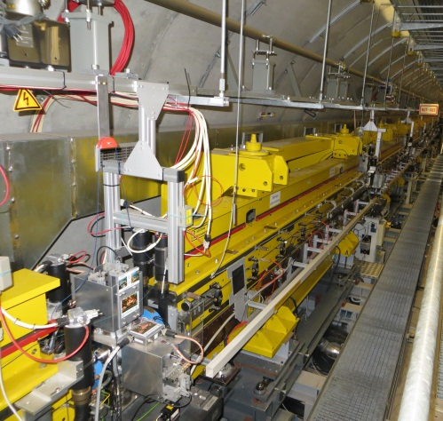
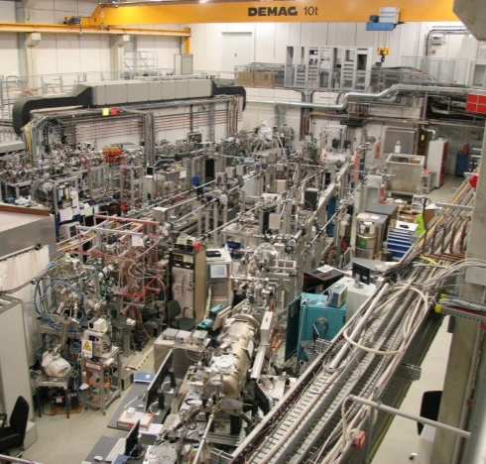
The FLASH facility.

Slide 4
The FLASH II Project.

Slide 5
FLASH II – Parameters.
Electron beam
Beam energy | 450…1250 MeV
Norm. emittance | 1…3 mm mrad
Energy spread | 500 keV
Peak current | 2.5 kA
Bunch charge | 20 … 1000 pC
Bunch spacing | 1 … 25 µs 1 MHz … 40 kHz
Repetition rate | 10 Hz
Undulator | FLASH1 | FLASH2
Period | 27.3 mm | 31.4 mm
Segment length | 4.5 m | 2.5 m
Segments | 6 | 12 (14)
Gap | fixed 12mm | variable min. 9mm
Focusing | FODO | FODO
K-Parameter | 0.9 | <1.95

Slide 6
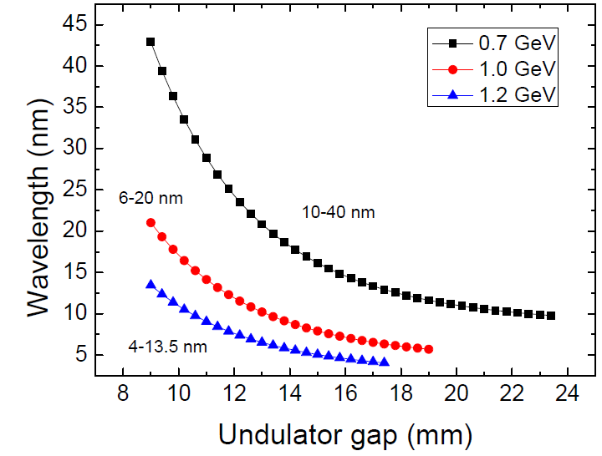
FLASH II – Wavelength tunability.
Electron energy | Wavelength at FLASH1 | Wavelength at FLASH2
0.7 GeV | 12.9 nm | 10 … 40 nm
1.0 GeV | 6.5 nm | 6 … 20 nm
1.2 GeV | 4.1 nm | 4 … 13.5 nm

Slide 7
FLASH II – Timing pattern (example).
FLASH1
500 bunches
1 nC
High compress.
High energy
FLASH2
250 bunches
0.3 nC
Low compress.
Low energy
No RF to modules
RF fililing time
RF change time
RF emptying time
– Bunch charge FLASH1
– Bunch charge FLASH2
– RF signal (e.g. Amplitude)
– Kicker amplitude
500 µs
500 µs
50 µs
250 µs
500 µs
98.2 ms
t
Kicker rise
Kicker flattop
Kicker fall
100 ms 10 Hz

Slide 8
Summary of the tests.
LASER1 and LASER2 are both functional
Different charges, repetition rates and bunch numbers could be generated
LLRF dual flat top tests have been successfull
Both flat tops controllable
Slow FB working (as long as bunch number stays the same)
The LFF was only working for a single flat top.
Using the second flat top the LFF had to be switched off, as it produces harmonics which wont be damped otherwise.
Optics mismatch between the end of ACC7 and „kicker“ have been studied
Simulated gradient changes of 50 MeV in either direction did affect the SASE level by around 10% to 20%.
Increase of losses in the collimator measureable, but acceptable.
Charge dependencies were investigated
The needed changes in the RF parameters fit inside the transistion time window

Slide 9
Test with two bunch trains (2013-01-13)
Adjust both UV injector lasers to the cathode
Get transmission with both lasers
Establish SASE
Change:
Energy
Compression
Charge

Slide 10
Starting with both beams centered on virtual cathode.
LASER 1
LASER 2

Slide 11
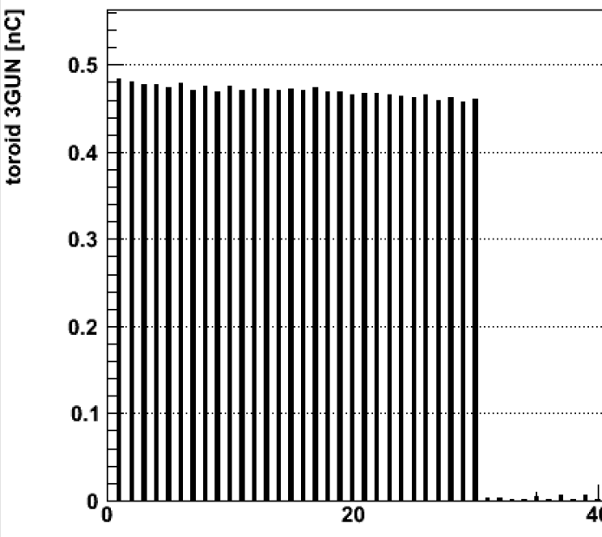
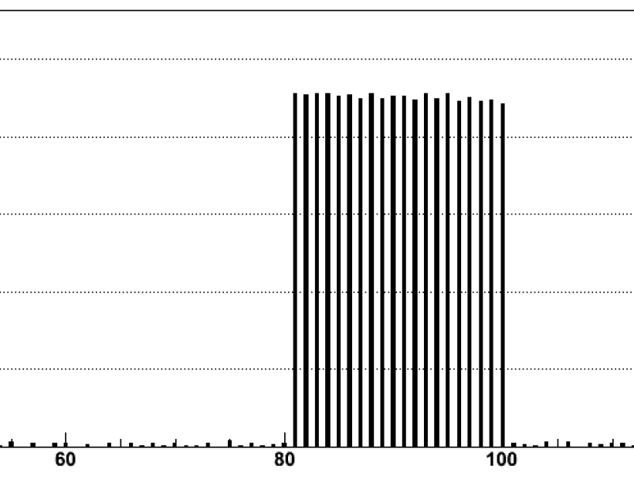
Putting both bunch trains to same bunch charge.
30 bunches
50 µs gap
20 bunches

Slide 12
Same lasing

Slide 13
Different compressions are possible
Same charge!

Slide 14
Different charges – different lasing

Slide 15
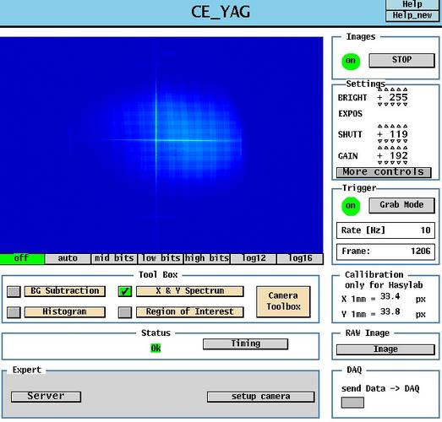
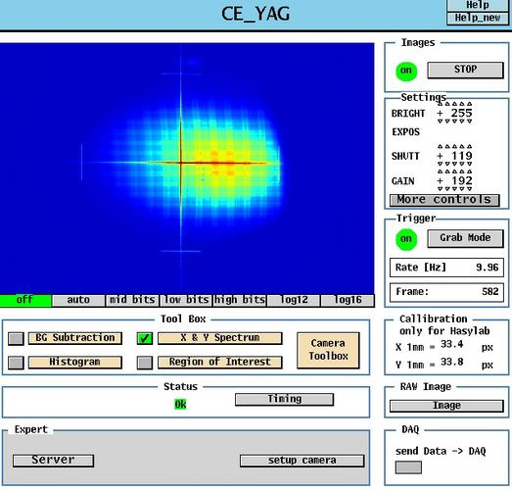
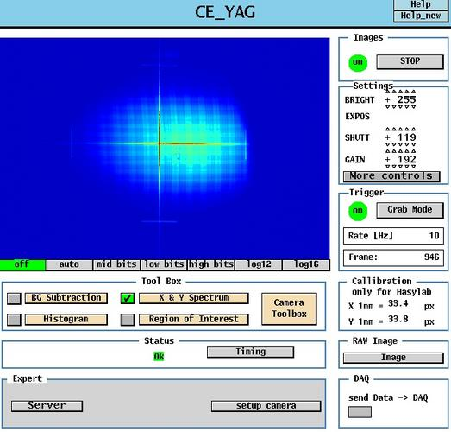
Both bunch trains lasing on Ce:YAG
LASER 1 only
Both lasers on the cathode
LASER 2 only

Slide 16
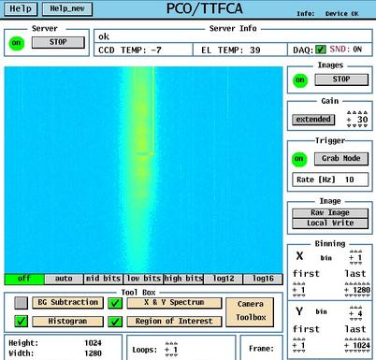
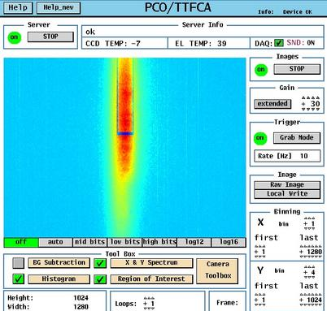
SASE-spectra of both bunch trains
LASER 1 only
Both lasers on the cathode
Spectrometer was not functional due to software reasons. Therefore only spectrometer camera images are shown
LASER 2 only

Slide 17
Varying gradients of second flat top
Changed ACC1 and ACC39 for compression
Changed gradient in ACC4/5 for small photon wavelength changes (FLASH1 has fixed gap undulators)

Slide 18
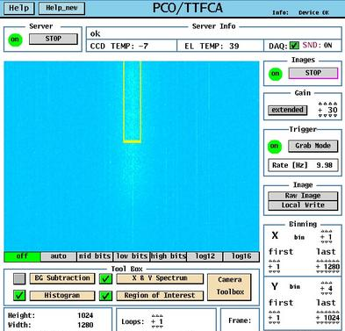
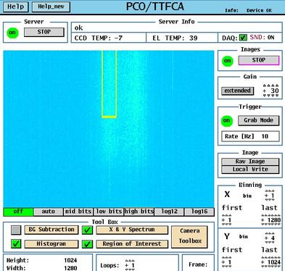
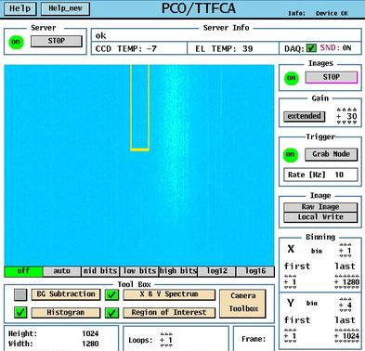
SASE-spectra of both bunch trains
LASER 1 only
Both lasers on the cathode
LASER 2 only
ΔE_{beam} ~ 7 MeV (1%)
Δλ ~ 0.27 nm (2%)

Slide 19
Test with two bunch trains – Lessons learned
Produced two bunch trains with 30 and 20 bunches, each lasing
Same charge, compression and energy led to same photon pulse energy
Different bunch charges
Different RF settings
Lasers interchangeable
Some tools work on a averaging basis, strange behaviour shown for the bunch pattern used (30 / 50 missing / 20).

Slide 20
Simulation of mismatched optics (2012-04-14)
Match optics in linac
Change quads to match higher energies (+/- 50 MV)
Observe SASE

Slide 21
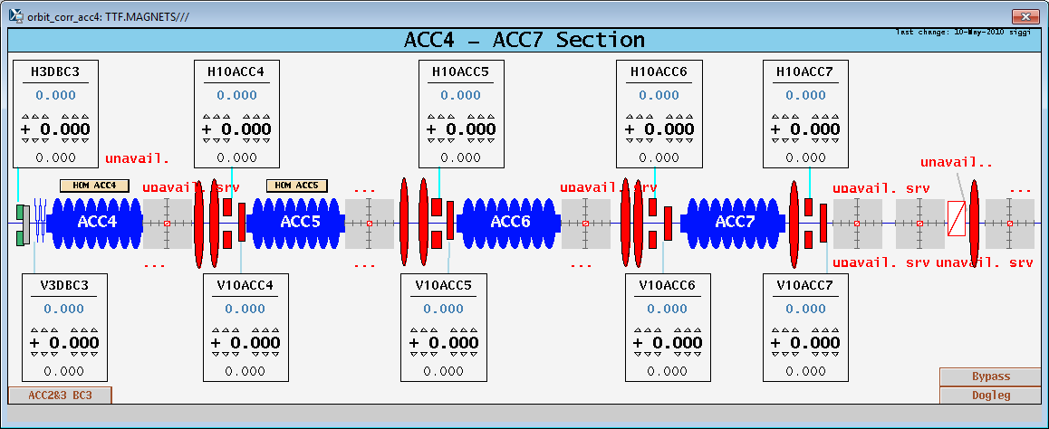
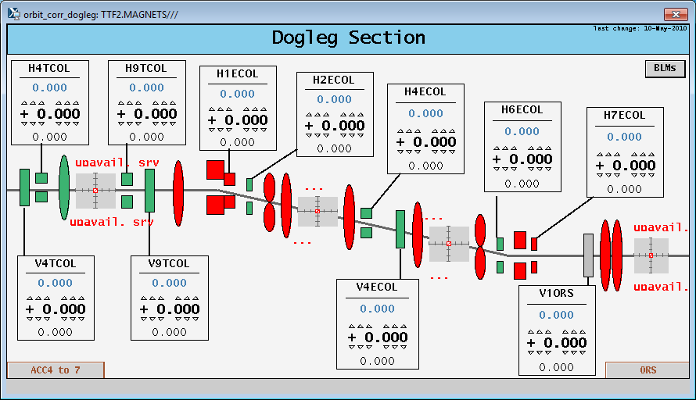
Simulation of mismatched optics (2012-04-14)

Slide 22
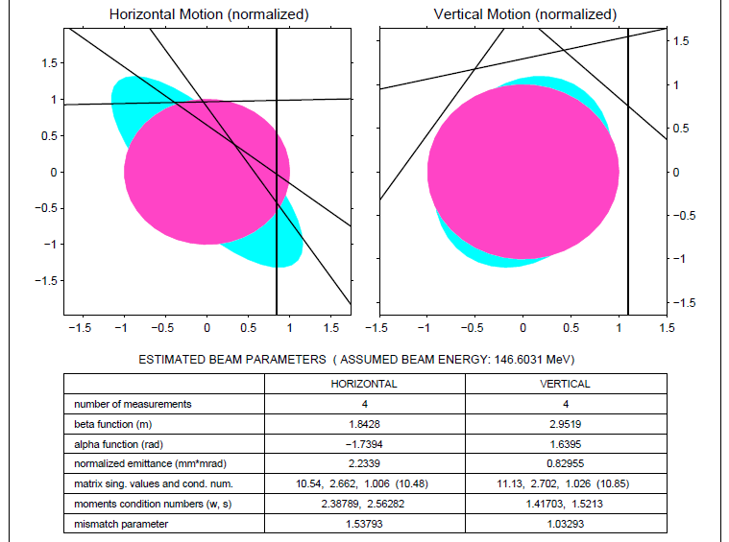
Measurements of injector optics

Slide 23
SASE after matching

Slide 24
Optics set for +0 MV - Transmission

Slide 25
Optics set for +50 MV - Transmission

Slide 26
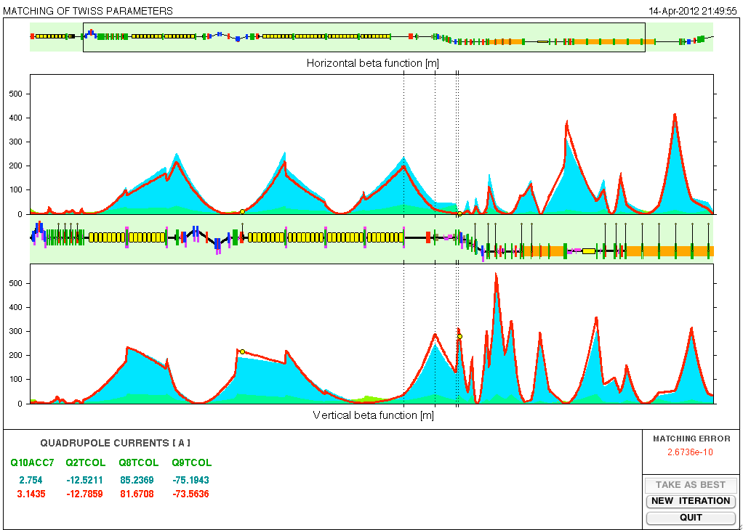
Optics set for +50 MV - Optics

Slide 27
More than 80% of SASE recovered

Slide 28
Simulation of mismatched optics – Lessons learned
Mismatched optics for simulated energy deviations between -50 MeV and +50 MeV were studied.
Energy range was limited by the transverse collimator acceptance
Transmission and lasing were almost unaffected
Mismatched optics upstream the ECOL, for example for the different energies for FLASH1 and FLASH2 don‘t seem to be too problematic.

Slide 29
Different charges (2012-04-13)
Establish SASE
Vary bunch charge
Measure bunch length
Measure SASE energy

Slide 30
Charge – Bunchlength relation

Slide 31
Charge – Bunchlength relation

Slide 32
Charge – SASE energy dependence
Charge [pC] | SASE [µJ] @ 700 MeV | SASE [µJ] @ 1090 MeV
600 | 210 | 165/110*
300 | 170 | 80/100
150 | 110 | 75
70 | 30/55 | 35
* Due to end of shift no further optimization was done
RF station | Phase [°] | Amplitude | Transition time [µs]
GUN | - 8.0 | - 0.04 MW | 50*** for 5°
ACC1 | +/- 0.3 | +/- 0.7 | < 50**
ACC39 | +/- 1.0 | +/-0.6 | < 50**
ACC23 | +/- 3.0 | - 2.2 | < 50**
** Design performance for extraction kicker was switching time of 50 µs max.

Slide 33
Further tests in 2013.
Explore larger energy and phase deviation ranges for the second flat top. This might be necessary for the seeding option of FLASH2.
A modified version of the LFF has to be tested
Charge dependency and bunch length test have to be repeated with both injector lasers
Tools have to be checked/modified for the dual flat top operation

Slide 34
Thanks for your attention!
These FLASH II test were performed by
S. Ackermann
V. Ayvazyan
B. Faatz
K. Klose
M. Scholz
S. Schreiber

