Slide 1
Beam Dynamics up to SASE3 for 250 pC compressed to 5 kA
Igor Zagorodnov
DESY, Hamburg
December 22, 2019

Slide 2
Outline
Layout, optics, technical constraints
Numerical approach
RF tolerances, collective effects and the choice of the working point
Beam dynamics up to SASE3 for 250 pC compressed to 5 kA (SASE1 closed with with K=3.9 but not lasing)

Slide 3







Layout, optics, technical constraints
$$L_{1}$$
$$L_{2}$$
$$L_{3}$$
3rd harmonic
dogleg
4 accelerator
modules
12 accelerator
modules
main
linac
collimator
booster
SASE2
gun
$${BC}_{1}$$
$${BC}_{2}$$
$${BC}_{3}$$
SASE1
SASE3
laser
heater
bunch compressors
the injector contains a high harmonic module to linearize the longitudinal phase space
there are three bunch compressors to compress the bunch to several kA’s and to mitigate collective effects
the design optics has a special phase advance between the bunch compressors to reduce effects due to coherent synchrotron radiation (CSR) kicks at them

Slide 4
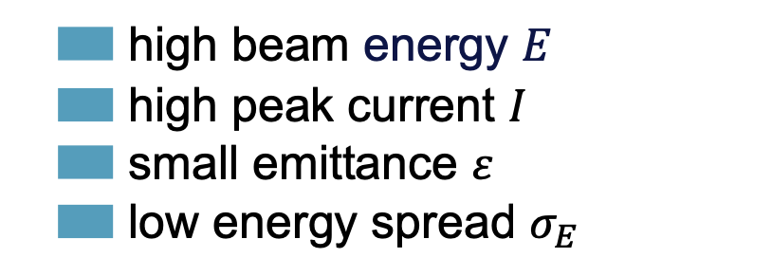
Layout, optics, technical constraints
$$L_{1}$$
$$L_{2}$$
$$L_{3}$$
3rd harmonic
dogleg
4 accelerator
modules
12 accelerator
modules
main
linac
collimator
booster
SASE2
gun
$${BC}_{1}$$
$${BC}_{2}$$
$${BC}_{3}$$
SASE1
SASE3
laser
heater
bunch compressors
Section name | booster | 3rd harmonic | L2 | L3
Maximal voltage, MV | 180 | 40 | 680 | 2470
Section name | BC1 | BC2 | BC3
|r56|, mm | 30-90 | 20-80 | 10-60
  high beam energy $E$
  high peak current $I$
  small emittance $ε$
  low energy spread $σ_{E}$

Slide 5





Numerical approach
$$L_{2}$$
$$L_{3}$$
main linac
$$L_{1}$$
SASE2
gun
$${BC}_{1}$$
$${BC}_{2}$$
$${BC}_{3}$$
SASE1
SASE3
6.5 MeV, I ~ A’s
14 GeV, I ~ 5 kA’s
Krack3
  cathode physics
  external fields by field maps
  self-fields with 2D/3D Poisson equation
  particle motion with finite-difference method
  cathode through mirror charge
  no chamber (no wakes)
Ocelot*
  external RF fields analytically
  self-fields with 3D Poisson equation
  CSR fields with 1D projected model
  particle motion with transport matrices of second order
  Chamber with wakes
  ISR effects
*S.Tomin, I.Agapov, M.Dohlus, I.Zagorodnov, Ocelot as framework for beam dynamics simulations of x-ray sources, in Proceedings of IPAC 2017, WEPAB031

Slide 6
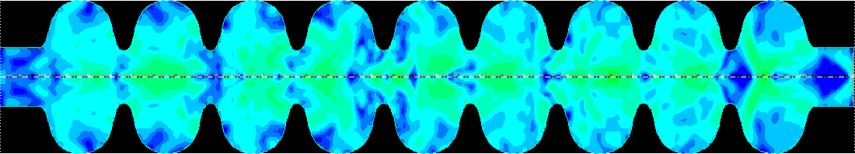
Numerical approach
energy loss
Q = 1nC, I_{peak} = 5 kA
“warm” pipe
collimators
about 2000 components:
824 cavities
500 flanges
220 BPMs (5 types)
78 pumps
20 OTR screens
7 collimators
5 BAMs
3 kickers
warm pipes, …
energy density
cavities
Source particle creates fields, test particle gets the integrated kick. Wakes are calculated analytically and with electromagnetic code ECHO*.
  update of transverse wakes: length << betatron wavelength
  update of longitudinal wakes: length << wavelength of longitudinal oscillations
  in accelerator effects due to transverse wakes are minor; effects due to longitudinal wakes are essential → long. phase space and compression
*I. Zagorodnov, T. Weiland, TE/TM field solver for particle beam simulations without numerical Cherenkov radiation, Phys. Rev. STAB 8, 042001 (2005)

Slide 7
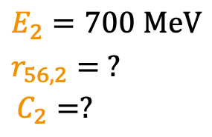
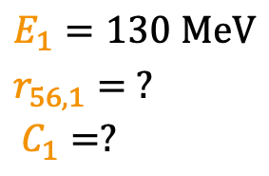

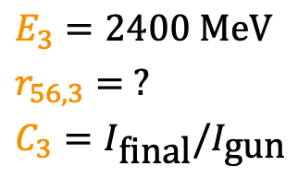
RF tolerances, collective effects and the choice of the working point
Working point (11 parameters of longitudinal beam dynamics)
$$C_{3}^{′} { C}_{3}^{′′}$$
  the first and the second derivatives of the global compression
  energy in BC:
  deflecting radius:
  compression factor:
$$E_{1}=130 \text{MeV}$$
$$r_{56,1}= ?$$
$$C_{1}=?$$
$$E_{2}=700 \text{MeV}$$
$$r_{56,2}= ?$$
$$C_{2}=?$$
$$E_{3}=2400 \text{MeV}$$
$$r_{56,3}= ?$$
$$C_{3}=I_{\text{final}}/I_{\text{gun}}$$
What is the optimal choice?
I. Zagorodnov, M. Dohlus, S.Tomin, Accelerator Beam Dynamics at the European XFEL, Phys. Rev. STAB, 2019.

Slide 8
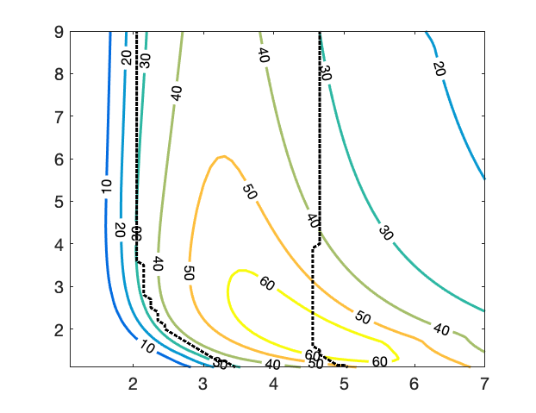
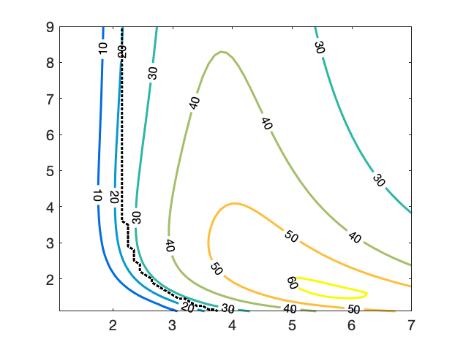
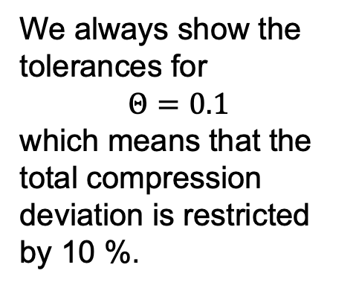
RF tolerances, collective effects and the choice of the working point
$r_{56}^{{BC}_{1}}$=-40 mm
$r_{56}^{{BC}_{1}}$=-60 mm
$$\frac{C_{2}}{C_{1}}$$
$$\frac{C_{2}}{C_{1}}$$
We always show the tolerances for
$$Θ=0.1$$
which means that the total compression deviation is restricted by 10 %.
$$C_{1}$$
$$C_{1}$$
The RF tolerance of the booster $θ_{11}{10}^{5}$ for two different compaction factors in BC1 for 500 pC, 5 kA. The red point shows the working point. The dashed black lines show the limits of available RF voltage.

Slide 9
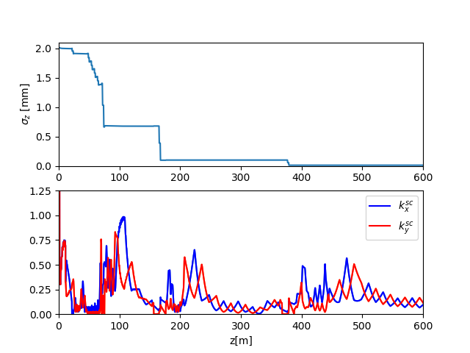
RF tolerances, collective effects and the choice of the working point
dogleg
$${BC}_{1}$$
$${BC}_{2}$$
$${BC}_{3}$$
the space charge parameters relate the space charge forces to the averaged focusing in the magnetic lattice
at the chosen working point the de-focussing due to the space charge forces is less than the focusing of the quadrupoles

Slide 10
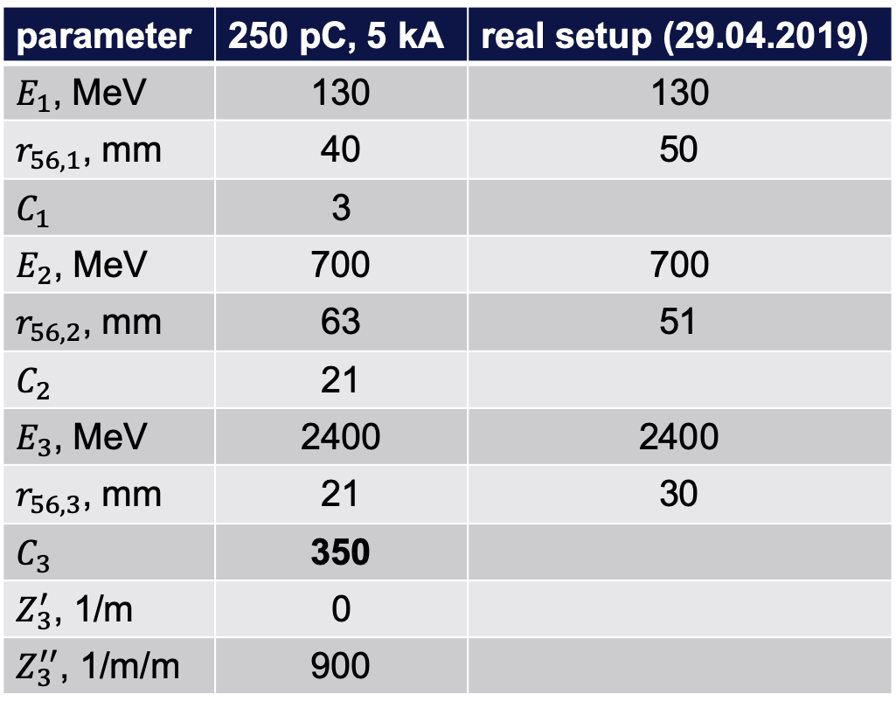
RF tolerances, collective effects and the choice of the working point
Longitudinal dynamics parameters
parameter | 250 pC, 5 kA | real setup (29.04.2019)
$E_{1}$, MeV | 130 | 130
$r_{56,1}$, mm | 40 | 50
$C_{1}$ | 3
$E_{2}$, MeV | 700 | 700
$r_{56,2}$, mm | 63 | 51
$C_{2}$ | 21
$E_{3}$, MeV | 2400 | 2400
$r_{56,3}$, mm | 21 | 30
$C_{3}$ | 350
$Z_{3}^{′}$, 1/m | 0
$Z_{3}^{′′}$, 1/m/m | 900

Slide 11
RF tolerances, collective effects and the choice of the working point
Analytical solution without self-fields
I. Zagorodnov, M. Dohlus, Semi-Analytical Modelling of Multistage Bunch Compression with Collective Effects,
Phys. Rev. STAB, 2011.
Solution with self-fields
nonlinear operator
(numerical tracking with self-fields)
numerical tracking
residual in parameters
analytical correction
of RF parameters

Slide 12
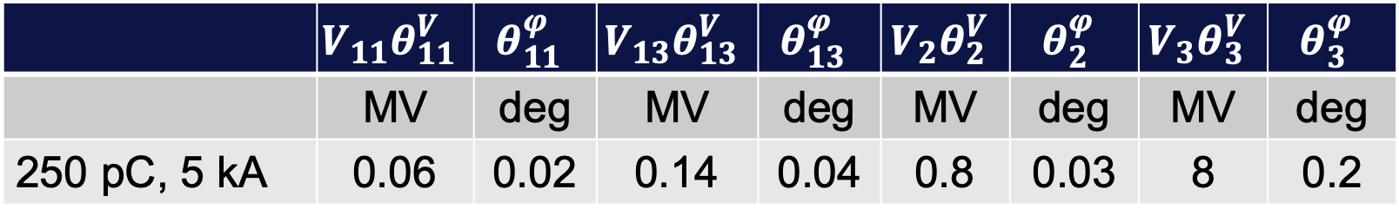
RF tolerances, collective effects and the choice of the working point
The RF tolerances for 10% change of the global compression
 | $$V_{11}θ_{11}^{V}$$ | $$θ_{11}^{φ}$$ | $$V_{13}θ_{13}^{V}$$ | $$θ_{13}^{φ}$$ | $$V_{2}θ_{2}^{V}$$ | $$θ_{2}^{φ}$$ | $$V_{3}θ_{3}^{V}$$ | $$θ_{3}^{φ}$$
 | MV | deg | MV | deg | MV | deg | MV | deg
250 pC, 5 kA | 0.06 | 0.02 | 0.14 | 0.04 | 0.8 | 0.03 | 8 | 0.2
In the simulations we use the laser heater in the injector to provide 2.2 MeV slice energy spread after the full compression (after BC2). This corresponds to the minimal energy spread as found in microbunching studies done by M. Dohlus (next slide).

Slide 13
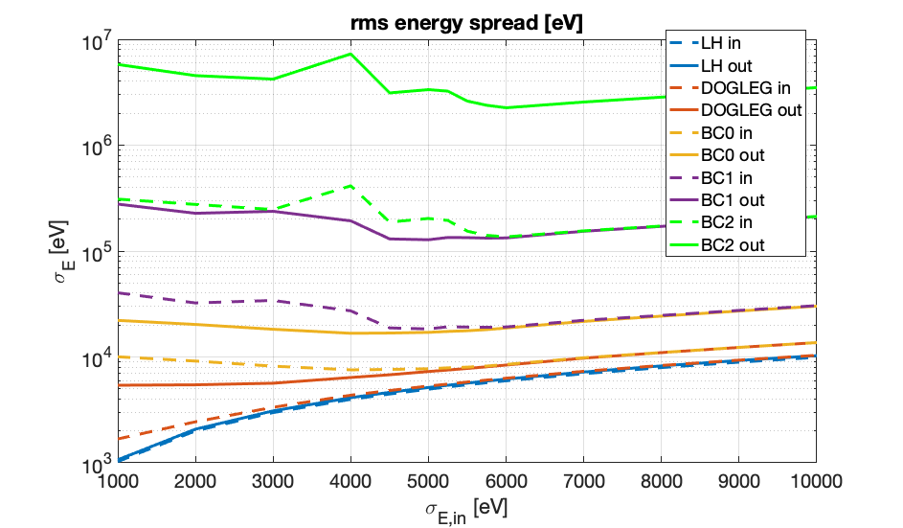
RF tolerances, collective effects and the choice of the working point
Microbunching. Minimal slice energy spread at the working point of 5 kA
2.2 MeV
The results are obtained by M. Dohlus numerically by tracking of real number of electrons (periodic model).
Quantum fluctuations. Spread due to ISR only negligible.
Position | Spread, keV
Before SASE1 | 40
Before SASE2 | 90

Slide 14
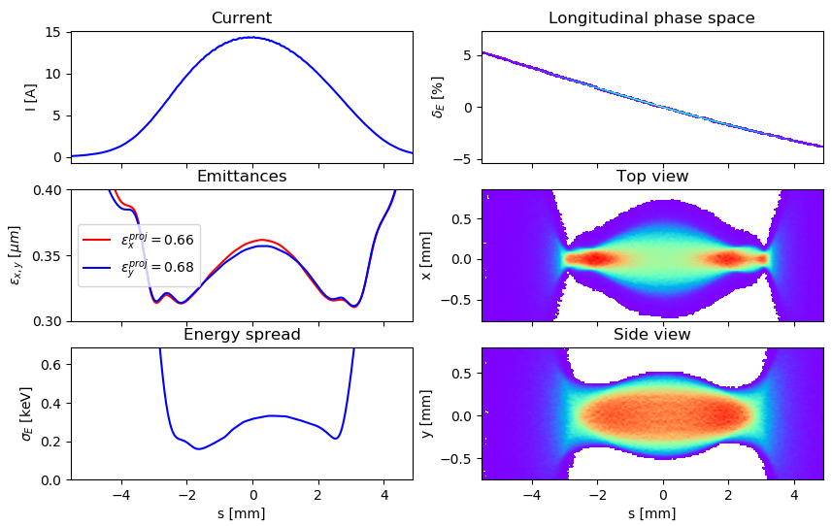
Beam dynamics for 5 kA (Gun → entrance of the laser heater)
$$L_{2}$$
$$L_{3}$$
main linac
$$L_{1}$$
gun
$${BC}_{1}$$
$${BC}_{2}$$
$${BC}_{3}$$
SASE1

Slide 15
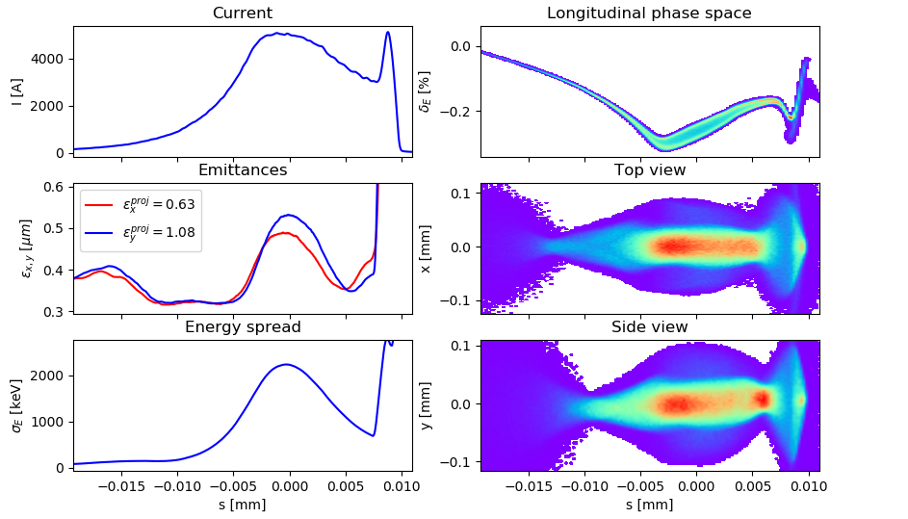
Beam dynamics for 5 kA (entrance of SASE1)
$$L_{2}$$
$$L_{3}$$
main linac
$$L_{1}$$
gun
$${BC}_{1}$$
$${BC}_{2}$$
$${BC}_{3}$$
SASE1
SASE3

Slide 16
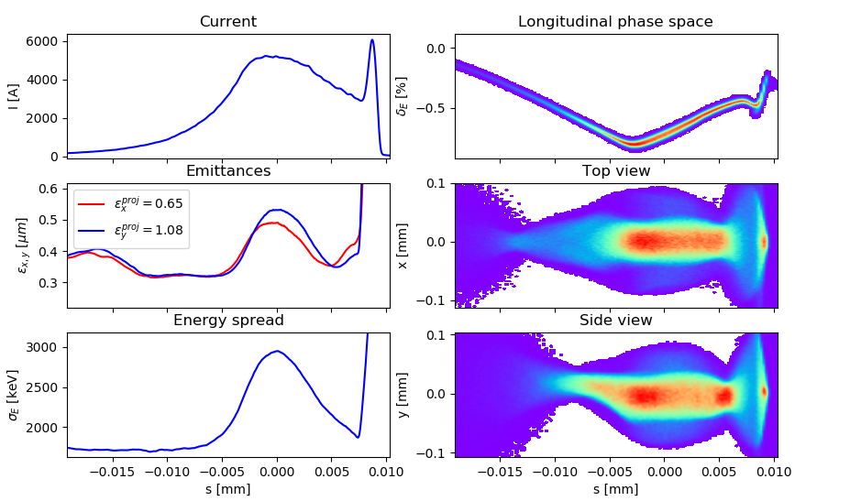
Beam dynamics for 5 kA (entrance of SASE3, SASE1 closed with with K=3.9)
$$L_{2}$$
$$L_{3}$$
main linac
$$L_{1}$$
gun
$${BC}_{1}$$
$${BC}_{2}$$
$${BC}_{3}$$
SASE1
SASE3

Slide 17
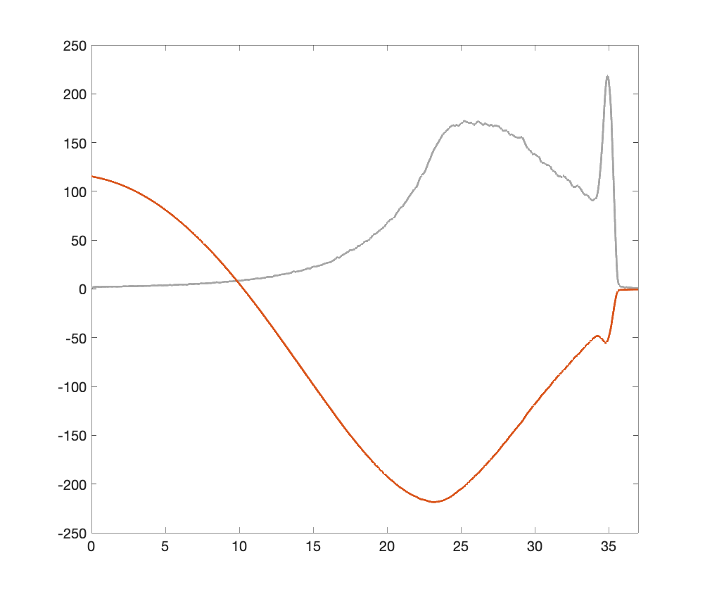
Wake at SASE3
W [kV/m]
I [a.u.]
s [𝞵m]

