Slide 1



Microbunching Instability: causes, consequences and control
Giovanni Perosa
EuXFEL, FPH group
Beam Dynamics Seminar Meeting
Hamburg, June 24th 2025

Slide 2
Outline
PART 1: Introduction
  Start-up & build-up
  Impact of MBI
PART 2: Modeling
  Analytical description
PART 3: Control of MBI
PART 4: Simulations
  Particle tracking

Slide 3
Disclaimer
The topics, papers, and results presented here are selected based on my «extensive»—albeit not exhaustive—experience with the subject. In my view, they represent a core set of significant contributions to the understanding of microbunching instability in LINACs.
Intrabeam Scattering (IBS) is mentioned as a teaser and NOT discussed in this seminar
A quite exhaustive discussion can be found at: 10.1103/PhysRevAccelBeams.28.044401

Slide 4
PART 1: Introduction

Slide 5
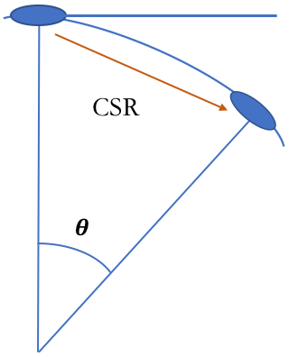
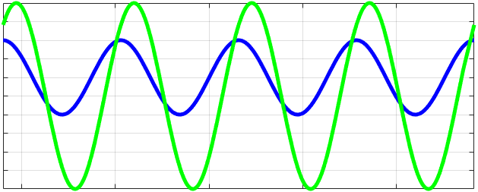
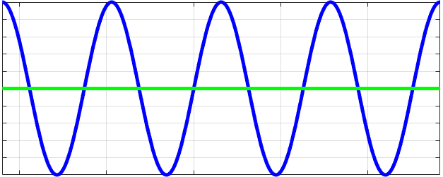
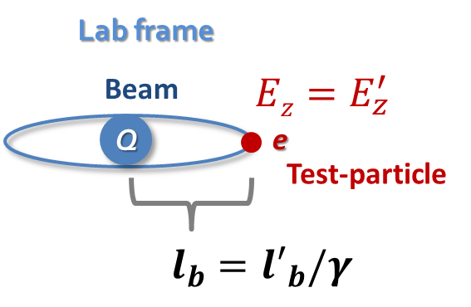
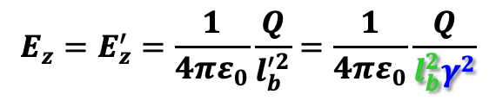
Start up & build up
z
energy mod.
R₅₆, CSR
Disomogeneity at wavelength ~1 𝜇m to hundreds of 𝜇m
density mod.
LSC
dispersive region
acceleration
= Lorentz factor
LSC = Longitudinal Space Charge
CSR =
Coherent
Synchrotron
Radiation
Magnetic Bunch Length Compression
Beam Energy
$${E_{z}=E}_{z}^{′}=\frac{1}{4πε_{0}}\frac{Q}{l_{b}^{′2}}=\frac{1}{4πε_{0}}\frac{Q}{l_{b}^{2}γ^{2}}$$

Slide 6
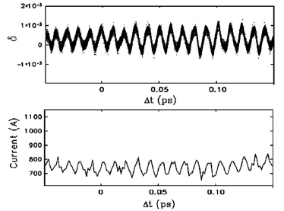

Consequences
energy mod.
R₅₆, CSR
z
Disomogeneity at wavelength ~1 𝜇m to hundreds of 𝜇m
density mod.
LSC
dispersive region
acceleration
Simulated 30 𝜇m wavelength, 1% amplitude at 100 MeV
Freq. mixing
S. Di Mitri & S. Spampinati, PRL 112 (2014)
Spurious harmonic content
Increased Energy Spread
Broadening
G. Perosa et al., PRAB 23 (2020)

Slide 7

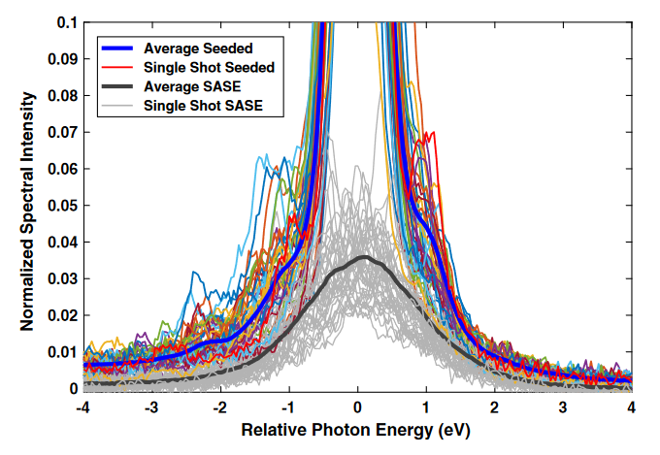
Consequences on FEL
∼ 1–few μm modulations contribute to pedestal and generate sidebands.
<< 1 μm modulations bring sidebands far from central peak, but can interfere with seeding laser, and generate large slice energy spread.
>> 1 μm modulations bring sidebands within the intrinsic FEL bw, generally not harmful.
SASE, Self-seeding or externally seeded FELs are all affected
G. Marcus et al., PRAB 22 (2019)
G. Perosa et al., PRAB 23 (2020)
λ_{mod} ∼ 4 μm

Slide 8
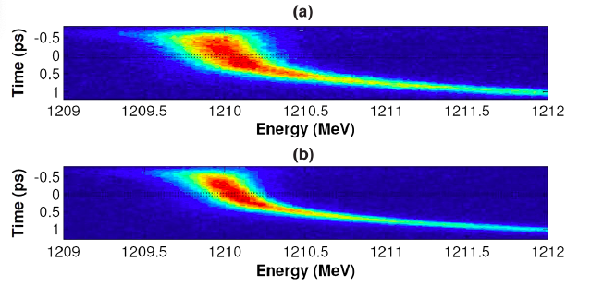
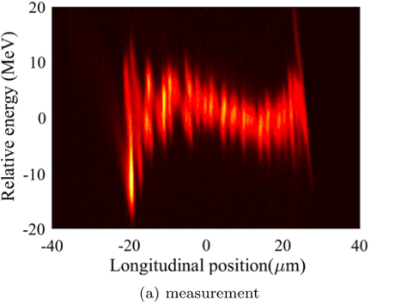
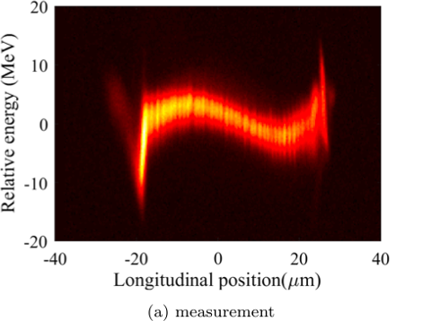
Consequences on Energy Spread
Parameters | Values
Charge | 500 pC
Energy spread | 2.0 (With MBI) MeV 1.2 (No MBI) MeV
Peak current | 400 A (C = 7)
Beam Energy | 1.21 GeV
S. Spampinati et al., PRSTAB 17 (2014)
With MBI
No MBI
With MBI
No MBI
Parameters | Values
Charge | 180 pC
Energy spread | 2.1 (With MBI) MeV 1.2 (No MBI) MeV
Peak current | 1000 A
Beam Energy | 4.3 GeV
J. Qiang et al., PRAB 20 (2017)

Slide 9
Take-home message on MBI
Accumualtion of modulations in longitudinal phase space in a wide range of wavelengths , ~1 𝜇m to hundreds of 𝜇m
Cascade effect enhanced by LSC and CSR
It affects the FEL performances directly and indirectly
It affects the energy spread adding a correlated term

Slide 10
PART 2: Modeling

Slide 11
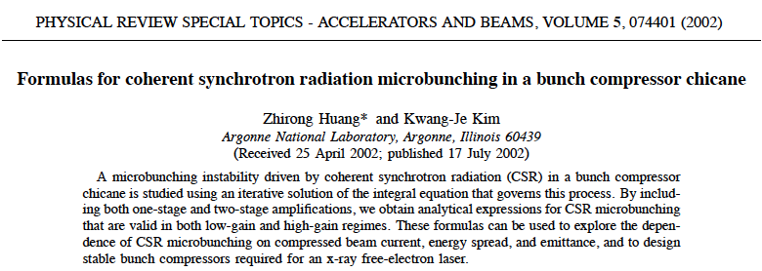
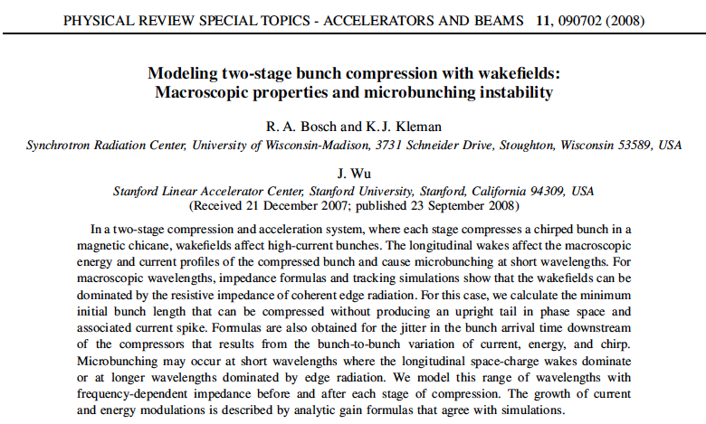
A bit of History
After the first measurement in 2001 and the conceptualization of SSY (2002), 2 main models were developed
Huang-Kim (HK)
Bosch-Kleman-Wu (BKW)
Both models aim at the description of a bunching factor considered as the harmonic content of the current profile
All models aim at the determination of a gain curve, which in the linear regime is the ratio of final and initial bunching
Time-independent, ultrarelativistic and with an average 𝜷-function

Slide 12
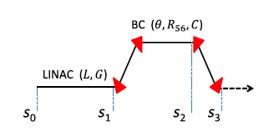


HK: the standard approach
ChatGPT says: The Huang and Kim model is a linearized Vlasov-based analytical framework that describes the evolution and amplification of small initial density modulations in an electron beam due to collective effects such as longitudinal space charge and coherent synchrotron radiation.
Starting from Poissonian shot noise
The kernel K is determined by the CSR impedance
Energy modulation induced by bunching are described via LSC impedance:
Updating density and energy modulations

Slide 13
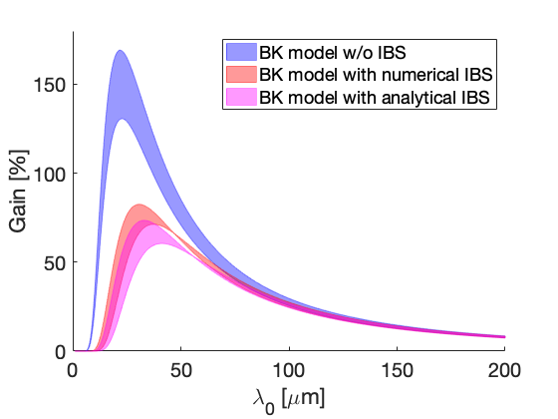
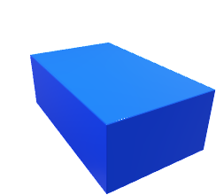
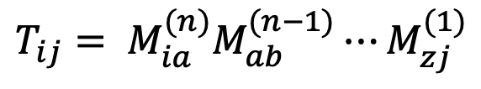
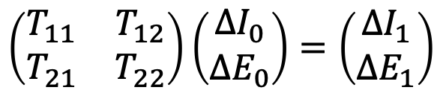

BKW: the agile model
R₅₆, CSR
Each single matrix describes the action of an element on the 2D longitudinal phase space: impedances, dispersive sections etc
The beamline is therefore a product of matrices
LSC
R₅₆, CSR
$$T_{ij}= M_{ia}^{(n)}M_{ab}^{(n−1)}⋯M_{zj}^{(1)}$$
to a matrix
$$\left(\begin{matrix}T_{11} & T_{12} \\ T_{21} & T_{22}\end{matrix}\right)\left(\begin{aligned}{ΔI}_{0} \\ {ΔE}_{0}\end{aligned}\right)=\left(\begin{aligned}ΔI_{1} \\ ΔE_{1}\end{aligned}\right)$$
LSC
Density modulation gain
R₅₆, CSR
Energy modulation gain
R₅₆, CSR
LSC
G. Perosa S. Di Mitri, Sci Rep 11 (2021)

Slide 14
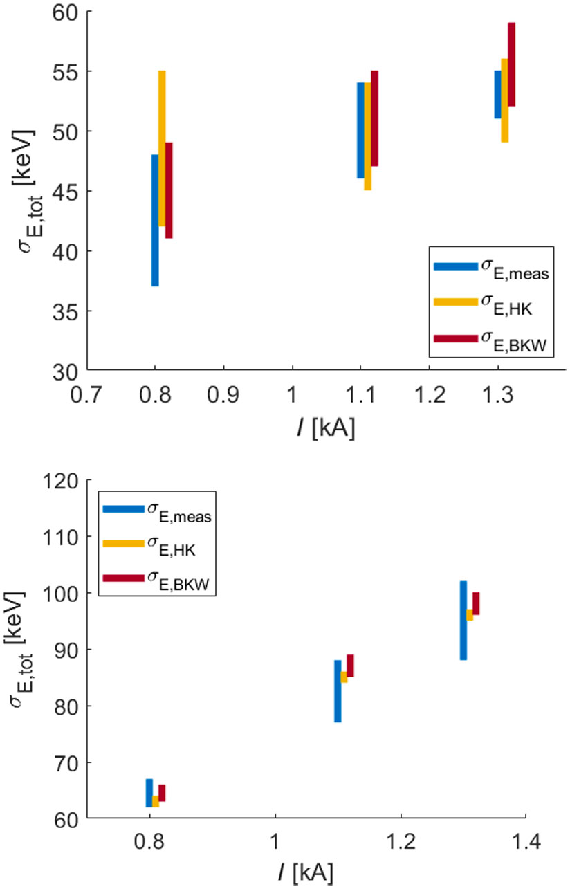
Semi-analytical approach
Uncorrelated effective energy spread is used as a figure of merit to benchmark the validity of the results
It also returns the modulations in the 2D longitudinal phase space
It determines the gain curve for a given beamline
Examples of slice energy spread: measurement vs model
Compressed initial energy spread:
IBS_induced energy spread:
Energy spread due to MBI:
where
S. Di Mitri et al., PRAB 28 (2025)

Slide 15
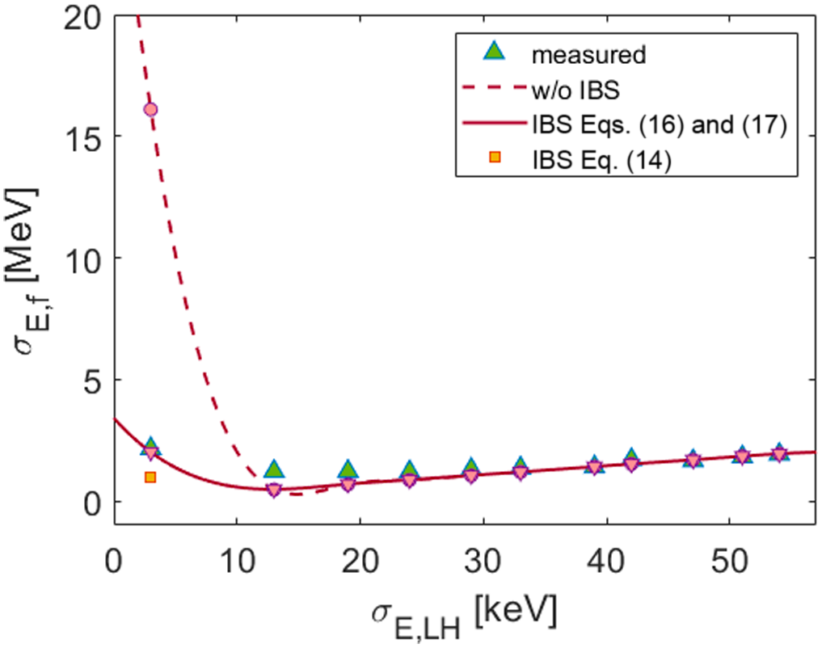
Semi-analytical approach
Uncorrelated effective energy spread is used as a figure of merit to benchmark the validity of the results
It also returns the modulations in the 2D longitudinal phase space
It determines the gain curve for a given beamline
Examples of slice energy spread: measurement vs model
Compressed initial energy spread:
IBS_induced energy spread:
Energy spread due to MBI:
where
S. Di Mitri et al., PRAB 28 (2025)

Slide 16
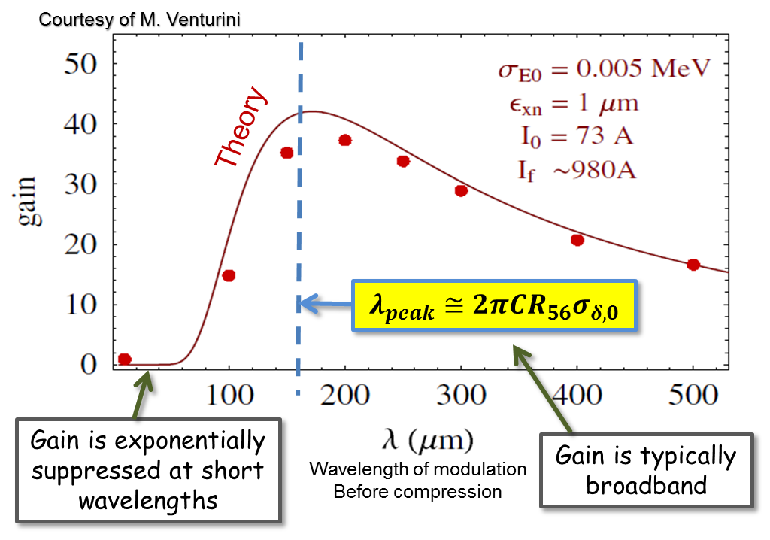
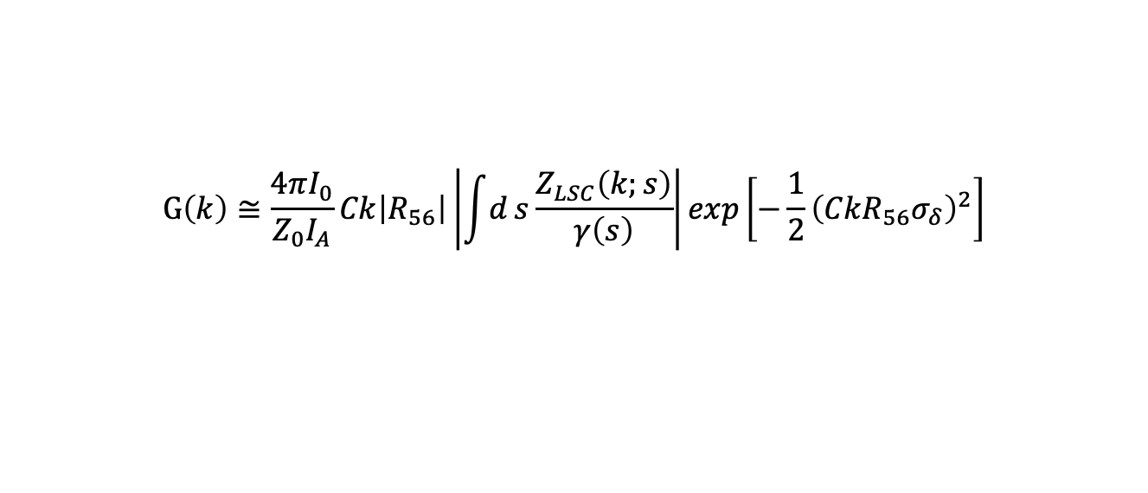
HK vs BKW: what do they agree on?
$$G\left(k\right)≅\frac{4πI_{0}}{Z_{0}I_{A}}Ck\left|R_{56}\right|\left|\int{d}s\frac{Z_{LSC}\left(k;s\right)}{γ\left(s\right)}\right|exp\left[−\frac{1}{2}{\left(CkR_{56}σ_{δ}\right)}^{2}\right]$$
amplification
damping
Gain is proportional to the current I and to the energy modulations
Gain is peaked around
Gain is exponentially suppressed at short wavelengths by the uncorrelated energy spread: (Longitudinal) Landau Damping
S. Di Mitri et al., PRAB 28 (2025)

Slide 17
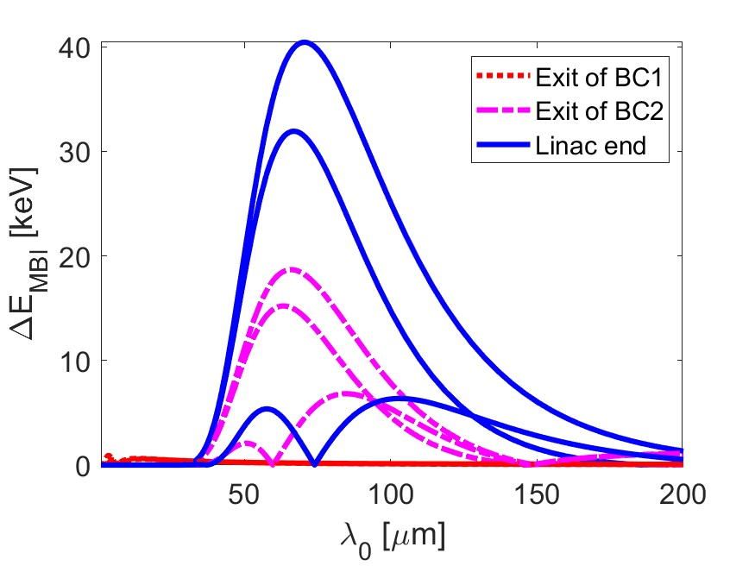
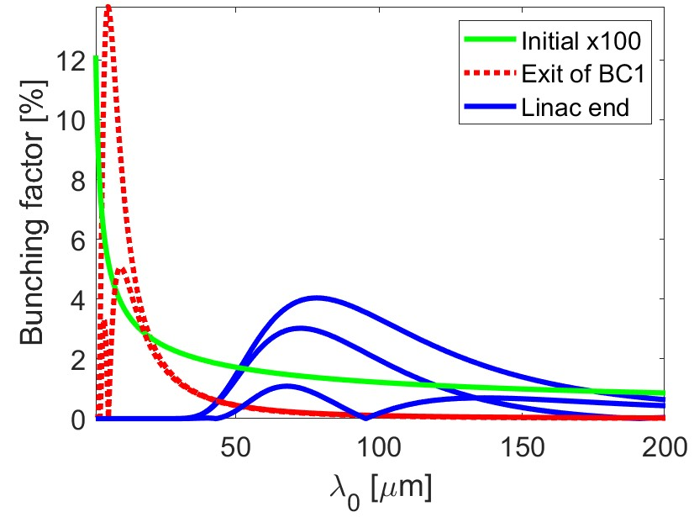
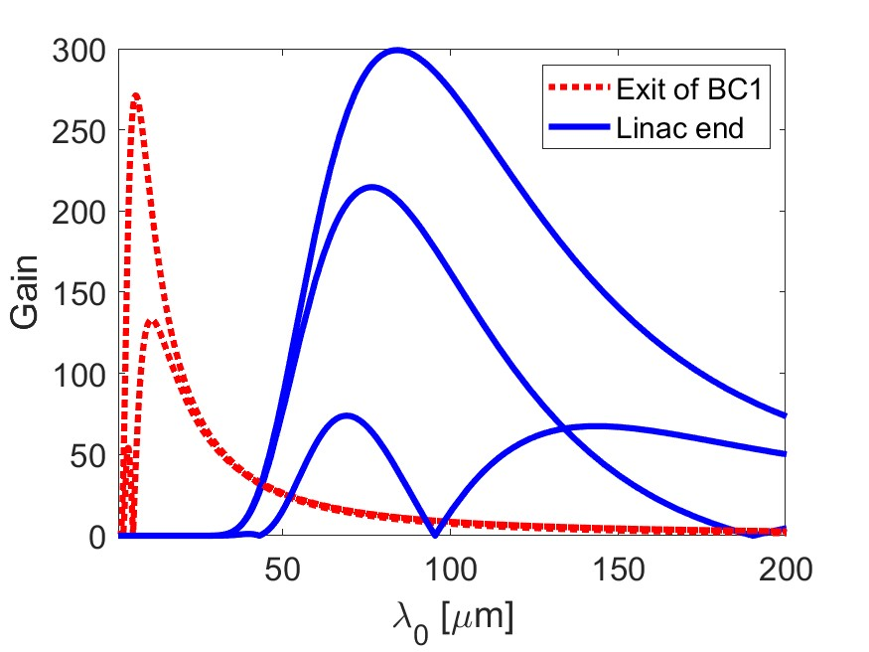
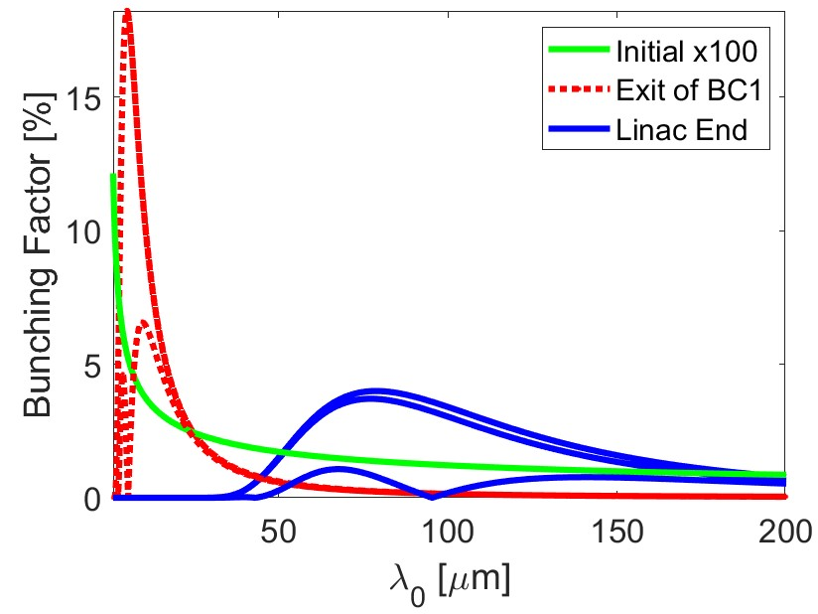
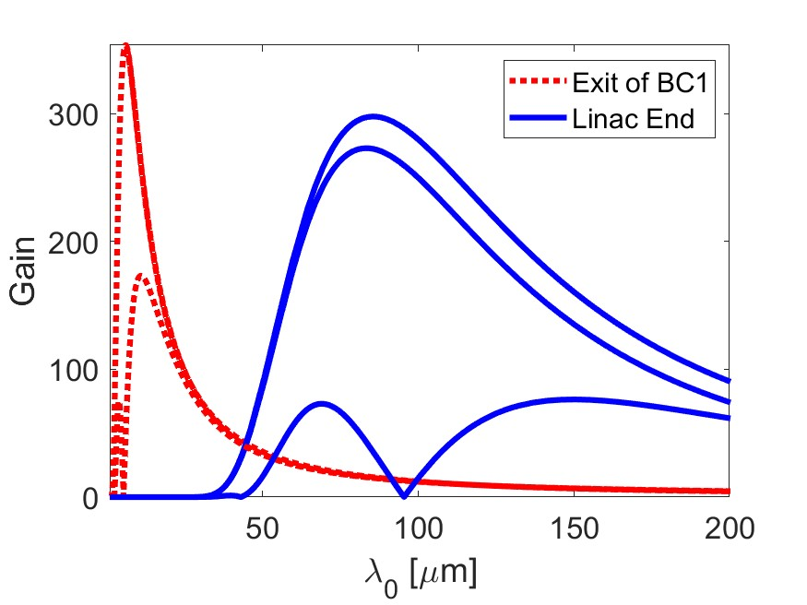
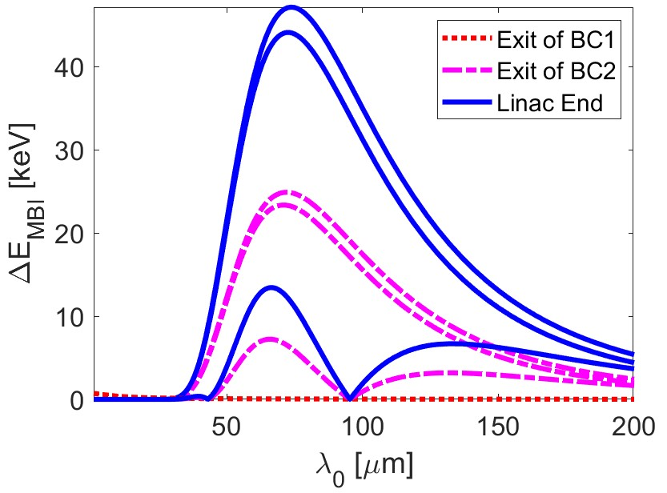
HK vs BKW: what do they agree on?
$I0=65A, CF=3 x 30, δ_{i}=1keV, δ_{LH}=3keV$
+CSR, CER
290 keV
BK
w/ IBS
288 keV
+ LH
349 keV
Agreement (within 20%) of BK and HK, both in gain and energy spread, 1- and 2-stage
+CSR
289 keV
HK
w/ IBS
288 keV
+ LH
395 keV
Courtesy of S. Di Mitri

Slide 18
Take-home message on MBI models
HK
Integral linearized Vlasov eq., solved by iteration at 2nd order in kernel.
4 dipoles chicanes
LSC + CSR
BK
Matrix model for modulations in the 2D long. ph. sp.
Generic dispersive term
LSC+CSR+CER
VS
Aiming at the prediction of bunching factor and gain function
Based on «linear approximation»
HK and BKW are in good agreement, but BKW model is more flexible
Gain is strongly affected by the uncorrelated energy spread

Slide 19
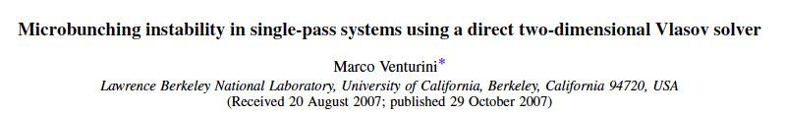
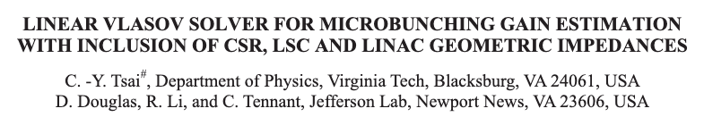

Honorable mention: Vlasov solvers
Venturini’s works
Tsai’s works
Amstutz & Vogt’s SelaV₁D

Slide 20
PART 3: Control

Slide 21

Controlling MBI: Laser Heater
  Why?
Laser Heater
  To induce uncorrelated energy spread, for suppression of MBI via energy Landau Damping
Laser
Undulator
  What is it?
  Laser Heater is a composed of a laser and a short undulator embedded in a 4-dipole chicane:
  UV laser-electrons collinear superposition
  Smearing of the laser-induced modulations in the second half of the chicane

Slide 22
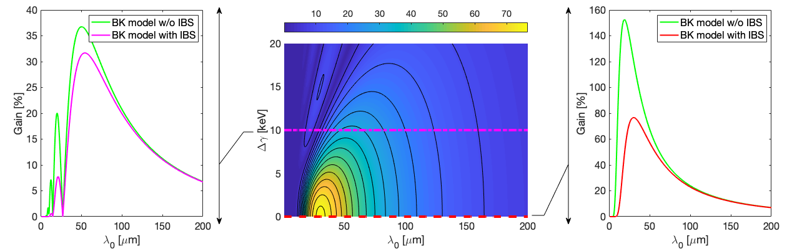
Controlling MBI: Laser Heater
  Why?
Laser Heater
  To induce uncorrelated energy spread, for suppression of MBI via energy Landau Damping
Laser
Undulator
G. Perosa Simone Di Mitri, Sci Rep 11 (2021)
  Laser Heater is a composed of a laser and a short undulator embedded in a 4-dipole chicane:
  UV laser-electrons collinear superposition
  Smearing of the laser-induced modulations in the second half of the chicane
Parameters | Values
Charge | 650 pC
Peak current | 600 A (C = 11)
Beam Energy | 0.89 GeV

Slide 23
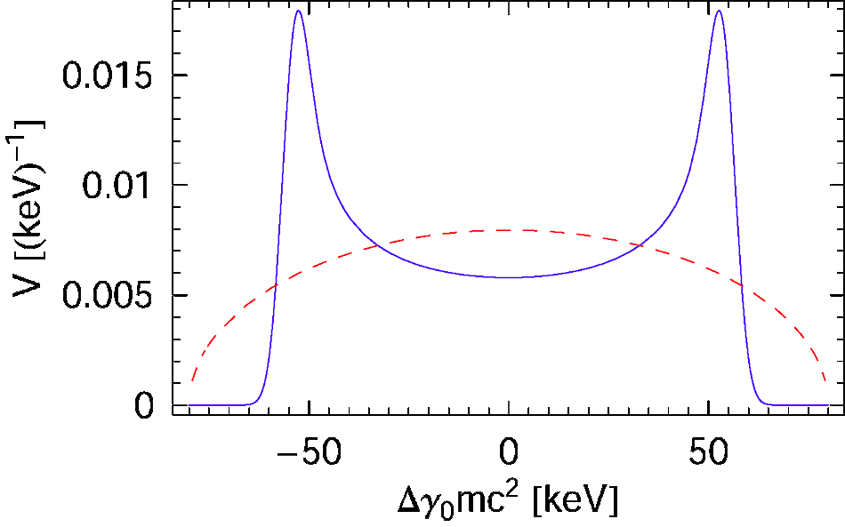
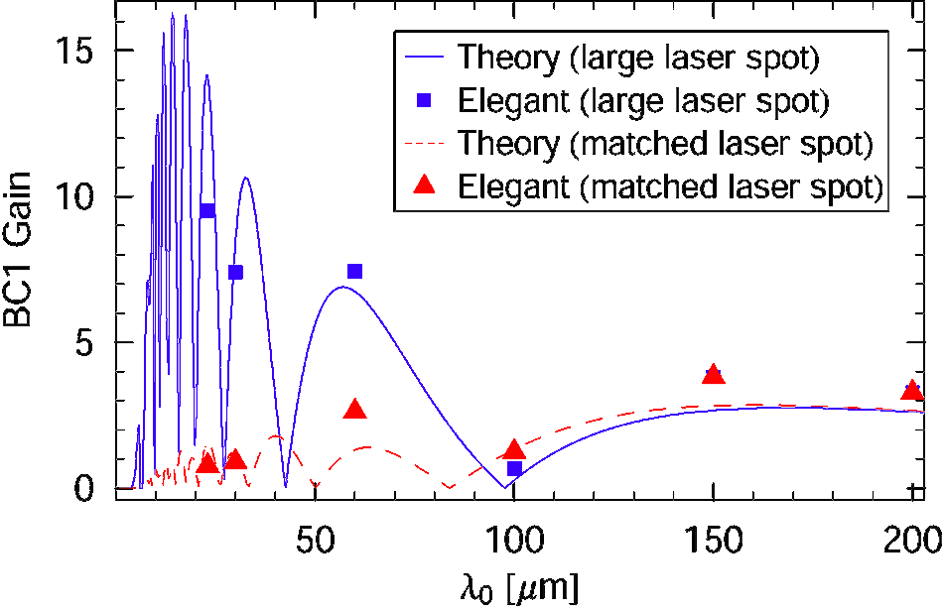
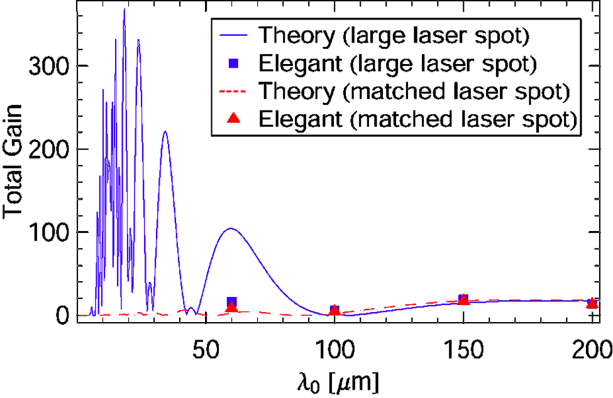
Controlling MBI: Laser Heater
Energy distribution after LH
The damping depends on the matching condition between the beam size and the laser size
Gain function after BC1 and after BC2
Z. Huang et al. PRAB 7, (2004)

Slide 24
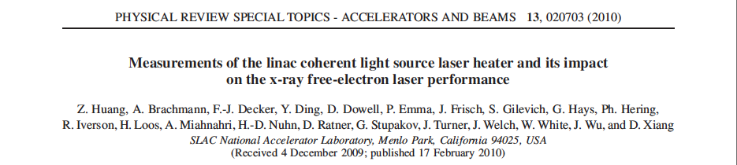
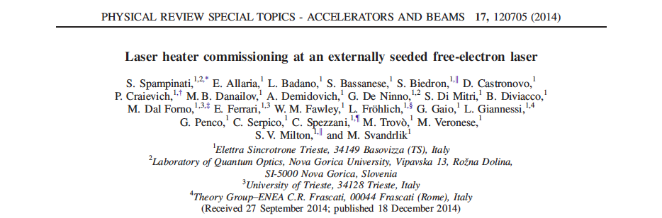
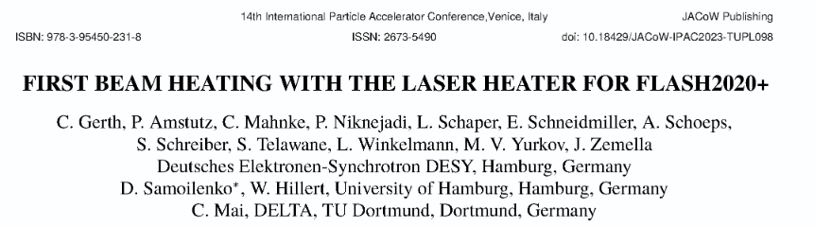
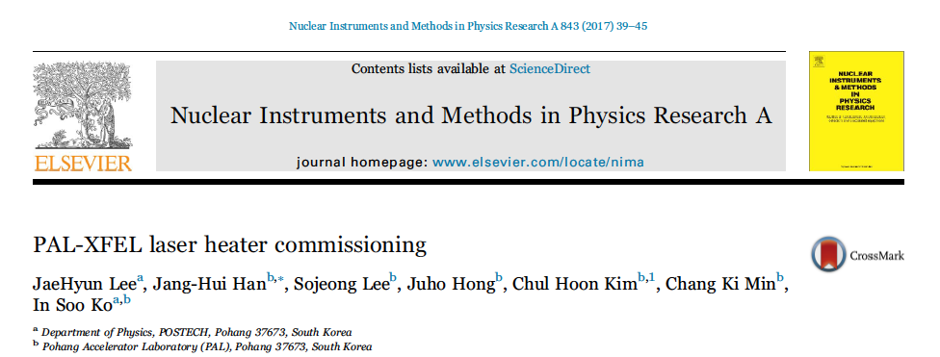
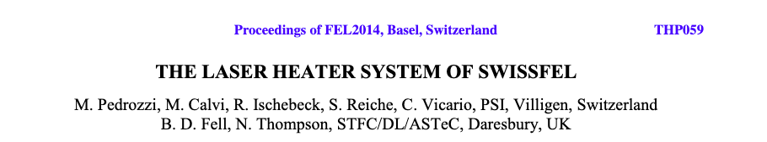
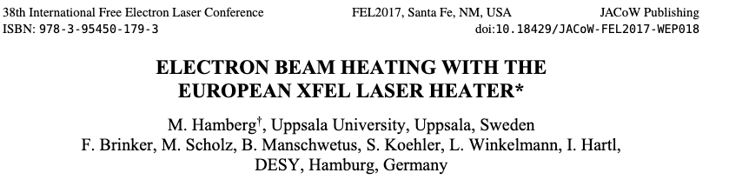
Controlling MBI: Laser Heater (Does it actually work?)
LCLS
FERMI
FLASH
PAL-XFEL
SwissFEL
EuXFEL

Slide 25
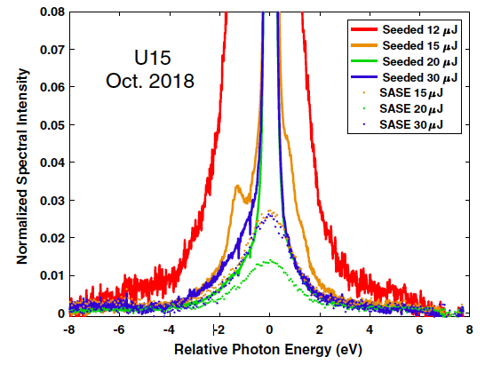
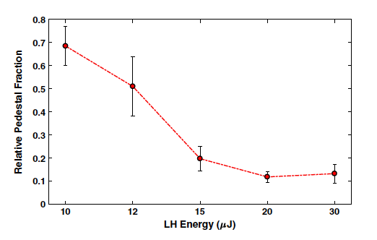
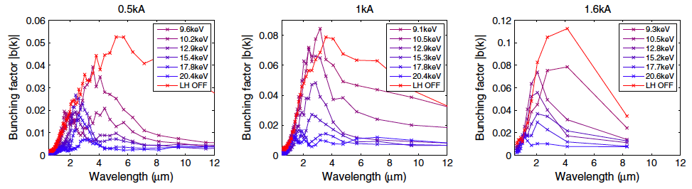
Controlling MBI: Laser Heater (Does it actually work?)
G. Marcus et al., PRAB 22 (2019)
Experimental evidence of the impact of LH on:
FEL pedestal
bunching factor
Fourier transform of the projected XTCAV images
Ratner et al., PRAB 18 (2015)

Slide 26
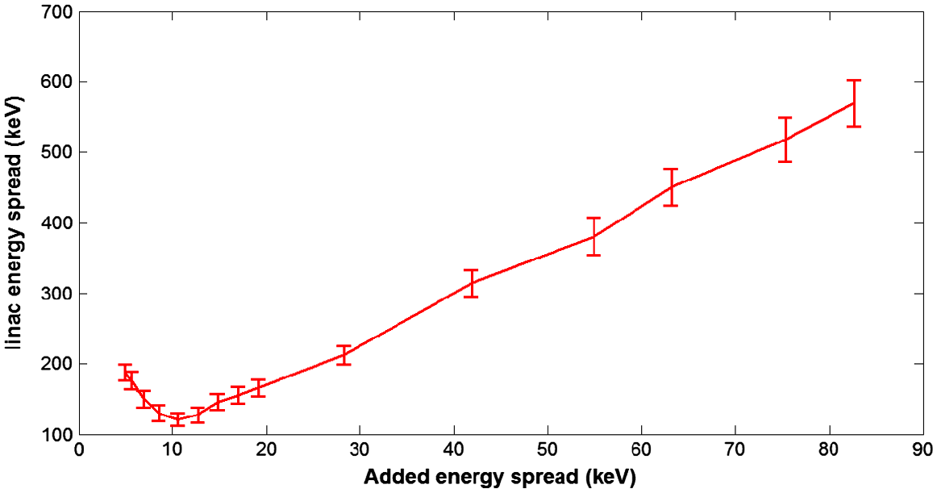
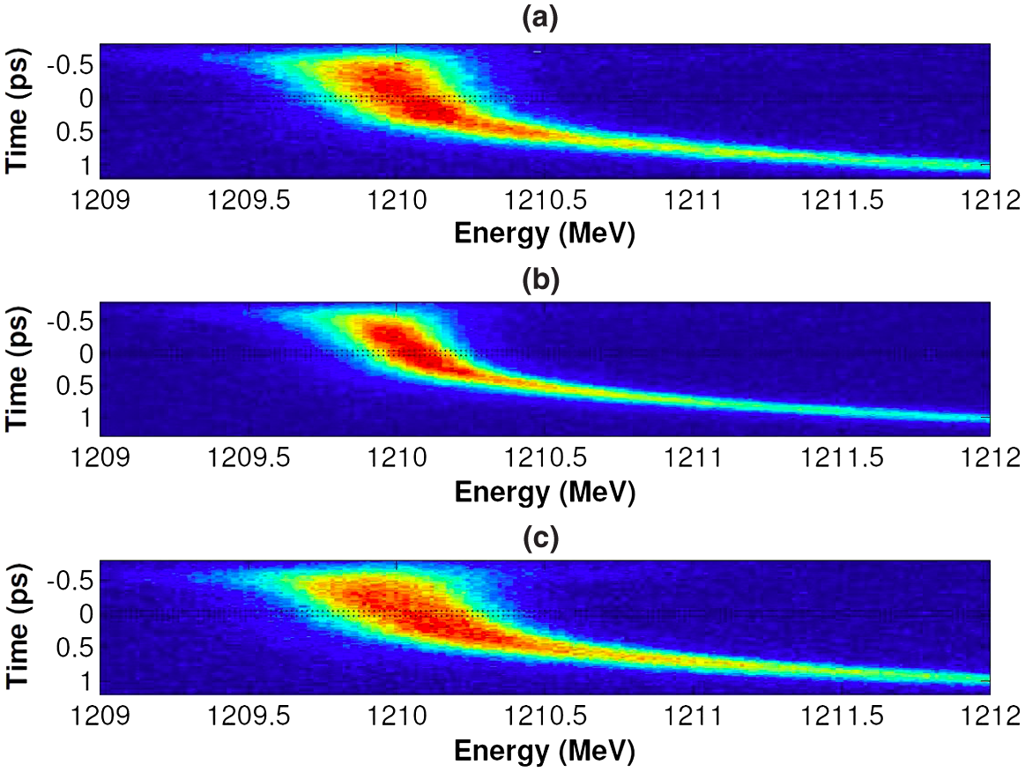
Controlling MBI: Laser Heater (Does it actually work?)
S. Spampinati et al., PRSTAB 17 (2014)
Slice energy spread as a function of the energy spread added by the LH
There exists a compromise (and an optimal setup) to minimize the slice energy spread and reduce MBI

Slide 27
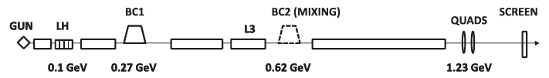
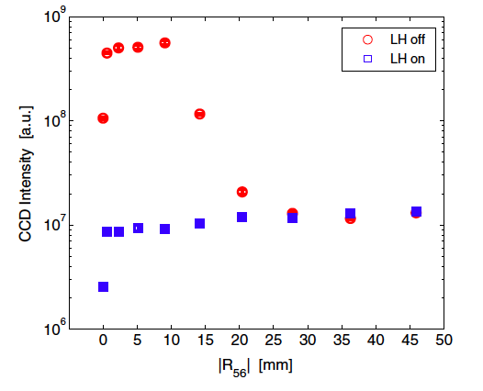
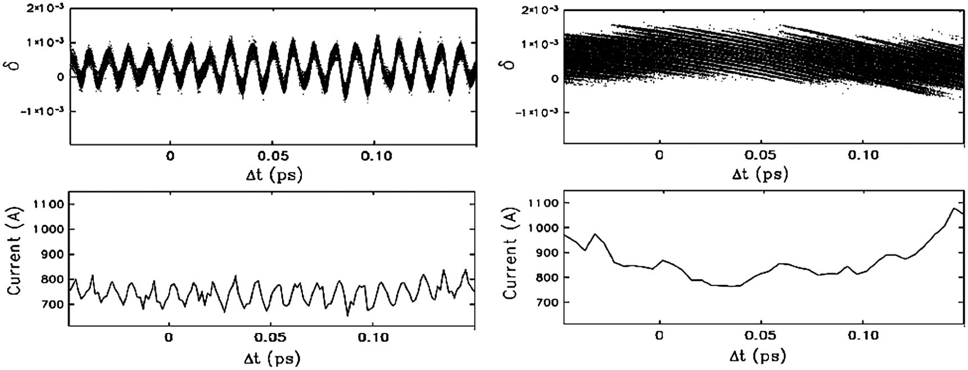
Controlling MBI: Phase Mixing
Di Mitri, Spampinati, PRL (2014)
Use of BC2/transfer line R₅₆ to mix the modulations
  Advantageous because is not increasing the uncorrelated energy spread of the beam
Integrated OTR intensity
Simulation of the «rotation» in LPS

Slide 28
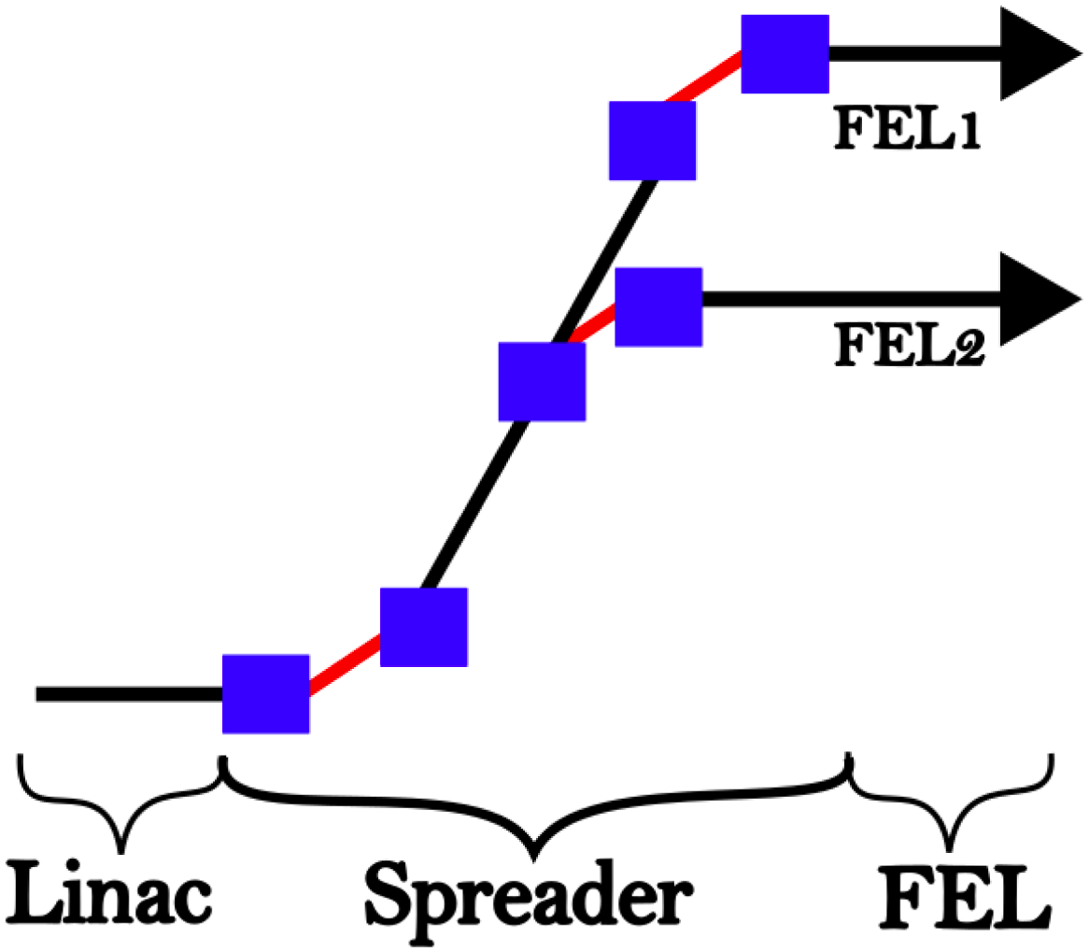


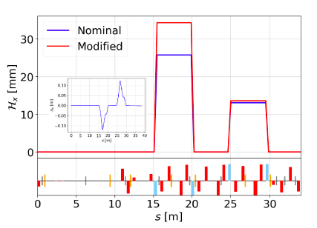
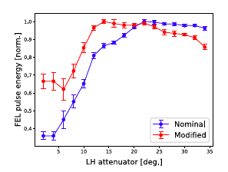

Controlling MBI: Transverse Landau Damping
Dispersive motion coupled to betatron emittance: H_{x}ε_{x}
  Advantageous because is not increasing the uncorrelated energy spread of the beam
  Less sidebands
  Less jitter
A. Brynes et al., PRAB 27 (2024)

Slide 29
PART 4: Simulations

Slide 30


Another bit of History
Pioneering work based on ELEGANT (see also references therein)
MBI comes from noise, therefore
Simulations of LSC+CSR
60 milions particles + low-pass filter + interpolation
NAFF (Numerical Analysis of Fundamental Frequencies) instead of FFT
Noise vs # of macroparticles

Slide 31


With MBI
J. Qiang et al., PRAB 20 (2017)
Particle tracking
Start-to-end simulations
of MBI at LCLS with IMPACT
Parameters | Values
Charge | 180 pC
Energy spread | 2.1 (With MBI) MeV 1.2 (No MBI) MeV
Peak current | 1000 A
Beam Energy | 4.3 GeV
No MBI
Left panels: Measurements
Right panels: Simulations

Slide 32
Thank you for the attention

Slide 33
Back-up Slides

Slide 34
PART 5: Measurement

Slide 35


Direct methods
Ratner et al., PRAB 18 (2015)
BC1
BC2
XTCAV
Laser Heater

Slide 36


Direct methods: SPIR
SPIR: SPectrometer in the InfraRed
The scheme uses a CaF₂ prism to disperse the broadband CTR (Coherent Transition Radiation) radiation emitted by a metallic foil.
PbSe and Pyroelectric detectors are used to cover a wavelength range from 0.25 to 10 𝜇m, both translated across the radiation beam and spectra.
Based on
Courtesy of M. Veronese and C. Spezzani

Slide 37




Direct methods: SPIR
Collection of MBI spectra as a function of the electron beam current
Laser Heater, standard configuration:
the whole beam experience
an “homogeneous” heating
In the standard configuration, MBI is exponentially suppressed when the induced energy spread is increased.
τ ~20 ps

Slide 38

Artificial MBI
Laser Heater, beating technique:
the whole beam experience a modulation
at the beating frequency of laser pulses
Collection of spectra from superimposed energy modulations in the beam as a function of the electron beam current
τ ~10 ps

Slide 39
Direct methods
2D FFT transform
Radon transform

Slide 40
Figures of merit

Slide 41




HK vs BKW: what do they agree on?
energy mod.
R₅₆, CSR
z
wavelength, ~1 𝜇m to hundreds of 𝜇m
density mod.
LSC
dispersive region
acceleration
HK
Integral linearized Vlasov eq., solved by iteration at 2nd order in kernel.
4 dipoles chicanes
Bunching factor:
1-D, shot noise
Energy modulation:
energy-dependent, s-integral
Final bunching factor:
$b\left[k(s);s\right]=b_{0}\left[k(s);s\right]+\int_{0}^{s}{dτ}K\left(τ,s\right)b\left[k(τ);τ\right]$
BK
Matrix model for modulations in the 2D long. ph. sp.
Generic dispersive term
$$S(s;λ)=\frac{1}{\left.E(s\right)}\left(\begin{matrix}\left.E(s\right) & 0 \\ −Z_{int}\left(λ\right)s & \left.E(0\right)\end{matrix}\right)$$

Slide 42
FFT vs NAFF

