Slide 1
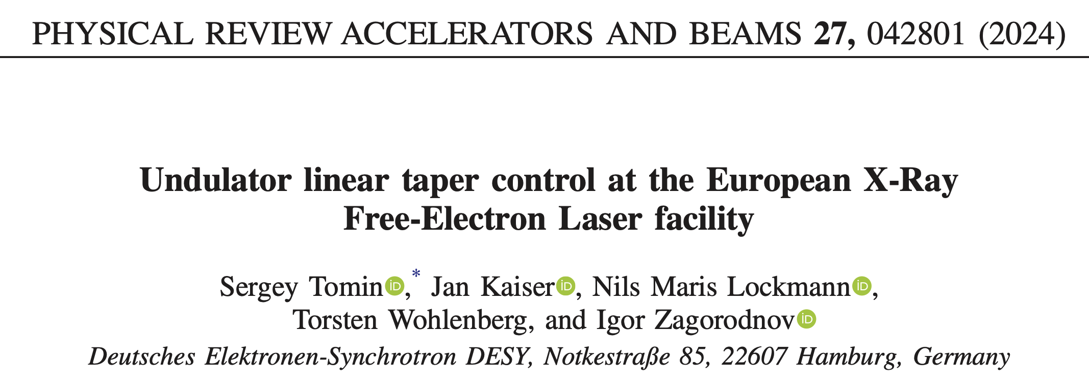
Undulator linear taper. Wakefield energy loss measurement.
Sergey Tomin
DESY
DESY, September 24, 2024

Slide 2
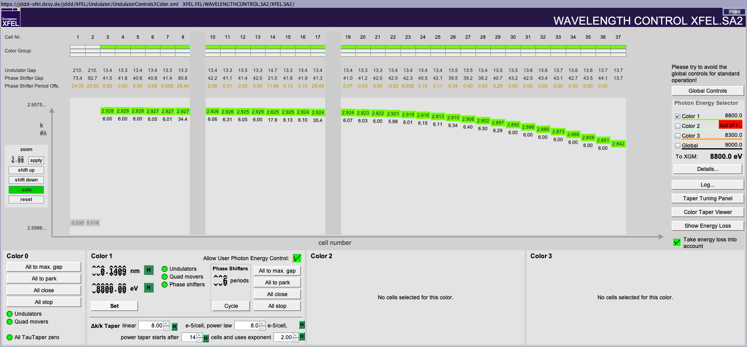
Undulator taper
Undulator tapering controls the resonance properties of the Free-Electron Laser (FEL) amplification process.
Undulator length 225 m
Resonance condition
$$λ= \frac{λ_{u}}{2γ^{2}}\left(1+ \frac{K^{2}}{2}\right)$$
Undulator parameter
Linear taper:
SR + wakes
$$K= \frac{{B λ}_{u} c}{2 π mc^{2}}$$
Nonlinear taper: SR + wakes + FEL
$$K\left(n\right)=K_{0} −A∙n −B∙ {\left(n −N\right)}^{C}H(n −N)$$
Taper to compensate energy loss
$$\frac{∆K}{K}= \frac{1+ {K^{2}}/2}{{K^{2}}/2}\frac{∆γ}{γ}$$
At the moment it is manual 4D optimization.

Slide 3
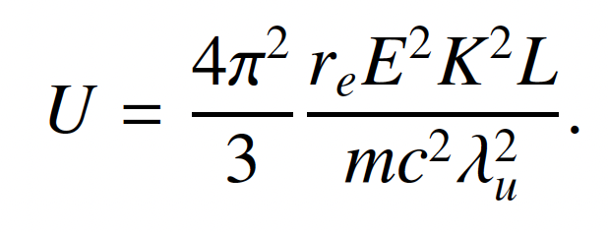
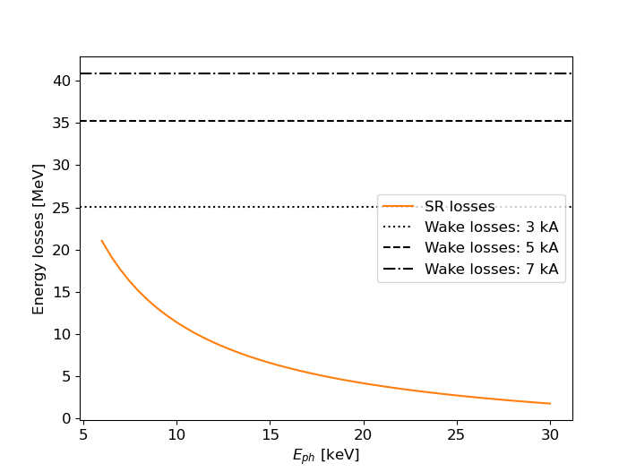
Undulator linear taper
Undulator tapering controls the resonance properties of the Free-Electron Laser (FEL) amplification process.
Linear taper is defined by beam energy losses due to SR and wakefields in undulator vacuum chamber
Spontaneous radiation is well know and can be easily calculated
Energy losses in SASE1/2 (35 cells) undulator due to wakefields and SR
Electron beam energy 14 GeV
SR losses are already taking into account by control system

Slide 4
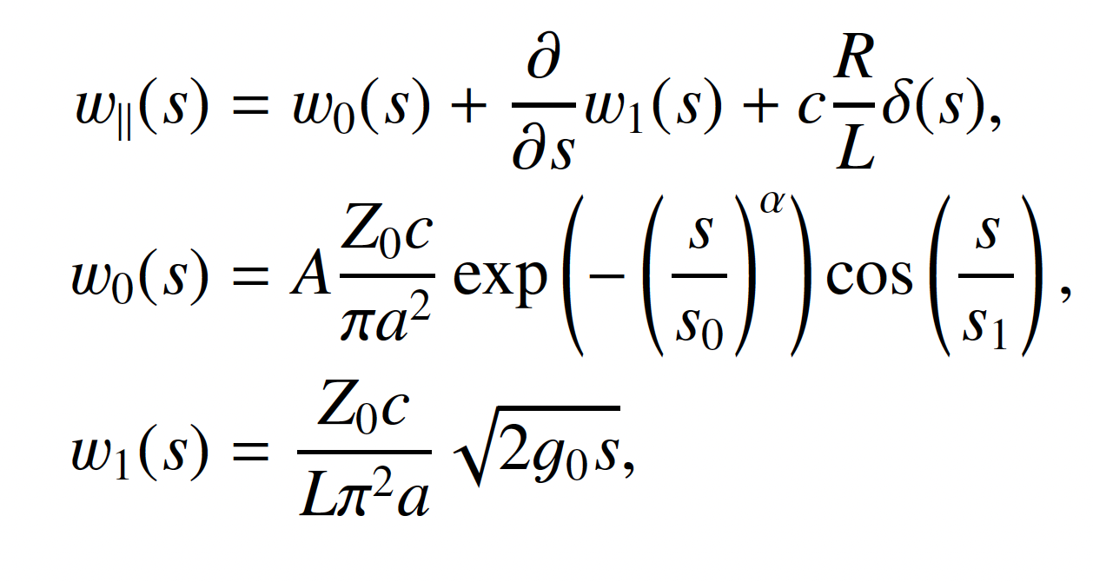
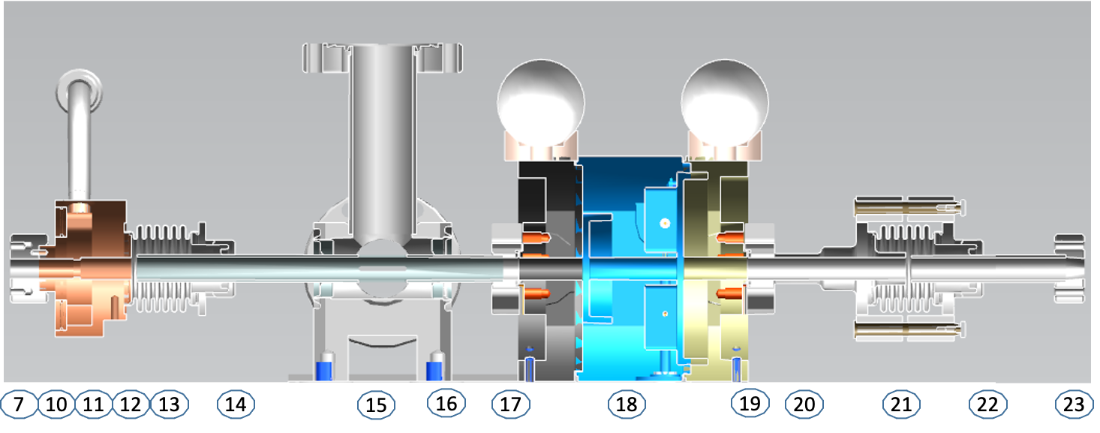
Undulator linear taper
Undulator tapering controls the resonance properties of the Free-Electron Laser (FEL) amplification process.
Linear taper is defined by beam energy losses due to SR and wakefields in undulator vacuum chamber
Spontaneous radiation is well know and can be easily calculated
Wakefields energy loss calculation requires undulator wakefield function and current profile
Analytical approximation of wakefield function was developed for EuXFEL undulator vacuum chamber by I.Zagorodnov
Analytical approximation
Wake potential
$L=6.1$m, $A=0.937$, $a=5$mm, $α=1.29$, $s_{0}=33.8$ m, $s_{1}=9.86$ m, $g_{0}=123$ mm, $R=30.5 Ω$
Absorber
Pumping slot
BPM
I.Zagorodnov et al., Short-range longitudinal wake function of undulator lines at the European X-ray free electron laser, Nucl. Instrum. Methods A, vol. 1043, 2022, 167490

Slide 5
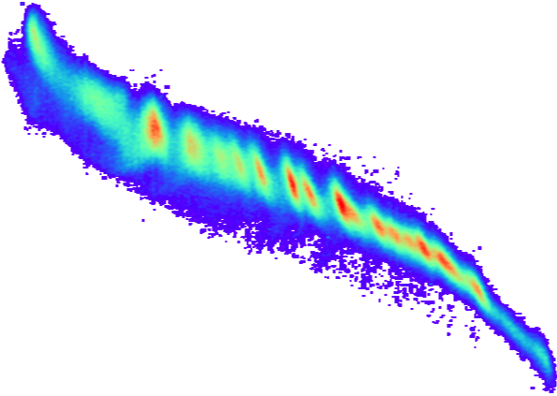
Current profile reconstruction with CRISP - non invasive THz diagnostics
A direct measurement of the current profile in the time domain can be achieved using transverse deflecting structures (TDS) – invasive, beam losses, low reprate.
TDS
Screen

Slide 6
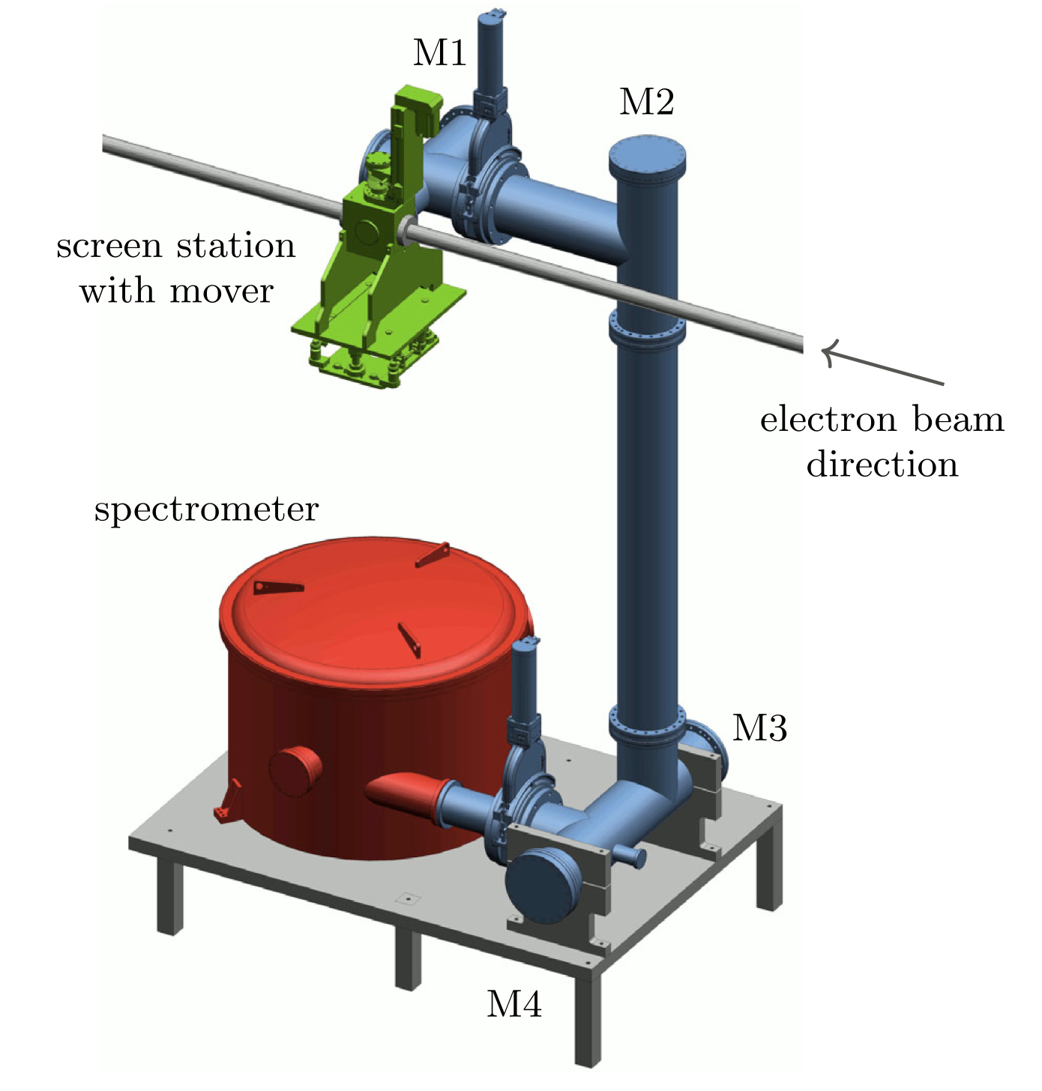
Current profile reconstruction with CRISP - non invasive THz diagnostics
A direct measurement of the current profile in the time domain can be achieved using transverse deflecting structures (TDS) – invasive, beam losses, low reprate.
Coherent diffraction radiation is generated by the electron bunch passing through an aperture inside an aluminum screen
The coherent radiation spectrum and current profile of the electron bunch are linked via Fourier transform
N. Lockmann et al, PRAB 23, 112801 (2020)
N. Lockmann et al, Non-invasive Longitudinal Profile Measurements of Electron Bunches Simultaneously to FEL Operation at MHz Rates, IBIC 2020

Slide 7
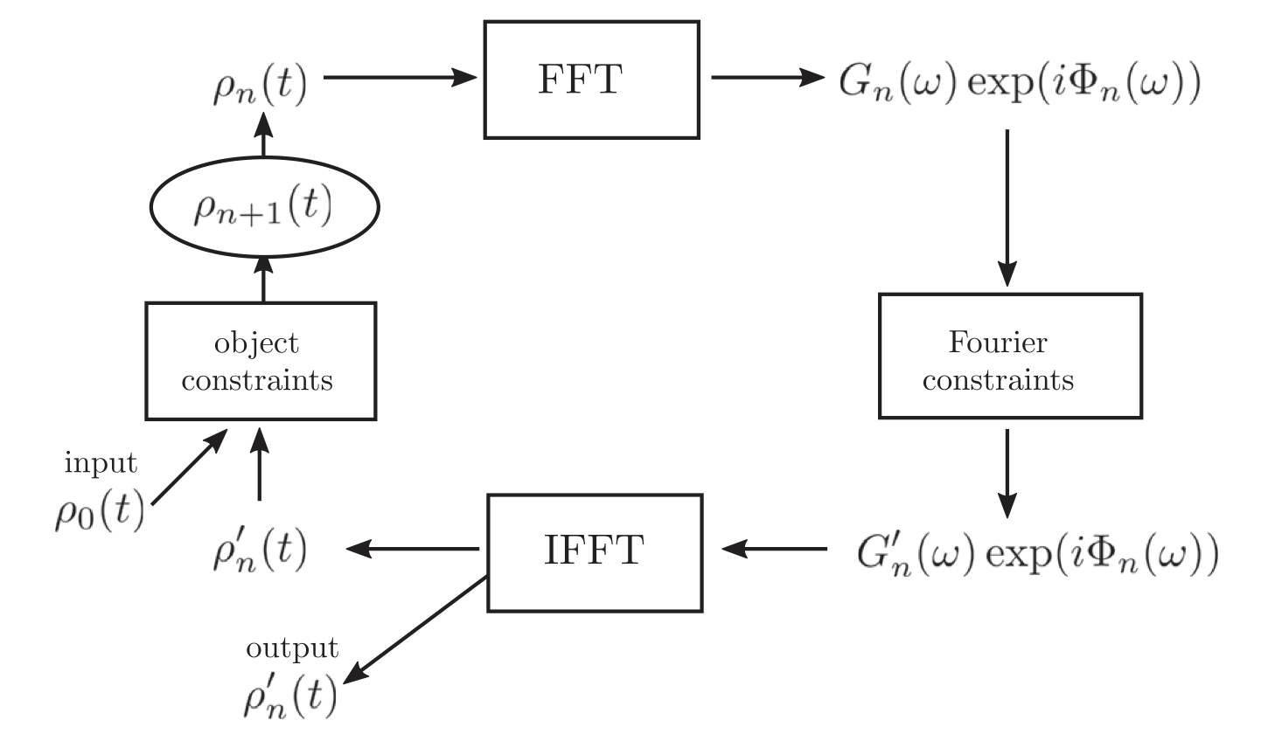
Current profile reconstruction with CRISP - non invasive THz diagnostics
A direct measurement of the current profile in the time domain can be achieved using transverse deflecting structures (TDS) – invasive, beam losses, low reprate.
Coherent diffraction radiation is generated by the electron bunch passing through an aperture inside an aluminum screen
The coherent radiation spectrum and current profile of the electron bunch are linked via Fourier transform
Assumed current profile:
Gaussian,
Rectangular …
Kramers-Kronig phase
Block diagram of the Gerchberg-Saxton algorithm
Current reconstruction
computed modulus $G_{n}\left(ω\right)$is replaced by measued $F_{n}\left(ω\right)$. Or it is retained at those discrete frequencies $ω_{i}$where it agrees within the estimated experimental error margin.
Current profile can not be negative
B. Schmidt et al, Benchmarking coherent radiation spectroscopy as a tool for high-resolution bunch shape reconstruction at free-electron lasers, PRAB 23, 062801 2020

Slide 8
Benchmark theory with experiment
Problem:
Beam energy monitors (BEM) is aimed for absolute energy measurement and they have low accuracy ~ 1%. Not enough to measure energy change of order of tens of MeV

Slide 9
Benchmark theory with experiment
Problem:
Beam energy monitors (BEM) is aimed for absolute energy measurement and they have low accuracy ~ 1%. Not enough to measure energy change of order of tens of MeV
Solution
Calibration BEM with spontaneous radiation – close undulators one by one
Obtained calibration factor for BEM#2
BEM #2 calibration with SR

Slide 10
Side story about SR based dispersion calibration
S.Tomin et al, First Measurement of Quantum Diffusion in the Undulator Radiation. FEL 2024, Warsaw.

Slide 11
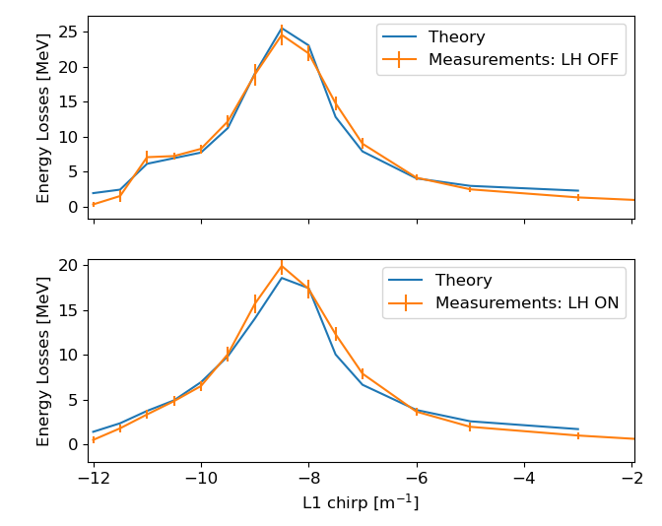
Benchmark theory with experiment
Energy FB to keep BEM#1 readings constant
Result of the experiment
We scanned beam compression – beam current profile
Beam energy at BEM#1 kept constant with energy FB.
Current profile comes from CRISP reconstruction.
Measurements were relative. Assuming that in lowest compression the beam energy loss <0.5 MeV
We performed two scans with LH off and on. It means different maximum current at full compression.

Slide 12
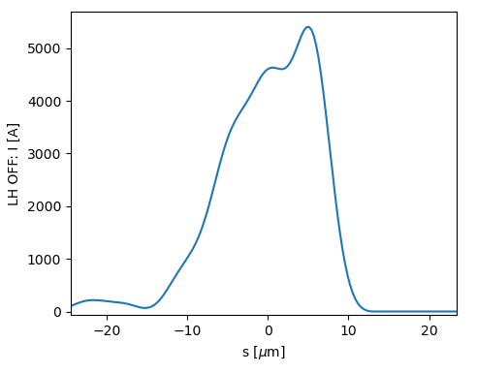
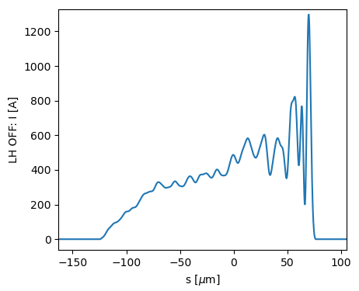
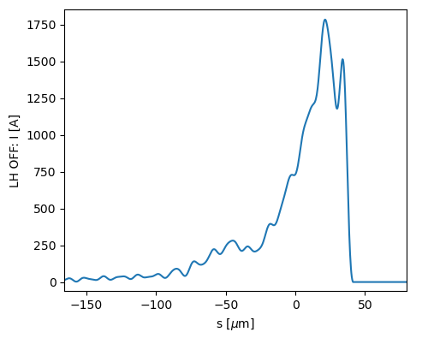
Benchmark theory with experiment
full compression
low compression
Energy FB to keep BEM#1 readings constant
Result of the experiment
over compression
We scanned beam compression – beam current profile
Beam energy at BEM#1 kept constant with energy FB.
Current profile comes from CRISP reconstruction.
Measurements were relative. Assuming that in lowest compression the beam energy loss <0.5 MeV
We performed two scans with LH off and on. It means different maximum current at full compression.

Slide 13
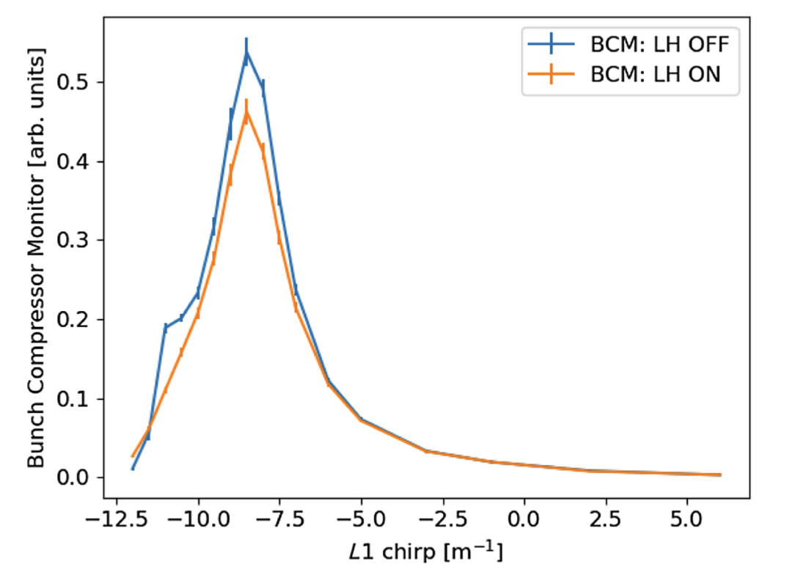
Benchmark theory with experiment
full compression
low compression
Energy FB to keep BEM#1 readings constant
BCM readings
Result of the experiment
over compression
We scanned beam compression – beam current profile
Beam energy at BEM#1 kept constant with energy FB.
Current profile comes from CRISP reconstruction.
Measurements were relative. Assuming that in lowest compression the beam energy loss <0.5 MeV
We performed two scans with LH off and on. It means different maximum current at full compression.

Slide 14
Wakefield contributions
BEM#1
314m
40mm pipe

Slide 15
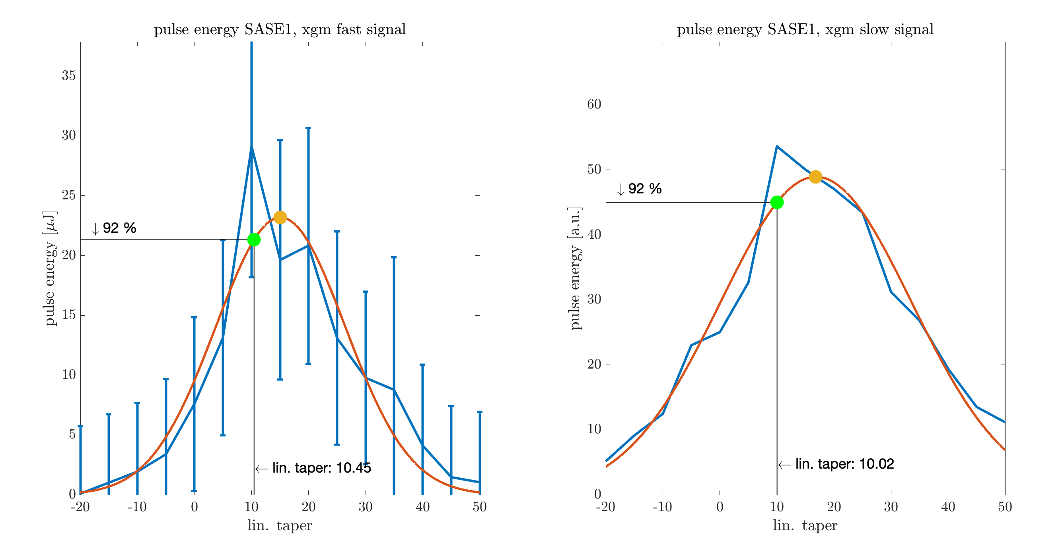
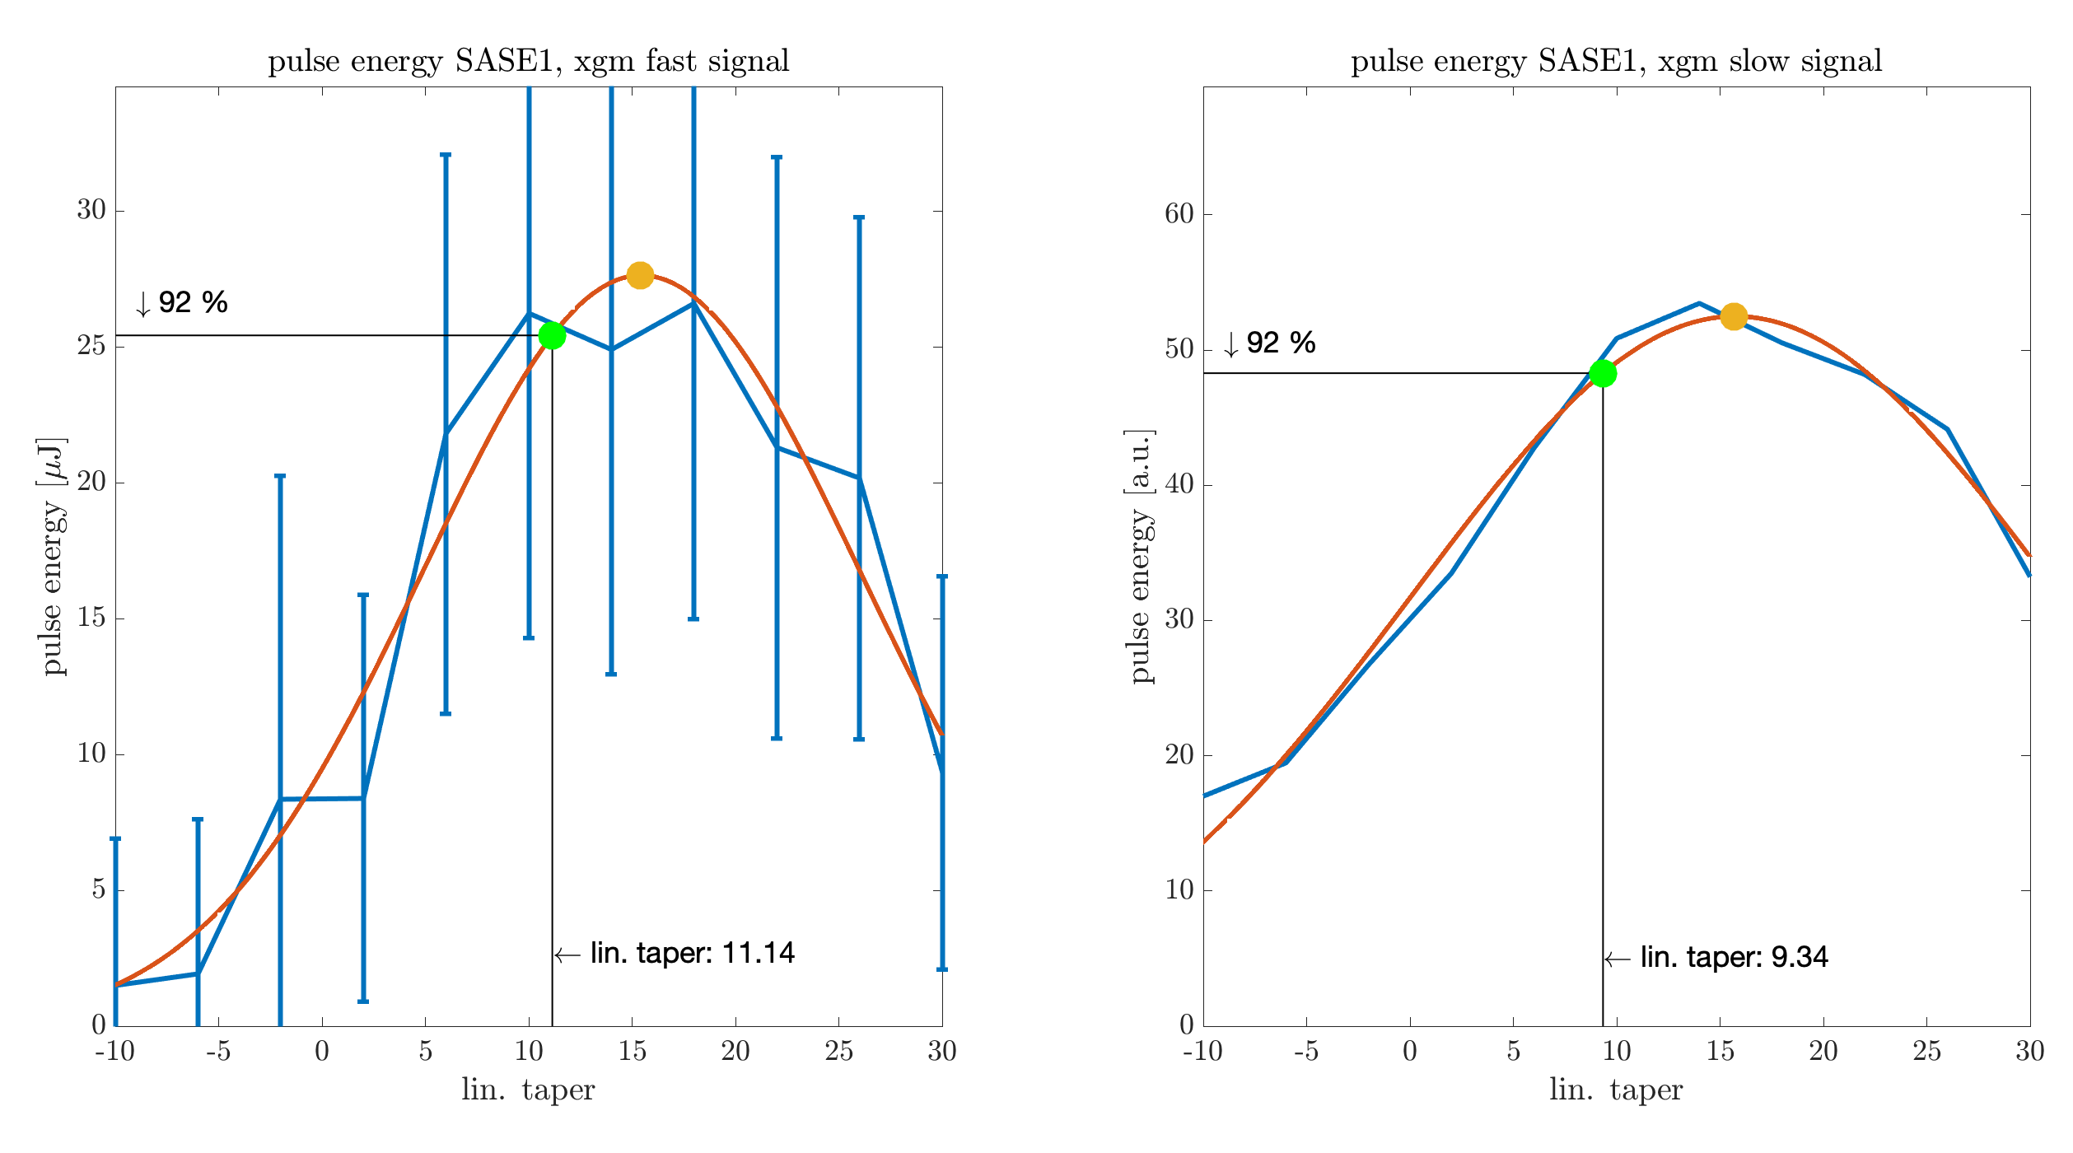
Comparison with the linear taper scan tool. Shift 25.09.2023
Sign is “wrong” here
SASE1 beam line
Beam Energy: 14000 MeV Photon Energy: 6300 eV
Measurement was done with E. Schneidmiller

Slide 16
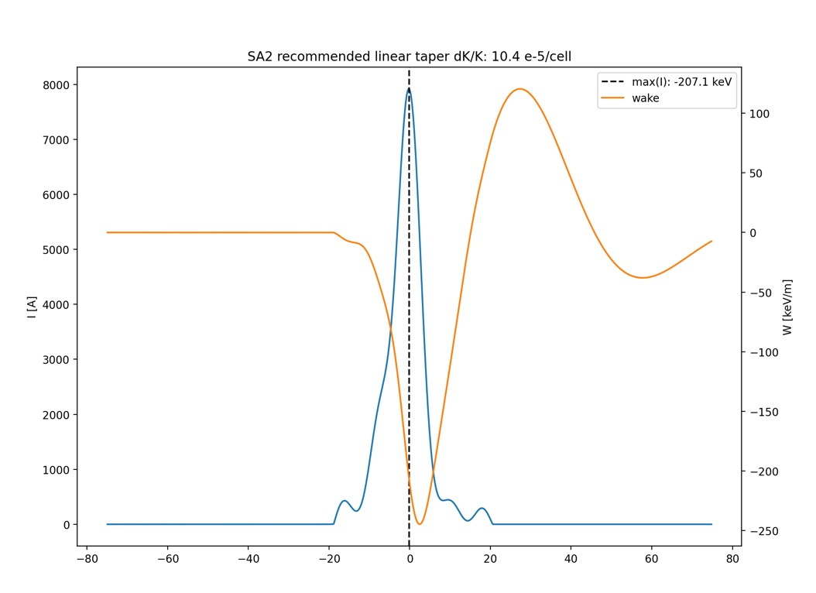
Comparison with the linear taper scan tool. Shift 3.10.2023, I = ~8 kA
SASE2 beam line
Beam Energy: 14000 MeV Photon Energy: 6505.71 eV
Measurement was done with E. Schneidmiller

Slide 17
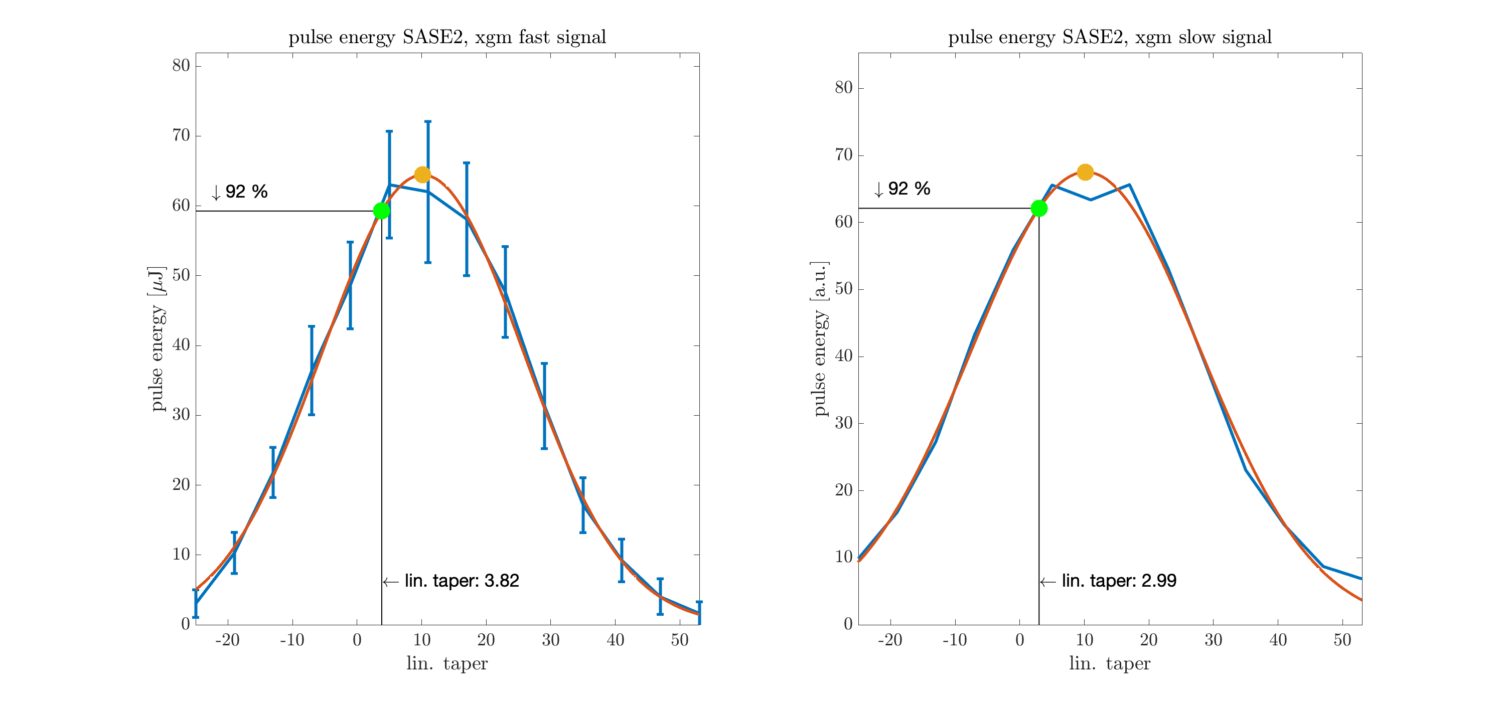
Comparison with the linear taper scan tool. Shift 3.10.2023, I = ~5 kA

Slide 18
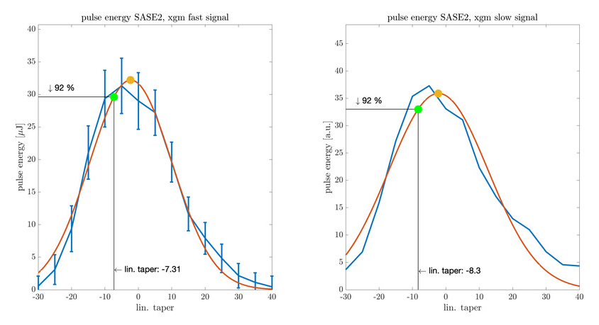
Comparison with the linear taper scan tool. Shift 3.10.2023, I = ~3 kA

Slide 19
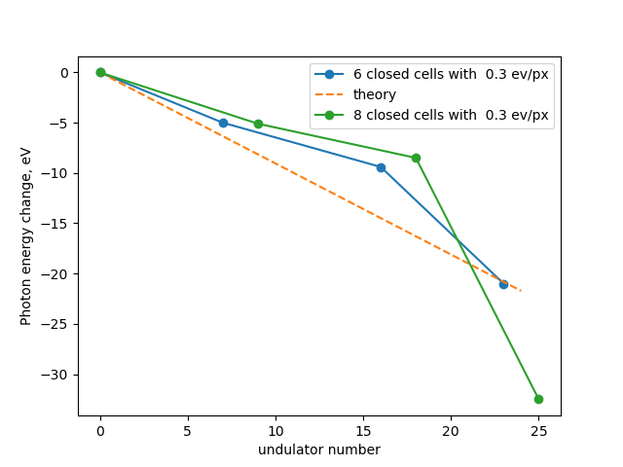
Compare with SASE spectrum shift
Idea of M.Yurkov.
Get radiation from 6-8 cells.
Find mean spectrum position on HIREX
Shift undulator (aka sliding window)
Measure mean spectrum position shift

Slide 20
Is CRISP good enough for current profile reconstruction?

Slide 21
Is CRISP good enough for current profile reconstruction?
Beam head and tail cannot be distinguished due to the missing phase in CRISP signal
Loss factor (mean energy loss) is the same for both cases
Undulator taper compensates energy loss for lasing slice
Energy loss for center of mass: 75 and 53 keV/m.
For maximum current: 73 and 68 keV/m

Slide 22
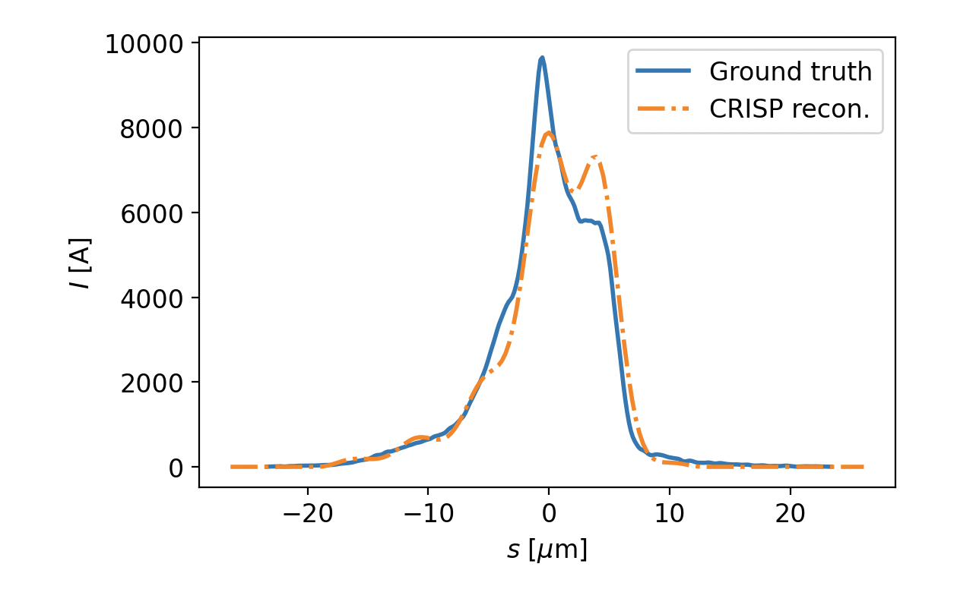
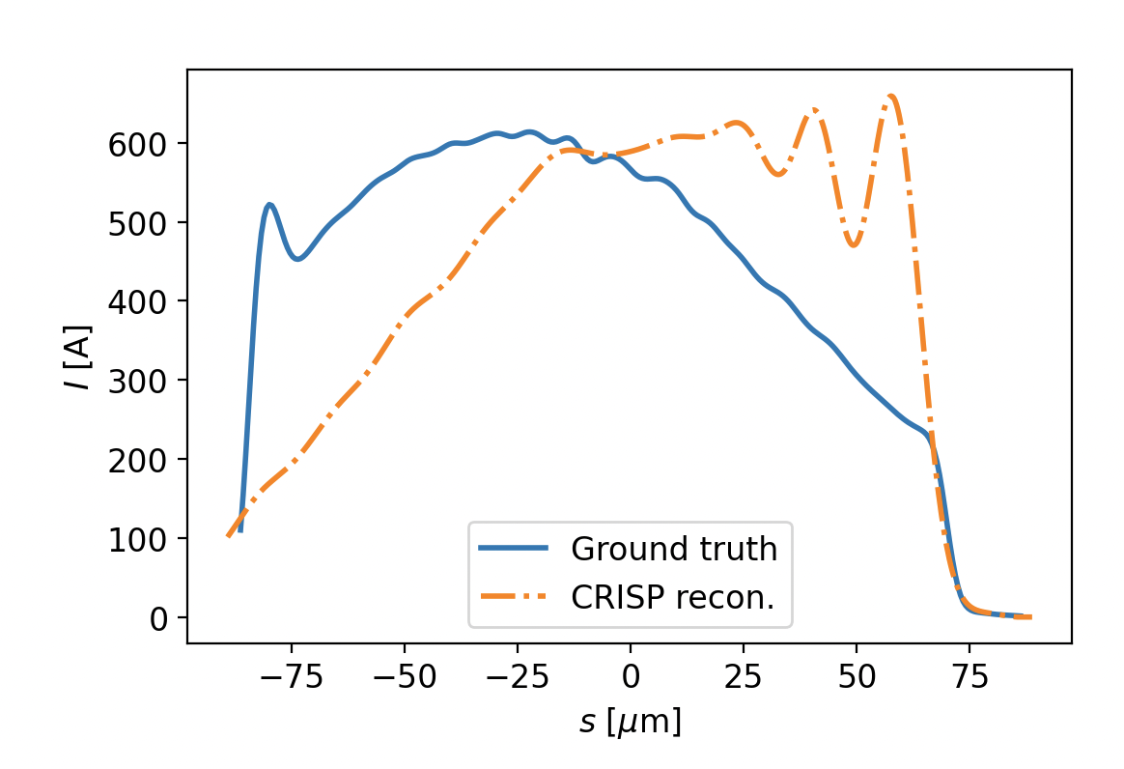
Is CRISP good enough for current profile reconstruction?
Beam head and tail cannot be distinguished due to the missing phase in CRISP signal
Loss factor (mean energy loss) is the same for both cases
Undulator taper compensates energy loss for lasing slice
CRISP reconstruction resolution is > 6fs
Noisy signal for low current
Energy loss for center of mass: 75 and 53 keV/m.
For maximum current: 73 and 68 keV/m

Slide 23
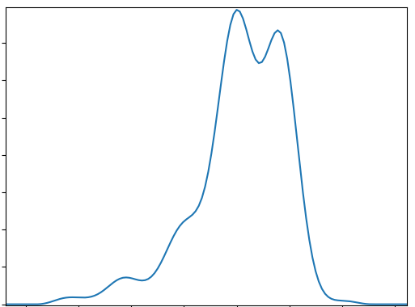
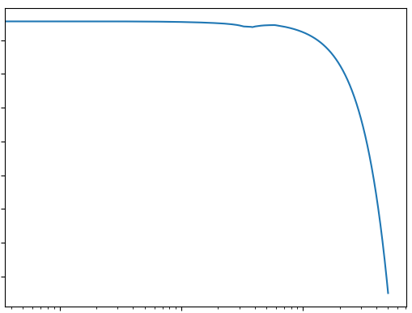
Machine Learning?
Ocelot accelerator model: 2nd order tracking, SC, CSR, wakes
Astra gun simulations
Ocelot s2e accelerator model was developed
tens of thousand simulations was performed with different RF parameters including physics effects: SC, CSR, wakes (40k particles).
CRISP outputs was simulated from the beam current profiles
Beam current
CRISP output
I [kA]
FF
FFT
t [fs]
f [THz]

Slide 24
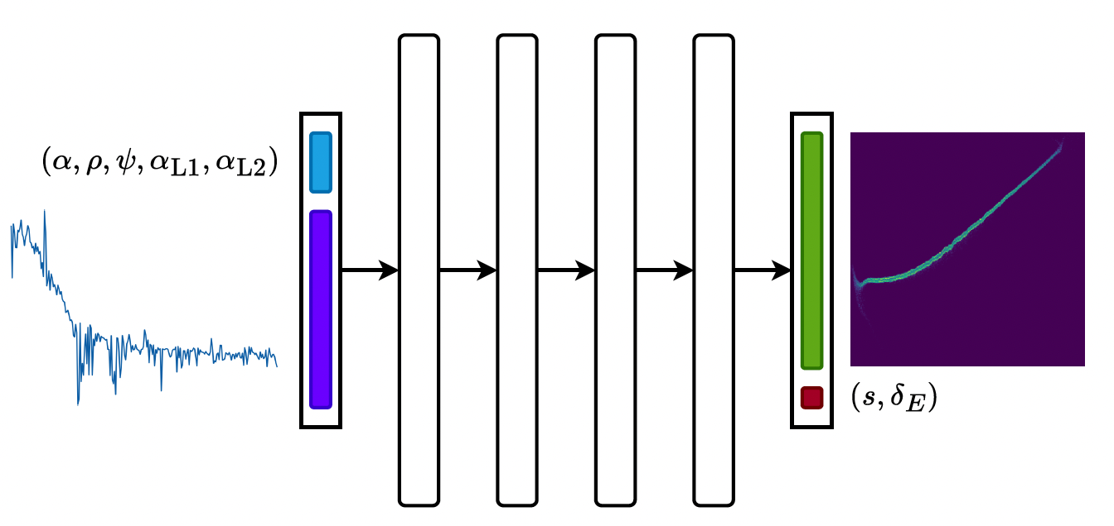
NN for LPS prediction
NN network was trained:
Input: CRISP form factor + RF parameters
Output: LPS
Does this approach work better then CRISP reconstruction?
J. Kaiser, A. Eichler, S. Tomin, Z. Zhu, Machine Learning for Combined Scalar and Spectral Longitudinal Phase Space Reconstruction, IPAC23.

Slide 25
Comparison of the CRISP, NN and ground truth
However if we need to compensate energy loss for particular slice we need to know current orientation. And here ML can help us

Slide 26
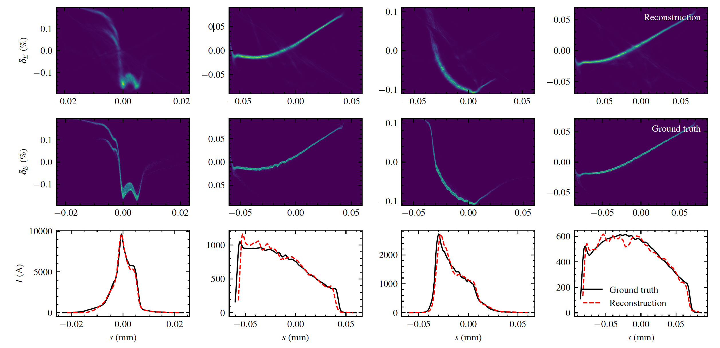
Summary
We demonstrated the wakefunction is agreed with experiment
It is essential to predict linear taper
It can also improve FEL simulations
CRISP diagnostics can be used for non invasive current profile measurements and it can be trusted.
Machine learning
It is useful already to improve the CRISP current profile reconstruction
And ML can be potentially useful for LPS prediction → we started new ML project to predict LPS based on simulations + CRISP and other non-invasive diagnostics

