Slide 1
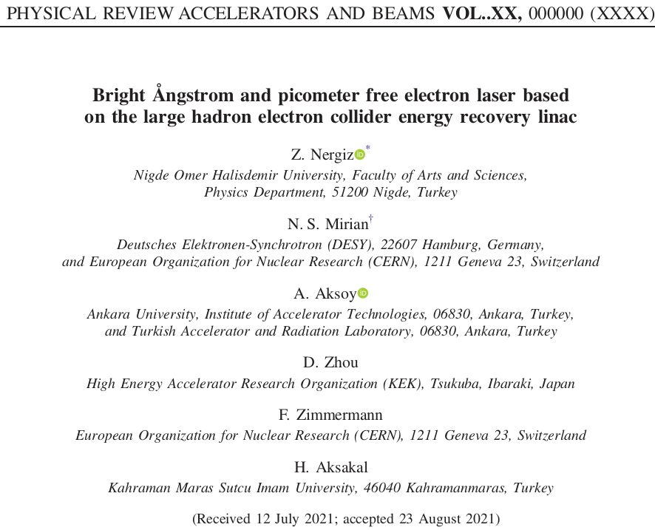
CSR effect in the ERL-Based light source
Najemh S. Mirian
DESY (MPY)
05/10/2021
This project was supported by CERN

Slide 2
Outline
Story of CSR in free space and in chamber
Story of our ERL from LHeC and our new proposal for FEL
Beam dynamics simulation
FEL simulation
Energy recovering
We review CSR and LHeC so fast and we go through beam dynamics and FEL discussion
I hope it does not bore you !
I try to present it in interesting way

Slide 3
Story of CSR in free space and in chamber
We go through the current equations and code from 1954 to 2020

Slide 4
CSR with shielding :
WE DO NOT TALK ABOUT THE DETAIL, JUST WE WANT TO HAVE A VIEW.
We know
The coherent radiation loss by electrons , increases with decreasing bunch size.
The coherent radiation mainly in microwave regions can be suppressed in part by the use of metallic shields.

Slide 5
POWER RADIATED BY ONE ELECTRON
I know you have seen the papers and reports start with Lienard-Wiechert field for free space.
WE NEED TO FIND GREEN FUNCTION
the Green's function, which is to be evaluated on the orbit as indicated, is the outgoing wave solution of
must satisfy appropriate boundary conditions if a metallic shield is present. We consider
three cases as follows: no shielding, infinite Parallel Plate shields and finite parallel Plate shield

Slide 6
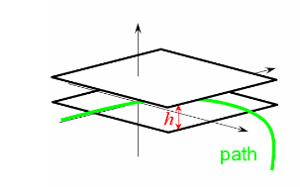
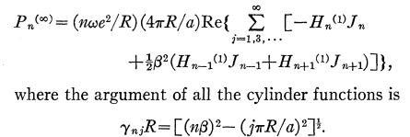
Free space
II. Infinite Parallel Plate Shields

Slide 7
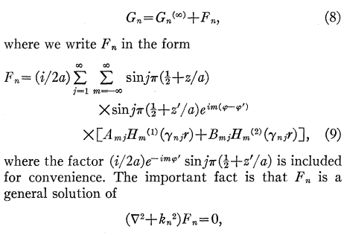
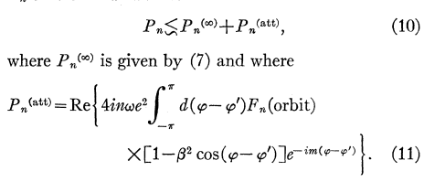
III. Finite Parallel Plate Shields
In this case, the Green's function in the region between the plates must satisfy appropriate (and very complicated) boundary conditions at the surfaces r=R1 and r=R2 in addition to the boundary conditions of Eq. (5). These extra conditions can be satisfied only if a general solution of the homogeneous equations is added to the Green's function of Eq. (6). Thus for this case we must have
THAT IS FOR SINGLE ELECTRON, FOR BUNCH !

Slide 8
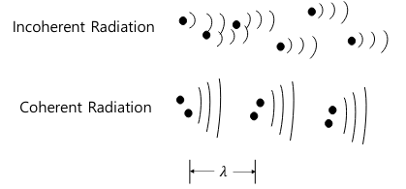
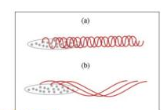
Radiation from beam of electron :
The kth electron to have the angular coordinate
at time t. In the Fourier decomposition of the fields, the contribution of each electron thus contains a phase factor
for the nth harmonic.
That the power radiated in the eth harmonic by the N electrons is
The first term gives just the incoherent power loss. Since the spectrum of this radiation is mostly in the visible or ultraviolet region, it is of course unaffected by the presence of the shields.. Our interest is in the second term, representing the coherent radiation, which we express as
probability

Slide 9
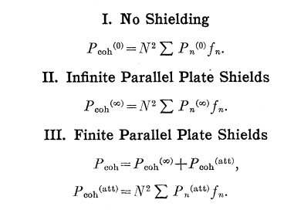
0D and 1D shielding
uniformly distributed over an angular interval ⍺, then
Schwinger
Schiff

Slide 10
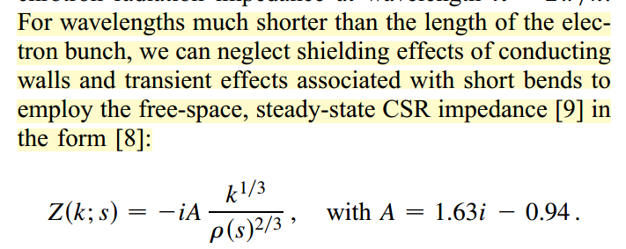
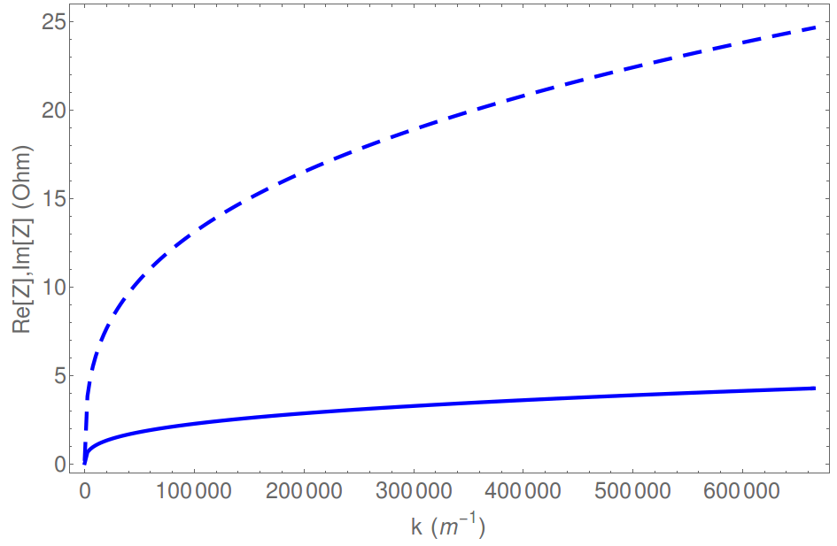
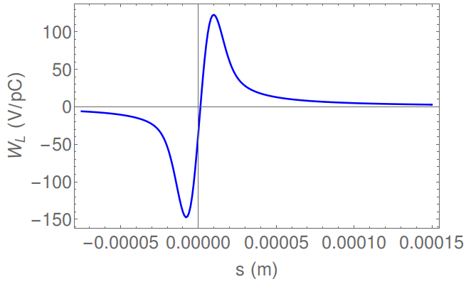
For tracking simulation we have to look at impedance or wakefield
Free space
head
Demin’s thesis
tail
Rbend=192.3 m
Lbend=1 m
Bunch length 75 um

Slide 11
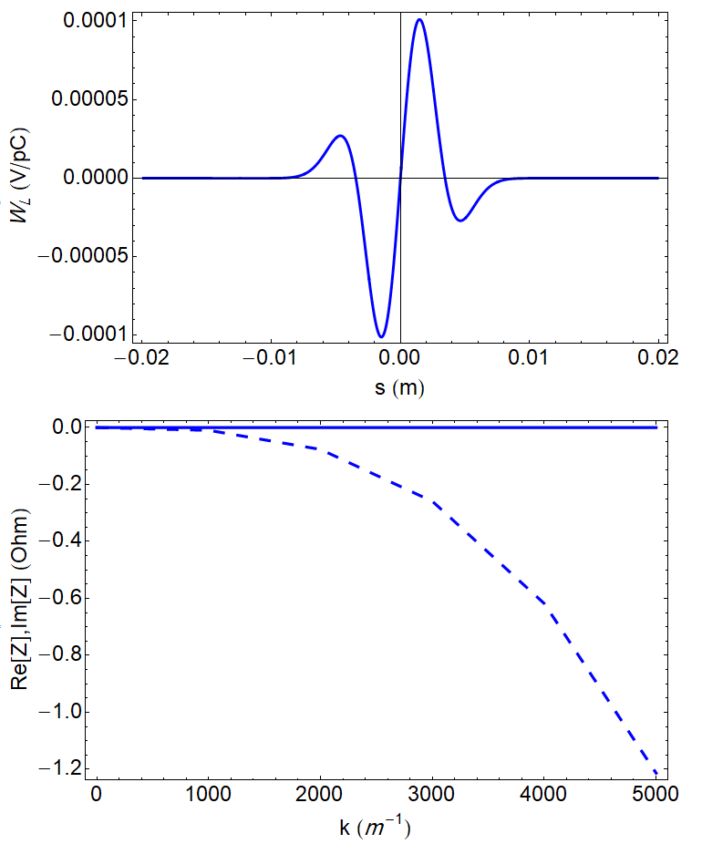
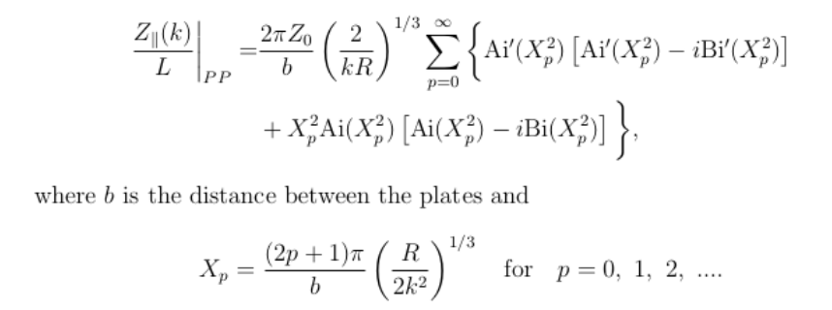
1D shielding
Two perfectly conducting plates in the horizontal plane
b=7 cm (FCC ee ring )
Bunch length =1.97 mm
L=20 m, roh=10 km
In term of Airy functions
John S. Nodvick and David S. Saxon. Suppression of Coherent Radiation
by Electrons in a Synchrotron. Phys. Rev., 96:180–184, Oct 1954

Slide 12
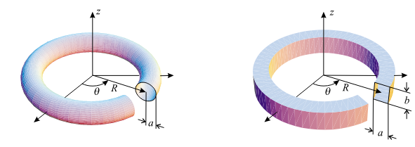
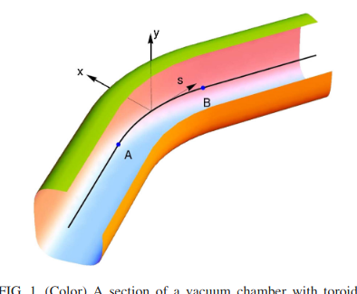
2D shielding
Analytical calculation of the electromagnetic field
When the beam enter to the toroidal and E(0)= steady state coulomb field, carries in the long straight pipe. And longitudinal field at entrance=0
after the beam exits from the toroidal section. The interaction between the radiation field and the beam ceases
an impedance due to coherent synchrotron radiation (CSR) generated by a short bunch of charged particles passing through a dipole magnet of finite length in a vacuum chamber of a given cross section. They decompose the electromagnetic field of the beam over the eigenmodes of the toroidal chamber and derive a system of equations for the expansion coefficients in the series.

Slide 13
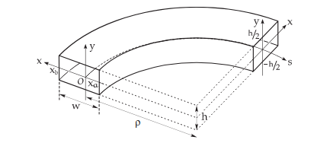
2D shielding
Field equation in the paraxial approximation
273 equations
Eq.178 gives us the shielding threshold

Slide 14
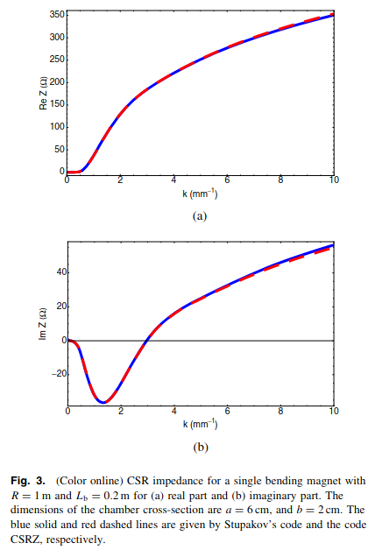
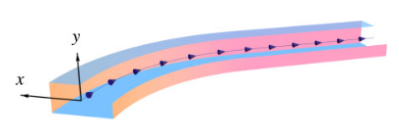
2D shielding
CSRZ also considers the edge effect,
CSRZ code takes R(s) as an arbitrary function (this allows single bend, multi-bends interleaved with drifts, and wiggler/undulator). It also handles resistive wall (RW) and finite beam energy (SC).
Stupakov's code treats a single bend: R(s)=0 with s<0; R(s)=R0 with 0<s<Lbend; R(s)=0 with s>Lbend. No RW and SC.

Slide 15
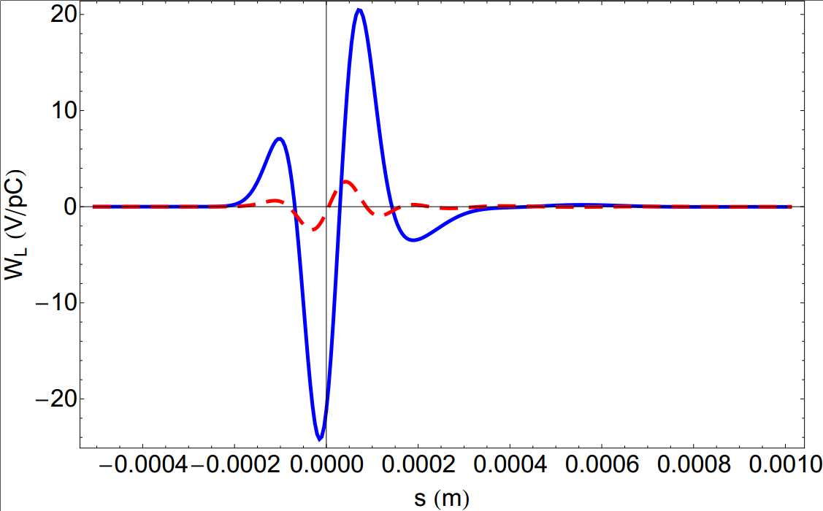
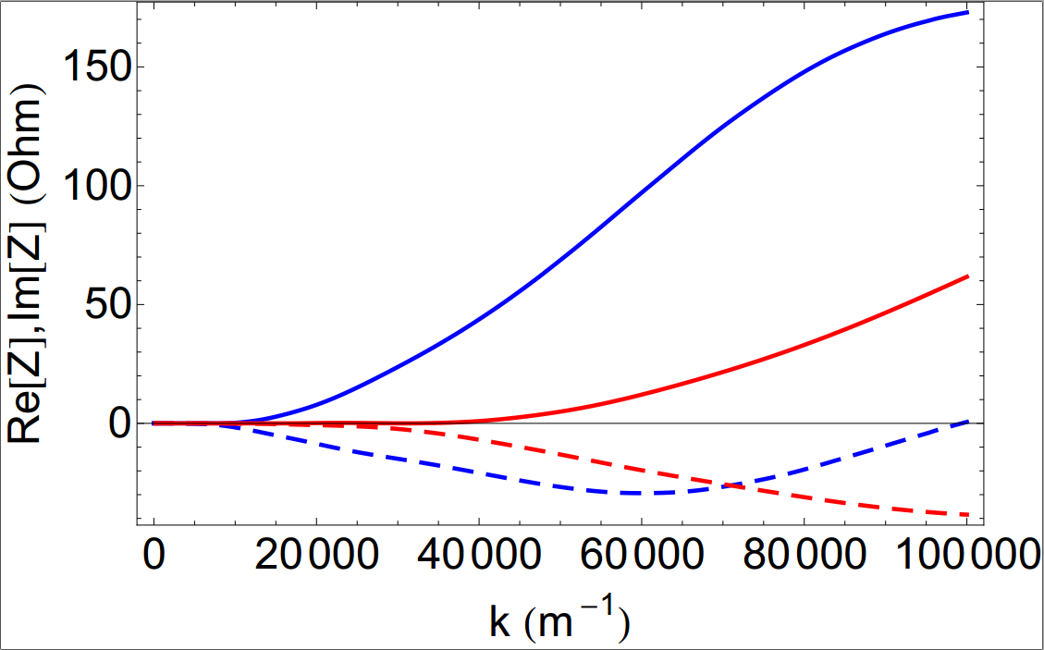
Comparing different chamber sizes
E-beam length=50 um
Chamber size =2 cm (blue)
Chamber size= 1 cm (red)

Slide 16
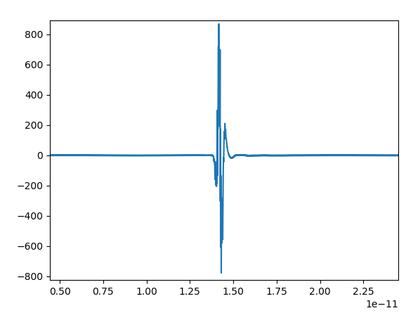
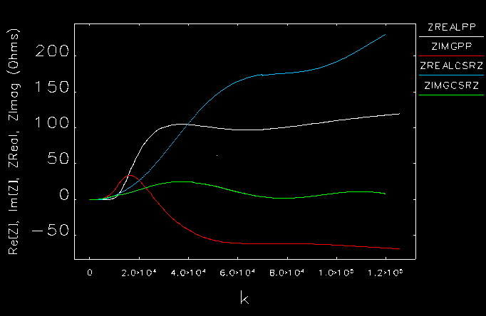
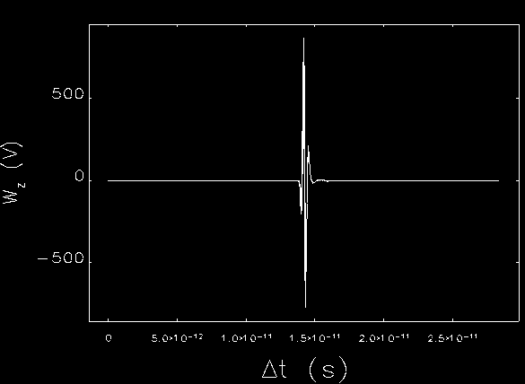
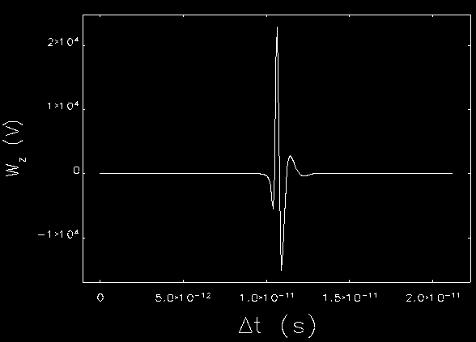
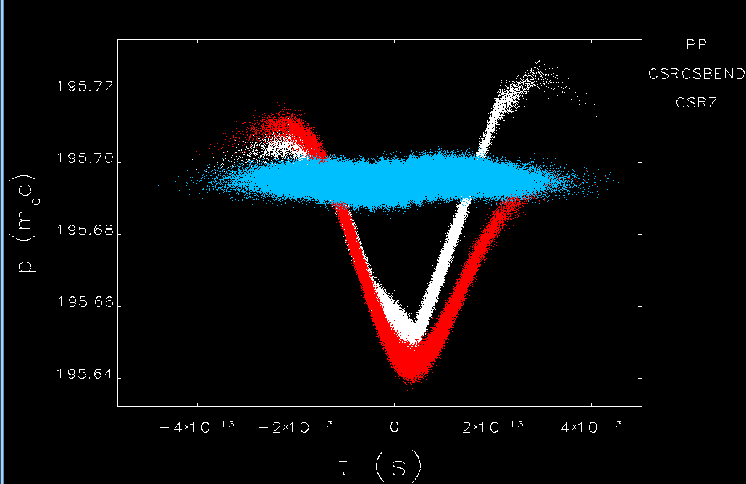
Comparing 1D and 2D shielding
CSRZ(2D)
2D
1D
1D shielding

Slide 17
(very short )Story of our ERL from LheC and our new proposal for FEL

Slide 18
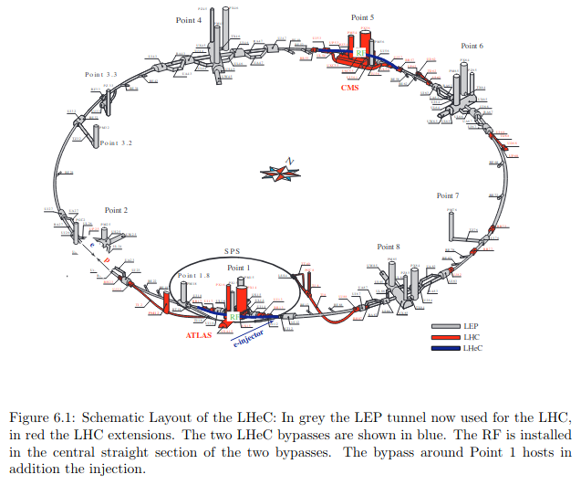
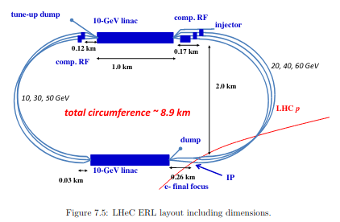
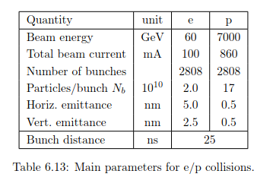
What is LHeC ?
Injection power 500 Mev
Two Superconducting linacs with 10 GV
Three revolution and final energy is 60 Gev
Three additional revolution for deceleration reconvert the energy stored in the beam back to radio frequency (rf) energy.
The beam emittance and the energy spread of the particle beam increase with beam energy due to quantum fluctuations.
J. L. A. Fernandez et al., J. Phys. G 39, 075001 (2012).

Slide 19
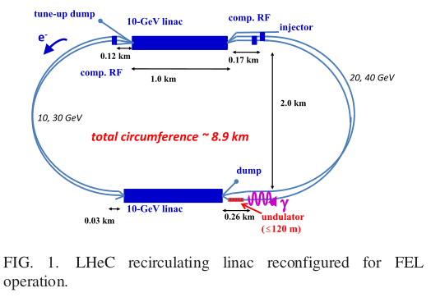
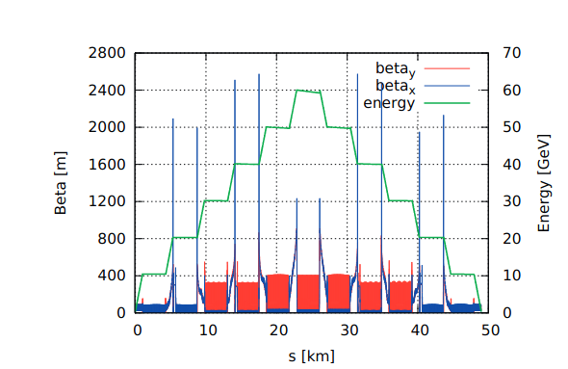
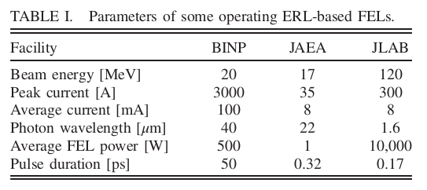
ADAPTING THE LHeC
We can have undulator chains after each linac. This facility give us a lot of opportunities .
We can have 4 FEL lines with different energies.
J. L. A. Fernandez et al., J. Phys. G 39, 075001 (2012).
R. Calaga, Report No. CERN-ACC-NOTE-2015-0015, http://cds.cern.ch/record/2020926.

Slide 20
Beam dynamics simulation

Slide 21
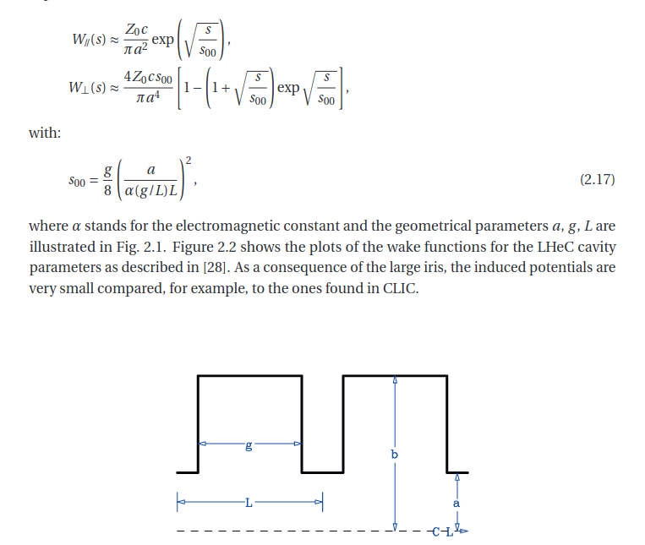
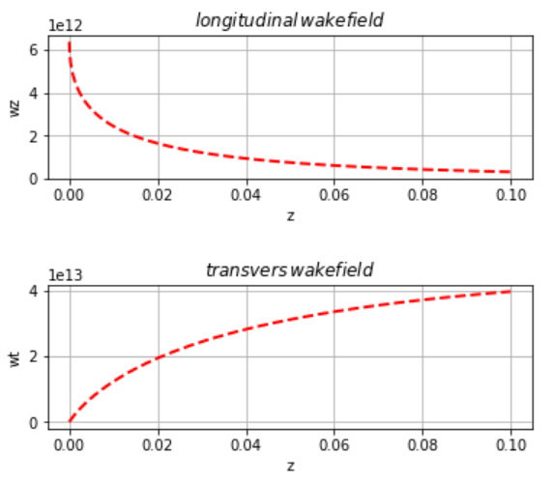
Wakefield of SC:
The transverse and longitudinal wakefields in the LHeC linac rf cavities are modeled using the short-range wake Functions.
the simulation uses the wake potentials (Green function wakefields), and then computes the bunch wakefield from the actual particle distribution whenever the tracked bunch passes through a cavity. To illustrate the magnitude of the LHeC linac wakefield, the nominal wake potential results in a longitudinal loss factor of 2.6 V/pC per cavity in case of a Gaussian bunch with 2 mm rms length.
R. Calaga, Report No. CERN-ACC-NOTE-2015-0015, http://cds.cern.ch/record/2020926.

Slide 22
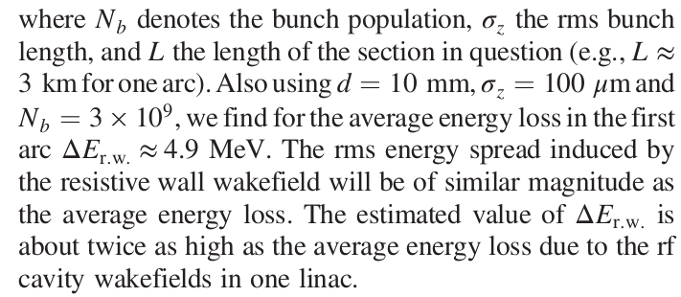
Resistive-wall wakefields
The material of the LHeC vacuum chamber has not been decided. It could be made from copper or aluminum, and possibly be coated.
The characteristics of the resistive wall wakefield are determined by the parameter
with Z0 the impedance of free space (about 120π Ω). The wake function is approximately constant over distances much shorter than s0 , but it oscillates over distances of a few s0 .
Copper ->
Average energy loss over a section of length L
A. W. Chao, Physics of Collective Beam Instabilities in High-Energy Accelerators (Wiley, New York, 1993),https://www.slac.stanford.edu/~achao/wileybook.html.
K. L. Bane and M. Sands, The short‐range resistive wall wakefields, AIP Conf. Proc. 367, 131 (1996).
A. Piwinski, Report No. DESY-94-068, 1994.

Slide 23
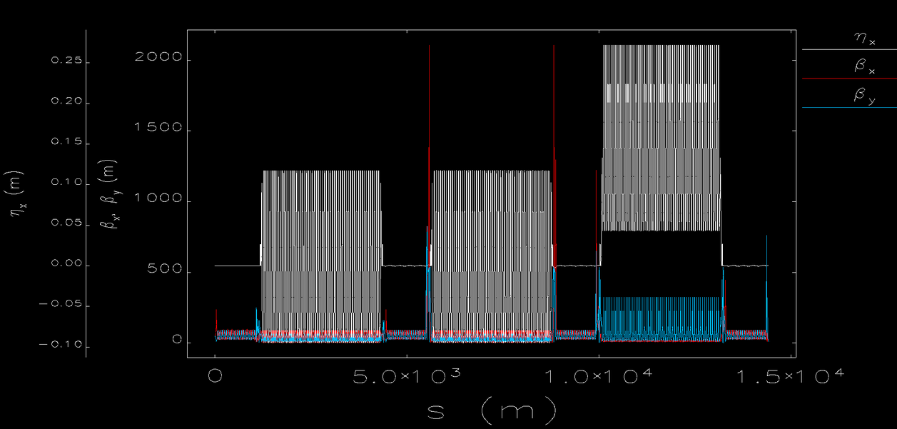
Optics in LHeC
The design was done by Alex Bogacz’s group
J. L. A. Fernandez et al., J. Phys. G 39, 075001 (2012).
For three arcs
R56=-0.3 m
R56=0.2 m
L1
L2
L1
L2

Slide 24
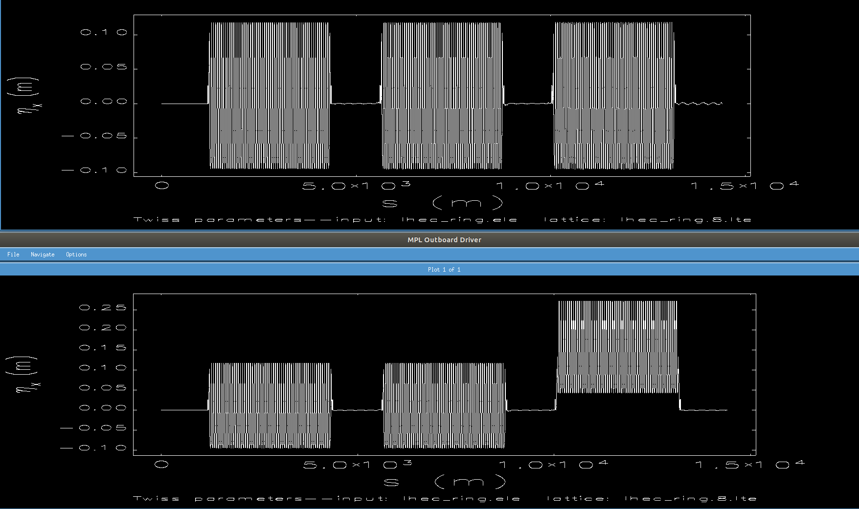
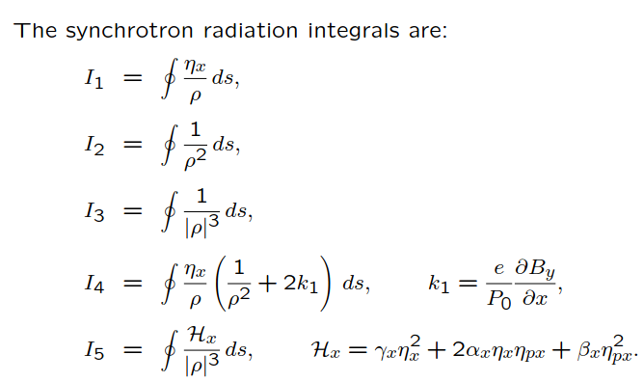
I5 (1/m) = 3.954045e-05 (new optics, arc 1,2 and 3 have same dispersion and R56=0.2 m )
I5 (1/m) = 3.301449e-05 (CDR optics, third arc has R56=-0.3)

Slide 25
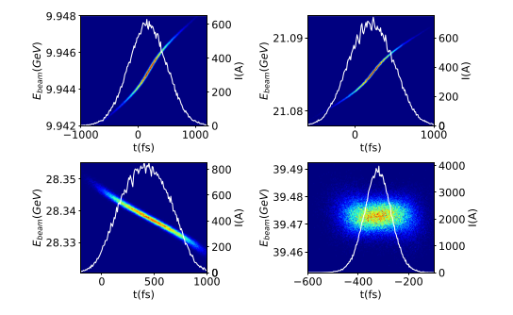
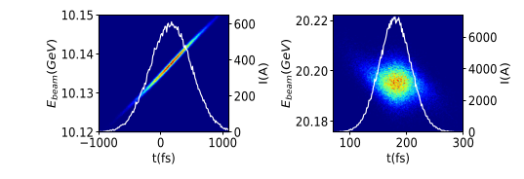
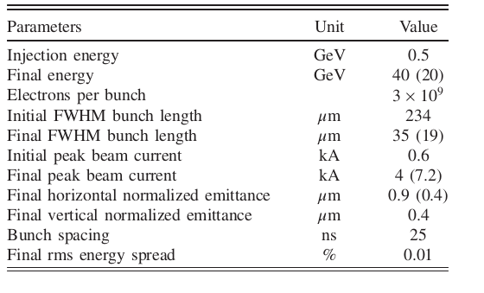
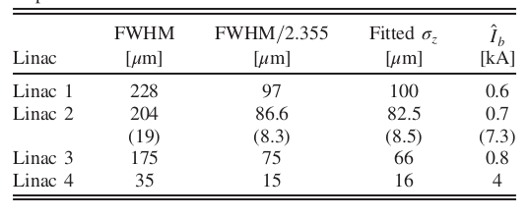
Beam dynamic Simulation
40 GeV operation
20 GeV operation

Slide 26
FEL Simulation &
Energy Recovering

Slide 27
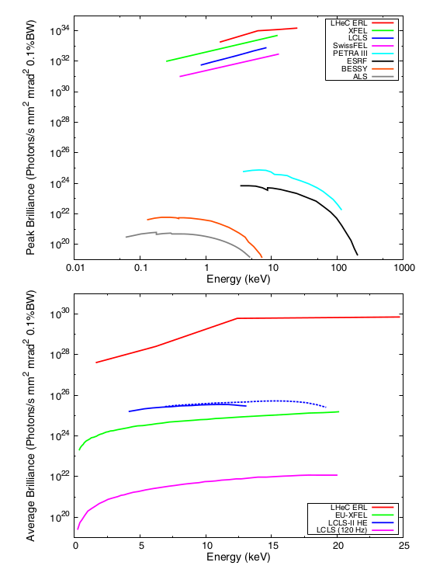
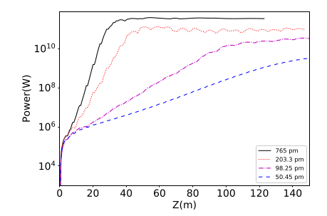
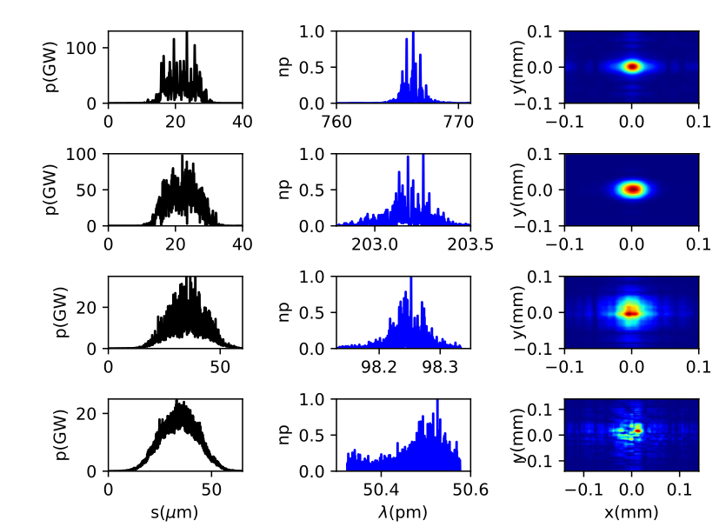
FEL Simulation
Soft X-ray undulator line in LCLS II
Periode length is 3.3 cm
Very high reputation 25 ns between pulses
In view of TC, going to the shorter wavelength is challenging

Slide 28
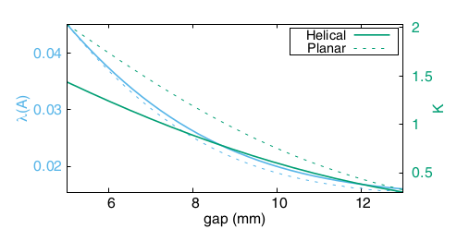
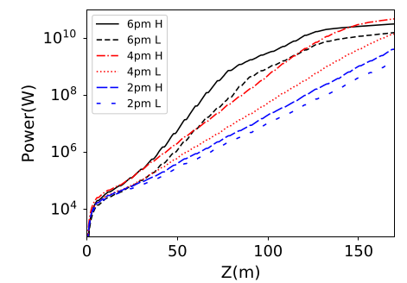
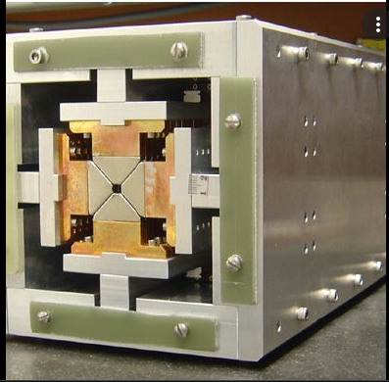
Picometer FEL radiation
To set foot in the domain of even shorter wavelengths,
The period length of the undulator is taken to be 18 mm
We checked the quantum FEL parameter and it was 5.9 (it is larger than 1)for 2 pm. Therefore, even at a wavelength of 2 pm the LHeC FEL dynamics remains essentially classical and is not strongly altered by the quantum recoil momentum.
Comparable with the MARIE FEL
In Cornell University.
Used in LCLS II
Our motivation for this study was experiments in particles physics, generation pair of e and e+, dark matter and study Axion.
A. B. Temnykh, Phys. Rev. ST Accel. Beams 11, 120702 (2008).

Slide 29
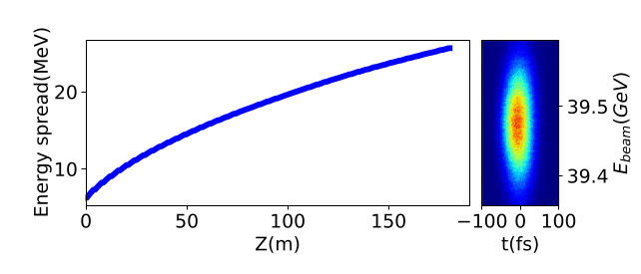
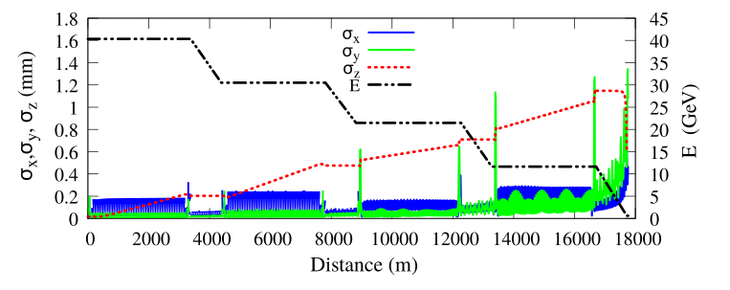
ENERGY RECOVERY
We finished the paper with list of applications and other proposals for this facility.

Slide 30
Special thanks to
Frank Zimmermann(CERN), for inviting me to this study, for all his supports, and his help,
Demin Zhou(KEK) for very very useful discussion
Zafer and Avni for their nice contribution in this work,
Sven Reiche( PSI), to Gianluca Geloni and Svitozar Serkez (European XFEL), for enlightening discussions on FEL simulations and effects at very short wavelengths.
Alex Bogacz (Jefferson Lab )
And Bolko Beutner (DESY) for useful discussion about CSR-tracking
Questions or comments ?

