Slide 1
Injector Dogleg Xtrack Studies
T.L., M. Dohlus, Y. Chen, Y. Kot

Slide 2
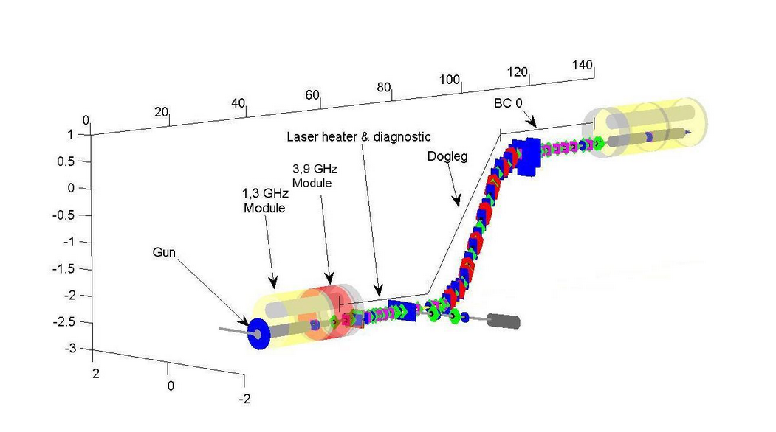
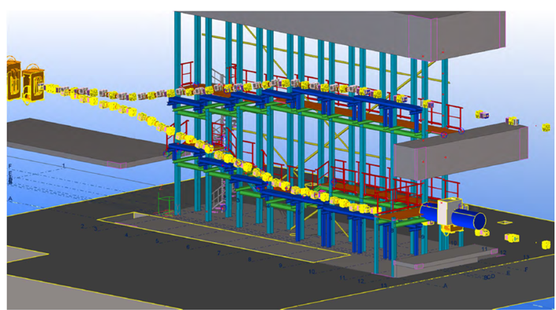
Why an Injector Dogleg?
Second Possible Injector (for instance CW)

Slide 3
One sees from the above list that it is not a big problem to construct a dogleg without sextupoles which, nevertheless, is free from first, second and third order dispersions.
But what can be done in this case (or in the case when the arc map is a second order achromat only with respect to the horizontal motion) to control chromatic focusing aberrations?
One possible way is to employ the concept of apochromatic focusing which, though having been developed mostly for straight drift-quadrupole systems [4, 5], can be generalized on systems with bending and sextupole magnets included.

Slide 4
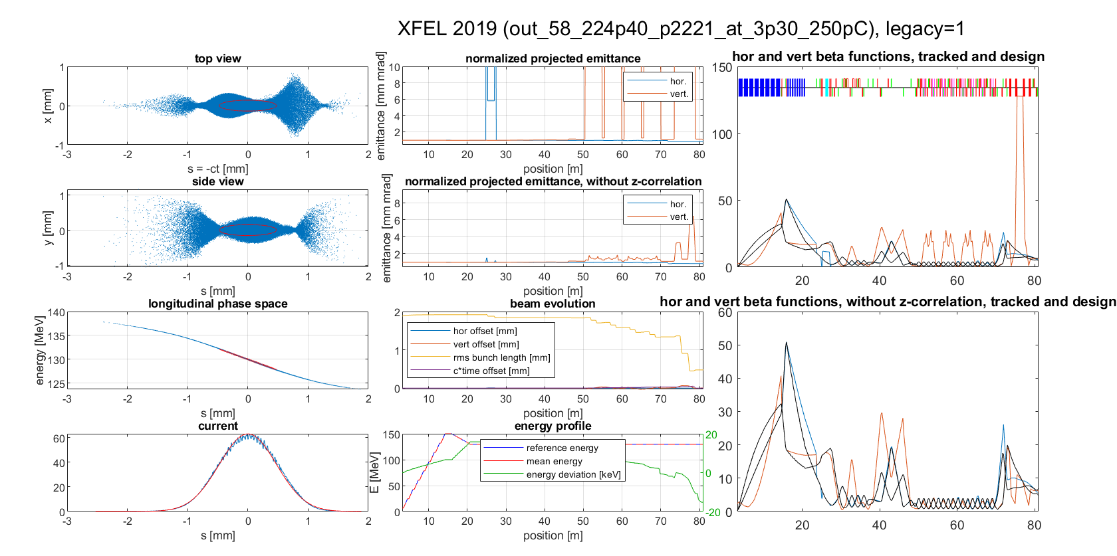
Xtrack calculation up to exit BC0

Slide 5
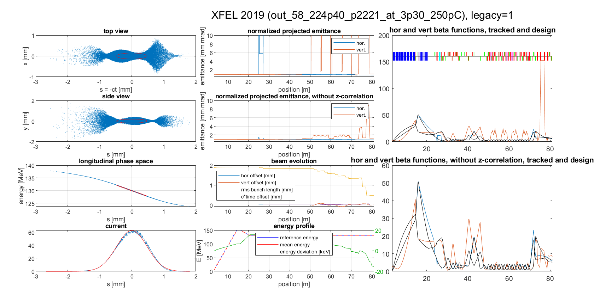
Xtrack calculation up to exit BC0, sextupoles off

Slide 6
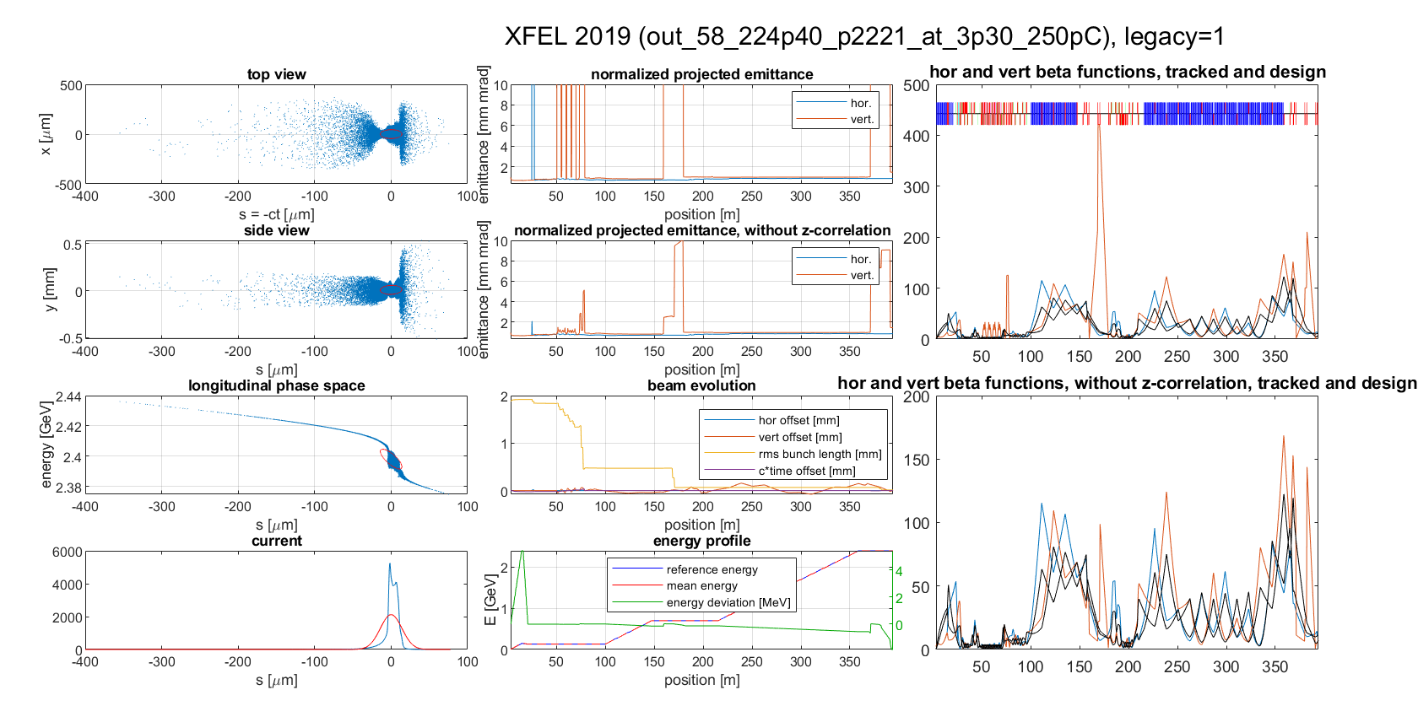
Xtrack up to exit BC2 (MD‘s original run, 3D SC, CSR, Wakes)

Slide 7
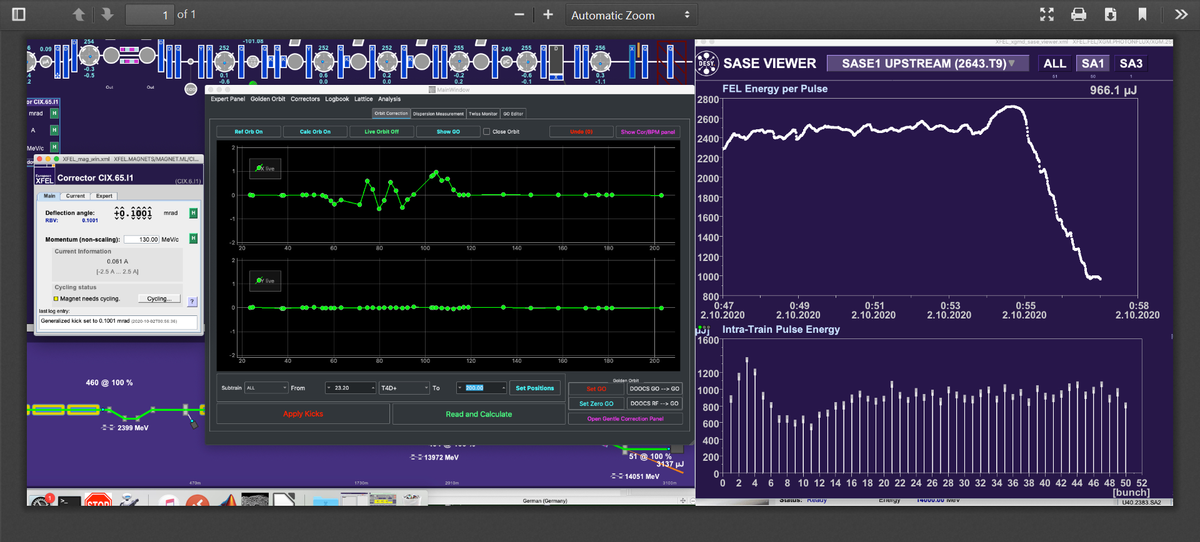
Bump in Injector Dogleg with CIX.65.I1 (1mm peak)

Slide 9
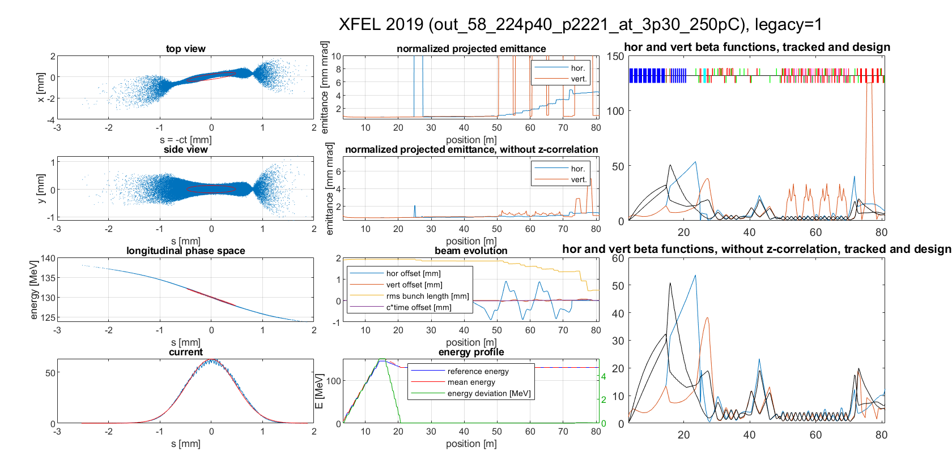
Xtrack with horizontal bump up to exit BC2

Slide 10
Dispersion up to exit BC2 (blue: horizontal, red: vertical, arb. units) from tracked beam matrix

Slide 11
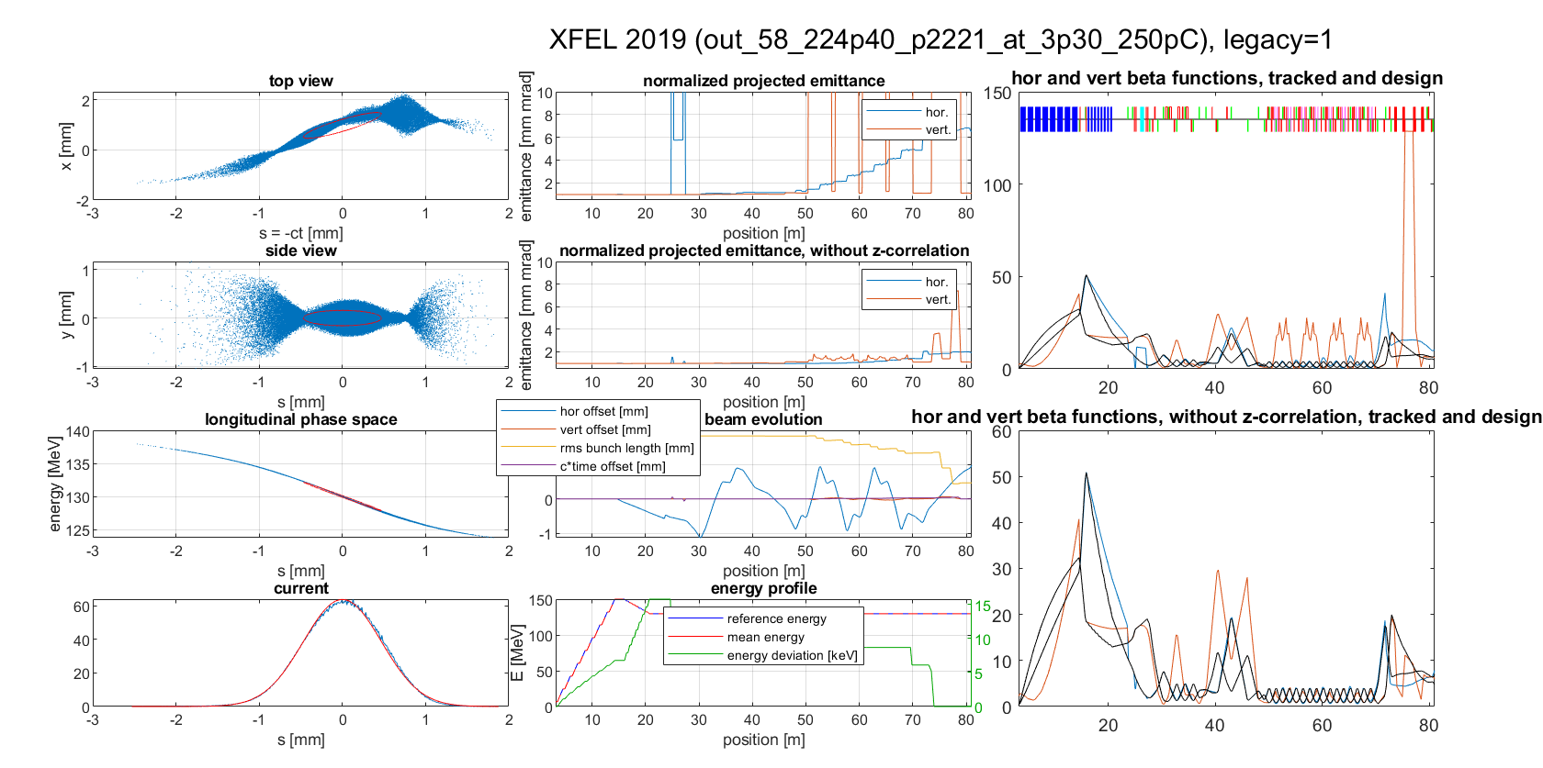
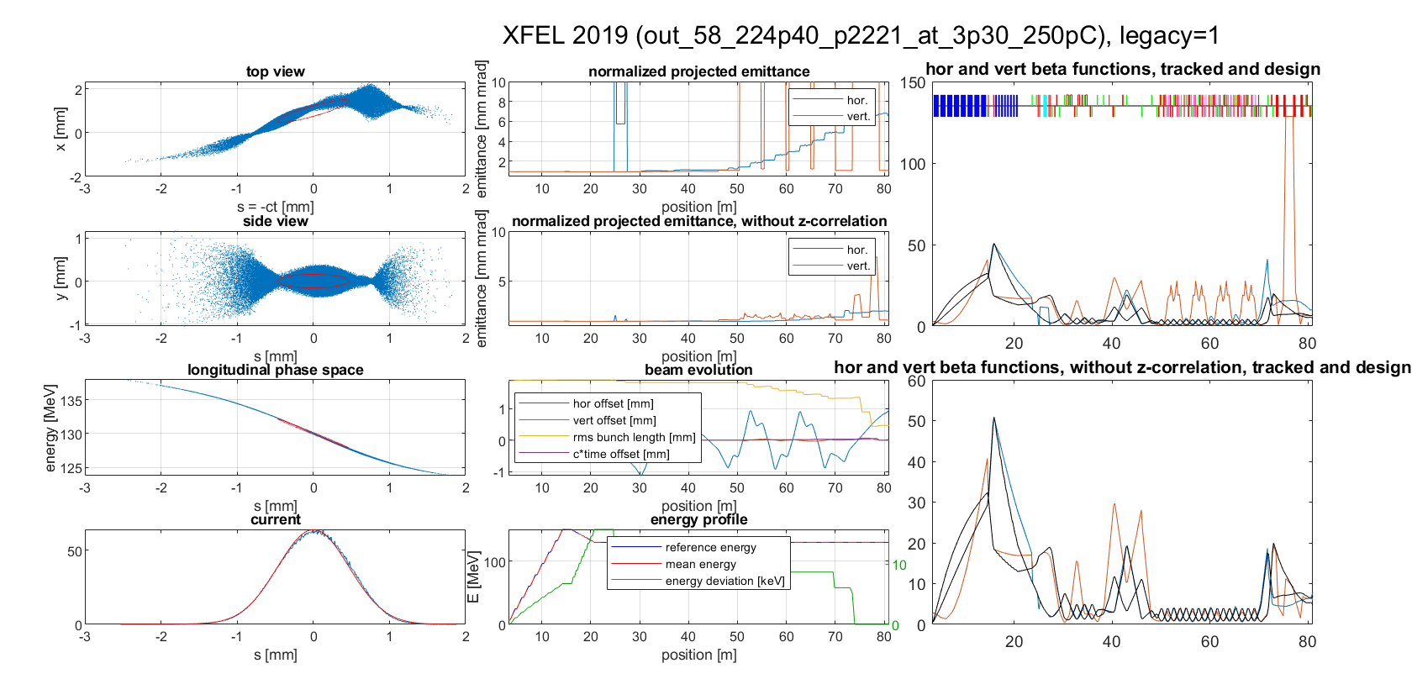
An aside: Similar result with first horizontal corrector turned on for 1 mm horizontal peak oscillation

Slide 12
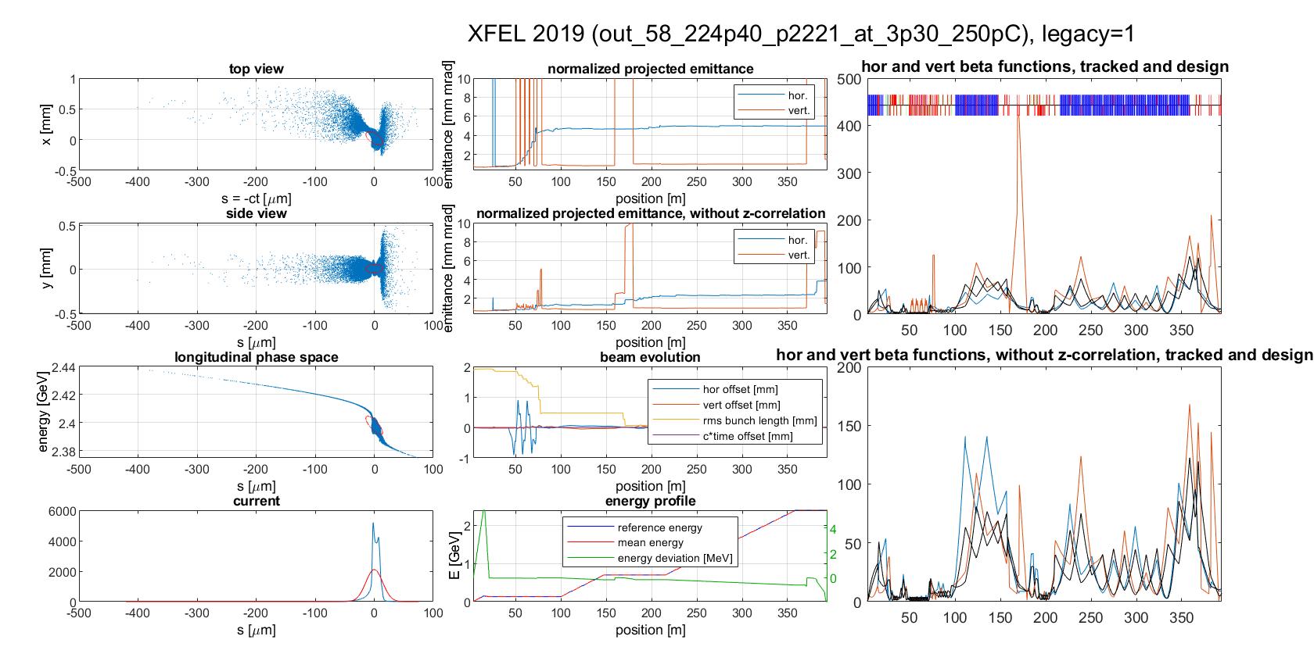
Xtrack with Bump on up to BC2 exit

Slide 13
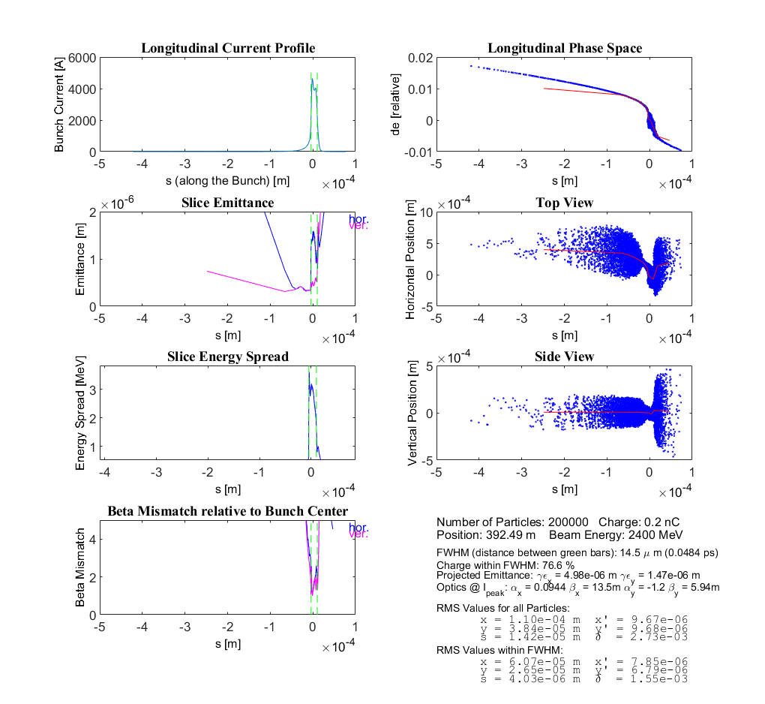
ps_viewer summary plot at exit BC2

Slide 14
Gain Length vs. Transverse Emittance in Ming Xie’s model
Measured:
Gain Length:
from 5.5 m without bump
to 9,5 m with bump

Slide 15
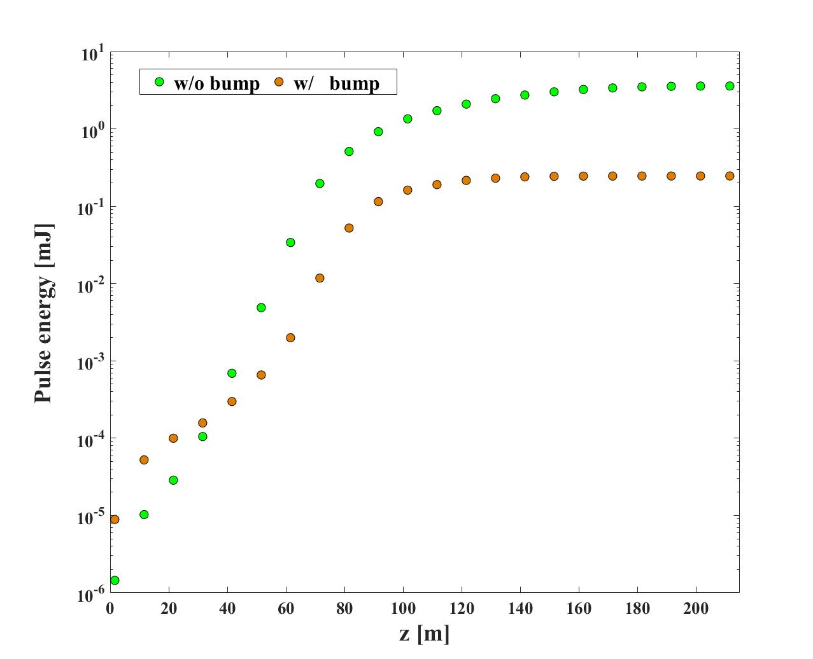
First Shot at GENESIS (Ye Chen):
3.6 mJ
0.25 mJ

Slide 16
Y. Kot: Xtrack Calculations

Slide 17
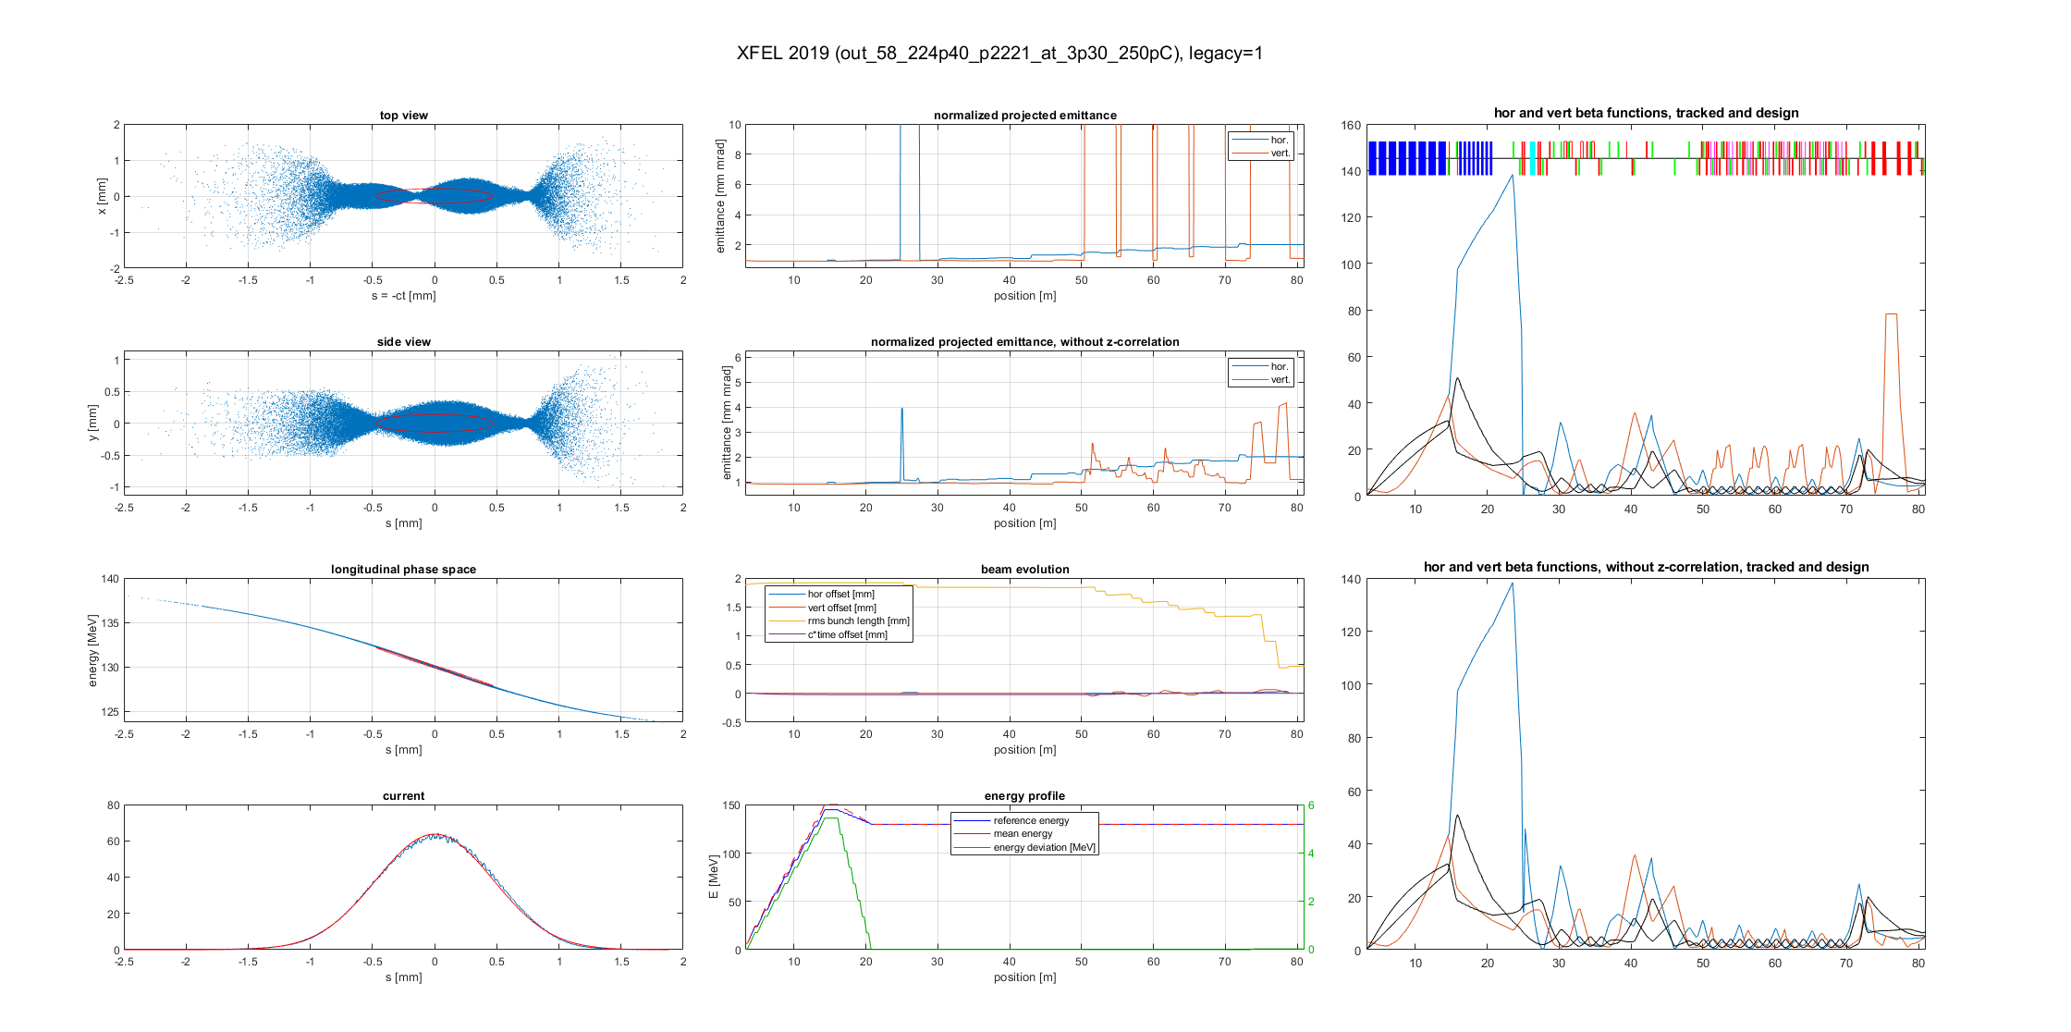
A different way to disturb the symmetry of the dogleg: optics mismatch

Slide 19
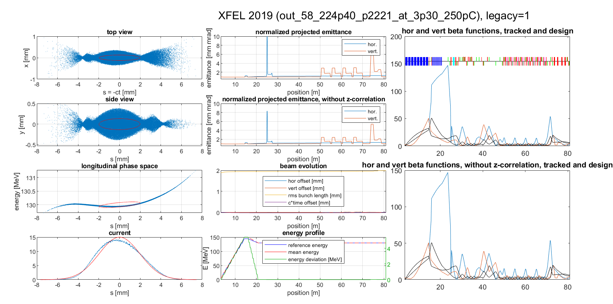
Without chirp: no effect on projected emittance

Slide 20
Optics Mismatch in Injector Dogleg

Slide 21
Optics Mismatch in Injector Dogleg

Slide 22
Possible Reasons for Optics Mismatch into Injector Dogleg
Injector matching job not done properly (rms?)
Compression tweaks without adapting quadrupole strengths between A1 and H1
Solenoid tweaking

Slide 23
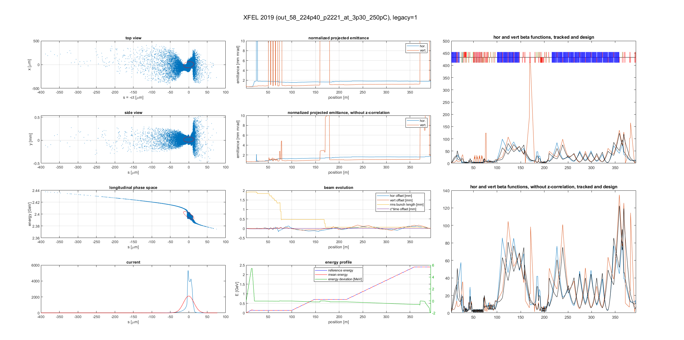
Xtrack up to exit BC2 (MD‘s original run) only ps Dump LH turned on, and 'source_2020__04_20‚ is used 120 min WS: 3D_SC, CSR, Wakes, CKs H:\mpy\Xtrack 2019_03\files_X_2019__03

Slide 24
SC off, CSR on, Wakes on, KCs off, matched

