Slide 1
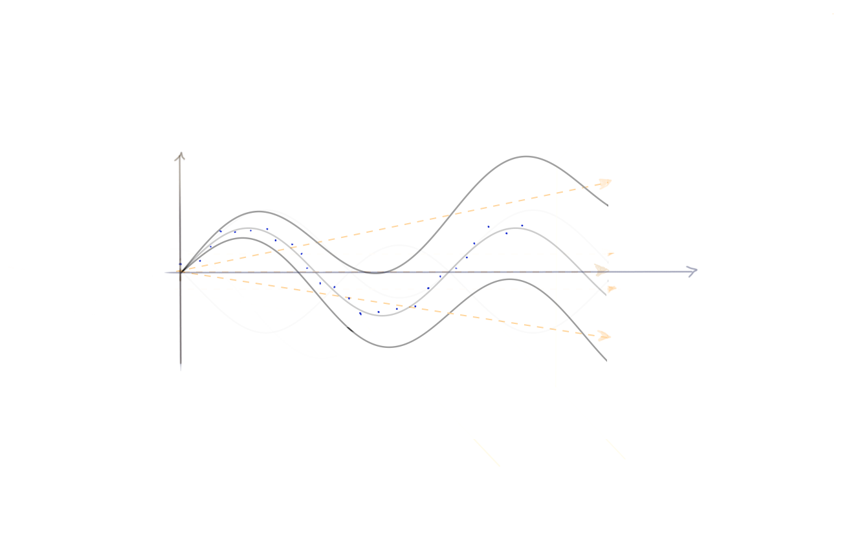
e-beam trajectories and p-beam pointing jitter
Attempt to derive correlations between e- and p-beam jitter

Slide 2
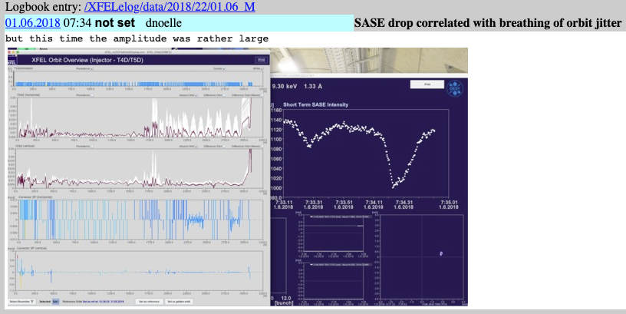
Motivation
Since the first days of photon beam delivery, experiments complain about ‘large jitter’
Eu-XFEL had some ‘bad’ states in the beginng of p-beam delivery …
… but this has vanished completely these days
But still experiments complain
→ XFEL GmbH launched
Stability Task Force
I’m WP leader for:
WP7: Electron based feedbacks

Slide 3
First steps
Aimed to get trustworthy ‘jitter parameter’
Winni brought up simply sine fit of trajectory through undulator line
Looks fine on first glance, but …
… shows dip around zero
so I started to look into this in more detail
  ported code to python
  created dashboard to process DAQ data

Slide 4
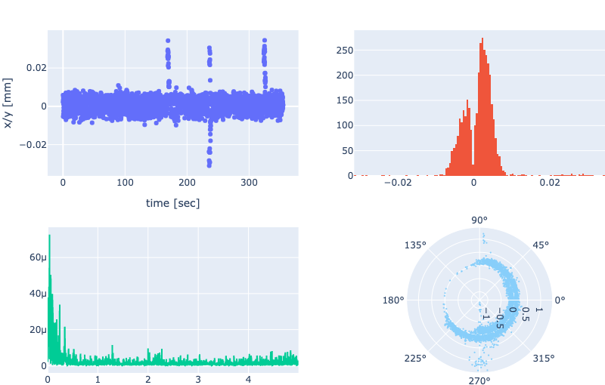
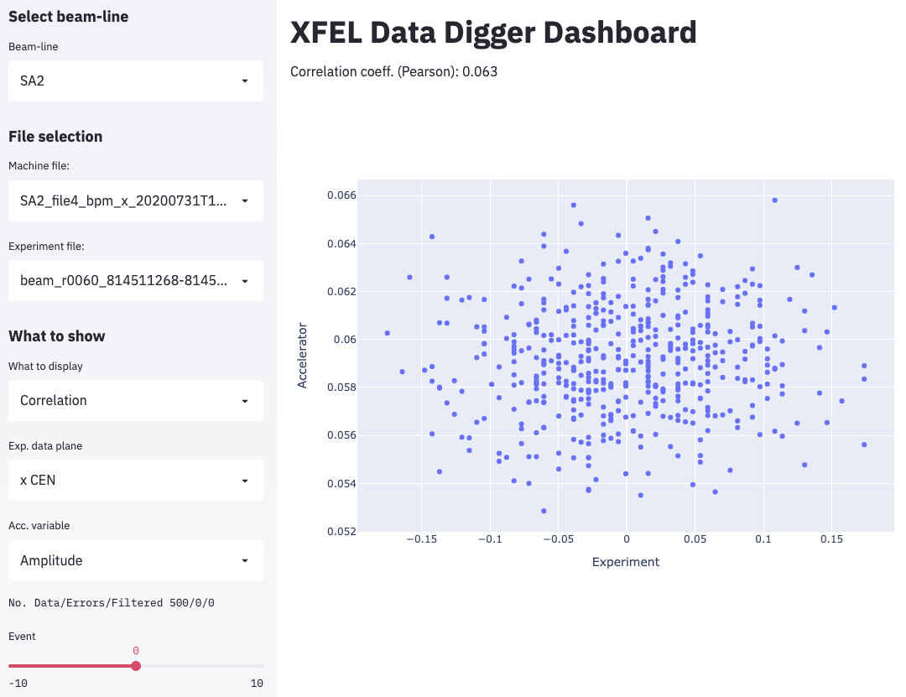
The Dashboard
Went for dashboard to offer e.g. p-beam-line scientists easy access (in these times of Corona -> Digital DESY ;)
Allows macro-pulse based correlation between experiment and machine data

Slide 5
First findings
To anticipate it right away: Near to zero correlations have been found (even the opposite: XFEL GmbH found several issues with mirrors and that like ;)
But I got more and more sceptic if the fit is reflecting the situation correctly!
  what about the dip (appears only if subtracting the mean - more later)
  what to constrain in the fit: period is known, phase-offset should be constrained, …

Slide 6
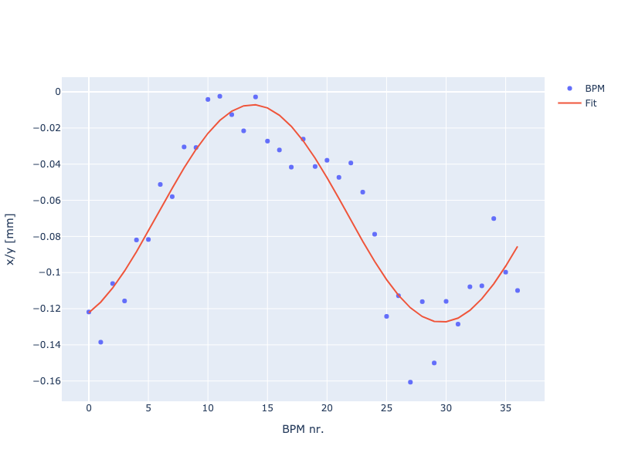
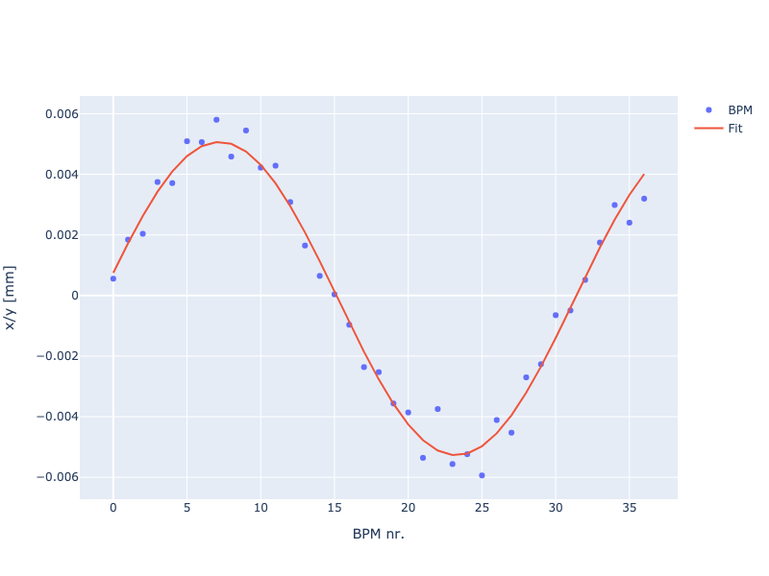
Details of the fit procedure
Sine fit to ‘raw’ BPM data
Sine fit - mean subtracted
Amplitude: 60.1851 ± 4.2075
Periode: 31.7 ± 1.0642
Phase: -1.1522 ± 0.1348
Amplitude: 5.1706 ± 0.1313
Periode: 32.1 ± 0.3581
Phase: 0.1643 ± 0.0473

Slide 7
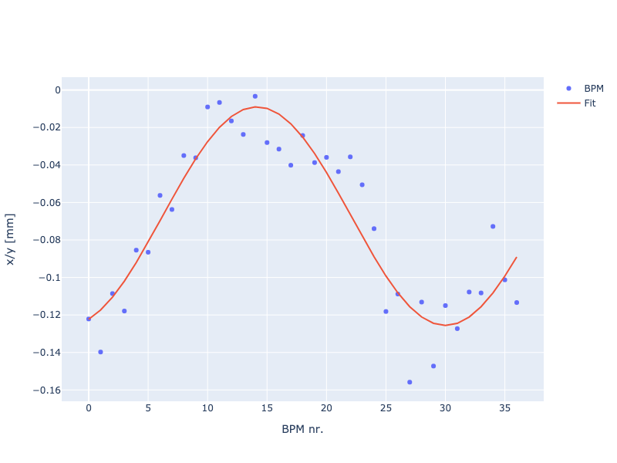
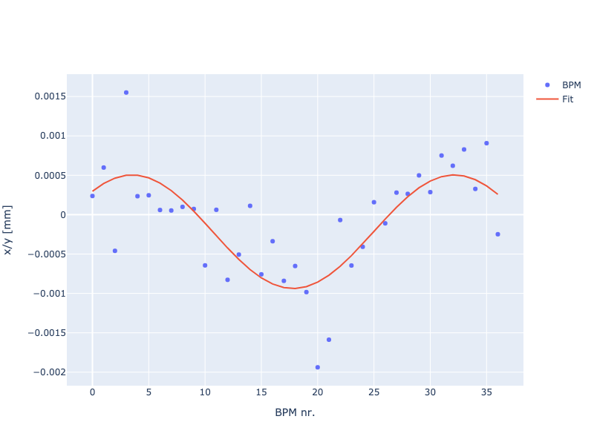
Details of the fit procedure
Sine fit to ‘raw’ BPM data
Sine fit - mean subtracted
Amplitude: 58.3267 ± 4.1043
Periode: 31.7 ± 1.1264
Phase: -1.2311 ± 0.1417
Amplitude: 0.7211 ± 0.1076
Periode: 28.6 ± 2.3597
Phase: 0.7938 ± 0.3649

Slide 8
First insides
The sine fit tends to always produce non-zero amplitudes
  Is this consistent with beam-dynamics?
  there might be completely ‘flat’ trajectories - aren’t there?
If this is true, one needs different fit procedure!

Slide 9
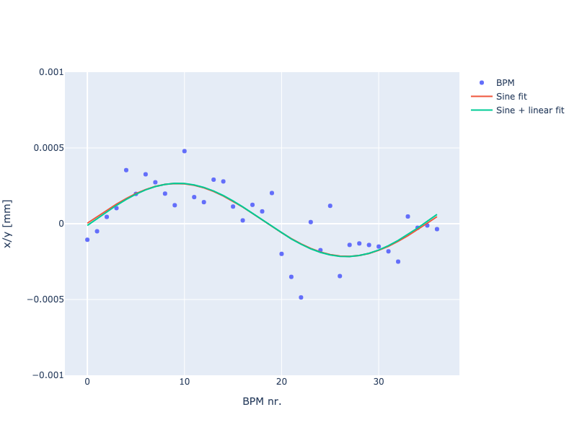
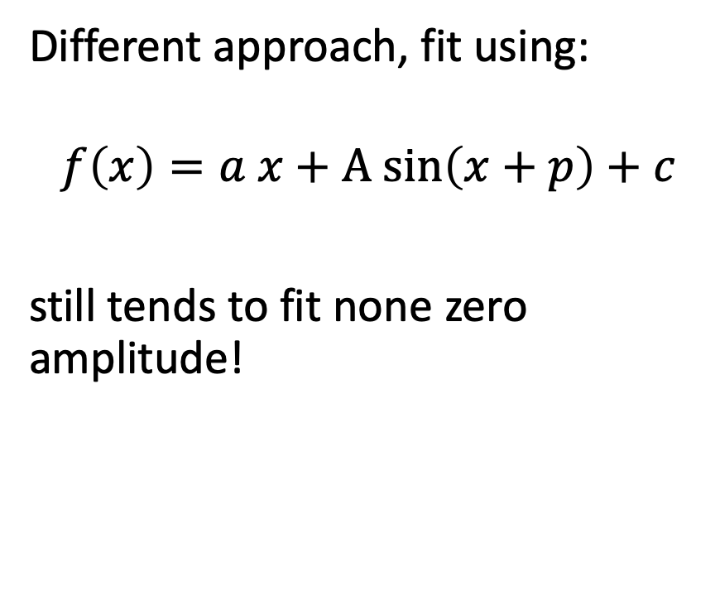
Different fit approach
Different approach, fit using:
$$f\left(x\right)=a x+A sin\left(x+p\right)+c$$
still tends to fit none zero amplitude!
pk2pk = 1 µm

Slide 10
Extended fit approach
Also sine + linear fit tends to always produce non-zero amplitudes
If this is true, one needs an even different fit approach!
Naïve idea:
  implement threshold to allow for ‘straight’ trajectories
  use linear fit below threshold, sine fit otherwise

Slide 11
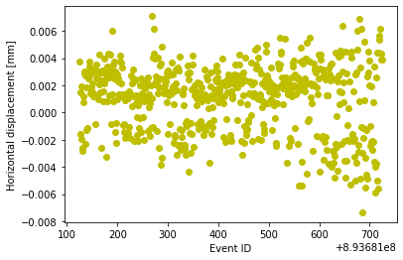
Extended fit approach
Pure sine fit

Slide 12
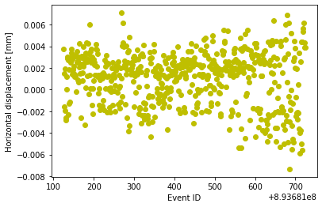
Extended fit approach
sine + linear fit (threshold: 3 µm)

Slide 13
Extended fit - some considerations
But now we got one free parameter:
  t_fit = pk2pk(BPM_i(event e) - mean(BPM_i(all events))
Varying t_fit one gets

Slide 14
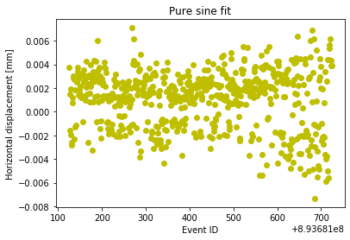
Extended fit approach - with threshold

Slide 15
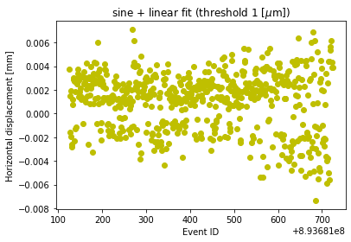
Extended fit approach - with threshold

Slide 16

Extended fit approach - with threshold

Slide 17
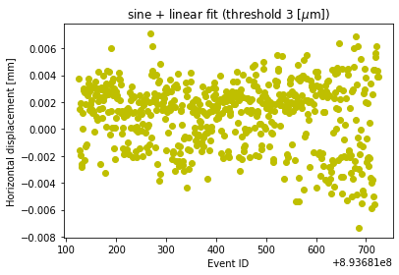
Extended fit approach - with threshold

Slide 18
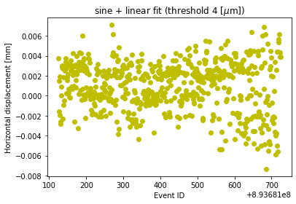
Extended fit approach - with threshold

Slide 19
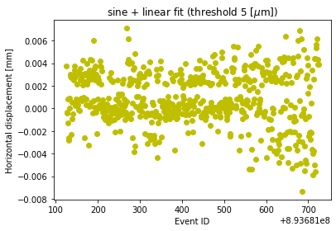
Extended fit approach - with threshold

Slide 20
Extended fit approach
Also not satisficing: How to choose the threshold?
What about the error of the fit?

Slide 21
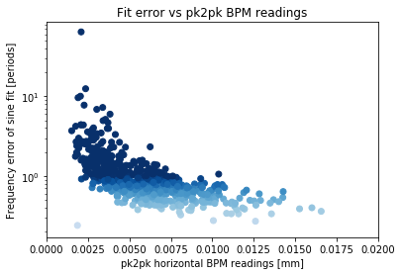
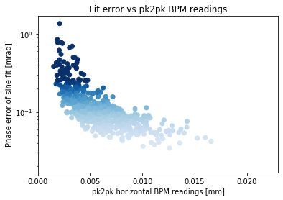
Extended fit approach - fit error

Slide 22
Extended fit approach
Obviously this ‘heals’ the ‘zero dip’ problem, but t_fit is a very sensitive parameter!
  how to safely determine the threshold?
  is this approach ‘correct’?
  are there better ones?
shouldn’t we have the mean already subtracted after technical calibration, BBAs, … ?
  BPM data is composed of:
    poly-parameter (technical calibration)
    OFFSET1: BBA
    OFFSET2: pointing shift

Slide 23
Summary
Brute force sine fit to get trajectory through undulator line is artificially creating pole around zero
Implementing a threshold to allow for ‘straight trajectories’ heals this problem, but adds sensitive parameter
I need to derive a robust, trustworthy parameter one can use as figure-of-merit to monitor e-beam jitter
Much learned (DAQ access, Maxwell, Eu-XFEL DAQ, …), many routines created to be able to evaluate these performance parameters online and/or near online
Thank you for listening

