Slide 1
Gain Curve Studies in SASE1
T. Limberg, W. Decking, M. Scholz, Ye Chen, S. Tomin, Y. Kot

Slide 2
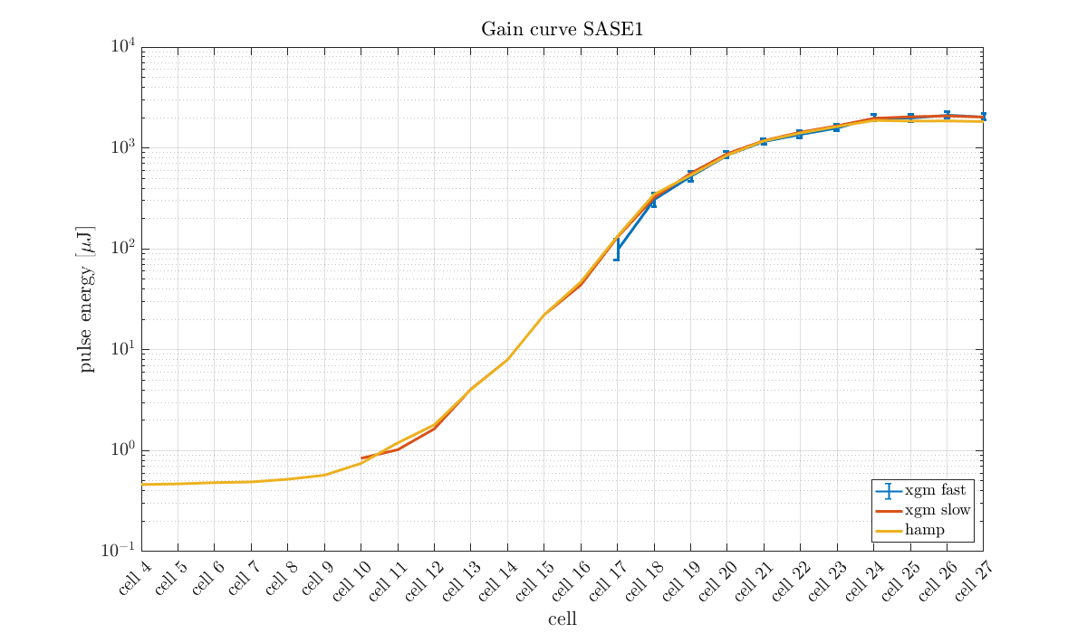
First Step: Check tool…
the following gain curves are using the ‘hamp’ signal

Slide 3
Start with simple things…

Slide 4
…shift the ‘3 cells open’ gain curve by three cells upstream

Slide 5
…and Diagnostics
XGM o.k.
TDS worked, but start up difficulties, peak current ambiguities
CRISP not used
HIREX operable, but no connection to tool yet
… Screens? not used

Slide 6
  Goal: Measure gain curve dependence on:
  Ming Xie Input Parameters:
  Peak Current (Bunch Compression Settings)
  Slice Energy Spread (vary Laser Heater Power)
  Transverse Emittance
    Vary Gun Parameters
    Extreme compression with slice emittance growth?

Slide 7

  Other Dependencies:
  Orbit
    Undulator (launch, closed bumps)
    Injector (bumps)
  Phase Shifter Settings
  Tapers
  Wave length
  Undulator $β$-function, $β$-mismatch

Slide 8
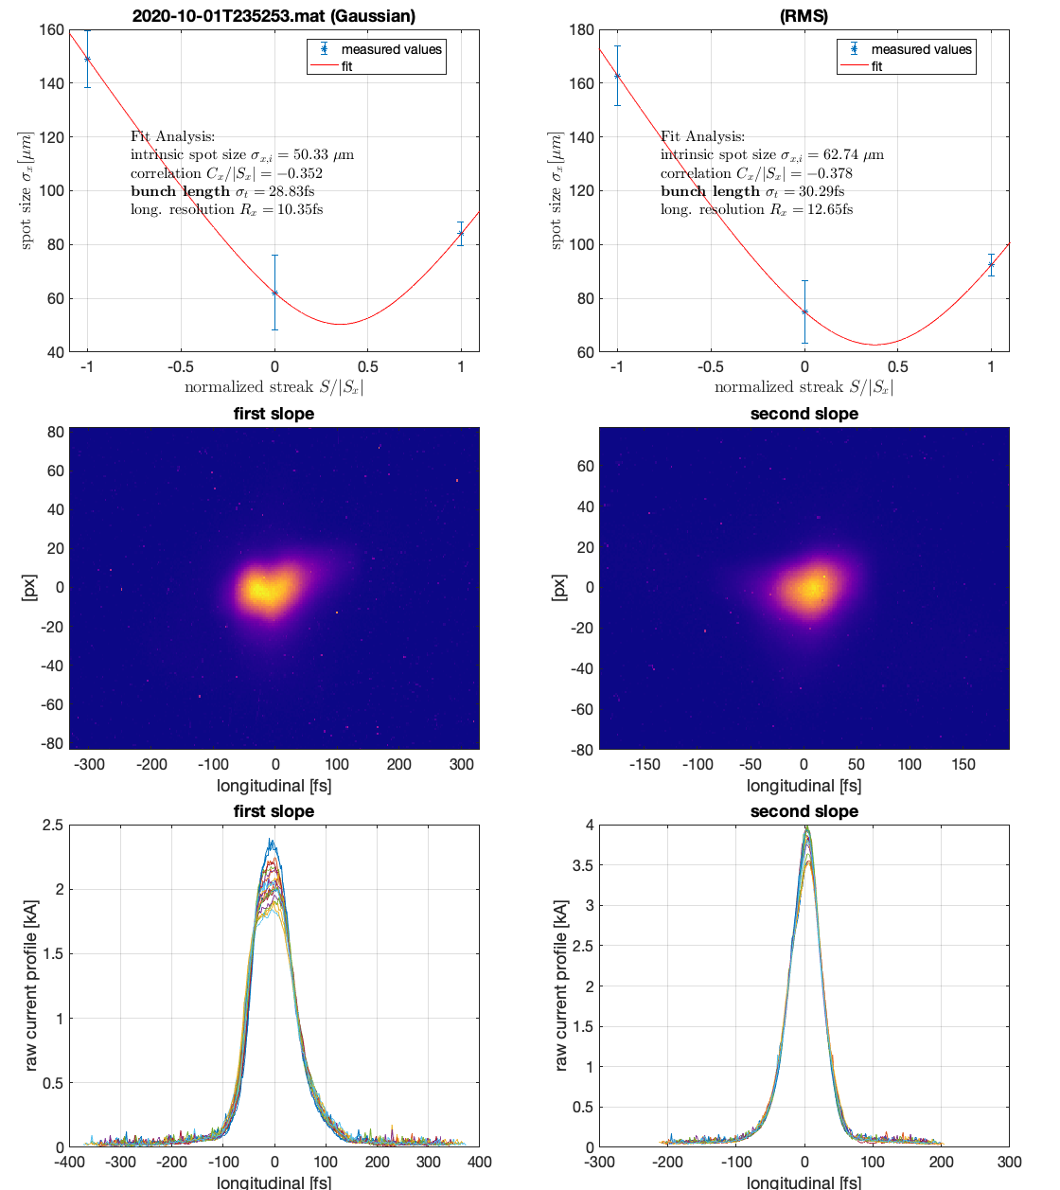
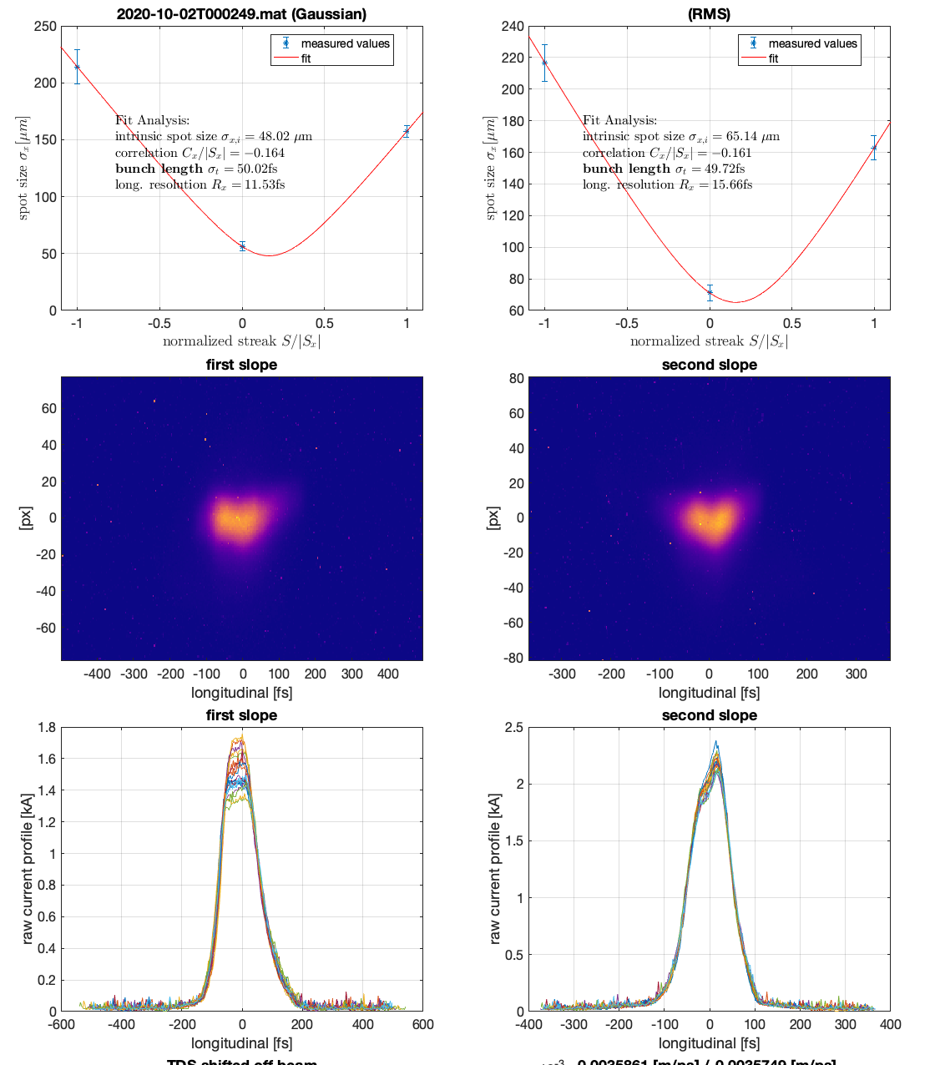
Varying Peak Current
TDS measurements before and after SASE reduction (factor 3) using L2 chirp

Slide 9

Fits: y=a·$e^{bx}$ by eye

Slide 10
Ming Xie (ε_{slice}= 0.5 mm mrad, slice energy spread = 3.8 MeV)
Peak Current from:
3.7 kA → 2.5 kA
Gain Length:
6 m → 7.5 m (~25%)

Slide 11
Gain Length vs. Transverse Emittance in Ming Xie’s model

Slide 12
Varying Transverse Slice Emittance
not easy; possible mechanisms:
  Extreme compression
    But: peak current more or less unknown
  Gun tweaks:
    Laser spot size
    Solenoid setting

Slide 13
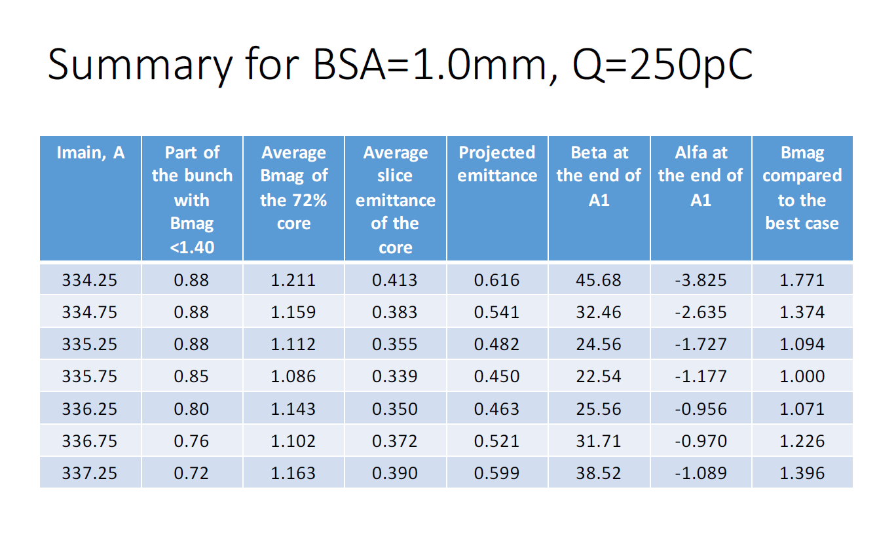
Vary Gun Solenoid (Y. Kot)

Slide 14
More Ming Xie:
Laser Heater!

Slide 15
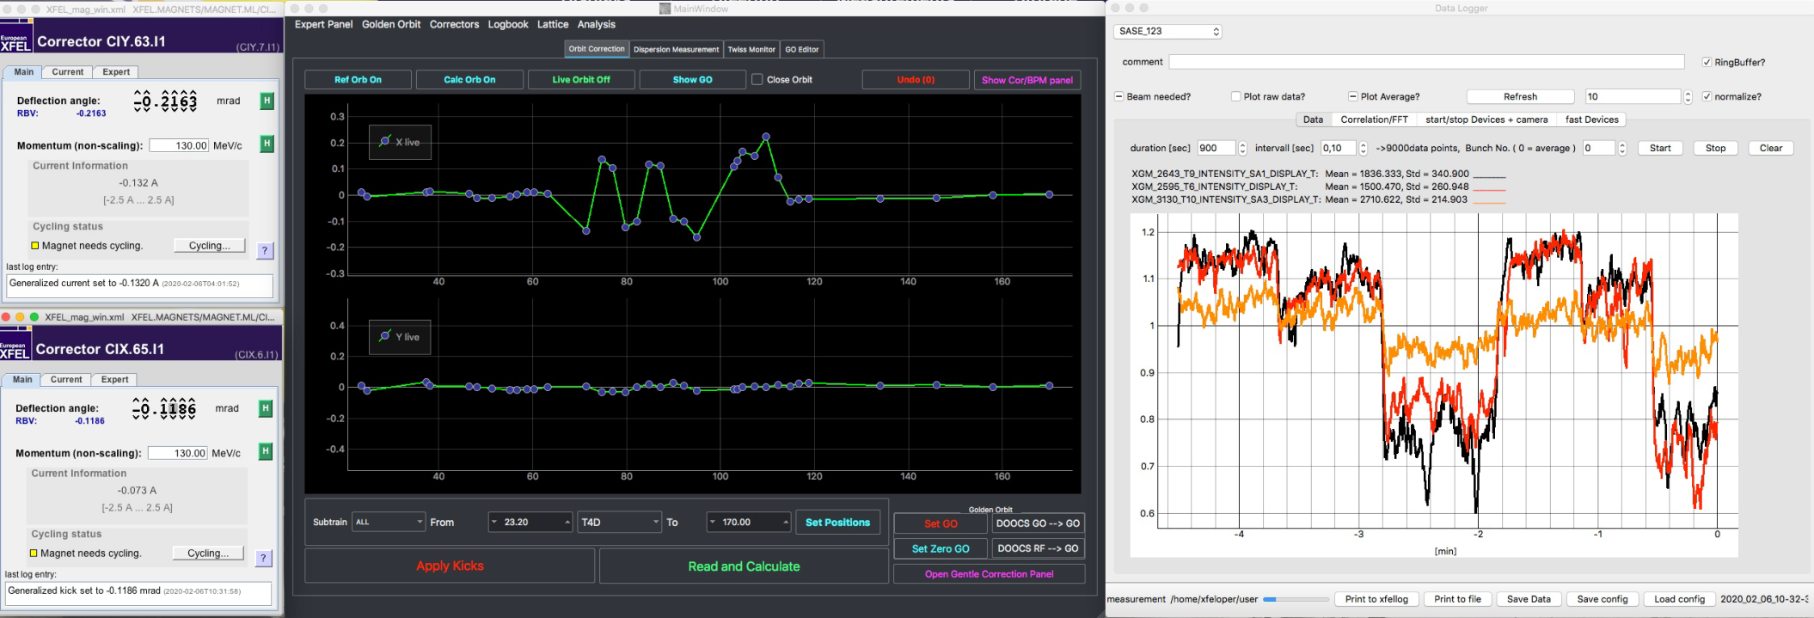
Things at least not straight forward in Ming Xie’s algorithm:
Non-Ming-Xie 1: SASE sensitivity to Injector Dogleg Bumps

Slide 16
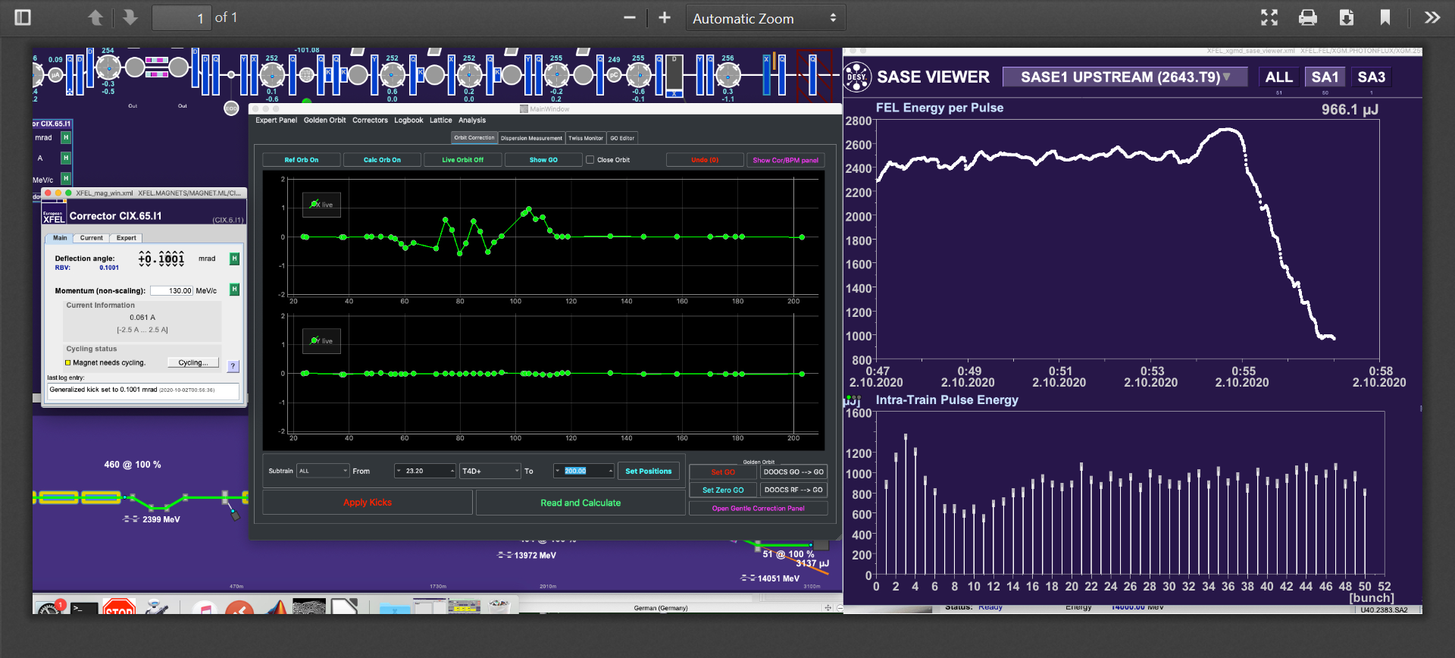
Bump in DL with CIX.65.I1 (1mm peak)

Slide 18
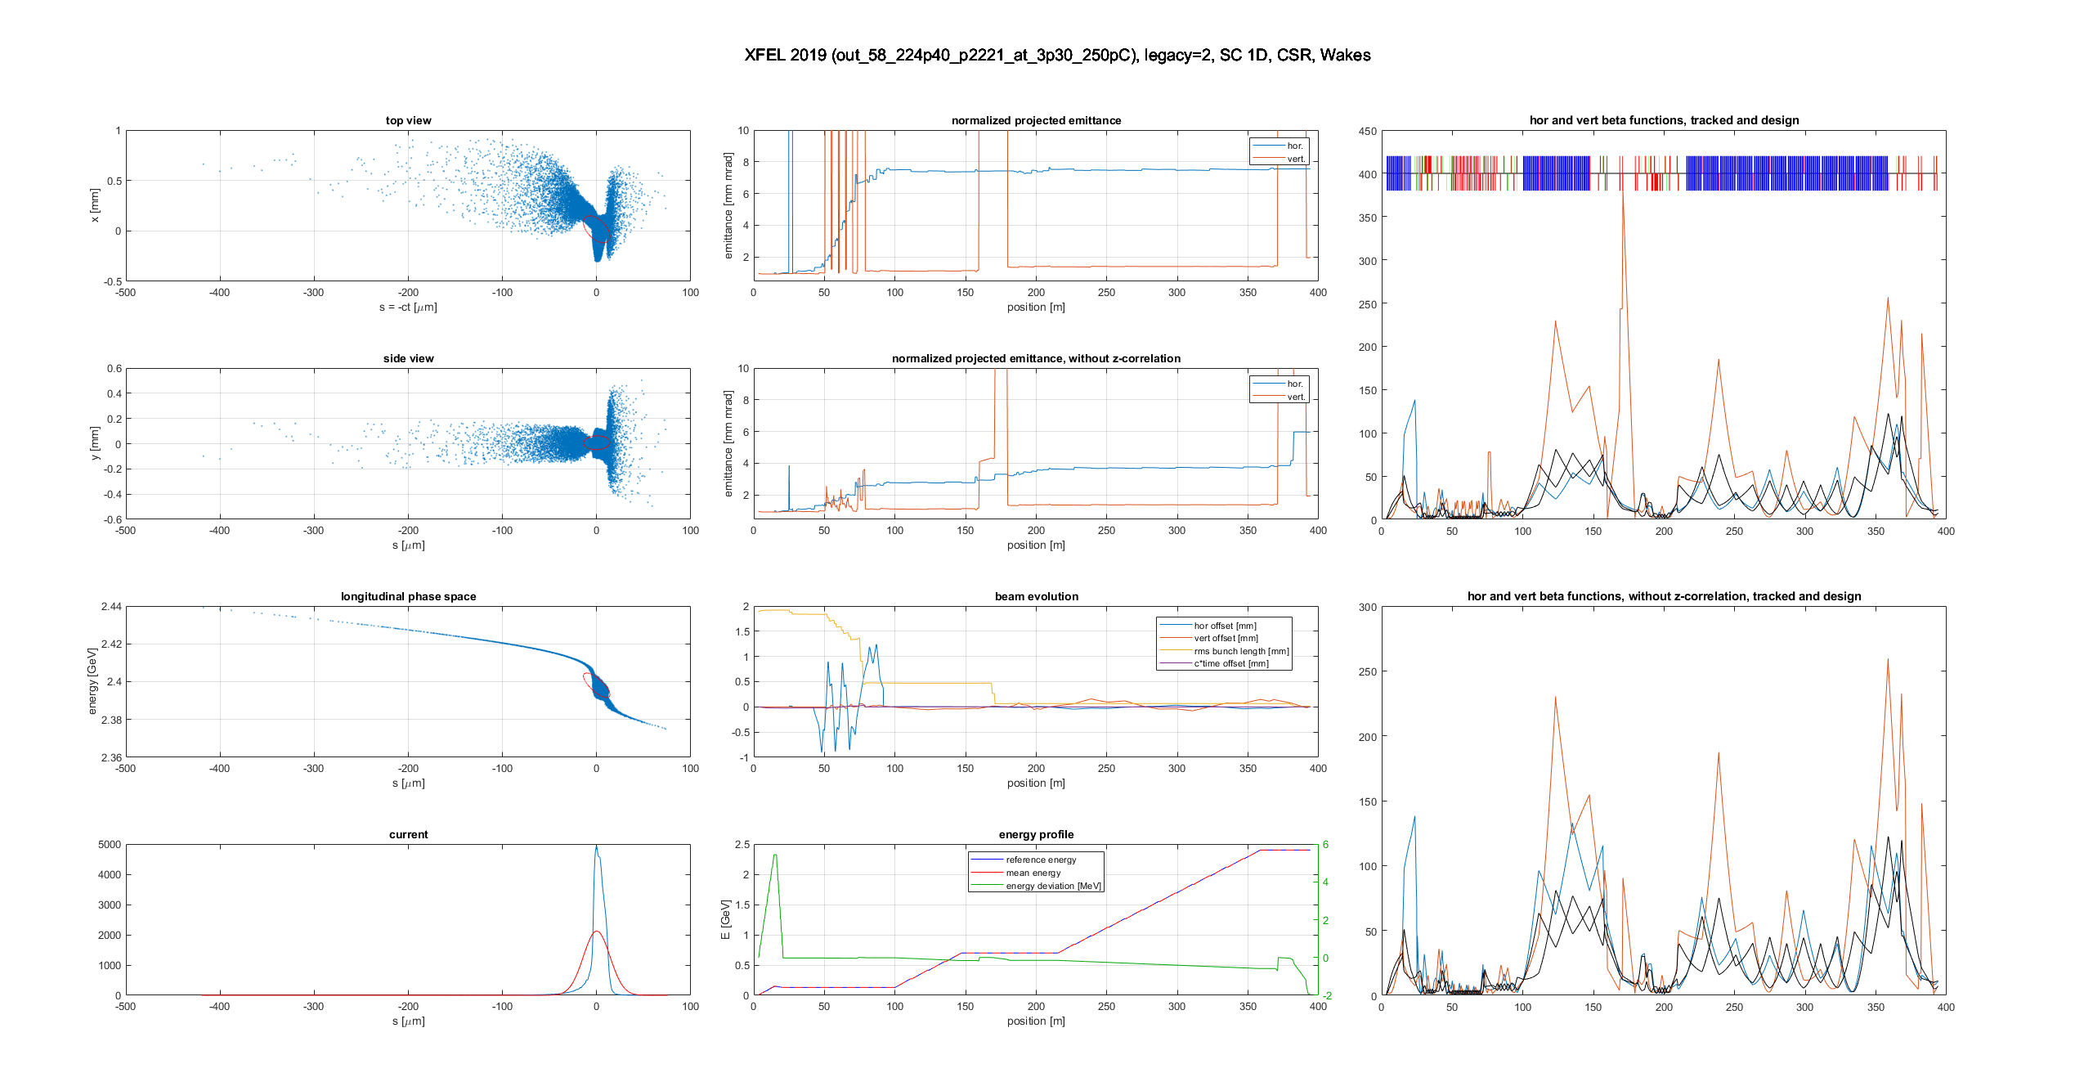
Xtrack Simulations ongoing

Slide 19
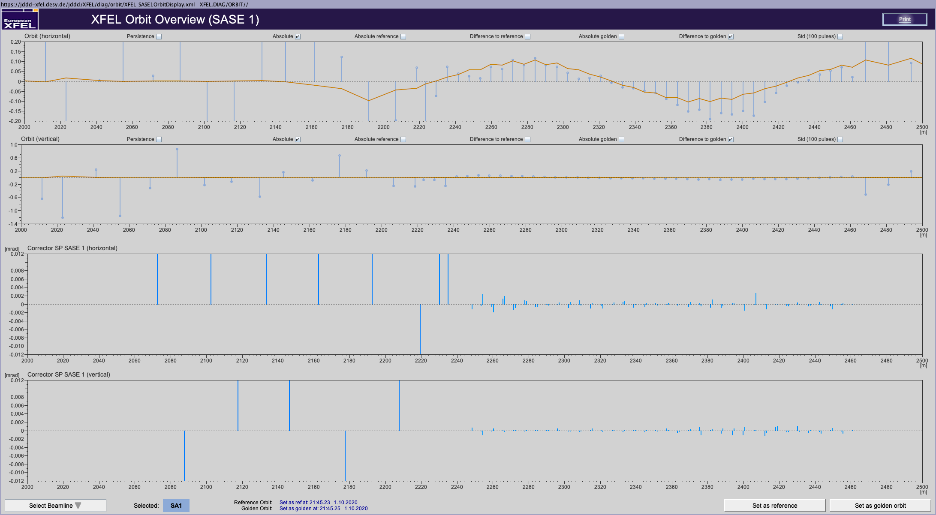
Non-Ming-Xie 2: Orbit Changes in Undulators, here:
Tweak horizontal Launch (100 um peak oscillation)

Slide 21
Non-Ming-Xie 3: Laser Heater off
(slice energy spread unknown, driven by micro-bunching instability)

Slide 22
Summary
With new tool we are able to measure 8+ gain curves per shift
First results in reasonable agreement with expectations and Ming Xie (where applicable)
Gain curves measured in the presence of more complex machine manipulations should be a very important check of our simulations of imperfect undulator systems

Slide 23
Ming Xie (ε_{slice}= 0.5 mm mrad, slice energy spread = 3.8 MeV)

