Slide 1
First Results from Non-Linear Compression Experiments
Bolko Beutner, Marc Guetg 10.2020
Tanks to:
Ye, Rivas, Mirian, Serkez, Mazza, Montano, Kujala, Lockmann
and the shift crew

Slide 2
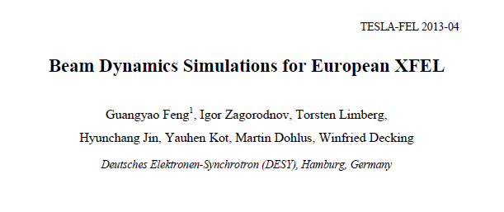
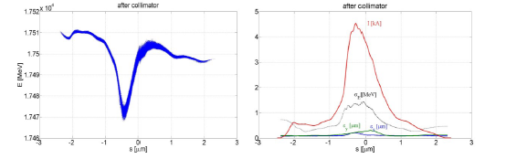
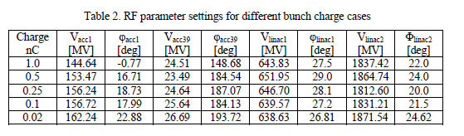
Introduction
Short (~1fs) FEL pulse generation
Design option is low charge operation (20pC)
20pC mode bunch length in the order of fs
Bolko Beutner, FEL R&D Meeting 16.01.20

Slide 3
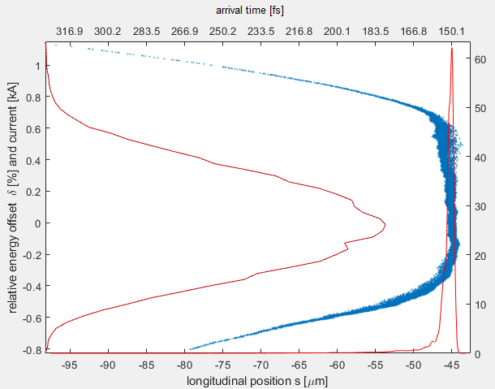
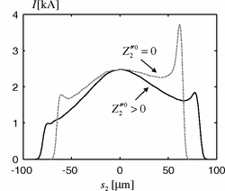
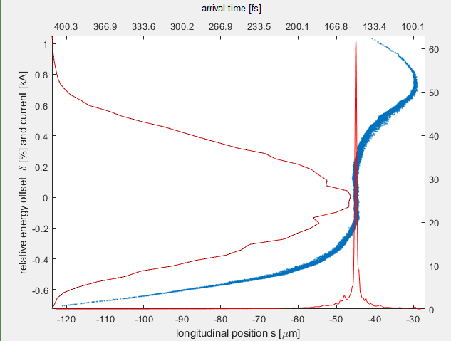
Options for short pulse
C-mode:
Full compression with linearised “central spike” – close to totally
nonlinear compression but more charge can be squeezed in spike
compared to real nonlinear compression
(positive third Taylor term in sum voltage)
Z-mode:
similar to standard compression but the 3rd harmonic is operated at a different slope to under-compress the head and tail of the bunch to create a narrower central spike
(negative third taylor term in sum voltage)
Bolko Beutner, FEL R&D Meeting 16.01.20
Igor Zagorodnov and Martin Dohlus
Phys. Rev. ST Accel. Beams 14, 014403 – Published 13 January 2011

Slide 4
Summary
 | 250pC design(ish) | 250pC C-shape | 100pC C-shape | 250pC Z-shape | 100pC Z-shape
A1 Voltage | 148.99 | 149.38 | 148.66 | 159.17 | 176.96
A1 Phase | 10.83 | 10.80 | 10.95 | 22.80 | 33.83
AH1 Voltage | 22.69 | 23.11 | 22.97 | 23.34 | 29.95
AH1 Phase | 166.89 | 167.14 | 167.67 | -164.89 | -141.79
L1 Voltage | 614.66 | 621.62 | 614.76 | 621.62 | 615.85
L1 Phase | 22.03 | 23.56 | 22.03 | 23.56 | 22.249
L2 Voltage | 1998.9 | 1878.4 | 1878.5 | 1878.4 | 1874.9
L2 Phase | 31.8087 | 25.1853 | 24.9435 | 25.1853 | 24.94
I1 chirp | -9.1 | -9.1 | -9.0 | -9.1 | -9.0
I1 curvature | 300 | 320 | 320 | 320 | 370
I1 third Taylor | 25966 | 25966 | 24992 | -52436 | -62500
L1 chirp | -9.0 | -9.7 | -9.0 | -9.7 | -9.1
FWHM at Collimator | 38.3fs | ~3fs | 1.9fs | ~3fs | 2.3fs
Bolko Beutner, FEL R&D Meeting 16.01.20

Slide 5
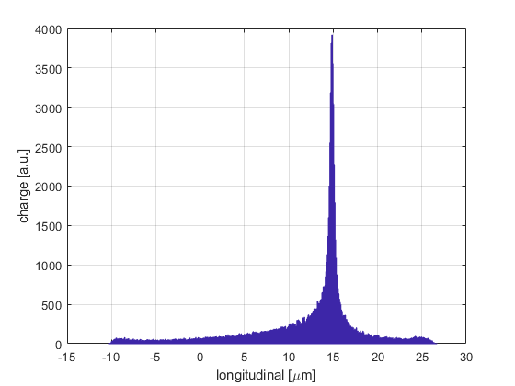
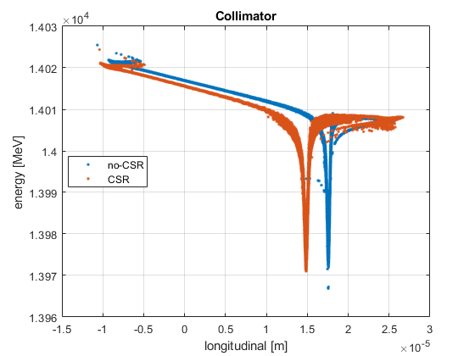
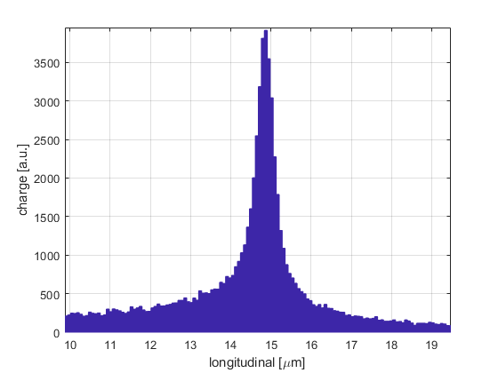
100pC C-mode
energy spread at BC2:
RMS = 0.30595% -- FWHM = 0.70445%
bunch length at BC2:
RMS = 0.021484ps / 0.0064452mm -- FWHM = 0.0019ps / 0.00057mm
energy spread at Collimator:
RMS = 0.092777% -- FWHM = 0.022885%
bunch length at Collimator:
RMS = 0.021504ps / 0.0064513mm -- FWHM = 0.0019ps / 0.00057mm
Bolko Beutner, FEL R&D Meeting 16.01.20

Slide 6
Study Shift 25.9.
We decided to limit changes to the machine to minimise additional tuning and setup complications for the following self-seeding shifts:
  250pC instead of 100pC
  No-optics matching or solenoid changes
  Laser heater was untouched
Not perfect conditions but good for a proof-of-principle study
Initial compression setup in B2D with TDS long. phase-space measurements
Supplemental bunch profile measurements with TDS diagnostic kickers and CRISP
FEL shot intensity histogram data acquisition to estimate number of modes
SA1 HIREX and SA3 Spectrometers for pulse duration reconstruction (based on PRSTAB 15, 030705 (2012) Lutman et al.)

Slide 7
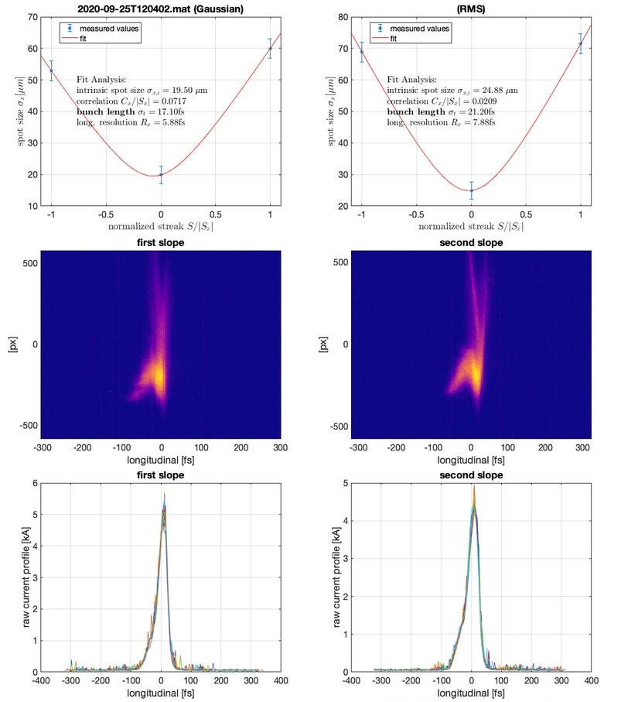
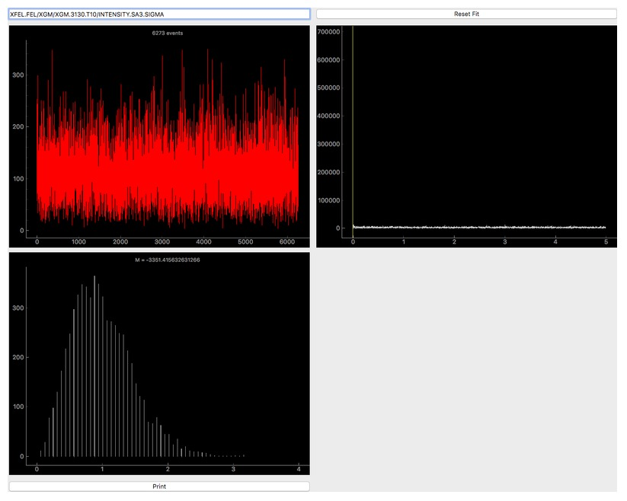
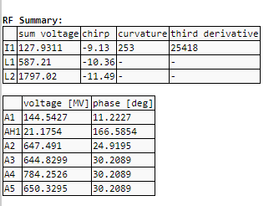
Shift Summary
First setup of compression similar to the “100pC C-mode”
  Preliminary analysis of fluctuations and spectral width
  suggested pulses longer than 10fs
  => roll-over-compression mode
  Data will be analysed further including filtering of machine jitter
~20fs

Slide 8
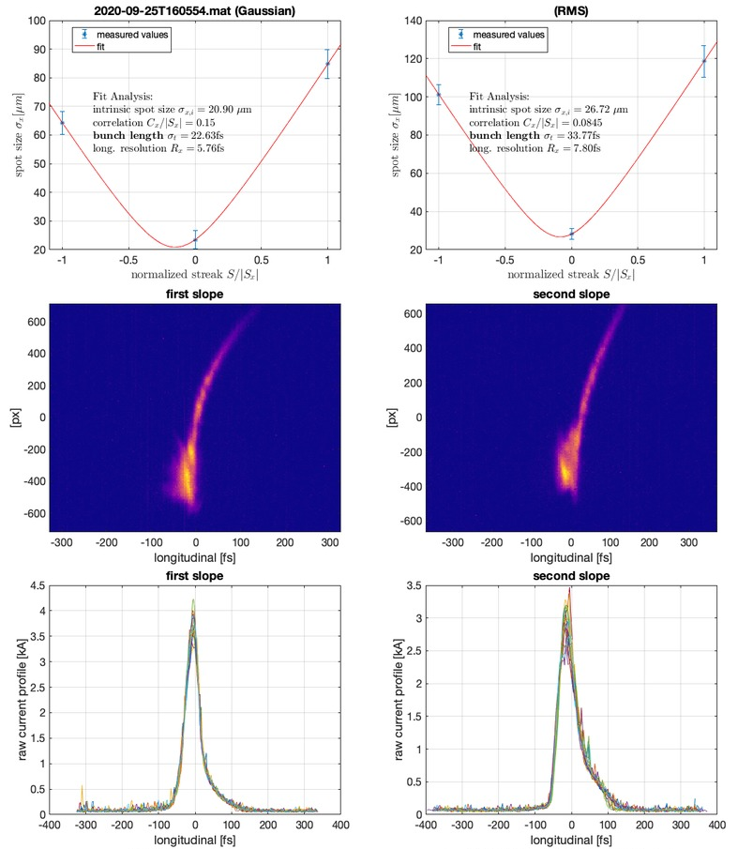
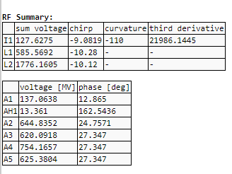
Shift Summary
Step by step reduction of curvature (2nd order Taylor
coefficient of sum-voltage after AH1) until SA1 power
was almost gone
~20fs

Slide 9
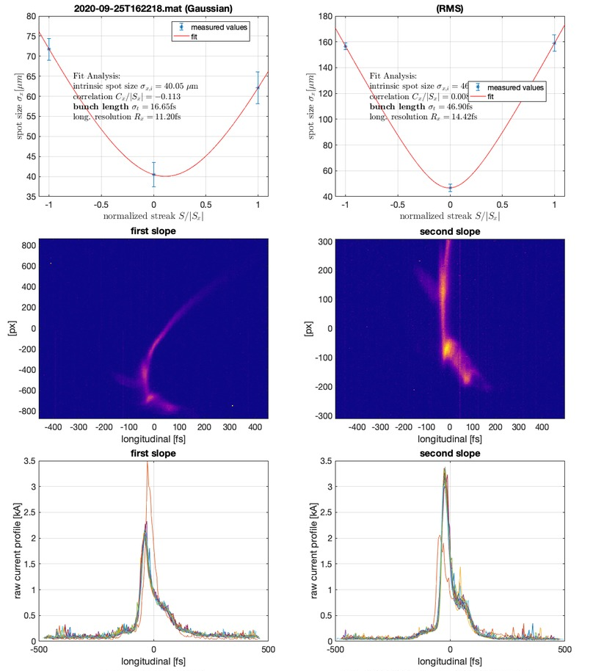
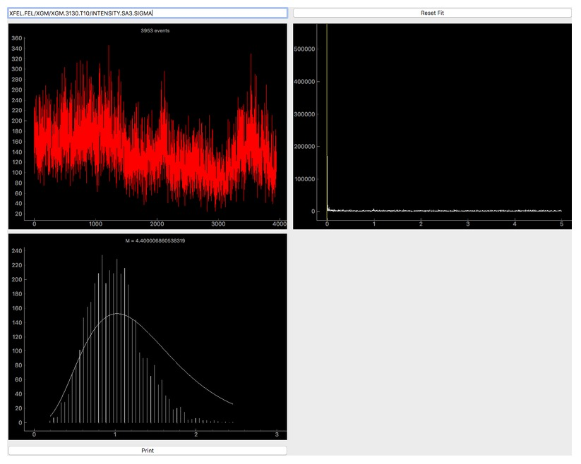
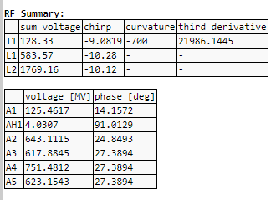
Shift Summary
Step by step reduction of curvature (2nd order Taylor
coefficient of sum-voltage after AH1) until SA1 power
was almost gone (roll-over compression)
Further reduction of 3rd harmonic voltage stopped SASE in SA1 (only limited attempts to re-establish SASE were done)
Clear signal in SA3 remained

Slide 10
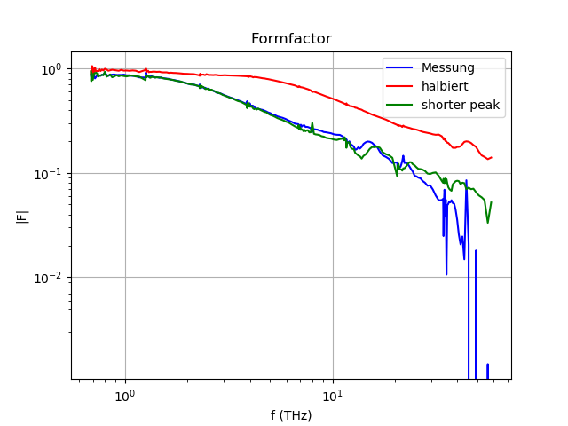
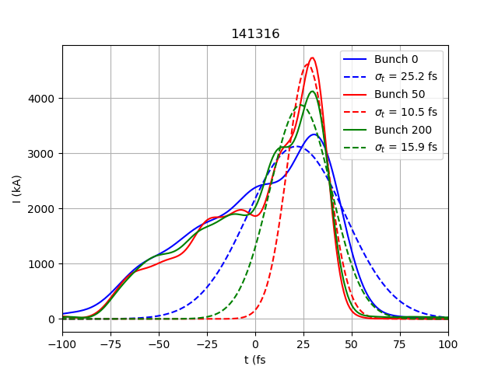
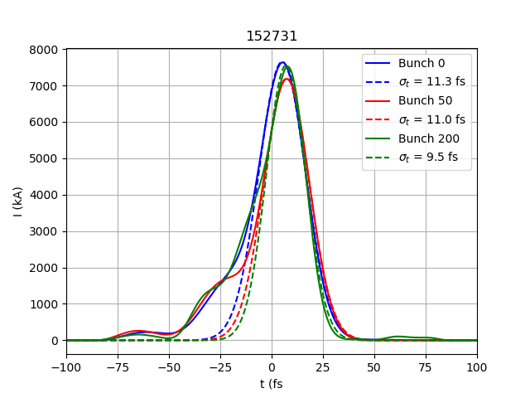
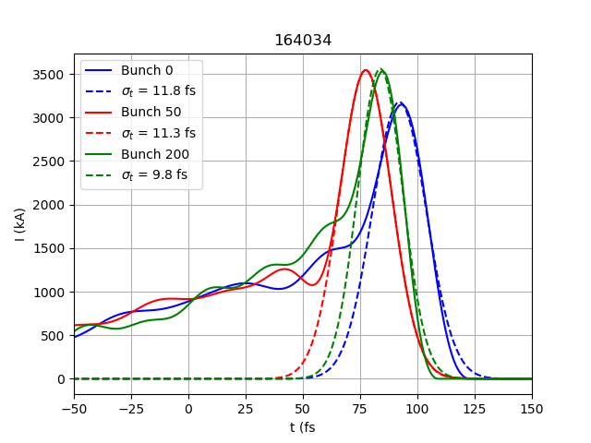
CRISP
Bunch length data measured with CRISP spectrometer
Resolution limited at about 5fs
“standard” compression
“roll-over” compression

Slide 11
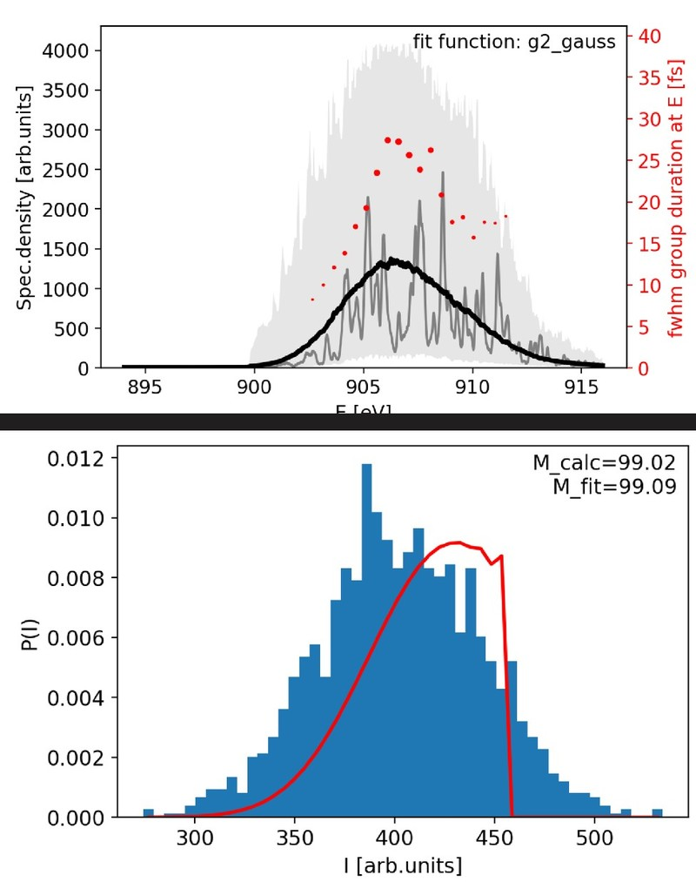
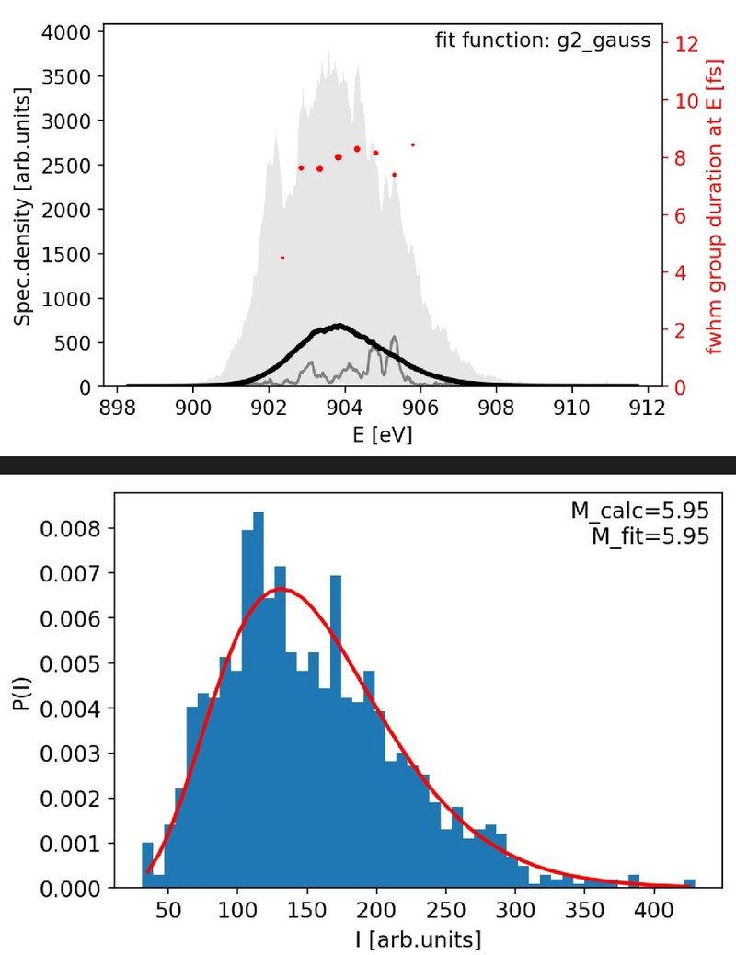
Photon Pulse duration Reconstruction at SA3
Photon pulses <10fs are detected in roll-over compression
“standard” compression
“roll-over” compression

Slide 12
Summary and Outlook
Summary:
  Photon pulses below 10fs duration were created
  Lasing in SA3 was reduced but available without major tuning
  SA1 din not lase for the short roll-over compression
  Only RF parameters a slight orbit adjustments required
Outlook:
  100pC studies next week
  LH adjustments
  Focus on SA3
  Study of required LLRF transition time for multi beamline operation (mainly for AH1)

