Slide 1
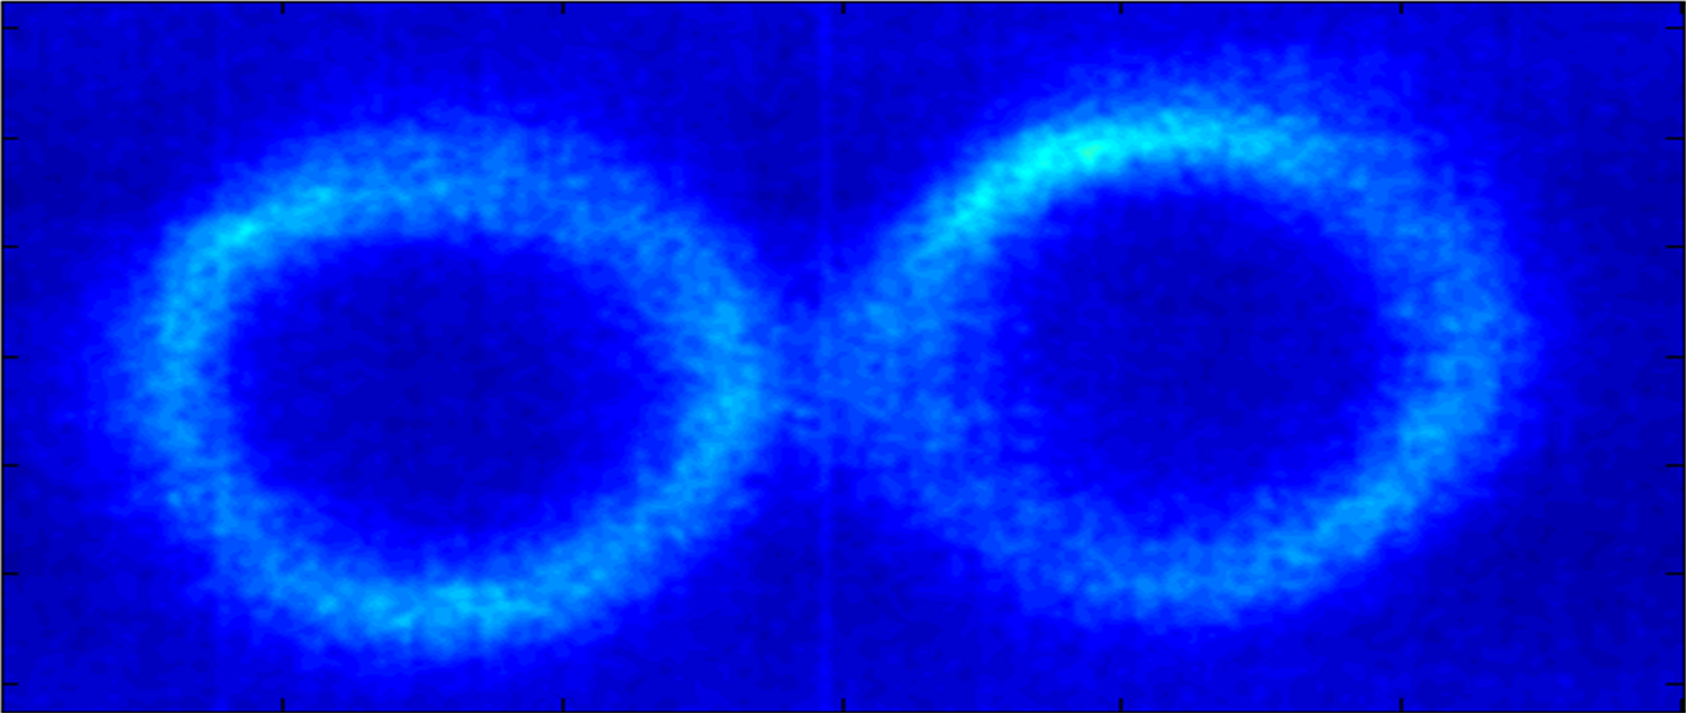
Undulator Measurements with the
K-Monochromator
Lars Fröhlich, Wolfgang Freund, Frank Brinker

Slide 2
Introduction
The instrument and undulator radiation basics

Slide 3
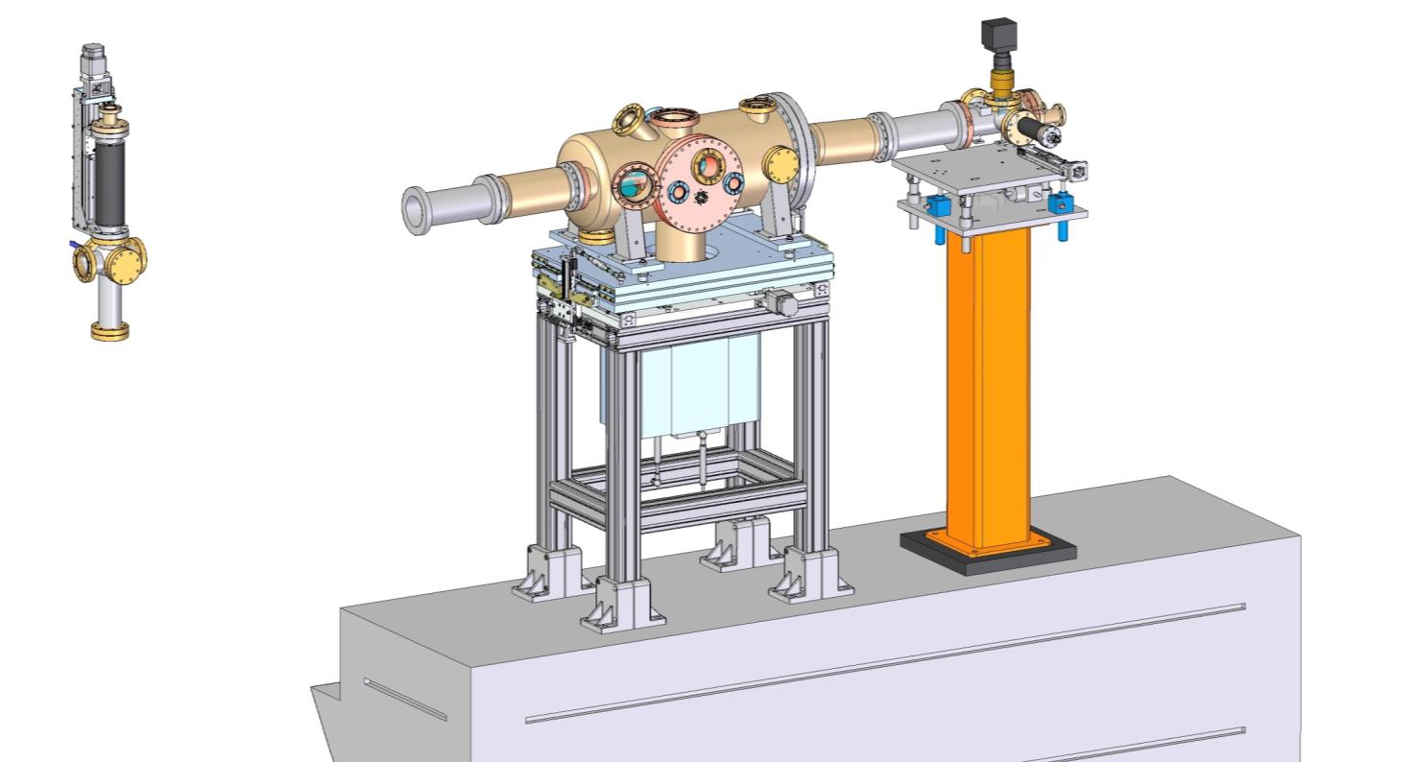
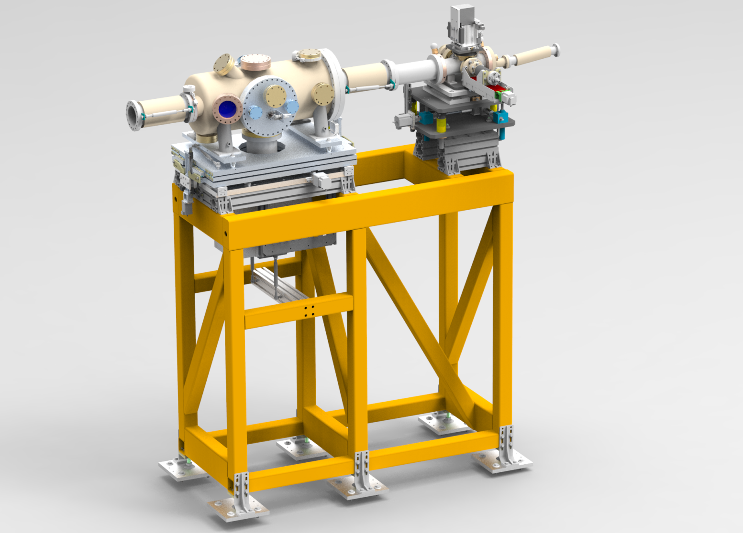
K-monochromator System
K-mono on
adjustment table
SR imager
(Spontaneous Radiation-IMG)
Filter chamber
(further upstream)
J. Synchrotron Rad. 26, 1037-1044 (2019)

Slide 4
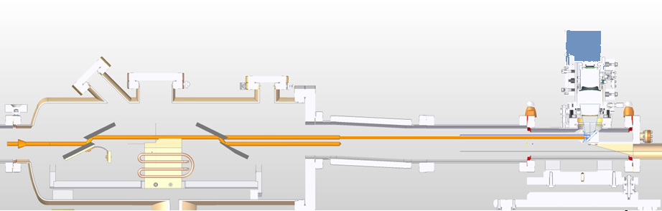
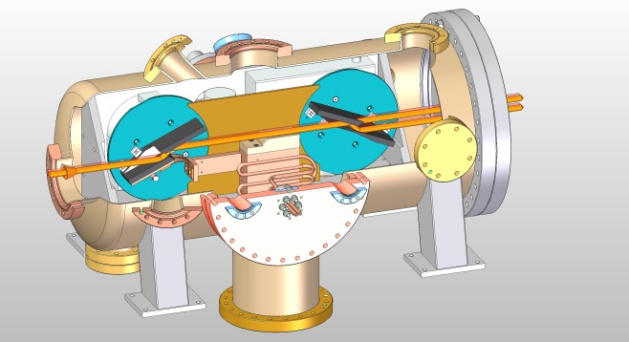
K-monochromator Setup
SR-imager
Two-bounce beam
(second crystal rotated out of the beam)
SR-beam
First channel-cut crystal
Second crystal
Four-bounce beam
(inline with beamline)
Specifications
Crystals | Two Si(111) channel-cut crystals
Bragg angle | ~7° to 55°
Energy range | 2.5 to >16 keV for Si(111) 7.5 to 48 keV for Si(333)

Slide 5
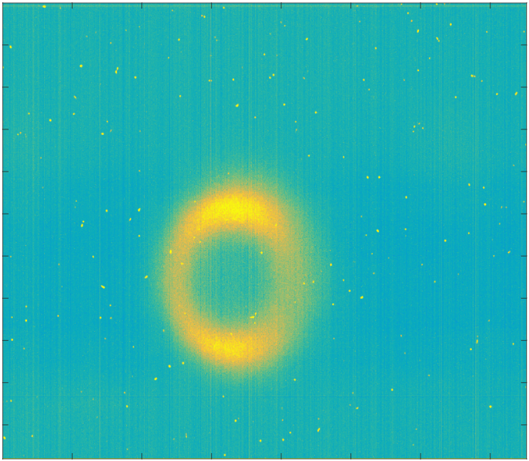


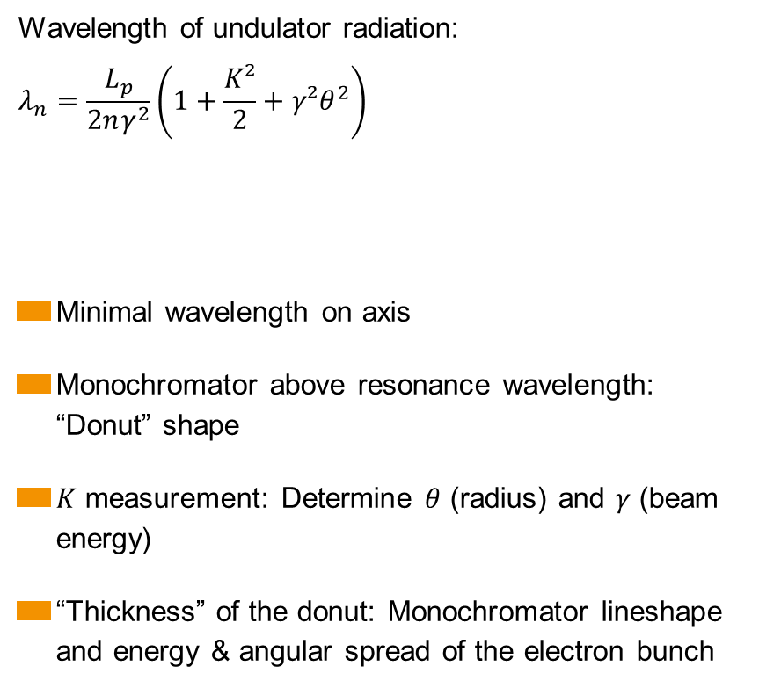
Undulator Radiation
Wavelength of undulator radiation:
$$λ_{n}=\frac{L_{p}}{2nγ^{2}}\left(1+\frac{K²}{2}+γ²θ^{2}\right)$$
Minimal wavelength on axis
Monochromator above resonance wavelength:
“Donut” shape
$K$ measurement: Determine $θ$ (radius) and $γ$ (beam energy)
“Thickness” of the donut: Monochromator lineshape and energy & angular spread of the electron bunch
$n$ – Harmonic (1=fundamental)
$θ$ – Angle of observation
$K$ – Undulator parameter
$L_{p}$ – Undulator period
$γ$ – Lorentz factor
r
K-mono
θ

Slide 6
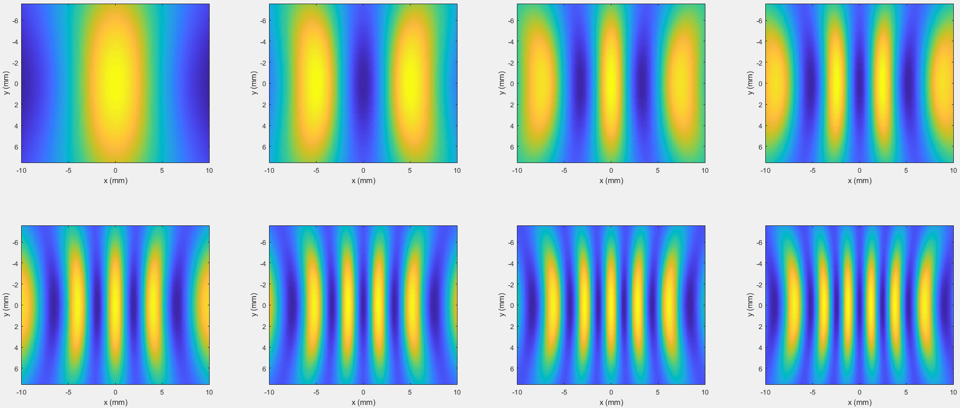

Harmonics: Intensity Distributions
$$∆z=200 \text{m}, K=2.88, γ=\frac{14000}{0.511}$$
1
2
3
4
5
6
7
8

Slide 7
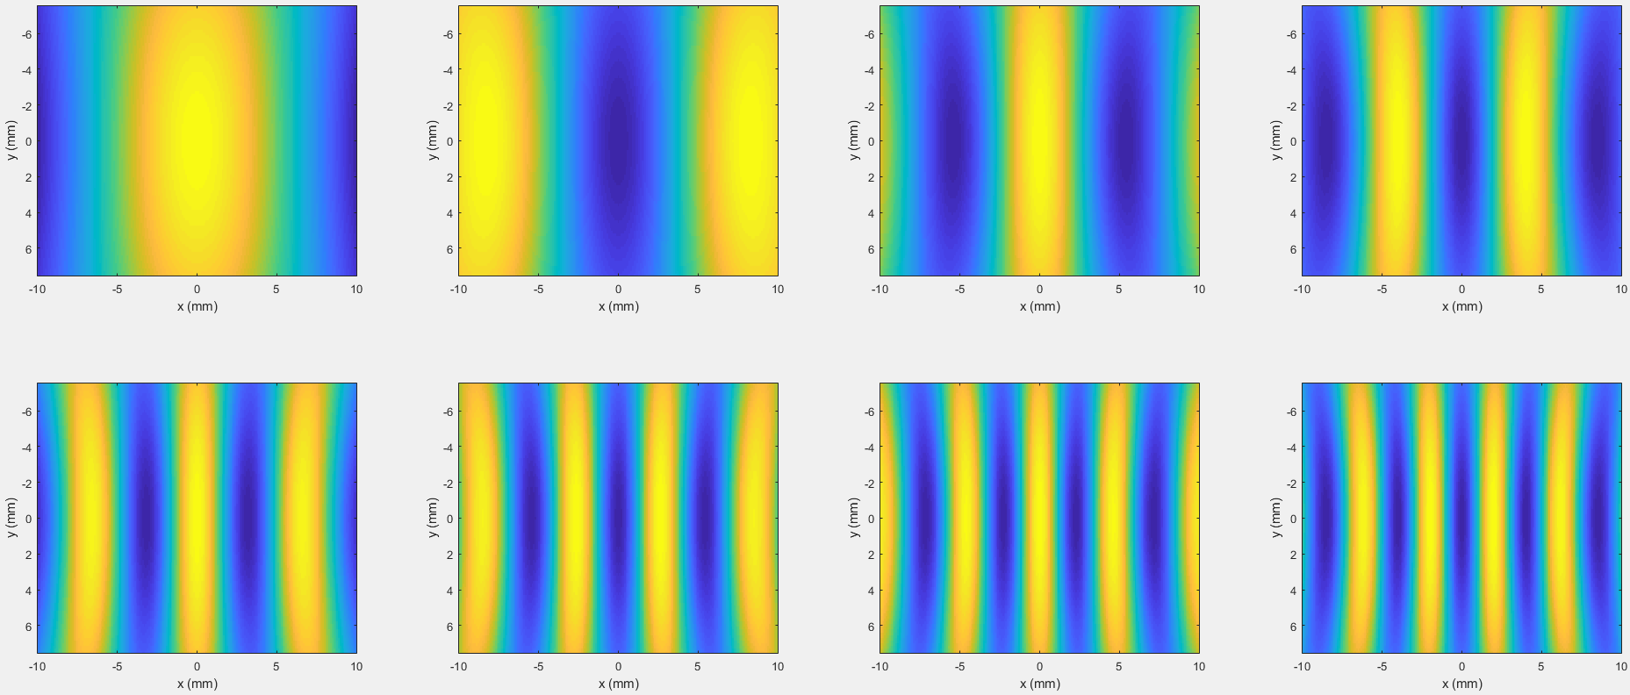

Harmonics: Intensity Distributions
$$∆z=180 \text{m}, K=5.87, γ=\frac{14000}{0.511}$$
1
2
3
4
5
6
7
8

Slide 8
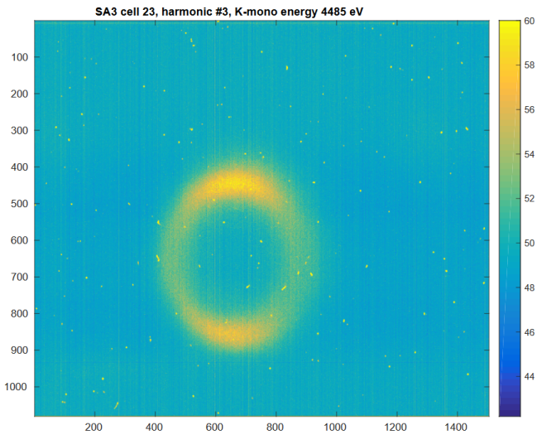
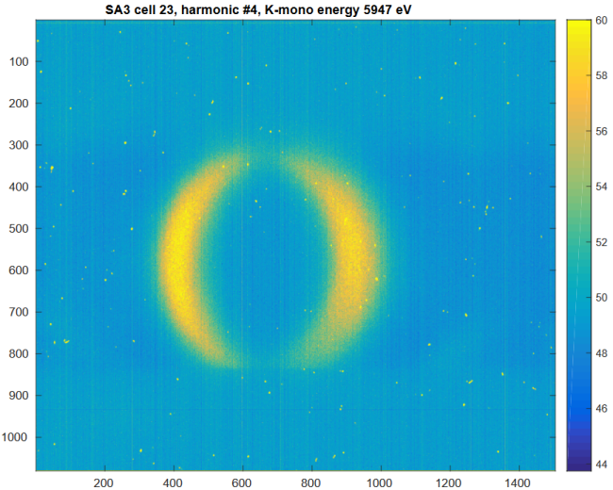
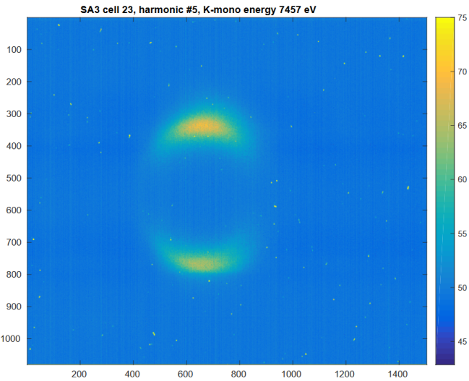
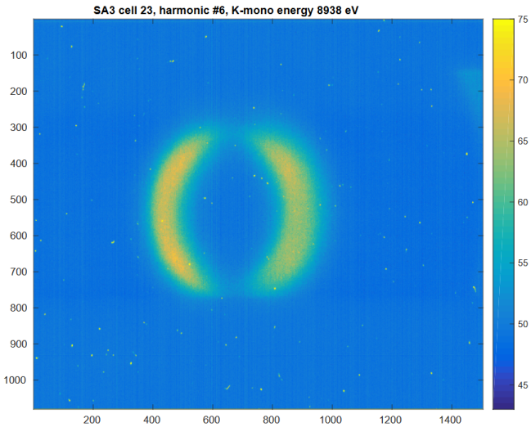
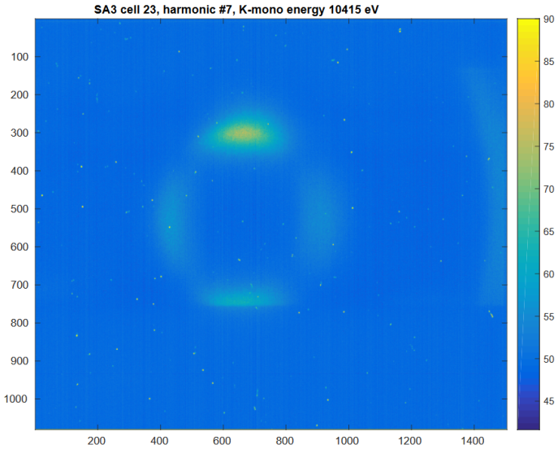
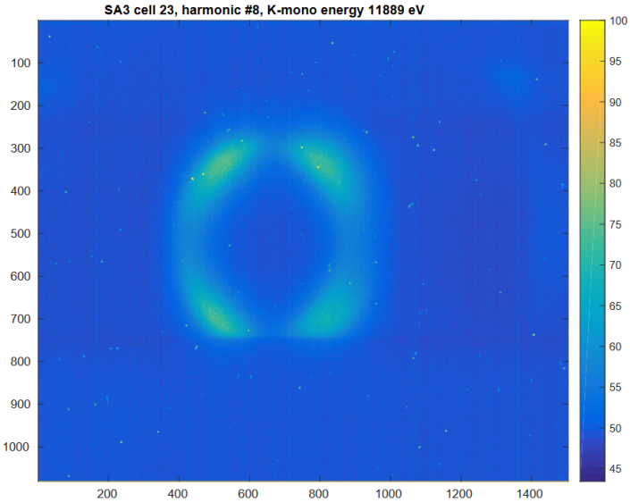
K-mono at SASE3: Harmonics
14 GeV
K = 5.8733
180 bunches,
average over
20 images
3
4
5
6
7
8

Slide 9
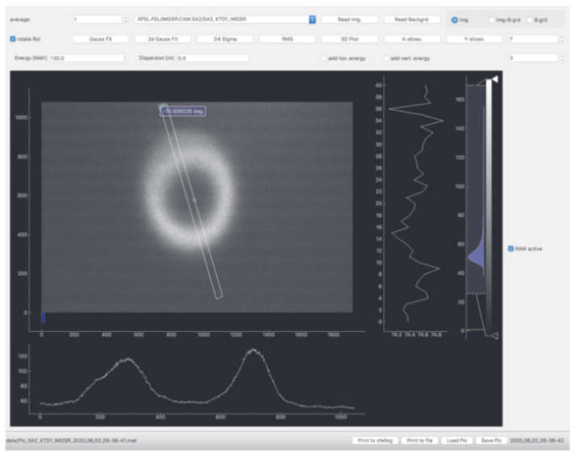
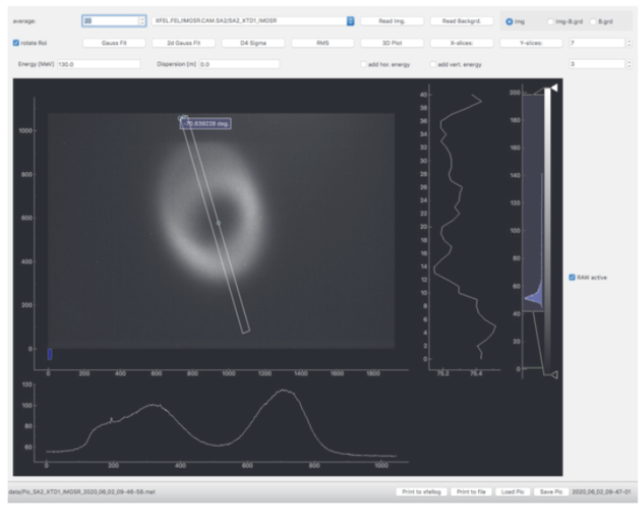
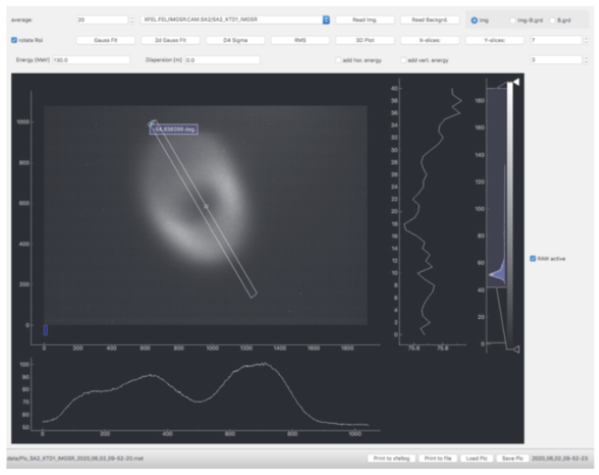
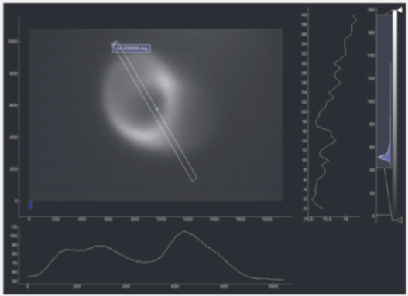
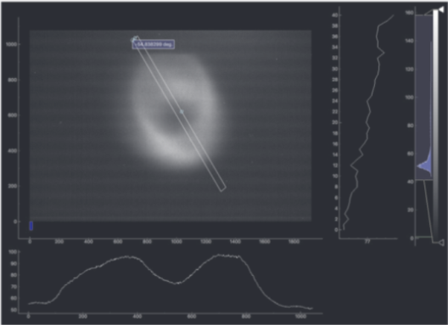
Impact of Energy & Angular Spread
Inj. chirp −8.193
(SASE)
Inj. chirp −8.244
Inj. chirp −8.274
Added hor. dispersion
in injector

Slide 10
Vertical Undulator Offset Scan
The “standard” undulator measurement after a BBA

Slide 11
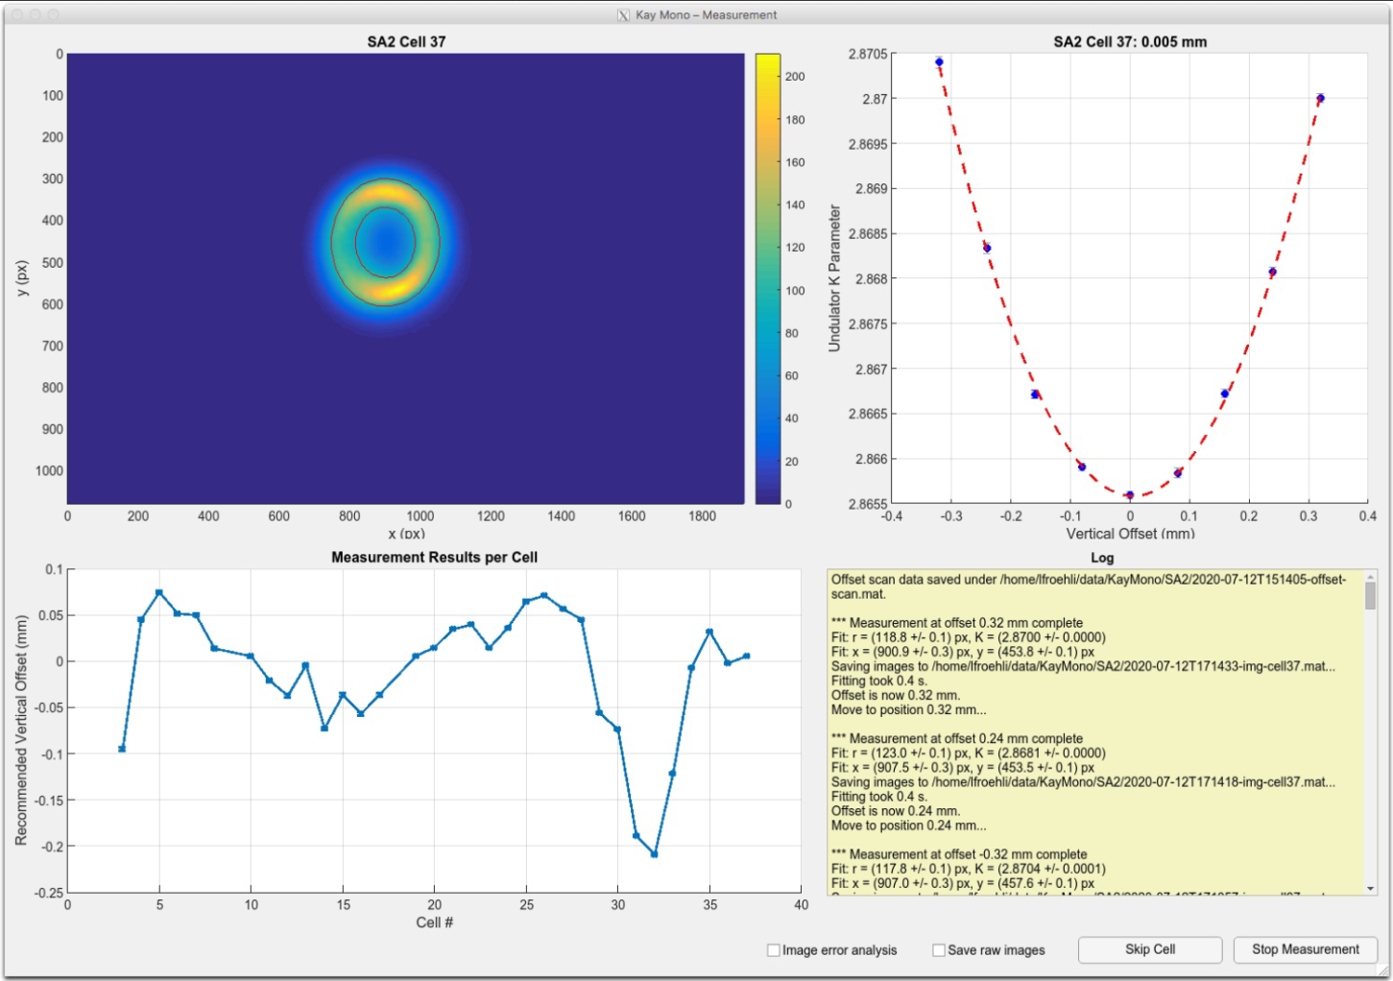
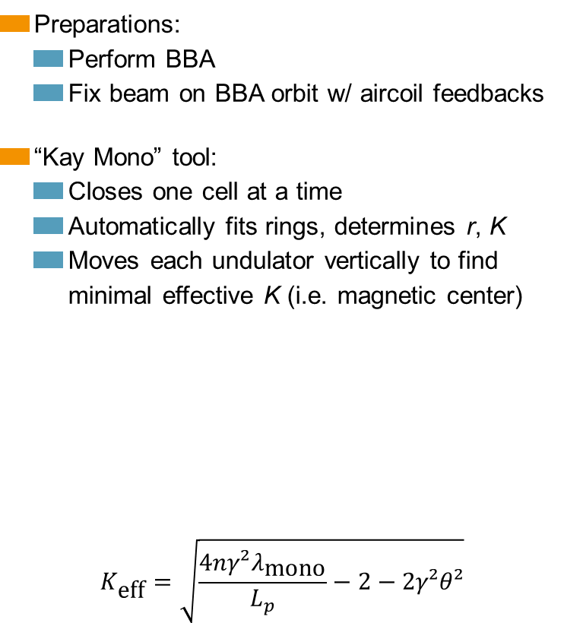
Standard Undulator Measurement: Vertical Offset Scan
Preparations:
  Perform BBA
  Fix beam on BBA orbit w/ aircoil feedbacks
“Kay Mono” tool:
  Closes one cell at a time
  Automatically fits rings, determines r, K
  Moves each undulator vertically to find minimal effective K (i.e. magnetic center)
$$K_{\text{eff}}=\sqrt{\frac{4nγ²λ_{\text{mono}}}{L_{p}}−2−2γ²θ²}$$

Slide 12
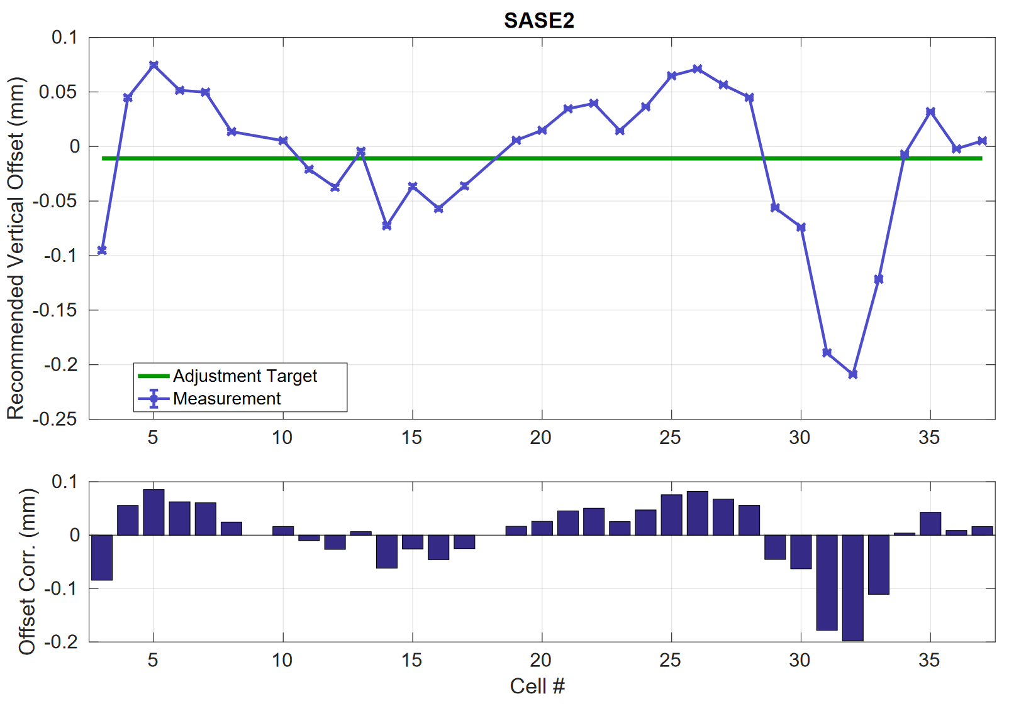
Vertical Offset Scan Results (1/3)
Suggested vertical position of each undulator segment
  At which undulator offset is the beam in the magnetic center?
  Relative to the chosen trajectory
2020-07-12

Slide 13
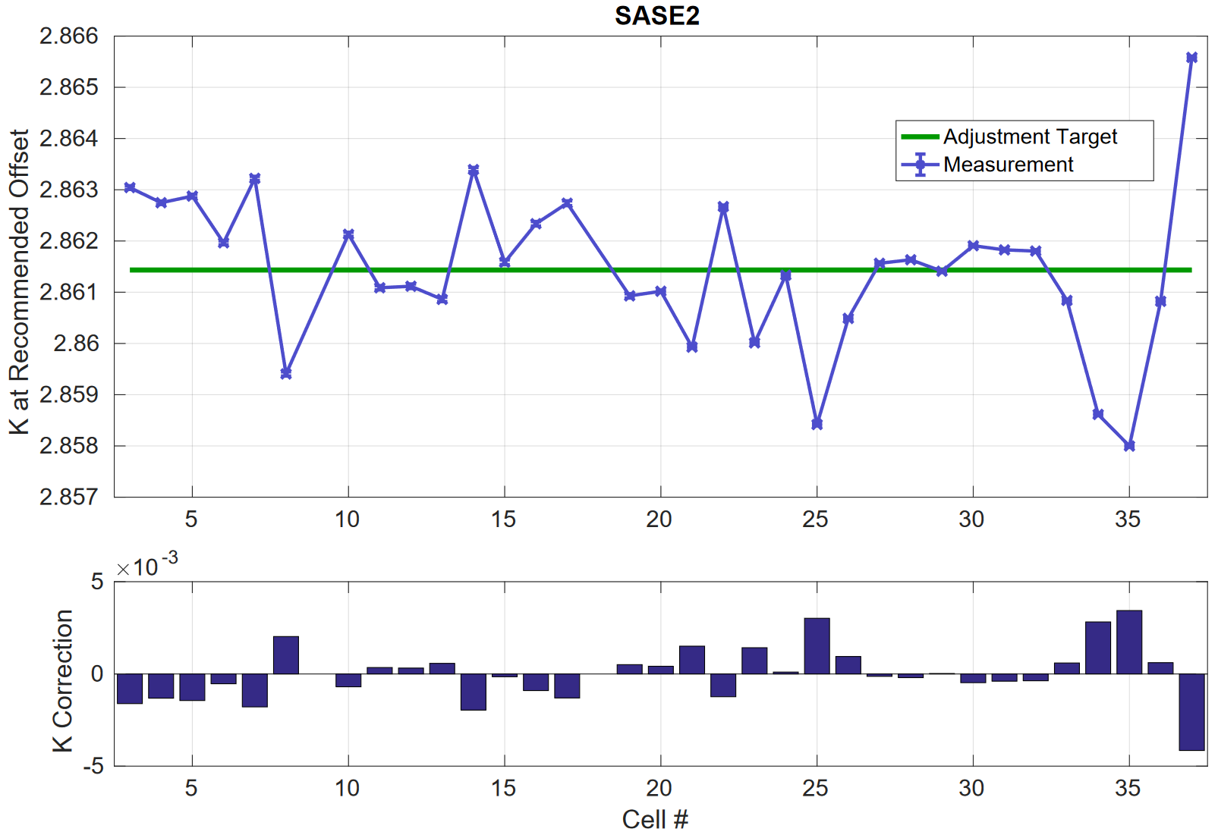
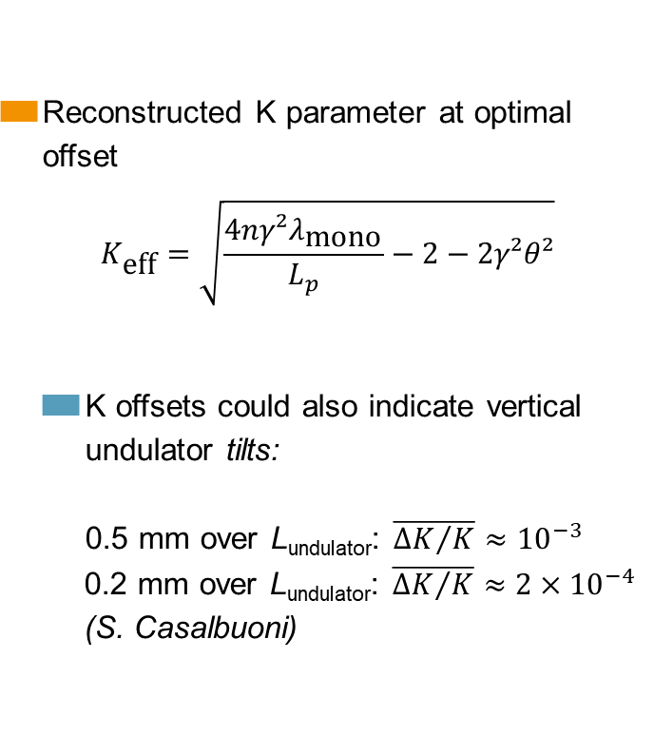
Vertical Offset Scan Results (2/3)
Reconstructed K parameter at optimal offset
$$K_{\text{eff}}=\sqrt{\frac{4nγ²λ_{\text{mono}}}{L_{p}}−2−2γ²θ²}$$
  K offsets could also indicate vertical undulator tilts:
  0.5 mm over L_{undulator}: $\overline{{∆K}/K}≈{10}^{−3}$
    0.2 mm over L_{undulator}: $\overline{{∆K}/K}≈{2×10}^{−4}$
    (S. Casalbuoni)
2020-07-12

Slide 14
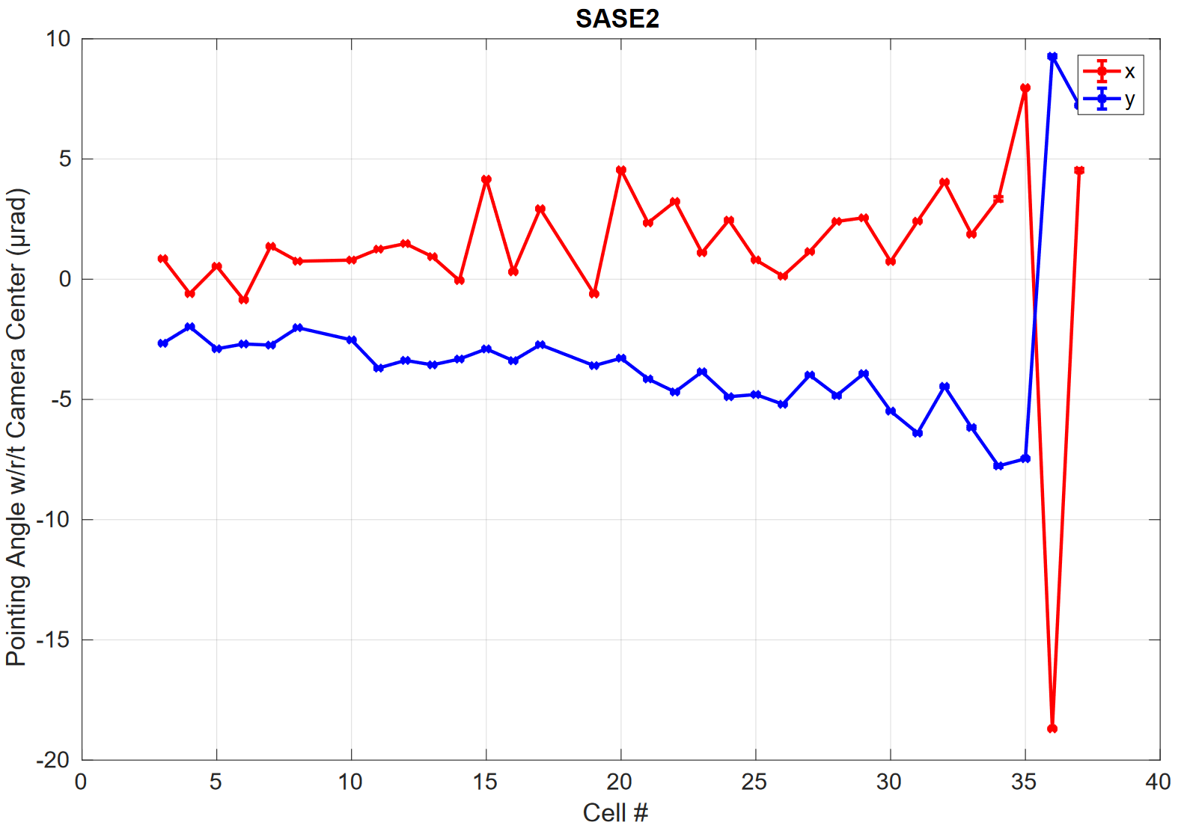
Vertical Offset Scan Results (3/3)
Pointing information w/r/t SR imager
  Center of the “donut”
  Angular errors dominate position errors
  (long lever arm: hundreds of meters)
  Susceptible to orbit feedback issues
2020-07-12

Slide 15
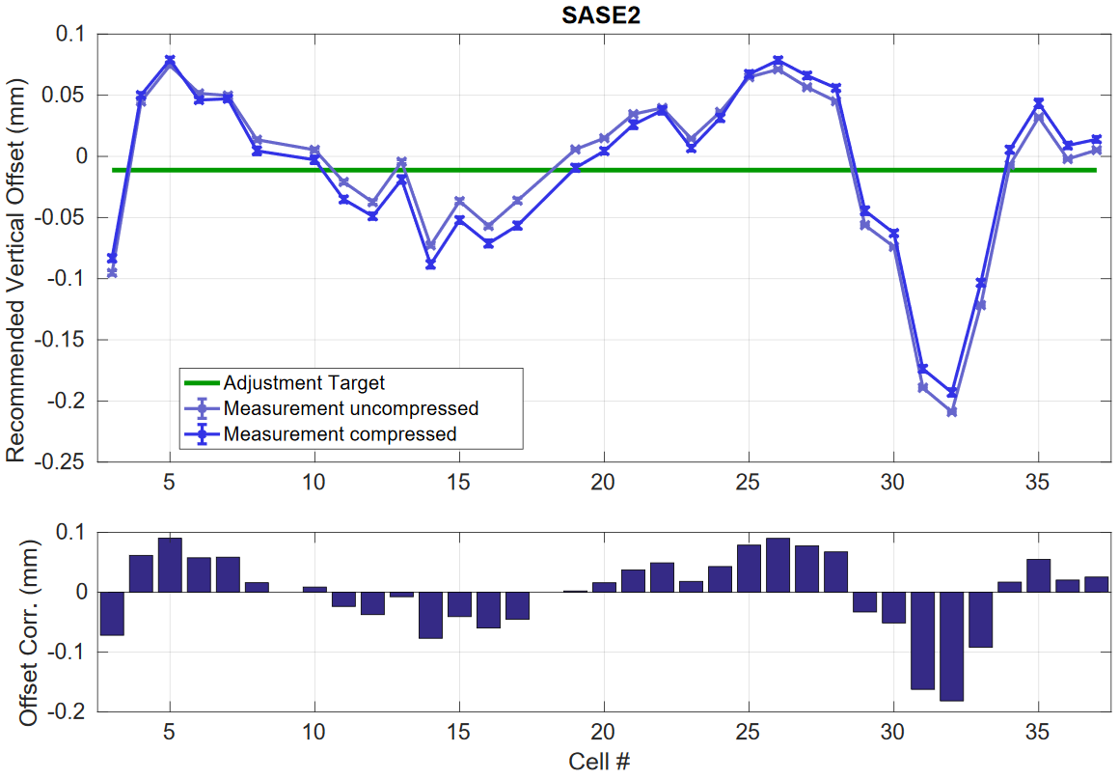
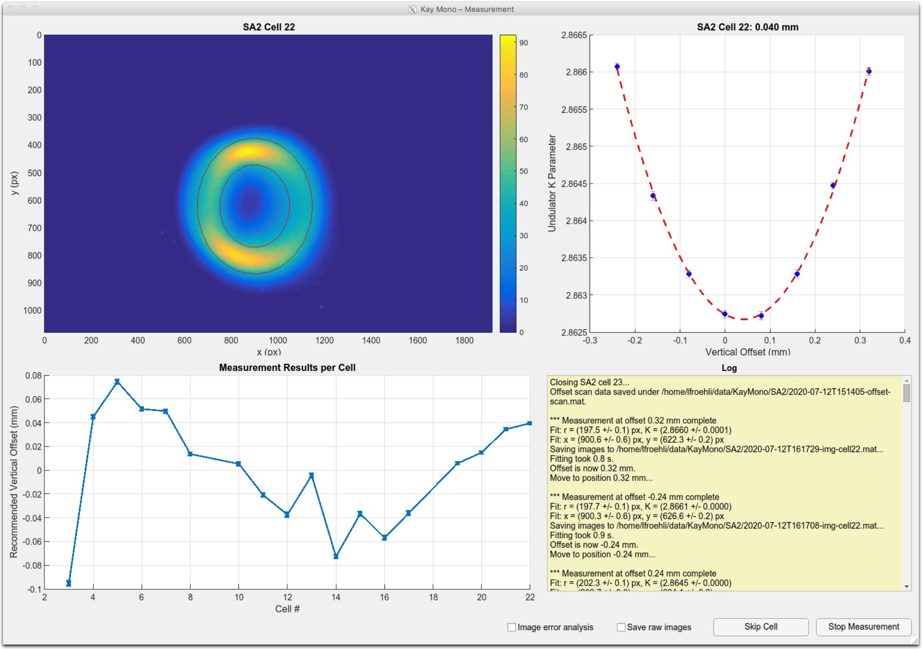
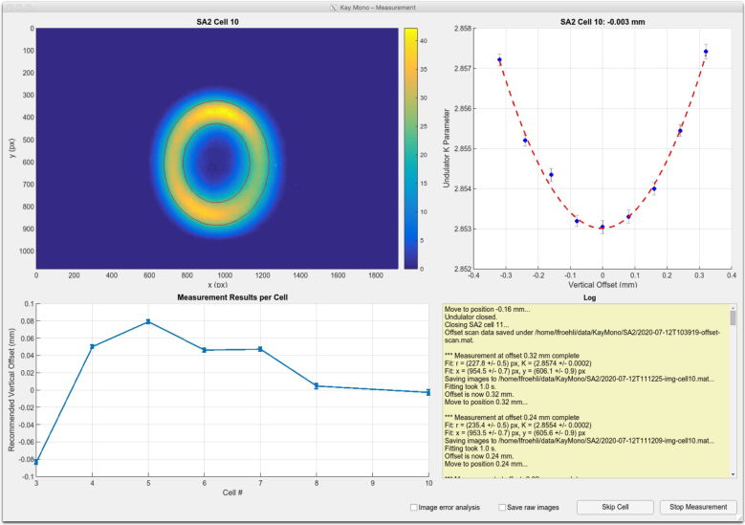
July 12: Compressed and Uncompressed Beam – Vertical Offset
uncompressed
compressed

Slide 16
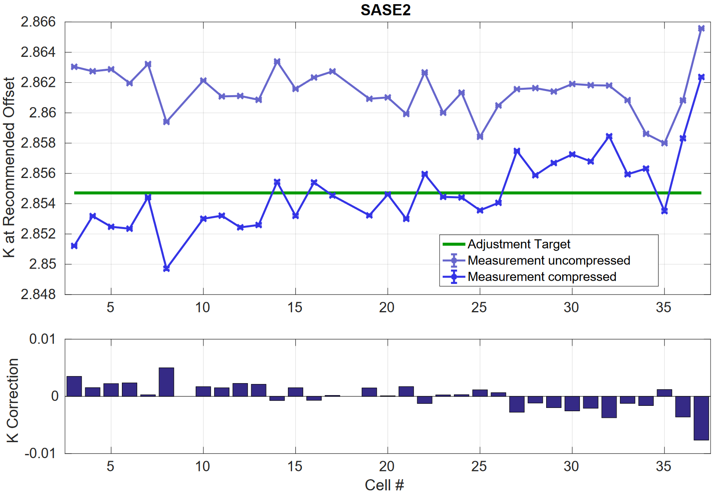
July 12: Compressed and Uncompressed Beam – K Parameters
uncompressed
compressed

Slide 17
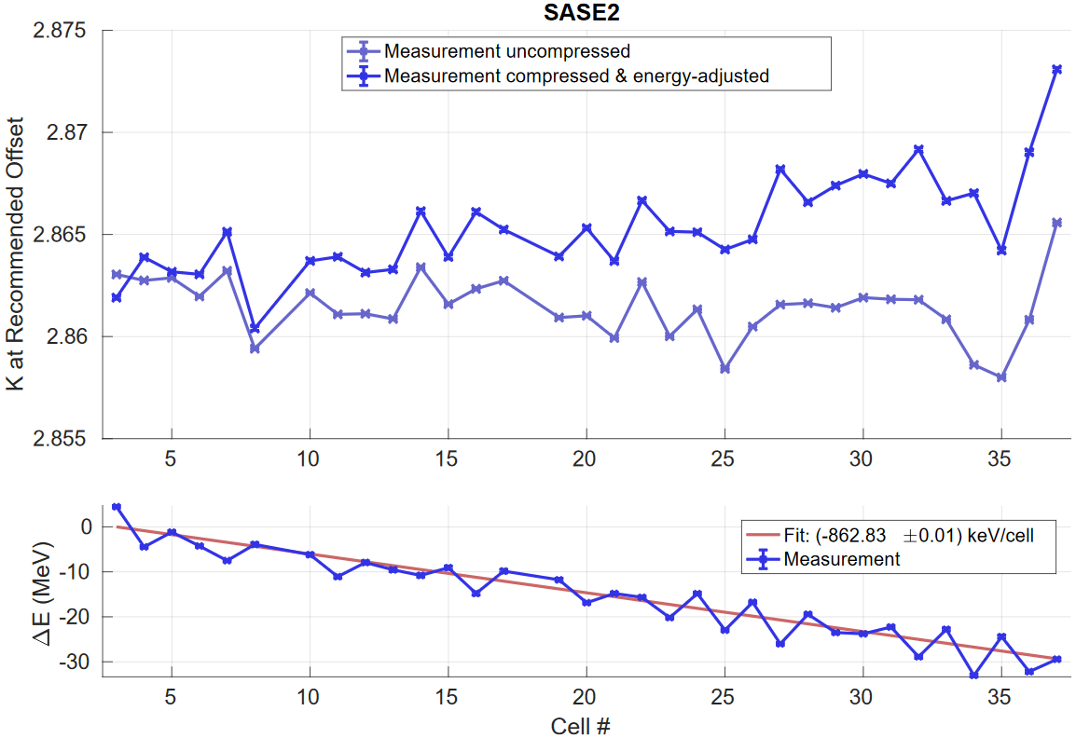
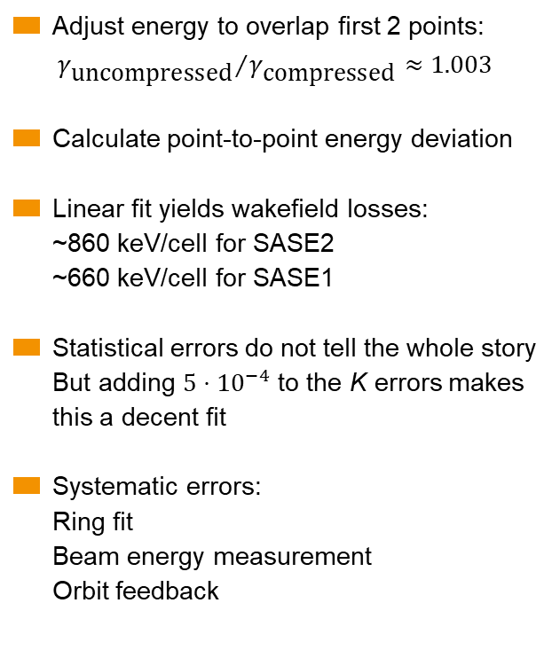
July 12: Compressed and Uncompressed Beam – Energy Difference
Adjust energy to overlap first 2 points:
${γ_{\text{uncompressed}}}/{γ_{\text{compressed}}≈1.003}$
Calculate point-to-point energy deviation
Linear fit yields wakefield losses:
~860 keV/cell for SASE2
~660 keV/cell for SASE1
Statistical errors do not tell the whole story
But adding $5⋅{10}^{−4}$ to the K errors makes this a decent fit
Systematic errors:
Ring fit
Beam energy measurement
Orbit feedback

Slide 18
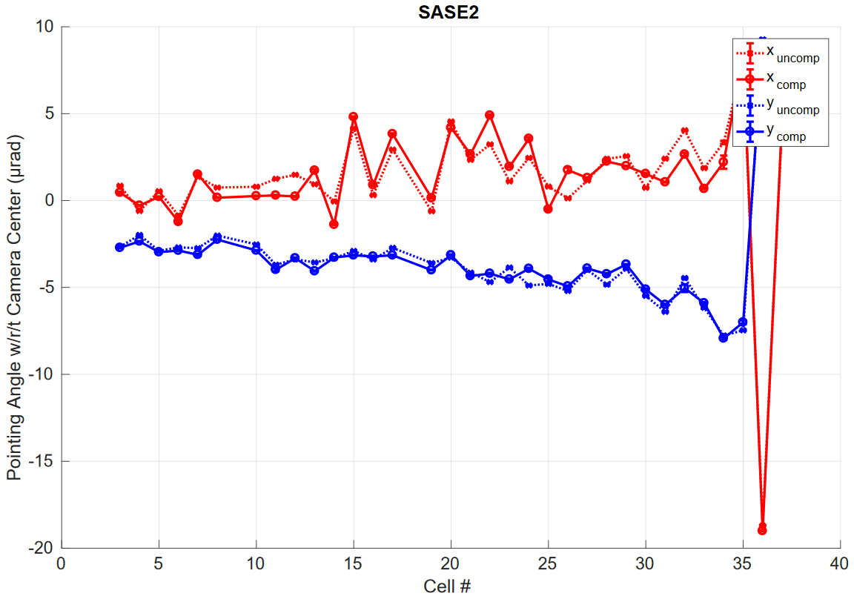
July 12: Compressed and Uncompressed Beam – Pointing
Keeping the trajectory is one of the major challenges of this measurement.

Slide 19
Other Measurements
Spectra and Phase Shifter Scans

Slide 20
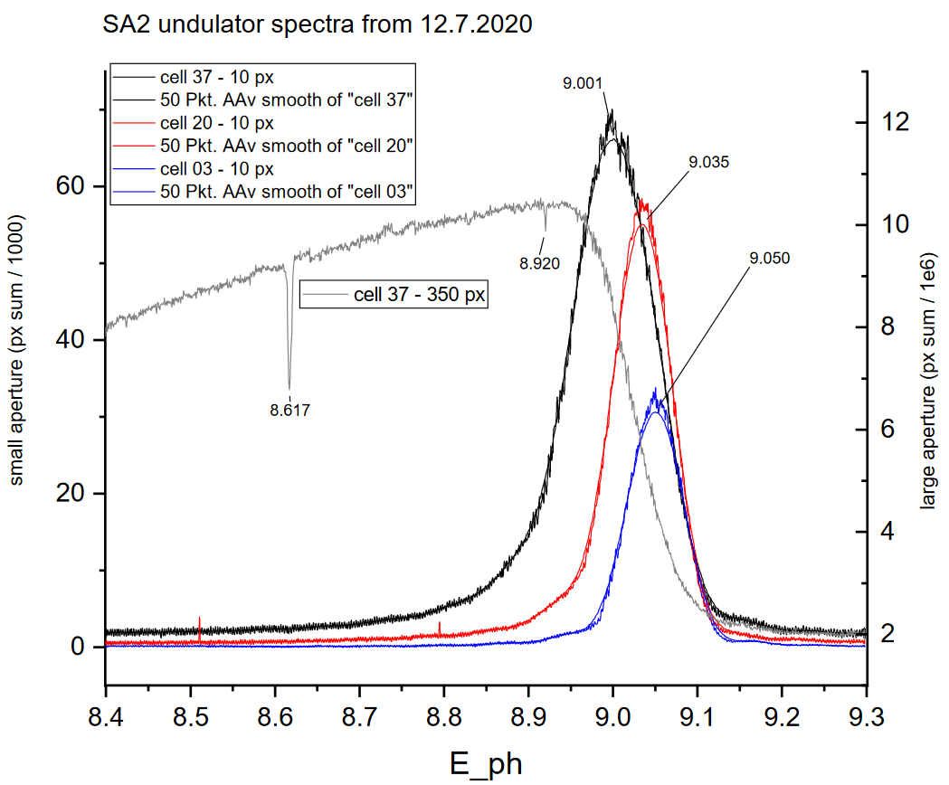
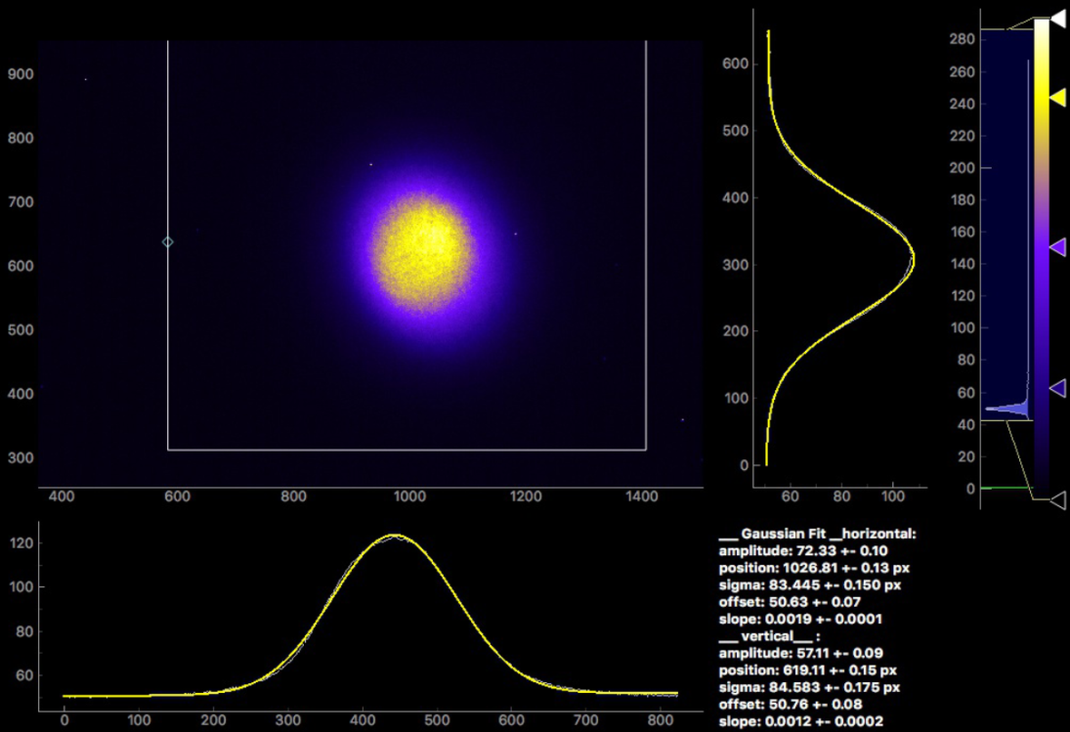
Undulator Radiation Spectra
Spectra are acquired by scanning the K-mono (~minutes)
Sensors:
  Photodiode
  SR imager w/ user-defined region of interest
Si(111) crystal glitch

Slide 21
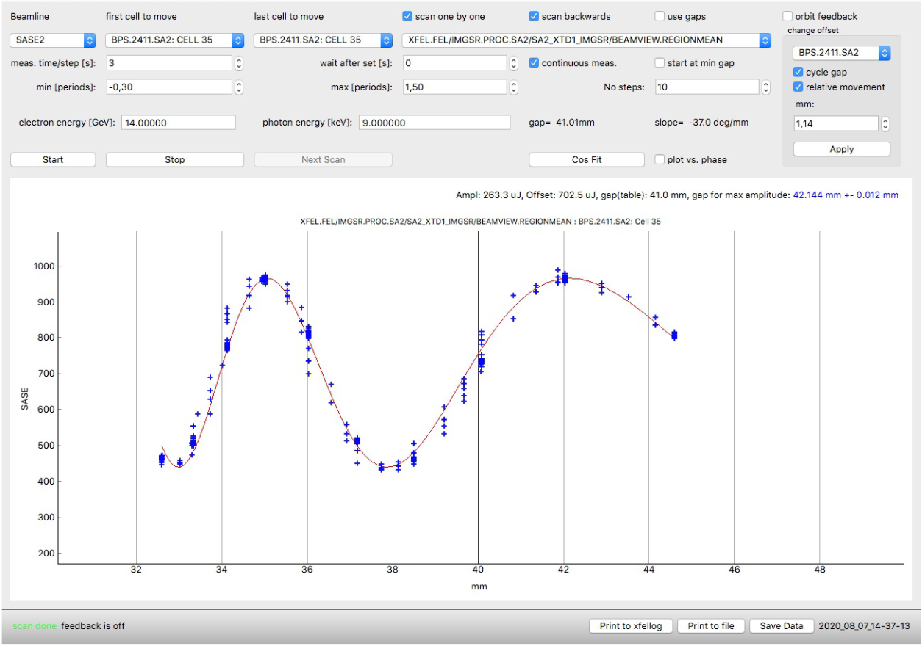
Phase Shifter Scans
Close two adjacent undulator cells
Scan phase shifter gap
Acquire intensity from SR imager in narrow ROI
Questions on reproducibility

Slide 22
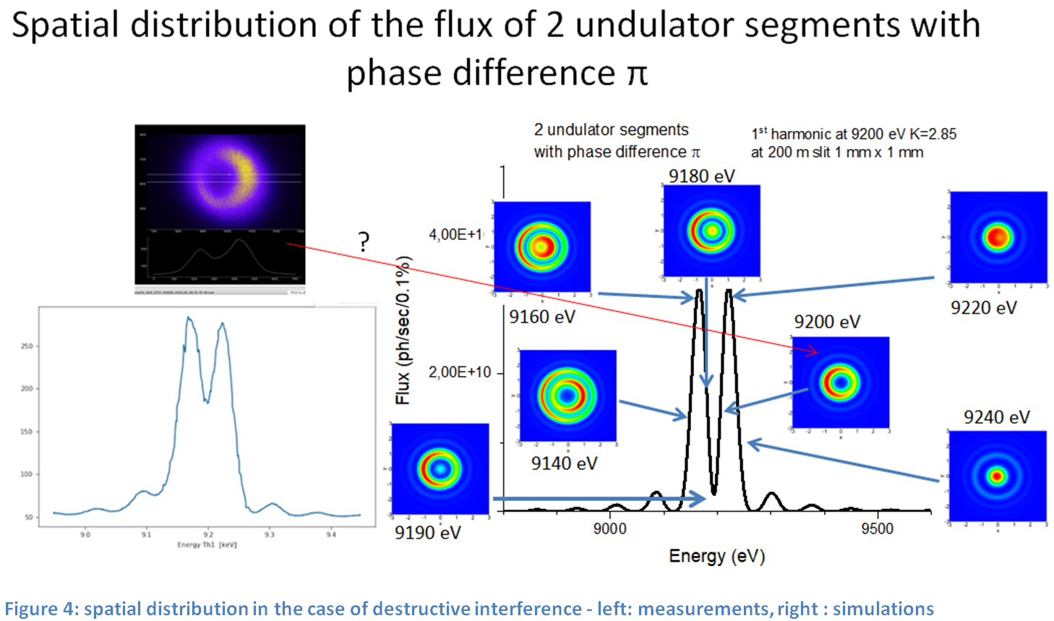

Slide 23
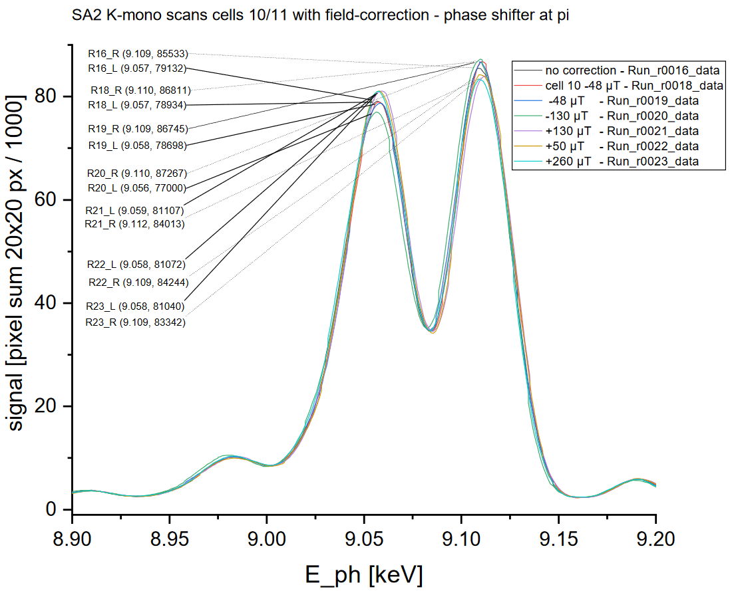
Influence of Ambient Field Correctors
Ratio of peak amplitudes depends on bending radius of trajectory
Under investigation
(Sara, Frank, Wolfgang)

Slide 24
Conclusions & Outlook

Slide 25
Conclusions
Vertical offset scan after BBA is well established for SASE1 and SASE2
  Application of offsets and K adjustments contributes to good FEL performance
  Pointing information can reveal problems in the BBA (but correction is hard)
  Major problem: Trajectory stabilization
Good bunch compression is essential for FEL, but also helps in K-mono measurements
  K-mono can diagnose bad longitudinal phase space (but does that help?)
Useful for phase shifter scans?
  Probably, but more development needed
Spectra can be useful for a variety of studies

Slide 26
Outlook
More automation needed
  “Vertical scan mode” on undulators has to be enabled manually by XFEL undulator group
  K-mono, SR imager, apertures have to be inserted, removed, configured manually from Karabo panels
Establish vertical offset scan for SASE3
  Difficult because of low intensity, use of higher harmonics
Develop phase shifter scans further
Study impact of ambient field correction coils
4-bounce mode: Transfer beam to downstream imagers or experiment

Slide 27
Thank you for your time.
Special thanks to Sara Casalbuoni and Evgueny Schneidmiller for helpful discussions.

