Slide 1
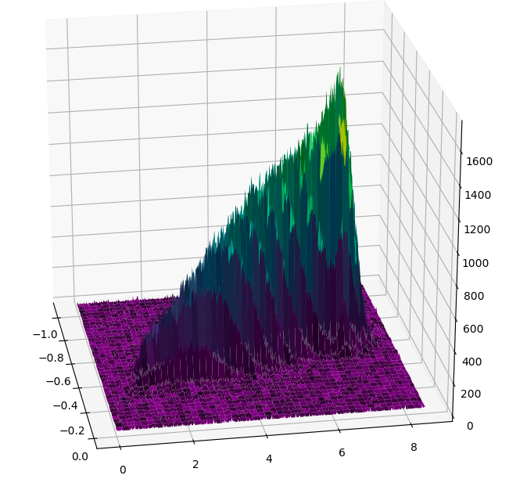
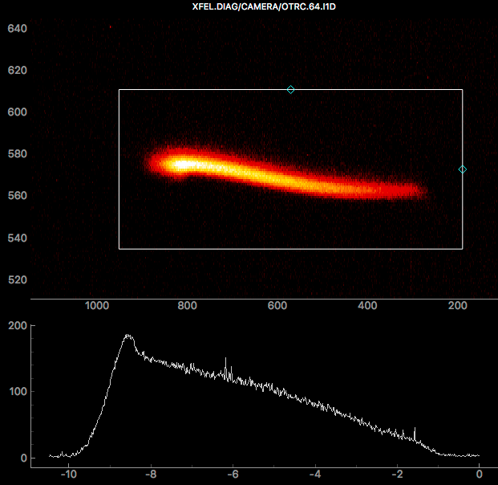
Beam dynamics at the XFEL injector:
Collection of observations and questions
F.Brinker
Dec. 3rd 2019

Slide 2
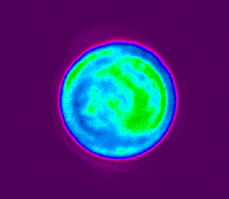
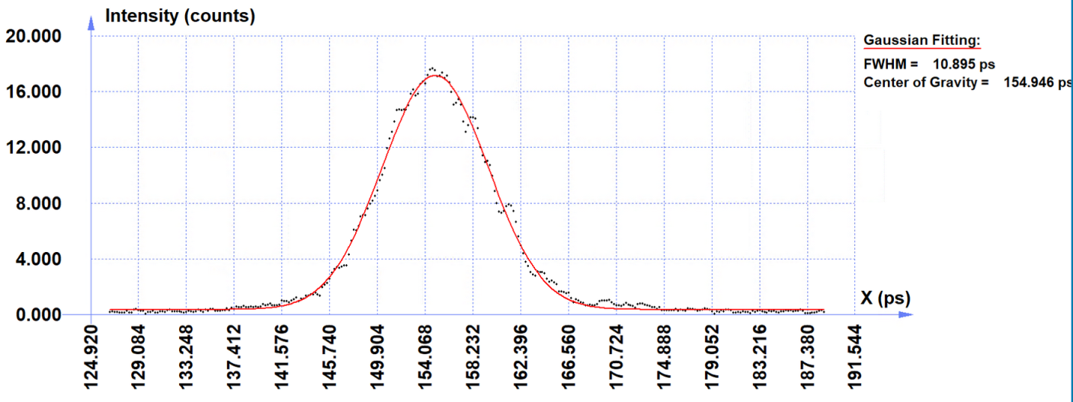
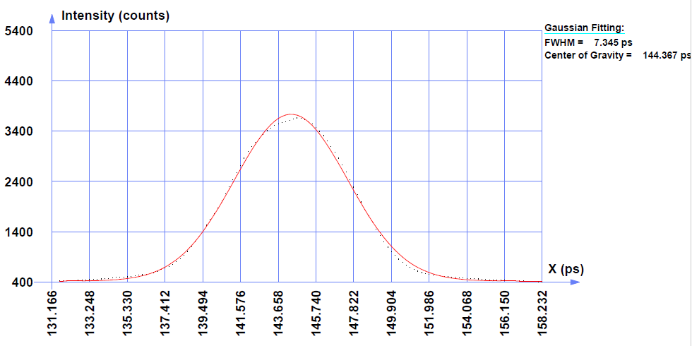
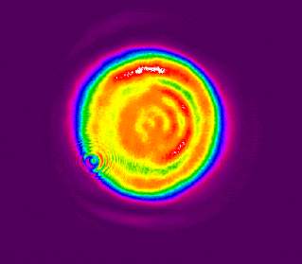
Spacial and temporal charge distribution: Laser profile
Laser 1 (MBI)
Laser 1 :
FWHM ~10.9 ps
Laser 2 :
FWHM ~ 7 - 7.3 ps
Laser 2

Slide 3
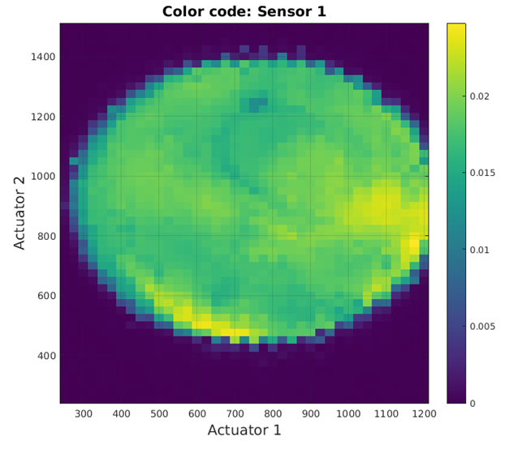
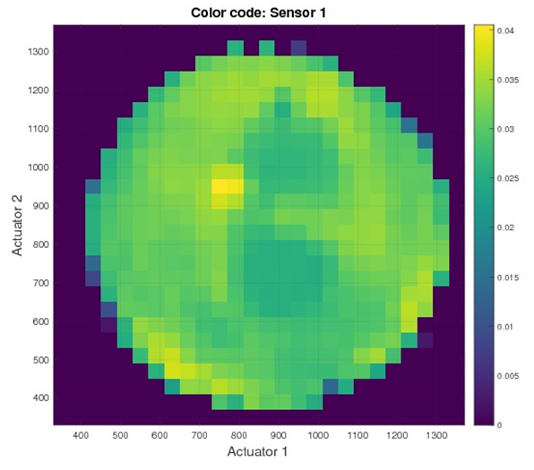
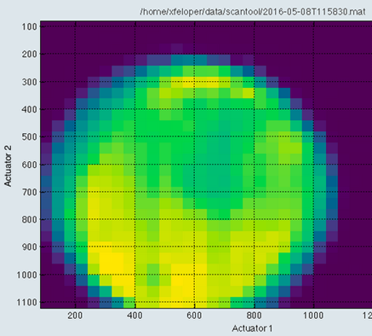
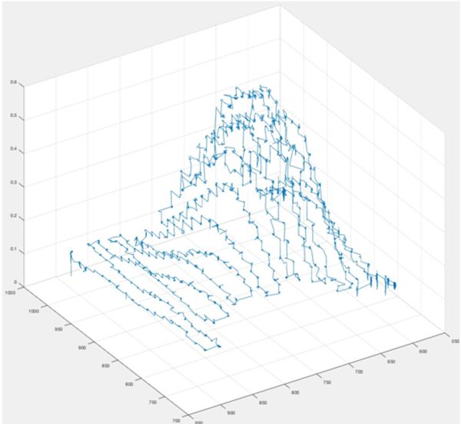
Spacial and temporal charge distribution: QE distribution
Nov. 2019:
Factor 7 intensity variation
~750 um FWHM
-> Might be caused by layer on laser window
May 2016
Dec. 2016
July 2018
Remeasure full QE Map in January
  Clean window
  2nd camera replaced
  Working laser pos. feedback

Slide 4
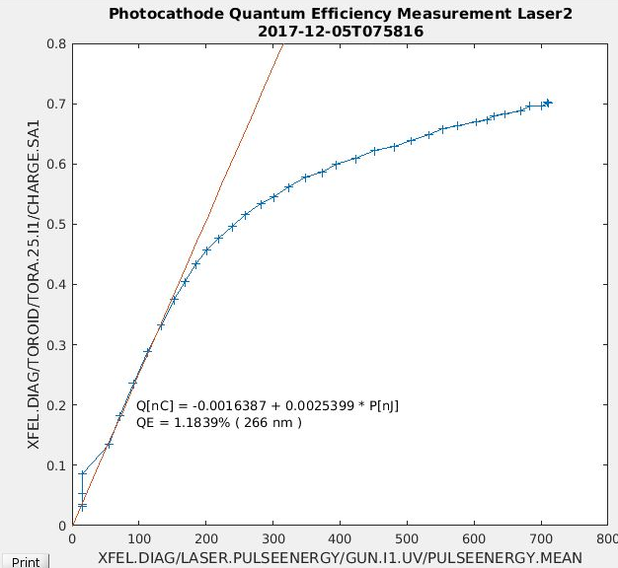
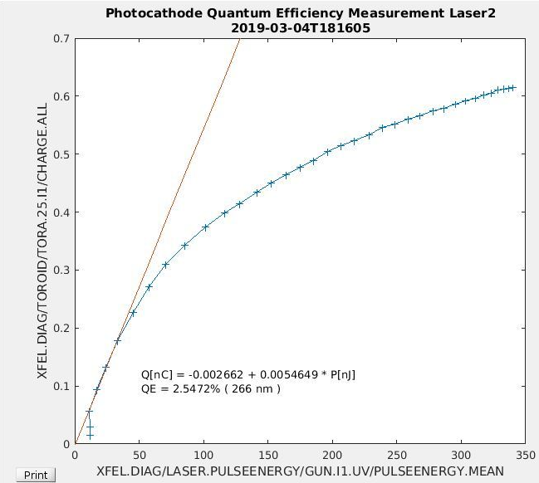
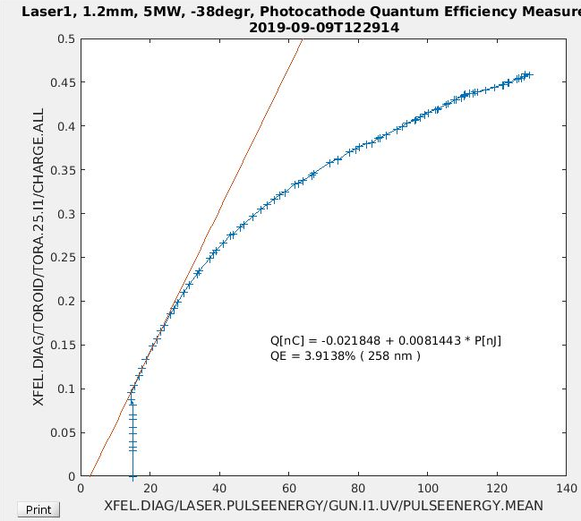
Spacial and temporal charge distribution: QE Scans with BSA 1.2mm
Early saturation : hint of reduced beam size on the cathode !
Sept. 2019:
Saturation starts at 0.2 nC
Dec 2017:
Saturation starts at 0.35 nC
March 2019:
Saturation starts at 0.2 nC
Remeasure in January

Slide 5
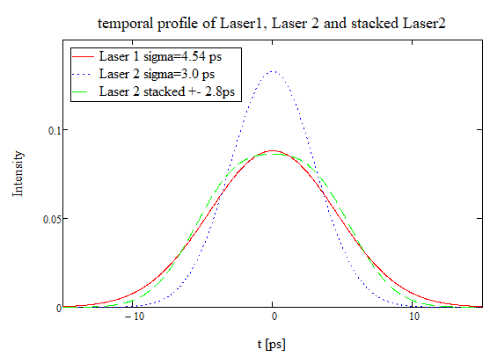
Temporal charge distribution:
Laser profile for Laser 1, Laser 2 and stacked Laser 2 ( -> 2020 )
Stacker for 2 pulses should be installed this shutdown,
Realization unclear due to delay of crystals
As soon as available:
Test influence on emittance, SASE
Easier switching between lasers ?

Slide 6
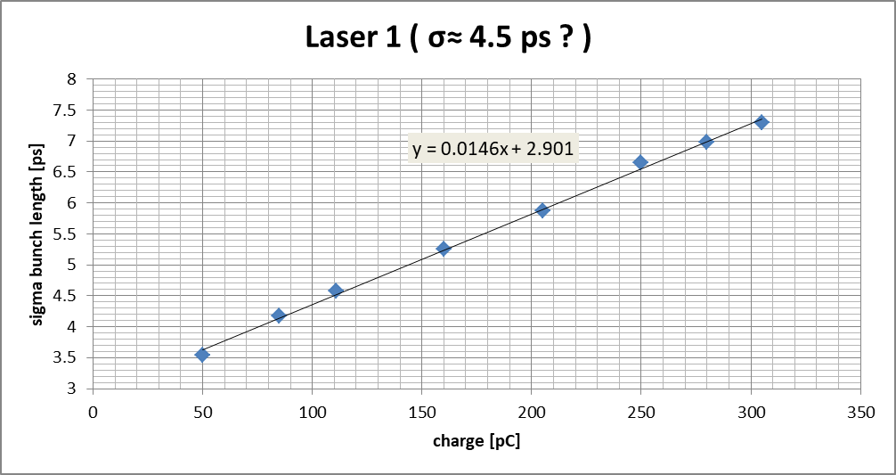
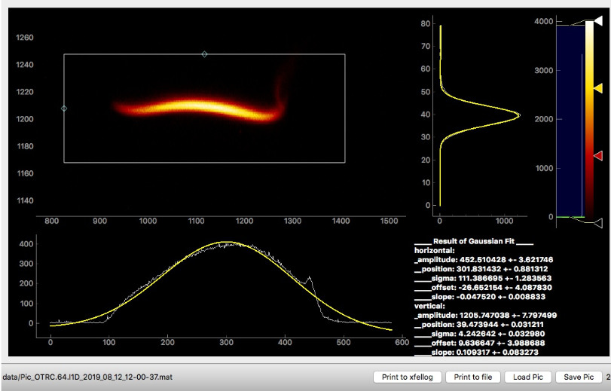
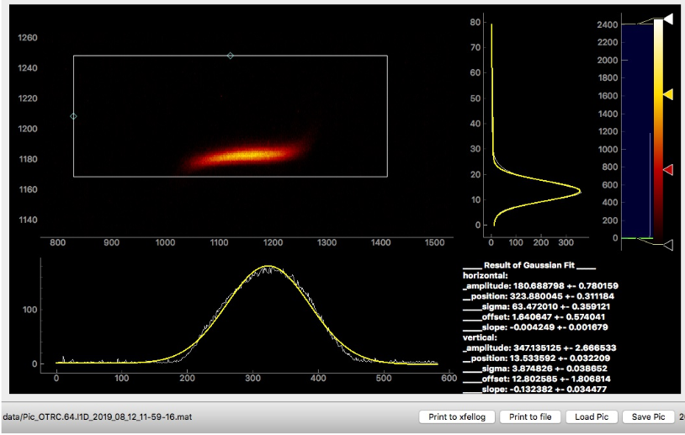
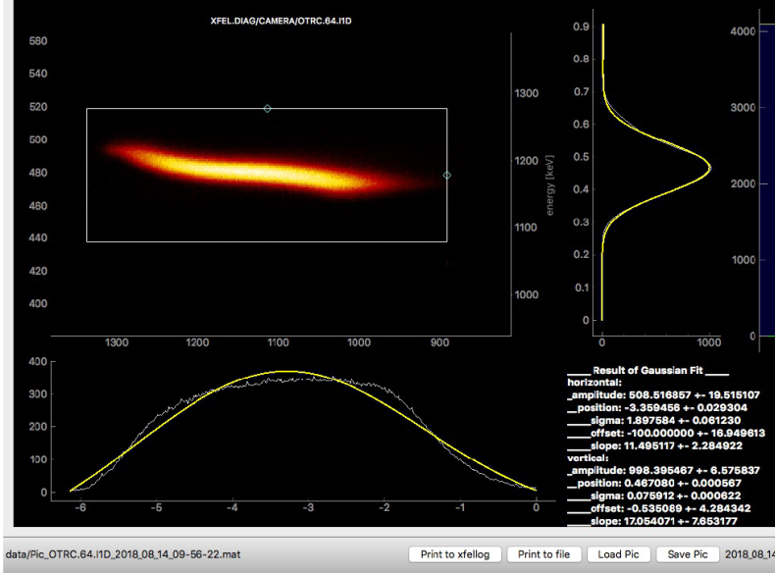
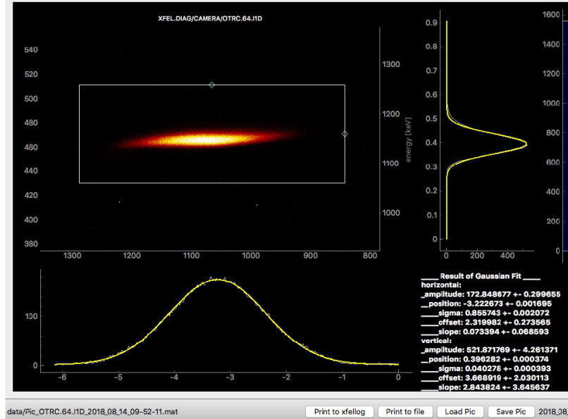
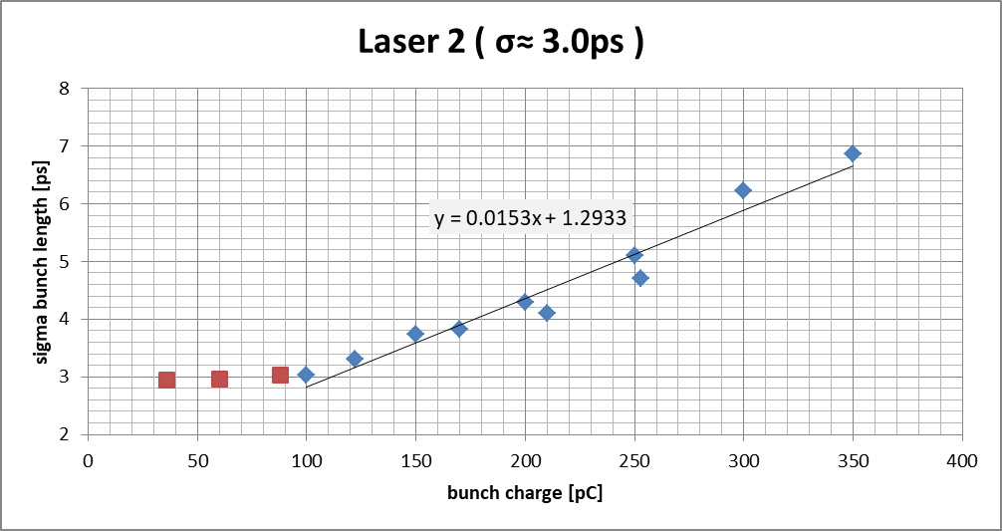
Spacial and temporal charge distribution: bunch length after A1 / AH1
L1:305 pC
L1: 85 pC
Remeasure in January
No plateau – shorter than laser ?
L2:300 pC
L2:100 pC

Slide 7
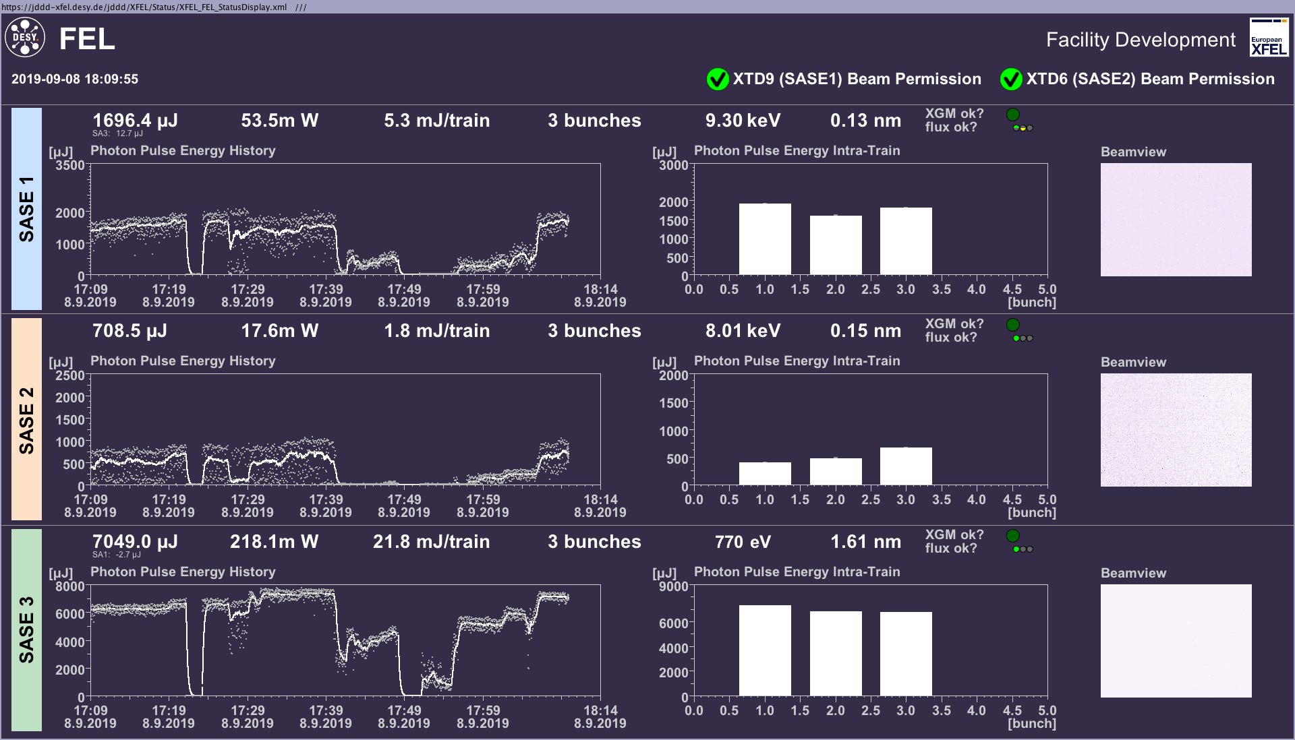
Differences in operating Laser 1 and Laser 2 tested on September 8th 2019:
timing between laser1 and laser2 was perfect ( delta phi <0.1 degree )
orbit was nearly unchanged - position on cathode adjusted to get the same starting
energies in LH, B0, B1, B2 were higher – adjusted back to old readings
compression was less – adjusted back to old readings
when going to T4D/T5D there was little lasing at SA3 and SA1
optimization done with gun phase, solenoid, QLN, compression, curvature 130->210 brought SASE2 up
encreasing the charge from 0.25 to 0.3 nC encreased SASE further to ~same values as with laser2
No magnets have been changed despite the main solenoid and QLN, QLS
Laser 1
Laser 2
switching back from Laser 1 to Laser 2

Slide 8
Differences in operating Laser1 and Laser2:
timing between laser1 and laser2 was perfect ( delta phi <0.1 degree )
orbit was nearly unchanged - position on cathode adjusted to get the same starting
energies in LH, B0, B1, B2 were higher – adjusted back to old readings
compression was less – adjusted back to old readings
when going to T4D/T5D there was little lasing at SA3 and SA1
optimization done with gun phase, solenoid, QLN, compression, curvature 130->210 brought SASE2 up
encreasing the charge from 0.25 to 0.3 nC encreased SASE further to ~same values as with laser2
No magnets have been changed despite the main solenoid and QLN, QLS
Differences in setpoints:
Differences in readbacks:
Does simulations also show this effect of energy change?
 |  | Laser 1 | Laser 2 | Ampl. L2-L1
 | Charge | 0.3 | 0.25
Magnets | Solenoid B | 333.3 | 332.9
 | QLN.23 | 0.439 | 0.039
 | QLS.23 | 0.086 | 0.026
Gun | Phase | -40.8° | -43.3°
I1 | Amplitude | 126.99 | 128.99 | 2 MV
 | Chirp | -9.2 | -8.86
 | Curvature | 210.1 | 119.71
 | 3rd derivative | 20112 | 22123
L1 | Amplitude | 581.12 | 593.5 | 12 MV
 | Chirp | -10.25 | -10.10
L2 | Amplitude | 1702.68 | 1750.79 | 48 MV
 | Chirp | -12.61 | -12.04
 |  | Laser 1 | Laser 2
Energies | LH | 127.5 | 127.7
 | I1T | 130.6 | 130.7
 | B0 | 127.4 MeV | 127.6 MeV
 | B1 | 699.7 MeV | 700.0 MeV
 | B2 | 2400 MeV | 2400 MeV
 | CL | 13731 MeV | 13735 MeV
 | TLD | 13997 MeV | 14007 MeV
 | T4D | 13983 MeV | 13970 MeV
 | T5D | 14004 MeV | 14005 MeV
compression | BC0.BCM2 | 0.087 | 0.0877
 | BC1.BCM1 | ? | 0.0934
 | BC2.BCM1 | 0.53 | 0.57
SASE intensity | SA1, 9.3 keV | 1.5 mJ | 1.7 mJ
 | SA2, 8.0 keV | 740 uJ | 710 uJ
 | SA3, 0.77 keV | 7.4 mJ | 7.1 mJ

Slide 9
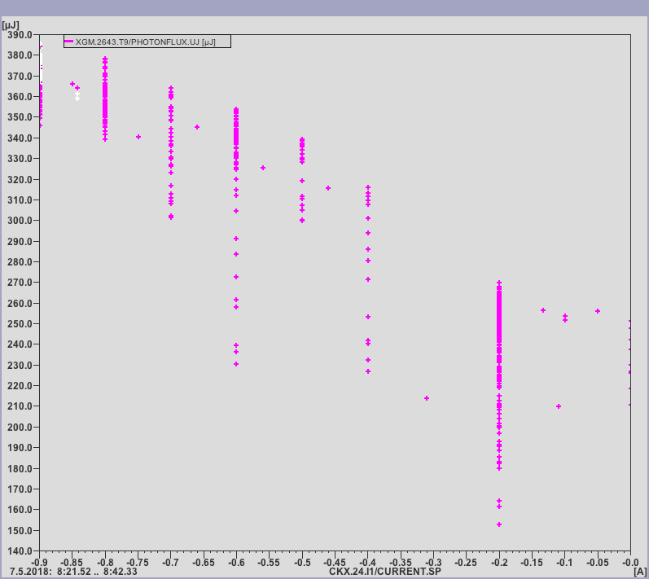
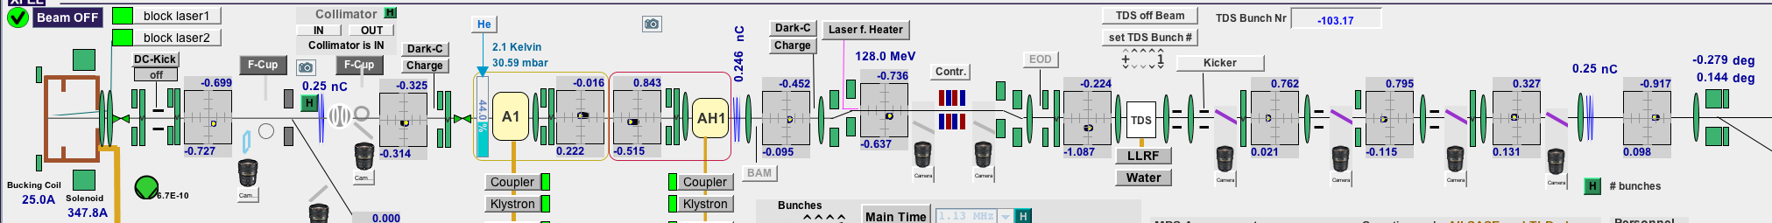
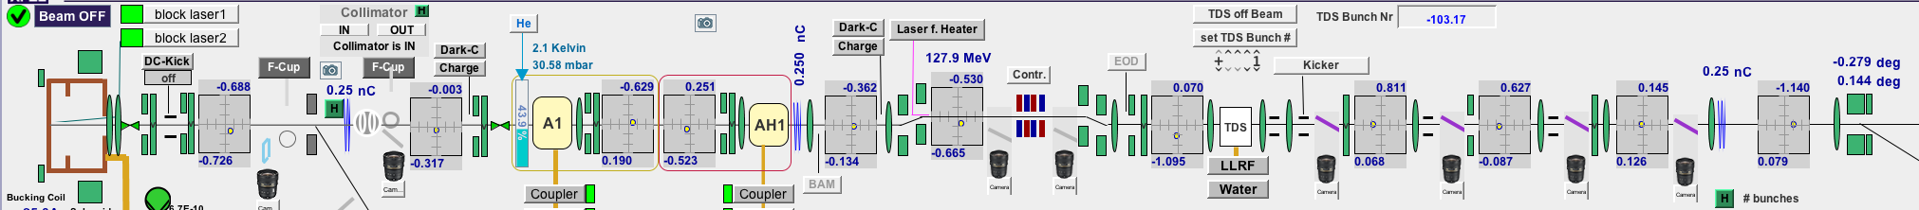
Sensitivity of SASE on injector orbit
CKX.24 | -0.9 A | -0.2 A
BPM.25 | -0.32 mm | 0.00 mm
BPM.38 | -0.02 mm | -0.63 mm
BPM.48 | -0.74 mm | -0.53 mm
BPM.52 | -0.22 mm | 0.07 mm
BPM.59 | -0.92 mm | -1.14 mm
SA1 | 370 uJ | 260 uJ
390 uJ
The SASE performance is strongly influenced by the orbit between Gun and L2 – and also in the collimation section
Example from 7.5.2018 : encrease from 260uJ to 370 uJ ( LH was off)
SASE 1
140 uJ
-0.9 A
CKX [A]
0.0 A
CKX.24 = -0.9 A
CKX.24 = -0.2 A

Slide 10
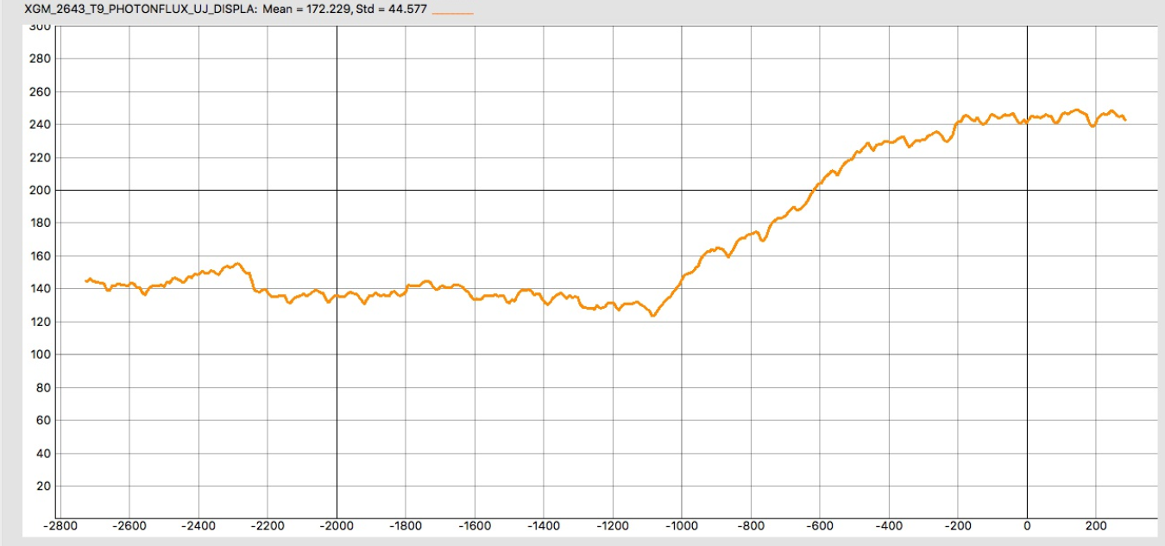
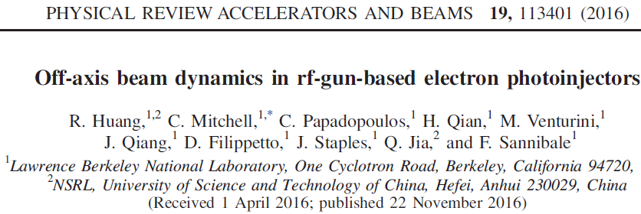
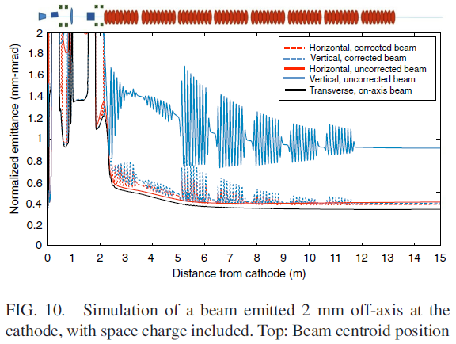
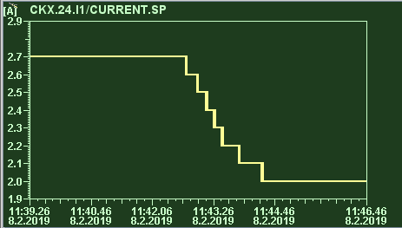
Sensitivity of SASE on injector orbit
Is this part of the explanation?
Compensating a beam offset in the gun with an offset in the following cavities.
Cons:
  only small effect on slice emittance
  Offsets needed much larger than observed
Another example from 8.2.2019 :
SA1 encrease from 280uJ to 500 uJ while changing CKX.24 from 2.7A to 2.0 A
( factor 2 since one out of 2 bunches is lasing )
CKX.24 | 2.0 A | 2.7 A
BPM.25 | -0.14 mm | 0.21 mm
BPM.38 | 0.40 mm | -0.15 mm
BPM.48 | -0.34 mm | 0.12 mm
BPM.52 | -0.70 mm | -0.48 mm
BPM.59 | -0.12 mm | -0.29 mm
SA1 | 490 uJ | 280 uJ

Slide 11
Calculations / Simulations:
Is this part of the explanation?
Compensating a beam offset in the gun with an offset in the following cavities.
Cons:
  only small effect on slice emittance
  Offsets needed much larger than observed (several mm )
Redo the laser and solenoid alignment

Slide 12
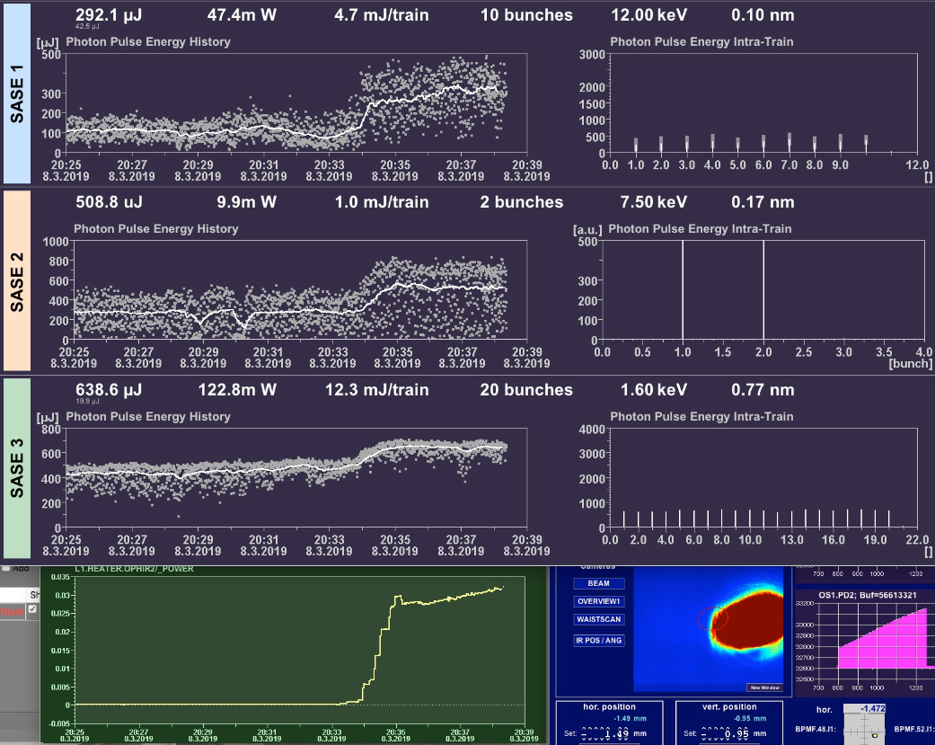
Laser heater: experiences from operation
Last year the laser heater was on beam during all SASE runs and helped a lot to encrease the SASE level.
The loss in intensity when switching off the laser heater was typically about 50% at SASE1, less for SASE2 and SASE3.
No significant differences could be found between IR laser „centered on beam“ or with „offset to the beam“ : after adjusting the laser intensity the SASE level was about the same.
Ramping up the LH power:

Slide 13
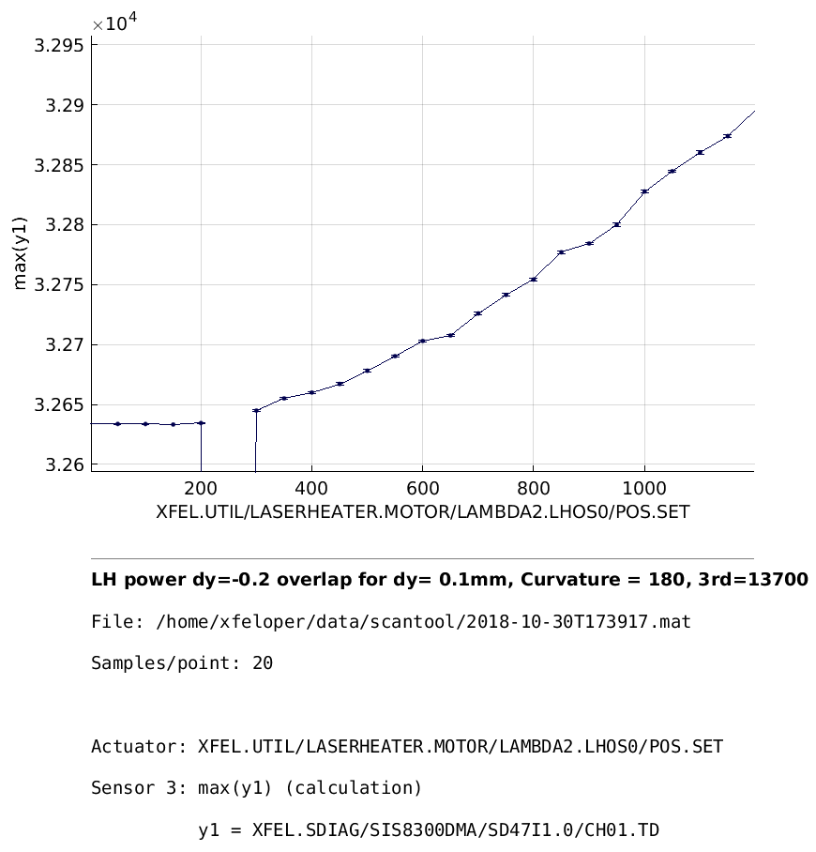
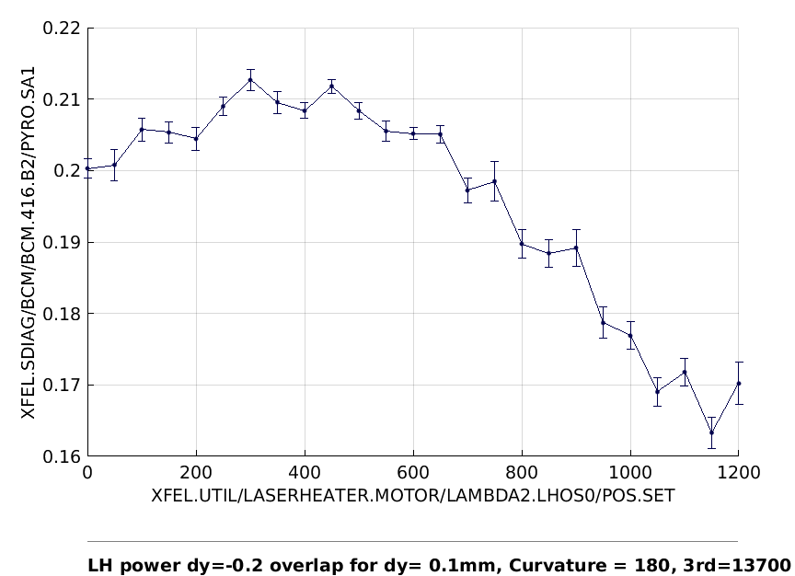
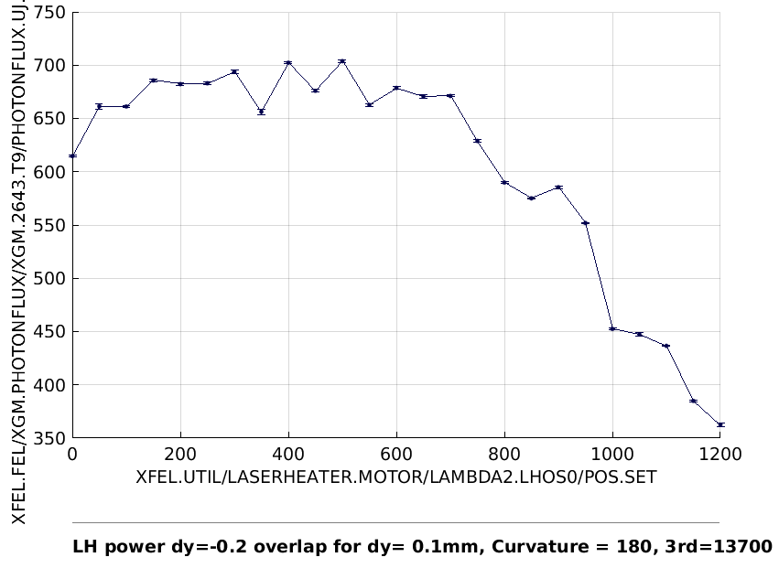
Studies influence of laser heater 10/2018:
Can we learn something from the spectrometer signals?
LH power vs. CRISP signal
LH power vs. Compression after BC2
LH power vs. SASE intensity

Slide 14
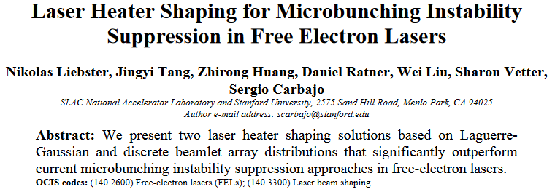
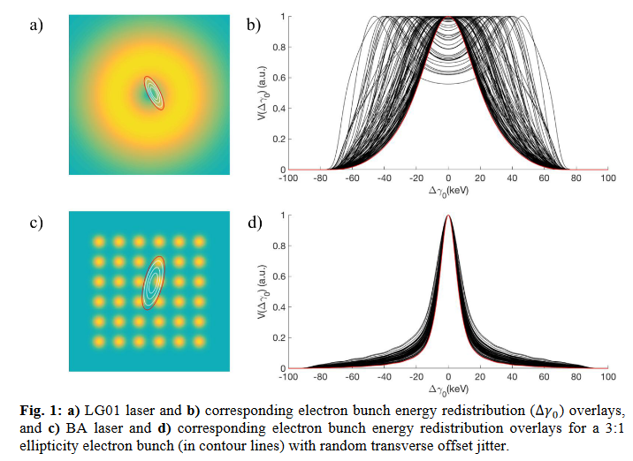
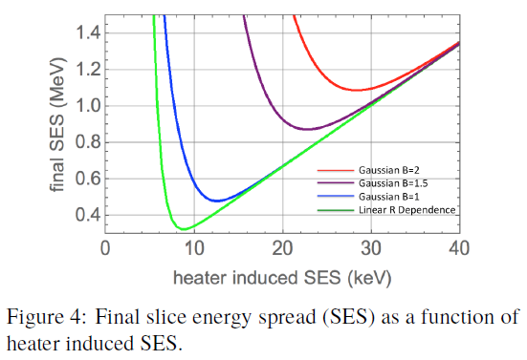
Laser heater: other ideas from SLAC – Is this something we should try ?
Can simulations help to decide whether it‘s worth the effort?
What studies / measurements ( with the present setup ) can be done to improve our understanding?

Slide 15
Measurement List:
Measure QE Map and decide about cathode exchange
Redo part of the injector studies from November ?
QE scan – saturation point?
Investigate pulse stacker when available
Remeasure bunch length with TDS depending on charge for laser 1
Investigate orbit depence in detail
  Use closed bumps to localize the orbit changes
  Find optimal orbit in A1/AH1 – change laser position – optimize orbit again
  More ideas ?

Slide 16
Simulation List:
Do we understand the bunch lengthening quantitatively ?
Can we simulate the effect of orbit changes in the range of 0.5mm ?
Does simulations explain the effect of energy change when switching the lasers ?
Can we use the spectrum signals to get better SASE/ find SASE faster
Is it worthwhile to implement sophisticated laser shapes for the laser heater ?

