Slide 1
1.6 cell SRF gun for CW upgrade.
Studies for NC gun: pulsed heating and symmetric RF input power coupler
Dmitry Bazyl
Hamurg, 19.11.19

Slide 2
Content
SRF gun for CW upgrade of the XFEL:
Overview
Multipacting
Focusing solenoid alignment errors
Mechanical vibrations
NC gun for XFEL:
RF heating
Coupler vibration
Design of a symmetric RF input power coupler

Slide 3
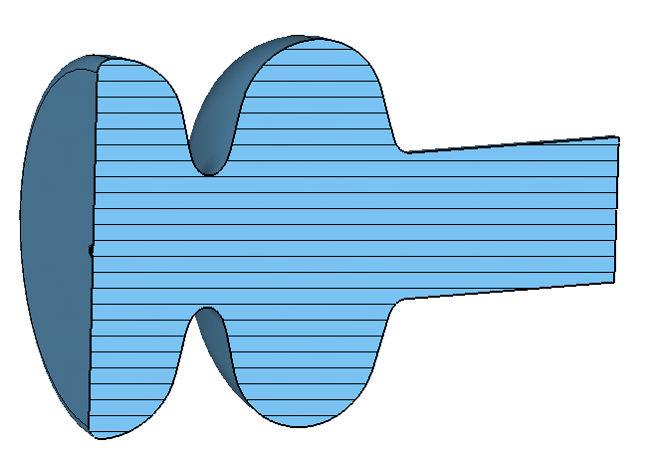
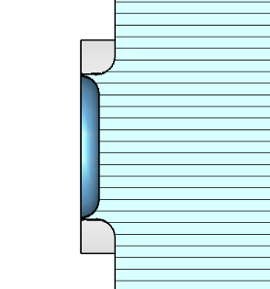
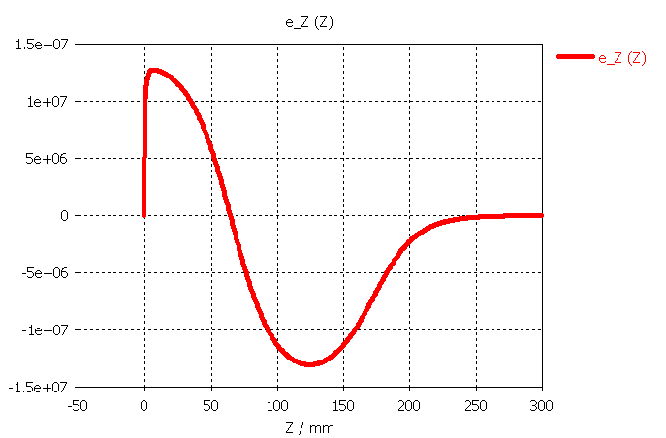
SRF gun for CW upgrade of the XFEL
Overview
1.6 cell 1.3 GHz TESLA structure
Peak field on axis – 40 MV/m
Retracted cathode -> additional focusing (?)
Procedure for SRF gun cavity design:
EM simulations
Beam-dynamics simulations
Mechanical simulations
Multipacting

Slide 4
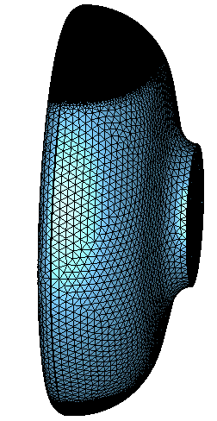
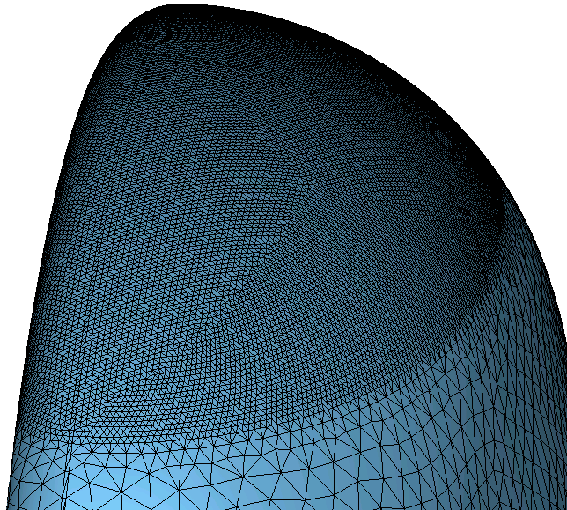
Multipacting in the SRF gun
CST MWS model
Calculate EM field of the fundamental mode with refined mesh in the region of interest for multipacting
Export EM field to PIC solver
CST MWS mesh model:
Local mesh: min. step size 0.75 mm

Slide 5
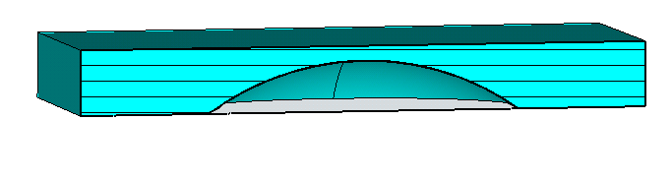
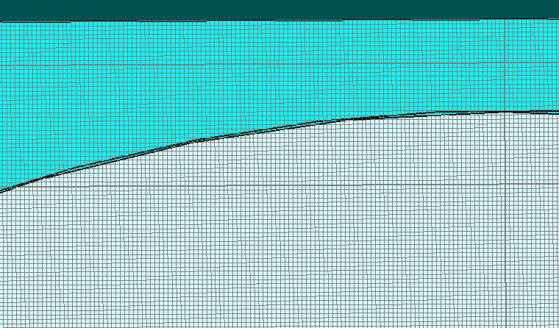
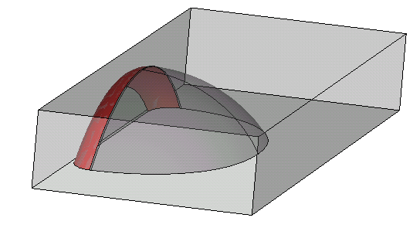
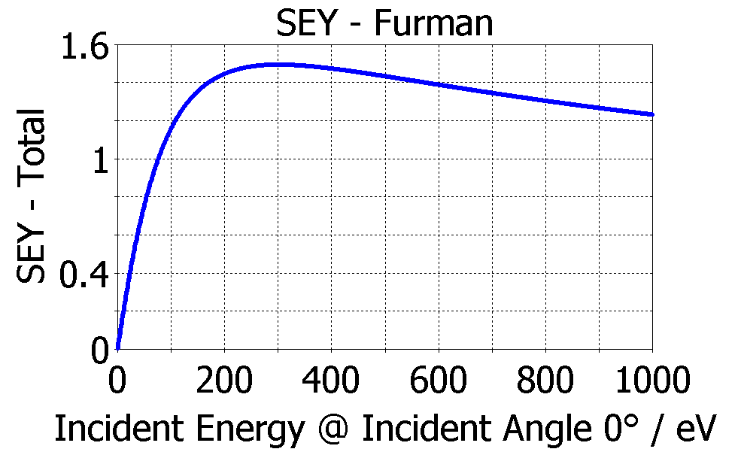
SRF gun model for multipacting simulation
CST PIC model
Hexahedral mesh
High density mesh needed to obtain accurate data
Reduce computational time -> part of the full model
Nb 300 deg bakeout; SEY Furman model:
Electron emission area; space charge effects are not taken into account

Slide 6
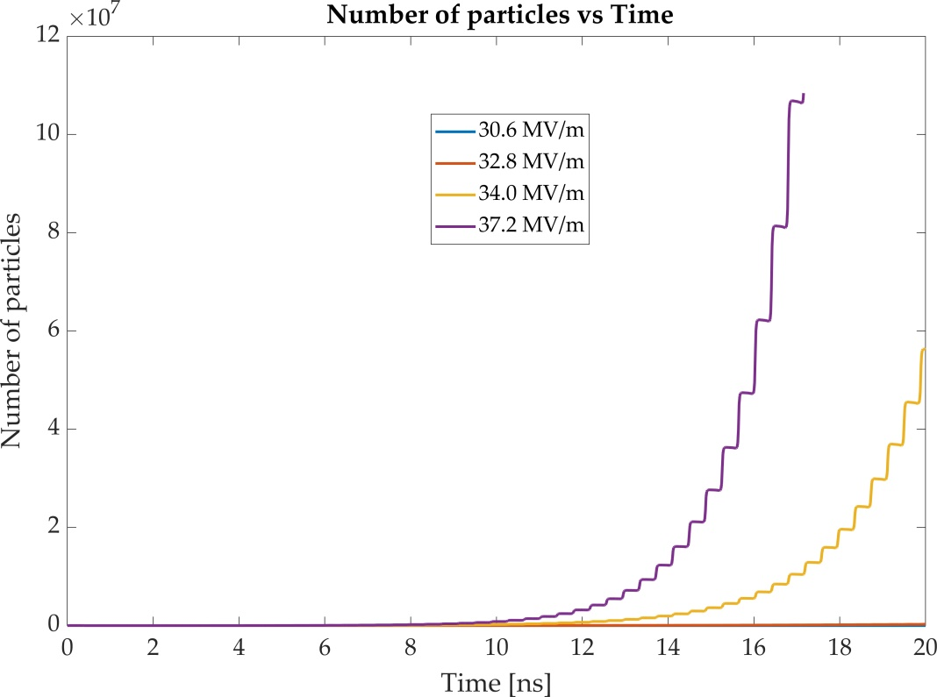
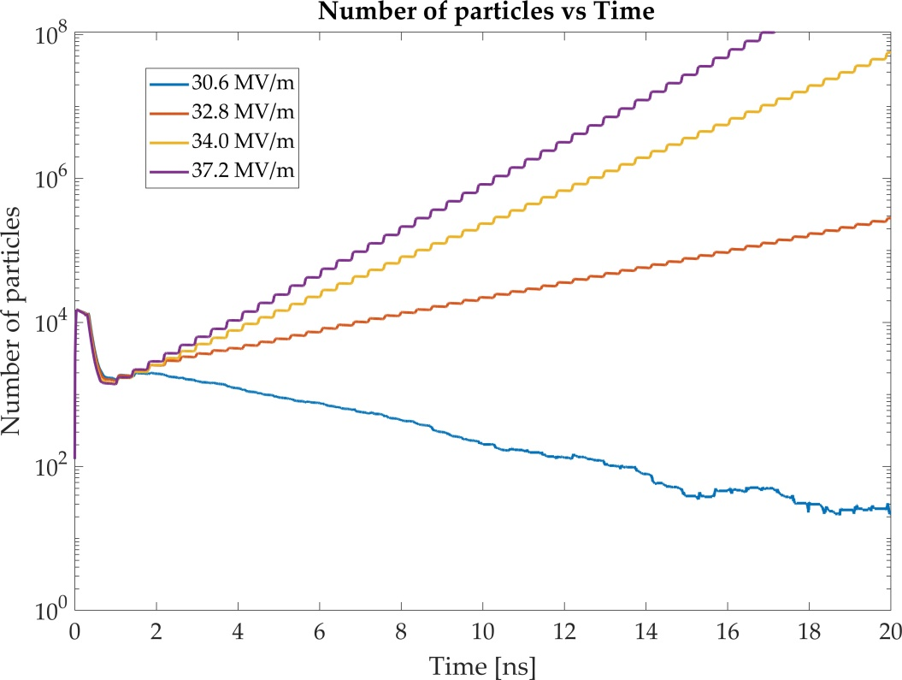
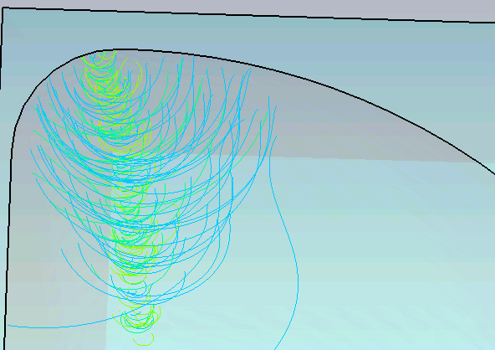
Multipacing
Results
Same data but with ‘y’ in log scale:
Peak E field on axis:
Peak E field on axis:
Criteria: gradual increase of SE
MP occurs at Ep of ~ 32 MV/m
Problem of MP has a low priority at the moment
Modify bending radius to eliminate MP

Slide 7
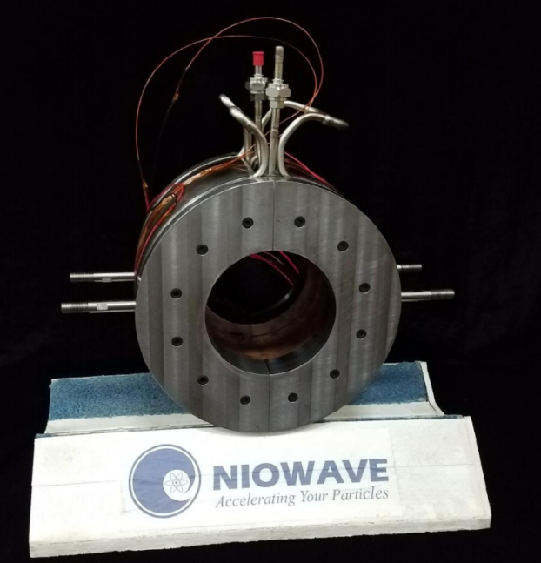
Solenoid alignment errors
Considered setup
Gun model considered in simulations: 1.6 cell – G7
Focusing solenoid from HZB
Simulated setup – 8.9 m total length
  Gun (E = 40 MV/m)
  Solenoid (151 mT on axis; 0.46 m from the cathode)
  4 tesla cavities (E =36 MV/m)
Particle tracking – ASTRA (2D)
EM field – CST MWS
Solenoid field – Poisson superfish

Slide 8
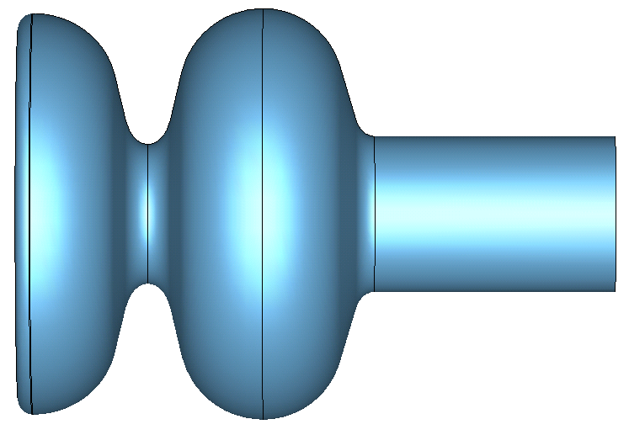
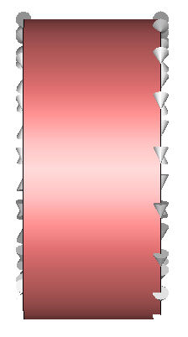
Solenoid alignment errors
Approach
Calculate emittance variation due to individual alignment errors
Evaluate alignment errors at which emittance growth is of 1 %
300 simulations with randomly distributed errors in each run
Errors distribution is Gaussian and in each case the rms width is defined by 1% emittance growth
4 TESLA cavities
y
x
z

Slide 9
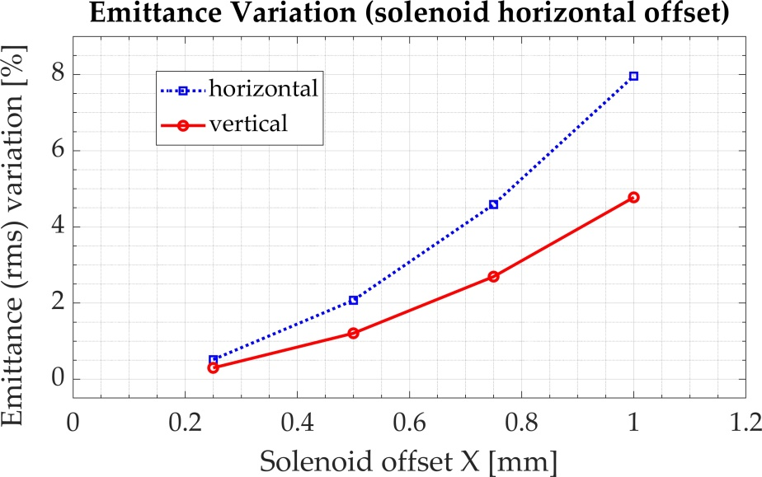
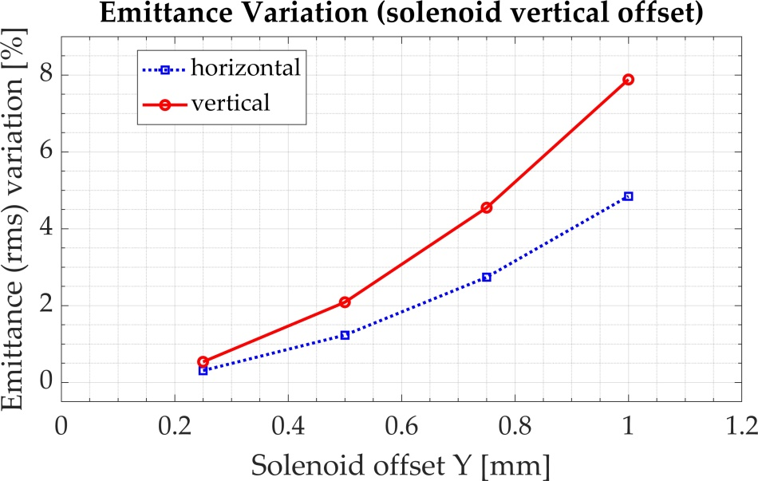
Solenoid alignment errors
Offsets
y
y
z
z
x
x

Slide 10
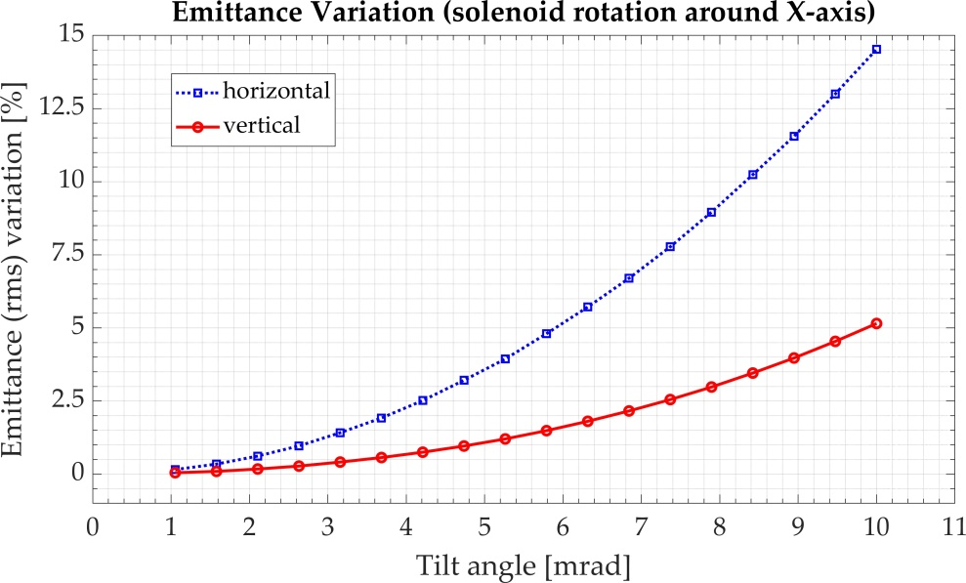
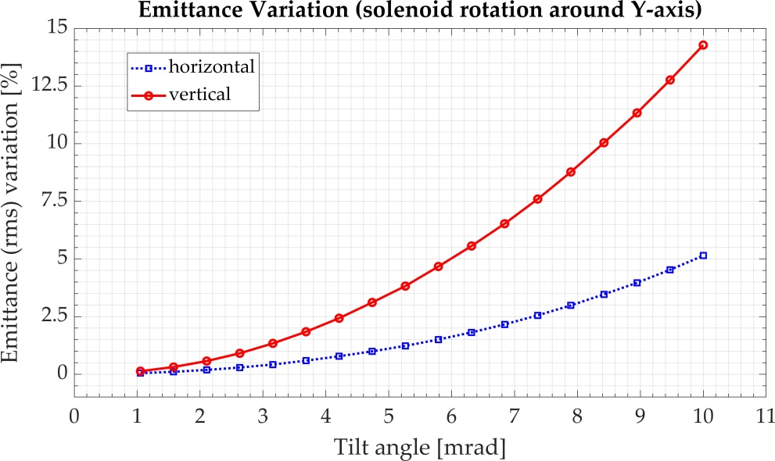
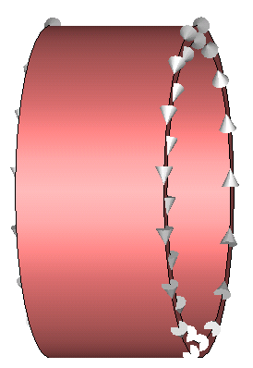
Solenoid alignment errors
Rotation
y
z
x
y
z
x

Slide 11
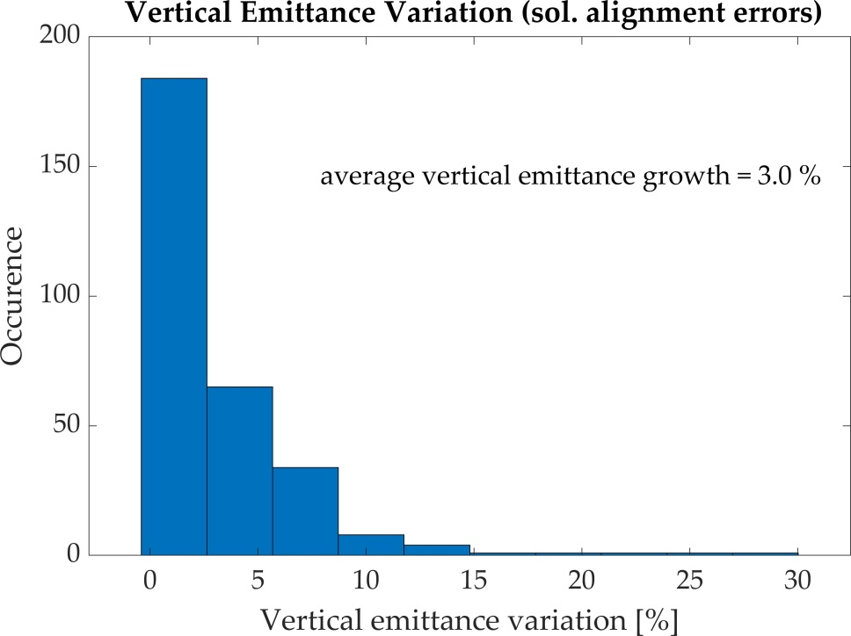
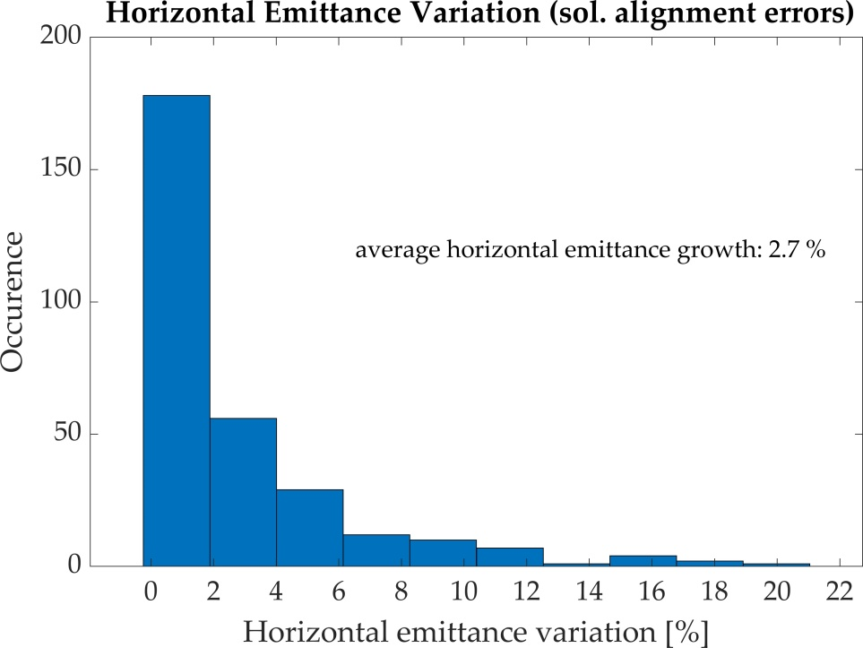
Solenoid alignment errors
Statistical data
300 simulations with randomly introduced errors
  Offsets + rotation
  Four variable errors are randomly distributed each simulation
  Errors are defined by rms gaussian width which corresponds to 1% emittance growth

Slide 12
Solenoid alignment errors
Conclusion and further work
Statistical approach for solenoid position errors requires a lot of computational time -> changes in the setup -> re-do computations
Begin ASTRA simulations on cluster
Slice emittance variation due to alignment errors
  First estimations indicate little dependence on the solenoid rotation angle
  Study slice emittance dependence on the solenoid offset
Compare the results for 2D and 3D space charge calculation in ASTRA

Slide 13
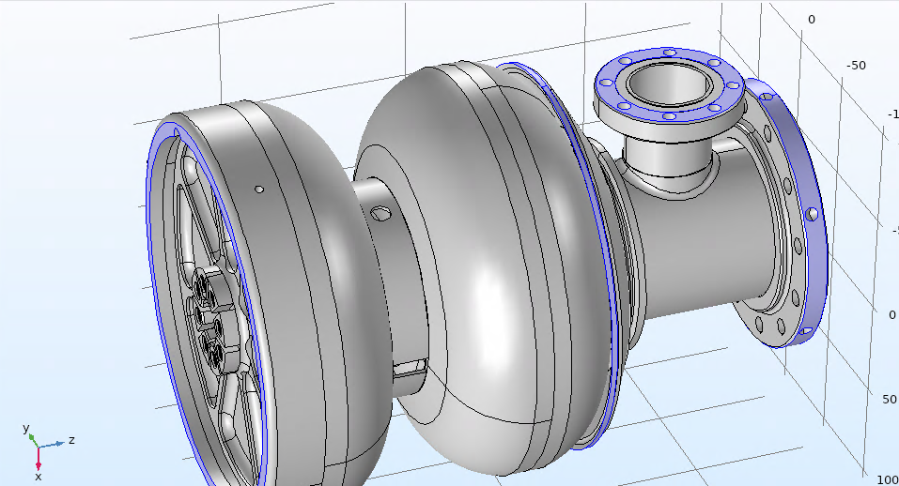
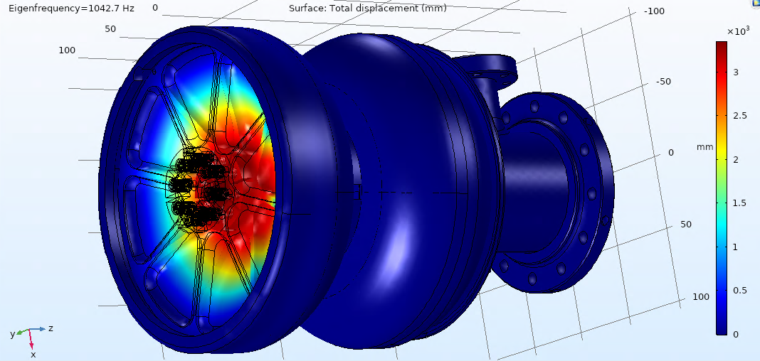
Mechanical model
Microphonics
Boundary conditions: colored areas fixed in all directions:
Mechanical vibrations detune the cavity
SRF photoinjector -> stability of the back wall
Realistic boundary conditions
?
Mechanical vibration mode with lowest resonance frequency of ~1 kHz
For detailed information CAD model of the cryostat needed
Longitudinal cavity stiffness is ~26 kN/mm
Preliminary (no convergence verification; trivial boundary conditions)

Slide 14
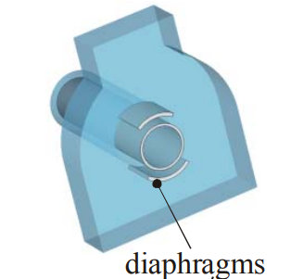
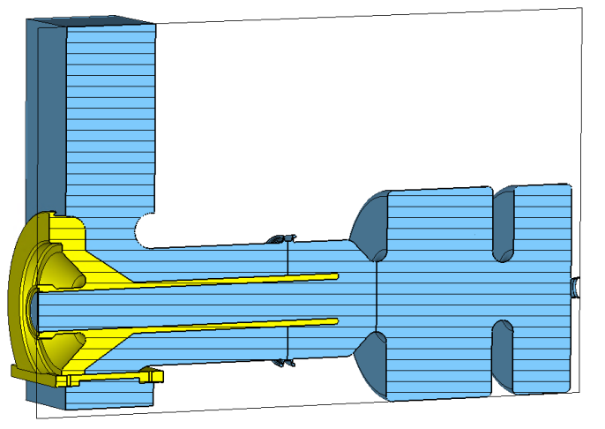
NC gun for the XFEL
Symmetric power coupler for the nc gun
The problem field asymmetry introduced by RF power couplers is well known
High power RF coupler design is a complicated multiphysics problem:
  Field symmetry
  RF losses
  Heating
  Mechanical deformation
*
* ELECTROMAGNETIC DESIGN OF NEW RF POWER COUPLERS FOR THE S-DALINAC
M. Kunze# , W.F.O. Mueller, T. Weiland, et. al.
…Design criteria required and now being discussed

Slide 15
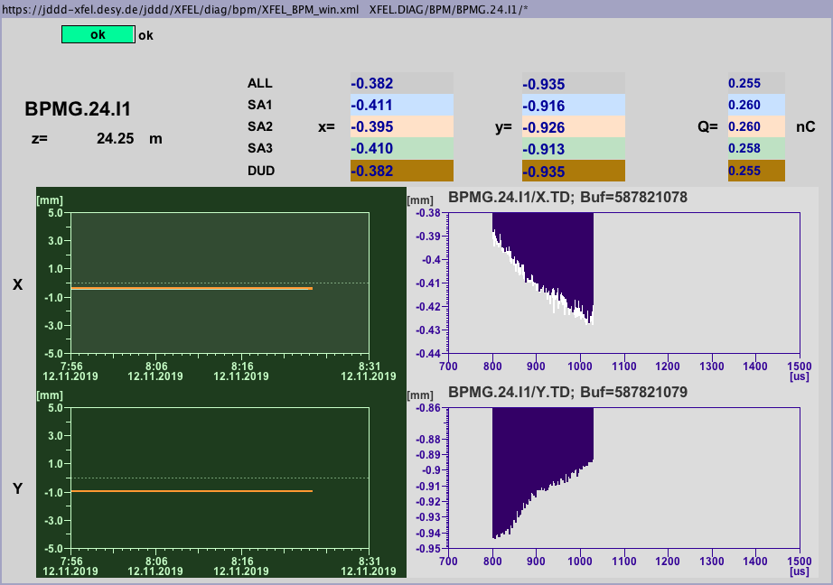
NC gun for the XFEL
Bunch train slope
Many reasons
On of them could be:
  Pulsed heating of the gun
  Mechanical vibration of the coupler induced by RF or other source

Slide 16
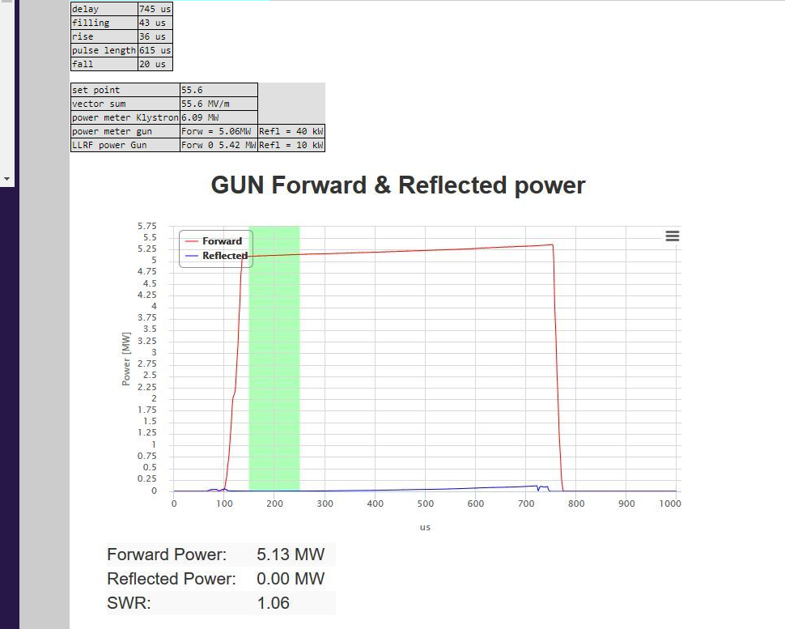
NC gun for the XFEL
RF gun heating effects
Input RF power
Stationary/pulsed heating study of the coupler part (COMSOL software + CST MWS)
Point of interested: symmetry of the gun heating, max. temperature (i.e deformation)
….Upcoming: new RF input power coupler to eliminate transverse kick

Slide 17
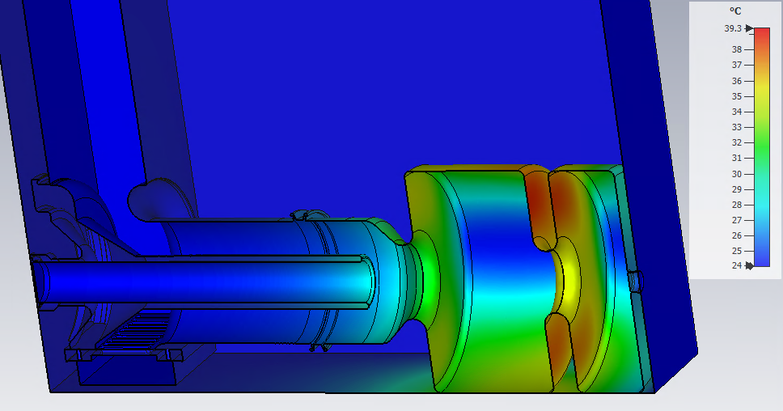
NC gun for the XFEL
RF gun heating effects – average heating
Preliminary – averaged losses – 19 kW average RF loss power: temperature map

Slide 18
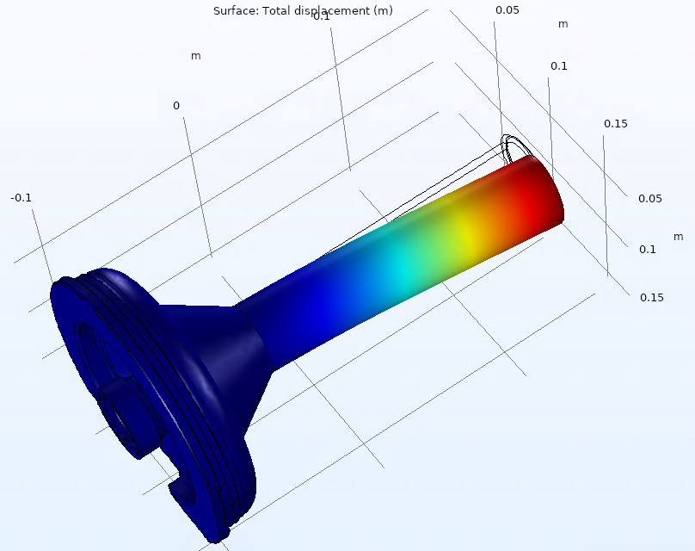
NC gun for the XFEL
Mechanical vibration of the input power coupler
RF coupler: inner conductor vibration
Lowest vibration mode f = 611 Hz
If present in operation: can produce transverse kick to the beam due to the field asymmetry
Verify if the mode is present:
Measurements with sensors (e.g. accelerometers) applied to a part of the gun closest to the coupler tube
f = 611 Hz
Further activities:
Calculate EM eigenmodes for the deformed model (mesh)
-> run beam dynamics simulations for different amplitudes of deformation
Unknown variables:
Potential amplitude of the deformation

Slide 19
Summary and further work
SRF gun
Preliminary estimations for solenoid alignment have been obtained
Further investigation of slice emittance variation due to alignment errors required
Mechanical model of the SRF gun will be investigated in details once the required data about the cryostat are obtained
Further on: analysis of wakefields in the laser mirror region
Normal conducting gun
Pulsed heating investigation
Mechanical vibrations of the inner conductor
Once required details are obtained -> begin with the symmetric coupler design

