Slide 1
Virtual Emittance Measurements based on Xtrack Results
Bolko Beutner
MPY
Beam Dynamics, XFEL Operation
Hamburg, 28.3.2017

Slide 2
Contents
Introduction
Methods
Results

Slide 3
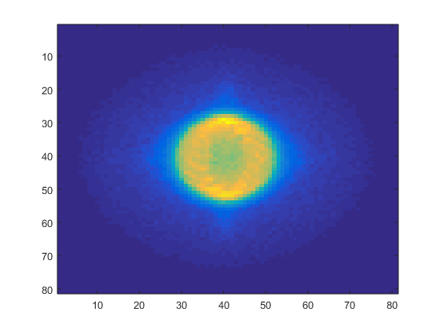
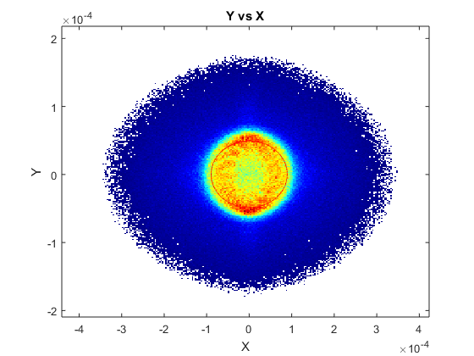
Xtrack Results at OTRB.218.B1 converted to Beam Spot Image

Slide 4
“Fake” Matching to B1 FODO
Phase space from Xtrack is matched using a general transfer matrix to the periodic solution
Phase advance is varied (simultaneously in x and y)

Slide 5
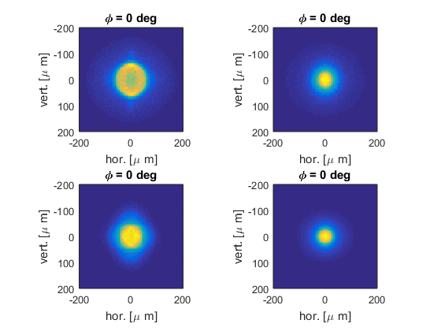
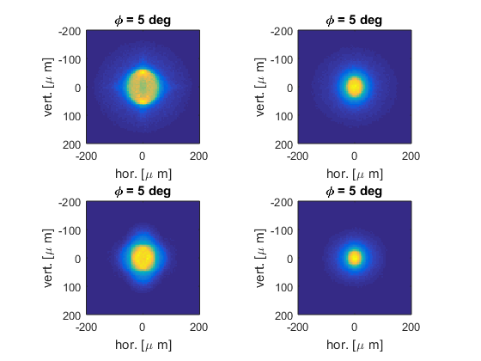
Simulated Beam Spot Images

Slide 6
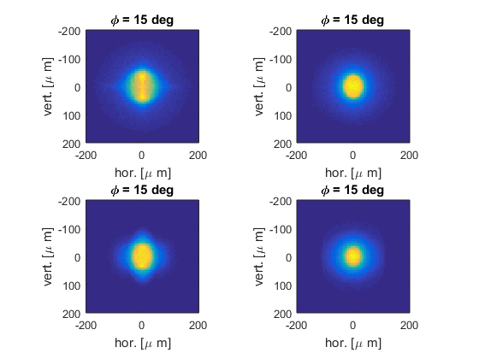
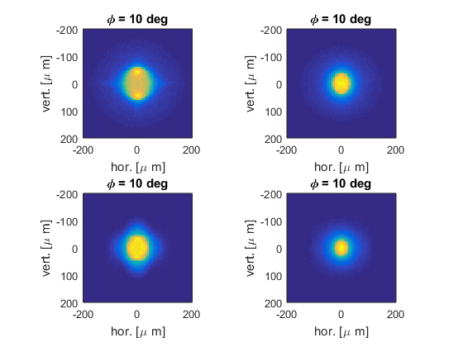
Simulated Beam Spot Images

Slide 7
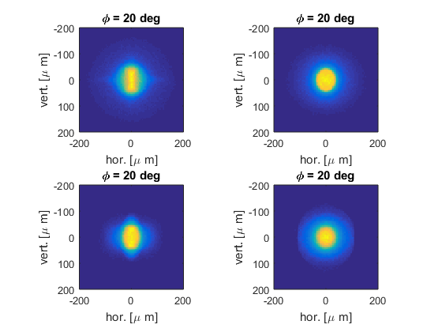
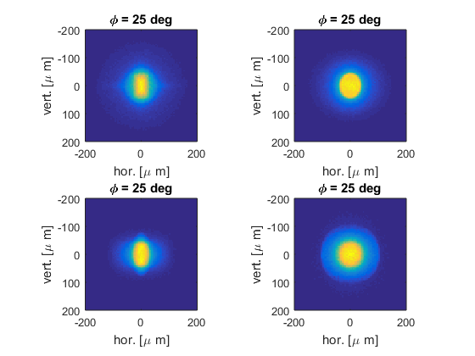
Simulated Beam Spot Images

Slide 8
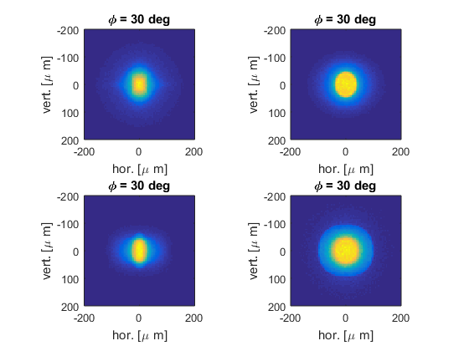
Simulated Beam Spot Images

Slide 9
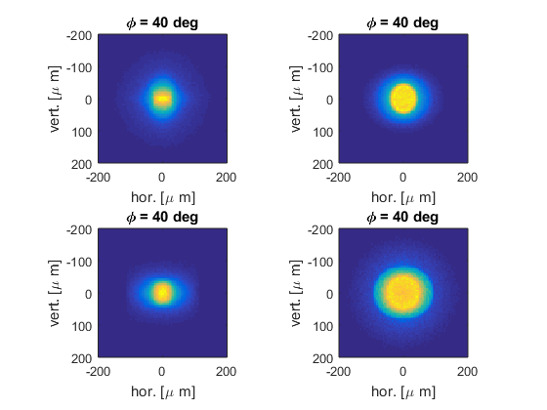
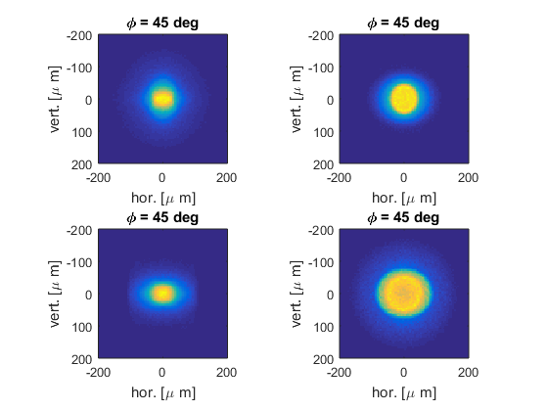
Simulated Beam Spot Images

Slide 10
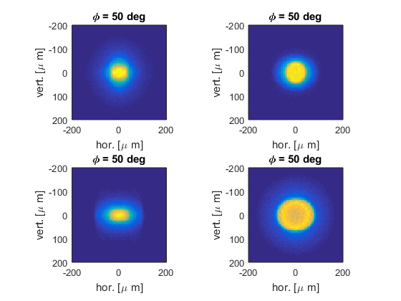
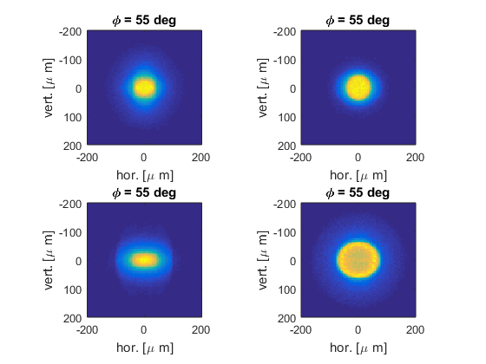
Simulated Beam Spot Images

Slide 11
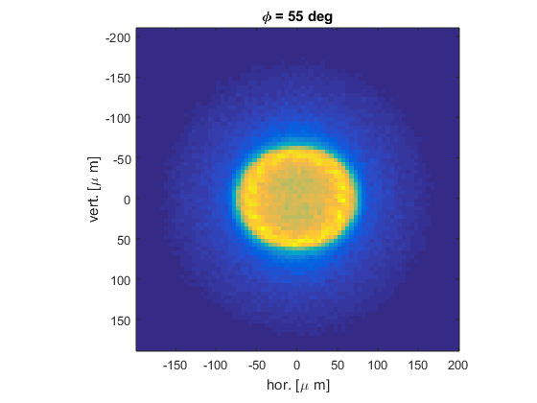
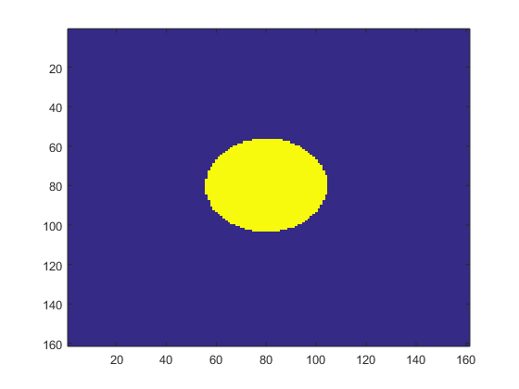
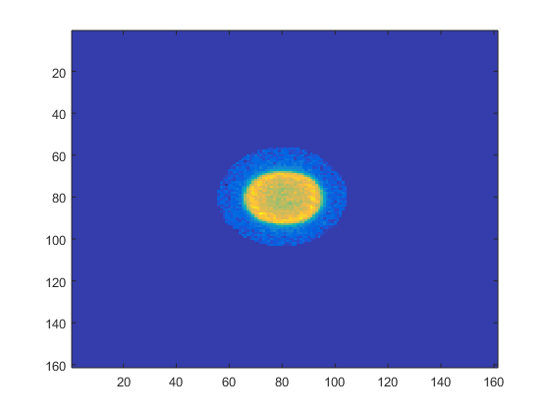
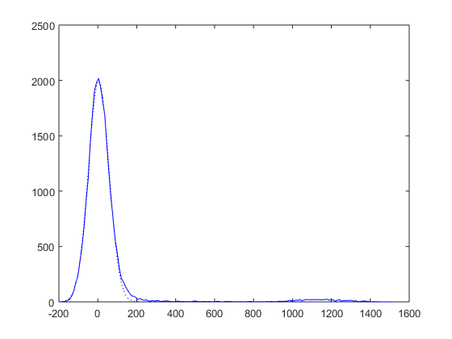
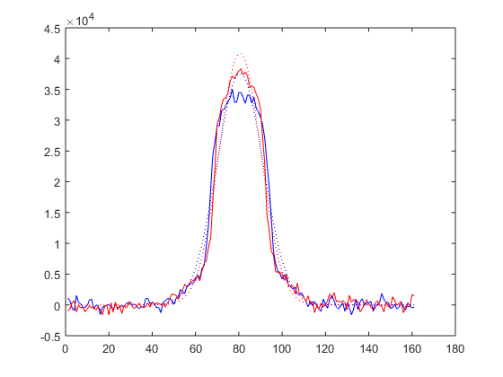
Noisecut

Slide 12
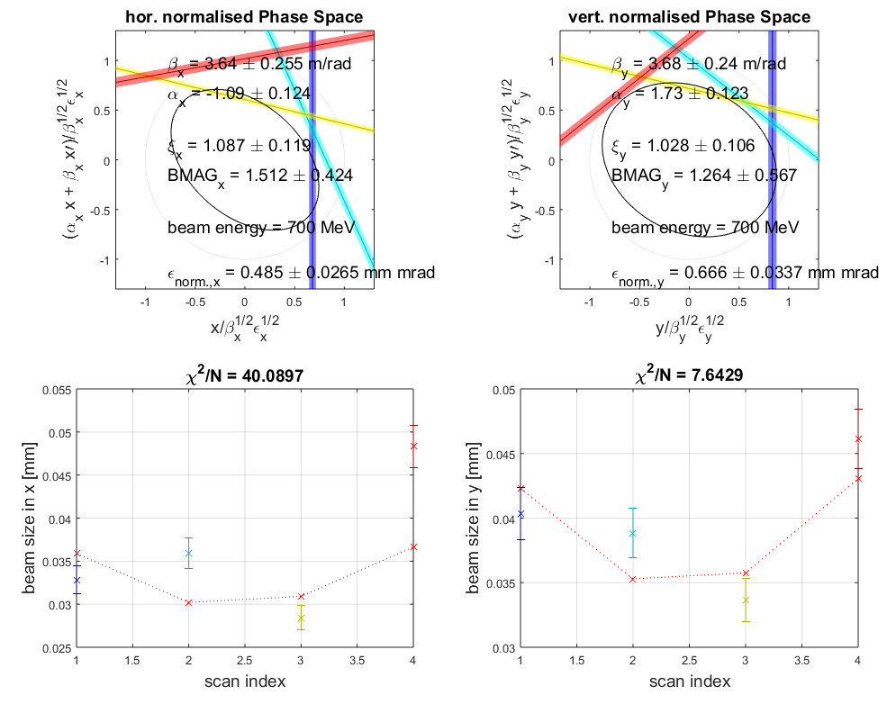
Virtual Measurement based on the reconstructed Beamsizes

Slide 13
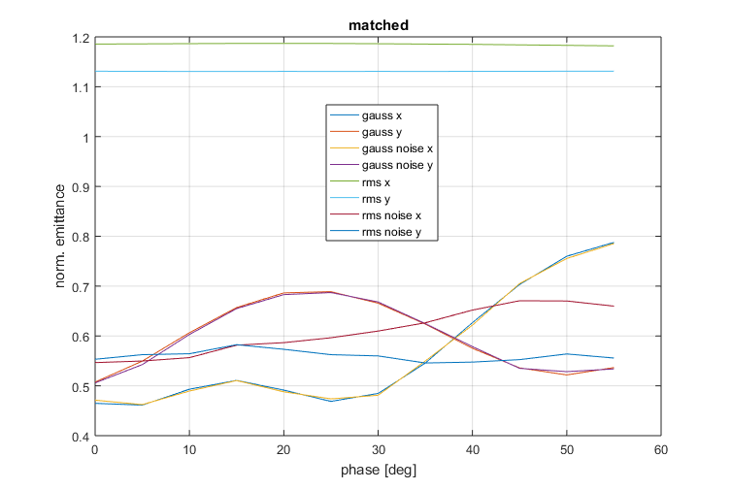
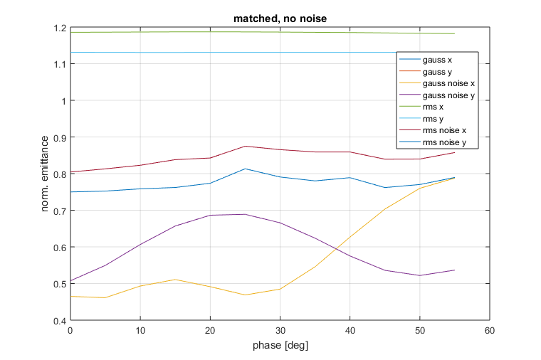
Result Summary
Beamsize [px] | Mean noise | std noise | mean No noise | std No noise
RMS | 10.3891 | 0.1218 | - | -
Gaussian Fit | 7.6149 | 1.3524 | - | -
RMS Noise | 7.3906 | 0.7851 | 8.7646 | 1.2461
Gaussian Fit Noise | 7.6156 | 1.3547 | 7.6149 | 1.3524
Emittance [mm mrad] | Mean noise | std noise | mean No noise | std No noise
RMS | 1.1581 | 0.0279 | - | -
Gaussian Fit | 0.5814 | 0.0968 | - | -
RMS Noise | 0.5842 | 0.0410 | 0.8086 | 0.0403
Gaussian Fit Noise | 0.5820 | 0.0978 | 0.5814 | 0.0968

