Slide 1
SASE optimization with OCELOT
Sergey Tomin
other co-workers: I. Agapov, G. Geloni, I. Zagorodnov

Slide 2
Outline
Motivation
How it works
Recent results of empirical tuning at FLASH (model-free optimization)
OCELOT features in beam dynamics simulations
Extending of empirical tuning by model-depending optimization
Summary

Slide 3
Motivation
The major motivation is the economic benefit of improving facility availability and performance through more effective and faster tuning

Slide 4
How it works
BLM
SASE det.
Typical tuning sequence for FLASH:
V14, V7, H10, H12, H3, V3
Q13SMATCH, Q14SMATCH, Q15SMATCH
FODO QUADS
intra-undulator orb. correctors
RF phases and Voltages
Orbit correctors and FODO quads have largest impact
corr. 1 – Nc
quad. 1 – Nq
sext. 1 – Ns
Optimizer
bend. 1 – Nb
Cavit. 1 - Ncv
Undul.
All steps programmed to avoid electron beam losses in the undulators above threshold (solutions above 0.7 alarm level highly penalized and above alarm level forbidden). .

Slide 5
How it works
Python script
from ocelot.utils.mint.mint import Optimizer, Action, TestInterface
from flash1_interface import FLASH1MachineInterface, FLASH1DeviceProperties
#from lcls_interface import LCLSMachineInterface, LCLSDeviceProperties
dp = FLASH1DeviceProperties()
mi = FLASH1MachineInterface()
opt = Optimizer(TestInterface(), dp)
opt.log_file = 'test.log'
opt.timeout = 1.2
seq1 = [Action(func=opt.max_sase, args=[ ['H10SMATCH','H12SMATCH'], 'simplex'] ) ]
seq2 = [Action(func=opt.max_sase, args=[ ['V14SMATCH','V7SMATCH'], 'simplex' ] )]
seq3 = [Action(func=opt.max_sase, args=[ ['Q13SMATCH','Q15SMATCH'], 'simplex' ] )]
opt.eval(seq1)
#opt.eval(seq1 + seq2 + seq3 + seq4 + seq5)

Slide 6
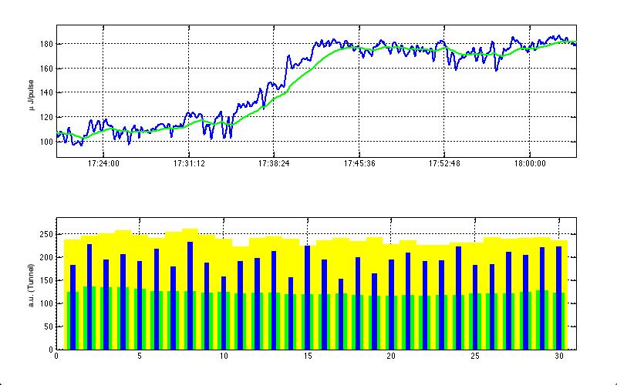
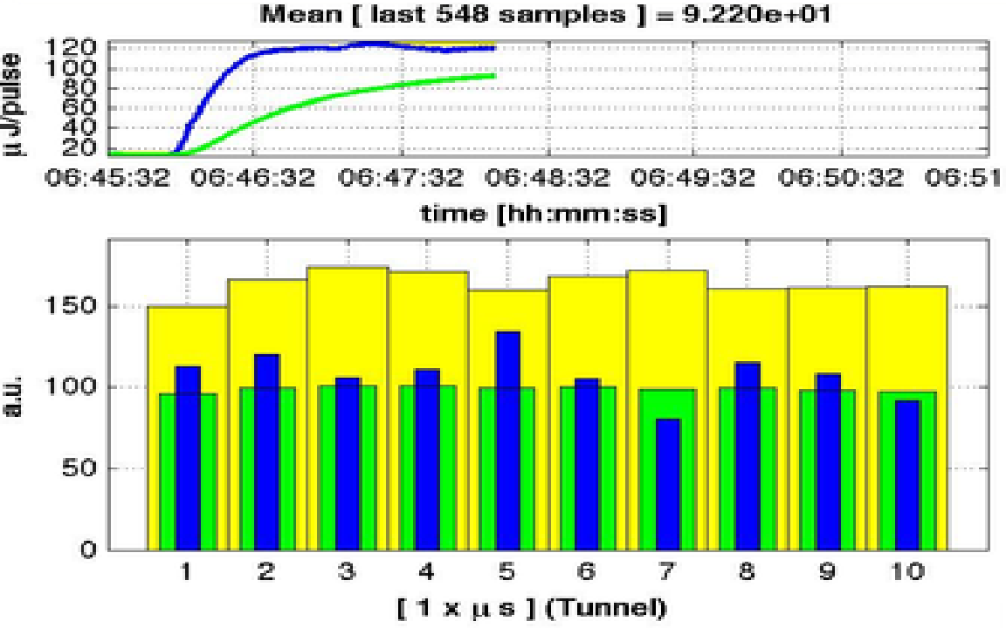
Experience of model-free optimization at FLASH
Automatic SASE tuning works in a few minutes if the machine is in initially stable condition
Demonstrated at several wavelengths (17nm, 13.5nm, 10.4 nm, 7 nm) with different bunch filling at about 0.3 nC charge

Slide 7
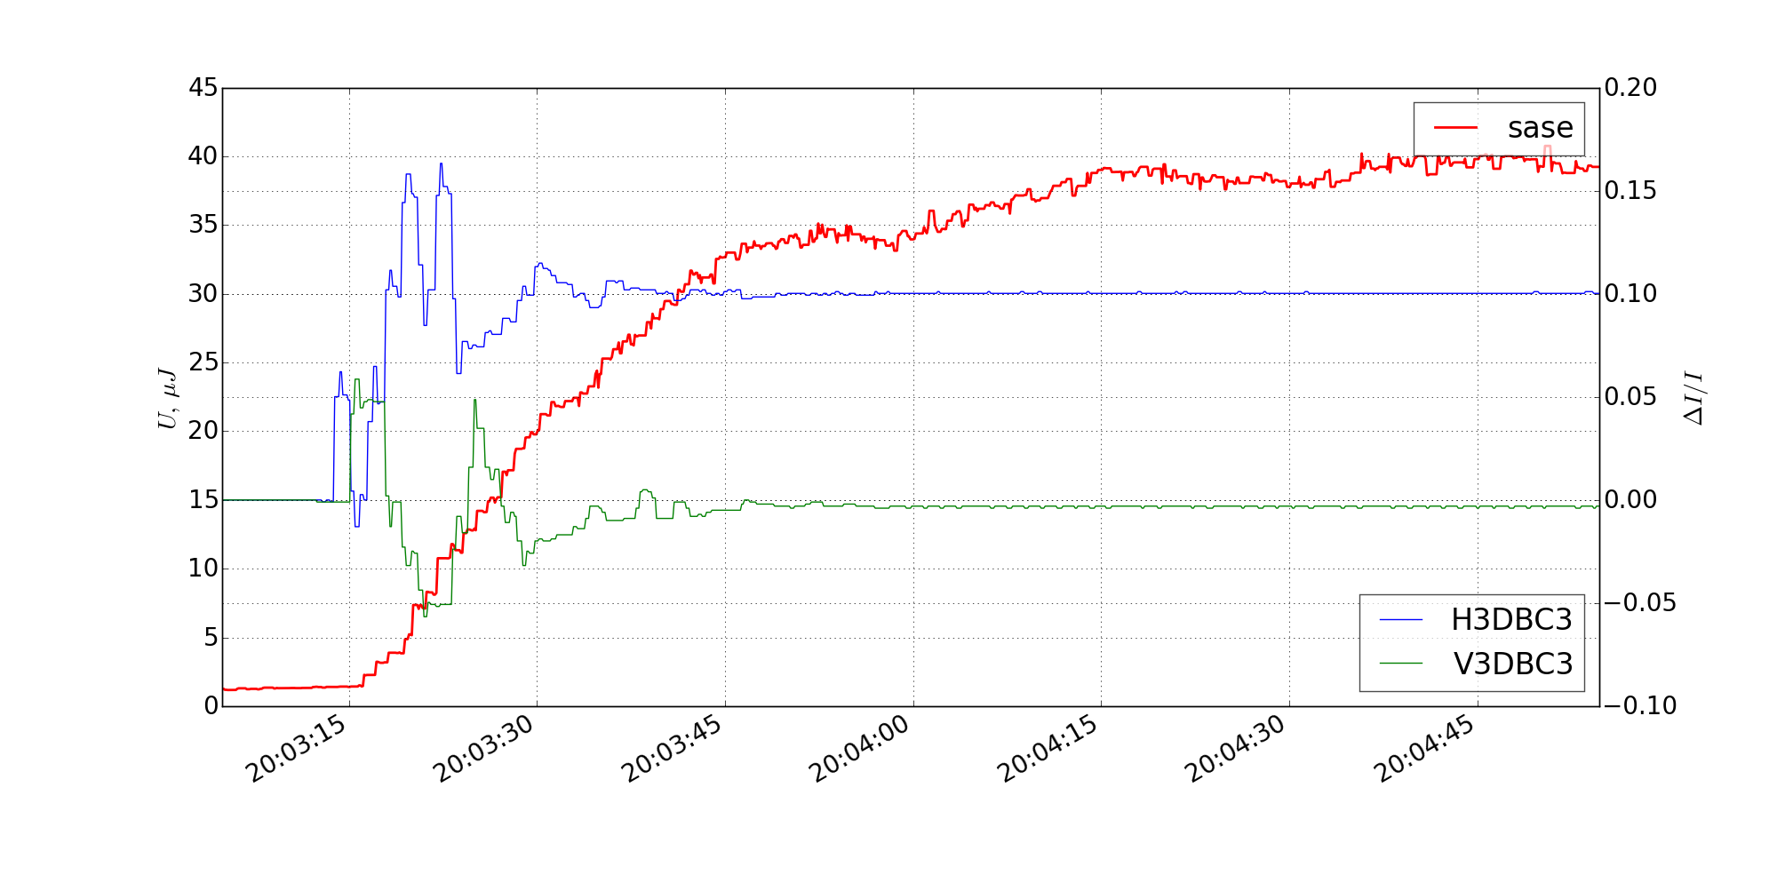

Last shift results: SASE optimization by correctors
$$λ=10.4 nm$$
For optimization is necessary initial SASE signal
To check repeatability of the optimization techniques we repeated the same experiment after resetting correctors to initial values

Slide 8
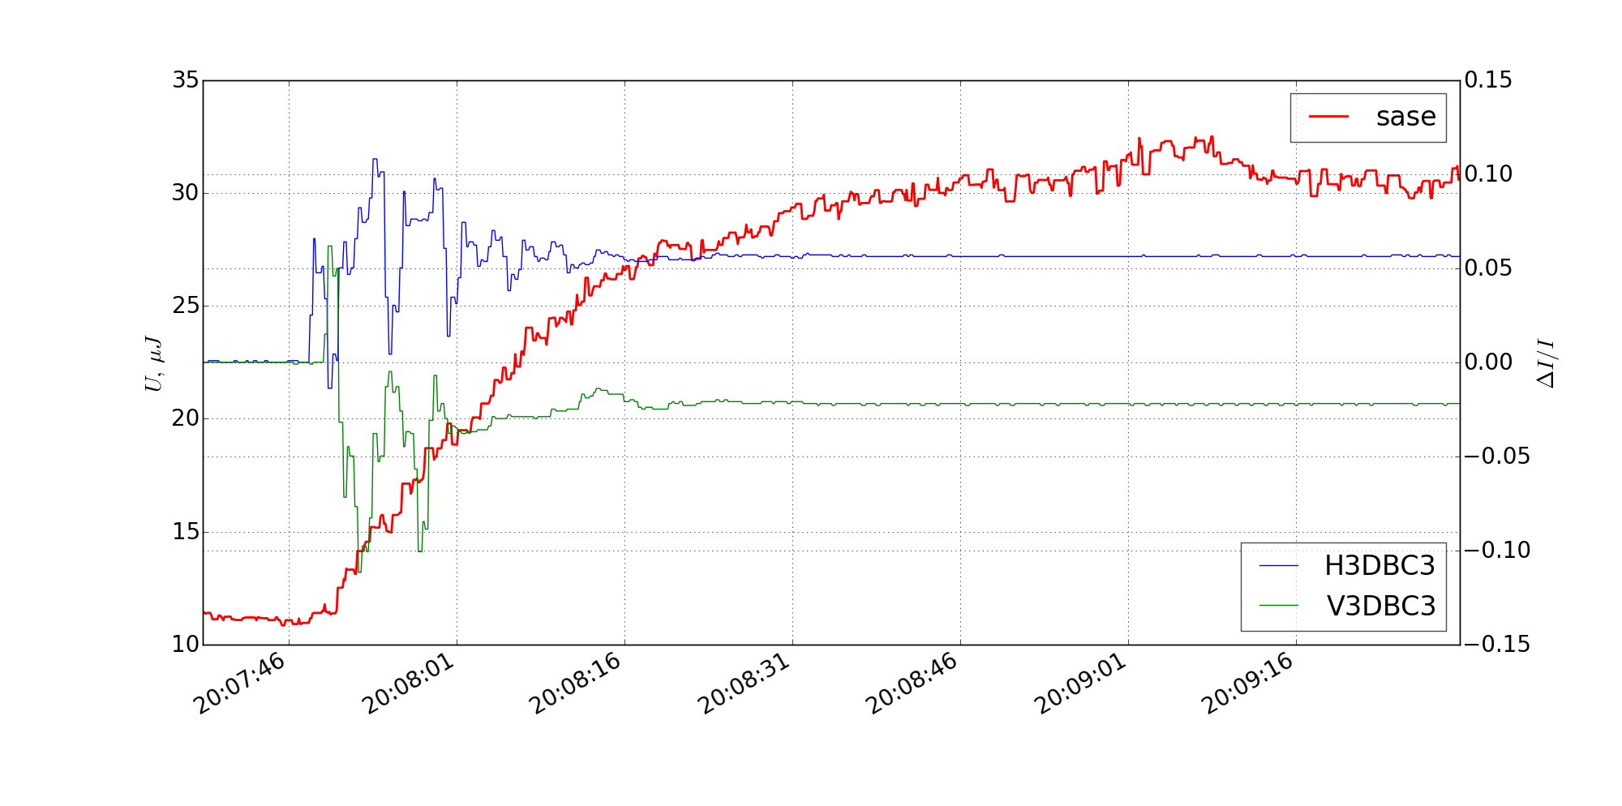
Last shift results: SASE optimization by correctors
$$λ=10.4 nm$$
after resetting correctors

Slide 9
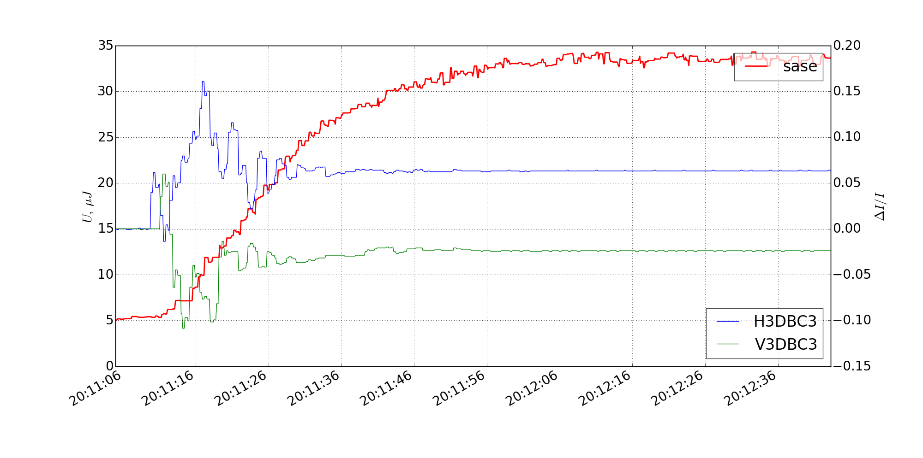
Last shift results: SASE optimization by correctors
$$λ=10.4 nm$$
… and after correctors cycling

Slide 10
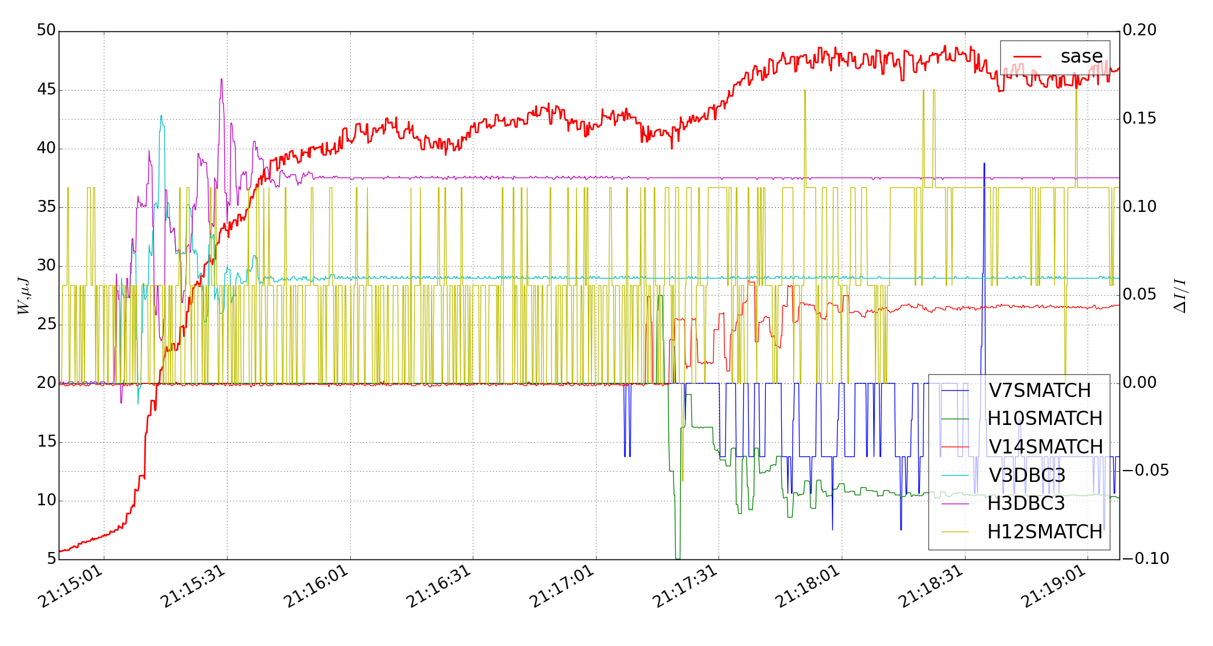
Last shift results: SASE optimization by correctors
$$λ=10.4 nm$$
H12SMATCH: I = 0.015 A
Extended set of correctors used
Was logged all changes what OCELOT optimizer did but without online processing

Slide 11
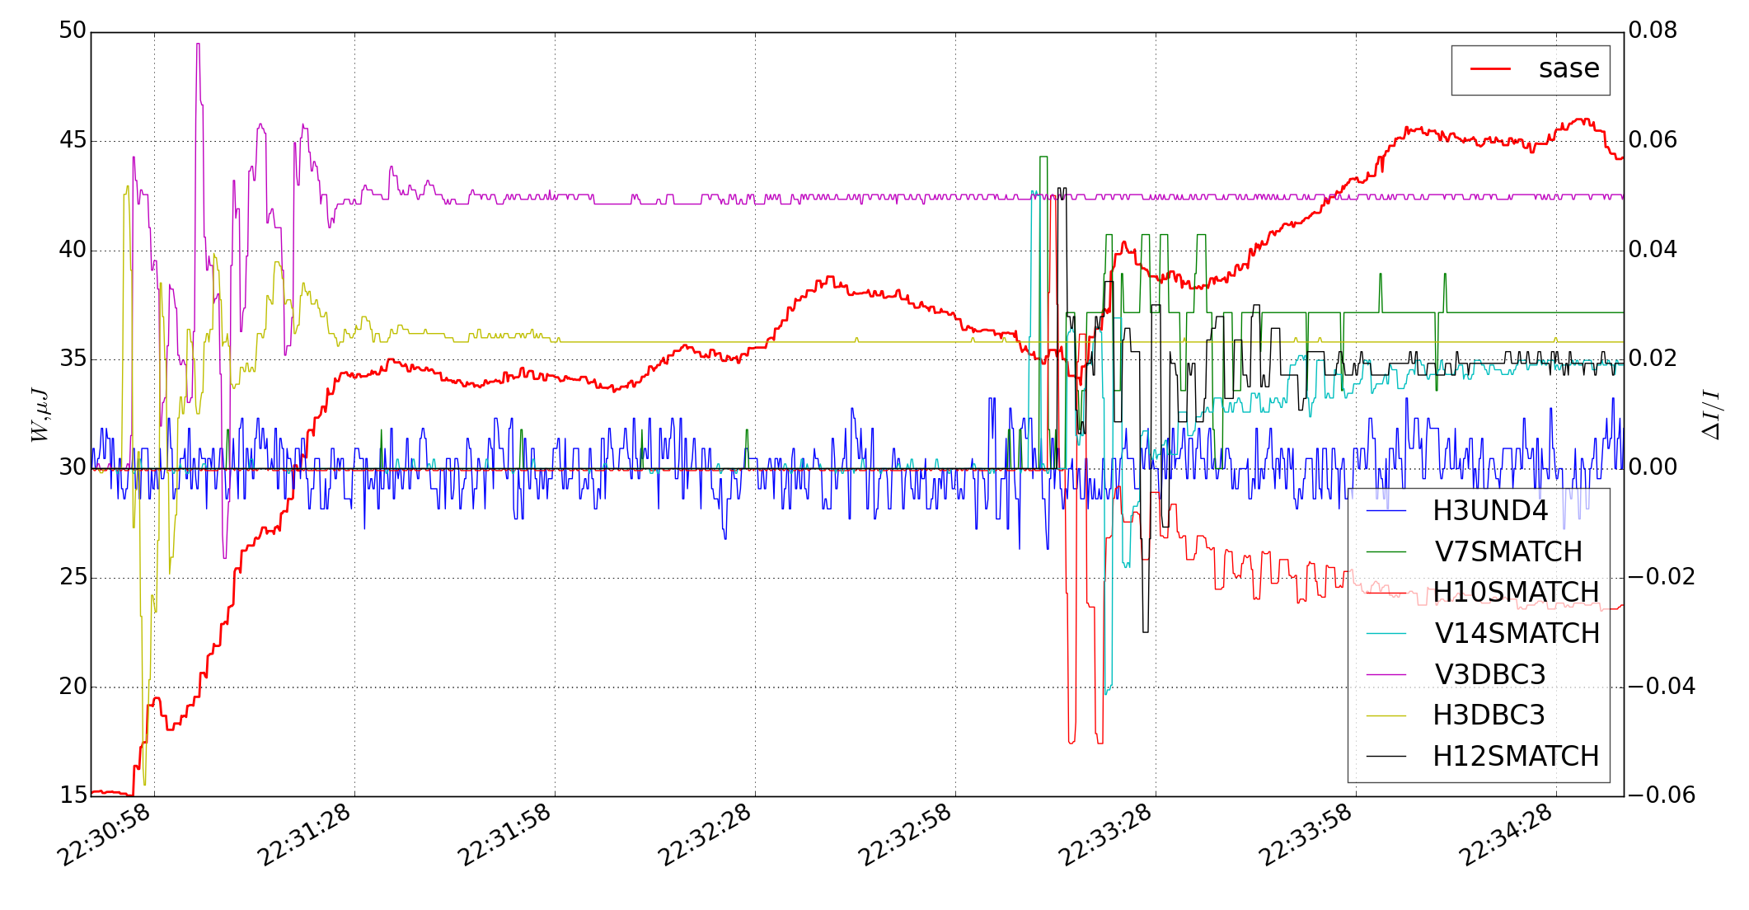
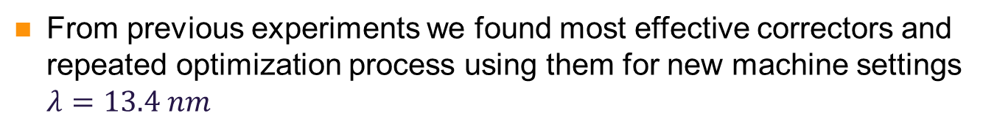

Last shift results: SASE optimization by correctors
$$λ=13.4 nm$$
H3UND4: I = 0.5 A
From previous experiments we found most effective correctors and repeated optimization process using them for new machine settings $λ=13.4 nm$

Slide 12
Resume
The empirical tuning works and was demonstrated at FLASH at several wavelengths (17nm, 13.5nm, 10.4 nm, 7 nm) with different bunch filling at about 0.3 nC charge
The method was demonstrated at SLAC (mainly uses quadrupoles in the linac. This tuning procedure they called “Ocelot optimization“)
Do not exist universally effective sequence of operations for fast SASE tuning (it is necessary to control the optimization from operator’s side).
Stability of the machine operation is necessary. From our experience in ~10-15% cases SASE fluctuations were great and the method does not work.
Scalability for XFEL needs to be studied.
The optimization is model-free.

Slide 13
Ocelot overview
Twiss parameters calculation (CPBD module)
Particle tracking (CPBD module)
Matching module (CPBD module)
Orbit correction module (was implemented for Siberia-2 Light Source at 2013 see Tomin et al., proc. IPAC 2013) (CPBD module)
Native module for spontaneous radiation calculation
SASE calculations using GENESIS
Native module for photon ray tracing
Python based
Open source https://github.com/iagapov/ocelot
OCELOT was designed with on-line capability in mind (see Agapov et al., NIM A. 768 2014)
Developed infrastructure for switching between flight simulator/controls mode with binding to DOOCS and EPICS. Already used for on-line beam control at Siberia-2 and for SASE tuning at FLASH and SLAC.

Slide 14
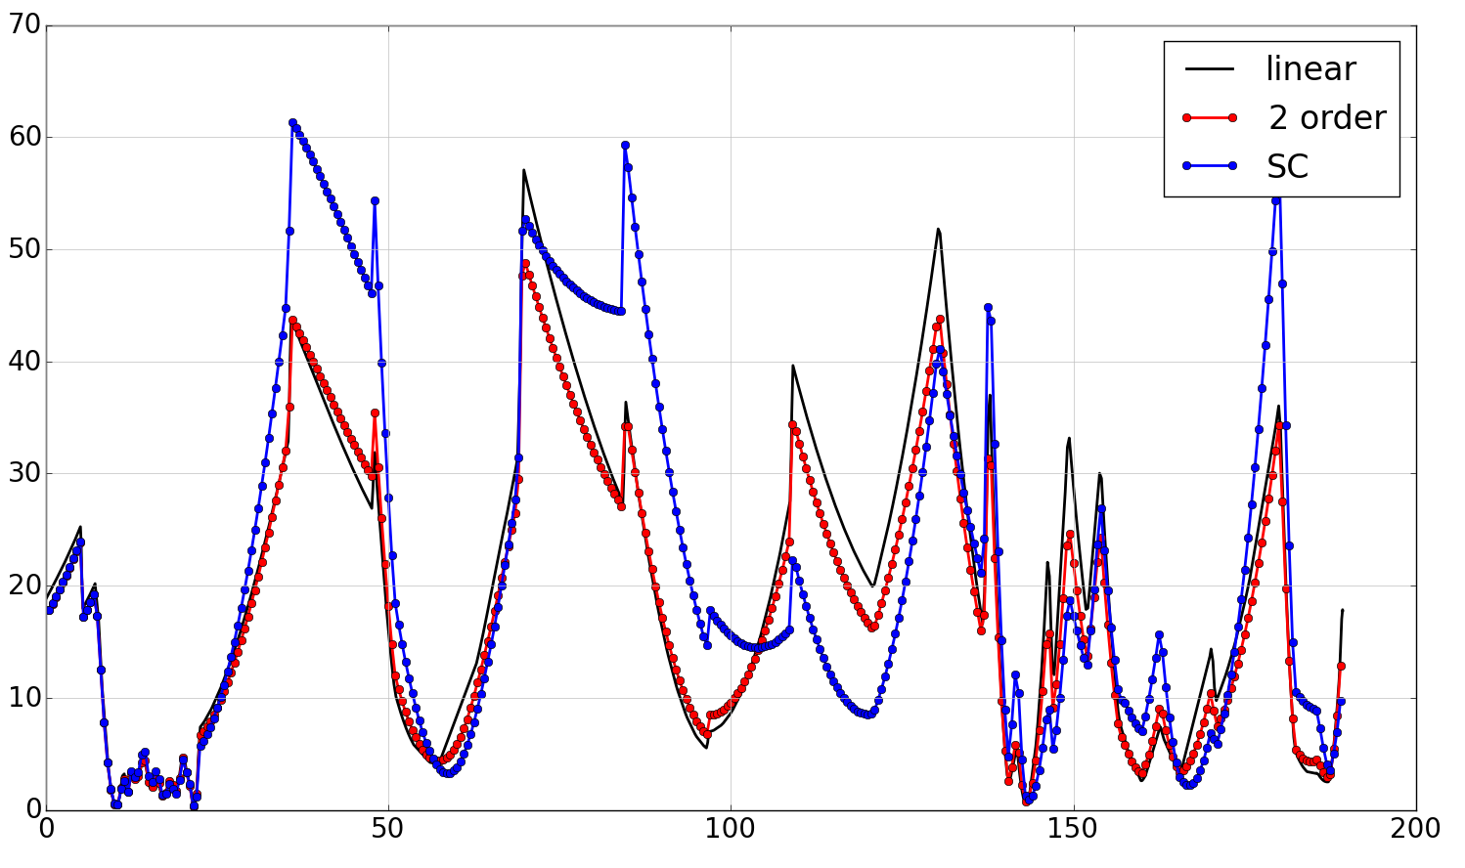


Developing Charge Particle Beam Dynamics (CPBD) module in OCELOT.
added second order matrices.
added space charge solver (@ M.Dohlus and I.Zagorodnov)
FLASH, Q = 1 nC
$$β_{y}, m$$
$$m$$

Slide 15
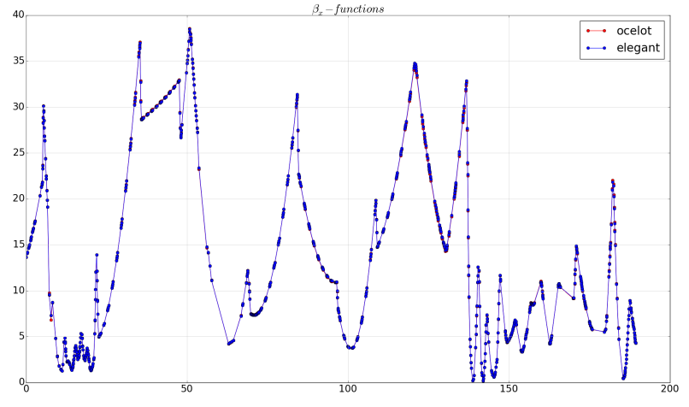
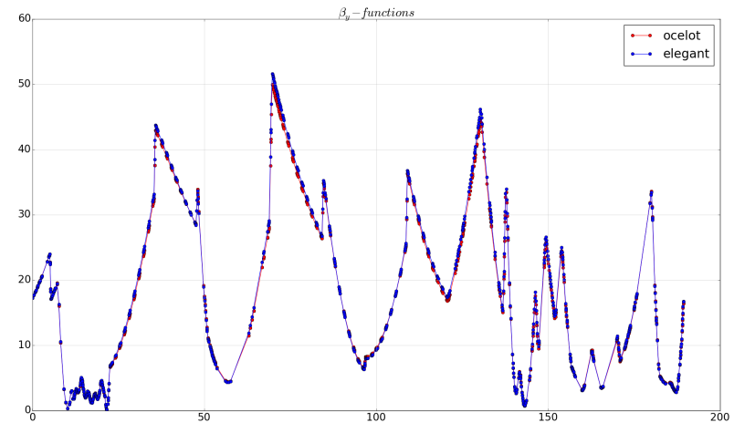


Cross-checking with Elegant:
Tracking including second order matrices
$β_{y}$ cross-checking
$β_{x}$ cross-checking

Slide 16
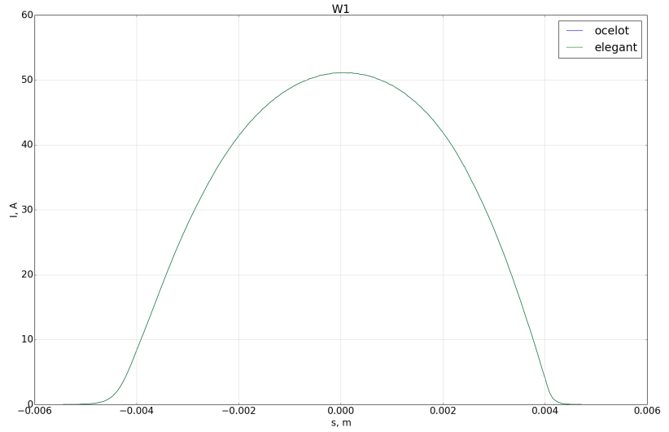
Cross-checking with Elegant:
Current profile at the Start point

Slide 17
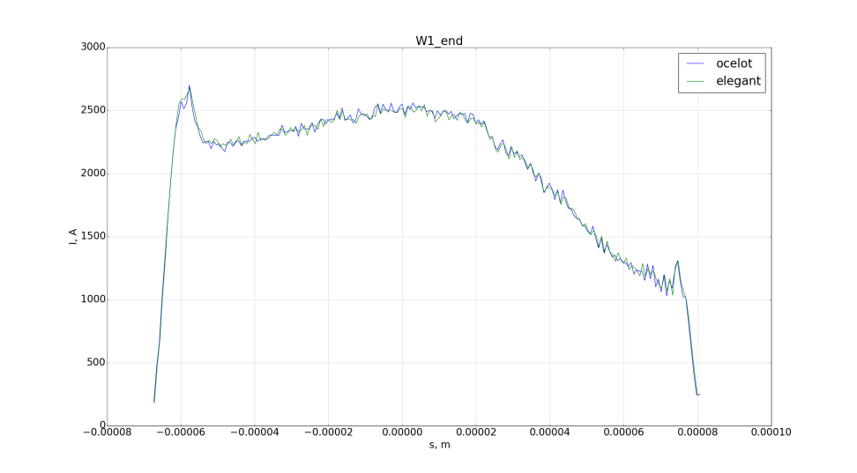
Cross-checking with Elegant:
Current profile at the End point
Using second order matrices

Slide 18
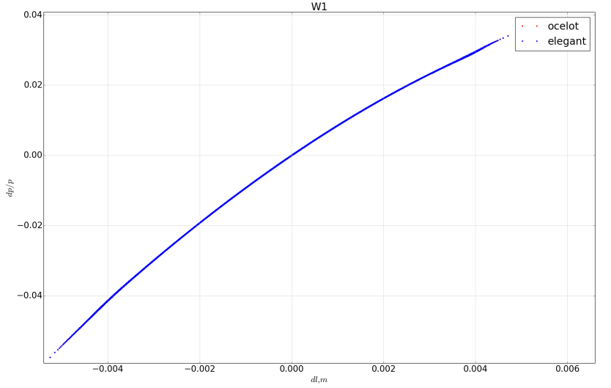

Cross-checking with Elegant:
Beam distribution in space $\left(∆l−{∆p}/p\right)$
at the Start point of FLASH

Slide 19
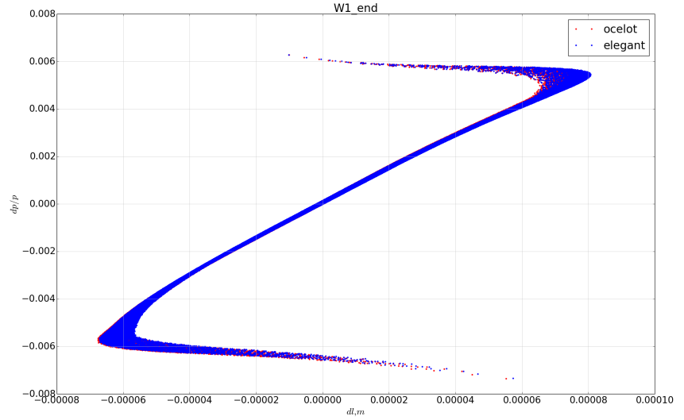
Cross-checking with Elegant:
Beam distribution in space $\left(∆l−{∆p}/p\right)$
at the End point of FLASH

Slide 20
Future plans of development CPBD module
Add CSR effect in cooperation with DESY
Add wakefield effects in cooperation with DESY
Testing and further development symplectic tracking
Further development of matching module

Slide 21
Extending of empirical tuning by model-depending optimization
Creation of realistic model of accelerator
Visualization of changes during Ocelot optimization.
Orbit steering
Algorithm of strategy selection
Online model ?

Slide 22
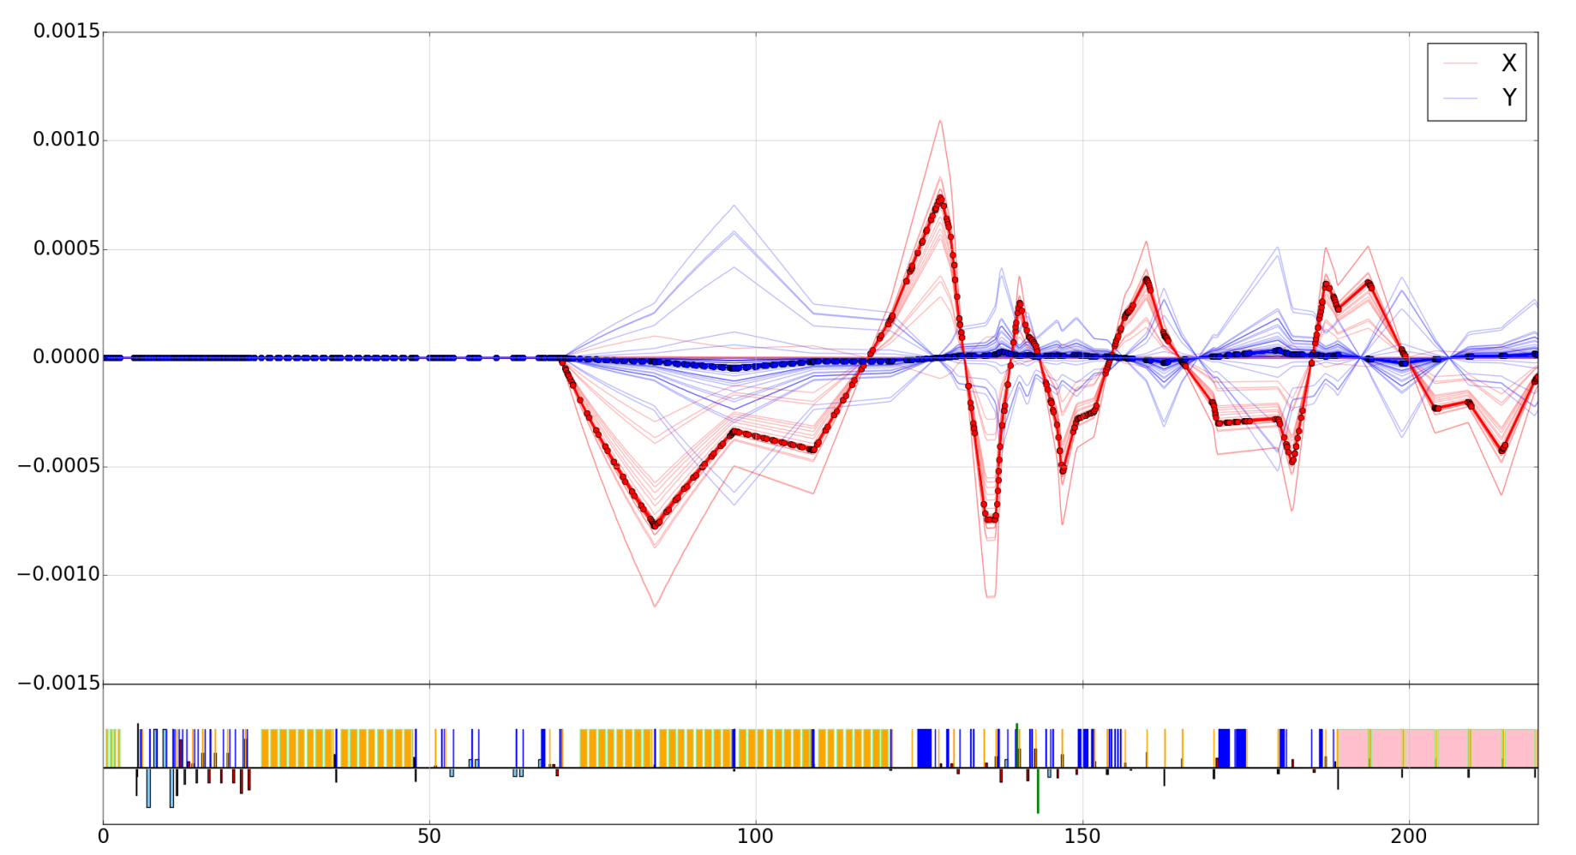
Visualization of changes during Ocelot optimization
Using converter tpi2k() (@Mathias Vogt) can be calculated relative changes in beam trajectory and in optical functions
X/Y, m
S, m

Slide 23
Visualization of changes during Ocelot optimization
Using converter tpi2k() (@Mathias Vogt) can be calculated relative changes in beam trajectory and in optical functions (?)
X/Y, m
S, m
It can give idea that problem was in horizontal direction

Slide 24
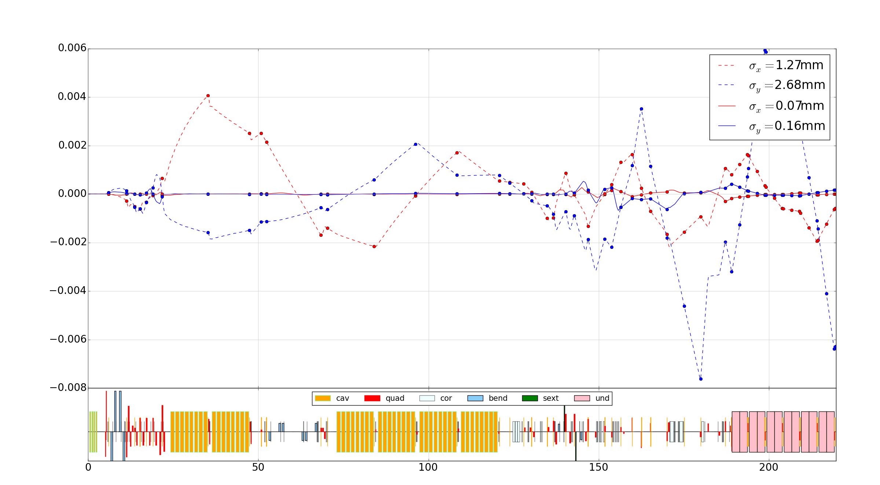
Orbit steering
Changing orbit in some point of the lattice to maximize SASE level.

Slide 25
Algorithm of strategy selection
BLM
algorithm of strategy selection (statistical analysis)
SASE det.
corr. 1 – Nc
quad. 1 – Nq
sext. 1 – Ns
Data Base of successful optimizations
Optimizer
bend. 1 – Nb
Cavit. 1 - Ncv
Undul.
Online module
(orbit steering)
BPM 1 – Nb

Slide 26
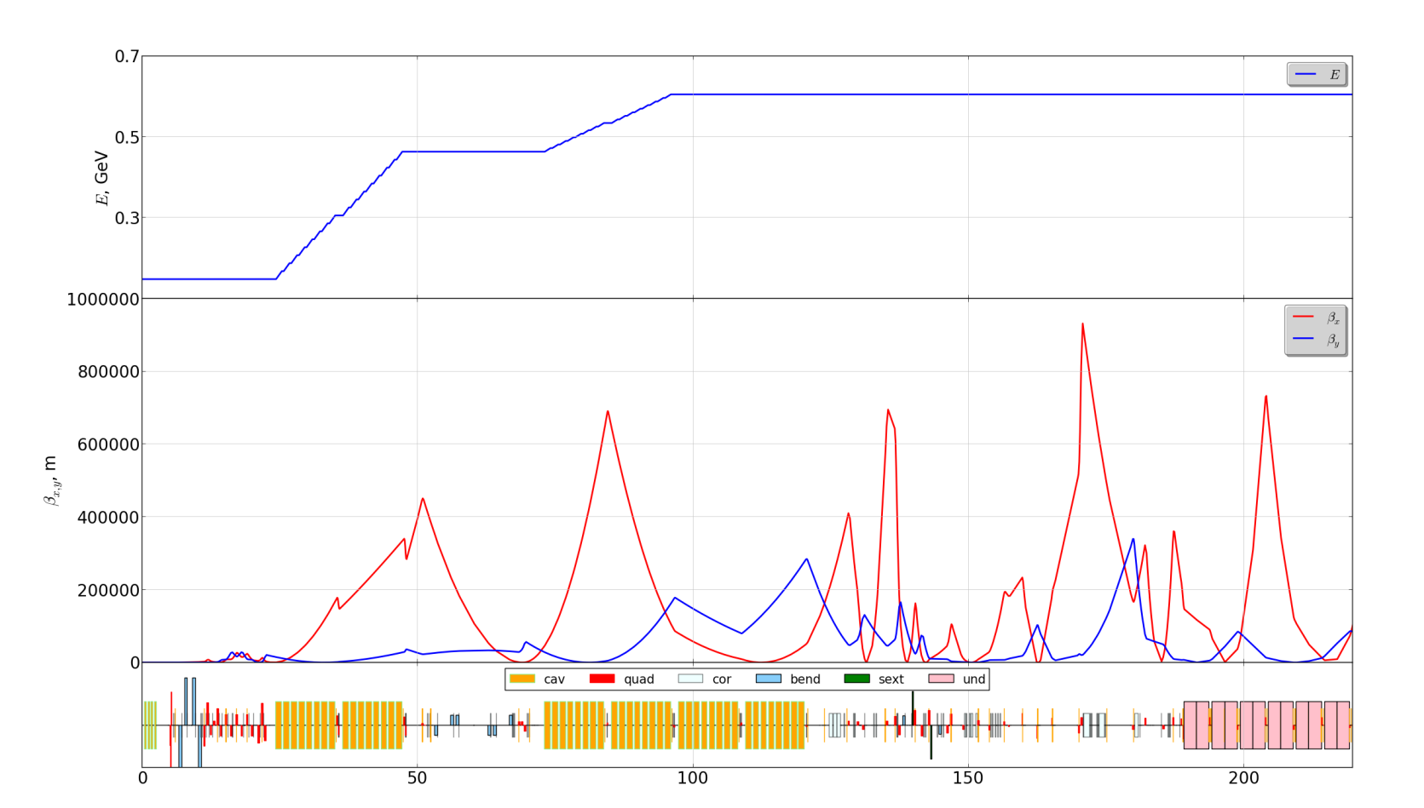
Online model of accelerator ?
Used last optics file (MAD8 and Elegant)
Taken the amplitudes and phases of cavities from control system by PyDoocs
Taken quadrupoles currents from the control system and using tpi2k we got the strengths
And we got these beta functions…

Slide 27
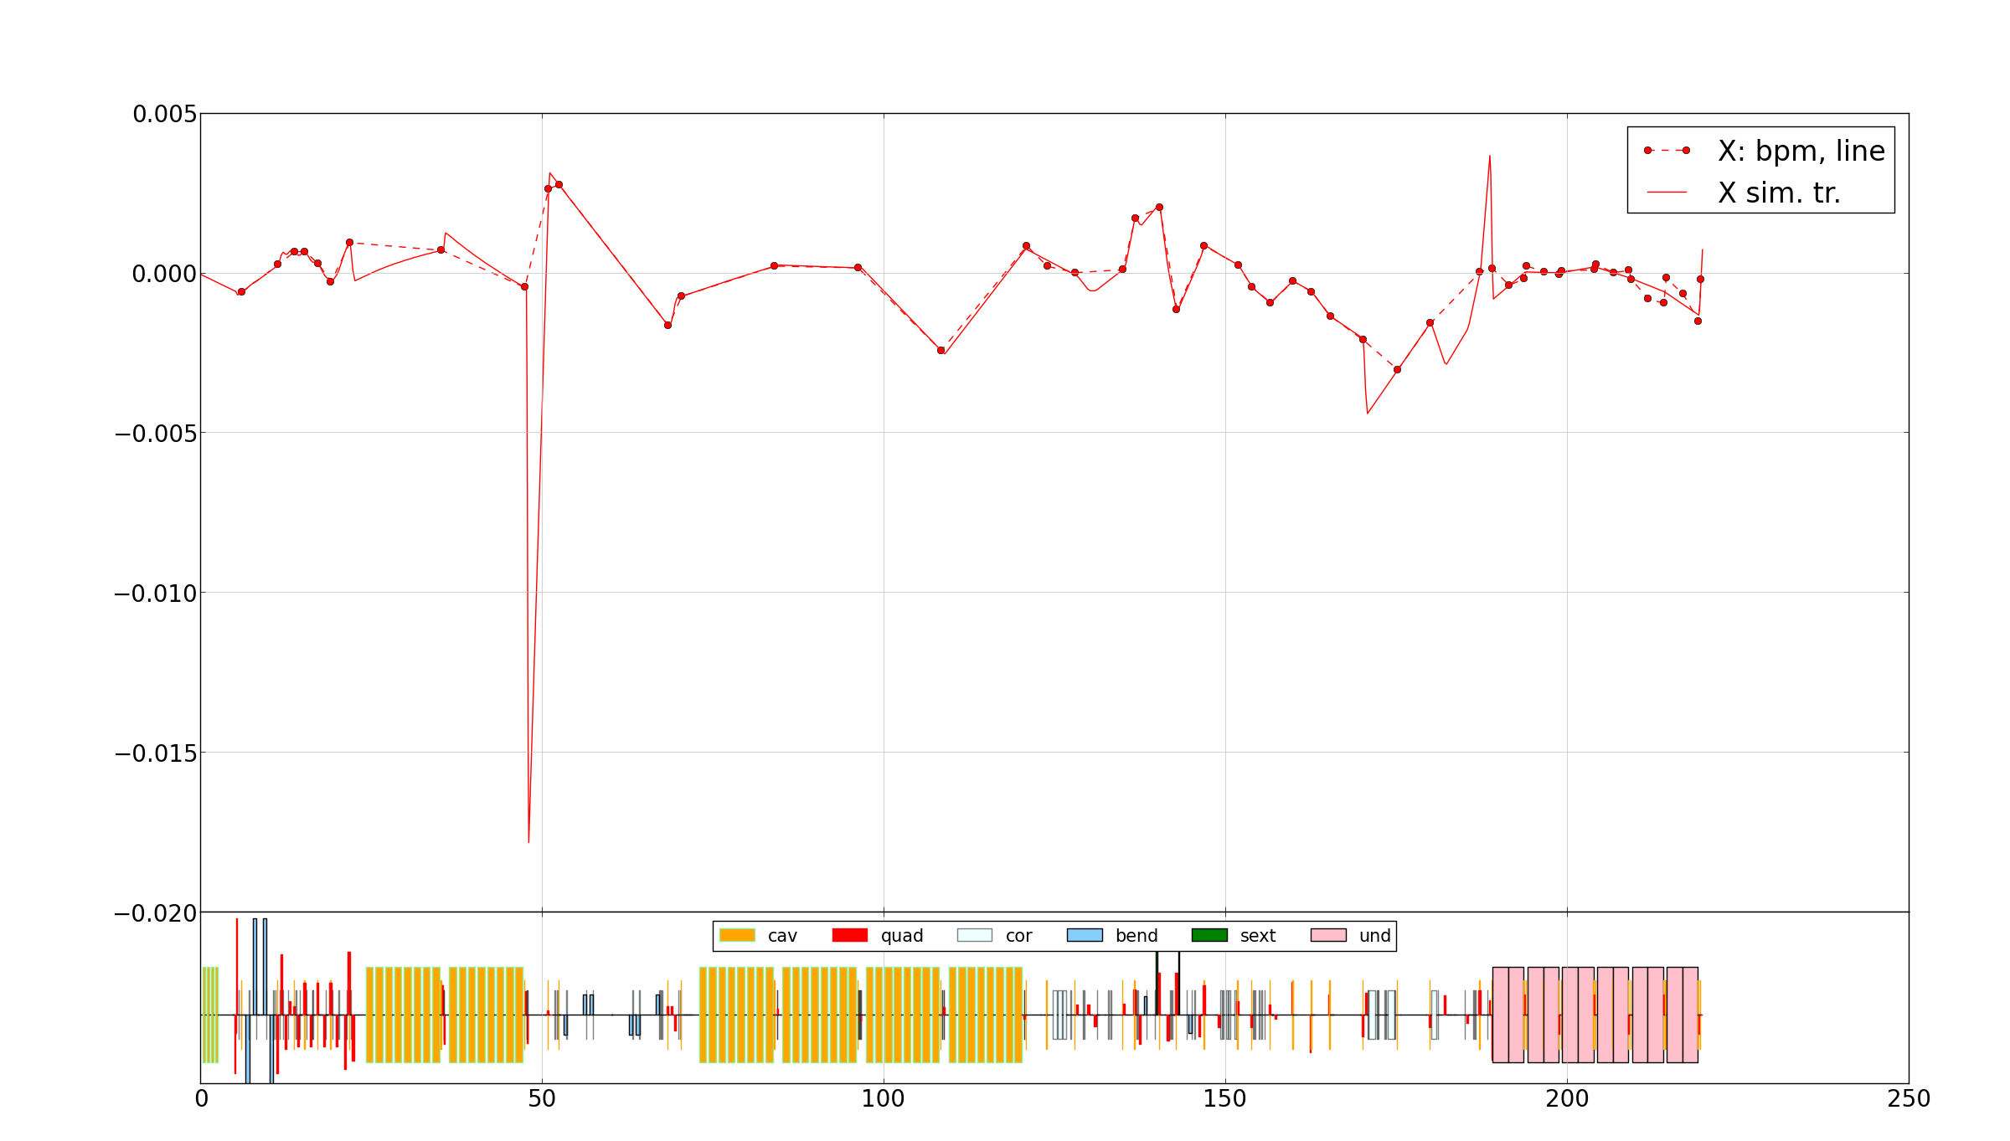
Reading real orbit and fitting beam trajectory
Horizontal plane

Slide 28
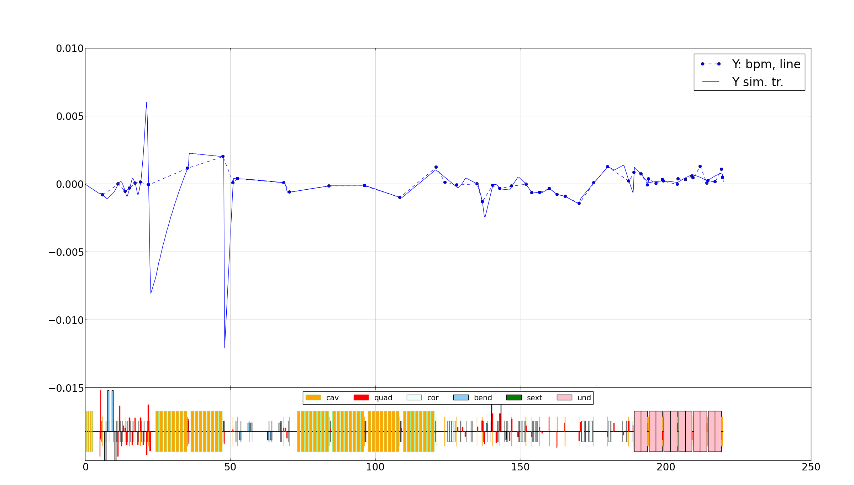
Reading real orbit and fitting beam trajectory
Vertical plane

Slide 29
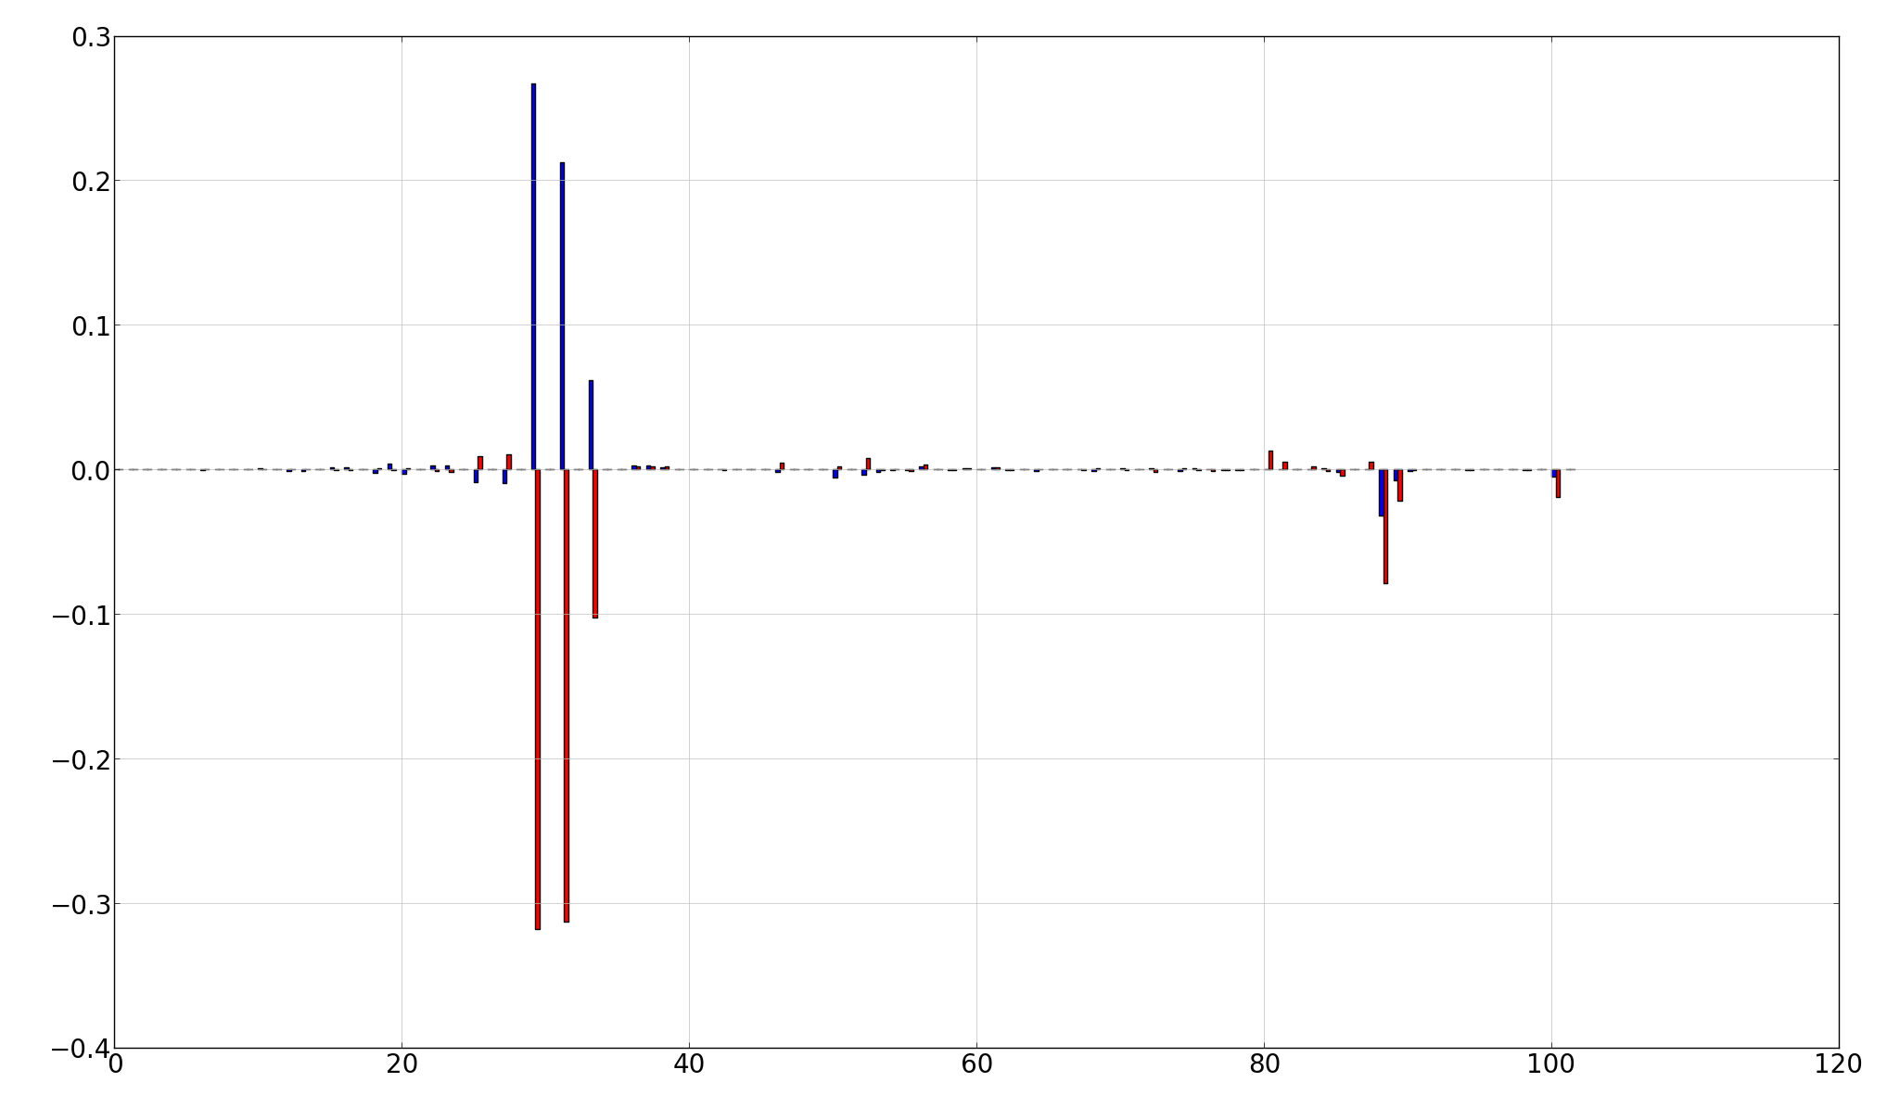
Reading real orbit and fitting beam trajectory
Quadrupole misalignments
m
Creation of realistic and online model is not simple task.
Number of quads

Slide 30
Summary
On-line control python tools have been developed
Demonstrated automatic SASE tuning at FLASH and SLAC
Proposal for further FLASH beamtime to study more advanced tuning methods has been approved and further developments are ongoing
Implementation of GUI for FLASH/XFEL in progress (~02.2016)
Planning of further steps wrt. XFEL.EU is underway. The first step of optimization tool implementation can be beam transmission tuning during commissioning.
R&D into more complex tuning methods are needed.
Even the simplest empirical tuning methods would bring significant advantage for facility availability.

