Slide 1
LOLA setup
LOLA L = 3.826 m; 2.856 GHz
Drift L = 2.693 m
Bend L = 0.447 m; −5 deg
Drift L = 0.131 m
Bend L = 0.447 m; −5 deg
Drift L = 4.481 m
OTR 17.5 µm / pixel

Slide 2
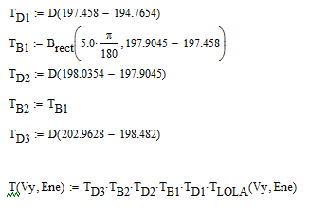
LOLA cavity, in reasonable approximation:
with
“time” axis

Slide 3
setup without bend:
drift
LOLA
“time” axis

Slide 4
“time” axis

