Slide 1
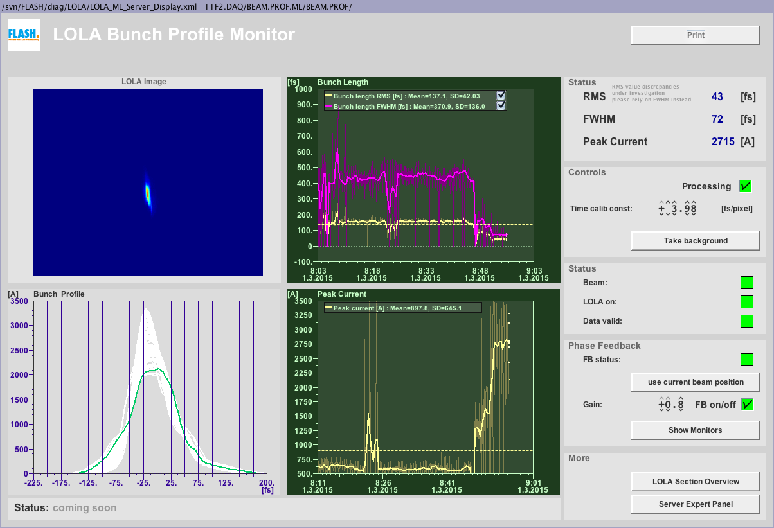
LOLA Measurements at FLASH
A large difference for two working points
Igor Zagorodnov
S2E Meeting
DESY
16. March 2015

Slide 2
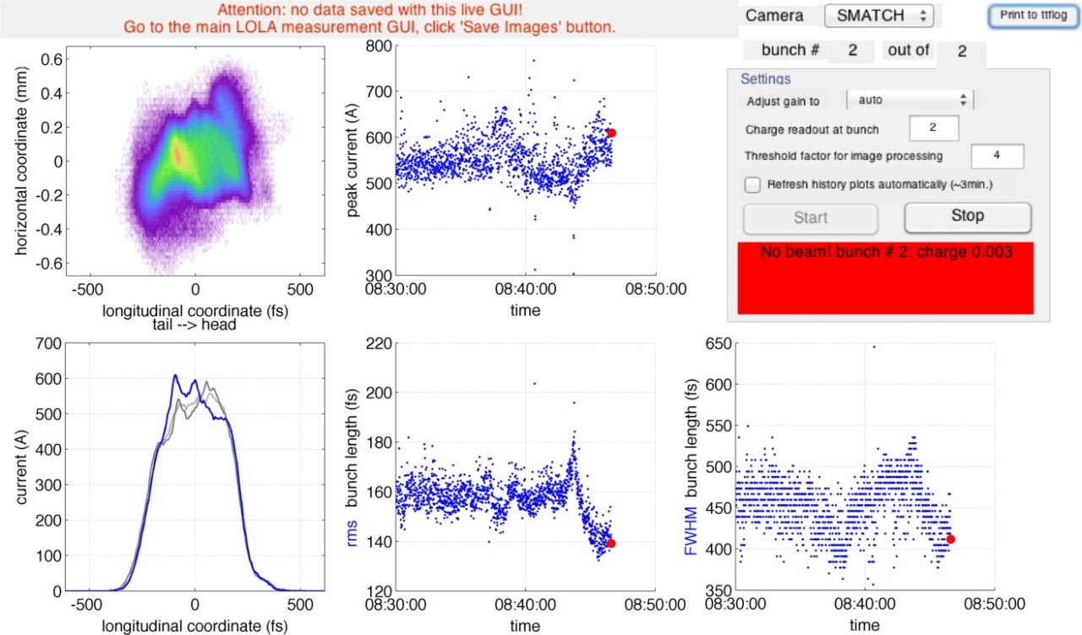
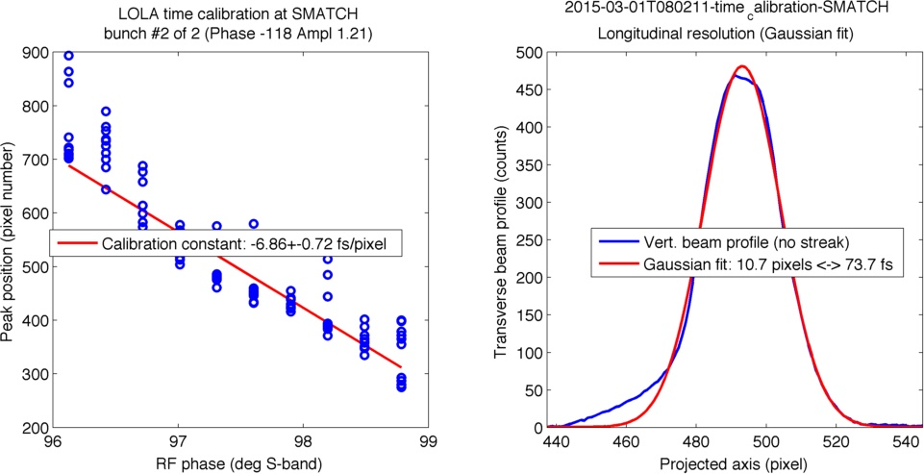
Case 1. 01.03.2015 08:47 (M. Vogt)
res1=75 fs sig1=125 fs
ampl=1.21 (phase1=-118 )

Slide 3
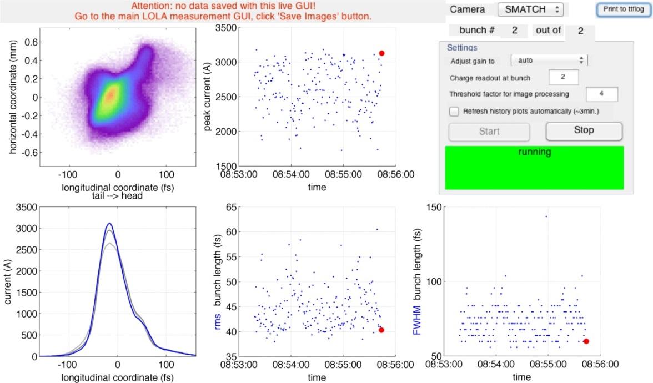
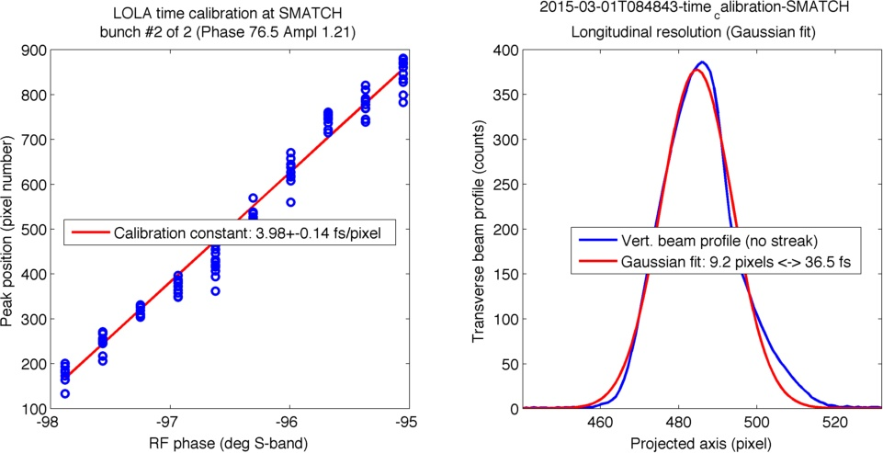
Case 1. 01.03.2015 08:55 (M. Vogt)
res2=35 fs sig2=45 fs
ampl= 1.21 (phase2 =76.5)

Slide 4
Case 1. 01.03.2015 08:55 (M. Vogt)
res1=75 fs sig1=125 fs
ampl=1.21 (phase1=-118 )
res2=35 fs sig2=45 fs
ampl= 1.21 (phase2 =76.5)
sig=sqrt(0.5*(sig1**2-res1**2+sig2**2-res2**2))
(reference?)
sig=73.48
$$σ=\sqrt{0.5({σ_{x+}^{}}^{2}−{σ_{x0+}^{}}^{2}+{σ_{x−}^{}}^{2}−{σ_{x0−}^{}}^{2})}$$

Slide 5
Case 1. 01.03.2015 08:55 (M. Vogt)
?
$${σ_{t}^{}}^{}=\sqrt{0.5({σ_{t+}^{}}^{2}−{σ_{t0+}^{}}^{2}+{σ_{t−}^{}}^{2}−{σ_{t0−}^{}}^{2})}$$

Slide 6
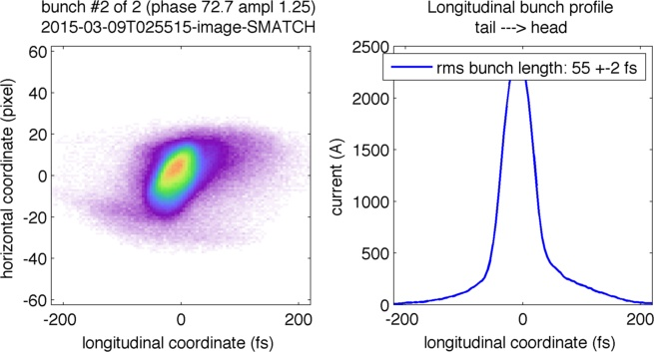
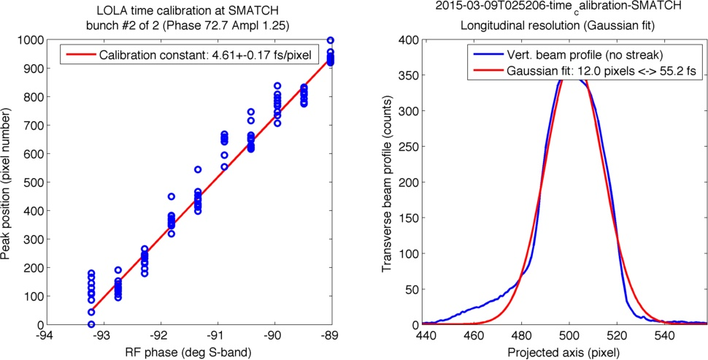
Case 2. 09.03.2015 02:56 (I. Zagorodnov)
res1=55 fs sig1=55 fs (phase1=72.7 )

Slide 7
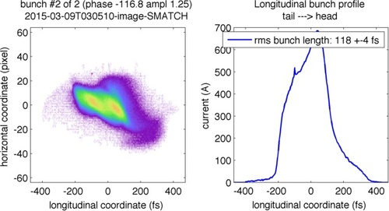
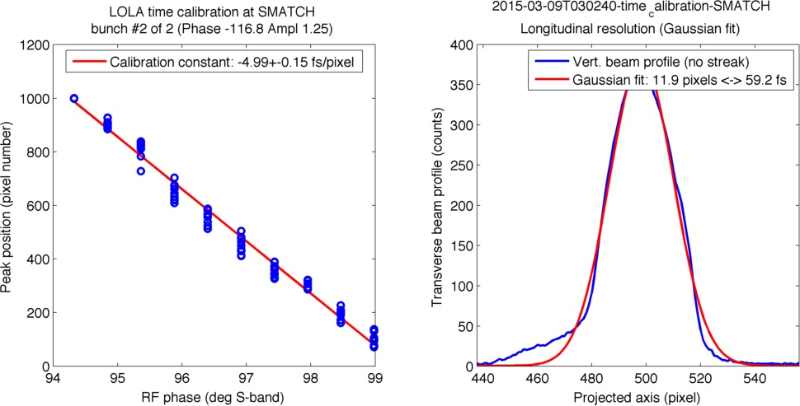
Case 2. 09.03.2015 03:05 (I. Zagorodnov)
res2=59.2 fs sig2=118 fs (phase2=-116.8 )

Slide 8
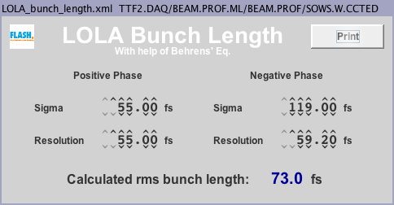
Case 2. 09.03.2015 03:05 (I. Zagorodnov)

Slide 9
Why it takes a lot of time?
The changing of the phase manually gives a large loses in the undulator section.
With large voltage (1.2) it takes some time to find another phase.
Conventional procedure to change the working point
To reduce the voltage to 0
Change the phase
Increase the voltage again.
New calibration.
It takes not less than 10 minutes.

Slide 10
How can we do it faster? (C. Behrens)
For the same amplitude the resolutions has to be the same. The difference comes solely due to different calibration and jitter in the unstreaked beam size.
Switching phase does only need seconds. If somebody woud measure the response (real phase vs set phase) a simple script could be written to make this happen.

