Slide 1
Reduced Gun Simulations
1. Comparison 60MV/m Gun vs 50MV/m Gun, Flat Top Laser Pulse
2. Comparison for the worst case: Gun50+Gauss Laser Pulse
3. Summary and Outlook
Yauhen Kot
Summary for the S2E Meeting 28.10.2013

Slide 2
Reduced Gun Simulations
1. Comparison Gun60 vs Gun50, Flat Top Laser Pulse
2. Comparison for the worst case: Gun50+Gauss Laser Pulse
3. Summary and Outlook

Slide 3
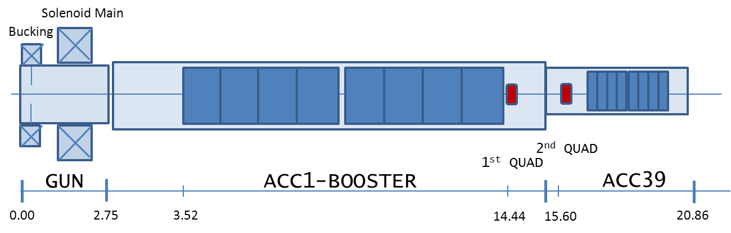
XFEL Photo Injector Setup
settings used in the simulations
RF-Gun | Cathode Laser | Booster | ASTRA
Field Balance= 1.12 | Temporal Profile: Flat Top 2/20\2ps Gauss 10-14ps FWHM | ACC1: 8xTESLA cavities: 1st cavity centered at z=4.0401m → 1st iris at z=3.637m | 200K particles
E_{cath}=50.00-60.00MV/m Phi=-1.9 deg | Transverse: radial homogeneous | E_{peak}=34.42MV/m Phase=6.31 deg | Rotational symmetry Mesh: NradxNlong=40x100
Solenoid: main centered at z=0.276m Bucking coil at compensation |  |  | Tuned Parameters: Main solenoid peak field Laser rms spot size Rms bunch length (?) Gun launch phase
Goals & Tasks: - minimized transverse emittance at the 1st quadrupole (z=14.44m) - matchable optics → β<60m, |α|<4 @1st quadrupole

Slide 4
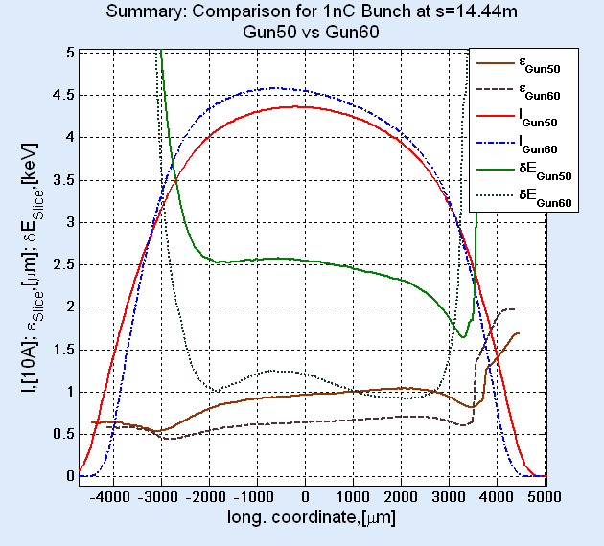
Operation with 1nC. Comparison Gun50 vs Gun60
Charge |  |  | 1nC
Max electric field in the gun, [MV/m] |  |  | 50 | 60
Laser form |  |  | FT 2/20\2
WP | MaxB,[T] |  | 0.1894 | 0.2226
 | XYrms,[mm] |  | 0.580 | 0.440
ε^{pr}_{s=14.44m}, [mrad] |  |  | 1.035 | 0.709
ε^{sl,peak}_{s=14.44m}, [mrad] |  |  | 0.955 | 0.626
ε^{sl,av}_{s=14.44m}, [mrad] |  |  | 0.905 | 0.624
ε^{sl,min}_{s=14.44m}, [mrad] |  |  | 0.538 | 0.439
ε^{sl,max}_{s=14.44m}, [mrad] |  |  | 1.030 | 0.704
δE^{sl,peak},rms [keV] |  |  | 2.555 | 1.238
Ip, [A] |  |  | 43.6 | 45.8
τ rms, [mm] |  |  | 2.168 | 2.048
Beam optical functions after 1st accelerating module |  | β,[m] | 22.18 | 8.73
 |  | α | -3.99 | 0.030
+46.0 % projected emittance growth
+52.6% growth of emittance at the current peak
+45.0% average slice emittance growth

Slide 5
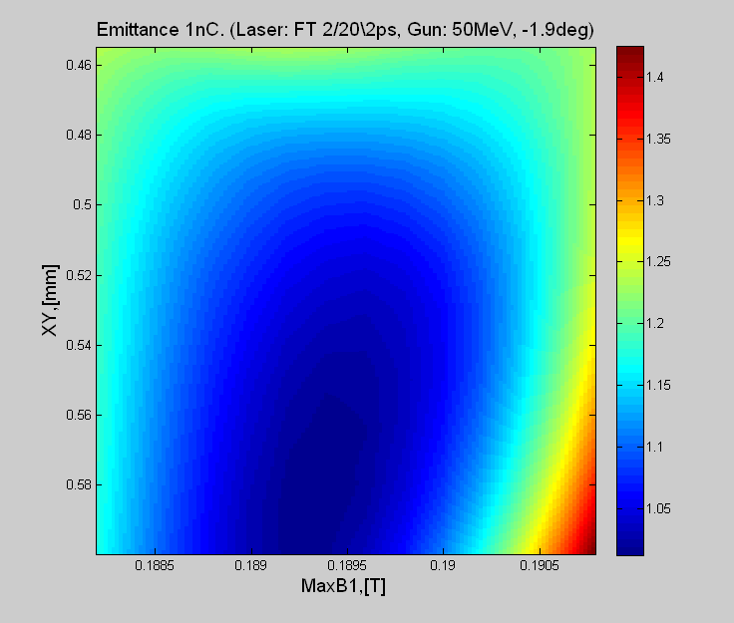
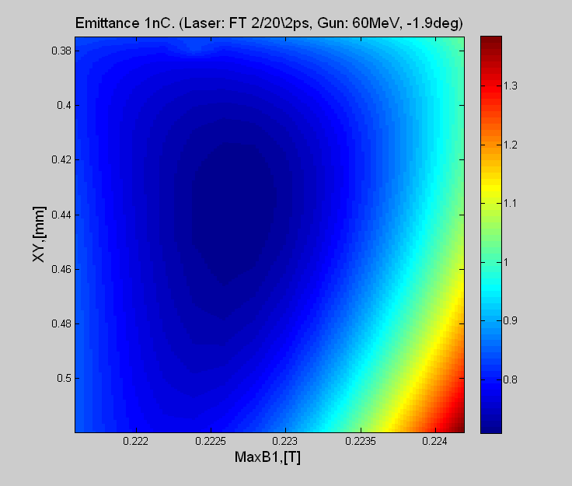
1nC at XFEL Injector with 50MeV and 60MeV Gun.
Emittance Comparison
 |  | Gun60 | Gun50
Working Point | MaxB, [T] | 0.2226 | 0.1894
 | XYrms,[mm] | 0.440 | 0.580
emittance | ε,[m⁻⁶] | 0.7091 | 1.0120
rms bunch lenngth | τ,[mm] | 2.048 | 2.094
Beam optical functions after the 1st accelerating module | β,[m] | 8.729 | 22.18
 | α | 0.030 | -3.99

Slide 6
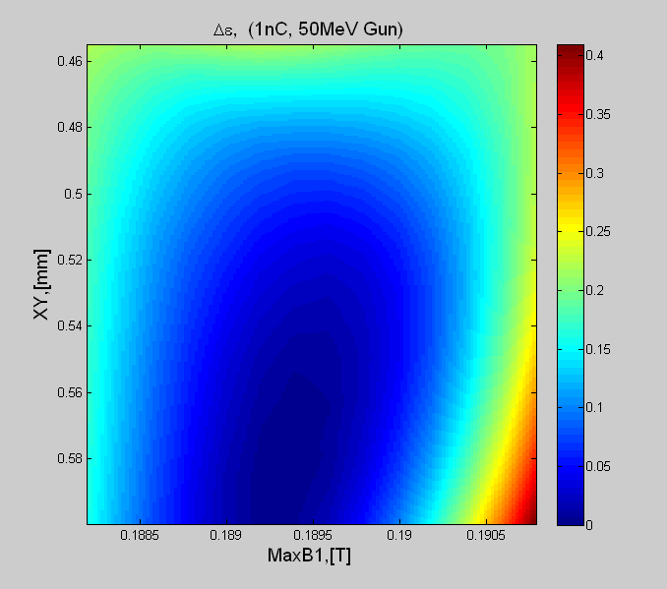
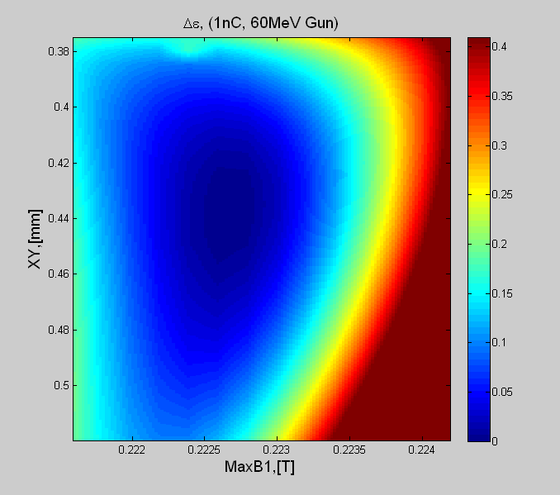
1nC at XFEL Injector with 50MV/m and 60MV/m Gun.
Emittance Stability
50MV/m Gun: stable emittance but more extreme beam optical functions

Slide 7
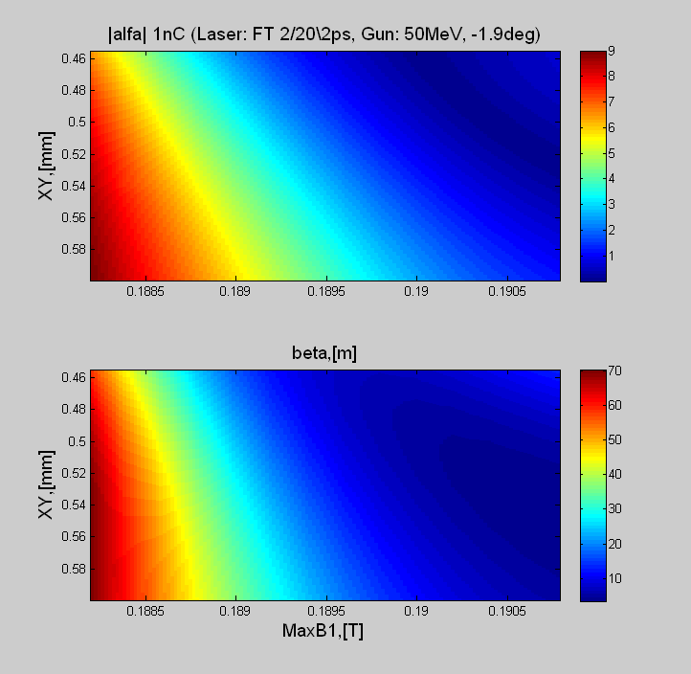
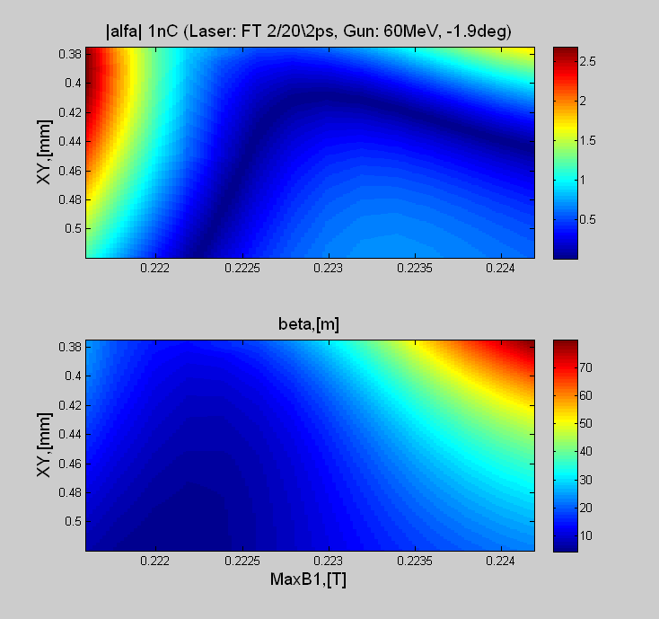
1nC at XFEL Injector with 50MV/m and 60MV/m Gun.
Comparison of Beam Optical Functions

Slide 8
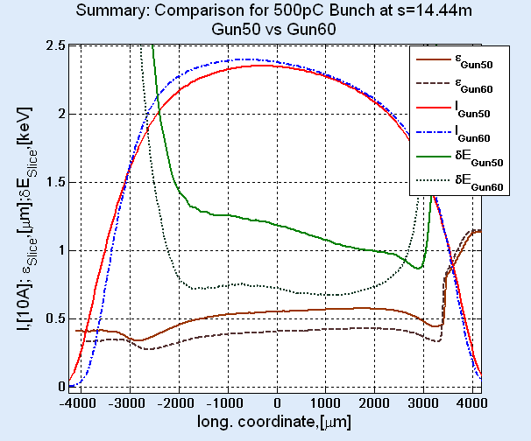
Operation with 500pC. Comparison Gun50 vs Gun60
Charge |  |  | 500pC
Max electric field in the gun, [MV/m] |  |  | 50 | 60
Laser form |  |  | FT 2/20\2
WP | MaxB,[T] |  | 0.1892 | 0.2224
 | XYrms,[mm] |  | 0.360 | 0.285
ε^{pr}_{s=14.44m}, [mrad] |  |  | 0.544 | 0.439
ε^{sl,peak}_{s=14.44m}, [mrad] |  |  | 0.543 | 0.393
ε^{sl,av}_{s=14.44m}, [mrad] |  |  | 0.518 | 0.386
ε^{sl,min}_{s=14.44m}, [mrad] |  |  | 0.336 | 0.274
ε^{sl,max}_{s=14.44m}, [mrad] |  |  | 0.572 | 0.426
δE^{sl,peak},rms [keV] |  |  | 1.209 | 0.735
Ip, [A] |  |  | 23.5 | 24.0
τ rms, [mm] |  |  | 1.984 | 1.944
Beam optical functions after 1st accelerating module |  | β,[m] | 7.957 | 19.81
 |  | α | -1.113 | -0.605
+23.9 % projected emittance growth
+38.2% growth of emittance at the current peak
+34.2% average slice emittance growth

Slide 9
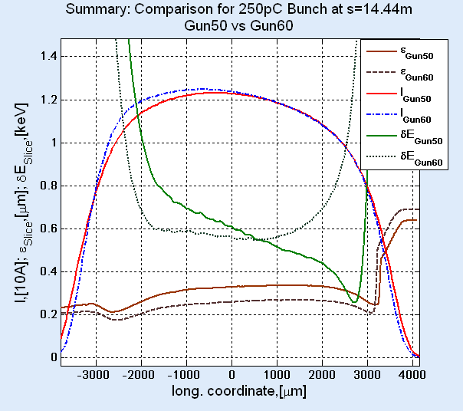
Operation with 250pC. Comparison Gun50 vs Gun60
Charge |  |  | 250pC
Max electric field in the gun, [MV/m] |  |  | 50 | 60
Laser form |  |  | FT 2/20\2
WP | MaxB,[T] |  | 0.1888 | 0.2220
 | XYrms,[mm] |  | 0.230 | 0.180
ε^{pr}_{s=14.44m}, [mrad] |  |  | 0.329 | 0.298
ε^{sl,peak}_{s=14.44m}, [mrad] |  |  | 0.325 | 0.252
ε^{sl,av}_{s=14.44m}, [mrad] |  |  | 0.308 | 0.246
ε^{sl,min}_{s=14.44m}, [mrad] |  |  | 0.212 | 0.175
ε^{sl,max}_{s=14.44m}, [mrad] |  |  | 0.336 | 0.268
δE^{sl,peak},rms [keV] |  |  | 0.633 | 0.575
Ip, [A] |  |  | 12.31 | 12.47
τ rms, [mm] |  |  | 1.880 | 1.884
Beam optical functions after 1st accelerating module |  | β,[m] | 12.77 | 42.13
 |  | α | -0.706 | -2.305
+10.4% projected emittance growth
+29.0% growth of emittance at the current peak
+25.2% average slice emittance growth

Slide 10
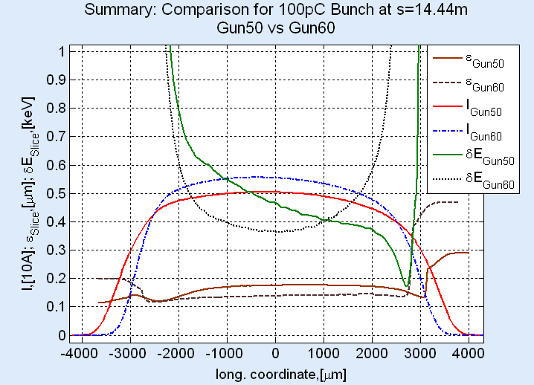
Operation with 100pC. Comparison Gun50 vs Gun60
Charge |  |  | 100pC
Max electric field in the gun, [MV/m] |  |  | 50 | 60
Laser form |  |  | FT 2/20\2
WP | MaxB,[T] |  | 0.1882 | 0.2218
 | XYrms,[mm] |  | 0.1228 | 0.133
ε^{pr}_{s=14.44m}, [mrad] |  |  | 0.1891 | 0.1945
ε^{sl,peak}_{s=14.44m}, [mrad] |  |  | 0.175 | 0.137
ε^{sl,av}_{s=14.44m}, [mrad] |  |  | 0.164 | 0.138
ε^{sl,min}_{s=14.44m}, [mrad] |  |  | 0.120 | 0.116
ε^{sl,max}_{s=14.44m}, [mrad] |  |  | 0.177 | 0.143
δE^{sl,peak},rms [keV] |  |  | 0.473 | 0.367
Ip, [A] |  |  | 5.05 | 5.56
τ rms, [mm] |  |  | 1.815 | 1.647
Beam optical functions after 1st accelerating module |  | β,[m] | 49.89 | 39.5
 |  | α | -2.568 | -2.013
-2.7% projected emittance growth
+27.7% growth of emittance at the current peak
+18.8% average slice emittance growth
With 1.4% growth of the projected emittance for Gun60 in order to get matchable beam optical functions

Slide 11
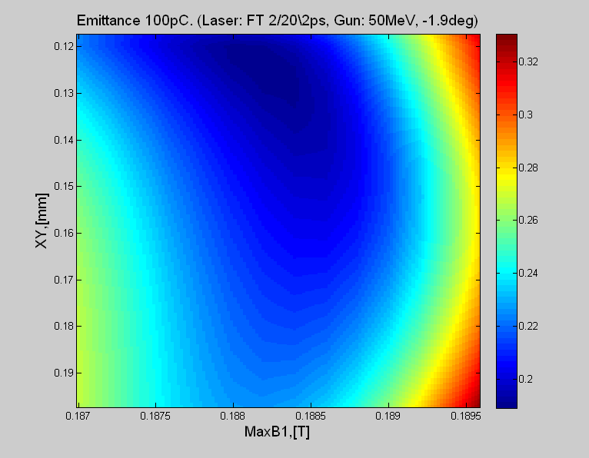
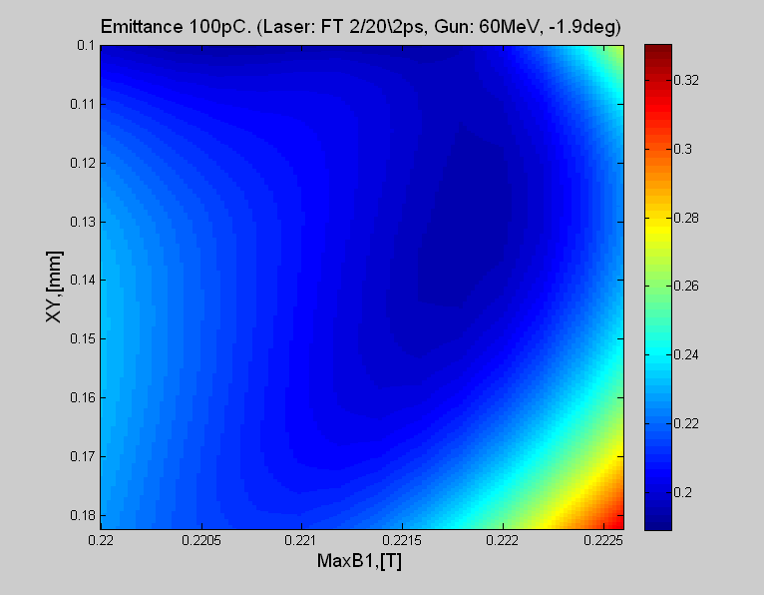
100pC at XFEL Injector with 50MeV and 60MeV Gun.
Emittance Comparison
Scan size: Δ_{MaxB} x Δ_{XYrms}=0.0025T x 0.080mm; Color range: 0.1891-0.3306 μm
 |  | Gun60 | Gun50
Working Point | MaxB, [T] | 0.2218 | 0.1882
 | XYrms,[mm] | 0.133 | 0.1228
emittance | ε,[m⁻⁶] | 0.1945 | 0.1891
rms bunch lenngth | τ,[mm] | 1.640 | 1.891
Beam optical functions after the 1st accelerating module | β,[m] | 39.5 | 49.89
 | α | -2.013 | -2.568

Slide 12
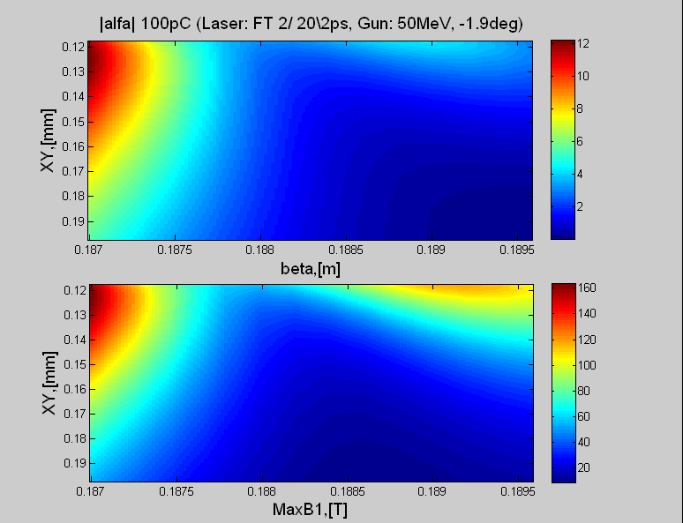
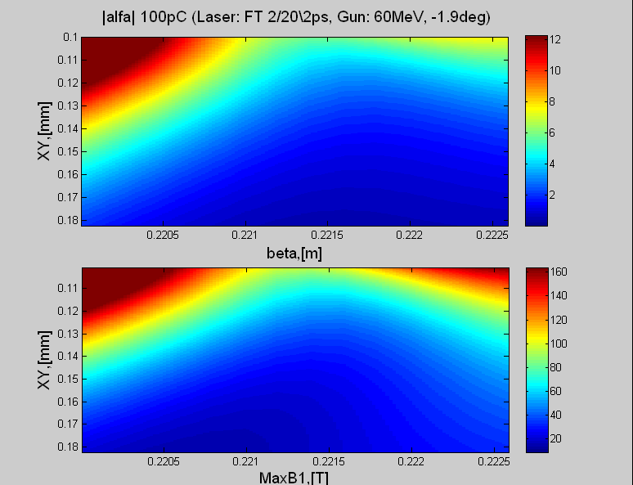
100pC at XFEL Injector with 50MV/m and 60MV/m Gun.
Comparison of Beam Optical Functions

Slide 13
Summary: Operation Gun60 vs Gun50
Flat Top Laser Pulse 2/20\2ps
Table: Change of some bunch parameters in % if the peak electric field of the gun is reduced from 60MV/m to 50MV/m. Laser Pulse profiles is Flat Top 2/20\2ps in both cases
Bunch Charge | 1nC | 500pC | 250pC | 100pC
Δε^{pr}, [%] | 46.0 | 23.9 | 10.4 | -2.7
Δε^{sl,peak},[%] | 52.6 | 38.2 | 29.0 | 27.7
Δε^{sl,av}, [%] | 45.0 | 34.2 | 25.2 | 18.8
Δ(δE)^{sl,peak}, [%] | 106 | 64.5 | 10.1 | 18.9
→Bunches with higher charge suffer more,
but the claimed design parameters may be hold

Slide 14
Reduced Gun Simulations
1. Comparison Gun60 vs Gun50, Flat Top Laser Pulse
2. Comparison for the worst case: Gun50+Gauss Laser Pulse
3. Summary and Outlook
Worst case:
- Maximum peak electric field of the gun by 50MV/m
- Longitudinal laser pulse profile: gaussian with 14ps FWHM (rms 5.95ps)

Slide 15
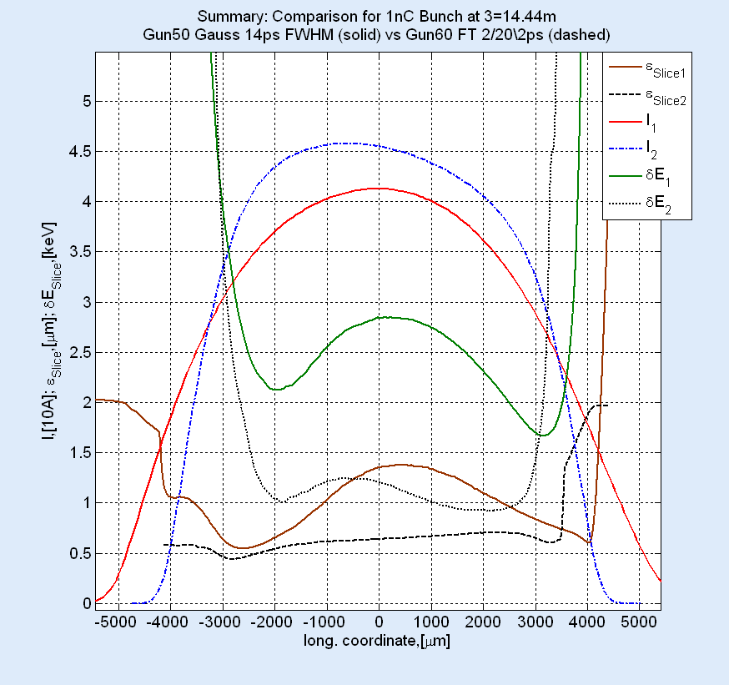
Operation with 1nC:
60MV/m Gun + FT 2/20\2ps vs 50MV/m Gun + Gauss 14ps FWHM
Charge |  |  | 1nC
Max electric field in the gun, [MV/m] |  |  | 50 | 60
Laser form |  |  | Gauss 14ps FWHM | FT 2/20\2 ps
WP | MaxB,[T] |  | 0.1889 | 0.2226
 | XYrms,[mm] |  | 0.460 | 0.440
ε^{pr}_{s=14.44m}, [mrad] |  |  | 1.501 | 0.7091
ε^{sl,peak}_{s=14.44m}, [mrad] |  |  | 1.352 | 0.629
ε^{sl,av}_{s=14.44m}, [mrad] |  |  | 1.064 | 0.634
ε^{sl,min}_{s=14.44m}, [mrad] |  |  | 0.546 | 0.439
ε^{sl,max}_{s=14.44m}, [mrad] |  |  | 1.38 | 0.704
δE^{sl,av},rms [keV] |  |  | 2.75 | 1.1
Ip, [A] |  |  | 41.3 | 45.8
τ rms, [mm] |  |  | 2.384 | 2.048
Beam optical functions after 1st accelerating module |  | β,[m] | 19.64 | 8.729
 |  | α | -2.419 | 0.030
+112% projected emittance growth
+115% growth of emittance at the current peak
+67.8% average slice emittance growth
Different rms bunch length

Slide 16
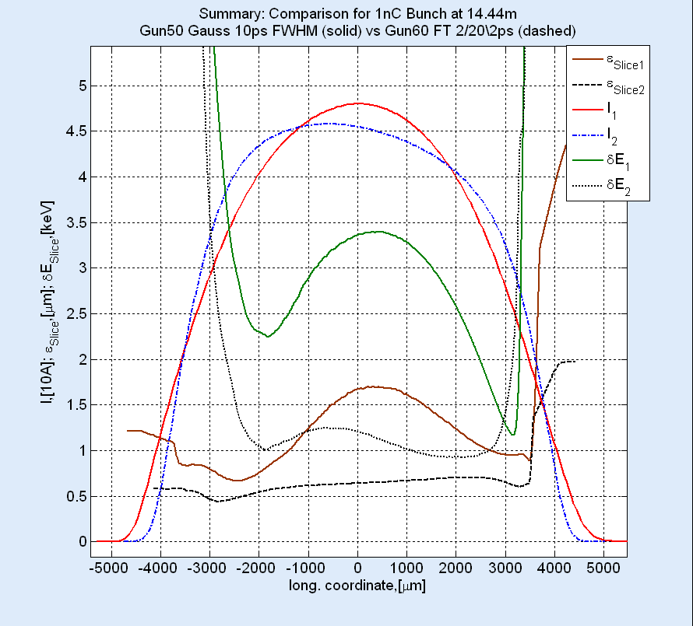
Operation with 1nC:
60MV/m Gun + FT 2/20\2ps vs 50MV/m Gun + Gauss 10ps FWHM
Charge |  |  | 1nC
Max electric field in the gun, [MV/m] |  |  | 50 | 60
Laser form |  |  | Gauss 10ps FWHM | FT 2/20\2 ps
WP | MaxB,[T] |  | 0.1891 | 0.2226
 | XYrms,[mm] |  | 0.505 | 0.440
ε^{pr}_{s=14.44m}, [mrad] |  |  | 1.887 | 0.7091
ε^{sl,peak}_{s=14.44m}, [mrad] |  |  | 1.681 | 0.629
ε^{sl,av}_{s=14.44m}, [mrad] |  |  | 1.271 | 0.634
ε^{sl,min}_{s=14.44m}, [mrad] |  |  | 0.665 | 0.439
ε^{sl,max}_{s=14.44m}, [mrad] |  |  | 1.698 | 0.704
δE^{sl,peak},rms [keV] |  |  | 3.36 | 1.1
Ip, [A] |  |  | 48.0 | 45.8
τ rms, [mm] |  |  | 2.054 | 2.048
Beam optical functions after 1st accelerating module |  | β,[m] | 20.49 | 8.729
 |  | α | -2.535 | 0.030
+166% projected emittance growth
+167% growth of emittance at the current peak
+100% average slice emittance growth
Equal rms bunch length

Slide 17
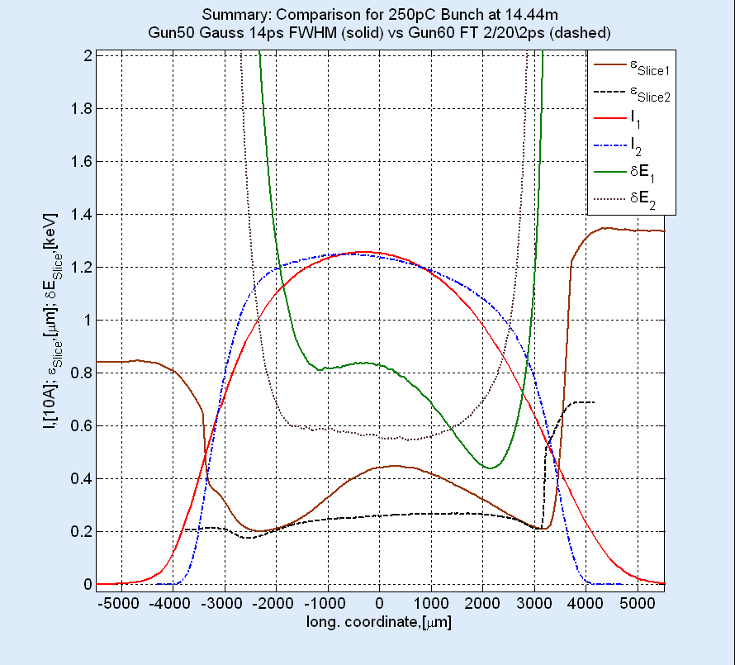
Operation with 250pC:
60MV/m Gun + FT 2/20\2ps vs 50MV/m Gun + Gauss 14ps FWHM
Charge |  |  | 250pC
Max electric field in the gun, [MV/m] |  |  | 50 | 60
Laser form |  |  | Gauss 14ps FWHM | FT 2/20\2 ps
WP | MaxB,[T] |  | 0.1884 | 0.2220
 | XYrms,[mm] |  | 0.2175 | 0.180
ε^{pr}_{s=14.44m}, [mrad] |  |  | 0.435 | 0.298
ε^{sl,peak}_{s=14.44m}, [mrad] |  |  | 0.430 | 0.252
ε^{sl,av}_{s=14.44m}, [mrad] |  |  | 0.353 | 0.246
ε^{sl,min}_{s=14.44m}, [mrad] |  |  | 0.201 | 0.175
ε^{sl,max}_{s=14.44m}, [mrad] |  |  | 0.447 | 0.268
δE^{sl,peak},rms [keV] |  |  | 0.838 | 0.575
Ip, [A] |  |  | 12.56 | 12.47
τ rms, [mm] |  |  | 1.972 | 1.884
Beam optical functions after 1st accelerating module |  | β,[m] | 21.45 | 42.13
 |  | α | -1.755 | -2.305
+46.0% projected emittance growth
+70.6% growth of emittance at the current peak
+43.5% average slice emittance growth

Slide 18
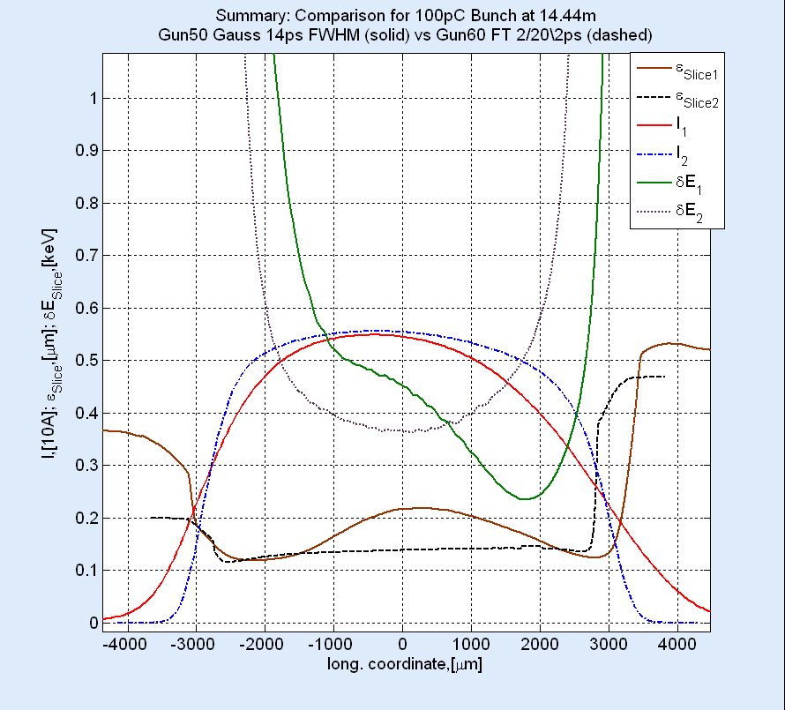
Operation with 100pC:
60MV/m Gun + FT 2/20\2ps vs 50MV/m Gun + Gauss 14ps FWHM
Charge |  |  | 100pC
Max electric field in the gun, [MV/m] |  |  | 50 | 60
Laser form |  |  | Gauss 14ps FWHM | FT 2/20\2 ps
WP | MaxB,[T] |  | 0.1880 | 0.2218
 | XYrms,[mm] |  | 0.128 | 0.133
ε^{pr}_{s=14.44m}, [mrad] |  |  | 0.247 | 0.1945
ε^{sl,peak}_{s=14.44m}, [mrad] |  |  | 0.204 | 0.137
ε^{sl,av}_{s=14.44m}, [mrad] |  |  | 0.179 | 0.138
ε^{sl,min}_{s=14.44m}, [mrad] |  |  | 0.119 | 0.116
ε^{sl,max}_{s=14.44m}, [mrad] |  |  | 0.219 | 0.143
δE^{sl,peak},rms [keV] |  |  | 0.476 | 0.367
Ip, [A] |  |  | 5.49 | 5.56
τ rms, [mm] |  |  | 1.815 | 1.647
Beam optical functions after 1st accelerating module |  | β,[m] | 38.47 | 39.5
 |  | α | -2.425 | -2.013
+27% projected emittance growth
+48.9% growth of emittance at the current peak
+29.7% average slice emittance growth
Different rms bunch length

Slide 19
Summary: Operation
Gun60 FT 2/20\2ps vs Gun50 Gaussian 14ps FWHM
Table: Change of some bunch parameters if the peak electric field of the gun is reduced from 60MV/m to 50MV/m and the Laser pulse profiles is changed from Flat Top 2/20\2ps to Gaussian.
Bunch Charge | 1nC |  | 250pC | 100pC
Laser Pulse Length FWHM, [ps] | 14 | 10 | 14 | 14
Δε^{pr}, [%] | 112 | 166 | 46.0 | 27.0
Δε^{sl,peak},[%] | 115 | 167 | 70.6 | 48.9
Δε^{sl,av}, [%] | 67.8 | 100 | 43.5 | 29.7
Δ(δE)^{sl,peak}, [%] | 150 | 205 | 45.7 | 29.7
Δτ rms, [%] | 16.4 | 0.3 | 4.7 | 10.2

Slide 20
Reduced Gun Simulations
1. Comparison Gun60 vs Gun50, Flat Top Laser Pulse
2. Comparison for the worst case: Gun50+Gauss Laser Pulse
3. Summary and Outlook

Slide 21
Summary
1. Comparison for 60MV/m Gun + FT 2/20\2 vs 50MV/m Gun + FT 2/20\2 done
→ 50MV/m Gun most probably fits the claimed design parameters of the beam
2. Comparison for 60MV/m Gun + FT 2/20\2 vs 50MV/m Gun + Gauss 14 ps FWHM
done for 1nC, 250pC and 100pC bunch charges
→ severe emittance growth for the nominal design bunch charge of 1nC.
doesn’t fit any more in the claimed design parameters of the beam.
→ different bunch length. Gaussian pulse must be shorter than 14ps FWHM
to produce the bunch of the same length as in the flat top case
Outlook
Finish comparison for the “worst case”: 500pC bunch charge,
equal bunch length at the exit
2. Implement the laser pulse form received from the laser group.

