Slide 1
Current Status of XFEL Simulations
Yauhen Kot
25.02.2013

Slide 2
2D Injector Scan vs MaxB1 and XYrms. Whole bunch
Tested and evaluated on the pair 250pC and 500pC
2D Scan for Q1 = 0.250 and for Q2= 0.500nC
vs MaxB1 and XYrms
Particles= 100000, Particles pro slice = 2500;
bounds set to -5 5
Nrad = 24 Nlong_in = 64
without selffields
Calculations done with …mpigo run 100 …/astra_r421_Linux_x86_64_OpenMPI_1.4.3_dyn
Xfel.in (input file)
FILE_EFieLD(1)='FLASHgun_p12.dat'
Nue(1)=1.3, MaxE(1) = 60 Phi(1) = -1.9
C_pos(1)=0.0,
FILE_EFieLD(2)='tesla4cav.dat'
Nue(2)=1.3 MaxE(2) = 36.2623 Phi(2) = 0
C_pos(2)=4.0401
FILE_EFieLD(3)='tesla4cav.dat'
Nue(3)=1.3 MaxE(3) = 36.2623 Phi(3) = 0
C_pos(3)=9.5745
ZStop=14.45 (entrance first quad)
Final energy=163.12MeV
generator
Lt=20.0E-3 rt=2.0E-3
Dist_pz=i Dist_x=r Dist_px=r LE=0.001
WP. No compression
MaxB1, T | XYrms, mm | ε₂₅₀ | ε₅₀₀ | ξ_{250/◊500} | penalty | ε_{250_1σ} | ε_{500_1σ} | ξ_{250/◊500_1σ}
0.2225 | 0.2895 | 0.5596 | 0.5045 | 1.1325 | 1.3378 | 0.3501 | 0.4746 | 1.6097

Slide 3
Scan for 250/500pC vs MaxE_ACC1 and Phase_ACC1: Whole Bunch
MaxB1=0.2225, XYrms=0.289
→ Operational Window: MaxE_ACC1 x Phi_ACC1 = [28.0:39.0+] x [0.0:25.0]

Slide 4
Scan for 250/500pC vs MaxE_ACC1 and Phase_ACC1: Peak Current
MaxB1=0.2225, XYrms=0.289
→ Operational Window: MaxE_ACC1 x Phi_ACC1 = [29.0:35.0] x [0.0:18.0]

Slide 5
Scan for 250/500pC vs MaxE_ACC1 and Phase_ACC1: 1σ-Core
MaxB1=0.2225, XYrms=0.289
Operational Window: MaxE_ACC1 x Phi_ACC1 = [29.0:35.0] x [0.0:18.0]
Core is quite well represented by the Peak Current

Slide 6
Scan vs MaxE_ACC1 and Phase_ACC1
MaxB1=0.2225, XYrms=0.289
Peak Current
Whole Bunch
Peak Current: larger betas but small slice emittance

Slide 7
Estimations for RFs: 500pC
Inputs:
Energy Profile 135-650-2300-17500MeV
R56: 70 - 53 - 37 mm
Compression: 3.0 – 10.0 – 650
e0ss and e0sss: 0.363 – 1.5
for symmetric BC
RF settings from RF Tweak
Section | Max. Energy Gain, MeV | Max. Field, MeV/m | Phase
ACC1 | 154.5 | 35.69 | 11.25
ACC39 | 22.04 | 15.30 | 16.60
L1 | 551.9 | 31.89 | 19.52
L2 | 2084 | 40.14 | 37.6

Slide 8
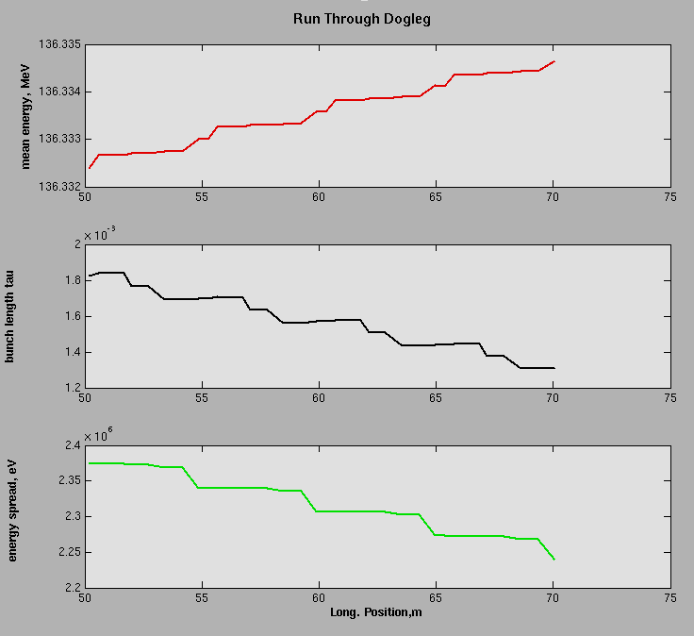
Dogleg Correction
Bunch length changes from 1.831 to 1.314mm (rms)
Compression of 1.39
BC0 Compression = 3.0/1.39=2.16
Compression Schema: 1.39 – 3.0 – 10.0 -650
BC0
BC1
BC2
→

Slide 9
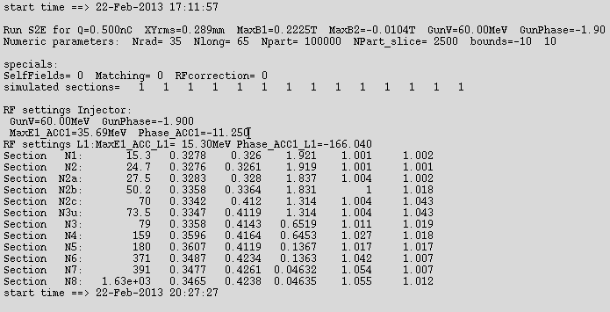
S2E: 500pC No Self Fields but with Compression. (Combined WP with 250pC)
Optics without significant mismatch
Peak Current Ip=5.1kA (single spike)
Slice Emittance in core: ε=0.28μm

Slide 10
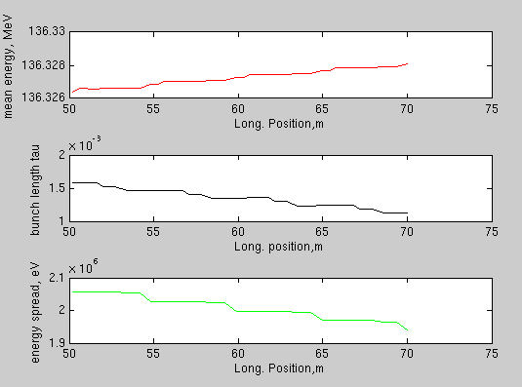
S2E: 250pC No Self Fields but with Compression. (Combined WP with 500pC)
→ Match kept for basic case also for 250pC

Slide 11
250pC. Combined WP with 500pC without Self Fields
Peak Current Ip=2.7kA (single spike)
Slice Emittance in Core: ε=0.15μm

Slide 12
Bunch Cores Mismatch. 250/500pC
@s=1630m
 | Design |  | 500pC |  |  | 250pC
 | β | α | β | α | ξ | β | α | ξ | ξ(250/500)
x | 34.8 | -0.54 | 60.1 | 0.02 | 1.42 | 16.0 | 0.54 | 1.99 | 2.55
y | 122 | 1.88 | 63.9 | 0.76 | 1.26 | 266 | 2.27 | 2.09 | 2.30

Slide 13
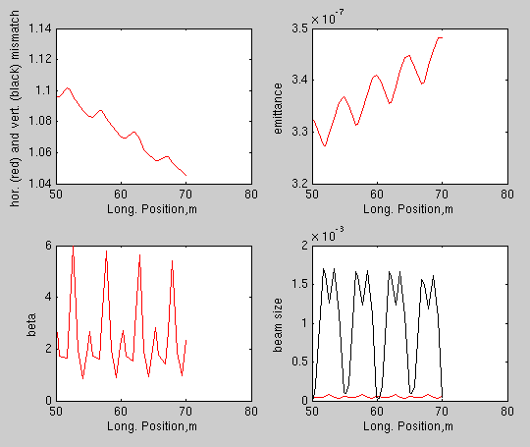
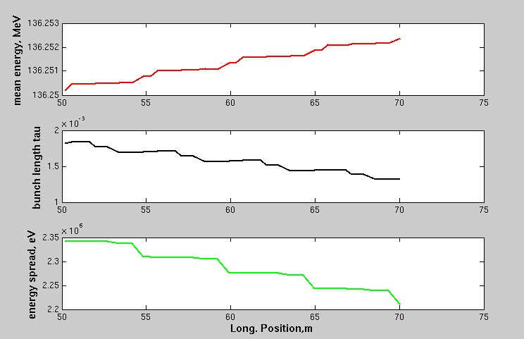
S2E: 500pC With Self Fields. (Combined WP with 250pC)
Matching disturbed (but not critical)
Vertical emittance blow up in BC2 (to be understood)

Slide 14
First SASE Simulations for 500pC. No lasing.
500pC with Self Fields
500pC No Self Fields

Slide 15
Ongoing Tasks/Open Questions
Correct Compression Schema/SASE Simulations
Why emittance blow up at BC2?
Combined WP for Cores
Documentation Case 250/500pC
Runs with two Injector Laser Systems

Slide 16
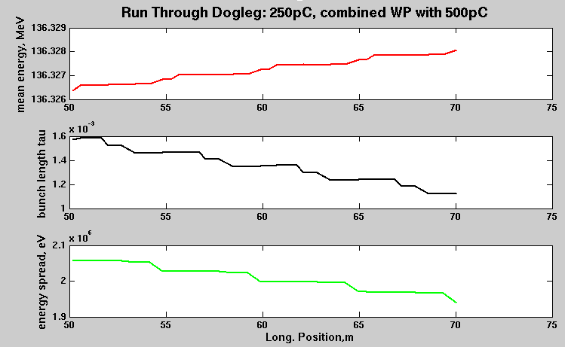
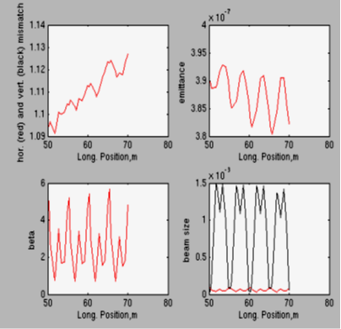

Slide 17
start time ==> 24-Feb-2013 12:27:47
Run S2E for Q=0.500nC XYrms=0.289mm MaxB1=0.2225T MaxB2=-0.0104T GunV=60.00MeV GunPhase=-1.900
Numeric parameters: Nrad= 35 Nlong= 65 Npart= 100000 NPart_slice= 2500 bounds=-10 10
specials:
SelfFields= 1 Matching= 0 RFcorrection= 0
simulated sections= 1 1 1 1 1 1 1 1 1 1 1 1 1 1
RF settings Injector:
GunV=60.00MeV GunPhase=-1.900
MaxE1_ACC1=35.69MeV Phase_ACC1=-11.250
RF settings L1:MaxE1_ACC_L1= 15.30MeV Phase_ACC1_L1=-166.040
Section N1: 15.3 0.3278 0.326 1.921 1.001 1.002
Section N2: 24.7 0.3228 0.3311 1.919 1.042 1.008
Section N2a: 27.5 0.3247 0.3337 1.838 1.068 1.008
Section N2b: 50.2 0.3323 0.3383 1.833 1.096 1.042
Section N2c: 70 0.3483 0.4246 1.322 1.046 1.032
Section N3u: 73.5 0.3548 0.4235 1.322 1.067 1.02
Section N3: 79 0.3548 0.4032 0.668 1.066 1.001
Section N4: 159 0.367 0.5659 0.6615 1.269 1.763
Section N5: 180 0.3666 0.5523 0.1552 1.446 1.718
Section N6: 371 0.3844 0.6196 0.1549 1.283 1.785
Section N7: 391 0.3867 2.151 0.03131 1.319 1.198
Section N8: 1.63e+03 0.4863 2.548 0.03133 1.088 1.077
start time ==> 24-Feb-2013 19:21:47

Slide 18
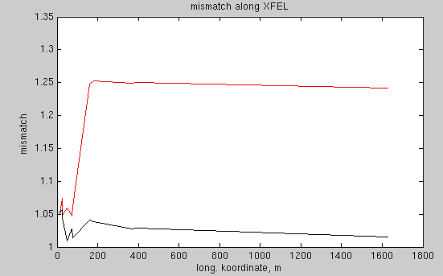
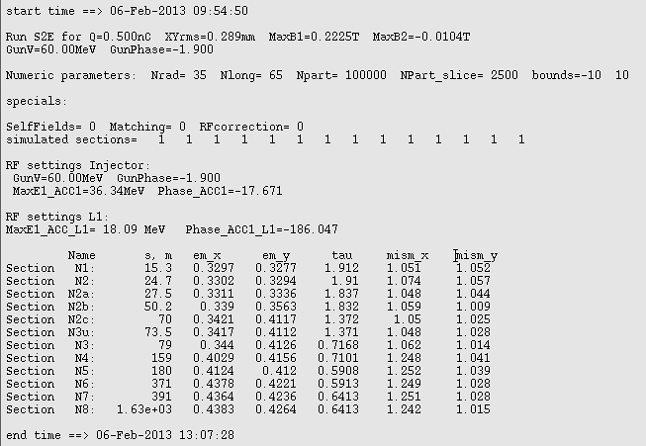
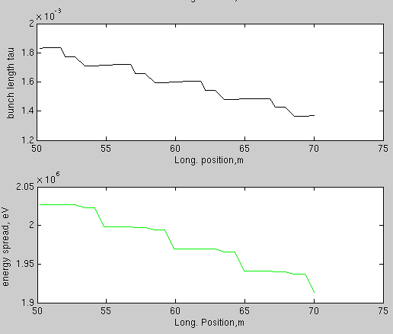
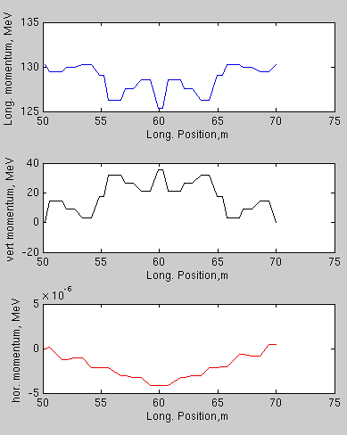
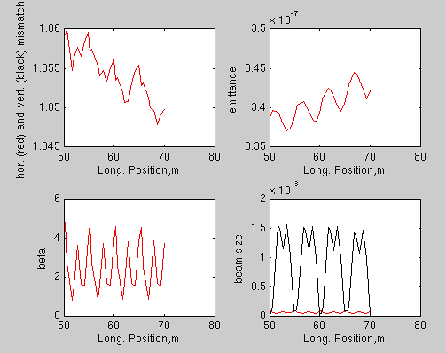
S2E with 500pC

