Slide 1
Charge and Bunch Length Scope
Compression Scenarios for the European XFEL
Igor Zagorodnov
1st Meeting of the European XFEL Accelerator Consortium
DESY, MPY
14. April 2012

Slide 2
Inhalt
Analytical and Numerical Approaches
Compression Scenarios for Different Charges
Strong Compression
Summary

Slide 3
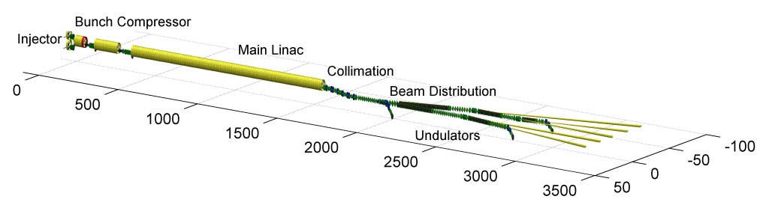
Analytical and Numerical Approaches
Layout

Slide 4
Analytical and Numerical Approaches
Working points (11 macro-parameters)
What is the optimal choice?
Zagorodnov I., Dohlus M., A Semi-Analytical Modelling of Multistage Bunch Compression with Collective Effects, Phys. Rev. ST Accel. Beams, 2011.

Slide 5
Analytical and Numerical Approaches
Choosing of machine parameters
very strong compression
at the bunch head (spike)

Slide 6
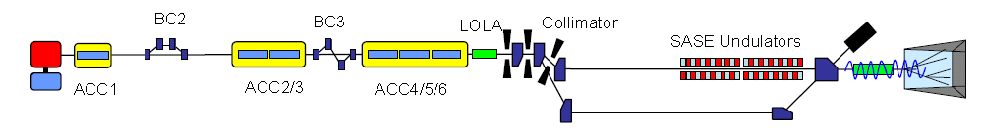
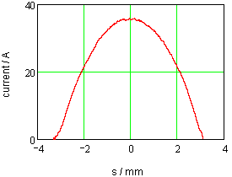
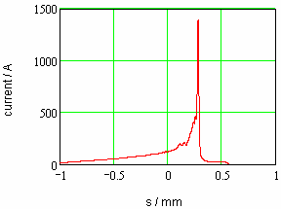
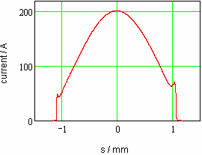
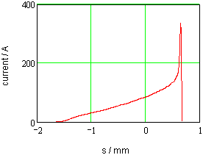
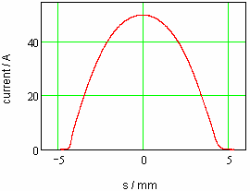
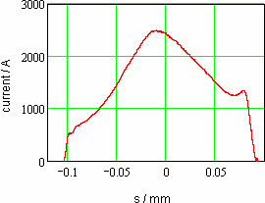
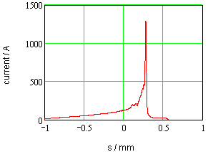
Analytical and Numerical Approaches
Rollover Compression vs. Linearized (FLASH)
Q=0.5 nC
~ 1.5 kA
slice emittance > 2μm
Q=1 nC
~2.5 kA
slice emittance ~ 0.3 - 1μm

Slide 7
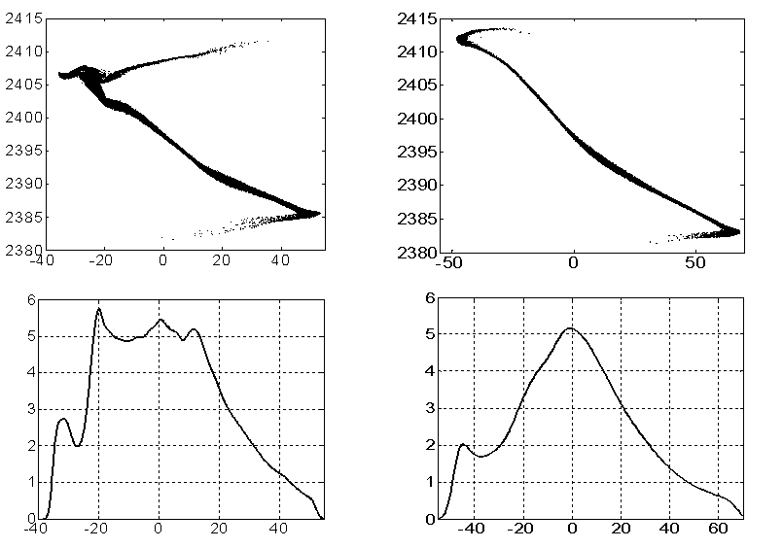
Analytical and Numerical Approaches
Q=1 nC

Slide 8
Analytical and Numerical Approaches
Analytical solution without self-fields
Solution with self-fields
nonlinear operator
(tracking with self-fields)
numerical tracking
residual in
macroscopic
parameters
Zagorodnov I., Dohlus M., A Semi-Analytical Modelling of Multistage Bunch Compression with Collective Effects, Phys. Rev. ST Accel. Beams, 2011.
analytical correction
of RF parameters

Slide 9
Analytical and Numerical Approaches
Beam dynamics simulation
Full 3D simulation method (200 CPU, ~10 hours)
W₁
TM
W₃
4W₁
TM
12W₁
TM
64W₁
ASTRA ( tracking with 3D space charge, DESY, K. Flötmann)
CSRtrack (tracking through dipoles, DESY, M. Dohlus, T. Limberg)
W1 -TESLA cryomodule wake (TESLA Report 2003-19, DESY, 2003)
W3 - ACC39 wake (TESLA Report 2004-01, DESY, 2004)
TM - transverse matching to the design optics

Slide 10
Compression for Different Charges
Q=1 nC
Phase space
Current, emittance, energy spread
bunch head

Slide 11
Compression for Different Charges
Q=250 pC
Phase space
Current, emittance, energy spread
bunch head

Slide 12
Compression for Different Charges
Q=20 pC
Phase space
Current, emittance, energy spread

Slide 13
Compression for Different Charges
Beam parameters from S2E simulations
Parameter | Unit
Bunch charge | nC | 1 | 0.5 | 0.25 | 0.1 | 0.02
Peak current (gun) | A | 43 | 24 | 13.5 | 5.7 | 1.2
Bunch length (gun, FWHM) | ps | 25 | 22 | 20 | 17 | 17
Slice emittance (gun) | μm | 0.8 | 0.5 | 0.3 | 0.21 | 0.09
Projected emittance (gun) | μm | 1 | 0.7 | 0.6 | 0.3 | 0.1
Compression |  | 114 | 233 | 363 | 877 | 3833
Peak current | kA | 4.9 | 5.6 | 4.9 | 5 | 4.6
Bunch length (FWHM) | fs | 178 | 72 | 39 | 12 | 2.2
Slice emittance | μm | 1 | 0.7 | 0.5 | 0.3 | 0.17
Projected emittance | μm | 3.5 | 2.2 | 1.5 | 0.84 | 0.26
Slice energy spread (laser heater off) | MeV | 0.45 | 0.44 | 0.6 | 0.6 | 0.8

Slide 14
Compression for Different Charges
Radiation Q=1nC. SASE
ALICE
ALICE
Genesis
Genesis
Zagorodnov I., Dohlus M., Numerical FEL studies with a new code ALICE, in Proceedings of FEL09, Liverpool, 2009.

Slide 15
Compression for Different Charges
Radiation energy statistics (1-25-120 runs)
Mean energy
Radiation pulse width (RMS)
250 pC
1 nC
1 nC
250 pC
20 pC
20 pC
Charge, nC | 1 | 0.25 | 0.02
Mean radiation energy, mJ | 1-4 | 1-2 | 0.1-0.4
Pulse radiation width (FWHM), fs | 25-50 | 10-20 | 1-2

Slide 16
Compression for Different Charges
Radiation Properties from S2E
Bunch charge, nC | 1 | 0.25 | 0.02
Wavelength, nm | 0.1
Beam energy, GeV | 14
Peak current, kA | ~ 5
Slice emmitance,mm-mrad | 1 | 0.5 | 0.2
Saturation length, m | 85 | 60 | 45
Energy in the rad. pulse, mJ | 1-4 | 1-2 | 0.1-0.4
Radiation pulse duration FWHM, fs | 25-50 | 10-20 | 1-2
Averaged peak power, GW | 10-50 | 10-100 | 50-150
Spectrum width, % |  | 0.15-0.3 | 0.18-0.5

Slide 17
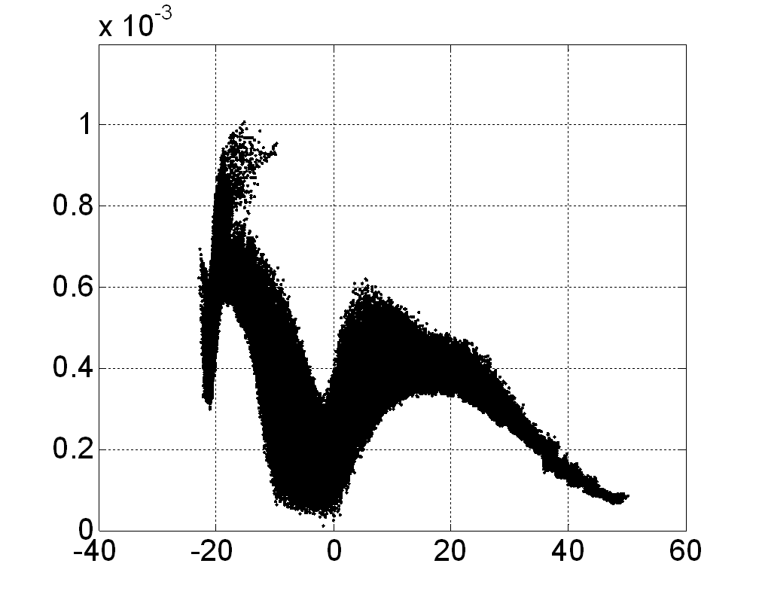
Strong Compression
Q=1 nC, I=10kA
Phase space
Current, emittance, energy spread

Slide 18
Strong Compression
Q=1 nC
Parameter | Unit
Bunch charge | nC | 1
Peak current (gun) | A | 43
Compression |  | 116 | 228
Peak current | kA | 5 | 9.8
Bunch length (FWHM) | fs | 178 | 75
Slice emittance | μm | 1 | 1
Projected emittance | μm | 3.5 | 8
Slice energy spread (laser heater off) | MeV | 0.45 | 1

Slide 19
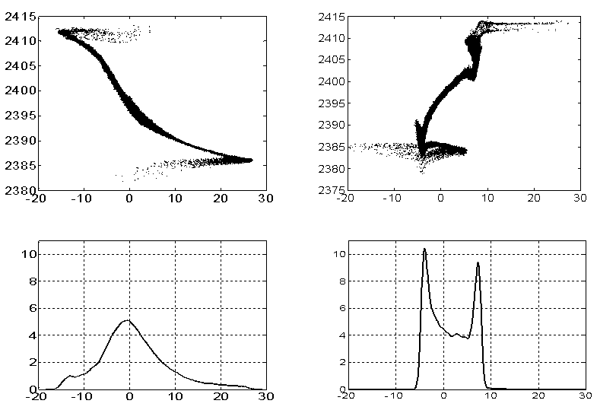
Strong Compression for 250 pC
R_{56,3}= -20 mm
R_{56,3}= -23.8 mm

Slide 20
Strong Compression for 250 pC
Macro-parameters
Momentum compaction factor in BC₁ R_{56,1}, [mm] | Compr. in BC₁ C₁ | Momentum compaction factor in BC₂ R_{56,2}, [mm] | Compr. in BC₂ C₂ | Momentum compaction factor in BC₃ R_{56,3}, [mm] | Total compr. C | Second derivative (C⁻¹)'', [m⁻²]
-78 | 3.5 | -50 | 8 | -20,…,-24 | 385 | 1000

Slide 21
Strong Compression for 250 pC
R_{56,3}=-20mm
Phase space
Current, emittance, energy spread

Slide 22
Strong Compression for 250 pC
R_{56,3} =-21 mm
Phase space
Current, emittance, energy spread

Slide 23
Strong Compression for 250 pC
R_{56,3} =-21.9 mm
Phase space
Current, emittance, energy spread

Slide 24
Strong Compression for 250 pC
R_{56,3} =-22.6 mm
Phase space
Current, emittance, energy spread

Slide 25
Strong Compression for 250 pC
R_{56,3} =-22.6 mm (70% of particles)
Phase space
Current, emittance, energy spread

Slide 26
Strong Compression for 250 pC
R_{56,3} =-23.2 mm (70% of particles)
Phase space
Current, emittance, energy spread

Slide 27
Strong Compression for 250 pC
Beam core parameters vs. R₅₆

Slide 28
Strong Compression for 250 pC
Beam core parameters vs. R₅₆

Slide 29
Strong Compression for 250 pC
Radiation energy vs. R₅₆ (with und. wake and taper)

Slide 30
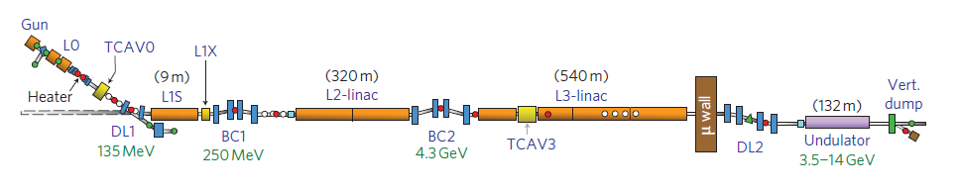
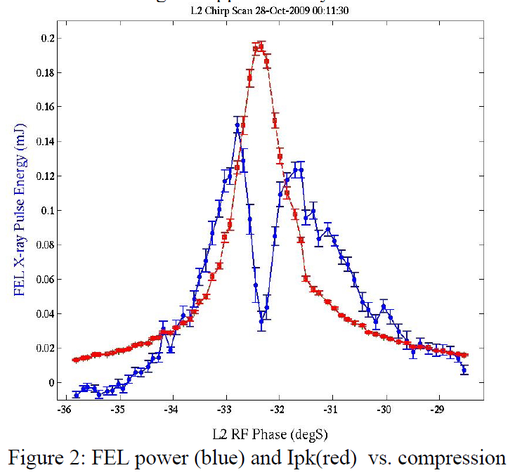
Strong Compression (SLAC)
Q=20 pC

Slide 31
Strong Compression for 250 pC
Radiation energy vs. compression rate

Slide 32
Strong Compression for 250 pC
Radiation energy vs. compression rate

Slide 33
Strong Compression for 250 pC
Radiation power vs. compression rate

Slide 34
Summary
Bunches with charge 20-1000 pC can be compressed to 5 kA and higher
Radiation energy drops down at “full” compression
Overcompression scenario can be used
Acknowledgements
to M.Dohlus and T.Limberg for many useful discussions

