Slide 1


LOLA Measurements vs. Beam Dynamics Simulations
Igor Zagorodnov
11.04.2011
DESY

Slide 2
Shift on 23.03.2011 (~3 hours afternoon)
Parameter
Q | 0.35-0.4 nC
E₁ | 150 MeV
Ө₁ | 18º
E₂ | 445 MeV
Ө₂ | 4.58º
E₃ | 665 MeV
On-crest phases
Parameter
φ₁₁ | 0º
φ₁₃ | 1.5º
φ₂ | -8º
φ₃ | -4.5º

Slide 3
On-crest
k_{s}=0.9256
k_{E} =1.1570
- an additional calibration of the measurement

Slide 4
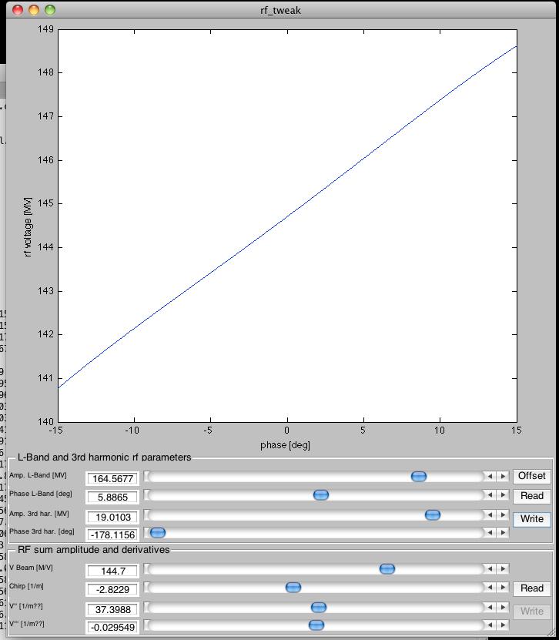
C=2.2
C₁ =1.9
C₂ =1.1

Slide 5
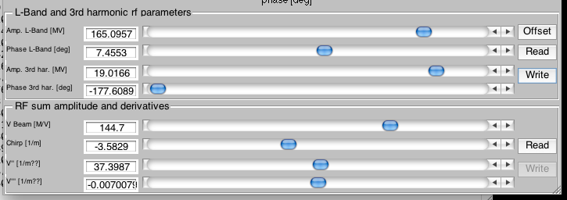
C=3.2
C₁ =2.6
C₂ =1.2

Slide 6
LOLA resolution increase. New Calibration.
C=3.2=2.6*1.2
k_{s}=0.9256
k_{E} =1.1570
- an additional calibration of the measurement

Slide 7
New additional calibration.
C=3.2=2.6*1.2
k_{s}=0.9256
k_{E} =1.1570
k_{s}=0.83
k_{E} =1.71

Slide 8
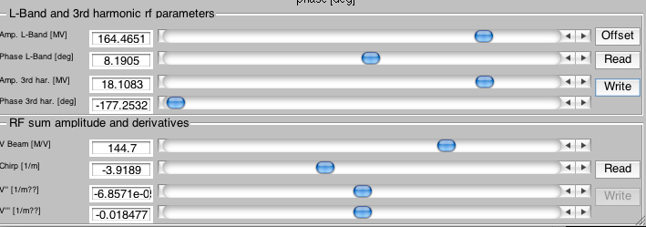
C=4.5=3.2*1.4

Slide 9
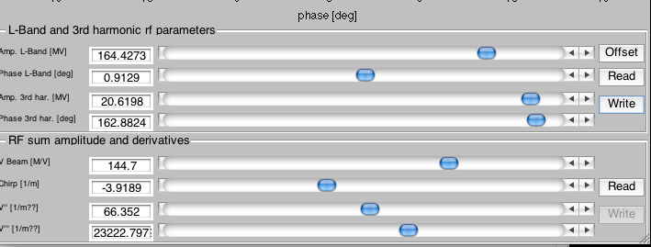
C=4.5=3.2*1.4

Slide 10
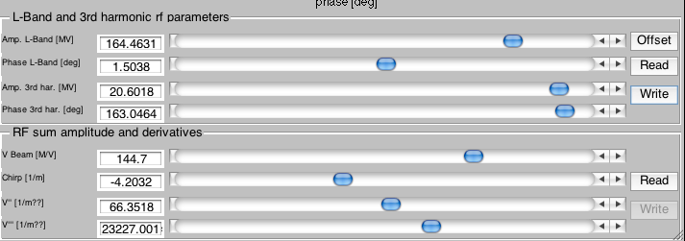
C=5.4=3.7*1.5

Slide 11
C=5.4=3.7*1.5
Without CSRtrack
With CSRtrack

Slide 12
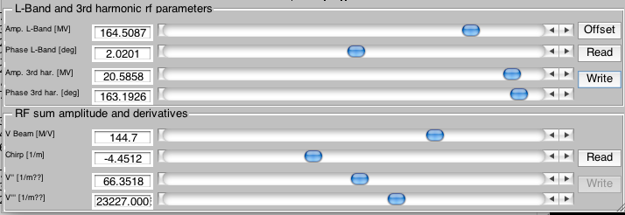
C=7.6=4.44*1.71
Without CSRtrack
With CSRtrack

Slide 13
Current profile?
I [A]
shot1
shot1
measurements
s [m]
I [A]
at LOLA
start
simulations
s [mm]

Slide 14
at LOLA
I [A]
I [A]
at LOLA
start
simul.
meas.
simulations
s [mm]
s [mm]

Slide 15
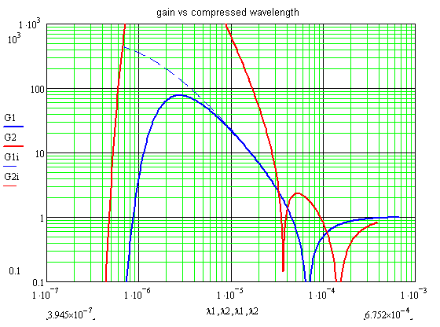
C=7.6=4.44*1.71
smooth current
new current

Slide 16
RF parameters?
V13=+0.9 MV
fi11=+0.3 deg

Slide 17
fi11=0 deg
fi11=+0.3 deg
V13=+0.9MV
RF parameters?
On-crest simulations
vs the measurement.

Slide 18
C=9.4=4.9*1.9
V13=+1.1 MV
fi11=-0.2 deg

Slide 19
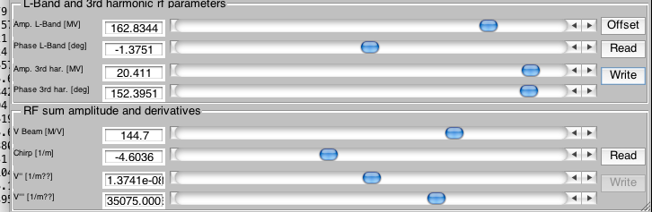
C=32=7.5*4.3
V13=+1.5 MV
fi11=-0.2 deg

