Slide 1
RF control and beam acceleration under XFEL conditions
Studies of XFEL-type Beam Acceleration at FLASH
Julien Branlard, Valeri Ayvazyan, Wojciech Cichalewski, Mariusz Grecki, Mathieu Omet, Sven Pfeiffer, Christian Schmidt, Nick Walker
DESY, 24.5.2015

Slide 2
Talk Outline
Motivation for the study
9mA study runs
Shift studies at FLASH (RF settings XFEL ≠ FLASH)
Shift outcome
Achievements from RUN1, RUN2, RUN3 and XFEL follow up study
Data analysis
Conclusions
Side effects (good and bad)
Tradeoff
Optimal Q_{L} ?

Slide 3
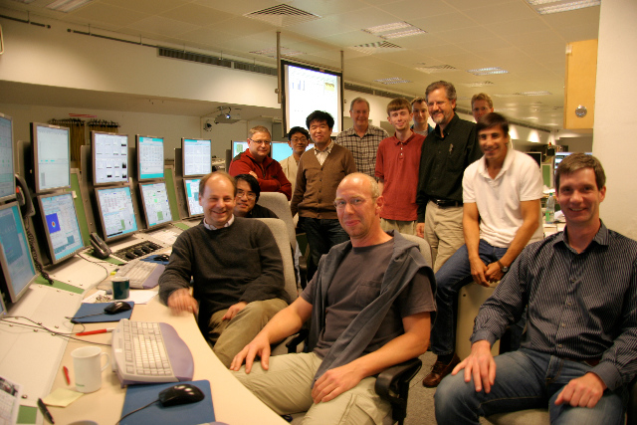
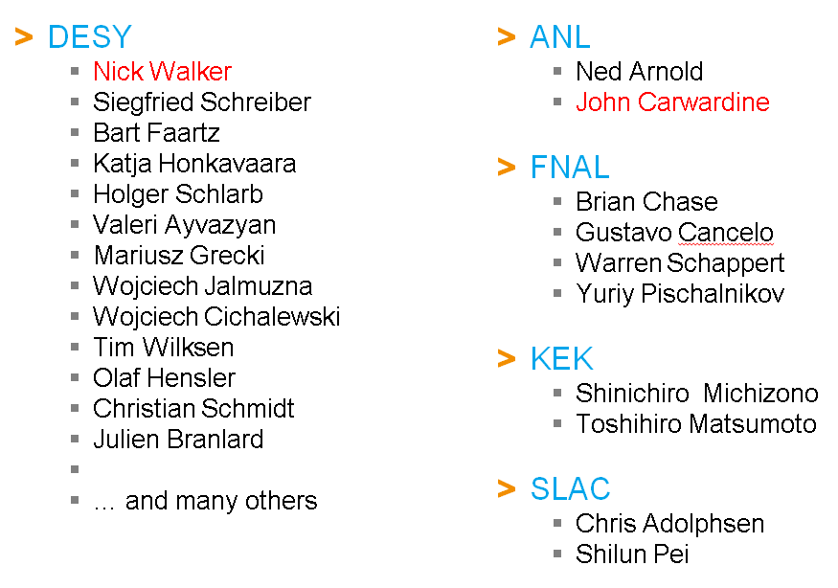
A bit of history…
FLASH seminar:
“ILC 9mA tests at FLASH“
02.07.2012

Slide 4
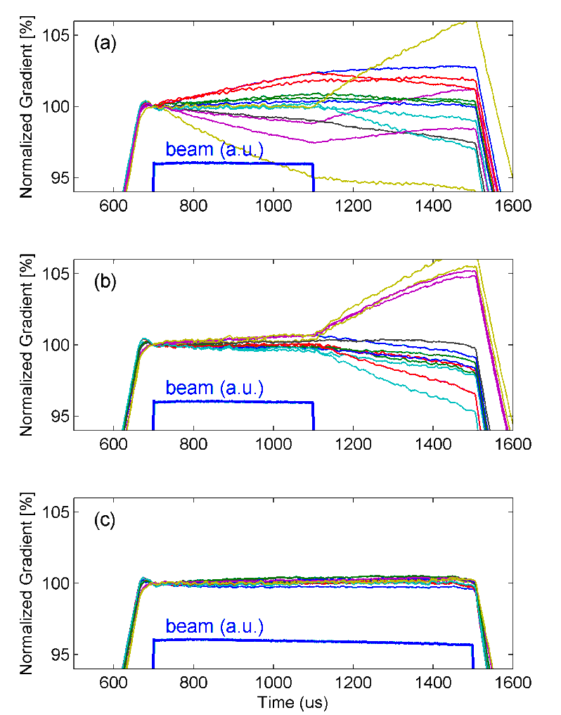
Short History of the “9mA run”, for the ILC
2007
Pushing towards long bunch trains and high beam currents
2009
9mA beam operation
Near quench operation
Beam loading induced gradient tilts
2011
First attempt at compensating gradient tilts using Q_{L}
2012
Ql studies
Quench studies
Power overhead studies
Q_{L} adjustment
longer bunch train

Slide 5
John Carwardine’s slides: Check-list of TD Phase accomplishments
Long bunch trains, heavy beam loading demonstration
6mA / 800us demonstrated ( TDR Baseline)
9mA / 800us marginally achieved (luminosity upgrade)
Vector Sum control of RF unit
Operation of RF units comprising 16 and 24 cavities
Intra- and inter-pulse stability better than 0.02%
Operating gradients
Operation up to average of 29MV/m (24MV/m to 33MV/m)
Lorentz-force detuning compensation on all cavities simultaneously
Pk/Ql control for optimizing gradient profiles
Demonstrated flat gradient solutions to +/-0.3%
ILC baseline has more knobs (power ratios), so easier
Operation close to quench
Operation of several cavities close to quench (5-10%) at 4.5mA, 800us
Quench detection / prevention and rapid recovery after quench
John Carwardine
GDE PAC: May 2012

Slide 6
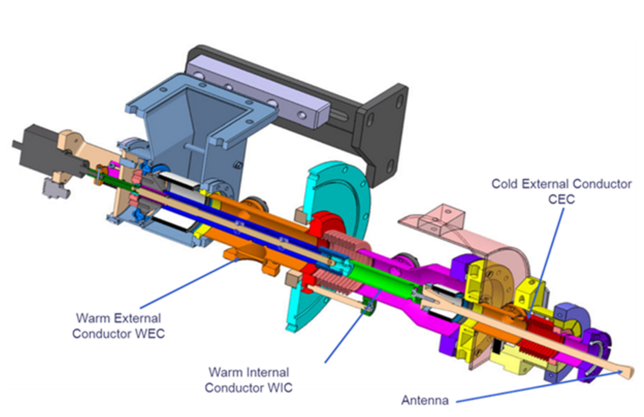
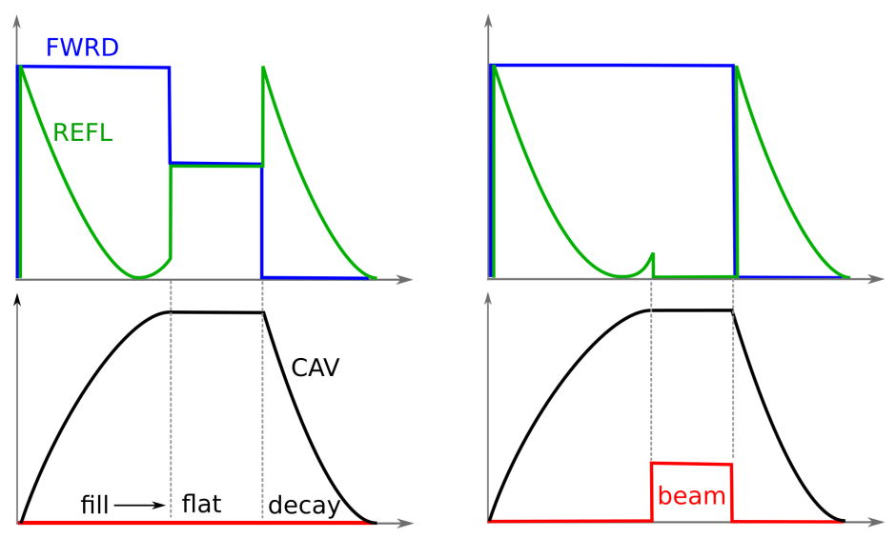
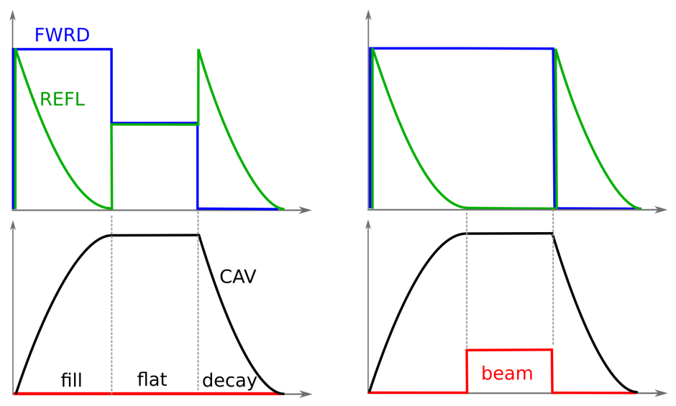
“What’s Q_{L} and why is it 3e6 at FLASH and 4.6e6 at XFEL ?”
Controls the input power coupling to the cavity
Higher Q_{L} → smaller bandwidth
Q_{L} = 3.0e6 BW = 433 Hz FLASH
Q_{L} = 4.6e6 BW = 283 Hz XFEL
Q_{L} impacts:
Power budget (cost)
Sensitivity to microphonics (performance)
Power overhead for FB controls (performance, cost)
How to choose Q_{L} ?
Match for nominal beam at nominal gradient
Facility | I_{BEAM} | Q_{L} | T_{FILL}
FLASH | 9.0 mA | 3.0e6 | 500 us
XFEL | 4.5 mA* | 4.6e6 | 750 us
* I_{BEAM}(nominal)= 1.35 mA

Slide 7
“XFEL-like” studies at FLASH
Investigate the impact of setting Q_{L} = 4.6x10⁶ instead of 3x10⁶
Impact on the cavity modes (i.e. 8π/9, 7π/9)
Impact on the RF control stability (i.e. dA/A, dPhi)
Impact on the multi-beamline control (FLASH1 / FLASH2)
Impact on the power budget
What is the “best” Q_{L} to operate the XFEL ?
Given the time constraints (modulator and klystron)
Given the moderate beam loading (XFEL I_{nom.} = 1.35 mA)
Simulation vs. experiment
Notes:
QL = 4,7e6 is matched conditions for 5 mA
Add motivation slide to explain the history of 4.6e6 in XFEL TDR… legitimate to ask if 4.6e6 still the optimal QL

Slide 8
“XFEL-like” studies at FLASH
RUN1: 2015.07.02 (afternoon and night shifts)
The goal of this study is to demonstrate the XFEL stability requirements (0.01 % in amplitude and 0.01 deg in phase), for XFEL nominal beam current (1–1.5 mA), and at an average accelerating gradient of 23.6 MV/m, using XFEL RF control parameters (Q_{L} = 4.6e6).
RUN2: 2015.11.16 (morning, afternoon and night shifts)
In this phase we would like to continue the studies already performed in July of this year, with the final goal of demonstrating multibeam operation with long pulses. Furthermore we would like to explore the option of pushing the beam currents higher in order to see stronger beam loading.
RUN3: 2016.01.28 (morning, afternoon and night shifts)
The goal of this study is to investigate in details the impact of changing Q_{L} and the fill time on the LLRF controller stability and the overall power budget. The impact of changing Q_{L} on the beam loading will also be investigated.

Slide 9
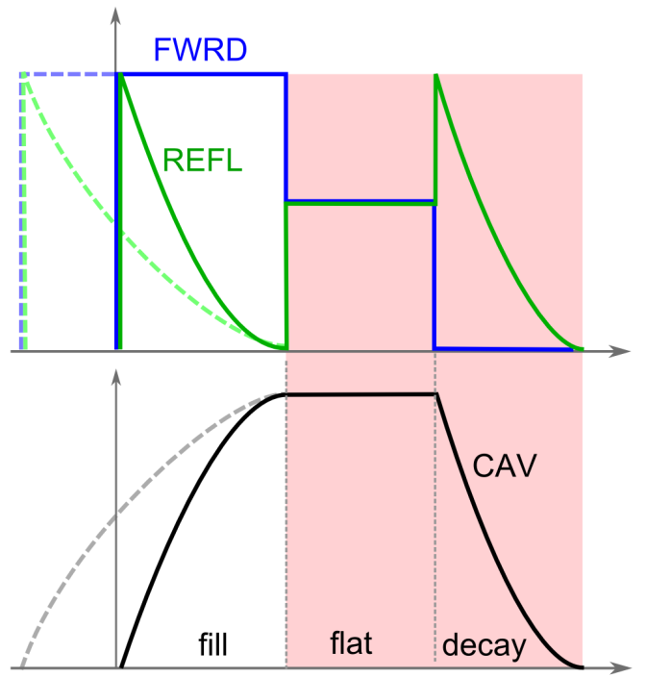
“XFEL-like” studies at FLASH
unchanged
LLRF setup
LLRF setup (changing Q_{L}, changing timing, connecting piezos: tunnel access)
Piezos: always need to bring back up system because not running routinely at FLASH
Only showed that we would be able to run with piezo but actually didn’t take measurement WITH piezos
Machine setup
High machine setup times (3 MHz x 5 Hz versus 1 MHz x 10 Hz)
Complications due to shifting to 3MHz → we stayed with same machine/laser rep rate in the last run (we “gave up” high current)
Beam setup
Transmission to 1 nC, problems above 1 nC
BEAM
Notes:
Piezos: always need to bring back up system because not running routinely at FLASH
Only showed that we would be able to run with piezo but actually didn’t take measurement WITH piezos
Complications due to shifting to 3MHz → we stay with same machine/laser rep rate in the last run (we “gave up” high current)

Slide 10
Talk Outline
Motivation for the study
9mA study runs
Shift studies at FLASH (RF settings XFEL ≠ FLASH)
Shift outcome
Achievements from RUN1, RUN2, RUN3 and XFEL follow up study
Data analysis
Conclusions
Side effects (good and bad)
Tradeoff
Optimal Q_{L} ?

Slide 11
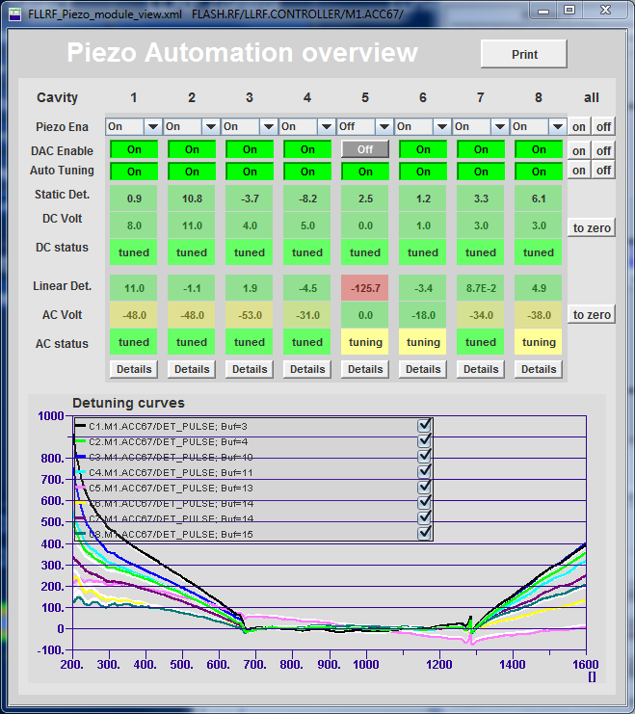
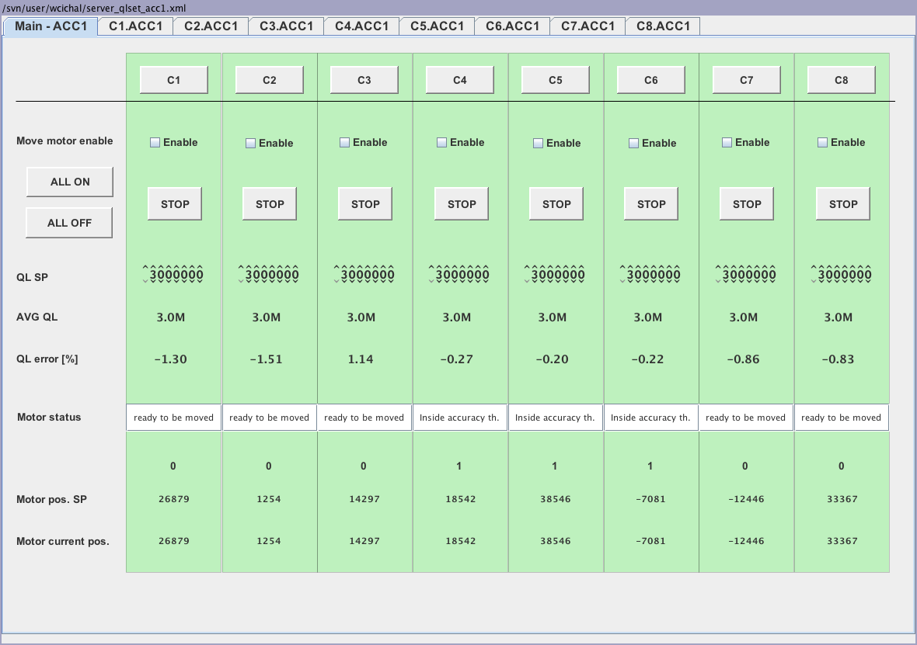
RUN1 achievements
Commissioning of the automatic Q_{L} adjustment software
Recommissioning of the piezo control and automation

Slide 12
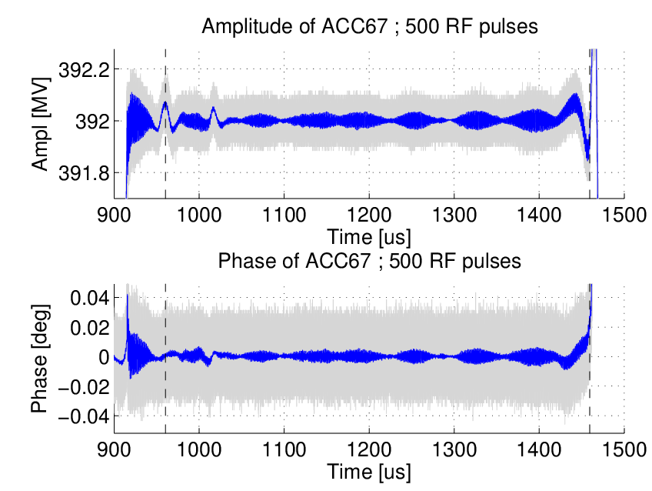
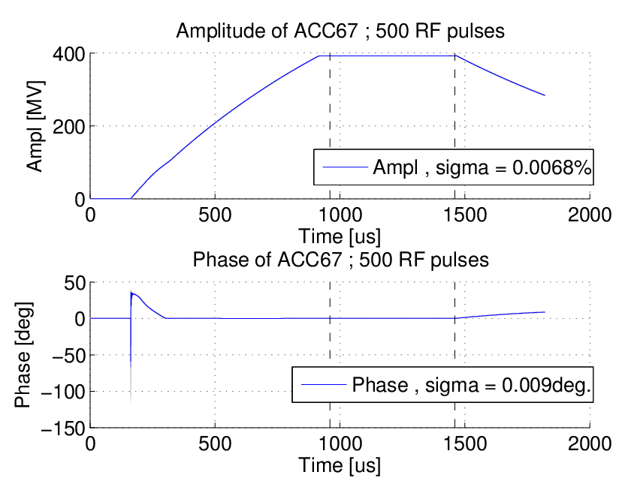
RUN1 achievements
Demonstration of XFEL stability requirements
with XFEL RF parameters
with low beam current
Amplitude of ACC67: 500 RF pulses (grey), average (blue)
XFEL specs: dA/A = 0.01%
dPhi = 0.01deg

Slide 13
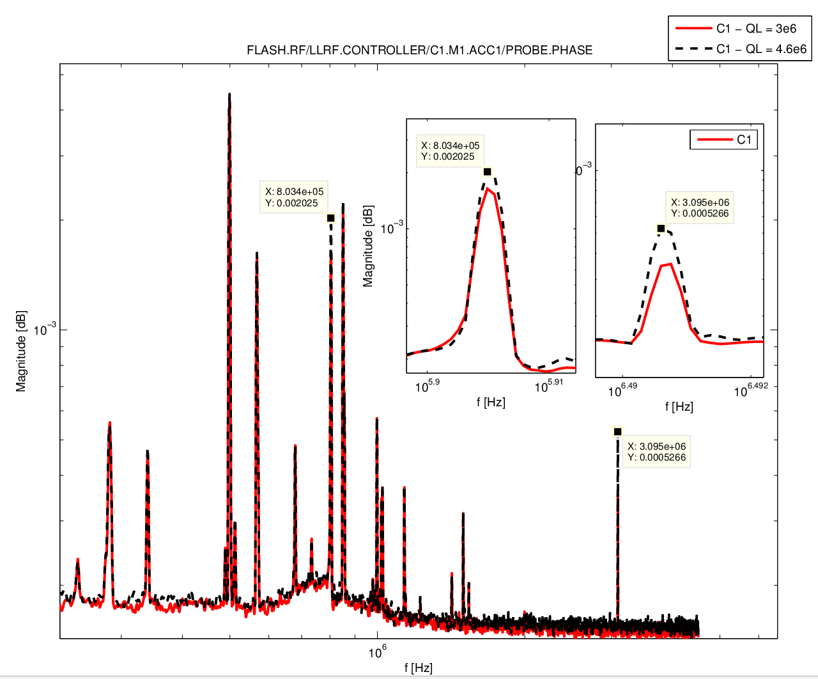
RUN1 achievements
Impact of changing Q_{L} on the single cavity modes
Note: ADC have been replaced since → many less spikes
Notes:
Repeat measurement with new ADC boards

Slide 14
RUN2 achievements
System identification with the new RF parameters (Q_{L} change)
@10kHz: OVC changes A/P driving signal
@7π/9 mode: spread of 7π/9 modes for VS?
Q_{L} = 3e6
Matches theory for single cavity
8π/9
7π/9
Q_{L} = 4e6
-0.4dB
+0.3dB
expected and observed model changes
Only minor system changes → MIMO controller adjustment is not necessary for ACC67
Depends on the RF system (location of passband modes in VS)
Notes:
@ 10kHz: higher Ql → larger fill-2-flat drop → different working point on the non-linear klystron curve

Slide 15
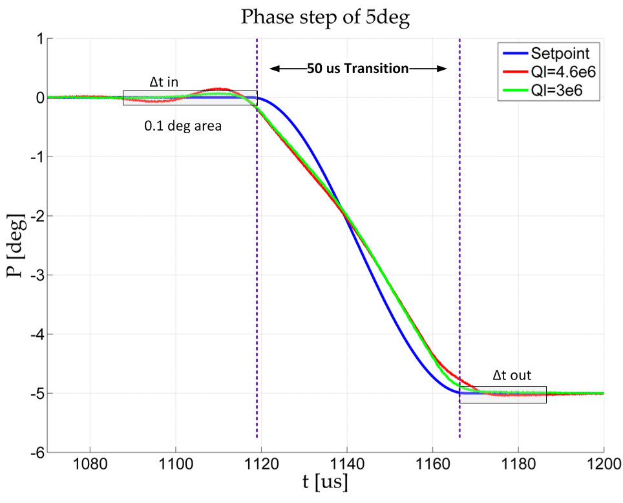
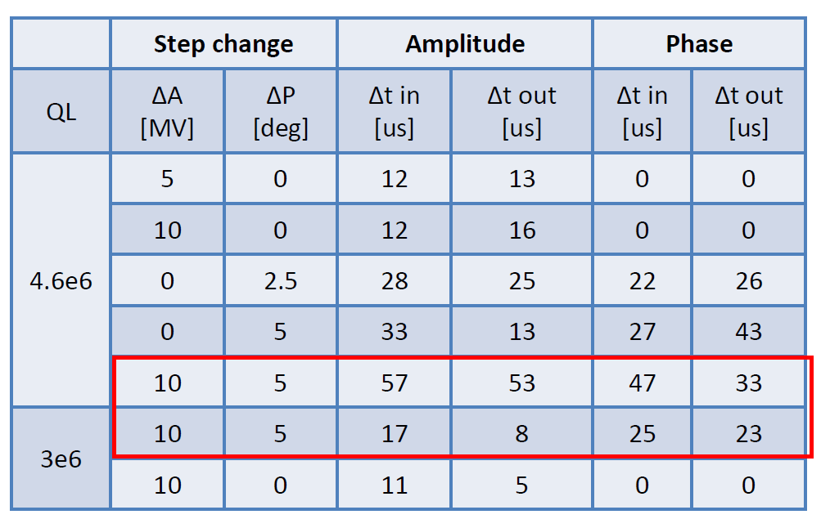
RUN2 achievements
Full beam transmission though FLASH I (1200 bunches) and FLASH II (30 bunches), 0.4 nC on-crest
Impact of changing Q_{L} on FLASH I - FLASH II transients
XFEL specs: 50 usec transition time
Notes:
Delta_t is the time the transient oscillations take to fall back within the XFEL specificiations (0,01%, 0.01deg) ON TOP of the allocated 50 usec ? Is this true ?

Slide 16
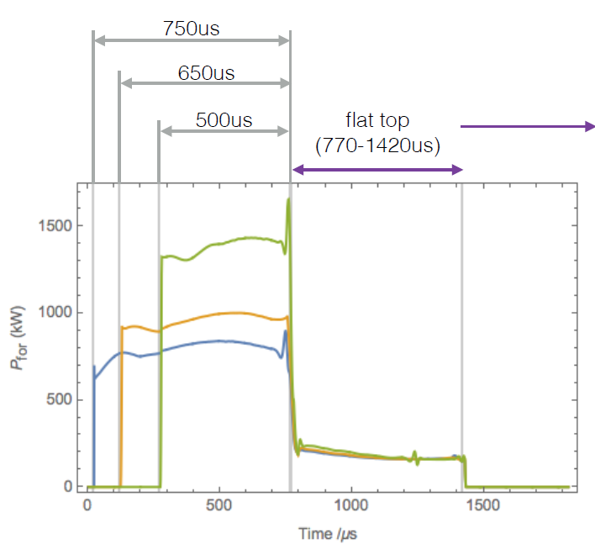
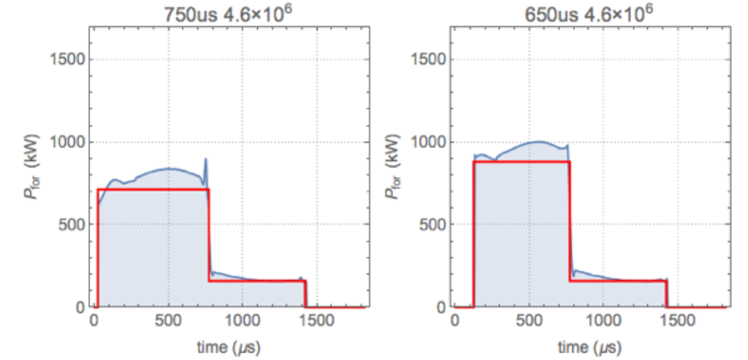
RUN3 achievements and follow up at XFEL A1.I1
Q_{L} and fill time parameter study
For each data point, measure:
controller performance with and without beam
total power usage (i.e. fill time + flat top) in closed-loop operation
T_{FILL} Q_{L} | 500 usec | 650 usec | 750 usec
2.0e6 | ✓ | ✓ | ✓
3.0e6 | ✓ | ✓ | ✓
4.0e6 | ✓ | ✓ | ✓
4.5e6 |  | ✓ | ✓
4.6e6 | ✓ | ✓ | ✓
2 data sets
beam ON (1nC) & beam OFF
experimental (FB)
ideal (FF)

Slide 17
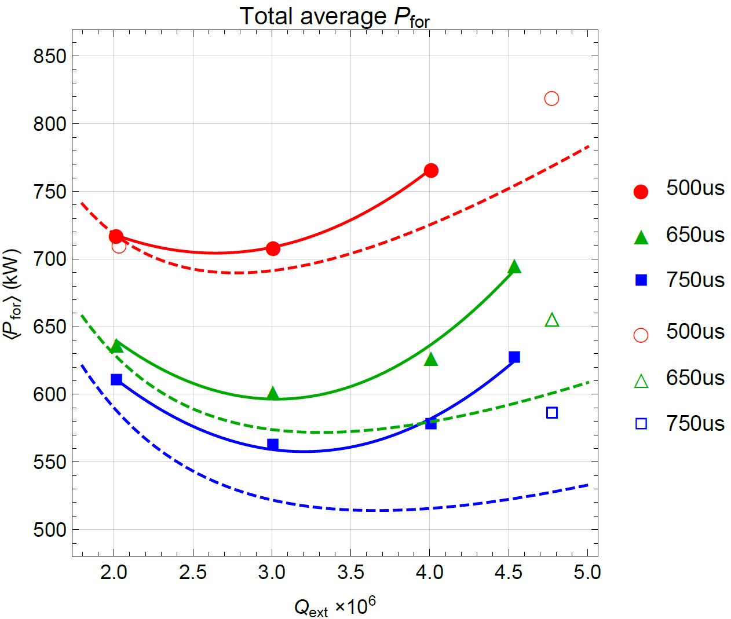
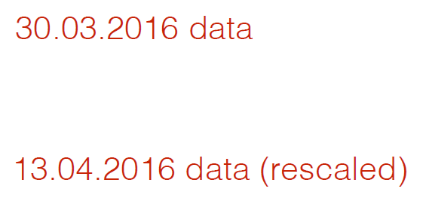
RUN3 achievements and follow up at XFEL A1.I1
Q_{L} and fill time on power budget
No beam
ideal case
quadratic fit

Slide 18
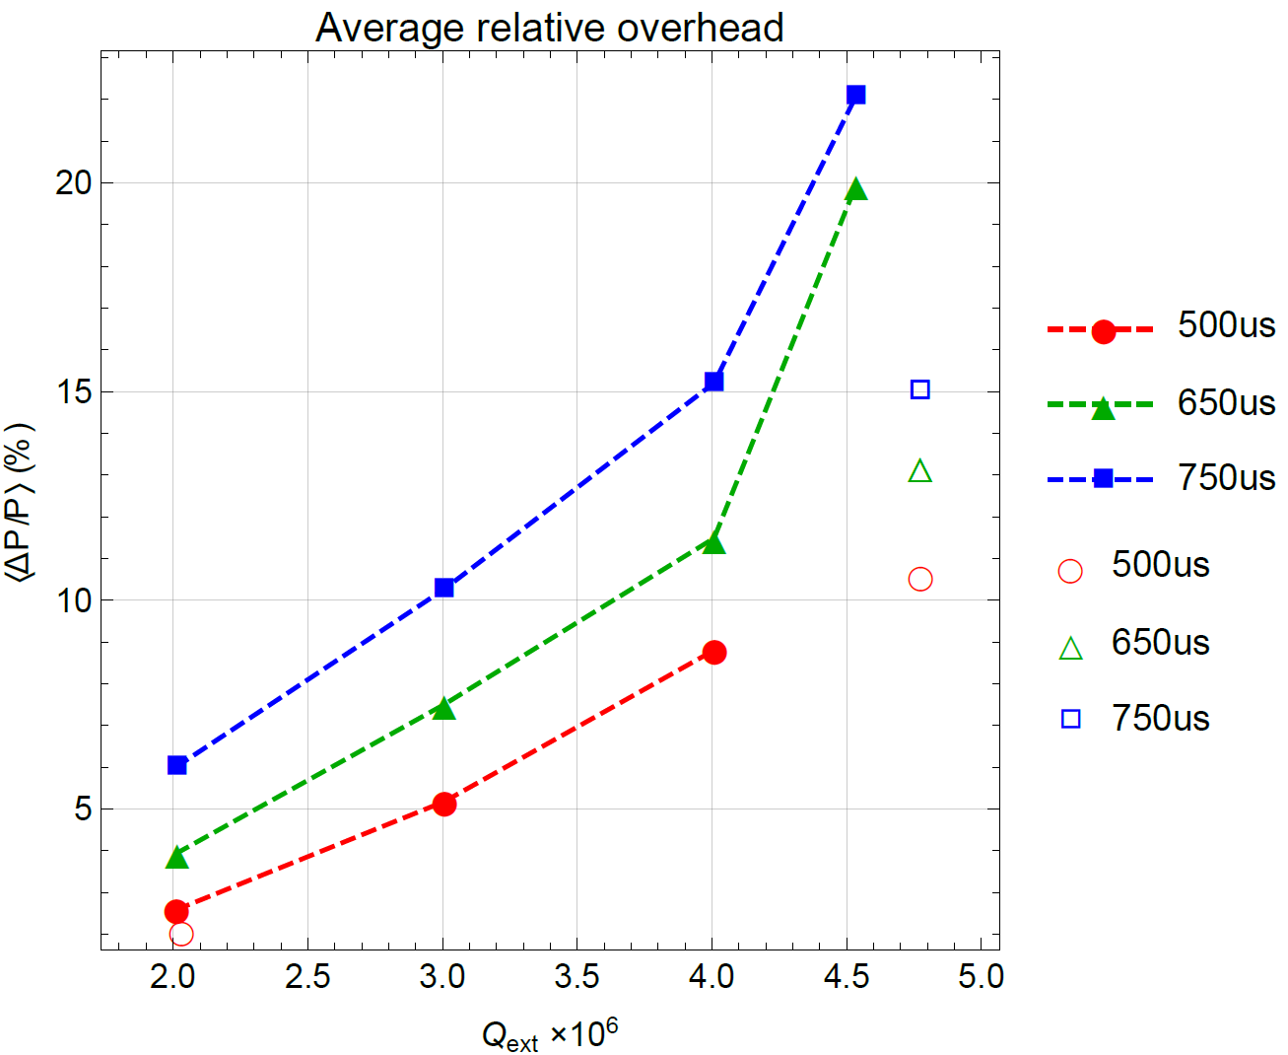
RUN3 achievements and follow up at XFEL A1.I1
Q_{L} and fill time on power budget (continued)
No beam
first data points of the day
Power overhead is defined as the relative difference between the measured data and the idea value
increase with fill time
increase with Q_{L}

Slide 19
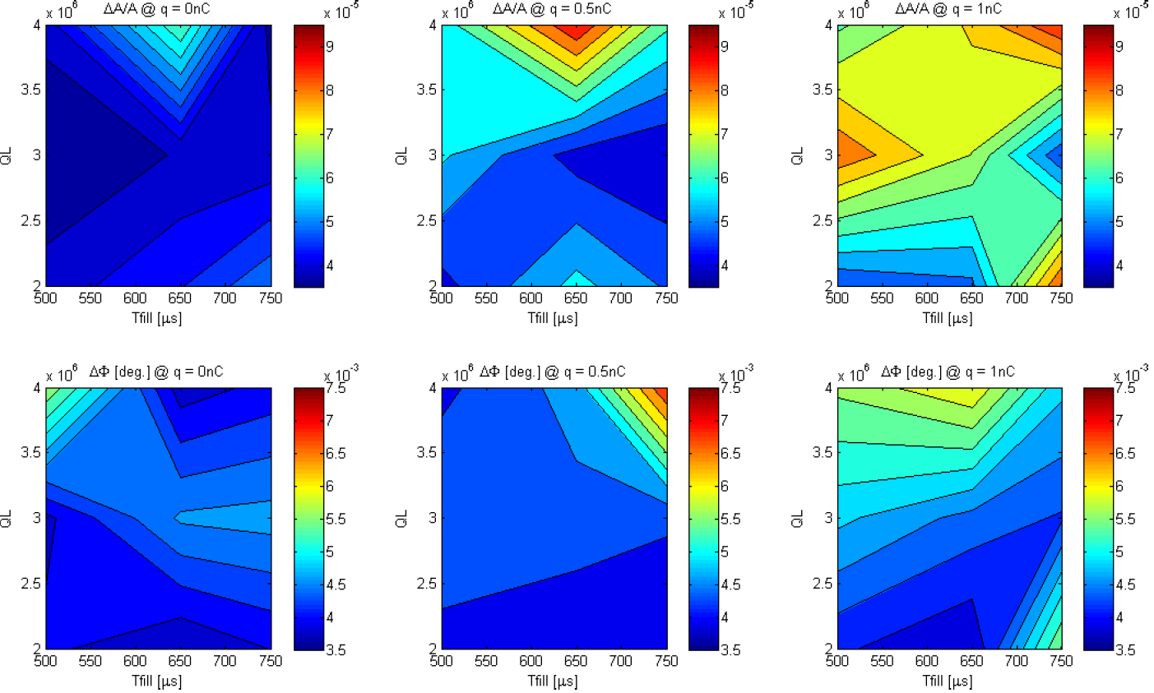
RUN3 achievements and follow up at XFEL A1.I1
Q_{L} and fill time on stability
0 nC
0.5 nC
1.0 nC
dA/A
Stability degrades with charge
dPhi
Stability degrades with Q_{L}

Slide 20
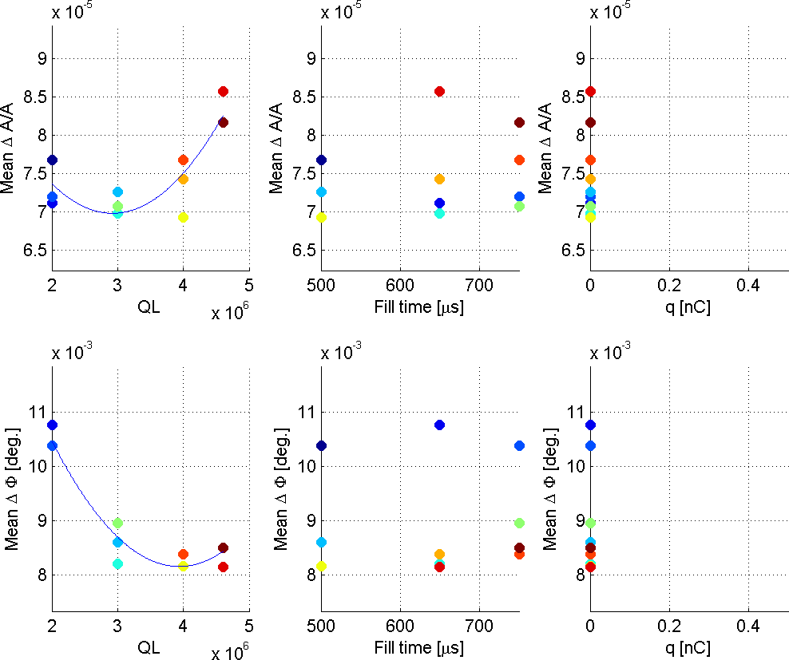
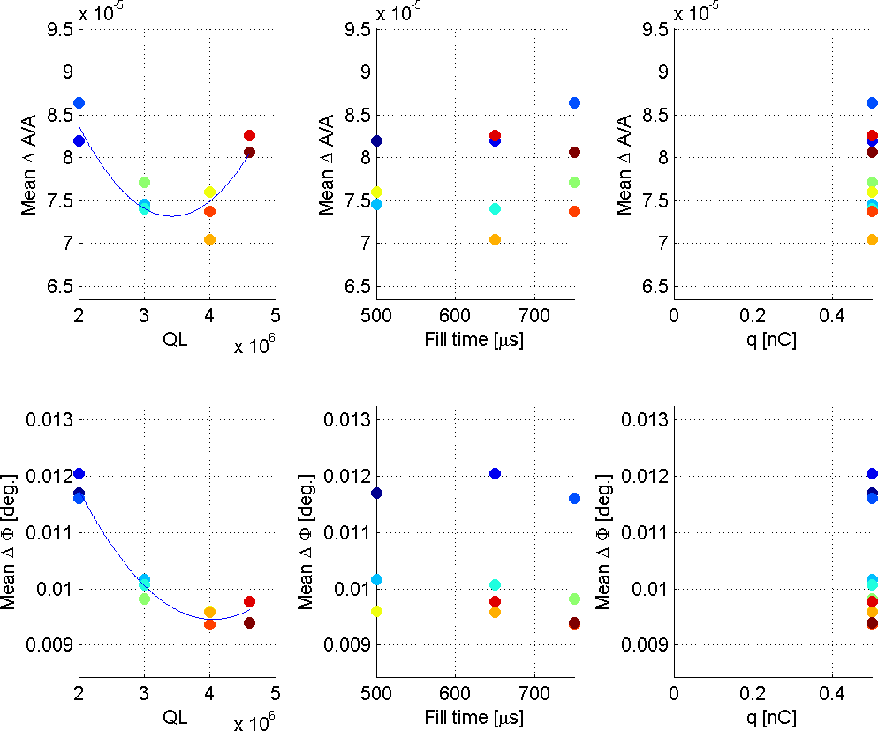
RUN3 achievements and follow up at XFEL A1.I1
Q_{L} and fill time on stability (continued)
0 nC
0.5 nC
Colors only denote different measurement points

Slide 21
Talk Outline
Motivation for the study
9mA study runs
Shift studies at FLASH (RF settings XFEL ≠ FLASH)
Shift outcome
Achievements from RUN1, RUN2, RUN3 and XFEL follow up study
Data analysis
Conclusions
Side effects (good and bad)
Tradeoff
Optimal Q_{L} ?

Slide 22
Side effects
C8.ACC7 field emission → dark current activation
What caused it?
What’s happening (follow-up shifts)?
Piezo recommissioning
LLRF system improvements
BLC, LFF
Optimal SP Q_{L}
“What is indeed the best Q_{L} ?”
Refocus of the shift goals
Lessons learnt for the XFEL ?
Notes:
No hard proof, suspicion that C8.ACC7 was triggered by Ql change
Christian will coach Julien about limitation s of current implementation of the BLC
Should LFF learn from truncated pulses, the root of the problem is BLC is not perfect

Slide 23
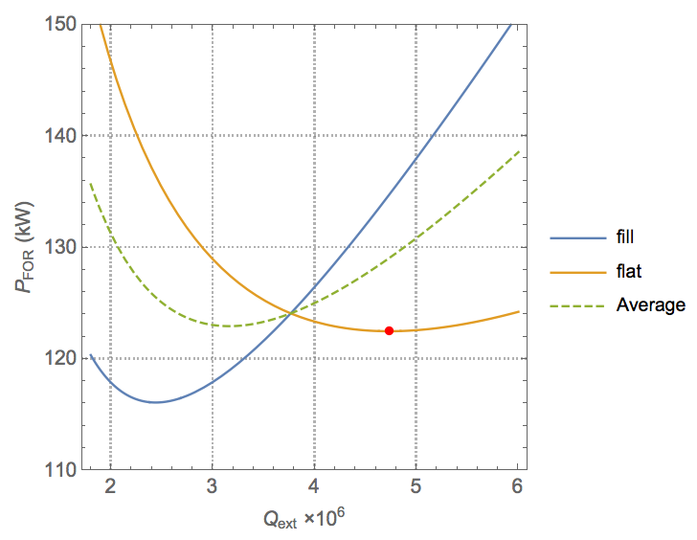
Fill versus Flat-Top Forward Power (trade off)
t_{fill} = 750 μs
t_{flat} = 650 μs
I_{b} = 5 mA
E_{acc} = 23.6 MV/m
minimum average power at lower Q_{ext}
minimum flat-top power at “matched” Q_{ext}
( = P_{beam})
P_{FOR} during fill time reduced

Slide 24
Conclusions
There is nothing magic about 4.6e6
The choice of 4.6e6 was based on full beam loading, valid for CW, but fails for pulse system, because one needs to take fill time take into account
lower bandwidth → more sensitive to detuning & microphonics → also requires more power for FB control
Piezo operation will help!
We would be better off at lower Q_{L}
☺ better stability (larger bandwidth)
☺ reduced power overhead for controls (follows from above)
☺ reduced average forward power
☺ reduced power during fill (which tends to be the peak operationally)
☹ higher forward and reflected power during the flat-top
There is actually flexibility
one could operate the machine at a different Q_{L}

Slide 25
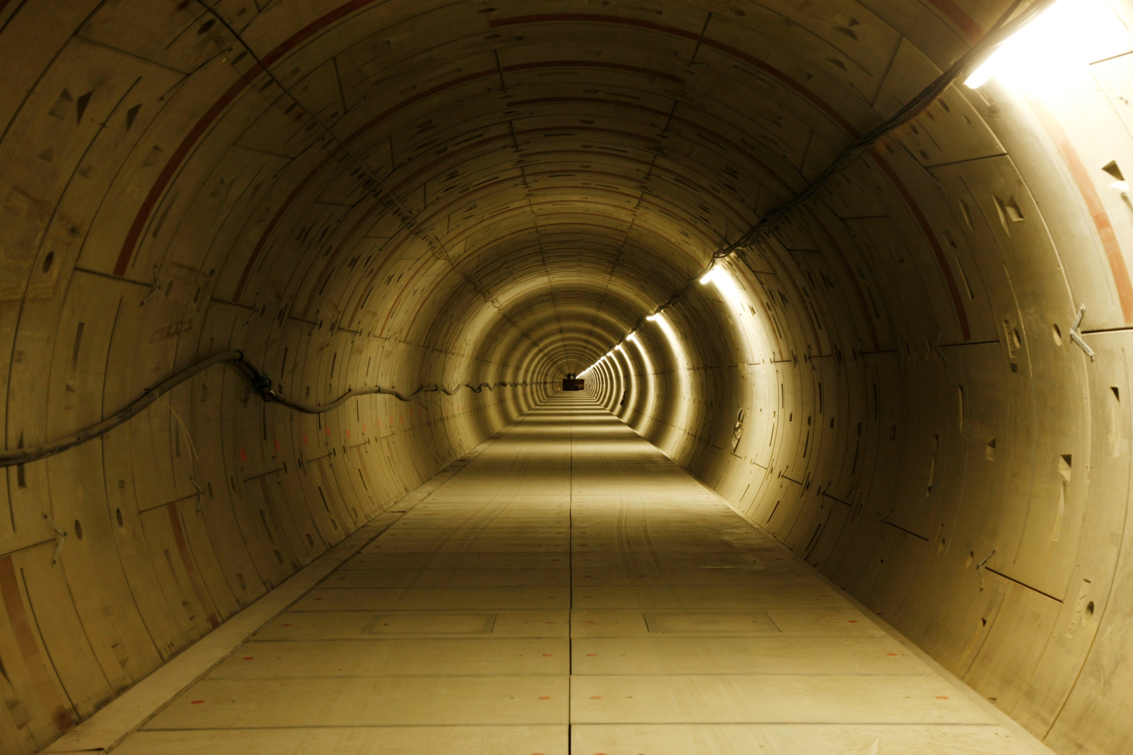
Thank you for your attention!
Photo: Dirk Noelle

Slide 26
BACKUP SLIDES

Slide 27
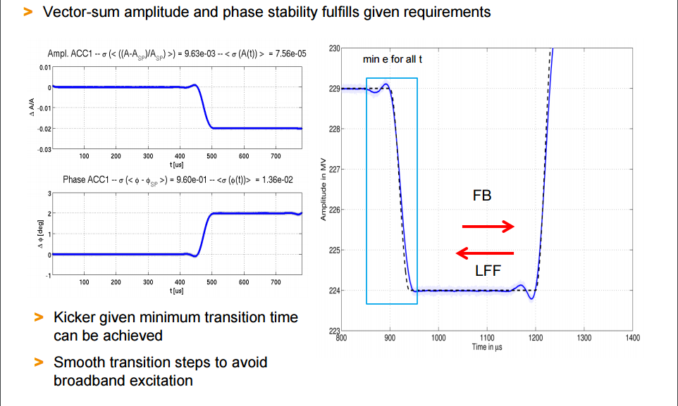
FLASH I – FLASH II transition
Courtesy: Valeri Ayvazyan: LLRF 2015, Shanghai

Slide 28
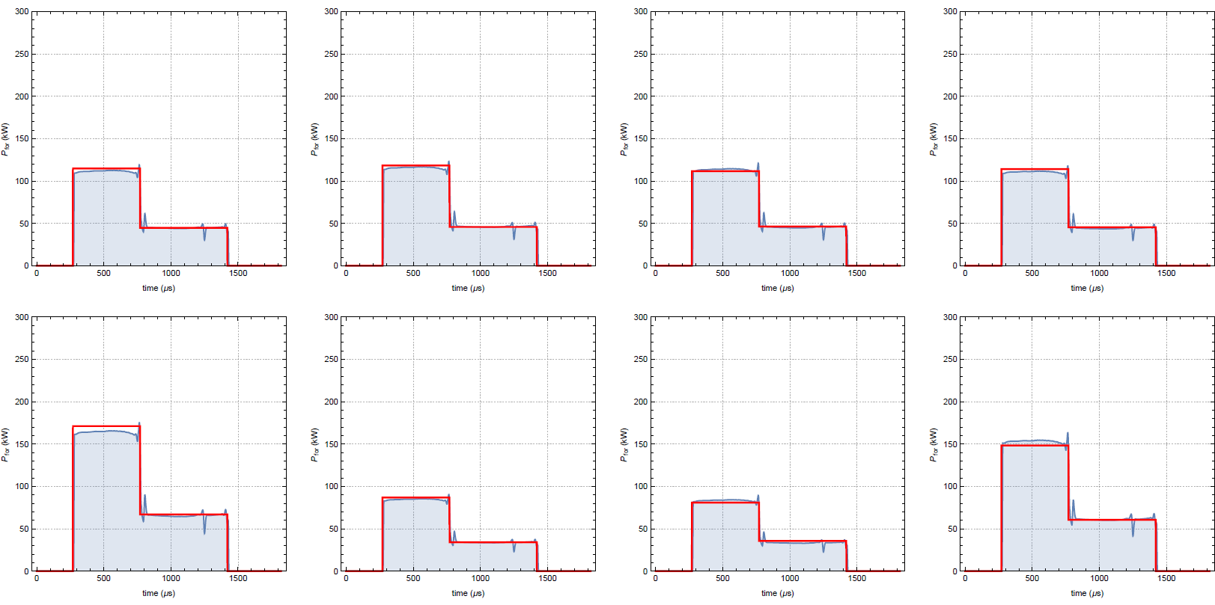
Forward power waveforms
T_{FILL} = 500 usec Q_{L} = 2.0e6

Slide 29
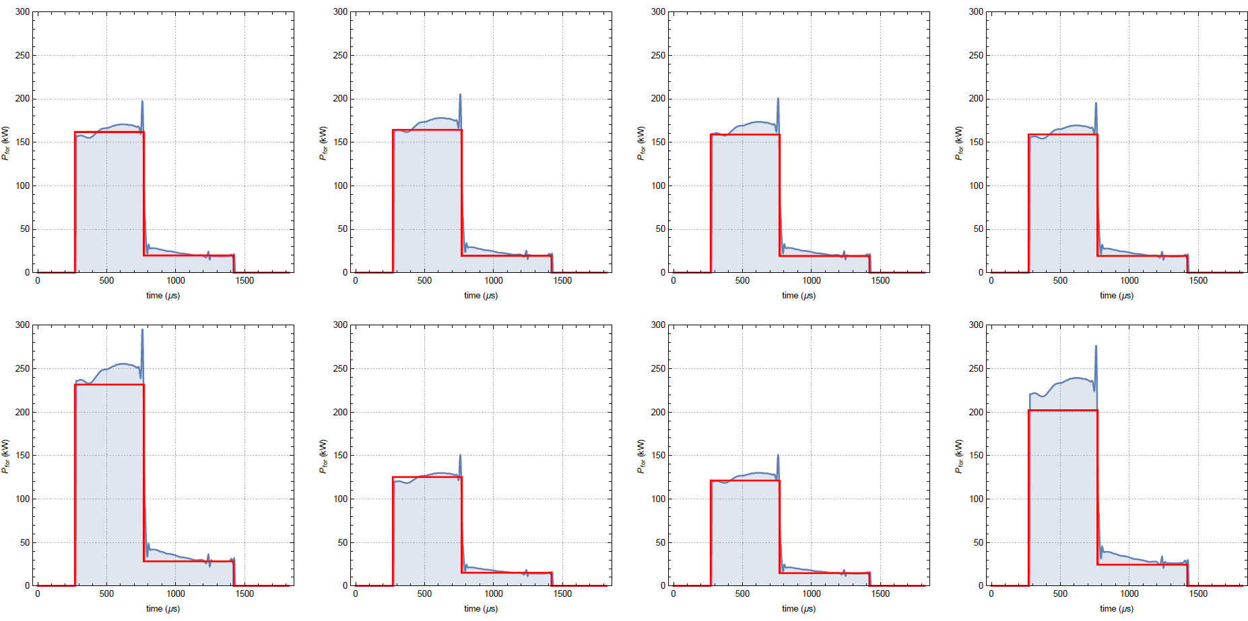
Forward power waveforms
T_{FILL} = 500 usec Q_{L} = 4.6e6

Slide 30
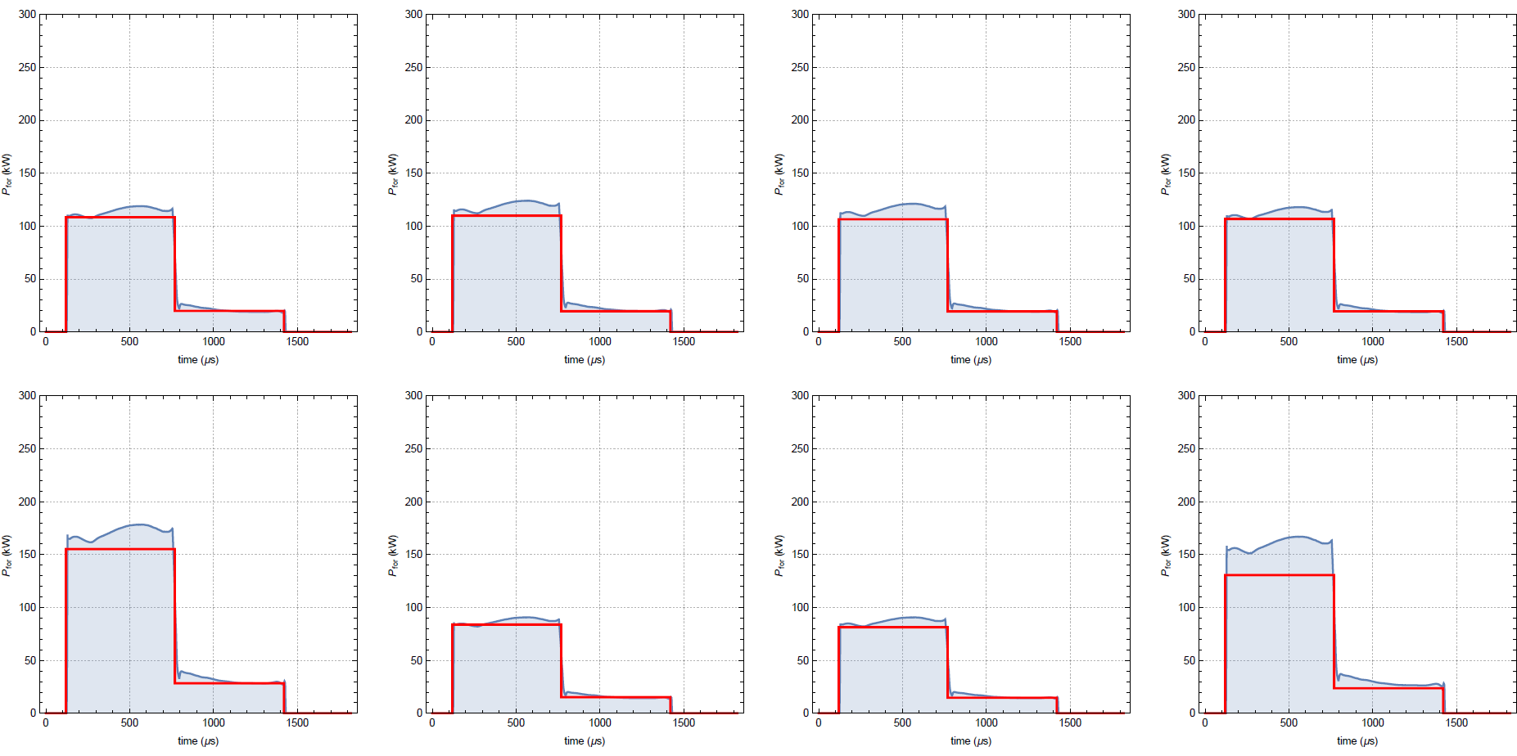
Forward power waveforms
T_{FILL} = 650 usec Q_{L} = 4.6e6

Slide 31
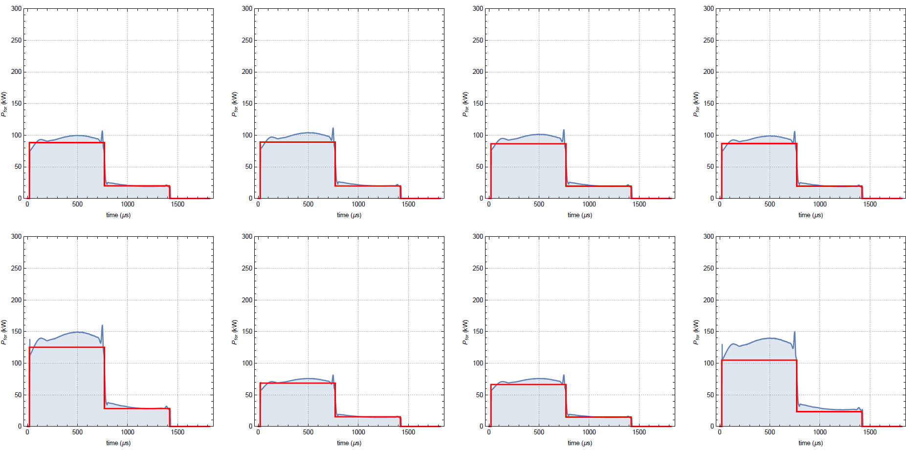
Forward power waveforms
T_{FILL} = 650 usec Q_{L} = 2.0e6

