Slide 1







Seeding at FLASH
Jörn Bödewadt on behalf of the seeding team
FLASH Seminar 17.05.2016
Introduction
Recent experimental results from sFLASH
Supported by BMBF under contract 05K13GU4 and 05K13PE3
DFG GrK 1355
Joachim Herz Stiftung
Helmholz Accelerator R&D
Notes:
Federal Ministry of Education and Research of Germany

Slide 2
Short history of seeding at FLASH
2007 – Design of sFLASH (direct seeding with HHG)
2009 – Installation of sFLASH infrastructure
2010 – Commissioning of sFLASH hardware
2012 – First direct seeding at 38nm (HHG)
2013 – Switch from direct seeding to HGHG (FLASH2 shutdown)
2014 – Commissioning of UV beamline
2015 – HGHG at 38nm
2016 – HGHG < 38 nm, FEL characterization, Laser upgrade

Slide 3
Seeding Team
Machine Operation
Laser Operation / Seed Source
FLASH operators
Bastian Manschwetus
Matthias Vogt & Johann Zemella
Core Team
Jörn Bödewadt
Nagitha Ekanayake (left 04/2016)
Tim Plath
Theo Maltezopoulos
Christoph Lechner
Leslie L. Lazzarino
Kirsten Hacker (left 01/2016)
Armin Azima
Guangyao Feng
Andreas Przystawik
UGRD students:
Philip Amstutz
Nils Lockmann
Florian Jacobs
Alexander Fröhlich
Martin Dohlus
Sergey Usenko
Simulation
FEL characterization
DESY
Uni HH
TU Dortmund

Slide 4
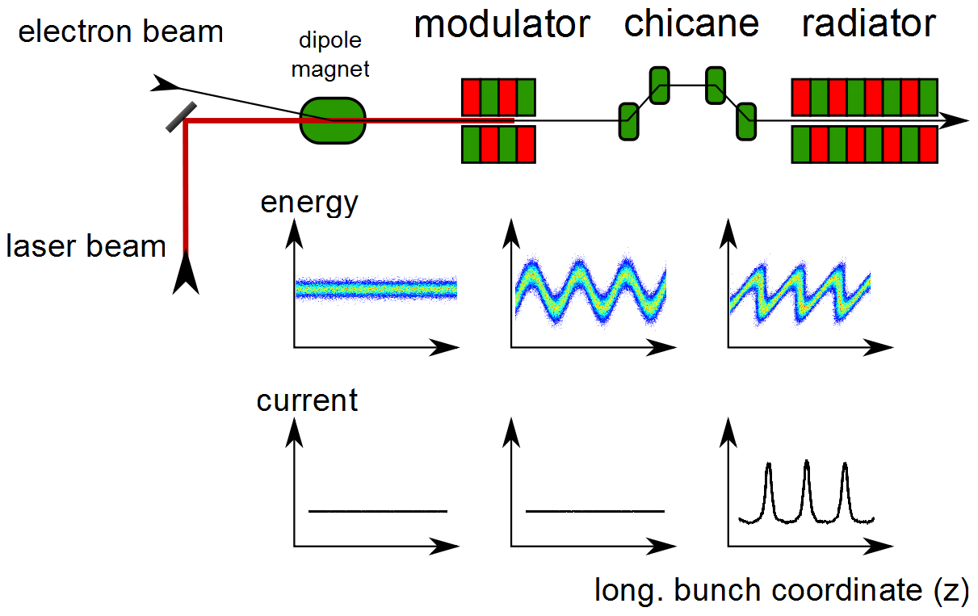

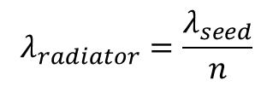


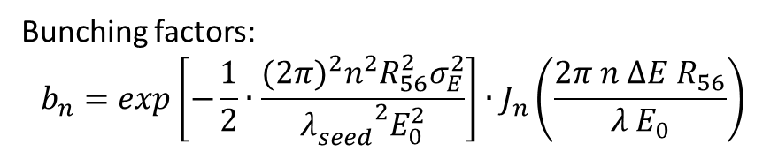

High-Gain Harmonic Generation
$$λ_{radiator}=\frac{λ_{seed}}{n}$$
mod amp. $∆E$
rms e. spread: $σ_{E}$
$$λ_{seed}$$
$$n<\frac{∆E}{σ_{E}}$$
Bunching factors:
$$b_{n}=exp\left[−\frac{1}{2}∙\frac{{{(2π)}^{2}n}^{2}R_{56}^{2}σ_{E}^{2}}{{λ_{seed}^{}}^{2}E_{0}^{2}}\right]∙J_{n}\left(\frac{2π n ∆E R_{56}}{λ E_{0}}\right)$$
L.H. Yu, Phys.Rev. A 44, 5178 (2001)

Slide 5
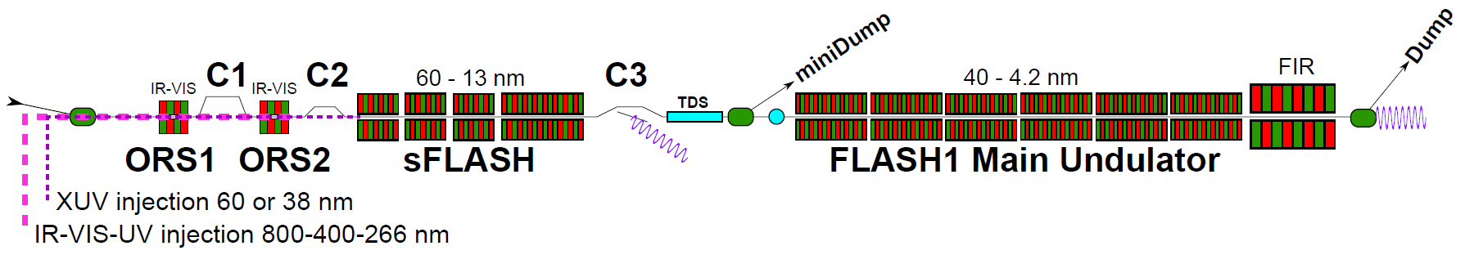
Seeding at FLASH
Overview of FLASH1 beamline
UV laser
NI
Seed laser
lab. 28g
NIR beamline
FEL diagnostic
hutch 28h
sFLASH
RF stations
1.3 GHz SC Accelerating Structures
FLASH1
Diagnostics
LOLA
Fixed Gap Undulators
Bunch Compressor
Bunch Compressor
FLASH2
RF Gun
FEL Experiments
5 MeV
150 MeV
450 MeV
1250 MeV
Variable Gap Undulators
315 m

Slide 6
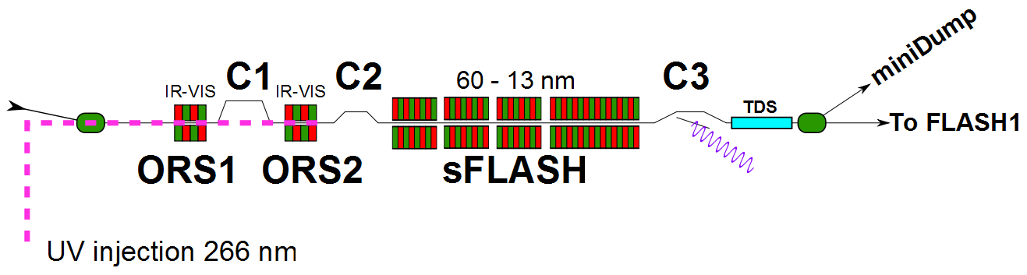
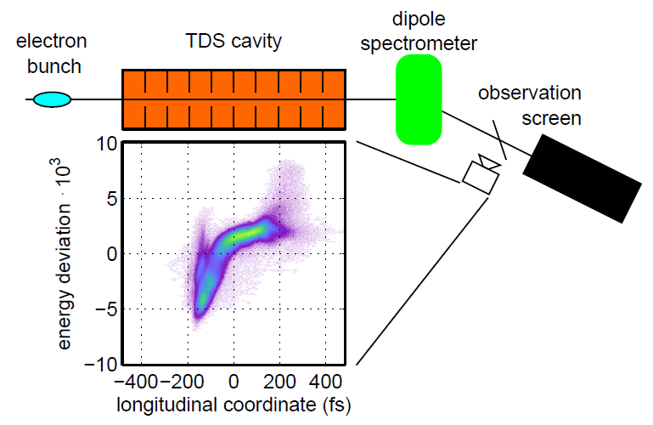
Temporal diagnostics
Transverse deflecting structure (TDS) and electron beam spectrometer is installed downstream of the sFLASH radiator
Mapping of longitudinal phase space distribution into transverse coordinates
THz streaking of seeded FEL pulses
FEL diagnostic
hutch
Seed laser
lab
NIR beamline

Slide 7
Outline
Beam based alignment / Beam optics setup
  Straight orbit in seed section
Optics compensation
Bunch compression studies
  Simultaneous operation of FLASH2 and sFLASH
  Microbunch instabilities
7th harmonic HGHG operation and characterization
  LOLA studies
  THz streaking
Outlook

Slide 8
Beam based alignment / Beam optics setup

Slide 9
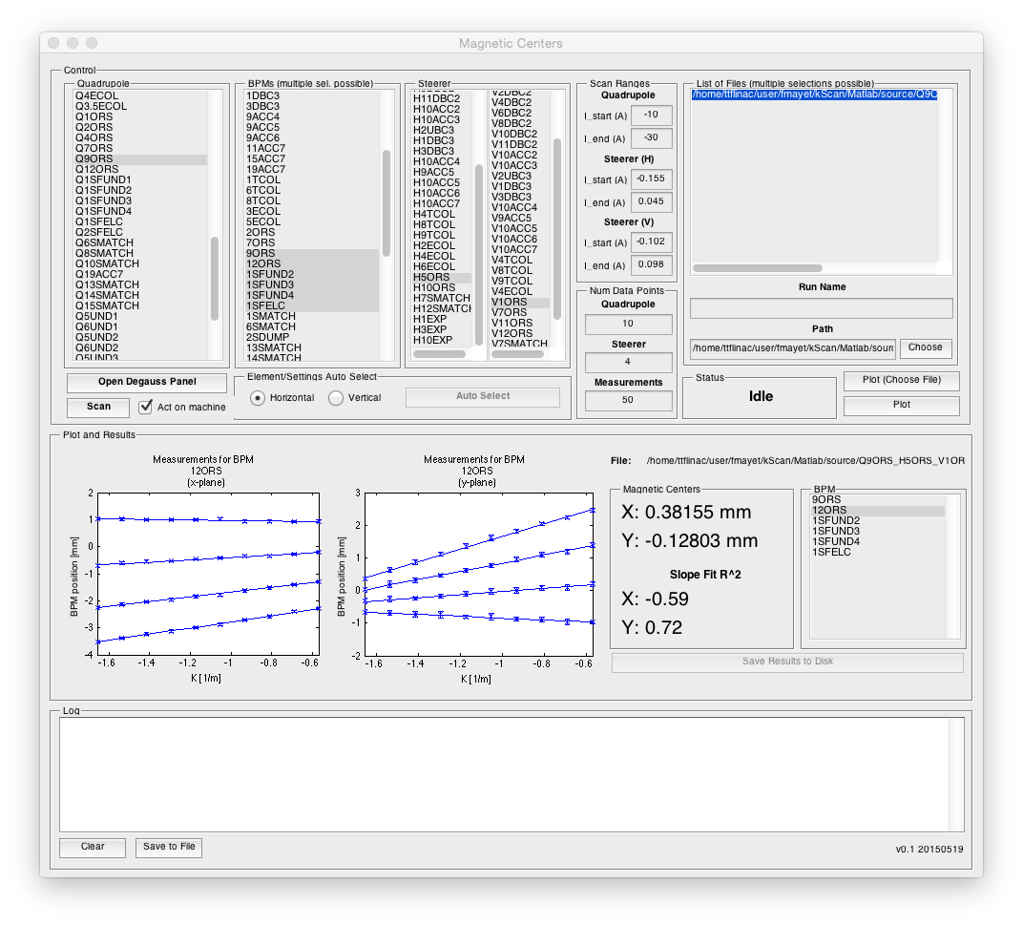
Beam based alignment
Quad scan tool (by F. Mayet and T. Plath)

Slide 10
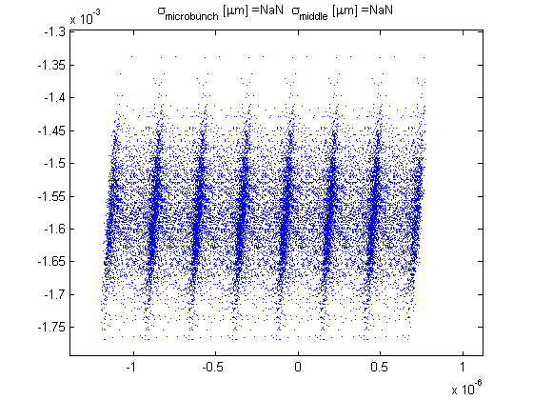
Beam based alignment of seed section
Checking the quadrupole position using beam-based alignment we observed significant misalignment of quadrupoles between the modulator and radiator.
Q1SFUND2
Q12ORS
Mod
Rad1
Rad2
Q9ORS
Q1SFUND1
TILTED
Quad | Offset ref. beam and magnetic centers
 | X (mm) | Y (mm)
Q2ORS | -0,26 | 0,15
Q7ORS | -0,02 | 0,28
Q9ORS | 0,77 | 0,16
Q12ORS | -0,09 | 0,24
Q1SFUND1 | 0,12 | 0,35
Q1SFUND2 | -0,02 | 0,12
Screen
Quad
X
BPM
Vertical steerer
Causes a kick of > 200 µrad
Wire scanner
Longitudinal coordinate (μm)
Notes:
Quad not on movers, because for the initial design for HHG seeding th

Slide 11
Beam based alignment of seed section
Checking the quadrupole position using beam-based alignment we observed significant misalignment of quadrupoles between the modulator and radiator.
Only quadrupoles in the radiator section are on movers as it was required for HHG seeding experiment.
To avoid quadrupole kicks we switched off the quads between modulator and in the radiator
Q12ORS
Mod
Rad1
Rad2
Q9ORS
Q1SFUND1
Notes:
Quad not on movers, because for the initial design for HHG seeding th

Slide 12
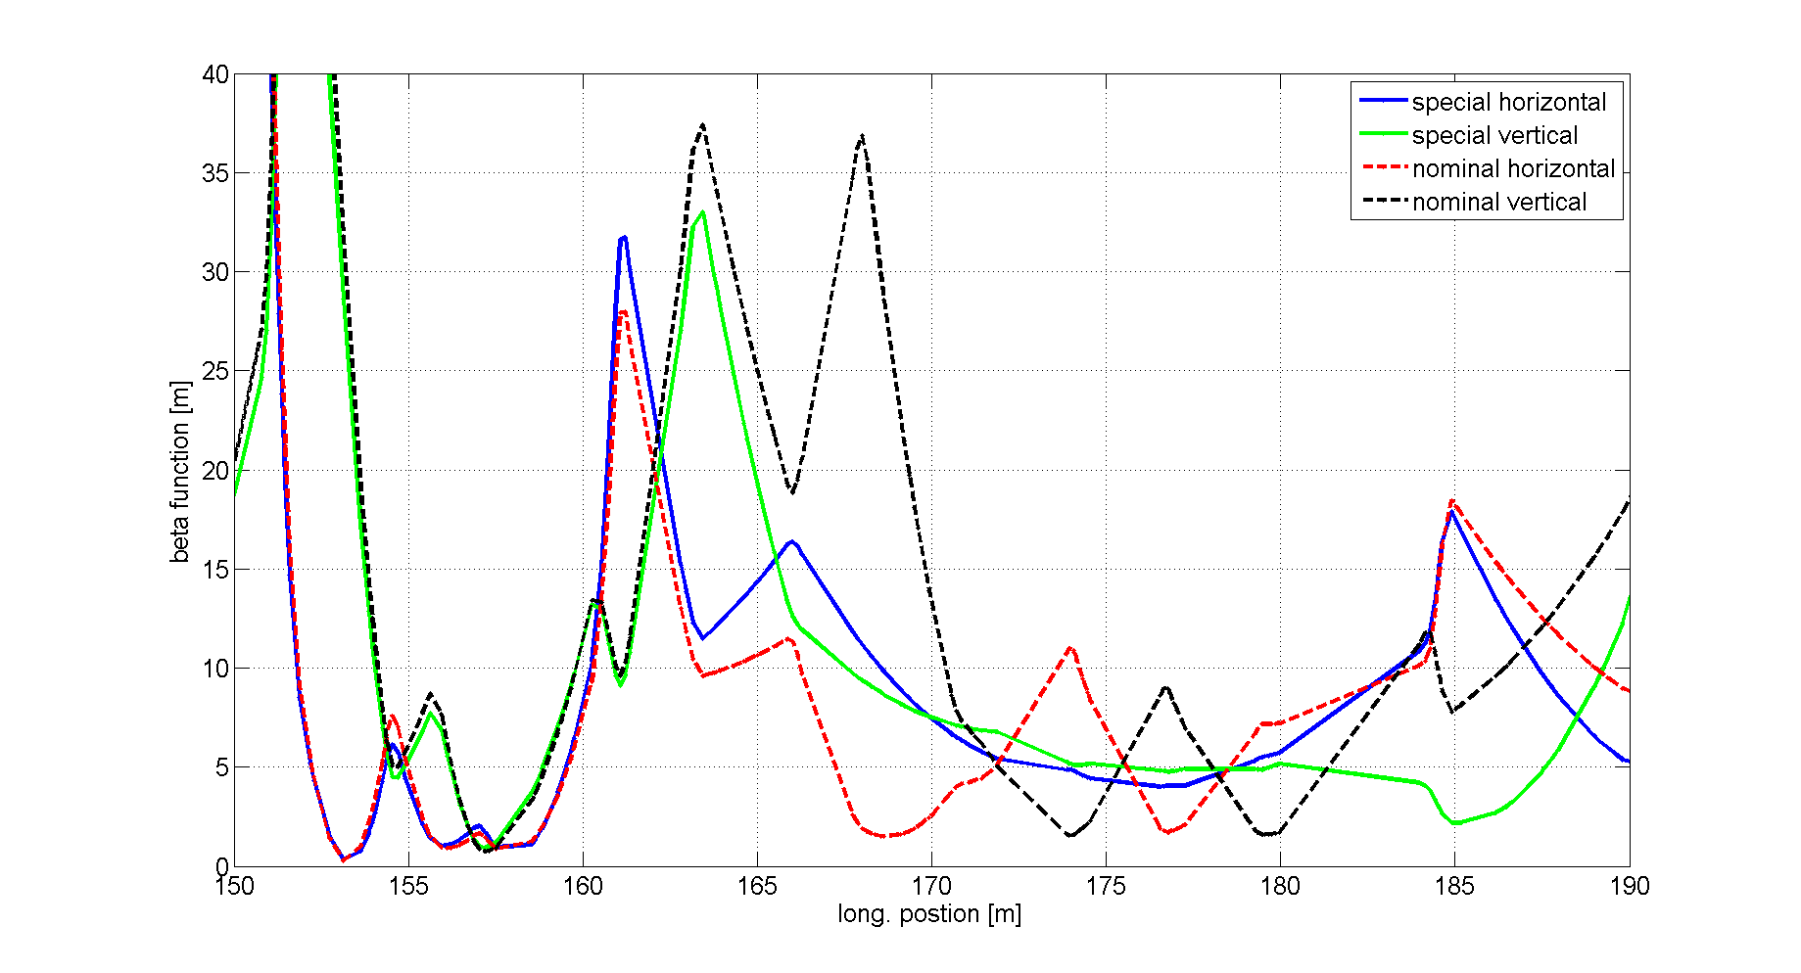
Changing beam optics in seed section
Q9ORS
Goal:
  Beam based alignment of seeding section
  CHG at 7th harmonic
Achievements:
  Using ballistic orbit and quadrupole scans, we identified misaligned quads between modulator and radiator
Mod
Rad1
Rad4

Slide 13
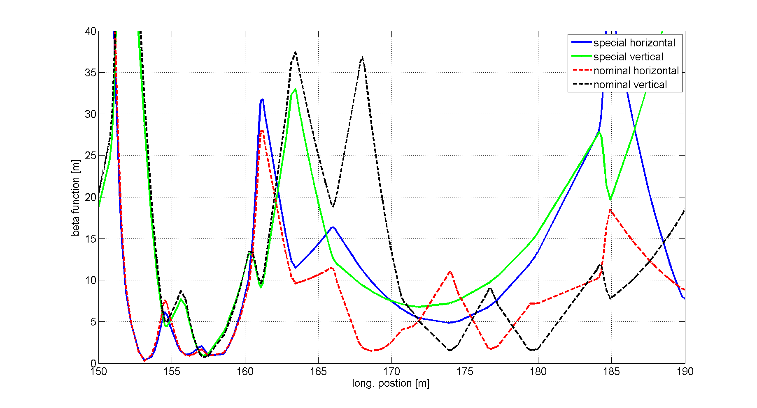
Changing beam optics in seed section (undulators open)
Q9ORS
Mod
Rad1
Rad4

Slide 14

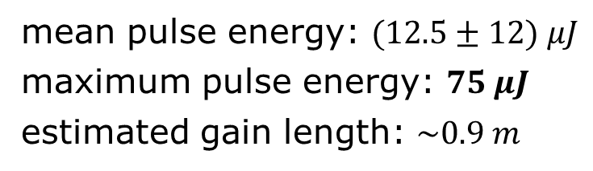
FEL gain 38nm (7th harmonic)
FEL pulse energy
mean pulse energy: $(12.5±12) μJ$
maximum pulse energy: $75 μJ$
estimated gain length: $\sim 0.9 m$
Seed laser on
Seed laser off
Seed laser on
$$12.5 μJ$$

Slide 15
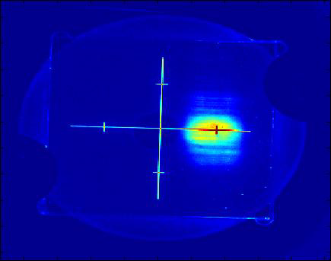
FEL gain 38nm (7th harmonic)
FEL beam profile
mean pulse energy: $(12.5±12) μJ$
maximum pulse energy: $75 μJ$
estimated gain length: $\sim 0.9 m$
Seed laser on
Seed laser off
Seed laser on
$$12.5 μJ$$
Strong fluctuation make systematic studies difficult

Slide 16
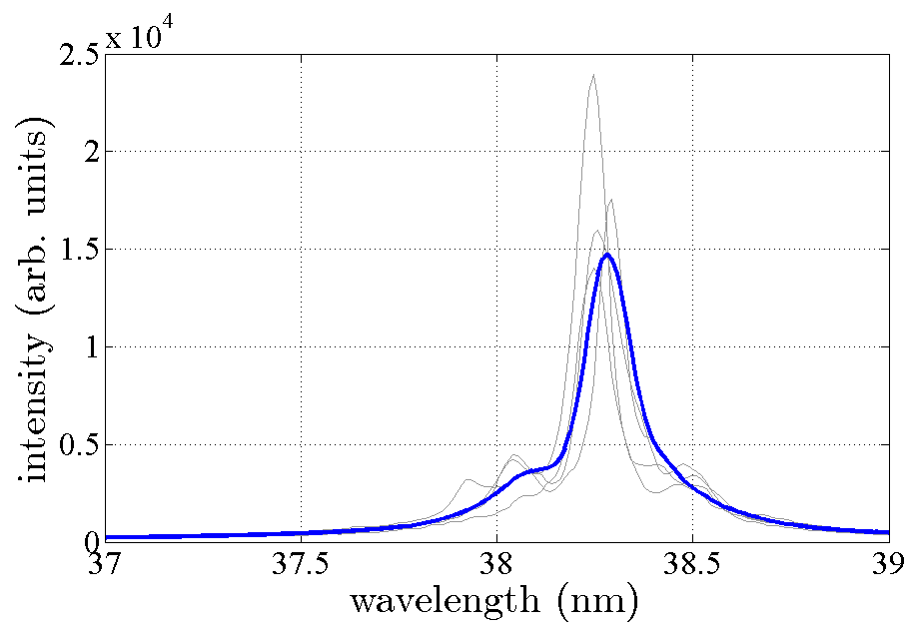

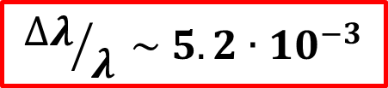
FEL gain 38nm (7th harmonic)
Spectra of HGHG (second run May, 1st 2015)
$${∆λ}/λ \sim 5.2∙{10}^{−3}$$
Data with special seeding optics
Realignment of quadrupoles Q9ORS and Q12ORS in shutdown 2015
SASE x1000
$$∆λ=0.2 nm$$

Slide 17
Nominal FLASH1 optics (design vs. measured)
Example of optics setup in seeding section
Optics measurements are done with uncompressed e-beam (minimum e-spread)
Radiator
Radiator
Modulator
Modulator

Slide 18
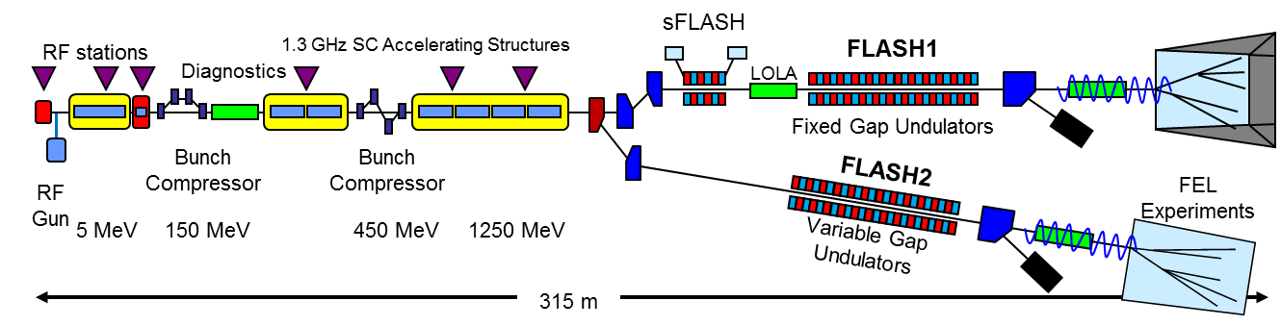
Optics setup for seeding
April 2016, Friday, 29/30.04.2016
DBC2 SFUND
Iteration | Mismatch parameter X / Y | Emittance X / Y [µm rad]
1 | 2.827 / 3.012 | 0.59 / 0.59
2 | 1.204 / 1.574 | 0.53 / 0.60
3 | 1.127 / 1.042 | 0.55 / 0.57
Iteration | Mismatch parameter X / Y | Emittance X / Y [µm rad]
1 | 1.047 / 1.197 | 2.00 / 1.24
2 | 1.000 / 1.001 | 2.12 / 1.92
DBC2
SFUND

Slide 19
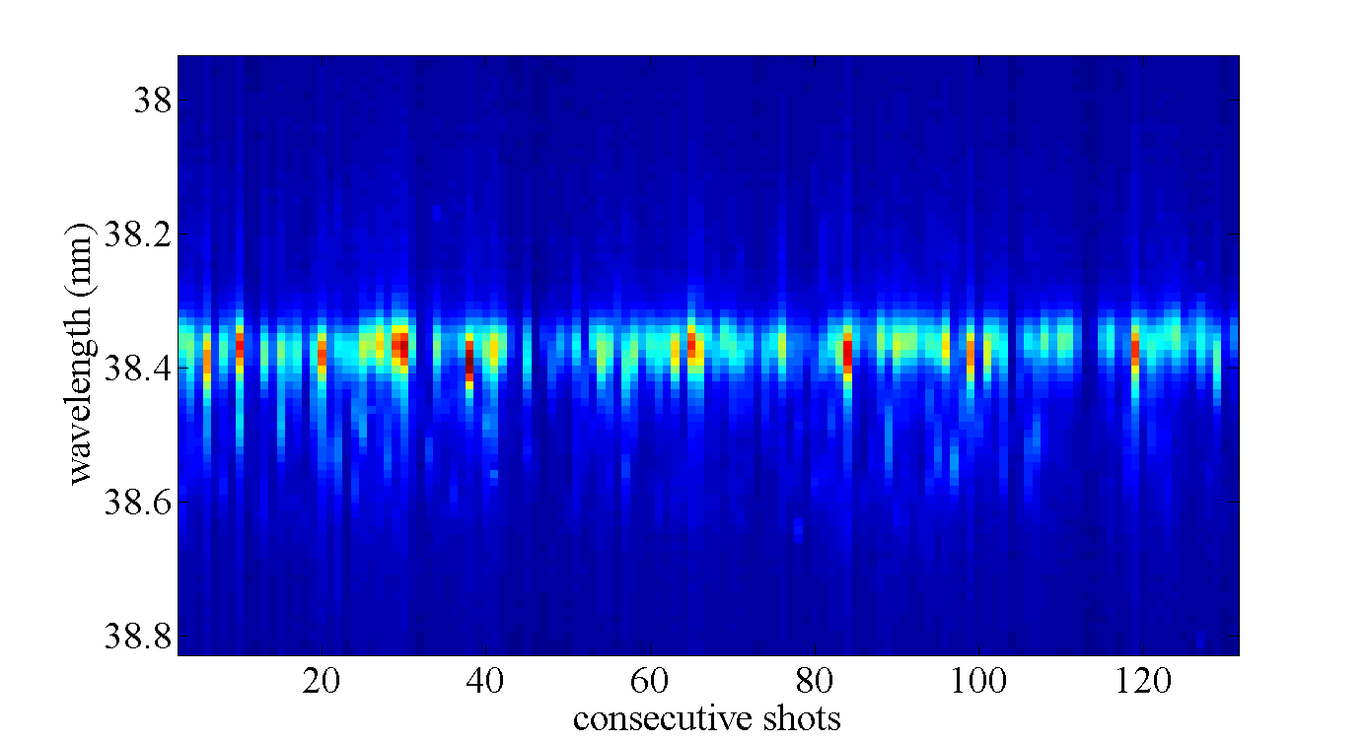
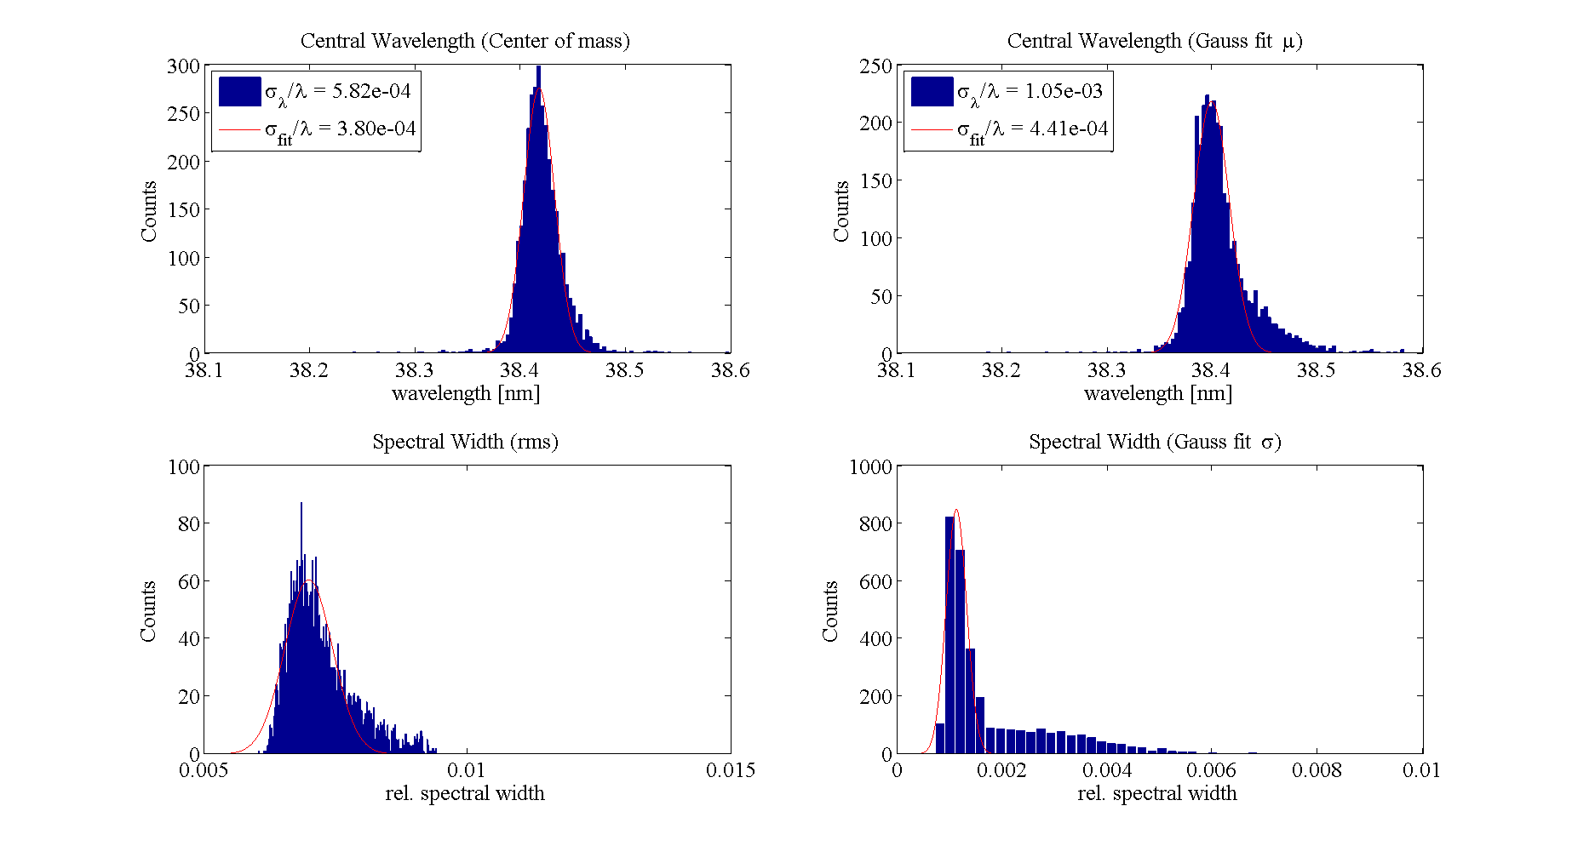
HGHG at 7th harmonic
Analysis of FEL spectra
Spectral resolution
λ/Δλ ~ 700

Slide 20
Optics compensation

Slide 21
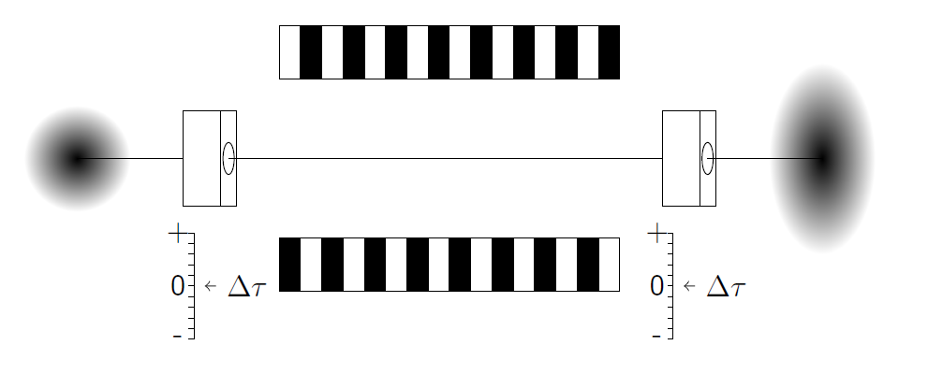
Compensate effect of vertical undulator focusing for closed variable-gap undulators
UV laser
Courtesy Philipp Amstutz

Slide 22
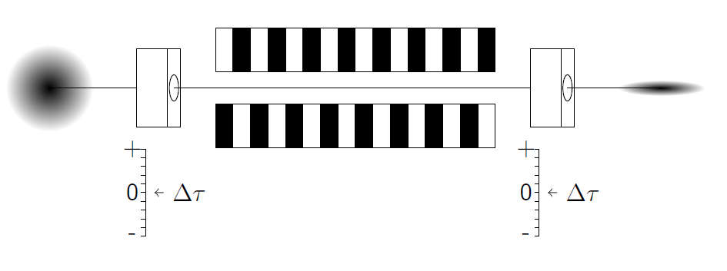
Compensate effect of vertical undulator focusing for closed variable-gap undulators
UV laser
Courtesy Philipp Amstutz

Slide 23
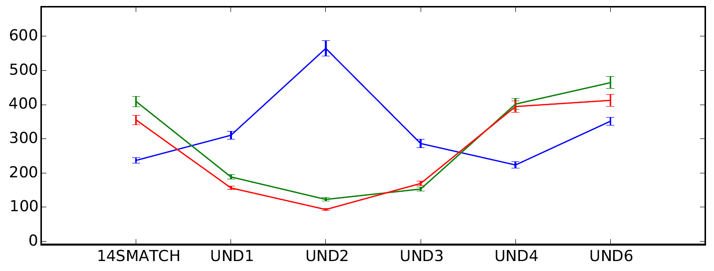
Compensate effect of vertical undulator focusing for closed variable-gap undulators
UV laser
Courtesy Philipp Amstutz
Initial situation
After closing undulator
After applying optics correction
rms vert. beam size [µm]
position along the FLASH undulator

Slide 24
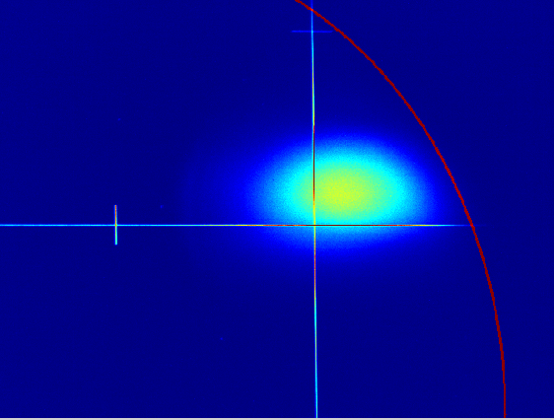
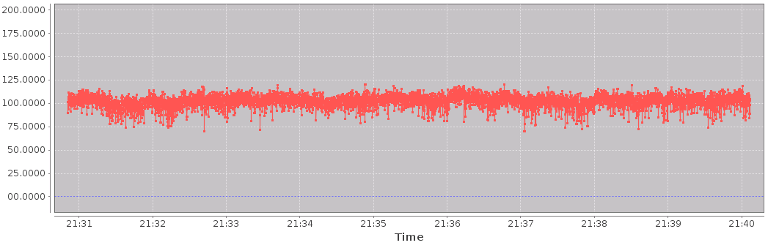
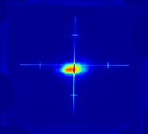
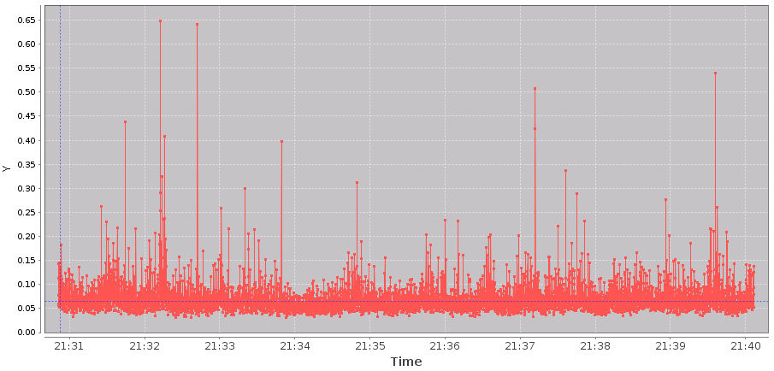
Simultaneous operation (January 2015)
Parallel operation of sFLASH@24nm SASE and FLASH@9nm SASE
FLASH
200
In saturation
Energy (µJ)
100
0
21:30
Time
21:40
sFLASH
In exponential gain regime
Energy (nJ)
~200 nJ
21:30
Time
21:40

Slide 25
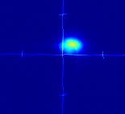
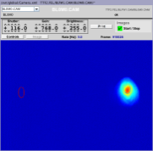
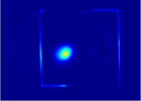
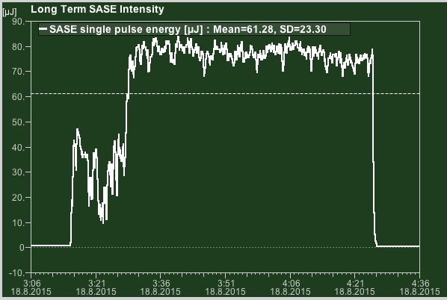
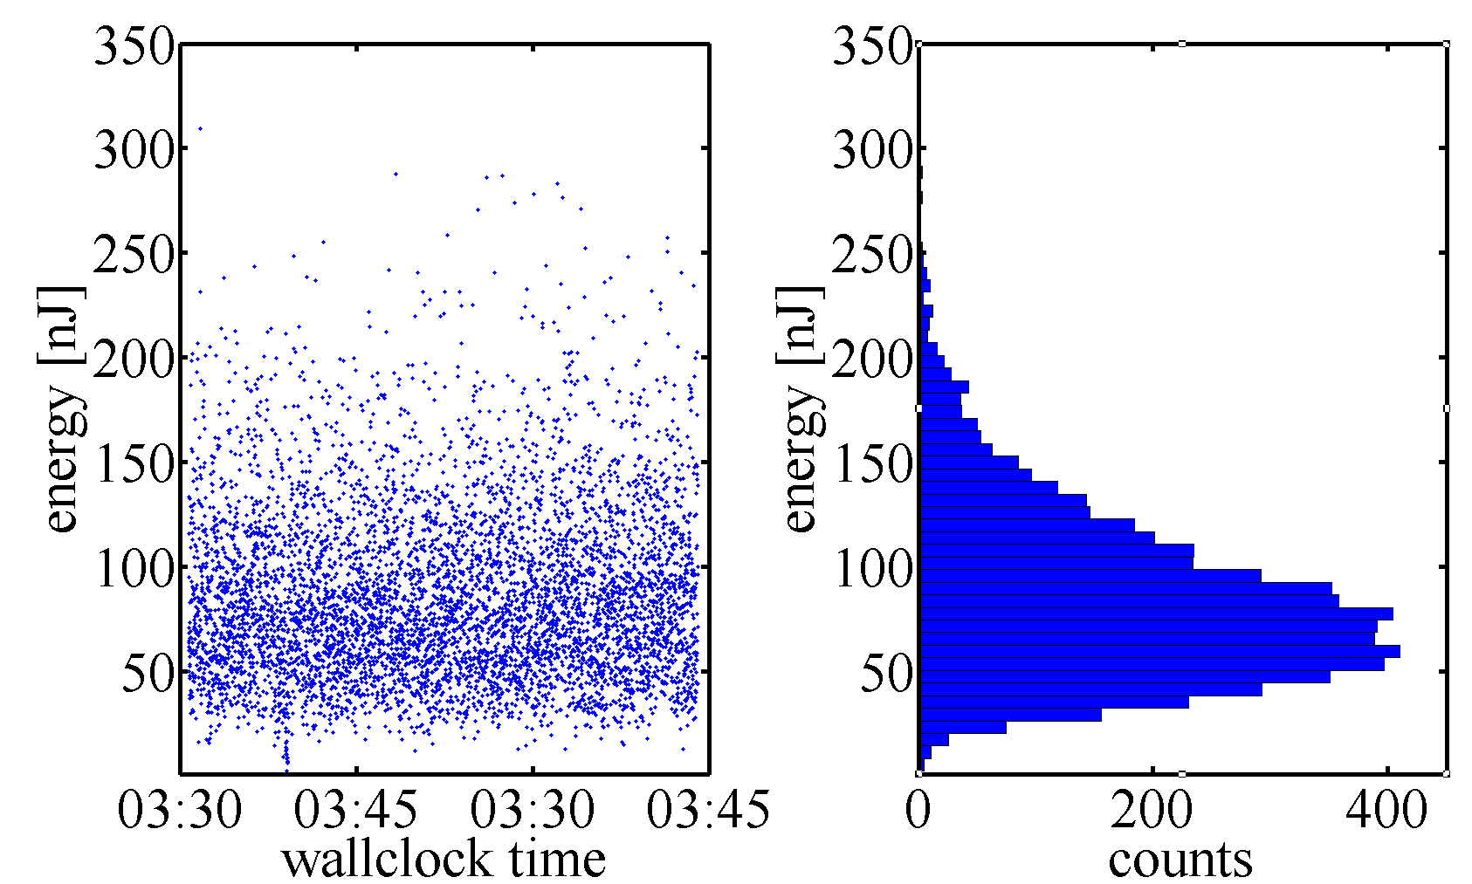
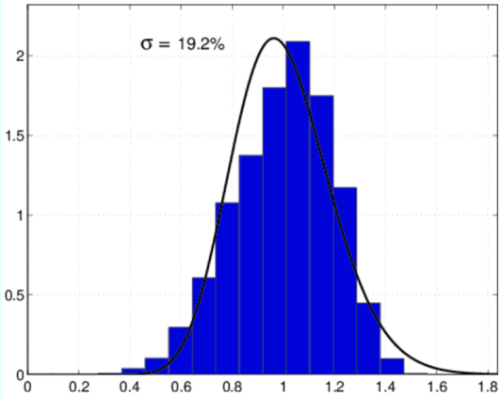
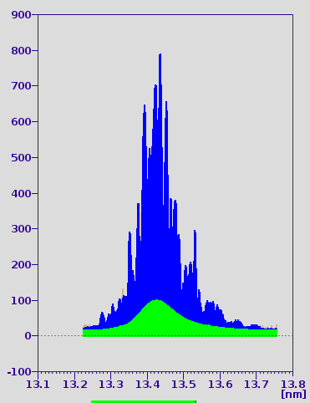
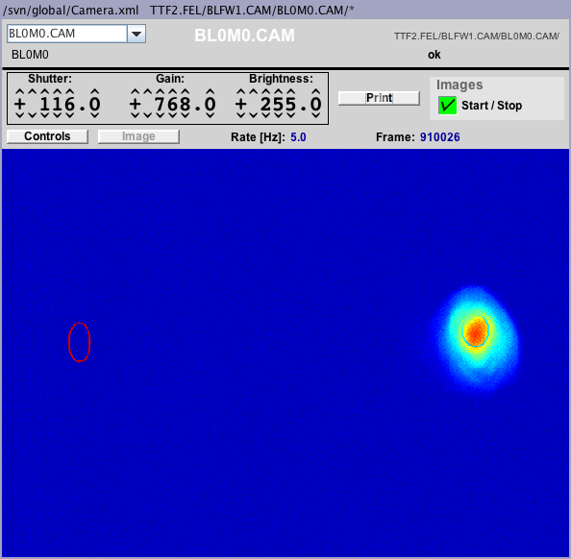
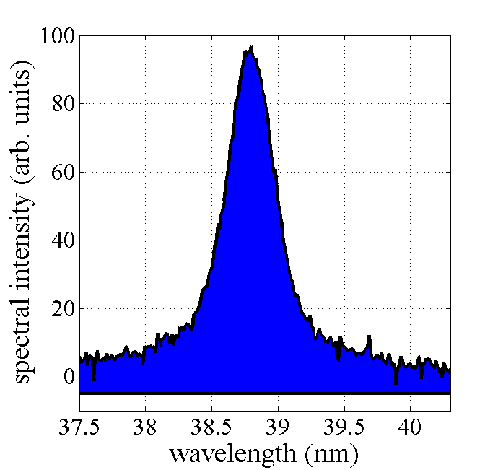
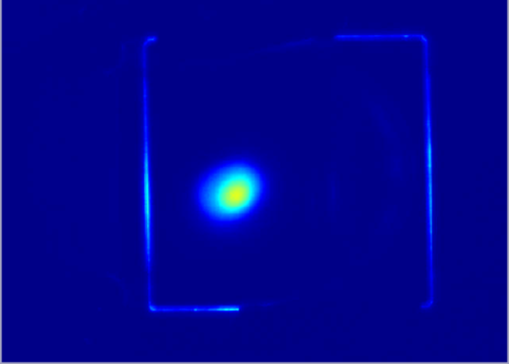
Simultaneous operation (August 2015)
FLASH1
FLASH2
FLASH1 @ 13 nm
sFLASH @ 38 nm
FLASH2 @ 20 nm

Slide 26
Bunch compression studies

Slide 27
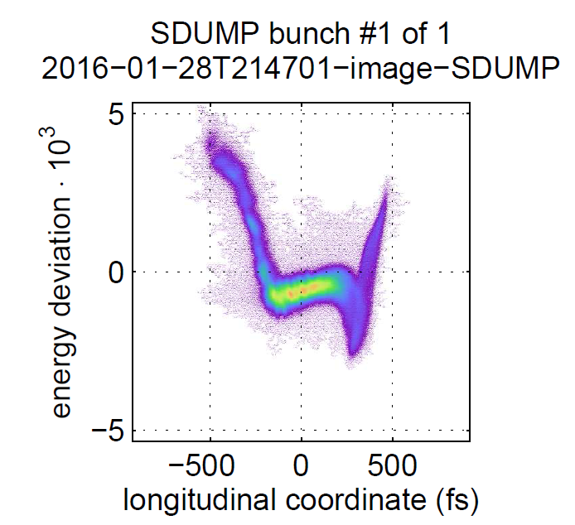
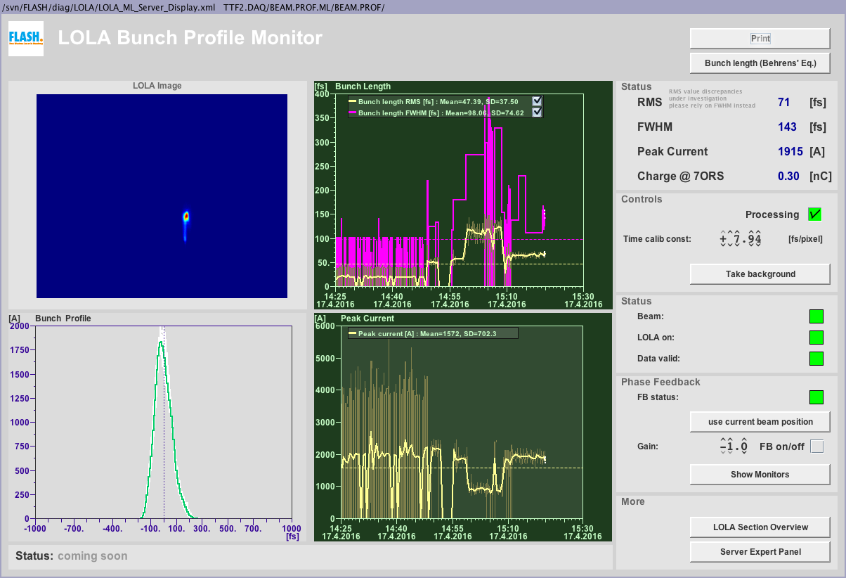
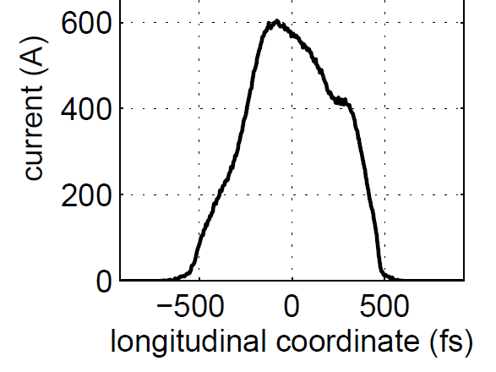
Bunch compression studies (SASE vs. SEEDING)
Typical compression modes
Seeding (0.4 nC)
SASE (e.g. 0.3 nC)
Notes:
Find better image for SASE condition (or tell what the image shows (screen shot from control room))

Slide 28
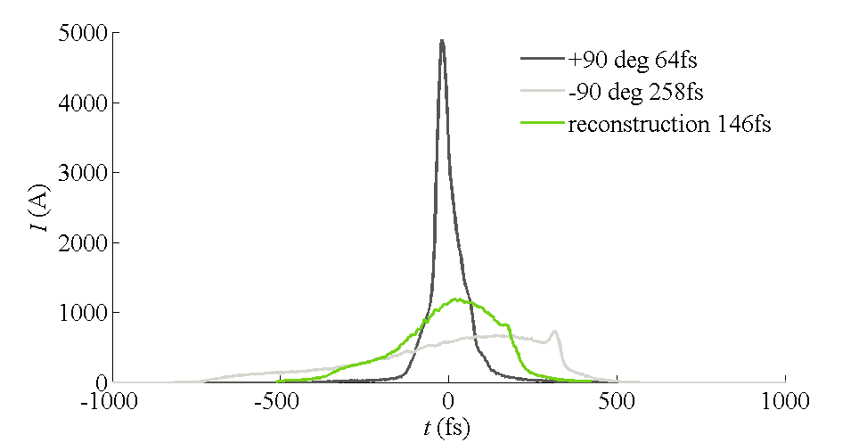
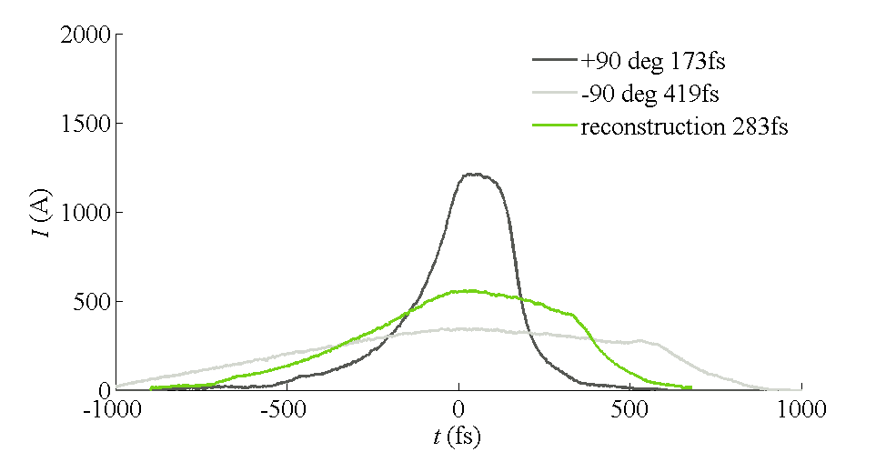
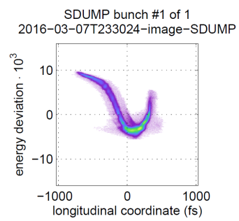
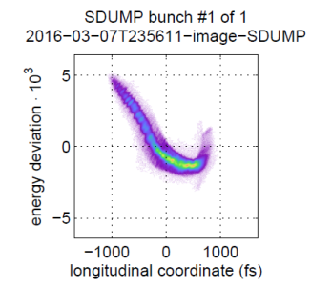
Bunch compression studies (SASE vs. SEEDING)
In view of FLASH2 a compression setting needs to be established which allows SASE operation in FLASH1 and seeded operation in FLASH2
Ansatz 1:
  Setup SASE in FLASH1 and FLASH2 with same bunch compression settings (check TDS)
  Keep FLASH2 under SASE and decompress for FLASH1 and setup seeding in sFLASH
SASE in FLASH1
Seeding in sFLASH

Slide 29
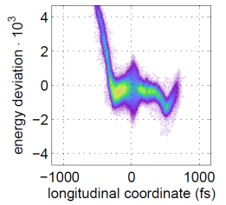
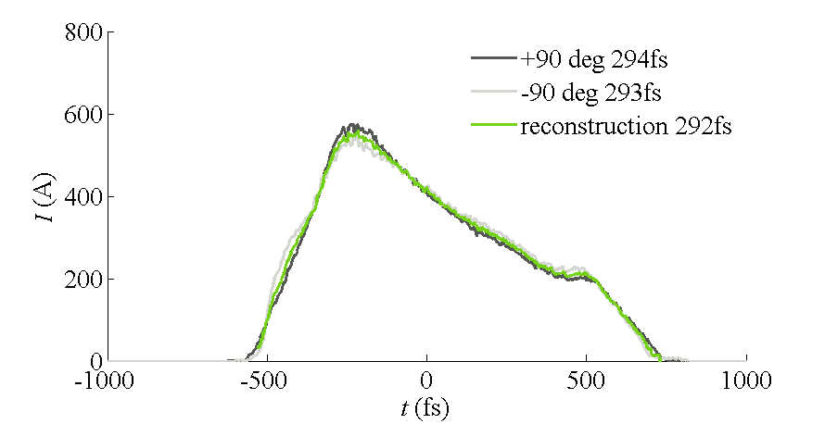
Bunch compression studies (SASE vs. SEEDING)
In view of FLASH2 a compression setting needs to be established which allows SASE operation in FLASH1 and seeded operation in FLASH2
Ansatz 1:
  Setup SASE in FLASH1 and FLASH2 with same bunch compression settings (check TDS)
  Keep FLASH2 under SASE and decompress for FLASH1 and setup seeding in sFLASH
Ansatz 2 (MD last week 30.04.2016 and 13.05.2016):
  Setup compression mode for seeding in sFLASH
  Further compress e-bunch (TDS monitor)
  Setup SASE in FLASH1 and FLASH2

Slide 30
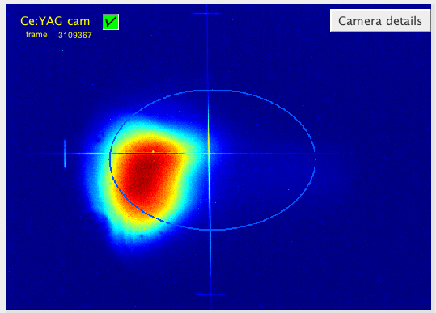
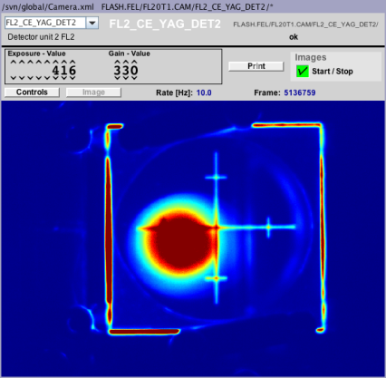
Bunch compression studies (SASE vs. SEEDING)
SASE in FLASH1
SASE in FLASH2
Single shot pulse energy
~ 10 µJ
Single shot pulse energy
~ 220 µJ

Slide 31
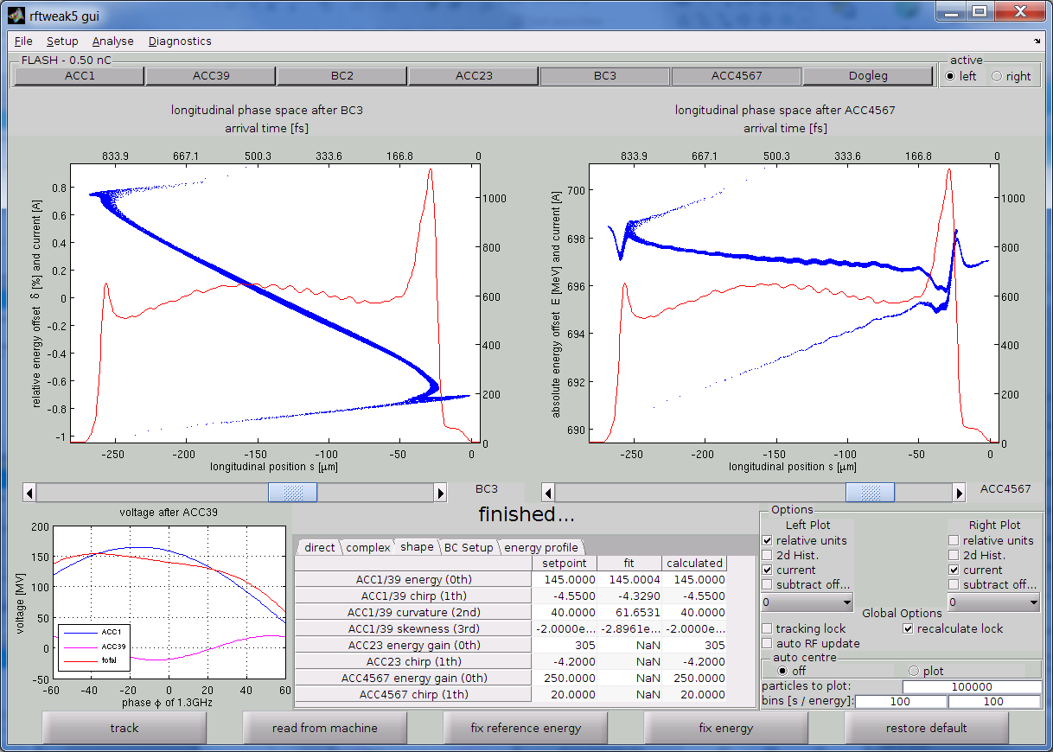
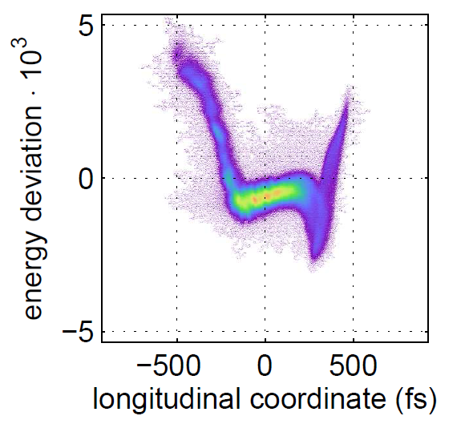
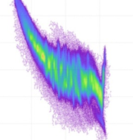
Impact of bunch compression on Microbunching Instability (MBI)
Example for a flat-top current profile and low energy chirp
  Very low HGHG signal observed
  Noisy spectrum
Modell
Reality
After BC3
After ACC67
energy spread
1e-3 (rms)
Notes:
Mention simulation of MBI (Xtrack, Martin Dohlus)

Slide 32
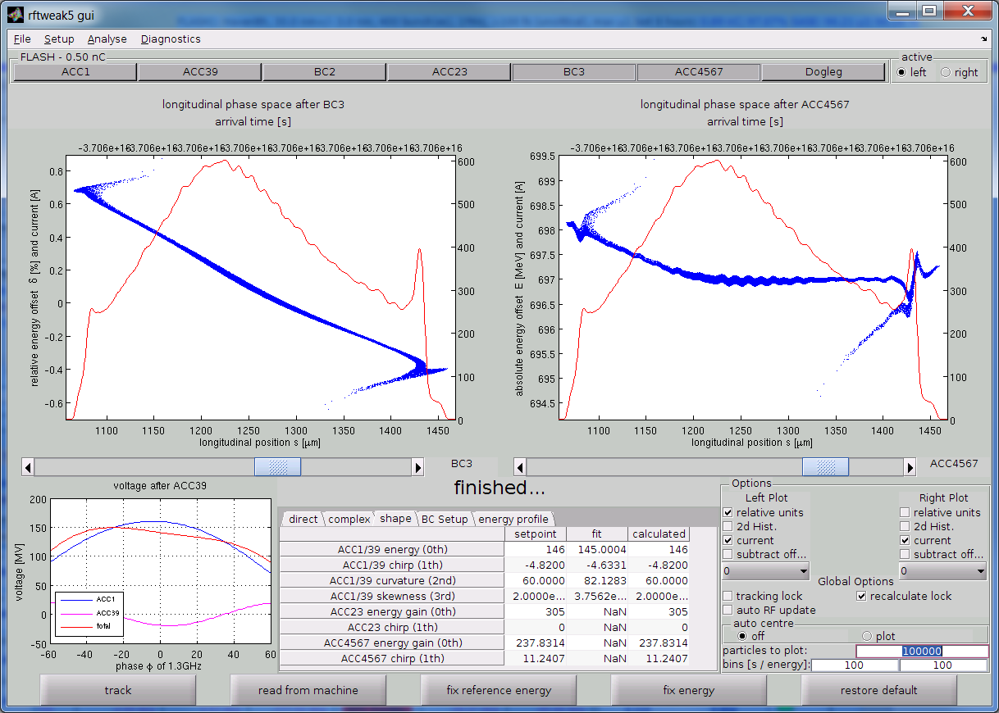
Impact of bunch compression on Microbunching Instability (MBI)
Example for a current profile with low energy chirp
  Good HGHG output
  Clean spectrum
Modell
Reality
After BC3
After ACC67
energy spread
<0.4 e-3 (rms)
Notes:
Conclusion of compression studies (MBI)

Slide 33







Bunching at 9th and 11th harmonic
Electron bunch compression unchanged (I_{peak} = 600A)
$$λ_{seed}=267 nm$$
$$h=7$$
$$h=9$$
$$h=11$$

Slide 34
7th harm. HGHG characterization

Slide 35



Effect of seeding on long. phase space distribution
unseeded
seeded
Changes in LPS distribution allow for characterization of photon pulse power profile:
Energy drop method
Energy spread method

Slide 36


Effect of seeding on long. phase space distribution
Seed on
Seed off
2
0.5
Energy (MeV)
Power (GW)
1
0
0.0
-400
-200
0
200
400
-400
-200
0
200
400
Time (fs)
time
 | Blue shot | Green shot
Approx. fwhm duration | 84 fs | 76 fs
Energy | 57.6 uJ | 48.2 uJ
Notes:
Larger fonts for plots

Slide 37

Comparison: energy drop vs. energy spread method
Seed on
Seed off
2
0.5
Energy (MeV)
Power (GW)
1
0
0.0
-400
-200
0
200
400
-400
-200
0
200
400
Time (fs)
time

Slide 38





Scheme of THz streaking camera
$$\text{streaking} \text{speed} \left|s\right| \text{\sim 1}\text{meV}\text{/}\text{fs}$$
$$E_{max}=0.6 MV/m$$

Slide 39
Seeding at FLASH
We established a standard procedure for the machine setup to guarantee reproducible operation conditions:
  Control of electron beam optics (injector and seeding section)
  Control of bunch compression
  Setup and control of laser-electron overlap
  FEL optimization
7th harm. HGHG operation at 38 nm (saturation)
Bunching up to 11th harm. verified
Temporal XUV characterization ongoing
Simultaneous operation of sFLASH (seeded) and FLASH2 (SASE)
Simultaneous operation of SASE in sFLASH, FLASH1, and FLASH2

Slide 40
Outlook

Slide 41
Upgrade is needed for injection beamline to eliminate…
Access restrictions to tripler and critical diagnostics in controlled access area
  More beamtime, longer operations -> increased probability of issues (e.g. tripler failure on 01.29)
  Currently FLASH maintenance time is extremely limited: ~4hrs. per every 2 -3 weeks!
Lack of real-time diagnostics & space constraints in tunnel for further development
  Having a in-lab tripler does not provide any real-time (non-invasive) measurements
Inability to meet future double-pulse (EEHG) seeding requirement
  A single tripler can not provide 10 GW peak power in the interaction regions

Slide 42




Upgrade of UV injection
Degradation of UV source
UV source currently installed in FLASH tunnel
After fresh setup
After several 10s hours of operation
UV near-field
UV focus

Slide 43

Seed Laser Lab: Current Layout
Space available for installing & testing the new beamline
UV source
In FLASH tunnel

Slide 44

New Seed Injection Beamline Design : Phase 01 (2015-2016)

Slide 45

Vacuum Beamline Design

Slide 46
On behalf of the seeding team
Thank you for your attention

