Slide 1


Reverse undulator tapering for polarization control at X-ray FELs
E. Schneidmiller and M. Yurkov
FEL Seminar, DESY
April 26, 2016
Notes:
How to edit the title slide
Upper area: Title of your talk, max. 2 rows of the defined size (55 pt)
Lower area (subtitle): Conference/meeting/workshop, location, date,
your name and affiliation,
max. 4 rows of the defined size (32 pt)
Change the partner logos or add others in the last row.

Slide 2
Circular polarization for X-ray FEL facilities
Strongly requested by the user community
Especially interesting is soft X-ray regime
Undulators are planar
There are many ideas for circular polarization production (following K.-J. Kim’s cross-planar configuration)
E. Schneidmiller and M. Yurkov, Workshop on variable polarization at SASE3, European XFEL, Feb. 11, 2016
Notes:
Before you start editing the slides of your talk change to the Master Slide view:
Menu button “View”, Master, Slide Master:
Edit the following 2 items in the 1st slide:
1) 1st row in the violet header:
Delete the existent text and write the title of your talk into this text field
2) The 2 rows in the footer area: Delete the text and write the information
regarding your talk (same as on the Title Slide) into this text field.
If you want to use more partner logos position them left
beside the DESY logo in the footer area
Close Master View

Slide 3
Mainstream for circular polarization production
Main SASE undulator is planar
Install helical afterburner
Try to get rid of powerful linearly polarized radiation
from the main undulator
planar undulator (saturation)
helical afterburner
E. Schneidmiller and M. Yurkov, Workshop on variable polarization at SASE3, European XFEL, Feb. 11, 2016
Notes:
Before you start editing the slides of your talk change to the Master Slide view:
Menu button “View”, Master, Slide Master:
Edit the following 2 items in the 1st slide:
1) 1st row in the violet header:
Delete the existent text and write the title of your talk into this text field
2) The 2 rows in the footer area: Delete the text and write the information
regarding your talk (same as on the Title Slide) into this text field.
If you want to use more partner logos position them left
beside the DESY logo in the footer area
Close Master View

Slide 4
Recent idea: reverse taper
reverse-tapered planar undulator (saturation)
helical afterburner
Fully microbunched electron beam but strongly suppressed radiation power at the exit of reverse-tapered planar undulator
The beam radiates at full power in the helical afterburner tuned to the resonance
E. Schneidmiller and M. Yurkov, Phys. Rev. ST-AB 110702(2013)16
Notes:
Before you start editing the slides of your talk change to the Master Slide view:
Menu button “View”, Master, Slide Master:
Edit the following 2 items in the 1st slide:
1) 1st row in the violet header:
Delete the existent text and write the title of your talk into this text field
2) The 2 rows in the footer area: Delete the text and write the information
regarding your talk (same as on the Title Slide) into this text field.
If you want to use more partner logos position them left
beside the DESY logo in the footer area
Close Master View

Slide 5
Standard (positive) taper
Undulator K decreases along the undulator length;
Positive taper is used to
- compensate beam energy loss due to spontaneous undulator
radiation and wakefields;
- increase power of a high-gain FEL after saturation
(post-saturation taper)
Notes:
Before you start editing the slides of your talk change to the Master Slide view:
Menu button “View”, Master, Slide Master:
Edit the following 2 items in the 1st slide:
1) 1st row in the violet header:
Delete the existent text and write the title of your talk into this text field
2) The 2 rows in the footer area: Delete the text and write the information
regarding your talk (same as on the Title Slide) into this text field.
If you want to use more partner logos position them left
beside the DESY logo in the footer area
Close Master View

Slide 6
Reverse (negative) taper
Undulator K increases along the undulator length;
Two applications were proposed for FELs:
- to increase efficiency of FEL oscillators
Saldin, Schneidmiller, Yurkov, Opt. Commun. 103(1993)297
- to use in an attosecond scheme for X-ray FELs combining taper
and energy chirp in a short slice
Saldin, Schneidmiller, Yurkov, Phys. Rev. ST-AB 9(2006)050702
Now we discover another useful feature of the reverse taper: a possibility
to produce strong microbunching at a very much reduced radiation power
Notes:
Before you start editing the slides of your talk change to the Master Slide view:
Menu button “View”, Master, Slide Master:
Edit the following 2 items in the 1st slide:
1) 1st row in the violet header:
Delete the existent text and write the title of your talk into this text field
2) The 2 rows in the footer area: Delete the text and write the information
regarding your talk (same as on the Title Slide) into this text field.
If you want to use more partner logos position them left
beside the DESY logo in the footer area
Close Master View

Slide 7





1D parameters
Detuning parameter
Normalized longitudinal coordinate
Gain parameter ($≈$inverse gain length at resonance)
Now let K be linear function of z:
Notes:
Before you start editing the slides of your talk change to the Master Slide view:
Menu button “View”, Master, Slide Master:
Edit the following 2 items in the 1st slide:
1) 1st row in the violet header:
Delete the existent text and write the title of your talk into this text field
2) The 2 rows in the footer area: Delete the text and write the information
regarding your talk (same as on the Title Slide) into this text field.
If you want to use more partner logos position them left
beside the DESY logo in the footer area
Close Master View

Slide 8


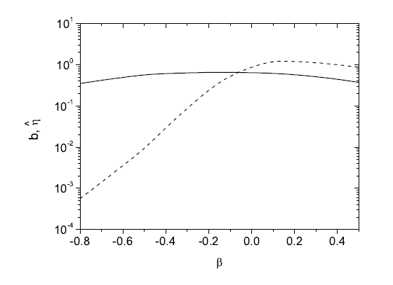
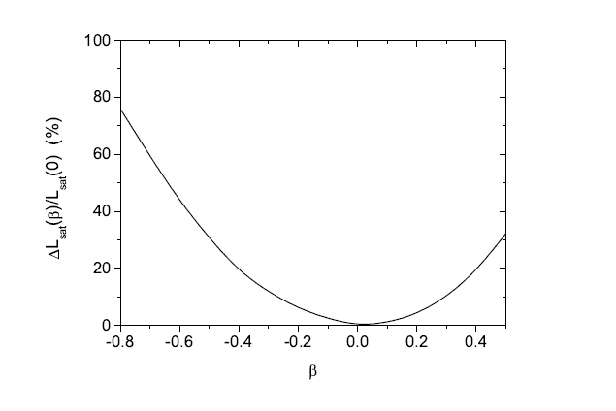

SASE FEL: 1D simulations
b bunching (0<b<1)
normalized power (efficiency)
$$=0.2$$
energy spread parameter
Bunching and power at saturation
Relative increase of the saturation length
Notes:
Before you start editing the slides of your talk change to the Master Slide view:
Menu button “View”, Master, Slide Master:
Edit the following 2 items in the 1st slide:
1) 1st row in the violet header:
Delete the existent text and write the title of your talk into this text field
2) The 2 rows in the footer area: Delete the text and write the information
regarding your talk (same as on the Title Slide) into this text field.
If you want to use more partner logos position them left
beside the DESY logo in the footer area
Close Master View

Slide 9
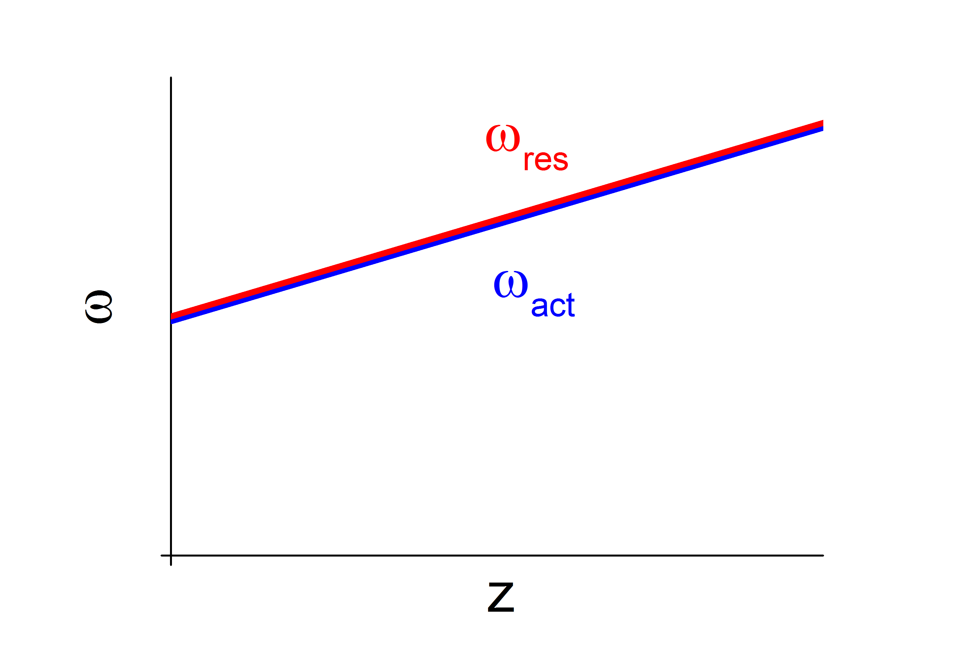
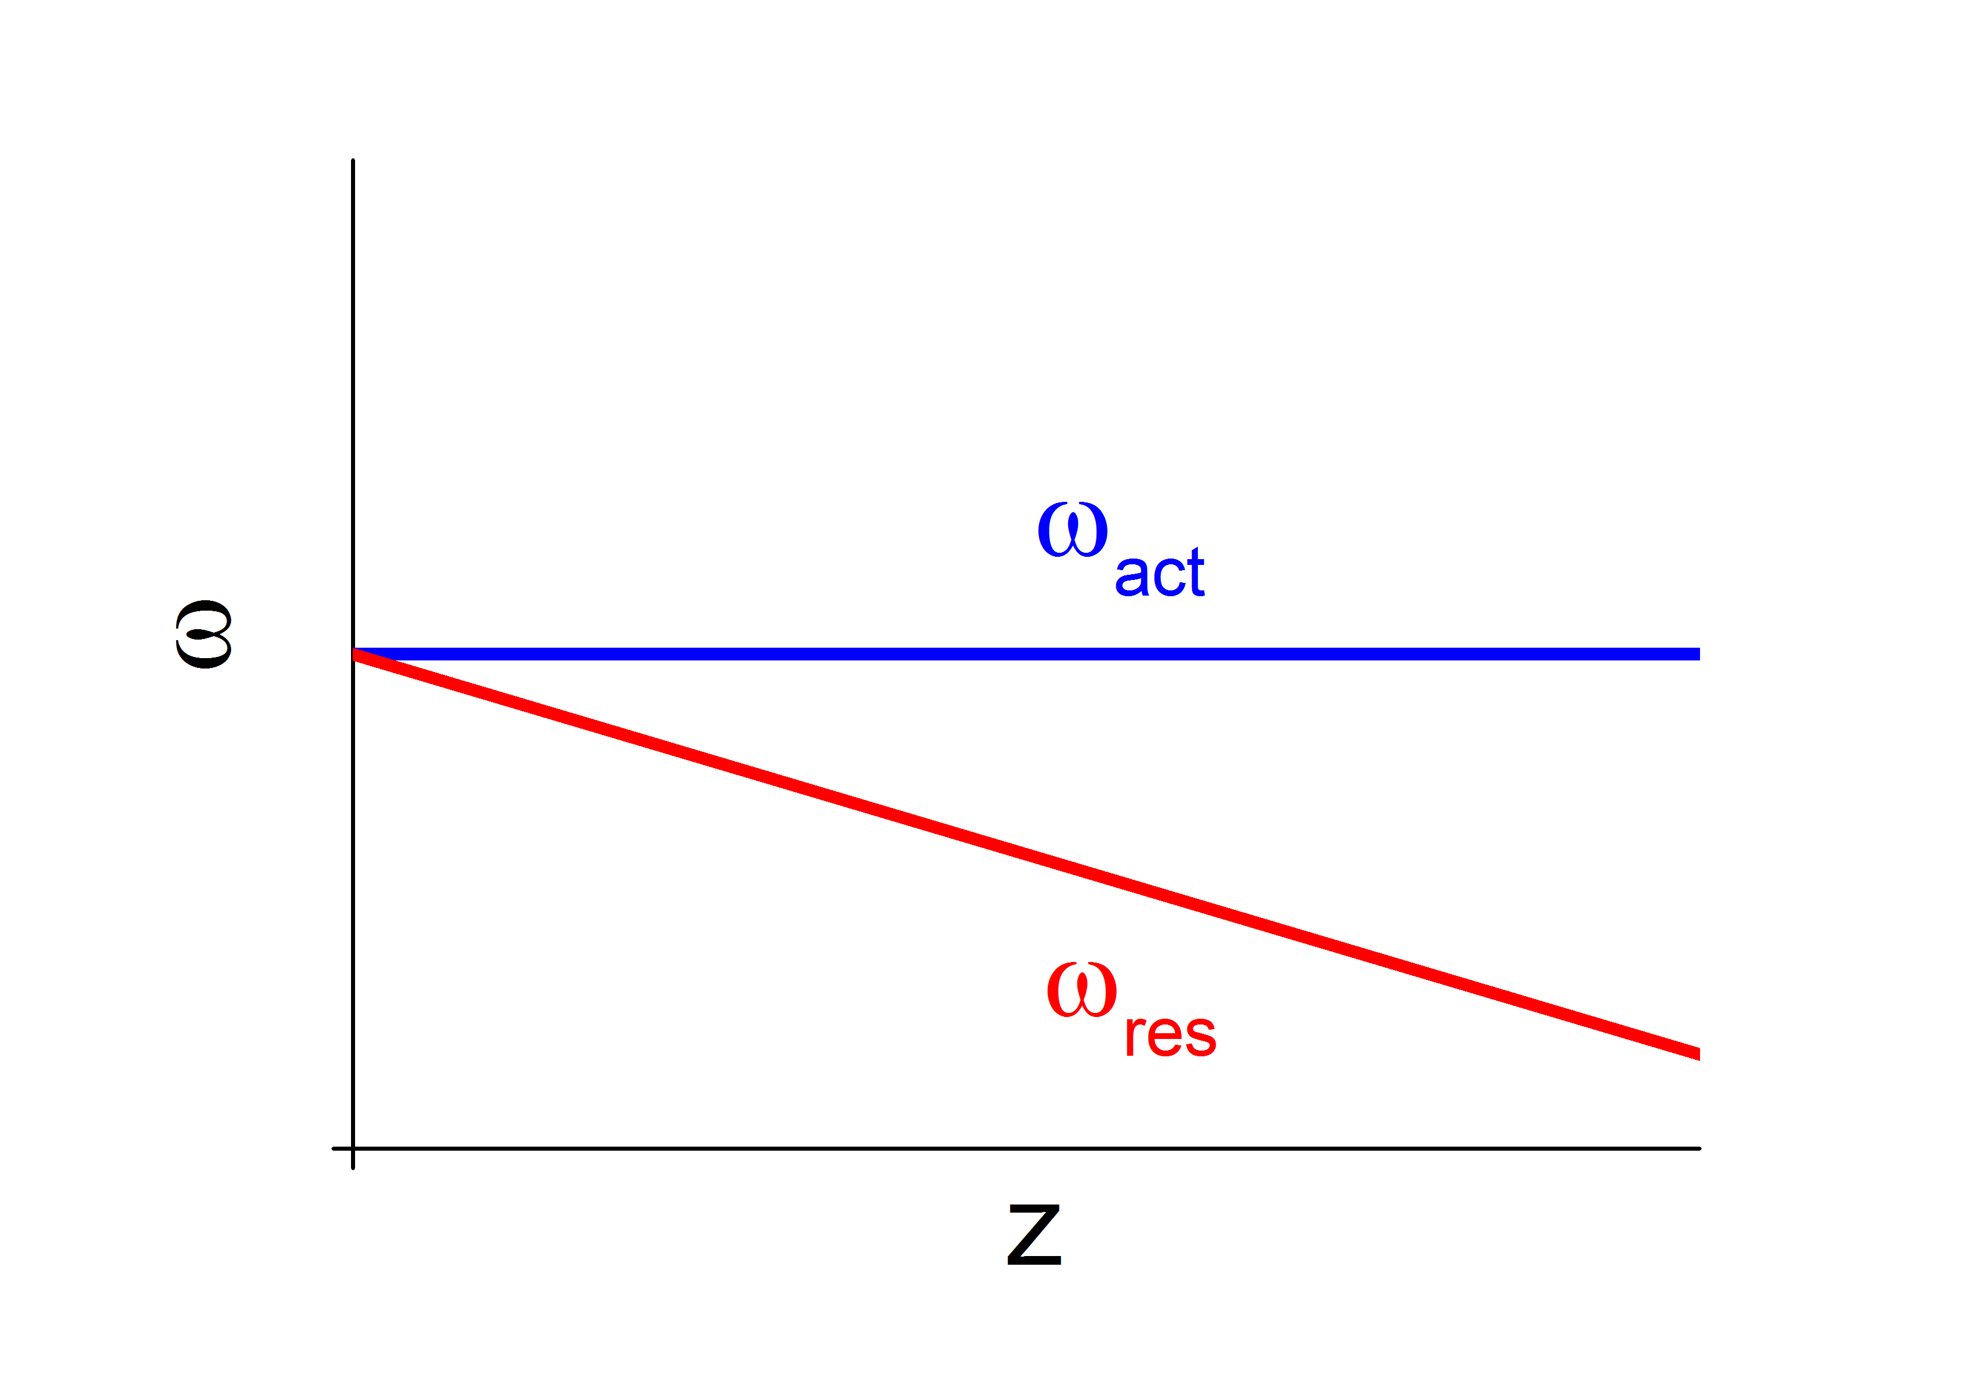
Frequency shift
In a SASE FEL the evolution of the amplified frequency band depends on tapering. Consider the asymptote of a large parameter |β|.
β > 0
β < 0
For positive parameter, the frequency follows the change of resonance completely. For negative parameter, it doesn’t follow current resonance at all; it stays at the resonance with undulator parameters at its entrance.
Notes:
Before you start editing the slides of your talk change to the Master Slide view:
Menu button “View”, Master, Slide Master:
Edit the following 2 items in the 1st slide:
1) 1st row in the violet header:
Delete the existent text and write the title of your talk into this text field
2) The 2 rows in the footer area: Delete the text and write the information
regarding your talk (same as on the Title Slide) into this text field.
If you want to use more partner logos position them left
beside the DESY logo in the footer area
Close Master View

Slide 10







Steady-state, exponential gain regime
Consider monochromatic seed, no taper but large negative detuning: ,
Scaled gain length is now $Lg$Γ $≈$
One can solve initial-value problem and find for the exponential gain regime:
field
bunching
energy modulation
Notes:
Before you start editing the slides of your talk change to the Master Slide view:
Menu button “View”, Master, Slide Master:
Edit the following 2 items in the 1st slide:
1) 1st row in the violet header:
Delete the existent text and write the title of your talk into this text field
2) The 2 rows in the footer area: Delete the text and write the information
regarding your talk (same as on the Title Slide) into this text field.
If you want to use more partner logos position them left
beside the DESY logo in the footer area
Close Master View

Slide 11

Steady-state, exponential gain regime: resonance
Scaled gain length is now $Lg$Γ $≈$1
field
1
1
energy modulation
bunching
1
Notes:
Before you start editing the slides of your talk change to the Master Slide view:
Menu button “View”, Master, Slide Master:
Edit the following 2 items in the 1st slide:
1) 1st row in the violet header:
Delete the existent text and write the title of your talk into this text field
2) The 2 rows in the footer area: Delete the text and write the information
regarding your talk (same as on the Title Slide) into this text field.
If you want to use more partner logos position them left
beside the DESY logo in the footer area
Close Master View

Slide 12

SASE FEL, large reverse paper
Now SASE and large reverse taper. The FEL frequency band stays close to resonance at the undulator entrance (and not at the present position), i.e. detuning increases as the beam propagates through the undulator. Gain length also increases
and the ratio is
Since gain length increases along the undulator length, an increase in saturation length is smaller than an increase in last gain length(s).
Notes:
Before you start editing the slides of your talk change to the Master Slide view:
Menu button “View”, Master, Slide Master:
Edit the following 2 items in the 1st slide:
1) 1st row in the violet header:
Delete the existent text and write the title of your talk into this text field
2) The 2 rows in the footer area: Delete the text and write the information
regarding your talk (same as on the Title Slide) into this text field.
If you want to use more partner logos position them left
beside the DESY logo in the footer area
Close Master View

Slide 13
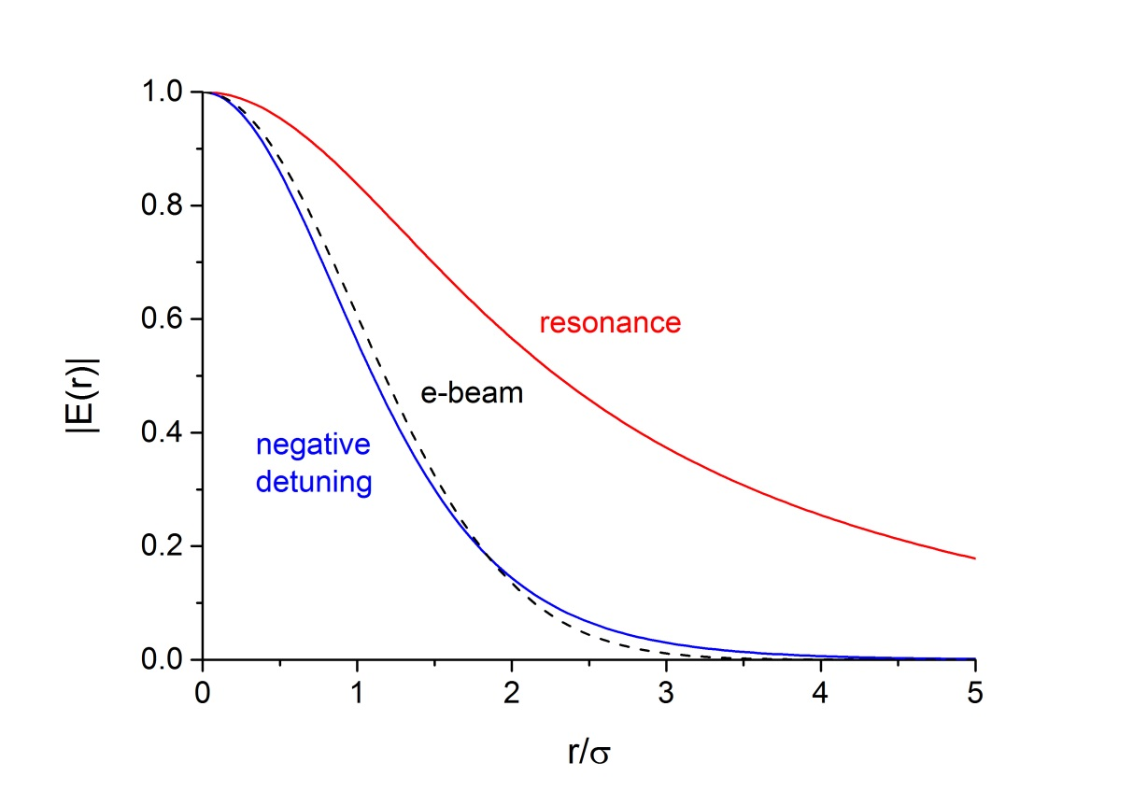
3D bonus
Transverse mode gets more narrow for negative detuning. Thus, the field acting on particles is stronger for the same power.
B = 0.1
C = 0
C=-20
Notes:
Before you start editing the slides of your talk change to the Master Slide view:
Menu button “View”, Master, Slide Master:
Edit the following 2 items in the 1st slide:
1) 1st row in the violet header:
Delete the existent text and write the title of your talk into this text field
2) The 2 rows in the footer area: Delete the text and write the information
regarding your talk (same as on the Title Slide) into this text field.
If you want to use more partner logos position them left
beside the DESY logo in the footer area
Close Master View

Slide 14
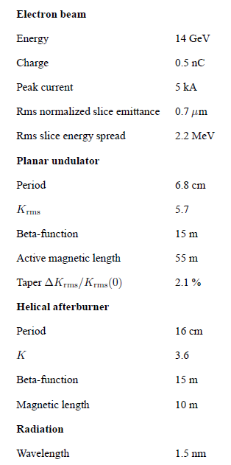
Parameters for 3D simulations of SASE3
Notes:
Before you start editing the slides of your talk change to the Master Slide view:
Menu button “View”, Master, Slide Master:
Edit the following 2 items in the 1st slide:
1) 1st row in the violet header:
Delete the existent text and write the title of your talk into this text field
2) The 2 rows in the footer area: Delete the text and write the information
regarding your talk (same as on the Title Slide) into this text field.
If you want to use more partner logos position them left
beside the DESY logo in the footer area
Close Master View

Slide 15
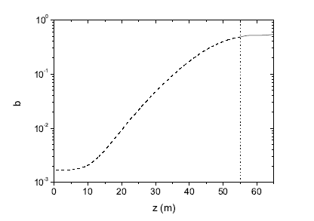
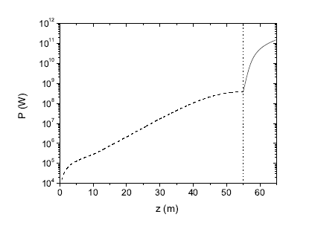
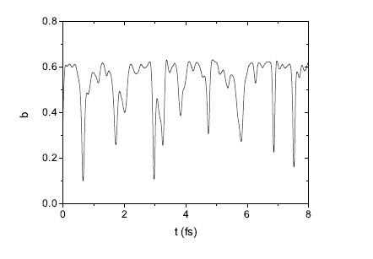
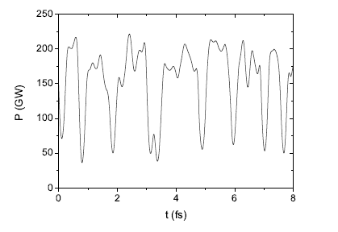

Results of simulations with FAST
$$≈400$$
bunching
power
E. Schneidmiller and M. Yurkov, Workshop on variable polarization at SASE3, European XFEL, Feb. 11, 2016
Notes:
Before you start editing the slides of your talk change to the Master Slide view:
Menu button “View”, Master, Slide Master:
Edit the following 2 items in the 1st slide:
1) 1st row in the violet header:
Delete the existent text and write the title of your talk into this text field
2) The 2 rows in the footer area: Delete the text and write the information
regarding your talk (same as on the Title Slide) into this text field.
If you want to use more partner logos position them left
beside the DESY logo in the footer area
Close Master View

Slide 16
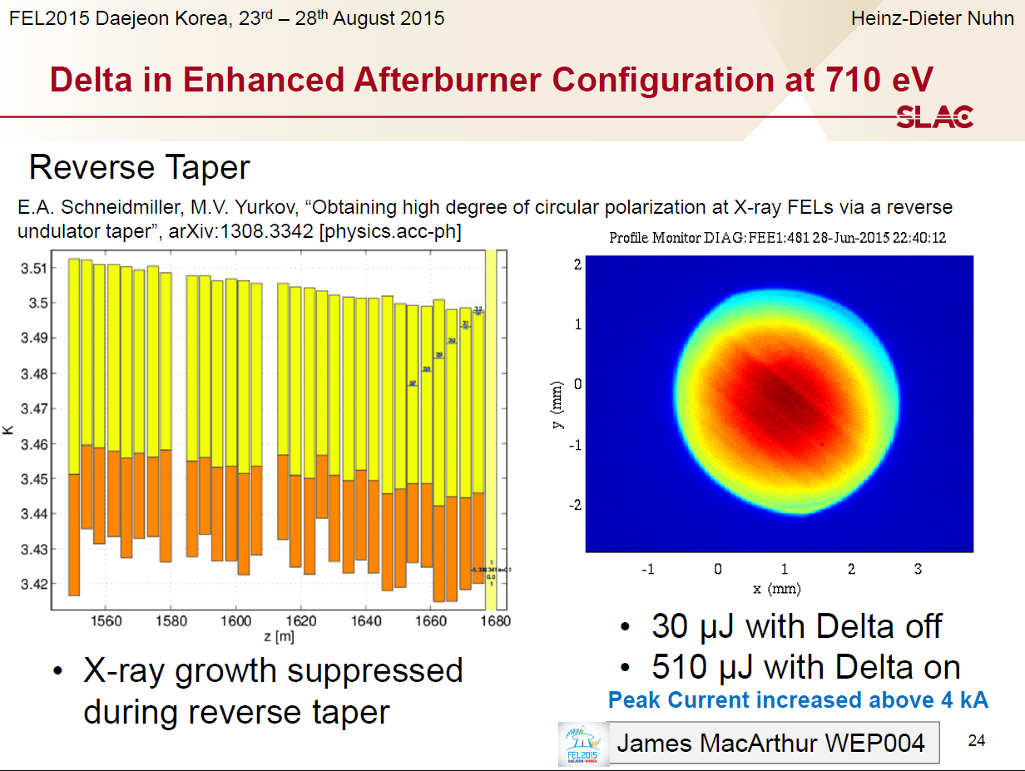
Reverse taper at LCLS
Courtesy
H.-D. Nuhn
Notes:
Before you start editing the slides of your talk change to the Master Slide view:
Menu button “View”, Master, Slide Master:
Edit the following 2 items in the 1st slide:
1) 1st row in the violet header:
Delete the existent text and write the title of your talk into this text field
2) The 2 rows in the footer area: Delete the text and write the information
regarding your talk (same as on the Title Slide) into this text field.
If you want to use more partner logos position them left
beside the DESY logo in the footer area
Close Master View

Slide 17
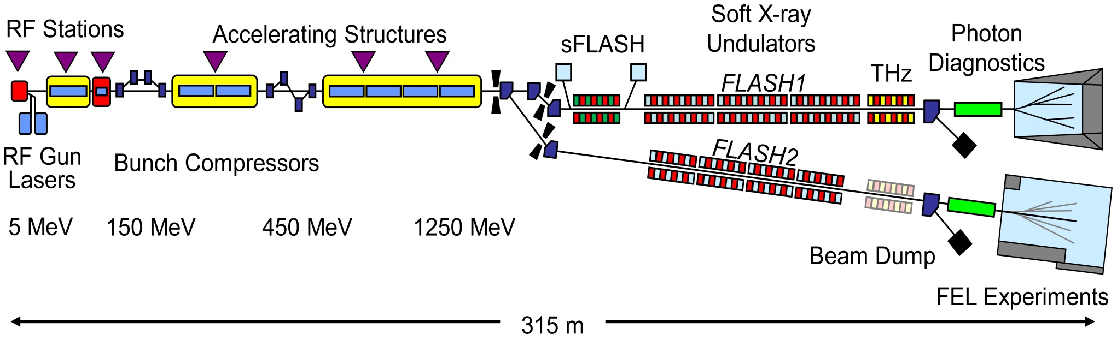
FLASH layout
Undulators
Period Length
FLASH1: 2.73 cm 27 m (6 x 4.5 m modules) fixed gap
FLASH2: 3.14 cm 30 m (12 x 2.5 m modules) variable gap
E. Schneidmiller and M. Yurkov, Workshop on variable polarization at SASE3, European XFEL, Feb. 11, 2016
Notes:
Before you start editing the slides of your talk change to the Master Slide view:
Menu button “View”, Master, Slide Master:
Edit the following 2 items in the 1st slide:
1) 1st row in the violet header:
Delete the existent text and write the title of your talk into this text field
2) The 2 rows in the footer area: Delete the text and write the information
regarding your talk (same as on the Title Slide) into this text field.
If you want to use more partner logos position them left
beside the DESY logo in the footer area
Close Master View

Slide 18
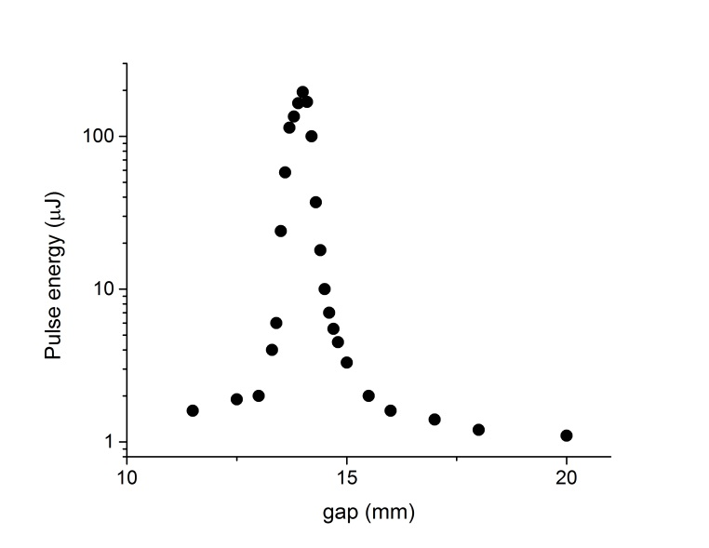

Reverse taper experiment at FLASH2
23.01.2016
Beam energy 720 MeV,
wavelength 17 nm.
Reverse taper (10%) was applied to the 10 undulator segments;
the gap of the 11th and 12th segments was scanned.
reverse-tapered undulator
“afterburner”
$$≈200$$
Power ratio of 200 was obtained. For a helical afterburner it would be larger by a factor of 2.
(x 2)
E. Schneidmiller and M. Yurkov, Workshop on variable polarization at SASE3, European XFEL, Feb. 11, 2016
Notes:
Before you start editing the slides of your talk change to the Master Slide view:
Menu button “View”, Master, Slide Master:
Edit the following 2 items in the 1st slide:
1) 1st row in the violet header:
Delete the existent text and write the title of your talk into this text field
2) The 2 rows in the footer area: Delete the text and write the information
regarding your talk (same as on the Title Slide) into this text field.
If you want to use more partner logos position them left
beside the DESY logo in the footer area
Close Master View

Slide 19
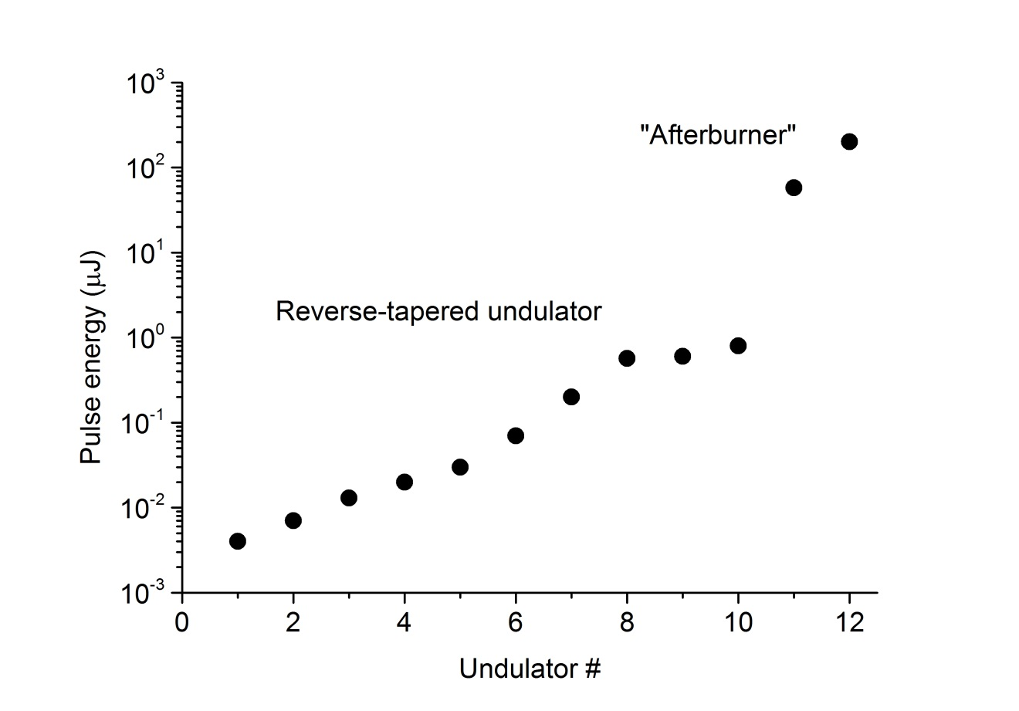
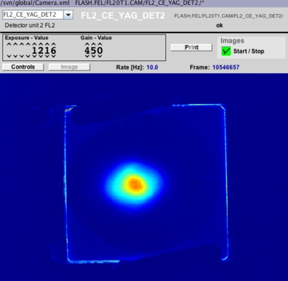

Reverse taper experiment at FLASH2 (cont’d)
$$≈200$$
(x 2)
Simulations for SASE3
$$≈400$$
E. Schneidmiller and M. Yurkov, Workshop on variable polarization at SASE3, European XFEL, Feb. 11, 2016
Notes:
Before you start editing the slides of your talk change to the Master Slide view:
Menu button “View”, Master, Slide Master:
Edit the following 2 items in the 1st slide:
1) 1st row in the violet header:
Delete the existent text and write the title of your talk into this text field
2) The 2 rows in the footer area: Delete the text and write the information
regarding your talk (same as on the Title Slide) into this text field.
If you want to use more partner logos position them left
beside the DESY logo in the footer area
Close Master View

Slide 20
Experiment at FLASH2 on March 12
We repeated the reverse taper experiment at the same wavelength but at a higher electron energy (930 MeV) on March 12.
Rms undulator parameter was 1.6, and the ten undulator sections were reverse-tapered by 5 %.
The pulse energy was 0.25 microjoules, while after tuning the 11th and the 12th sections to the resonance it reached 60 microjoules, i.e. the contrast above 200 was demonstrated again.
We could also tune the "afterburner" to the second harmonic and measure 1.8 microjoules.
This is an important demonstration because a harmonic afterburner with variable polarization might be installed at FLASH2. Reverse tapering in the main undulator will provide background-free radiation from the afterburner.
E. Schneidmiller and M. Yurkov, Workshop on variable polarization at SASE3, European XFEL, Feb. 11, 2016
Notes:
Before you start editing the slides of your talk change to the Master Slide view:
Menu button “View”, Master, Slide Master:
Edit the following 2 items in the 1st slide:
1) 1st row in the violet header:
Delete the existent text and write the title of your talk into this text field
2) The 2 rows in the footer area: Delete the text and write the information
regarding your talk (same as on the Title Slide) into this text field.
If you want to use more partner logos position them left
beside the DESY logo in the footer area
Close Master View

Slide 21
Conclusion
A method for suppression of linearly polarized background and obtaining high degree of circular polarization is proposed
The method is free and easy to implement
It is routinely used at LCLS and shown to work nicely at FLASH2
The method will be used for SASE3 undulator of the European XFEL, it can also be used for FLASH2 with harmonic afterburner
Notes:
Before you start editing the slides of your talk change to the Master Slide view:
Menu button “View”, Master, Slide Master:
Edit the following 2 items in the 1st slide:
1) 1st row in the violet header:
Delete the existent text and write the title of your talk into this text field
2) The 2 rows in the footer area: Delete the text and write the information
regarding your talk (same as on the Title Slide) into this text field.
If you want to use more partner logos position them left
beside the DESY logo in the footer area
Close Master View

