Slide 1
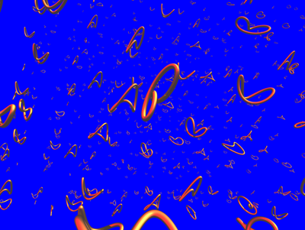
String Theory
A picture book

Slide 2
Closed strings and SUGRA
Closed string theory in background X
Infinite tower of vibrational modes M² ~ n/ℓs
String interaction through 3-vertex gs
String length
2
String
coupling
-1
At low energies (E « ℓs ): massless closed str.
modes behave like gravitons
10D SUGRA

Slide 3
Closed strings and SUGRA
Closed string theory in background X
Infinite tower of vibrational modes M² ~ n/ℓs
String interaction through 3-vertex gs
String length
2
String
coupling
-1
At low energies (E « ℓs ): massless closed str.
modes behave like gravitons
10D SUGRA

Slide 4
Solitonic & Dirichlet p-branes
10-dim SUGRA has
solutions describing
massive & charged
objects localized on
p+1 - dim. surfaces.
D-branes are objects on
which open strings can
end [Polchinski]
[black branes]
Branes in string theory ?

Slide 5
Open strings & gauge theory
-1
At low energies (E«ℓs ):
massless modes of the
open string behave like
gauge bosons + matter
on the world-volume of
D-branes.
Aab
p+1- dimensional
gauge theory
a .. b N

Slide 6
Gauge-String theory dualities
Depending on Δy
one side simpler
Δy << ℓs: gauge th
↔ closed string th
Holography
← Δy →
• Closed string in curved 10-dimensional space
• Gauge theory loop ← classical string theory !
High redshift ↔ soft strings ↔ meson resonances

Slide 7

Example: AdS₅ / CFT₄ duality
Gauge theory on stack Strings in their near
of Nc D3 - branes horizon geometry
N=4 4D S Yang-Mills
Strings in AdS₅ x S⁵
U(Nc) gauge field A; 6 scalars Φ
par.: λ=g²_{YM} N_{c} ; N_{c} | R⁴ / ℓ_{s}⁴=λ ; g_{s}=λ/N_{c}
Gauge inv. operators | Closed string states
Anomalous dimensions | Mass of string mode
…...
…...
Notes:
in dictionary mention T <-> graviton
Sum: CST & gravity, branes, open strings, gauge theory; Maldacena duality (strong weak coupling)

Slide 8
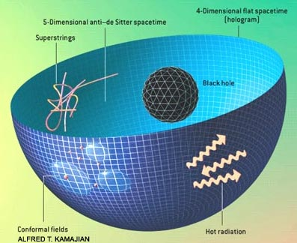
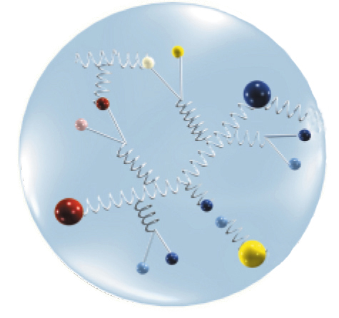
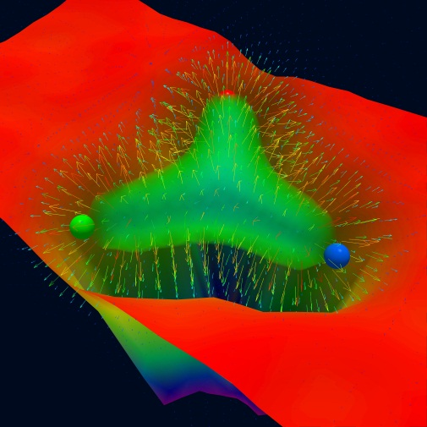
Map of Physics
ls/R
[Polyakov, Maldacena]
pert. String Theory
Nc
pert.
Gauge
Theory
[‘t Hooft]
Lattice
Gauge Theory
gs
Quantum Gravity
λ
Notes:
AdS/CFT is not so important for this picture since it is not directly linked to integrability!
It is possible to have integrability even when there is no sigma model regime.
QCD might be integrable even if it does not have an AdS dual.
It might still simplify in the large coupling regime (but not to geometric theory)

