Slide 1



WELCOME
DESY SUMMER STUDENTS
2022

Slide 2
Why doing a doctorate at DESY?
Is one of the world’s leading accelerator centres
Excellence of DESYs Scientists
Cooperations with excellent partners worldwide
Exciting interdisciplinary setting
Cooperates with industry and business
Benefits from the metropolitan regions of the two DESY locations: Hamburg& Zeuthen
DESY is directly involved in 4 graduate schools which offer tailored made structure, services and scientific excellence to the young scientists

Slide 3
DESY is directly involved in 4 graduate schools
DASHH
Data Science in Hamburg-Helmholtz Graduate School for the Structure of Matter
Photon Science / Accelerator Science / Particle Physics / Structural Biology / Materials Science / Reproducible Data Science
Call for applications: once per year, last call was in September 2021
https://www.dashh.org
HELIOS
Helmholtz-Lund International Graduate School
Atomic, Laser and Molecular Physics / Particle Physics / Nano-Bio and Nano-Physics
Next call for applications: summer 2023
https://www.heliosgraduateschool.org/

Slide 4
DESY is directly involved in 4 graduate schools
International Helmholtz-Weizmann Research School Multi-Messenger Astronomy
DESY Zeuthen
https://www.multimessenger-school.de/
PIER Helmholtz Graduate School (PHGS)
Graduate Program at DESY in Cooperation with Universität Hamburg
Particle & Astroparticle Physics / Photon Science / Nanoscience / Infection & Structurla Biology / Accelerators / Theoretical Physics
Membership possible all year long
https://graduateschool.pier-hamburg.de/

Slide 5
PHGS students at DESY and the PIER Helmholtz Graduate School (PHGS)
About 300 PhD students have a working contract with DESY
Thereof about 230 with the PIER Helmholtz Graduate School (PHGS)
PHGS: biggest Graduateschool on Campus Bahrenfeld/Hamburg
PHGS: oldest Graduateschool at DESY – founded in 2012

Slide 6
PIER Helmholtz Graduate School (PHGS)
Graduate Education Program at DESY in Cooperation with Universität Hamburg
Located on Campus Bahrenfeld Hamburg
Open to PhD students who have an affiliation with DESY and/or the University Hamburg who do their PhD in one or more of the following research fields:
  Particle and Astroparticle Physics
  Photon Science
  Nanoscience
  Infection and Structural Biology
  Accelerators
  Theoretical Physics
60 % international PhD students

Slide 7
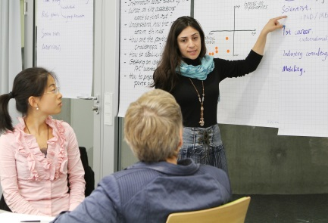
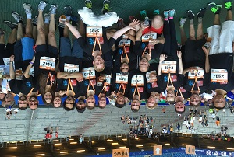
PIER Helmholtz Graduate School
PhD programme with focus on:
  Interdisciplinary qualification
  Career planning & key skills
  Internationality & service
    + Leisure activities
    + Social events
    + Networking
→ The graduate school provides a framework for
the pursuit of knowledge beyond the (narrow)
focus of the thesis research.

Slide 8
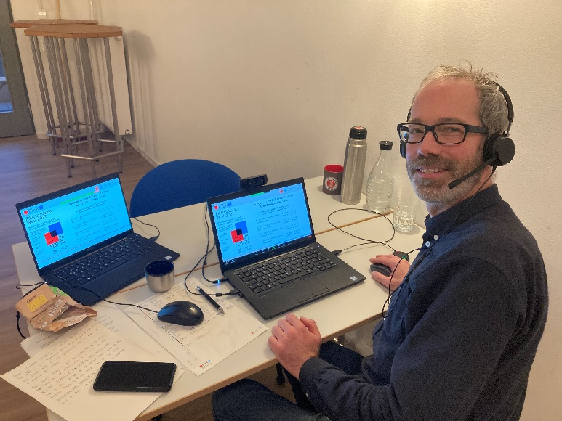
PIER activities: PIER Graduate Week
Back in 2022 after two years of absence
140 participants
8 lecture series with 25 national & international experts
4 skills workshops
Notes:
Die letzte Graduate Week fand im Oktober 2019 (in Präsenz) statt

Slide 9
Focus Career Planning & Soft Skills (online/onsite)
Communicating Science
Science Communication I: Blogging
Science Communication II: Podcasts
Science Communication III: Science Slam
Science Communication IV: (YouTube) Videos
Career Development
How to apply sucessfully
Career Orientation for PhD Students
Coordination and Management
Good Scientific Practice
Project Management
Scientific Writing
Convincing Scientific Presentations
Software
Python Basics
Python Advanced
Introduction to Machine Learning with Python
Quantum Computing
Notes:
In den vergangenen Monaten hatten wir einen Schwerpunkt auf dem Thema Communicating Science mit attraktiven modernen Formaten wie dem 1st PIER Science Slam mit 5 Slammern, einem Seminar zum Thema Blogging und Podcasting. Die Ergebnisse aller Veranstaltungen sind auf der Website der PHGS zu finden. Animieren Sie die Teilnehmenden gerne sich, in die Ergebnisse der spannenden Workshops reinzuhören. Es lohnt sich. Aber natürlich haben wir auch Angebote in den anderen 3 Schwerpunkten gemacht (Career Development, Coordination & Management, Software)

Slide 10
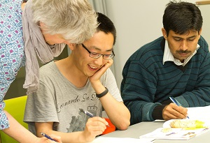

Focus Internationality & Service
Buddy programme for international PhD students
German and English language courses
Assistance with housing and visa issues
Travel grants for research trips
PhD Social hour, BBQs, Language Cafe
    One-stop-office & bridge between DESY and UHH

Slide 11
Some general facts on doing the doctorate at DESY
PhD positions are funded through a working contract e.g. with DESY or a scholarship
Duration working contract at DESY: approx. 3 - 3.5 years
Every doctoral candidate has to be enrolled at an university (e.g. Univerisität Hamburg, Humboldt Universität Berlin etc.)
Only universities can award the doctorate
No tution fees

Slide 12
How to apply for a PhD position at DESY
Use your contacts from the DESY Summer Students Programme
Look for open positions on the DESY website or the websites of your favourite research teams
Contact the respective group leaders
General information on the German education system: DAAD (www.daad.de)
(German Academic exchange Service)

Slide 13

Thank you very much for your attention
We are looking forward to seeing you again as one of our PhD students ... graduateschool.pier-hamburg.de https://twitter.com/PIERCampus https://www.linkedin.com/company/70375638/admin/

