Slide 1

Multi-lepton and general searches at HERA
Andrea Parenti (DESY-Hamburg)
on behalf of H1 and ZEUS collaborations
- DIS 2008 -
Outline:
Multi-electron search
Multi-lepton search
General search
Conclusions

Slide 2
Multi-electrons (H1+ZEUS)

Slide 3
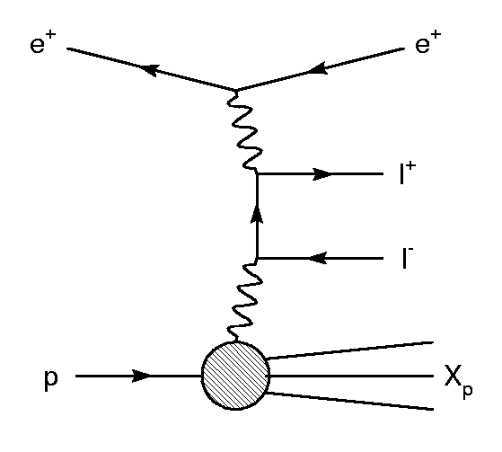
Motivation
Main production process is Bethe-Heitler: ggl⁺l⁻ (l=e, m, t)
This is a QED process, precisely calculable by theory.
SM expectation falls steeply with PT: deviations from SM would be hint of new physics.

Slide 4
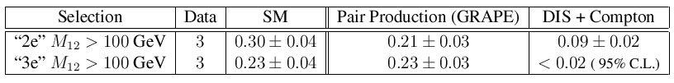
History of the electron search
H1 found some excess in HERA-I data, at high di-electron mass:
But:
  no excess found in di-muon search (mm & emm channels) by H1 (HERA-I data)
  no excess found by ZEUS, both in di-e and di-m.
More investigation was needed!

Slide 5
Data sample and selection
Full HERA data (1994-2007):
  0.94 fb⁻¹ (H1+ZEUS)
Selection cuts:
  Two electrons in 20°<q<150° with PT>10, 5 GeV
  Additional electrons searched for in 5°<q<175°
  Events are classified as “2e” or “3e” according to the number of electrons found.

Slide 6
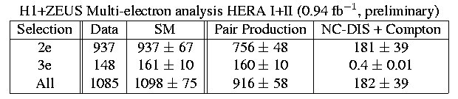
Data/SM comparison
Overall agreement between data and SM:
Let's see the differential distributions...

Slide 7
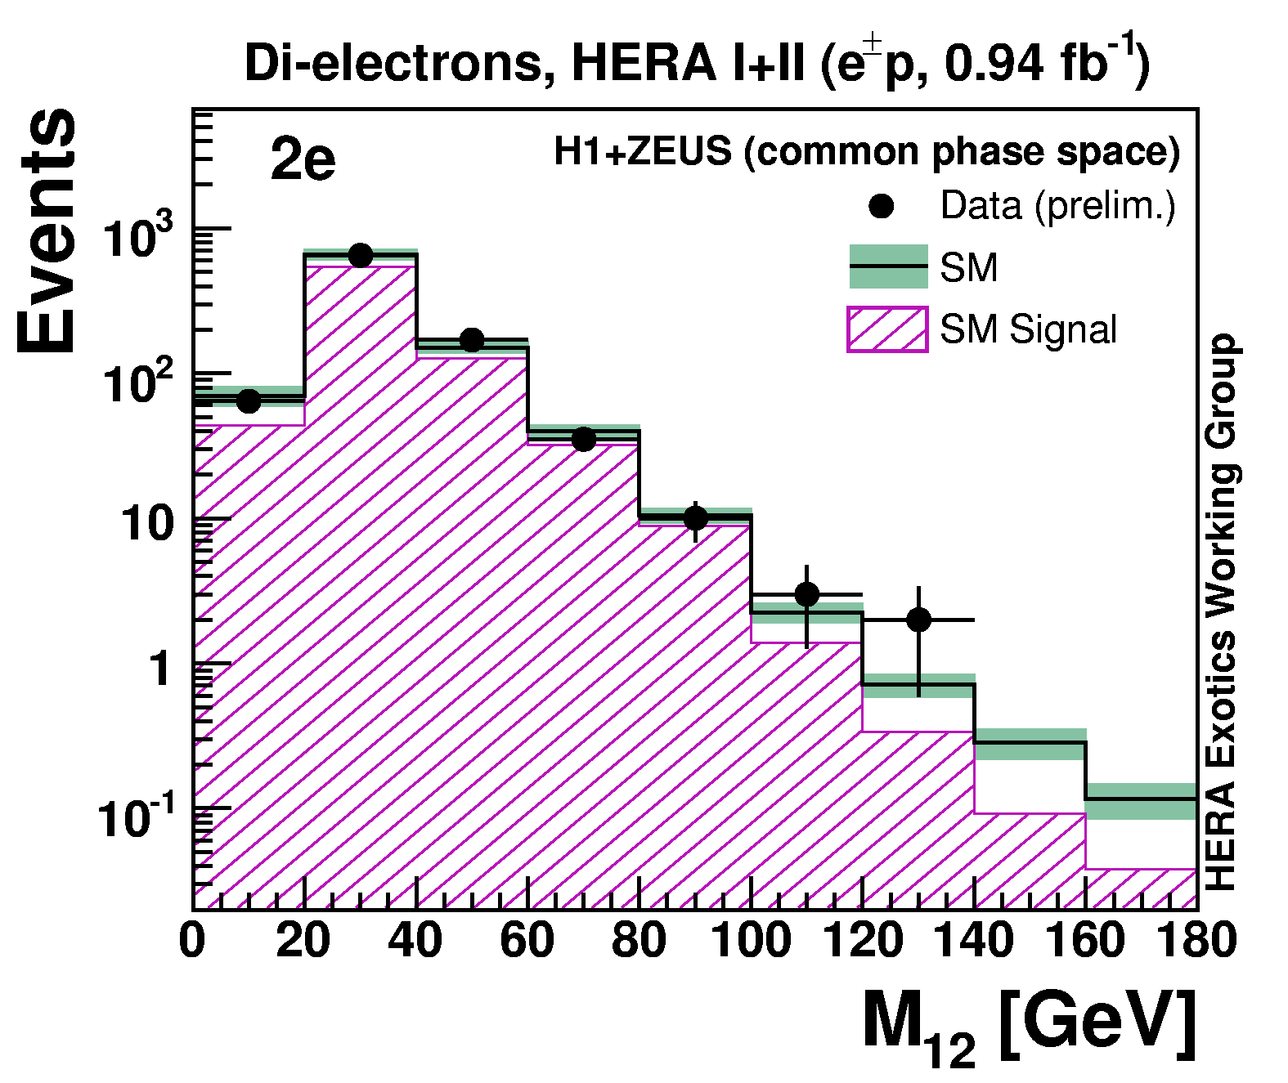
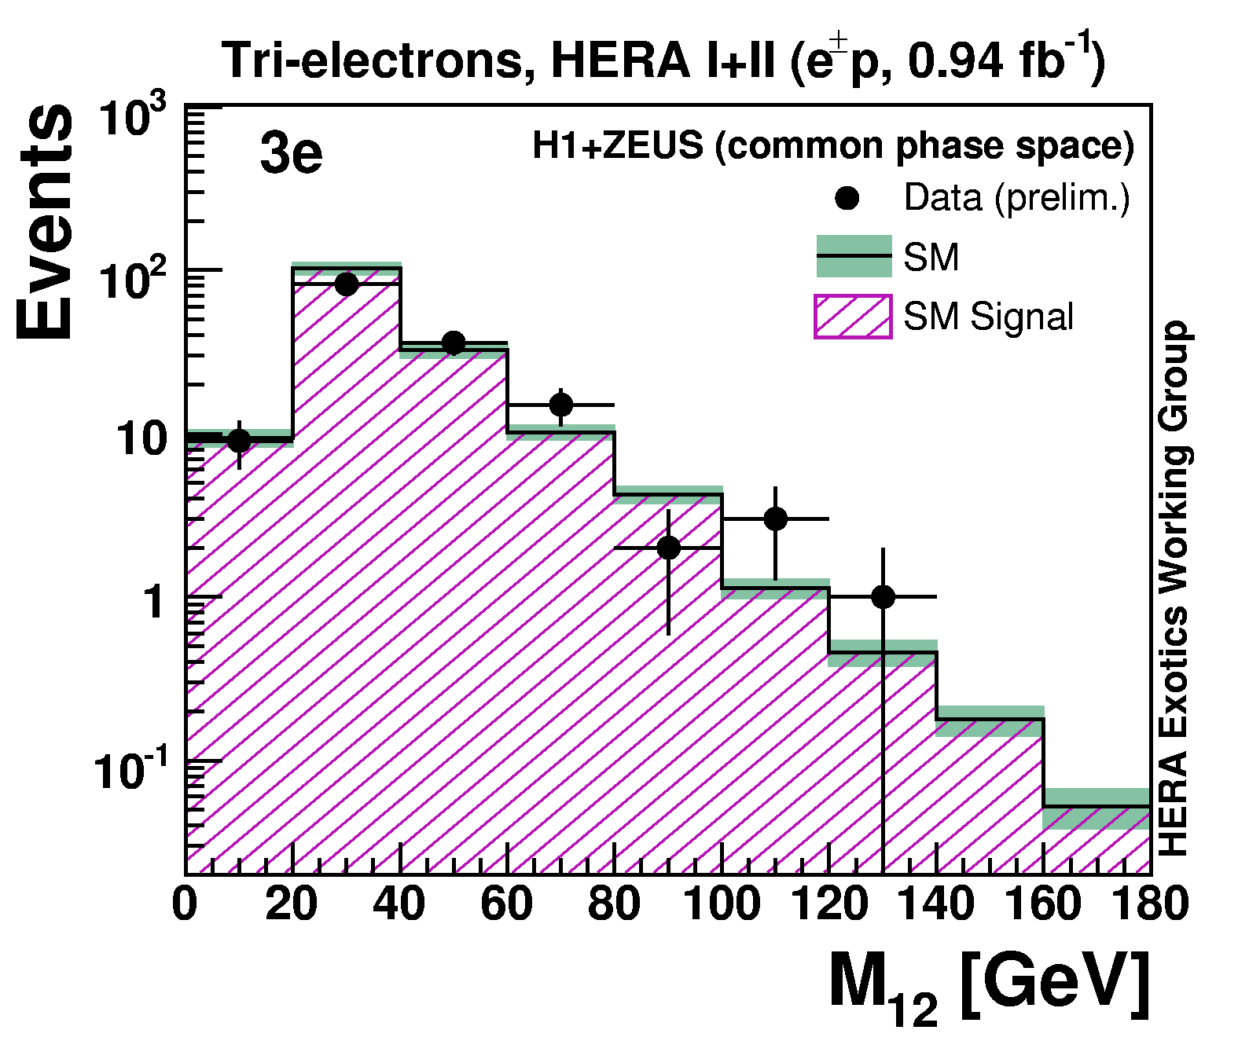
Invariant-mass distribution
M12 is the invariant mass of the two highest-PT electrons.

Slide 8
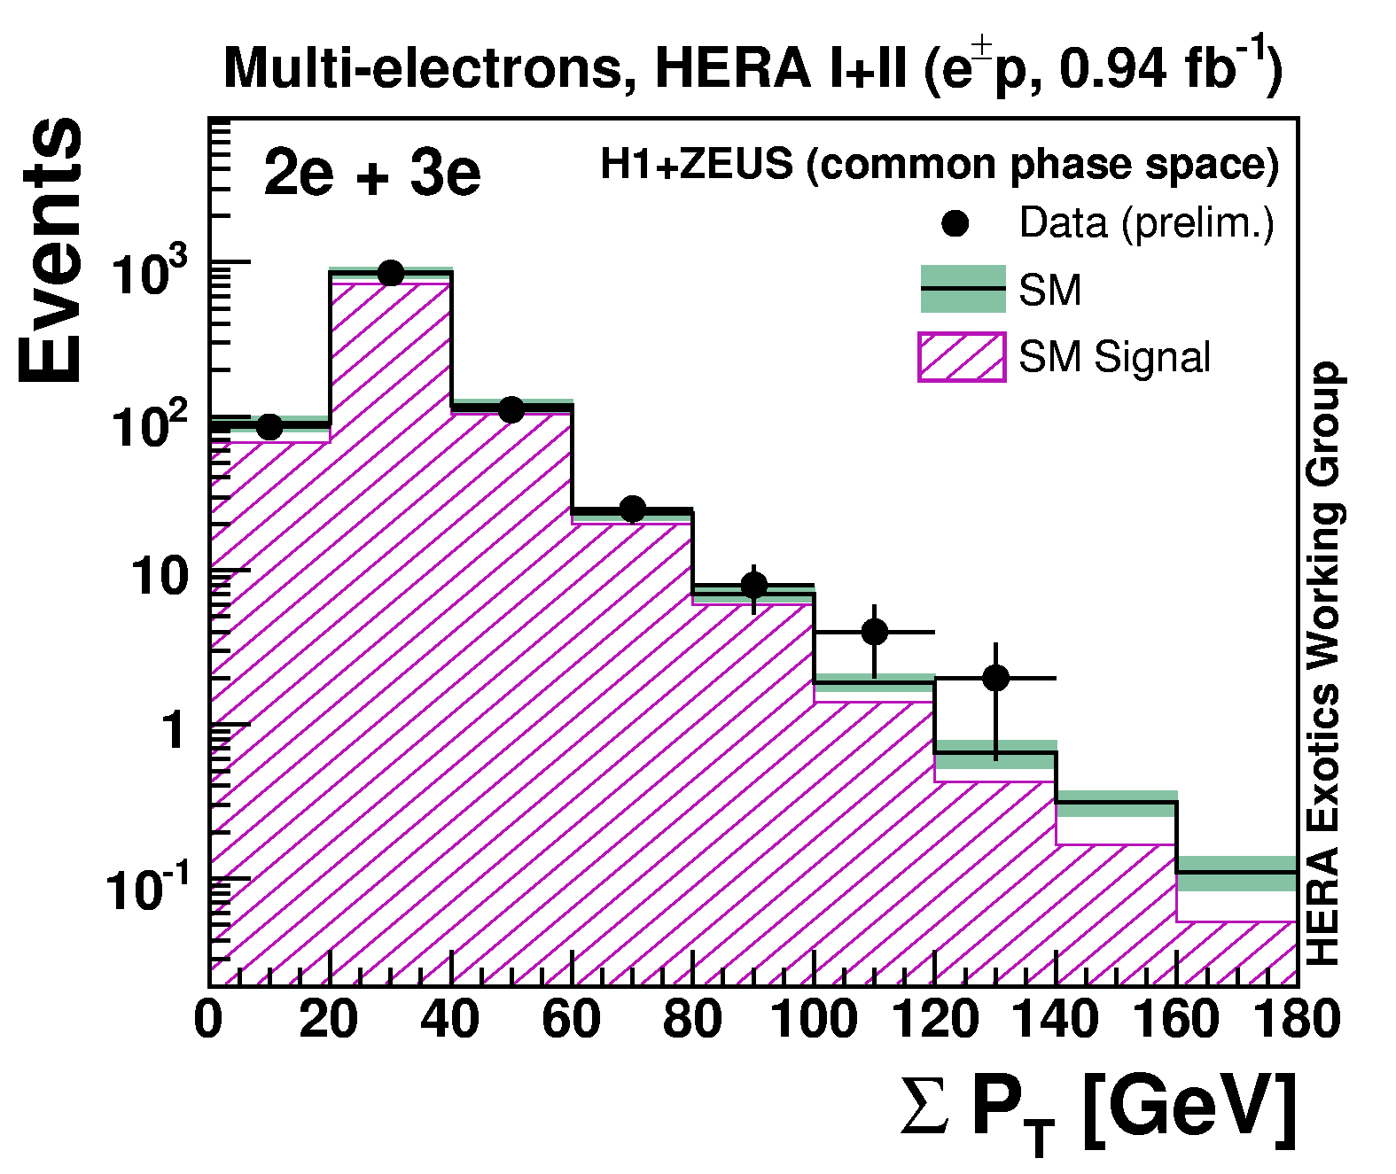
SPT distribution
Scalar sum of electron PT.

Slide 9
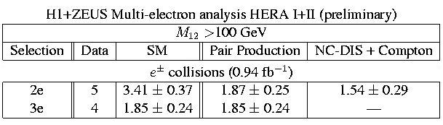
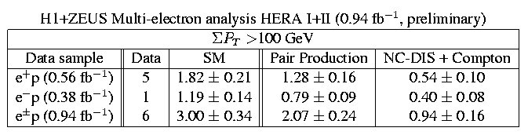
Data/SM comparison
Some striking events found at high mass...
... and high SPT

Slide 10
Multi-leptons (H1)

Slide 11
Data sample and selection
This is an extension of multi-electron search: look for events with electrons or muons.
Full HERA data (1994-2007):
  459 pb⁻¹ (H1)
Selection cuts:
  2 leptons (e, m) in 20°<q<150° with PT>10,5 GeV
  Additional electrons searched for in 5°<q<175°
  Additional muons searched for in 20°<q<160°

Slide 12
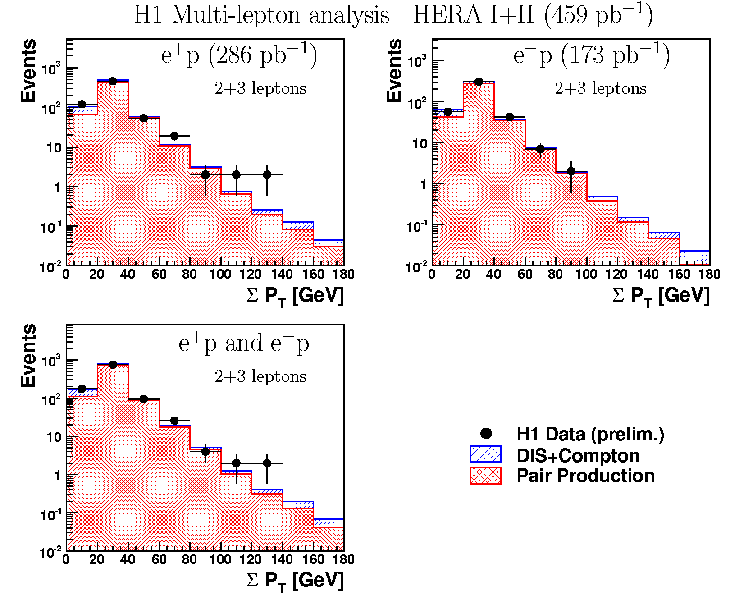
SPT distribution

Slide 13
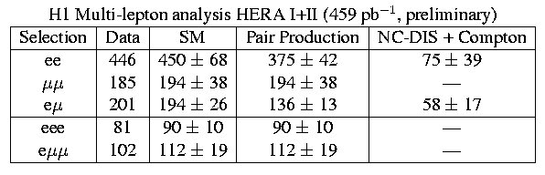
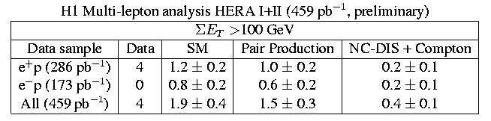
Data/SM comparison
Overall nice agreement between data and SM:
Few events found at high SPT:

Slide 14
General search for new phenomena (H1)

Slide 15
Introduction
Model independent search: look for all high-PT topologies, where SM expectation is small.
Unify all searches in a coherent statistical treatment:
  few channels may fluctuate, we want to evaluate the global significance of these fluctuations.
Though the selection (and sensitivity) is different, this search allows to inspect same topologies as multi-leptons and isolated-leptons and evaluate their global significance

Slide 16
Data sample and selection
Full HERA-II data (H1)
  e⁺p collisions (178 pb⁻¹)
  e⁻p collisions (159 pb⁻¹)
  HERA-I data published [PLB602(2004)14]
All final states involving isolated, high-PT, and well reconstructed electrons (e), muons (m), jets (j), photons (g), neutrinos (n) are investigated.
 2 of these “objects” are required, having:
  PT > 20 GeV and 10°<q<140°

Slide 17
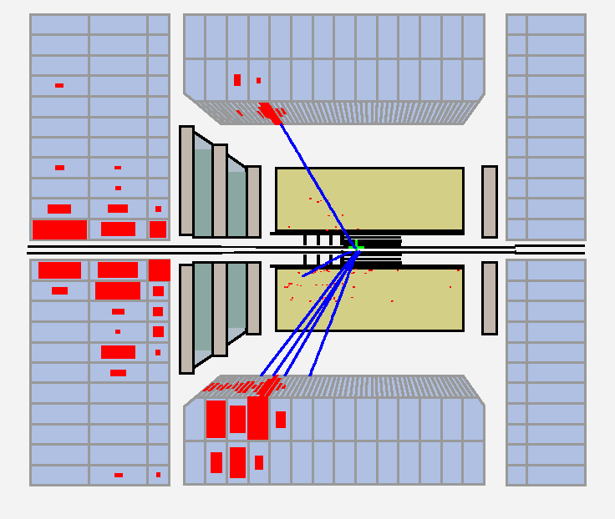
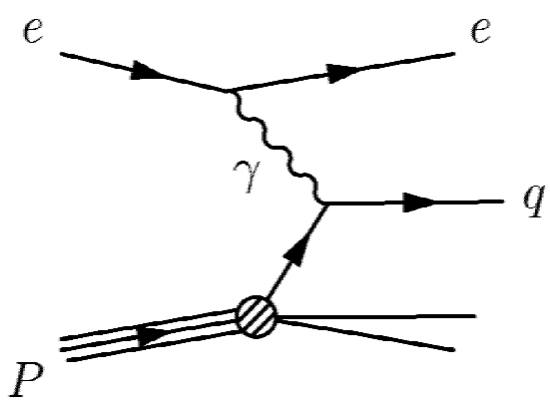
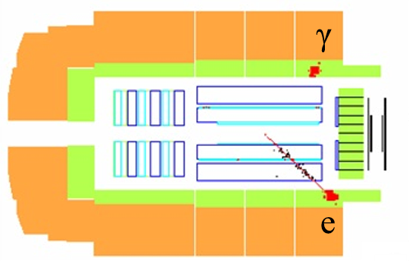
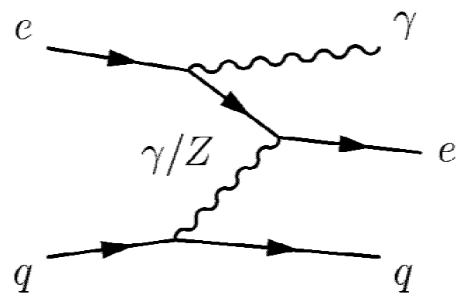
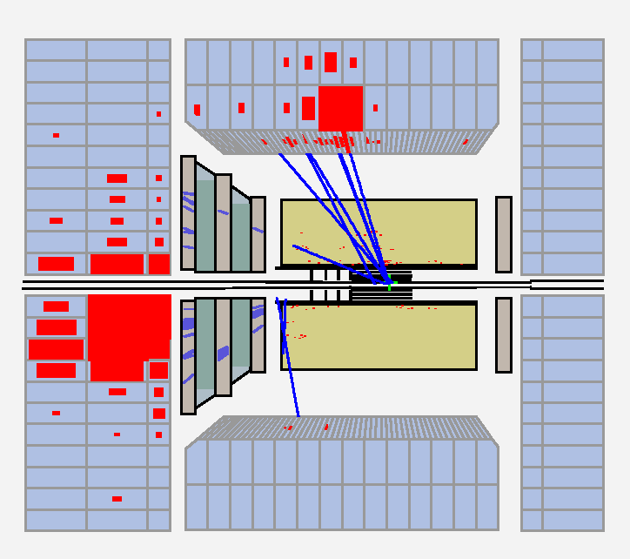
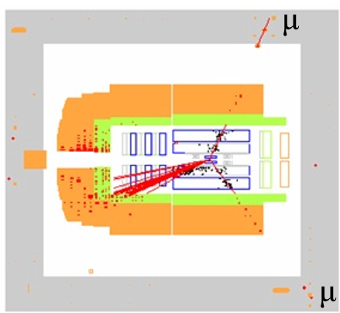
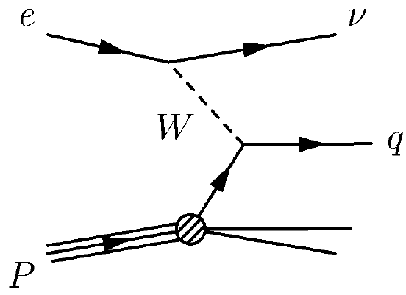
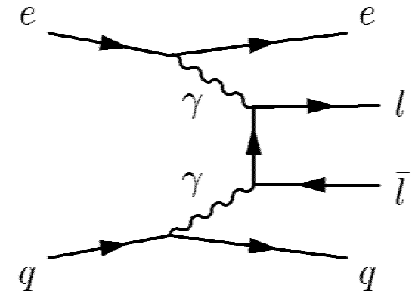
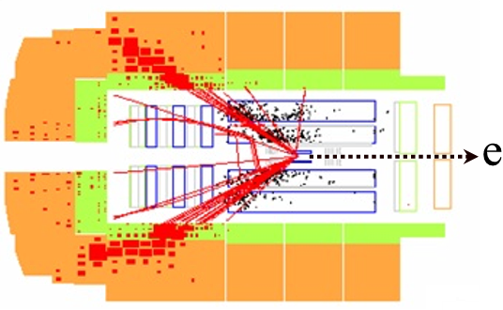
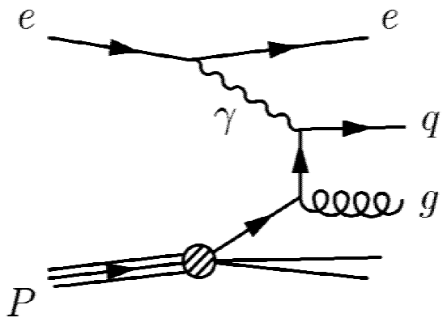
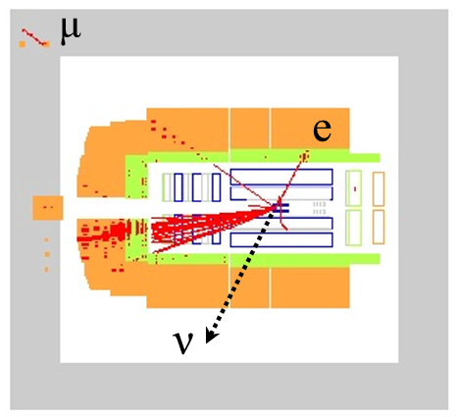
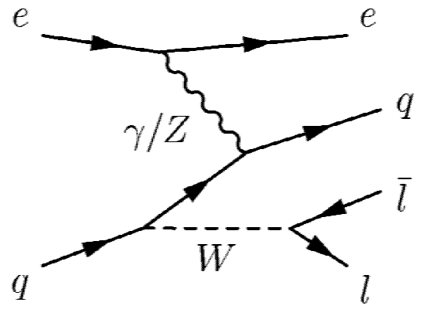
Standard Model processes
All SM ep processes need to be simulated
High statistics needed
QED Compton: ep  egX
Neutral Current DIS: ep  eX
Charged Current DIS: ep  nX
Lepton pair production: ep  ellX
Photoproduction: gp  X
W production: ep  eWX

Slide 18
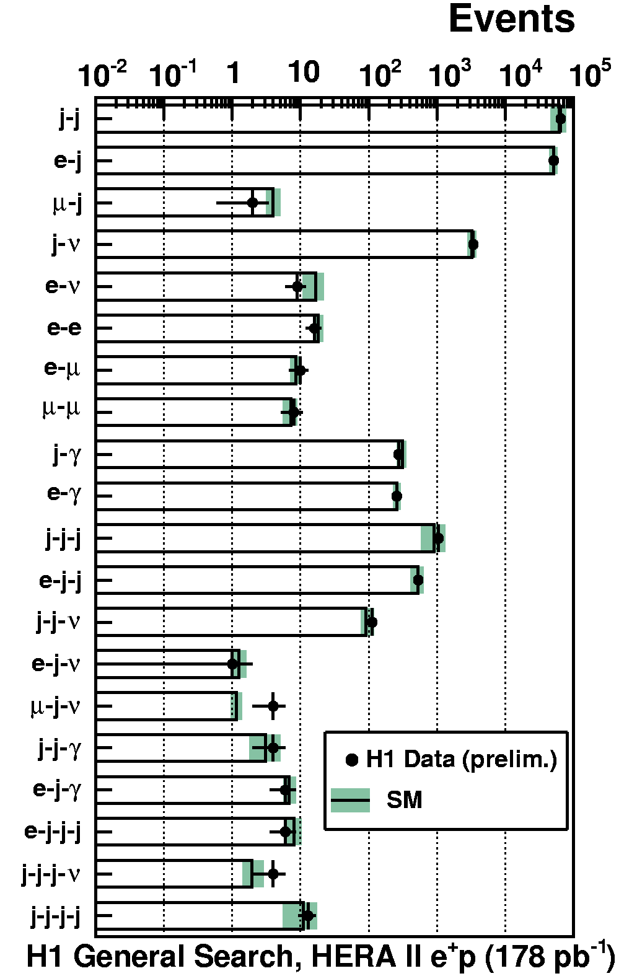
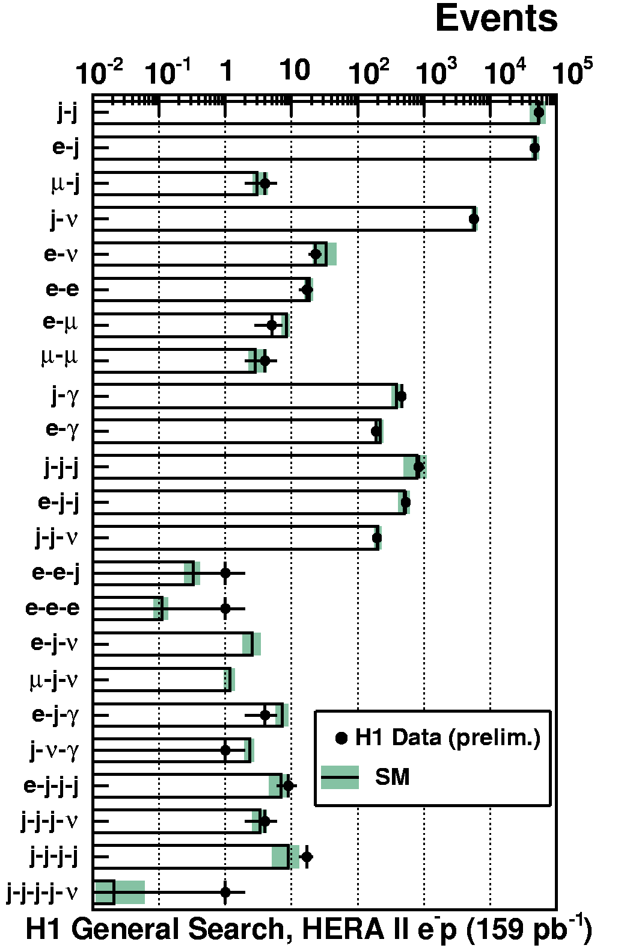
Check of SM predictions
Only channels with ≥1event (Data or SM) are shown
Same topology as isolated leptons

Slide 19
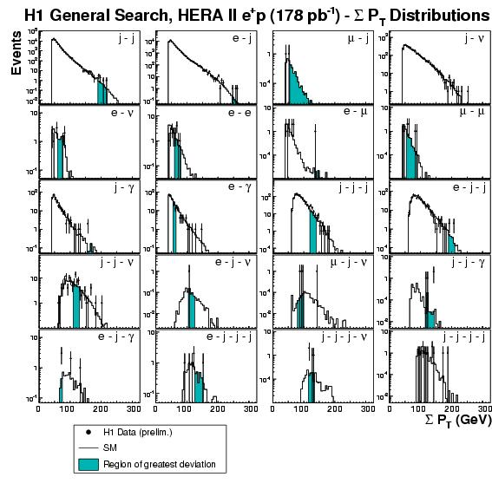
Data/MC comparison
Regions of largest deviation from SM (shaded) are identified
Significance of largest fluctuation (P) is evaluated with use of toy experiments
  Not done on jjjj and jjjjn classes (large uncertainty on SM prediction)
^

Slide 20
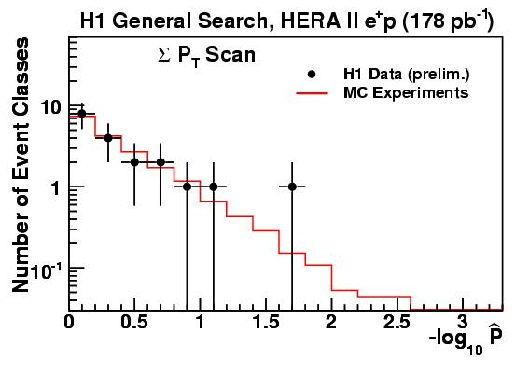
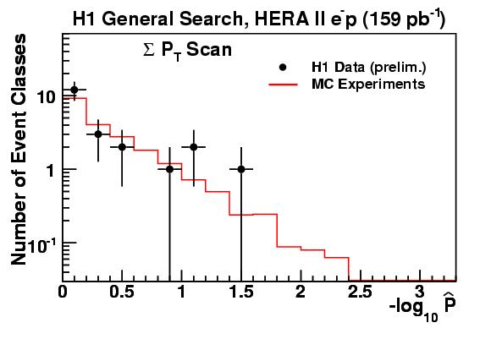
Data/SM comparison (cont.)
^
P evaluated also on SM:
  Data are completely replaced by Toy MC: we re-do a large number of "H1" experiments with ~300pb⁻¹ of lumi
SM reproduces data:
mjn
channel

Slide 21
Conclusions
A search for multi-lepton production has been done by H1 and ZEUS in HERA data (~1fb⁻¹):
  The event yield of multi-lepton events in HERA data is in good agreement with SM predictions.
  few striking events are found at high-PT
A general search for high-PT topologies has been done by H1 in HERA-II data (~0.3 fb⁻¹; HERA-I already published)

Slide 22
Conclusions (cont.)
  The largest deviation in HERA-II is observed in mjn class in e⁺p collisions. The significance of this observation is -log10P=1.7.
    In HERA-I also the largest deviation was in mjn, having -log10P=3.
  The significance distribution of data is well reproduced. No significant deviation from the Standard Model was found.
^
^

Slide 23
Additional Slides

Slide 24
Multi-electrons (H1+ZEUS)

Slide 25
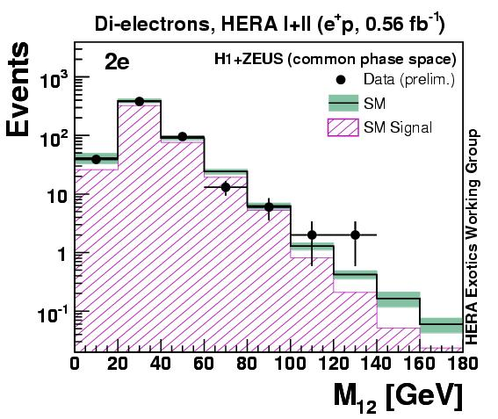
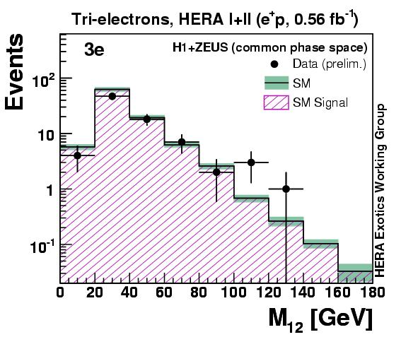
Invariant mass distribution
Invariant mass M12 for 2e and 3e samples, e⁺p collisions only.

Slide 26
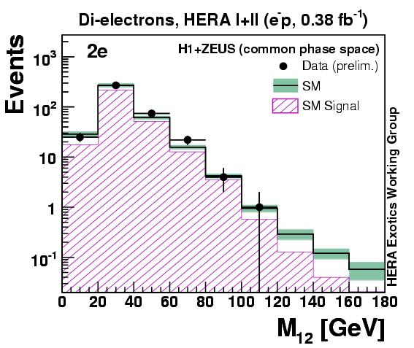
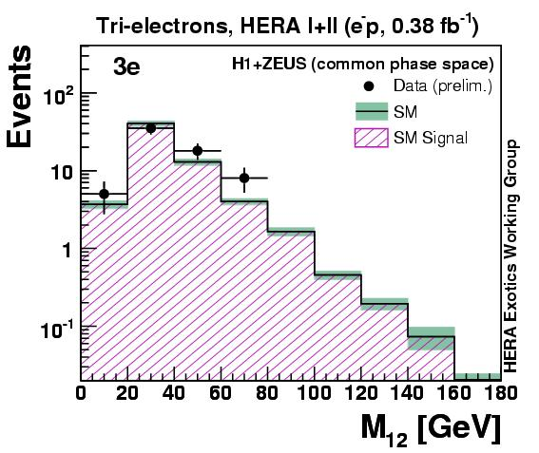
Invariant mass distribution
Invariant mass M12 for 2e and 3e samples, e⁻p collisions only.

Slide 27
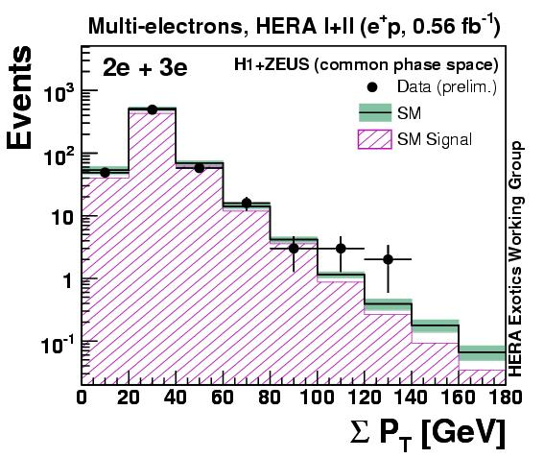
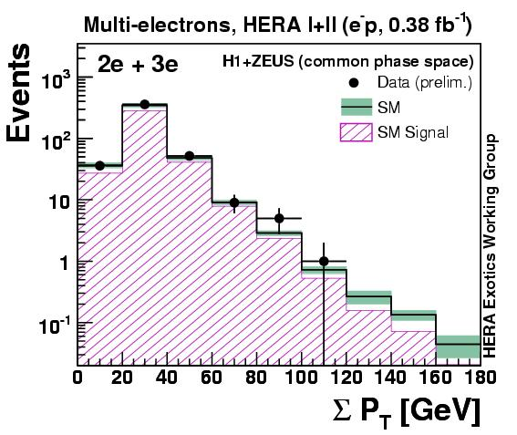
SPT distribution
Scalar sum of electron's PT, 2e+3e sample, e⁺p and e⁻p collisions separately.

Slide 28
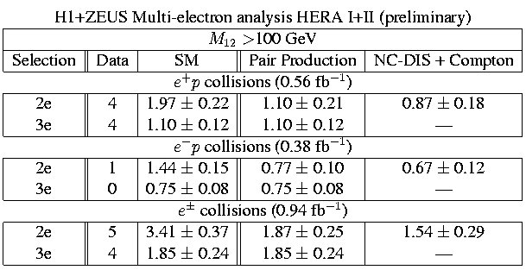
Data/MC comparison
Few events found at high mass:

Slide 29
Multi-leptons (H1)

Slide 30
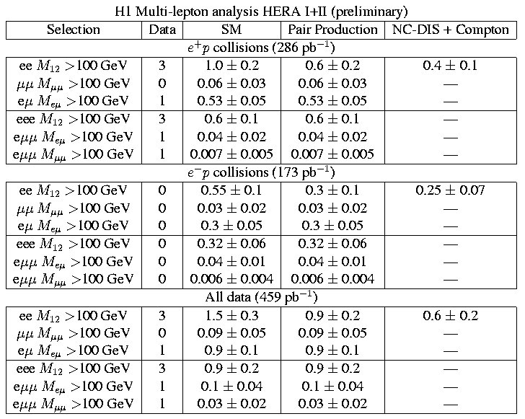
Data/MC comparison

Slide 31
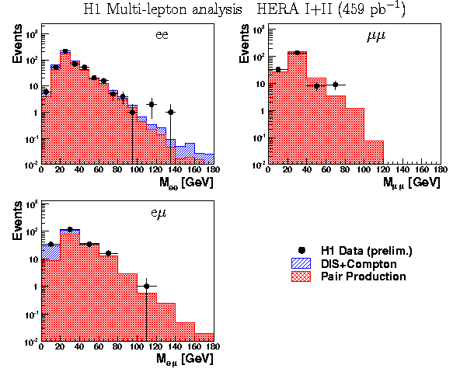
Two-lepton sample

Slide 32
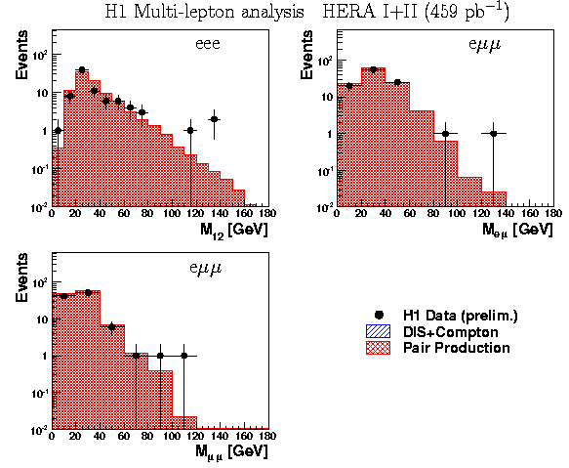
Three-lepton sample

Slide 33
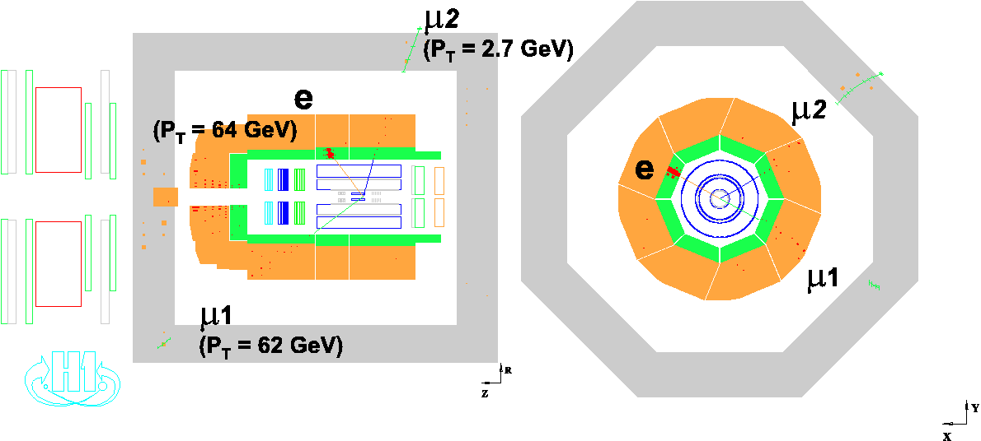
The emm event at high SPT

Slide 34
General search for new phenomenon (H1)

Slide 35
Standard Model processes

Slide 36
“Object” identification
Electrons:
  e.m. deposit in calorimeter, compact and isolated
  High quality track matched in position and momentum, isolated
  Finding efficiency: 90% (70% in the forward region)
Photons:
  Same calorimeter requirements as for electrons
  No track, isolation from high-PT jets
  Finding efficiency: ~85%

Slide 37
“Object” identification (cont.)
Muons:
  track in the forward muon system or inner tracker
  track segment or energy deposit in the central muon detector
  Di-muons: separated by < 165° (cosmic rejection)
  Muons must come from vertex (halo-m rejection)
  Isolation from high-PT jets (suppresses mis-identified hadrons)
  Efficiency: >90%

Slide 38
“Object” identification (cont.)
Jets:
  Identified by inclusive k algorithm in lab frame
  It is run an all tracks not associated to objects
  Cuts against fake jets
  Efficiency: 97%
Neutrinos:
  Identified by missing momentum
  “neutrino” must be isolated from other objects
  If one lepton is found, Df(l-Xtot)<170°

Slide 39


Search strategy
“Regions”: are sets of connected bins (SPT or Mall) wide at least twice the resolution
Probability of fluctuation of data in a region:
pmin is the smallest value in a distribution
pminSM is also evaluated for the MC by varying NSM accordingly to dNSM.

Slide 40
Search strategy
Significance per event class: the fraction of MC histograms having pminSM<pmin is the probability P.
  A pmin-value of 5.7E-7 (“5s”) corresponds to a probability 1E-6 to 1E-5, depending on the final state
Global significance: Many MC experiments are performed in order to evaluate P for the SM.
^
^

Slide 41
Systematic uncertainties
Luminosity measurement: 2.5%
Electron/photon measurement:
  Electromagnetic energy scale: 1-3%
  Polar angle measurement: 3 mrad
  Tracking efficiency (for e/g separation): 3-5%
Jets:
  Hadronic energy scale: 2%
  Polar angle measurement: 5-10 mrad

Slide 42
Systematic uncertainties (cont.)
Muon measurement:
  PT measurement: 5%
  Polar angle measurement: 3 mrad
  Muon identification: 5%
Trigger efficiencies:
  Jet or missing PT triggered events: 3%
  Muon triggered events: 10%
  Electron/photon triggered events: negligible

Slide 43
Theoretical uncertainties

Slide 44
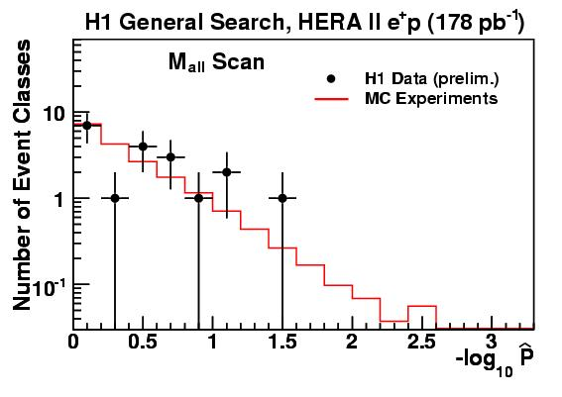
Global significance – e⁺p data

Slide 45
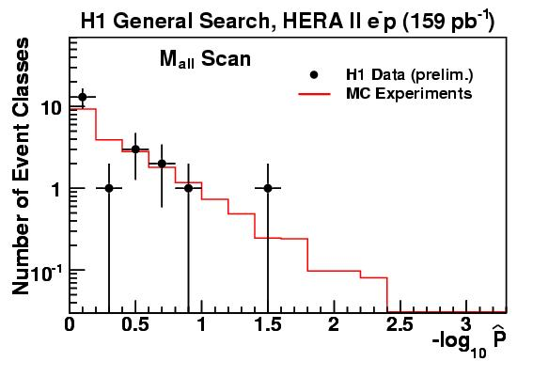
Global significance – e⁻p data

Slide 46
Region of interest - e⁺p data
Shaded areas are regions of greatest deviation from SM
No search performed for jjjj and jjjjn classes (large uncertainty on SM prediction)

Slide 47
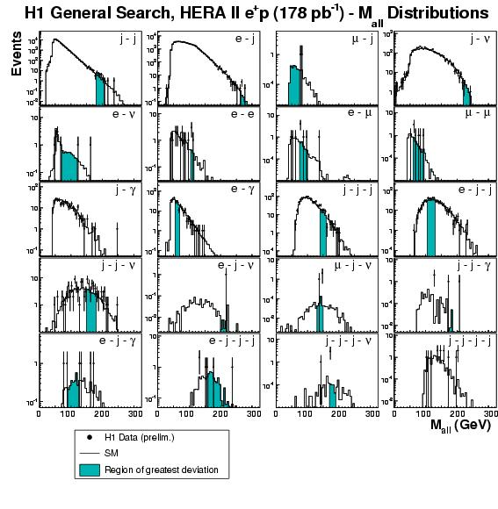
Region of interest - e⁺p data

Slide 48
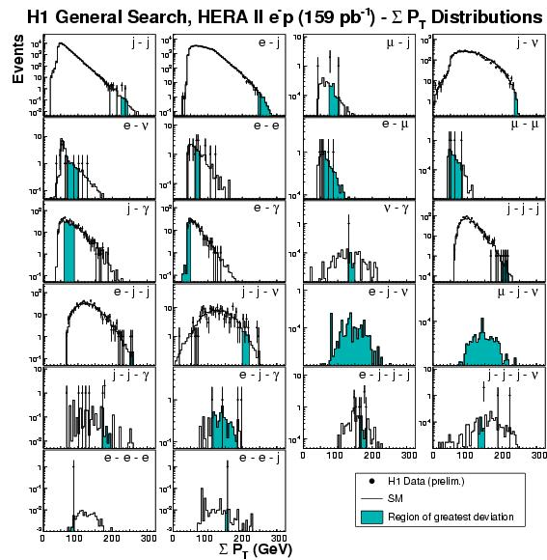
Region of interest - e⁻p data

Slide 49
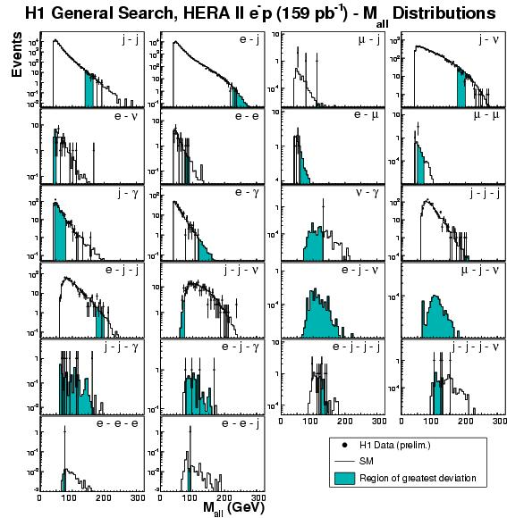
Region of interest - e⁻p data

