Slide 1
Nonlinear Optimization for SPring-8 Upgrade
3WM 2016 (DESY, Sep. 15, 2016)
Kouichi SOUTOME
^{(a)} Accelerator Divison, JASRI
^{(b)} RIKEN SPring-8 Center
on behalf of
Lattice Team, SPring-8 UG Project
H.Tanaka ^{(b)}, M.Takao ^{(a)}, Y.Shimosaki ^{(a)} and KS ^{(a,b)}
Contents
(1) Remarks on MBA Lattice Design
(2) A New Scheme for Suppressing Lattice Nonlinearity
- auxiliary weak sextupoles between arcs -
(3) Precise Description and Control of High-Order ADTS
- high-order formula by canonical perturbation and its use -
(4) Application to SPring-8-II Lattice Design
e-mail: soutome@spring8.or.jp

Slide 2
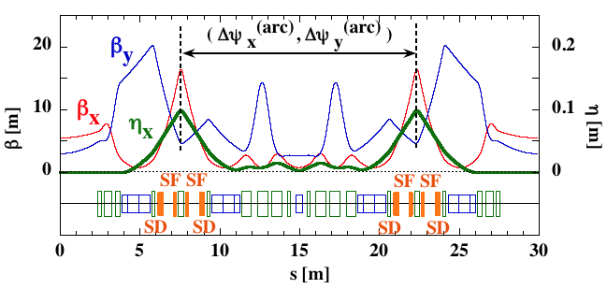
Remarks on MBA Lattice Design (1)
Multi-bend achromat (MBA) structure is generally used in designing a ring with very low emittance:
for simple MBA cell with L_{BM}/2 at both ends
As N_{BM} becomes larger, θ_{BM} is smaller and dispersion η_{x} in the arc takes smaller values, and then chromaticity correcting SXs become stronger.
The "hybrid MBA" lattice proposed by the ESRF has two dispersion bumps in a cell and
low order contributions from
SXs almost cancel due to
betatron phase matching.
This lattice has been adopted
for the SPring-8 upgrade,
however, ...
Δψ^{(arc)} 〜 (3π, π)

Slide 3
Remarks on MBA Lattice Design (2)
The number of independent knobs for nonlinear optimization is not many, and their tuning range is limited:
(1) Sextupoles (SF and SD) are localized in a narrow area around a peak of each dispersion bump, and so they almost degenerate in terms of betatron phase.
(2) Phase matching between arcs also impose a constraint, and phase relations among SXs are almost fixed.
(3) Tunable range of tune per cell (ν_{x}^{(cell)}, ν_{y}^{(cell)}) is limited since beta values at ID
straights must be set to
optimum values and
the emittance is closely
related to ν_{x}^{(cell)}.
Δψ^{(arc)} 〜 (3π, π)

Slide 4
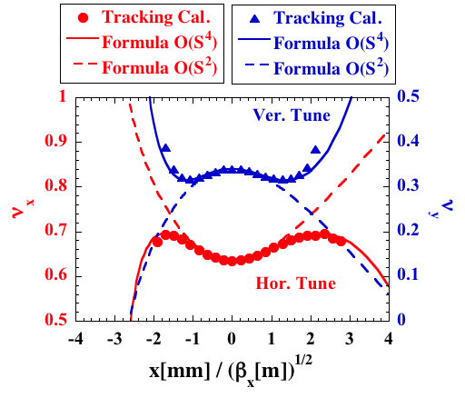
Remarks on MBA Lattice Design (3)
In addition, higher order terms of SXs dominate the dynamic stability and restrict the dynamic aperture (DA).
A proper objective function in optimization is then difficult to set without taking acount of higher order terms.
An example showing O(S⁴) terms dominate the amplitude-dep. tune shift (ADTS)
So, the situation is very complicated and many people like to use genetic algorithms like MOGA ...

Slide 5
A New Scheme for
Suppressing Lattice Nonlinearity (1)
Our Approach:
From a viewpoint of beam physics we should understand what limits the beam stability and think the way to solve the problem, not fully relying on genetic algorithms.
The origin of lattice nonlinearity such as high-order ADTS is the leakage (incomplete cancellation) of kicks by chromaticity correctiong SXs, and so the key point is how
we can manage it.
To suppress the leakage
kick, we propose to install
additional weak SXs at
around the middle of unit
cell (H.Tanaka).
Aux. SXs

Slide 6
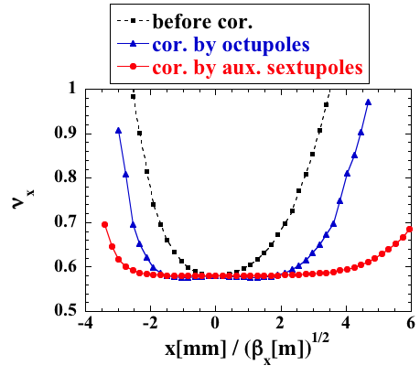
A New Scheme for
Suppressing Lattice Nonlinearity (2)
We checked our scheme of installing aux. SXs and found that ADTS is indeed suppressed well.
Necessary strength is about one order of magnitude smaller than chromaticity correcting SXs, and the range of flatness is wider than the case using octupoles, which means that higher order terms are well controlled.
Horizontal ADTS

Slide 7
Formula of Higher-Order ADTS (1)
In the MBA lattice with strong SXs, the ADTS is dominated by the terms of O(S⁴) (or higher). To control such high-order terms, it is necessary to know their response to SX.
→ We did canonical perturbation calc. up to O(S⁴)
by neglecting terms of O(J_{y}²).
This is adequate since large DA is required mainly in the hor. direction, and the Hamiltonian is written as
O(S²)
O(S⁴) ← new formula

Slide 8
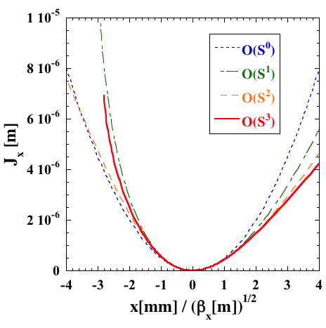
Formula of Higher-Order ADTS (2)
The higher-order formula was incorporated in the objective function of SX optimization procedure, and the hor. ADTS was evaluated up to O(S⁴) or O(J_{x}²).
An example case calculated with the formula up to O(S⁴)
The relation between the action J_{x} and coordinate x is distorted at large amplitudes, and a naive lowest order treatment is inadequate.

Slide 9
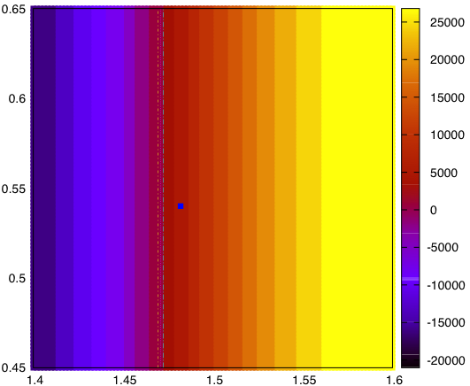
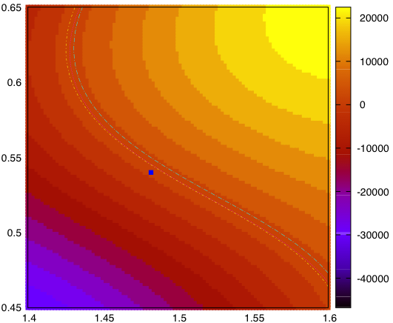
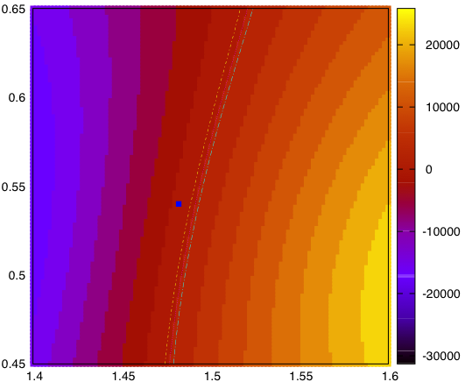
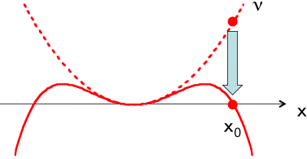
SPring-8-II Lattice Design
- Optimization of Unit Cell -
Tuning Knobs in Nonlinear Optimization:
* SX excitation pattern under the constraint of fixed chrom.
5 families in a cell: { SD₁ SF₁ SF₂ SD₂ S_{aux} S_{aux} SD₂ SF₂ SF₁ SD₁ }
* detuning of phase between arcs: (Δν_{x}^{(arc)}, Δν_{y}^{(arc)})
* tune/cell
Response of lowest-order ADTS coef. (O(S²)) to detuning (example)
C_{xx}
C_{xy}
C_{yy}
Δν_{y}^{(arc)}
Δν_{x}^{(arc)}
Δν_{x}^{(arc)}
Δν_{x}^{(arc)}
Objective Function:
* ADTS with the use of perturbation formula up to O(S⁴)
* 1st and 2nd order terms of chromaticity
* resonance driving terms (when needed)
NB: We also have octupoles but these are saved as a future knob.

Slide 10
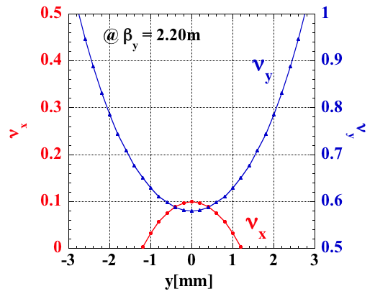
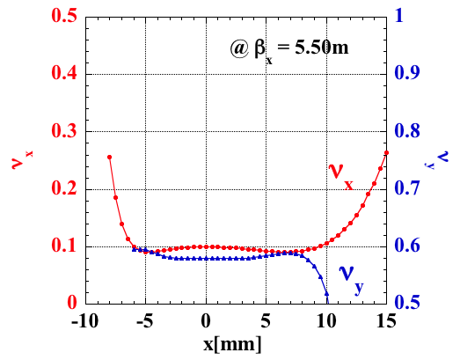
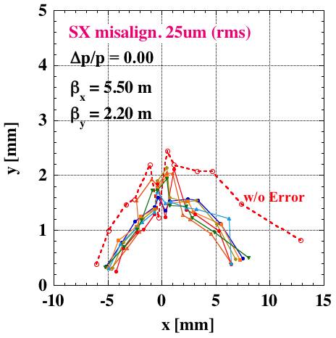
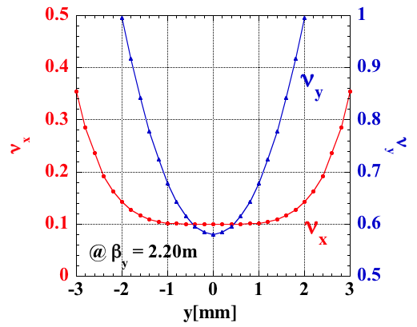
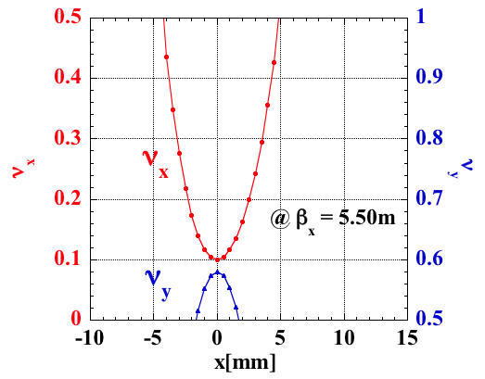
SPring-8-II Lattice Design
- Optimization of Unit Cell -
ADTS
before optimizing SXs
ADTS and DA
after optimizing SXs

Slide 11
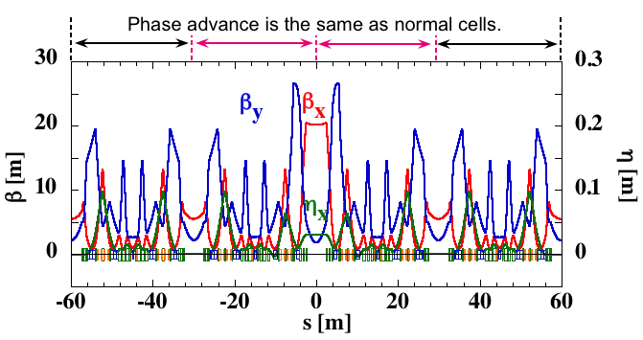
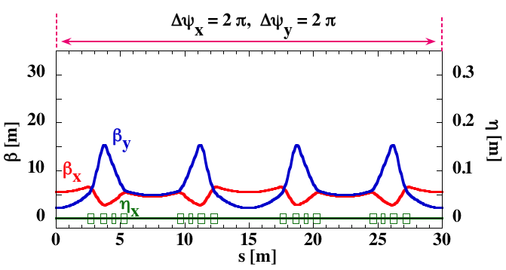
SPring-8-II Lattice Design
- Insertion of LSS and Injection Section -
The ring has four long straight sections (LSS) of about 30m and an injection section having high horizontal beta of β_{x} = 20m.
In both sections phase matching condition is imposed and these sections are transparent for on-momentum electrons.
LSS
Injection Section
* Beam injection will be discussed in detail by H.Tanaka.

Slide 12
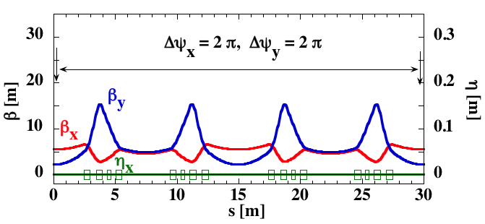
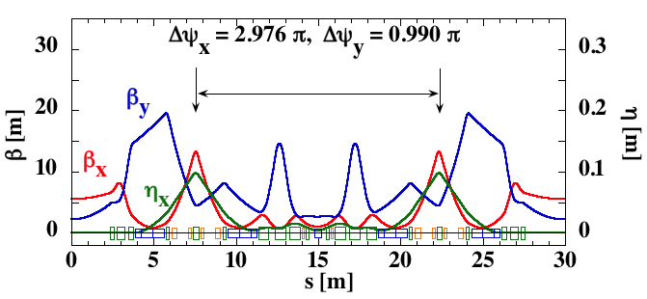
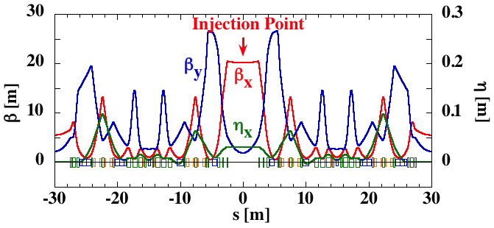
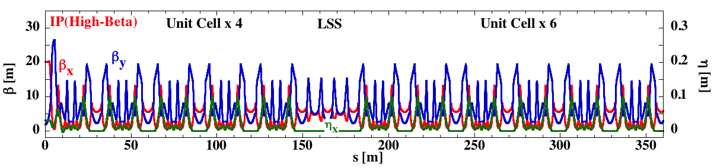
Ring Structure
Unit Cell
Long Straight Cell
Injection Cells
Storage Ring
42 Unit Cells
+ 2 Injection Cells
+ 4 Long Straight Cells
IP

Slide 13
Machine Parameters (tentative, as of Sep. 2016)
 | SPring-8-II | SPring-8 (Present)
E [GeV] | 6 | 8
I [mA] | 100 | 100
C [m] | 1435.45 | 1435.95
Lattice | 5BA (w/ Long. Var.) | DB
ε [nmrad] | 0.157 〜0.10 w/ undulators | 6.6 (Achromat) , 2.4 (Non-Achromat)
(β_{x}, β_{y}) [m] @ ID | (5.5, 2.2) | (24.4, 5.8) (A) , (31.2, 5.0) (NA)
η_{x} [m] @ ID | 0.0 | 0.0 (A) , 0.146 (NA)
(ν_{x}, ν_{y}) | (108.10, 44.58) | (40.15, 18.35) (A) , (41.14, 19.35) (NA)
(ξ_{x}, ξ_{y})_{natural} | (-143, -147) | (-90, -41) (A) , (-117, -47) (NA)
α | 3.24e-5 | 1.46e-4 (A) , 1.60e-4 (NA)
σ_{Δp/p} [%] | 0.093 | 0.109
κ [%] | 10 | 0.2
h | 2436 | 2436
f_{RF} [Hz] | 508.76 | 508.58
ΔU [MeV/turn] | 2.96 | 9.12
Notes:
What I show here is the preliminary ring design parameter together with the present one. Five bend achromatic configuration was adopted to reduce the emittance. A horizontal beta function is set to be about 5 m at ID straight sections to increase the brilliance. We therefore introduced special injection cell structures for off-axis beam injection. Estimated natural emittance is 100-pmrad under realistic operation condition and horizontal beam size in one sigma is about 20 microns, which is about 15 times smaller than the present value.

Slide 14
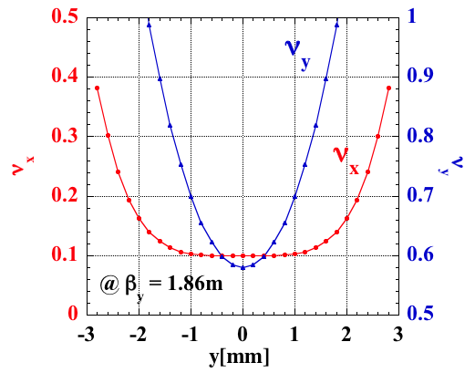
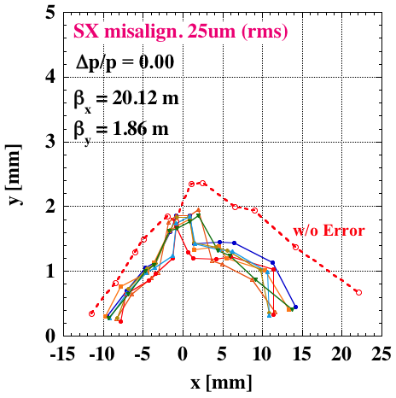
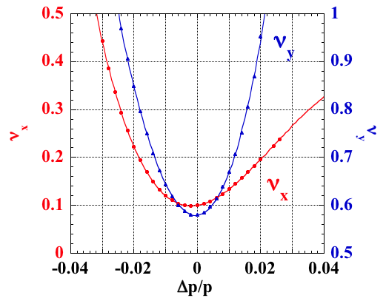
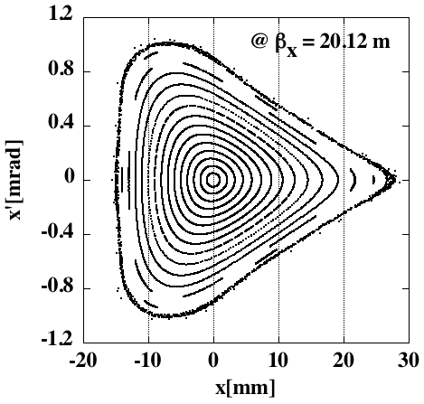
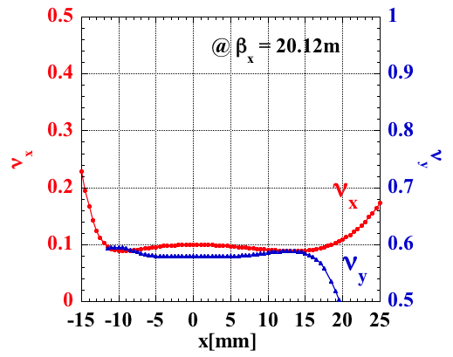
Dynamics
Dynamic Aperture (@ IP)
Amplitude-Dep. Tune Shift
injected beam (x=-2mm)
Hor. Phase Space (@ y=0)
Chromaticity

Slide 15
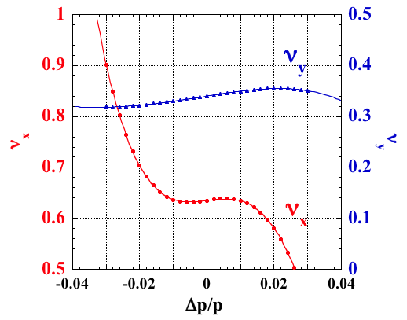
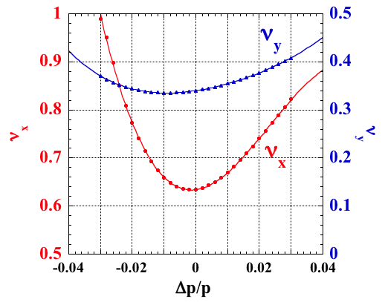
Nonlinear Chromaticity
To obtain enough Touschek beam lifetime, the momentum acceptance (MA) must be as large as possible. The MA of the present lattice is about 2% and we are trying to suppress the 2nd order chromaticity ξ⁽²⁾_{x,y} by extending the SX excitation pattern to plural cells.
An example of ξ⁽²⁾-control with 3-cell modulation of SX
about 20%
modulation
Studies are ongoing to find an optimum set of SXs to suppress ξ⁽²⁾_{x,y} and ADTS at the same time.

Slide 16
Summary and Future Outlook
* We proposed a new scheme of introducing weak SXs for suppressing leakage kick due to chrom. correcting SXs.
This scheme is found to be effective for suppressing ADTS and obtaining a large dynamic aperture.
* We also developed a higher-order formula of ADTS up to O(S⁴). Higher-order terms dominate the dynamic stability of the MBA lattice, and the formula was used to set a proper objective function.
* Nonlinear chromaticity still needs to be optimized to get a larger mom. acceptance. To suppress the 2nd order term we are trying to extend the SX excitation pattern to plural cells.
* Lattice optimization is ongoing aiming at better performance (working point, sxtupoles and octupoles, injection cell design, nonlinear chromatisity and dispersion ...).

