Slide 1
Magnet lattice and beam optics of deflection section to SASE2
Nina Golubeva
Beam dynamics meeting
DESY, 04.08.2020

Slide 2
Contents
Magnet lattice and beam optics of deflection section to SASE2
Beam Dynamics Meeting, 04.08.2020, DESY, Nina Golubeva
Overview of the design of beam deflection section to SASE2
Additional information
W. Decking, F. Obier, “Layout of the Beam Switchyard at the European XFEL”, in Proc. 8th Int. Particle
Accelerator Conf. (IPAC’08), Genoa, June 2008, WEOC073, p.2163
V. Balandin, W. Decking. N. Golubeva, “Tilted Sextupoles for Correction of Chromatic Aberrations in Beam Lines with Horizontal
and Vertical Dispersions ”, in Proc. 10th Int. Particle Accelerator Conf. (IPAC’10),
Kyoto, May 2010, THPE062, p.4656.
V. Balandin, W. Decking, N. Golubeva, “Optics for the Beam Switchyard at the European XFEL”, in Proc. 11th Int. Particle
Accelerator Conf. (IPAC’11), San Sebastian, September 2011, WEPC008, p.2016.

Slide 3
Extraction to SASE2: Geometry
Magnet lattice and beam optics of deflection section to SASE2
Beam Dynamics Meeting, 04.08.2020, DESY, Nina Golubeva
X
SASE2
Top view
2.286°
SASE1
Y
Kicker Lambertson-septum layout
CL
Δy ≈ 24 mm
Side view
~100 m
~100 m
SASE2
Z = ~1997 m

Slide 4
Design of Deflection Section: Specifications, requirements
Magnet lattice and beam optics of deflection section to SASE2
Beam Dynamics Meeting, 04.08.2020, DESY, Nina Golubeva
Kicker-Lambertson-septum layout
• different bending planes by kickers and septa
• horizontal and vertical dispersions Dx and Dy
Extraction to Sa2 - from FODO lattice in the straight line TL
• constraints on possible location of kickers and septa
• Twiss functions at the entrance of deflection section are fixed
(no matching section in the front)
Accept bunches with different energies (up to ±1.5% from nominal energy)
First-order achromatic beamline (R16, R26, R36, R46 = 0 in the transfer matrix)
First-order isochronous beamline (R56 = 0 in the transfer matrix)
Necessary to avoid collisions of magnets from different beamlines

Slide 5
Deflection section to SASE2: Two parts
Magnet lattice and beam optics of deflection section to SASE2
Beam Dynamics Meeting, 04.08.2020, DESY, Nina Golubeva
Extraction elements (kickers, first septum) are located in the straight line TL leading to SASE1
Part 1: Part of TL beamline with KL kickers and first BZ septum
• the beam to Sa1 is going straight in this section
• the beam to Sa2 is off-axis
These is a shift of the beam in the kicker bending plane (vertical),
that is taken into account in the geometrical layout
of the downstream beamline.
Part 2: Deflection arc T1 for the beam to Sa2
• start is at the entrance of second septum
• the beam to SA2 is on-axis in this section
• in the end of arc the beam is brought back to the horizontal plane y=0

Slide 6
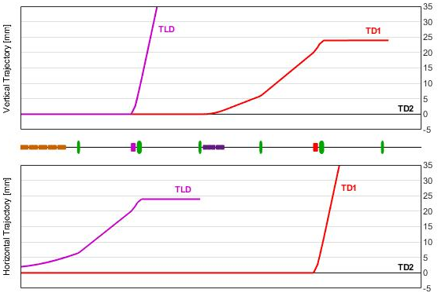
First part (Part 1): Trajectory
Magnet lattice and beam optics of deflection section to SASE2
Beam Dynamics Meeting, 04.08.2020, DESY, Nina Golubeva
Part 1: Joint line for two beams (Sa1 and Sa2).
Δy ≈ 24 mm
Kick in vertical plane (KL kickers),
≈0.51 mrad kick angle
Additional kick from QF quadrupole
At the entrance of first BZ (H) septum:
20 mm vertical separation
First BZ (H) septum is tilted by ~12°
(slight bend also in Y-plane)
First septum BZ (H) and downstream
QK quadrupole remove the beam slope
Δy = 20 mm
KL
BZ
QK
KS kickers
QF
QK
mm
Beam to Sa2 is off-axis in this section

Slide 7
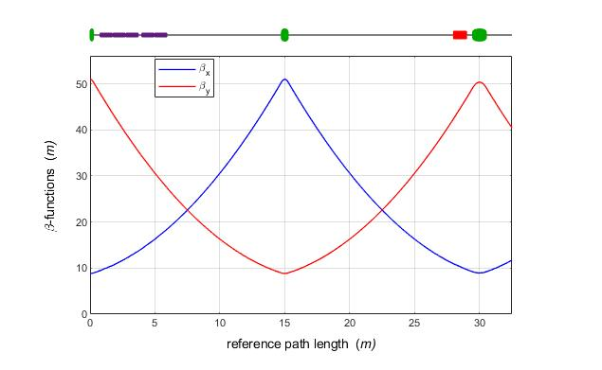
Part 1: Optics
Magnet lattice and beam optics of deflection section to SASE2
Beam Dynamics Meeting, 04.08.2020, DESY, Nina Golubeva
KL
BZ
Twiss functions: Periodic solution of FODO lattice in TL section
Dispersions:
• in vertical plane starts from KL kickers, at the exit Dy ≈ -0.0265 m
• in horizontal plane is generated by BZ (H) septum, at the exit Dx ≈ -0.025 m
• R56 ≈ +22.7 μm

Slide 8
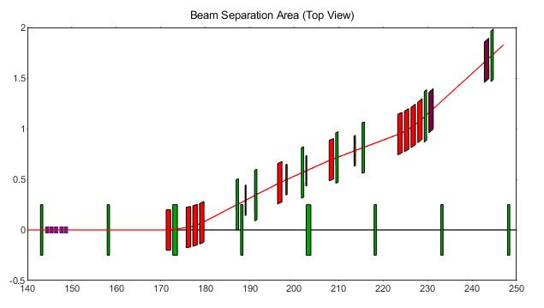
Second part (Part 2): Magnet Lattice
Magnet lattice and beam optics of deflection section to SASE2
Beam Dynamics Meeting, 04.08.2020, DESY, Nina Golubeva
Part 2: Start at the entrance of second BZ septum ̶ Deflection arc T1
T1
X-plane: 2.286⁰ (total) deflection
• 4 BZ septa (1st septum is tilted)
• 4 dipoles (H)
• 2 dipoles (H-reverse), for R56
Y-plane: Dogleg in the end
• close the linear vertical dispersion • bring the beam back to
the horizontal plane y = 0
• no quads between dipoles
Multipoles for correction
of chromatic aberrations
Quadrupoles (6)
SASE2
Quadrupoles
Dipoles (H)
Dipoles (H-reverse)
Dogleg
Dipoles (V)
Part 1
Septa (H)
Kickers
SASE1

Slide 9
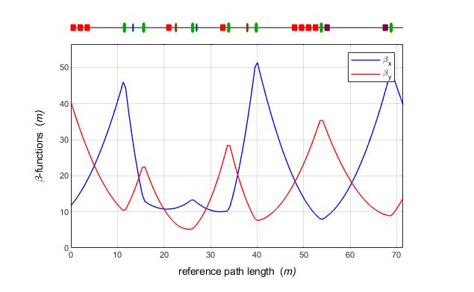
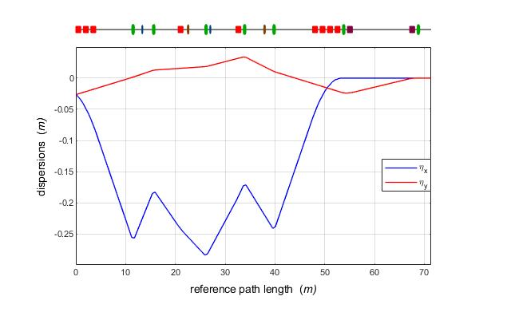
Part 2: Optics
Magnet lattice and beam optics of deflection section to SASE2
Beam Dynamics Meeting, 04.08.2020, DESY, Nina Golubeva
Length ≈ 70 m
Entrance: Fixed Twiss parameters (FODO lattice in the straight TL section)
Exit: Twiss functions are designed to be easily matched to the downstream line
Dispersion in X-plane:
• not zero at the entrance, suppressed at the exit of last horizontal dipole
Dispersion in Y-plane:
• not zero at the entrance, suppressed by the dogleg in the end

Slide 10
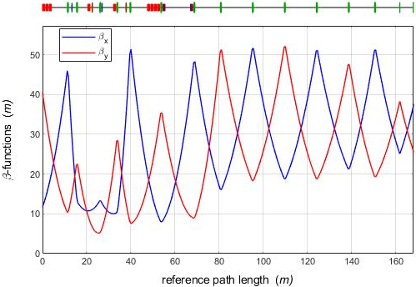
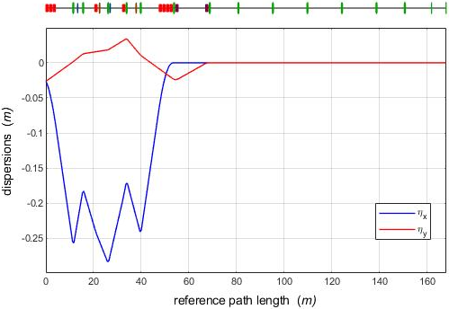
Matching section to SASE2
Magnet lattice and beam optics of deflection section to SASE2
Beam Dynamics Meeting, 04.08.2020, DESY, Nina Golubeva
Matching
2 QA quads
Magnet lattice: close to FODO lattice in the straight section TL
Matching to Sa2:
• in the most cases the matching can be done using 4 QF quadrupoles
• at low energies and some special average betatron-functions in Sa2
more quadrupoles are needed
• it is better to keep 2 QA quadrupoles in the front of Sa2 equal to Sa2 quads

Slide 11
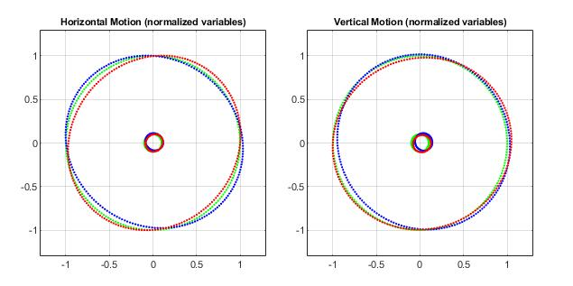
Chromatic properties (1)
Magnet lattice and beam optics of deflection section to SASE2
Beam Dynamics Meeting, 04.08.2020, DESY, Nina Golubeva
Phase space portraits of monochromatic 0.1σ_{x,y}
and 1σ_{x,y} ellipses (matched at the entrance)
after the tracking through the deflection beamline.
Deflection arc: simultaneous nonzero
horizontal and vertical dispersions.
For correction of chromatic aberrations
the tilted multipoles are used
• two tilted sextupoles
• two tilted octupoles
Note: Both, linear optics and nonlinear
properties, were designed together
number of σ_px
number of σ_x
number of σ_y
V. Balandin, W. Decking. N. Golubeva, “Tilted Sextupoles for Correction of
Chromatic Aberrations in Beam Lines with Horizontal and Vertical Dispersions ”,
in Proc. 10th Int. Particle Accelerator Conf. (IPAC’10),
Kyoto, May 2010, THPE062, p.4656.
The relative energy deviations:
-1.5% (red), 0% (green), +1.5% (blue).

Slide 12
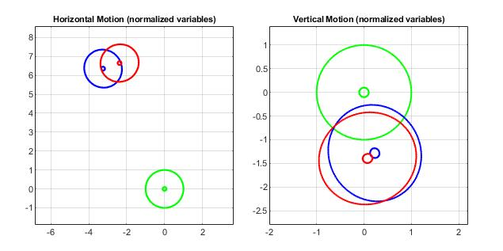
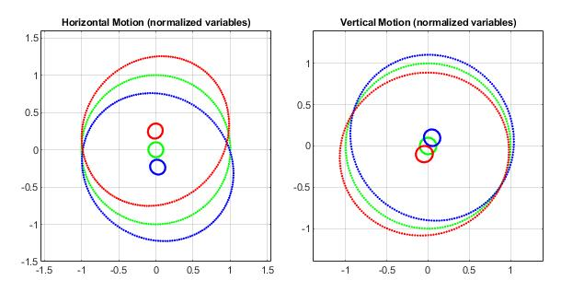
Chromatic properties (2)
Magnet lattice and beam optics of deflection section to SASE2
Beam Dynamics Meeting, 04.08.2020, DESY, Nina Golubeva
Sext off
Octup off
Sext on
Octup on
Phase space portraits of monochromatic 0.1σ_x,y
and 1σ_x,y ellipses (matched at the entrance)
after the tracking through the deflection beamline.
Sext on
Octup off
The relative energy deviations:
-1.5% (red), 0% (green), +1.5% (blue).

Slide 13
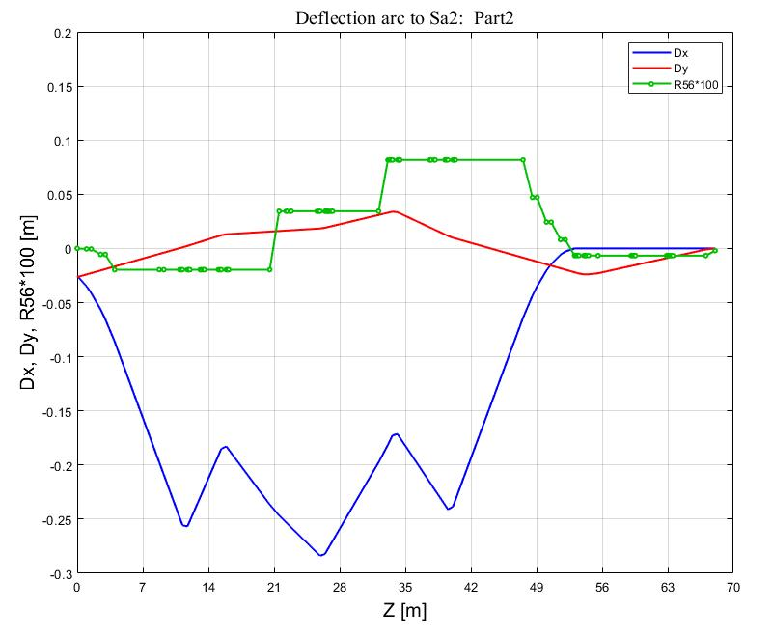
Isochronicity
Magnet lattice and beam optics of deflection section to SASE2
Beam Dynamics Meeting, 04.08.2020, DESY, Nina Golubeva
The entire deflection section
• from the entrance of the first KL kicker
• up to the exit of the last vertical dipole
is a first-order isochronous beamline:
R56 coefficient of the transfer matrix of this section is equal to zero.
Part 2 (deflection arc T1)
Transfer map up to 3d order
-2.1e-05 * pz [m]
-5.9e-03 * pz²
+1.6e-02 * pz³
R56
BZ-H
BD-H
Dy
Dx

Slide 14
Separation area (Top view)
Magnet lattice and beam optics of deflection section to SASE2
Beam Dynamics Meeting, 04.08.2020, DESY, Nina Golubeva
SASE2
dogleg
KL
BZ
SASE1
Red, magenta and blue
colors mark septa and dipoles
of beamlines to Sa2, TLD, TD20
Third beamline TD20 for the future upgrade has been also considered
during the design of the separation area.

Slide 15
Contents (2)
Magnet lattice and beam optics of deflection section to SASE2
Beam Dynamics Meeting, 04.08.2020, DESY, Nina Golubeva
Overview of the design of beam deflection section to SASE2
Unusual design
Careful design of magnet lattice and optics meets
the main design specification (Page 4)
Additional information
Measurements of orbit response and dispersions
Possibility to tune R56 ?

Slide 16
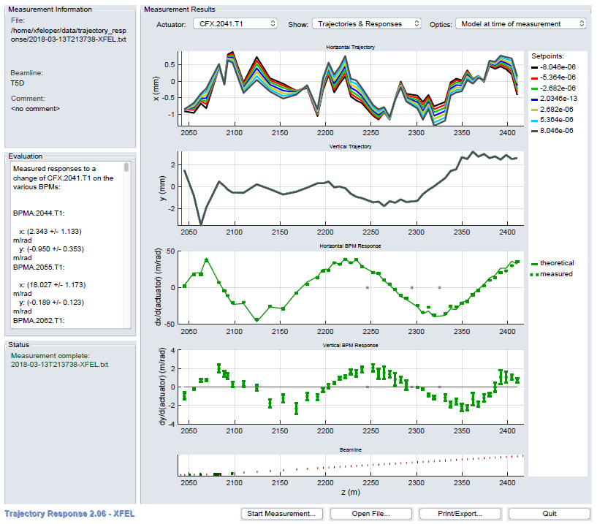
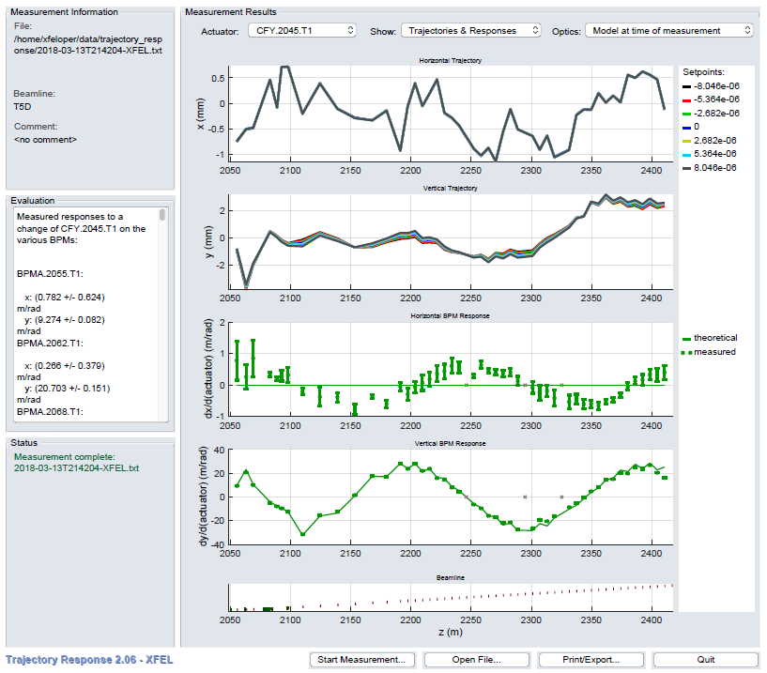
Measurements: Trajectory response (1)
Magnet lattice and beam optics of deflection section to SASE2
Beam Dynamics Meeting, 04.08.2020, DESY, Nina Golubeva
CFX.2041.T1: after 1st quad in T1 arc
CFY.2045.T1: after 2d quad in T1 arc
1st corrector
in T1 arc
13.03.2018
13.03.2018
13.03.2018: First beam to T5D

Slide 17
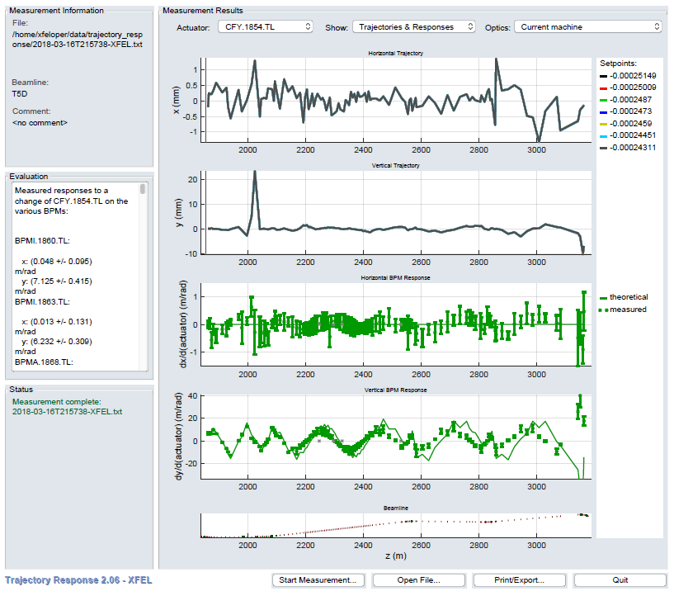
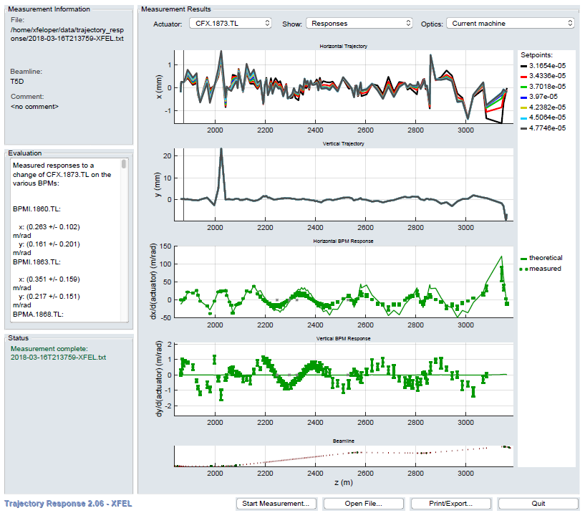
Measurements: Trajectory response (2)
Magnet lattice and beam optics of deflection section to SASE2
Beam Dynamics Meeting, 04.08.2020, DESY, Nina Golubeva
CFY.1854.TL : 1st corrector after CL
CFX.1873.TL : in the front of IBFB
KL kickers
16.03.2018
16.03.2018
Deflection to Sa2

Slide 18
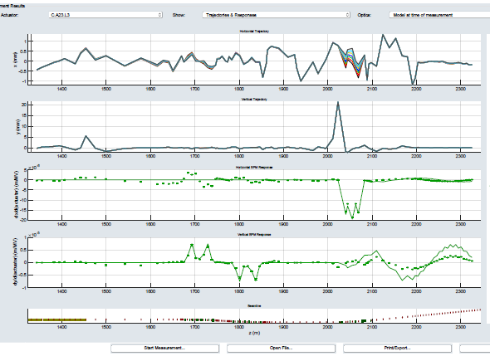
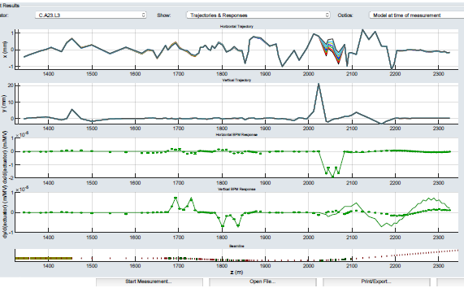
Measurements: Dispersion
Magnet lattice and beam optics of deflection section to SASE2
Beam Dynamics Meeting, 04.08.2020, DESY, Nina Golubeva
10^{-6}
10^{-5}
theoretical: solid curve
10^{-5}
10^{-5}
CL
03.10.2018 12:25, Decking, Tamras
Nominal setting (0.110 deg) for BD.2084.T1/BD.2097.T1
(2 vertical dipoles in dogleg)
03.10.2018 12:59, Decking, Tamras
Decreased settings (0.100 deg) of BD.2084.T1/BD.2097.T1 and QF.2083.T1 (in the front of dogleg) from -106 mrad/m to -76 mrad/m
Tuning of vertical dispersion

Slide 19
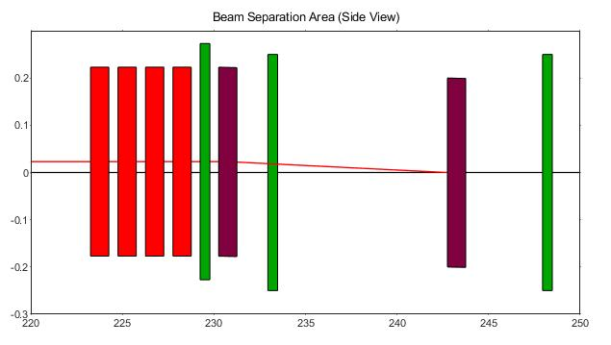
Not design strength of KL kickers
Magnet lattice and beam optics of deflection section to SASE2
Beam Dynamics Meeting, 04.08.2020, DESY, Nina Golubeva
Dogleg in the end of deflection arc
Y
One example: KL setting
May 2020: ~340 A
July 2020: ~310 A
Let us take -5% (-17A from 340 A)
It produces: at 2d septum at dogleg entrance
ΔDy +1.1 mm +1.3 mm
ΔDpy -0.114 mrad
Δy -1 mm +1.7 mm
Δpy +50μm +50μm
without orbit correction
~24 mm
According to design: at dogleg entrance
|Dy| and Dpy must be equal to
the values generated by dogleg (Dpy = 0)

Slide 20
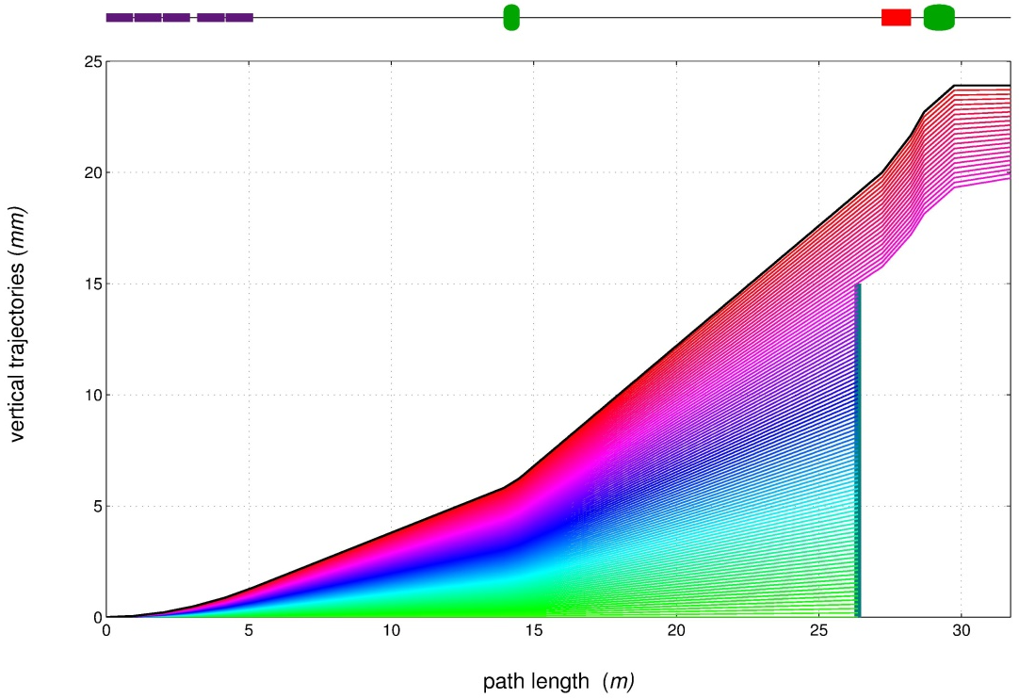
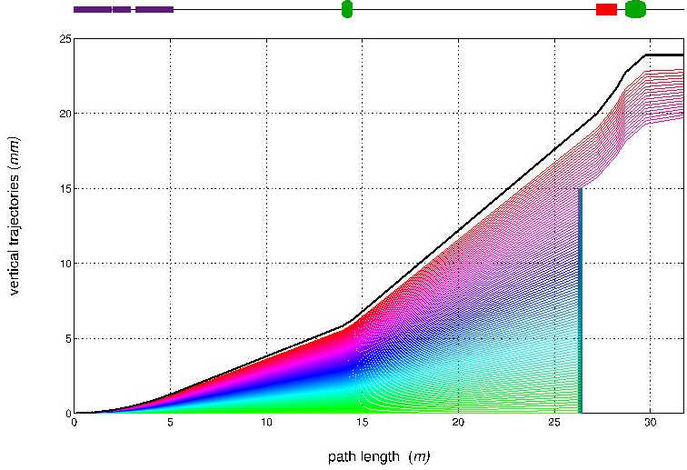
Tracking studies: Part 1
Magnet lattice and beam optics of deflection section to SASE2
Beam Dynamics Meeting, 04.08.2020, DESY, Nina Golubeva
Vertical beam trajectories starting from KL kickers up to the entrance of second septum.
Design trajectory is marked by black color (upper curve).
Design setting of KL kickers
KL kickers are reduced by 5%
Absorber VCABSA.2024.TL.
Trajectories with Y > 15 mm come to the first septum.

Slide 21
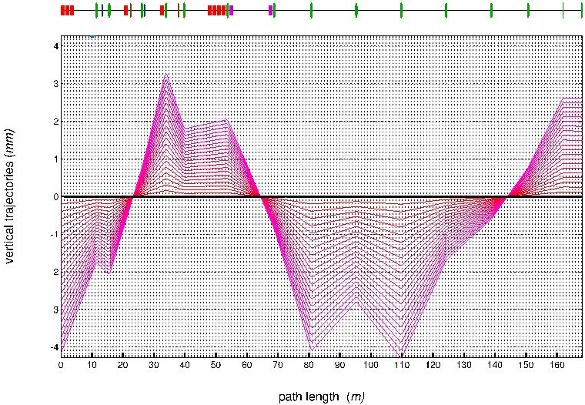
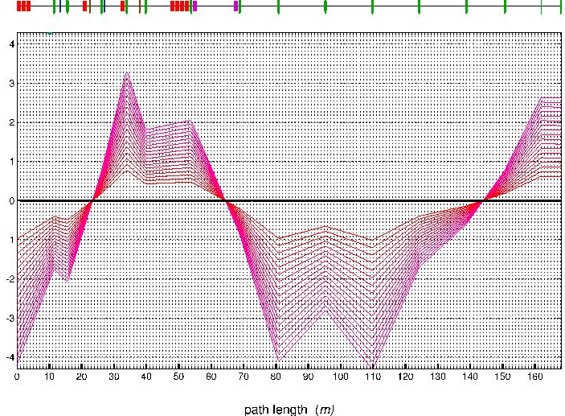
Tracking studies: Part 2
Magnet lattice and beam optics of deflection section to SASE2
Beam Dynamics Meeting, 04.08.2020, DESY, Nina Golubeva
Vertical beam trajectories starting from second septum up to the entrance of the SASE2 undulator.
Design setting of KL kickers
KL kickers are reduced by 5%
Search for more optimal positions for the location of an additional collimator
in the deflection arc T1. Position with the largest deviations from the axis
can be considered as candidates for the placement of collimator (scraper).

Slide 22
R56 of deflection beamline
Magnet lattice and beam optics of deflection section to SASE2
Beam Dynamics Meeting, 04.08.2020, DESY, Nina Golubeva
Design: R56 = 0 (entire beamline from kickers to the end of last dipole)
One example for E_beam ≠ E_magnets
Possibility to change R56 of Part 2 (deflection arc T1)

Slide 23
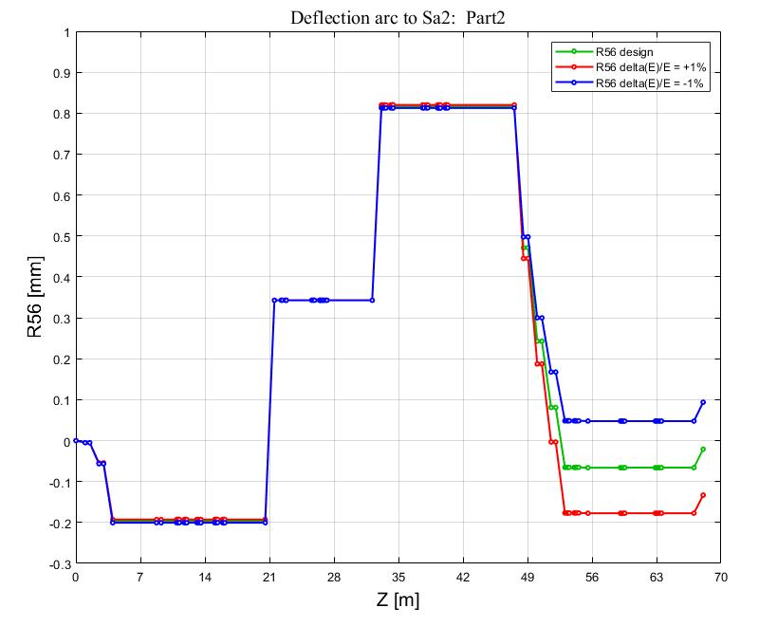
E_beam ≠ E_magnets
Magnet lattice and beam optics of deflection section to SASE2
Beam Dynamics Meeting, 04.08.2020, DESY, Nina Golubeva
Beam energy error → magnet strength error: k_{0,1,2,3} = k_design * 1/(1+ΔE/E)
ΔE (MeV) ΔE/E_0 R56
-140 -1% +94 μm
-70 +0.05% +36 μm
0 0 -21 μm
+70 +0.05% -77 μm
+140 +1% -133 μm
+700 +5% -554 μm
MAD8 variables: R56 in chicane with (+)
E_0 = 14 GeV
ΔR56 ~ ± 100 μm at ΔE/E = ±1%

Slide 24
Possibility to change R56 ?
Magnet lattice and beam optics of deflection section to SASE2
Beam Dynamics Meeting, 04.08.2020, DESY, Nina Golubeva
R56 of first part (Part 1) is small (~20 μm)
and practically fixed
R56 is mainly produced and driven by H-dipoles
If the geometry does not change,
R56 may be changed by tuning the horizontal
dispersion in two H-reverse dipoles
Both, linear optics and nonlinear properties,
were designed together
No room for changing R56
2d H-reverse
+0.8 mm
BZ-H
BD-H
1st H-reverse
Part 2 : Deflection arc T1

Slide 25
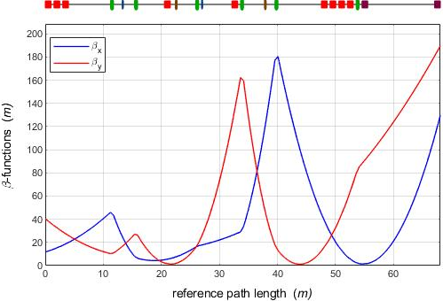
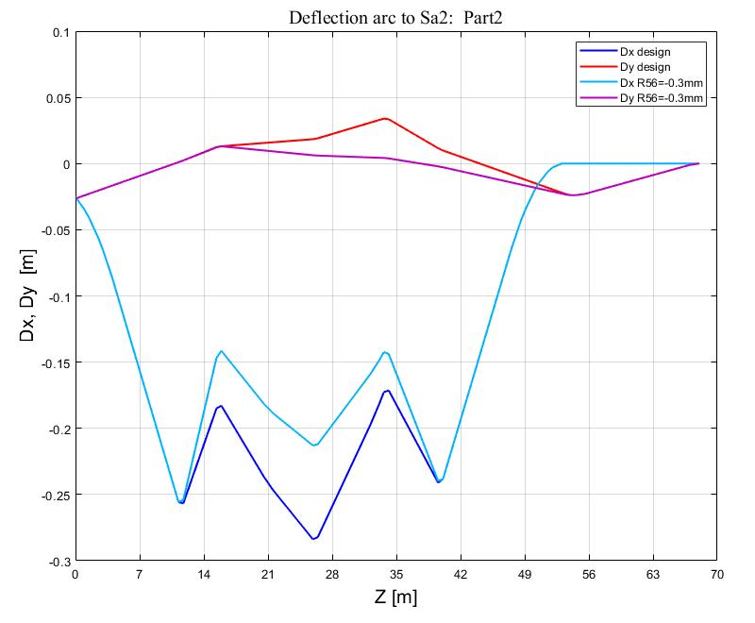
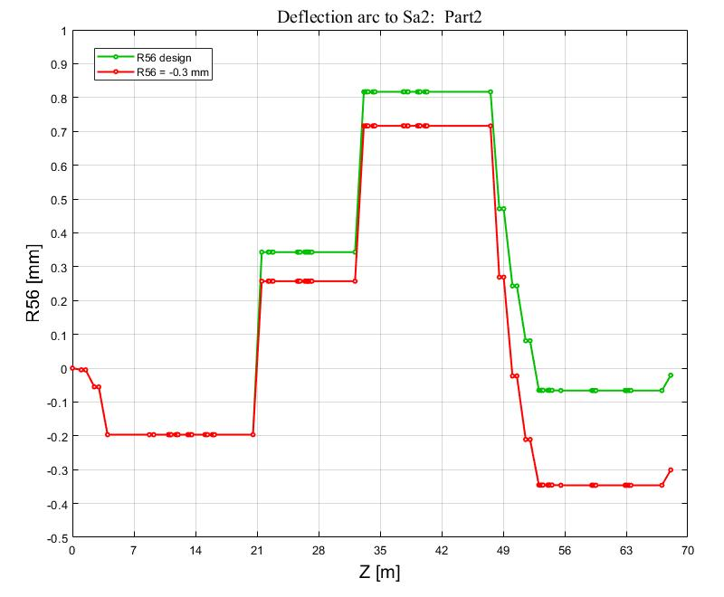
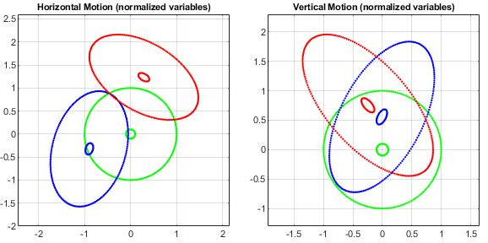
Part 2: Deflection arc T1
Magnet lattice and beam optics of deflection section to SASE2
Beam Dynamics Meeting, 04.08.2020, DESY, Nina Golubeva
This example is only for the illustration
• not working variant
• R56 = -0.3 mm
• Dx is reduced in H-reverse magnets

Slide 26
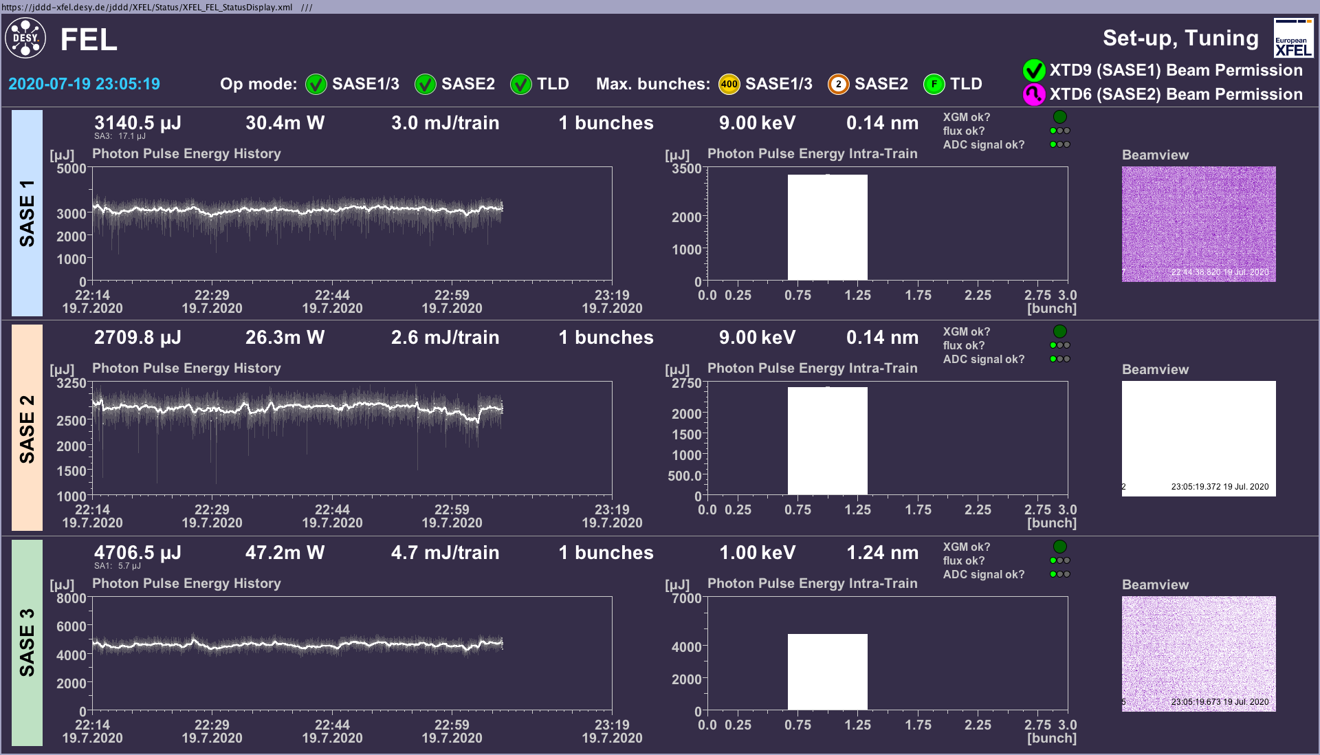
Summary
Magnet lattice and beam optics of deflection section to SASE2
Beam Dynamics Meeting, 04.08.2020, DESY, Nina Golubeva
Unusual design of extraction beamline to SASE2
• horizontal and vertical dispersions simultaneously
• tilted septum
• tilted multipoles for corrections of chromatic aberrations
Satisfies the design requirements and constraints (Page 4)
19 July 2020
In operations from March 2018

Slide 27
Memory note
Magnet lattice and beam optics of deflection section to SASE2
Beam Dynamics Meeting, 04.08.2020, DESY, Nina Golubeva
Suggestion to use the tilted septum and tilted multipoles for correction
of chromatic aberrations came from Vladimir Balandin.
Vladimir has also developed the model and code for the design
and calculations of the beam optics in separation area.

