Slide 1
Update on Design and CSR Simulation Study of Bunch Compressor for the PITZ THz SASE FEL Experiment
Anusorn Lueangaramwong, PITZ
DESY-TEMF winter meeting 28.11.2019

Slide 2
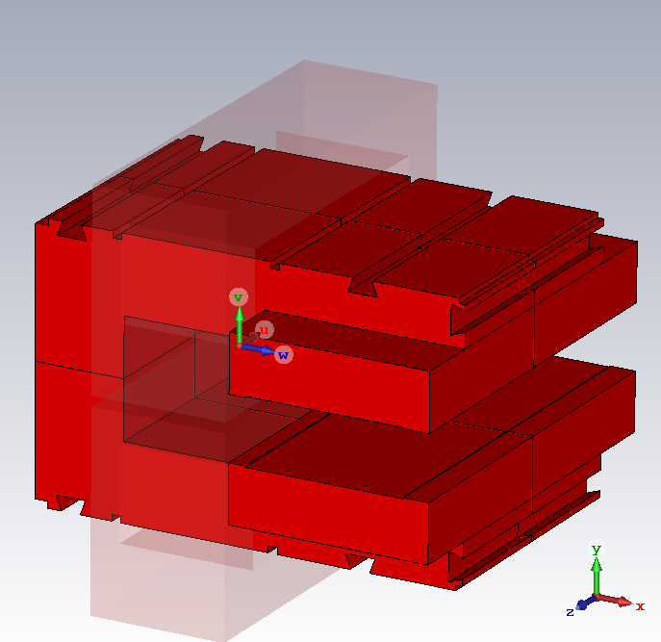
Bunch Compressor Design at PITZ
Purpose
  To shorten saturation length in SASE FEL
  To propose a superradiant THz source & seeded FEL
Status of design
  Chicane angle = 19° (Minimum angle & No collisions in model)
  R₅₆~-0.2 m
Dipole magnet optimized with shims
  Flat profile in bending axis
  Pole shoes will be modified in Zeuthen
Undulator
Gun&Booster
CST EM studio--optimizer
w/ shims
w/o shims
bending axis
shims
Note: Design is improved from H. Shaker et al., presented at FEL'19, 2019, paper TUP003.

Slide 3
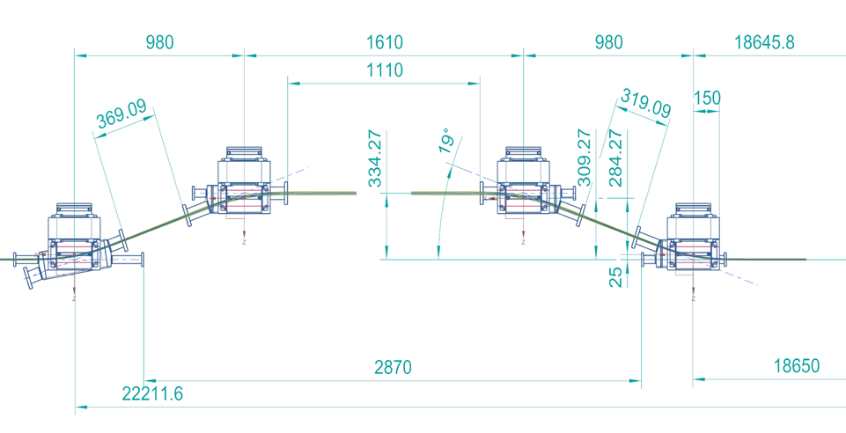
Study with Simulations
To check performance of the bunch compressor design
When considering
  CSR effect
  Space charge effect
  Use of B-field profile
  Charge ~ up to few nC
D3
D2
D4
D1
Simulations w/ & w/o CSR
  Scan charge up to 1 nC
  Scan longitudinal parameters
  Next: Import beam distributions from PITZ colleagues
Undulator
Gun&Booster

Slide 4
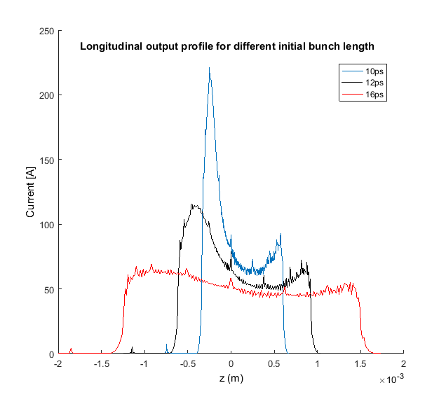
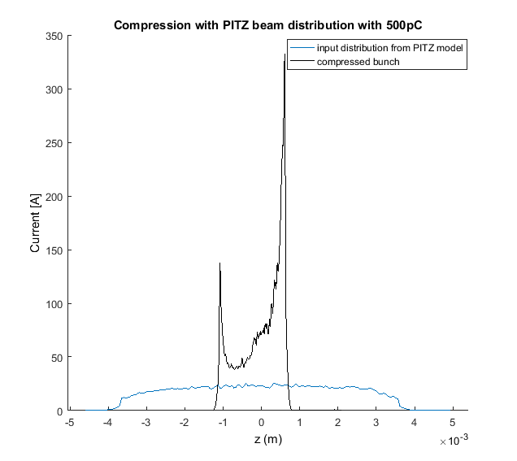
Previous Study
Done by H. Shaker using CSRtrack
Old design (17-deg Chicane)
charge = 500 pC
Compression works
But we want to investigate more
with initial flat-top beam
with initial PITZ beam
H. Shaker et al., presented at FEL'19, 2019, paper TUP003.

Slide 5
Simulation Programs
for CSR effect
Our Requirements
Fringe field (we import field profile from CST EM studio)
Space charge effect (we have low E beam ~ 16 MeV)
Programs (so far we know)
according to their manuals
program | track dim | csr | sp charge | import B field | fringe field
astra | 3d | no? | yes | 3d on "cavity" | w/ import file
impactt | 3d | yes | yes | 1d | Enge function
csrtrack | 3d | yes | no | no | no
xtrack | 3d | yes | yes (1d) | no | no

Slide 6
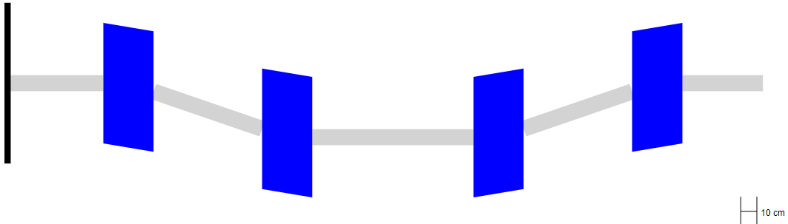
IMPACT-t setup and disadvantage
For fast scan
3D space charge
  x = bending axis
  Grid 64x32x64
  Time step = 1e-13 s
Fringe field
  extended to the maximum of 0.5m from dipole edge
  allow calculation of CSR in drift between dipoles
D1
D2
D3
D4
fringe field

Slide 7
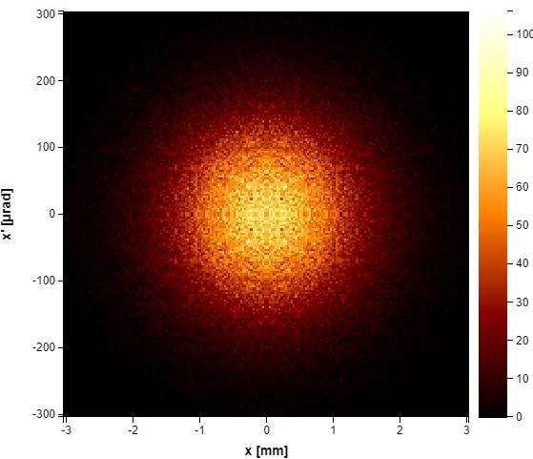
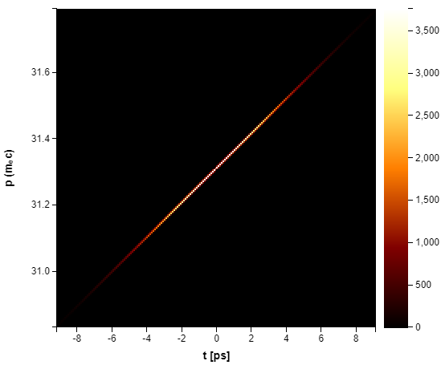
Ideal Beam Input
For ImpactT and Elegant (benchmark)
Gaussian Beam
  500000 macroparticles
  p = 16 MeV/c
  geometric emittance = 1e-7m
  beta = 10 m, alpha = 0
  (sigma x = 1 mm)
  sigma t = 3 ps
  sigma s = 0.9 mm
  dp_s_coupling = 0.9999
  sigma dp = 0.005, dp = p/p₀
tail
head
Notes:
Normalized emittance ~ 1um for <= 1nC
P = 17 MeV/c
sigma t = 3-4 ps

Slide 8
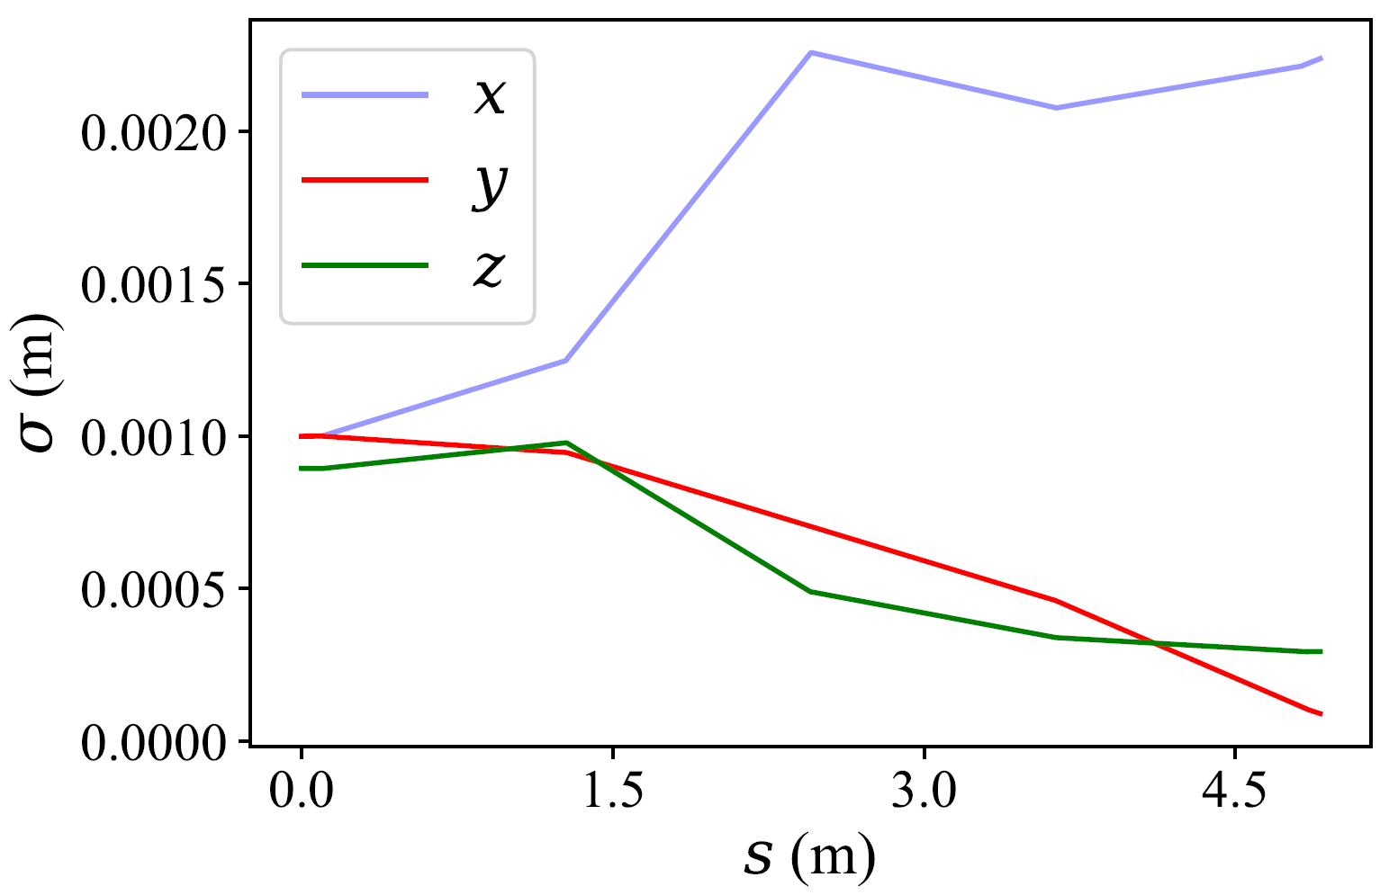
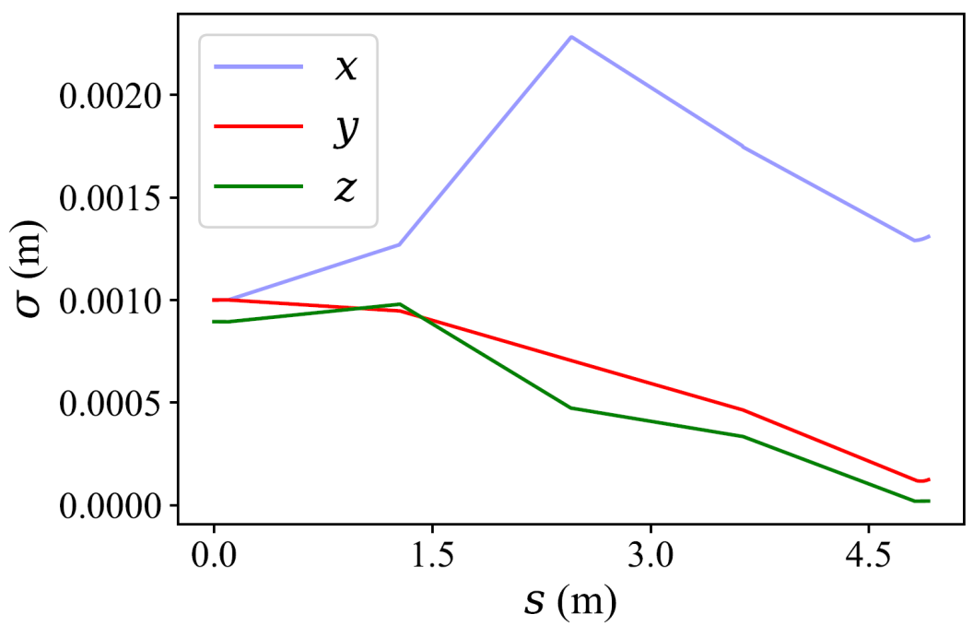
Beam size
ImpactT (default) results
ImpactT uses axes of ref. particle at each dipoles entrance and exit
Degradation of compression performance
  optimize longitudinal parameters?
  is overcompression a solution?
mismatched slice transverse emittance due to CSR
CSR on
charge = 1nC
Not compressing
D1
D2
D3
D4
CSR off
charge = 1nC
Space Charge effect is still on
total dispersion ~ 0
D1
D2
D3
D4
Notes:
Sigma x theoretically increases due to different CSR kicks along the longitudinal distribution in dispersive motions forming a mismatched slice transverse emittance

Slide 9
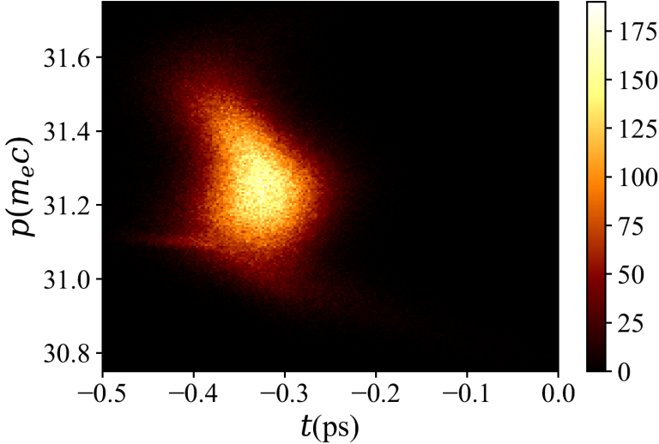
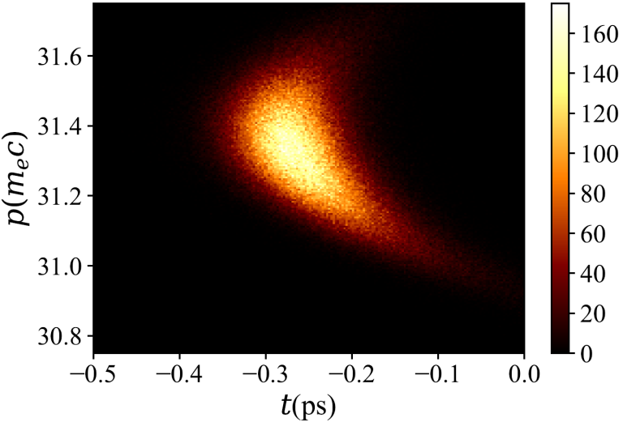
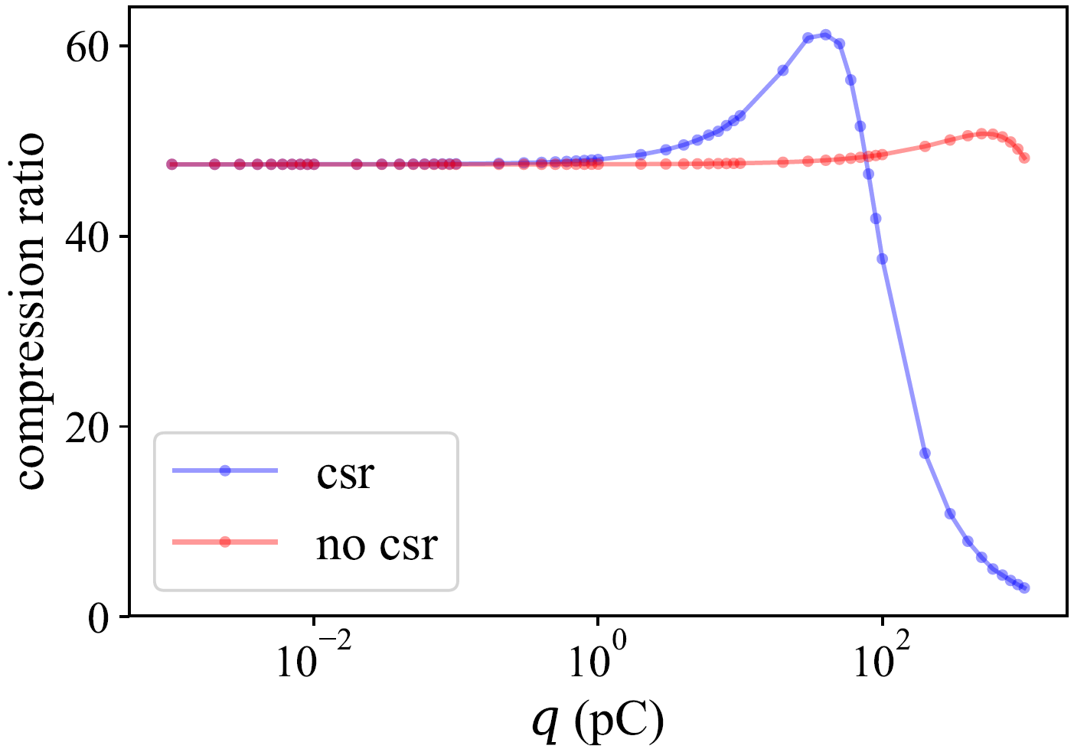
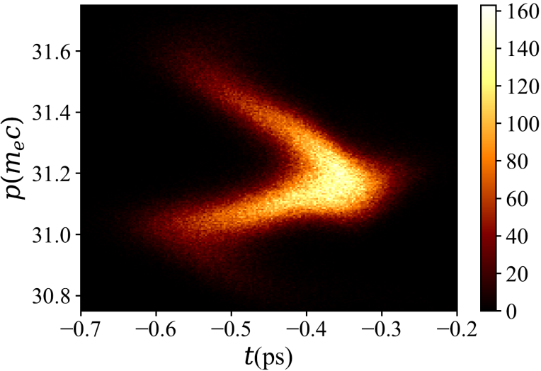
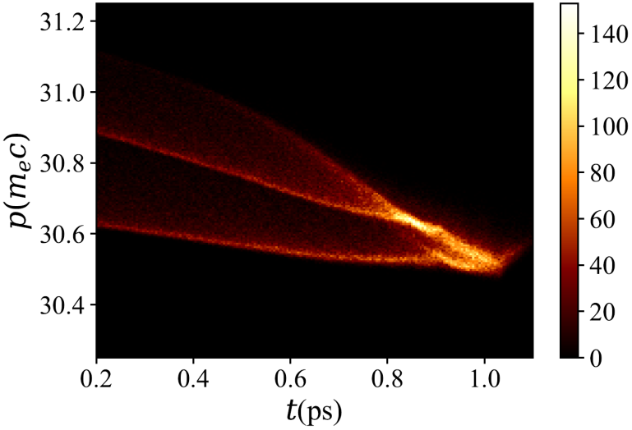
Compression vs Bunch Charge
Evolution of filaments
40pC
1pC overcompressed
100pC
1nC

Slide 10
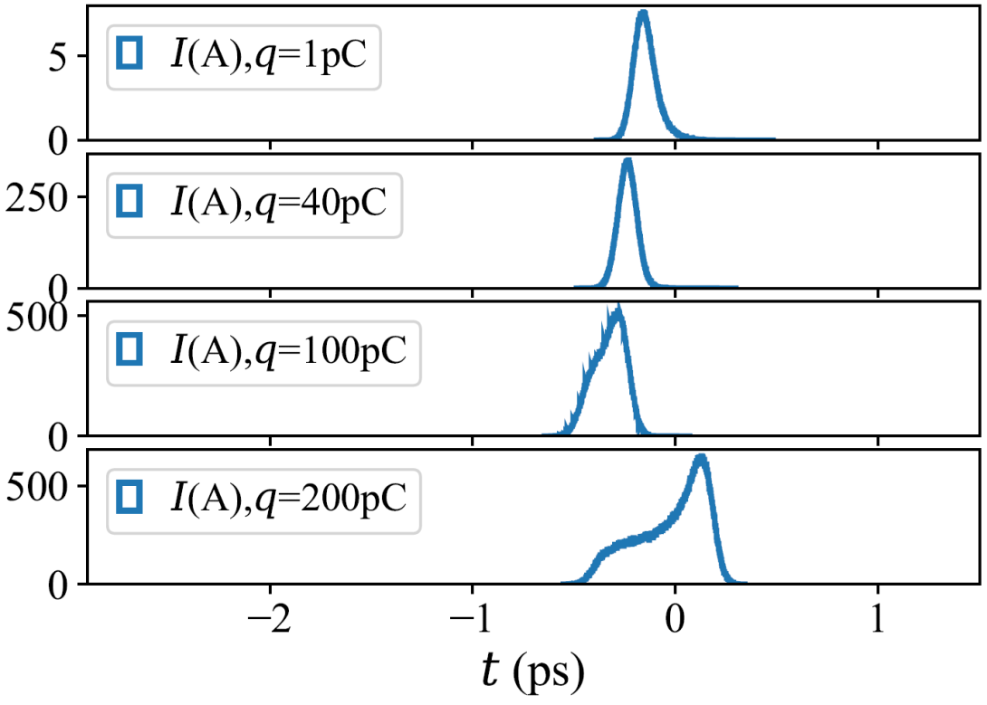
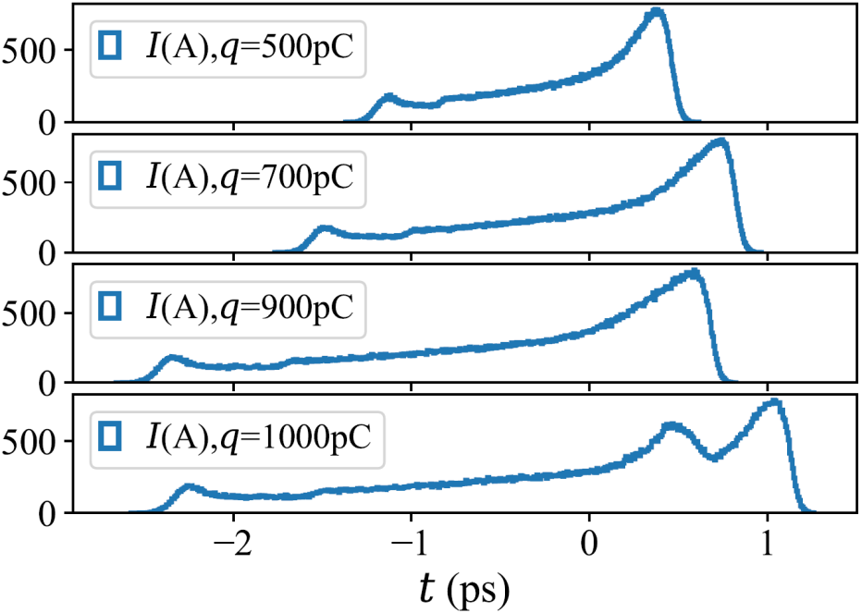
Compression vs Bunch Charge (continue)
profiles
overcompressed
optimum
2 filaments
2 peaks
Charge > 100 pC
  forming 2 filaments or more
  larger bunch length
Charge ~1nc
  forming 2 peaks in profile

Slide 11
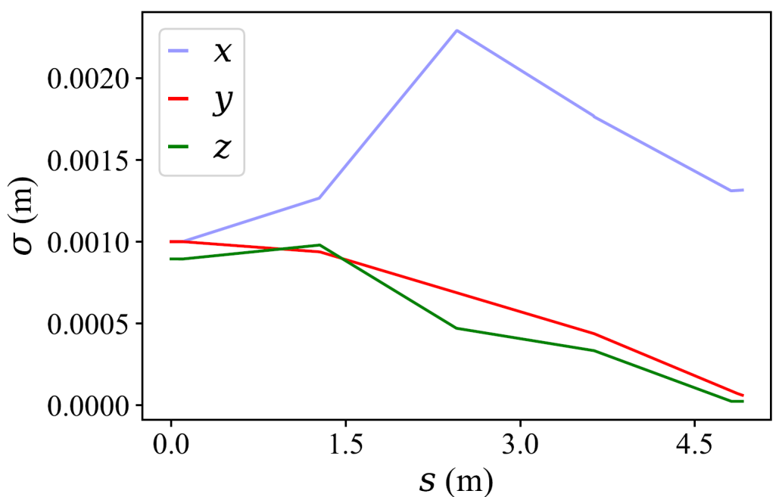
2-filament Beam @ 100 pC
Beam size
  Selected for longitudinal parameter scan
  Still compressing in last dipole
Still compressing
D1
D2
D3
D4
100pC

Slide 12
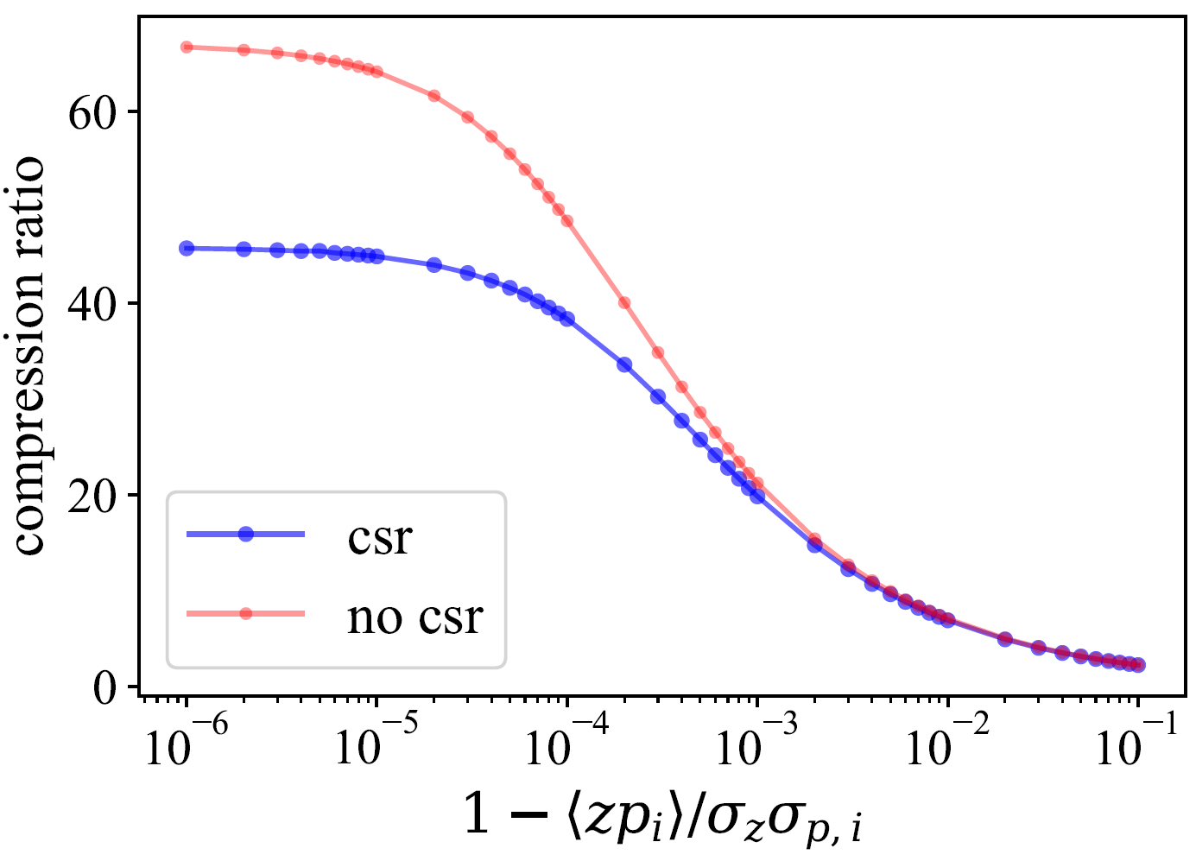
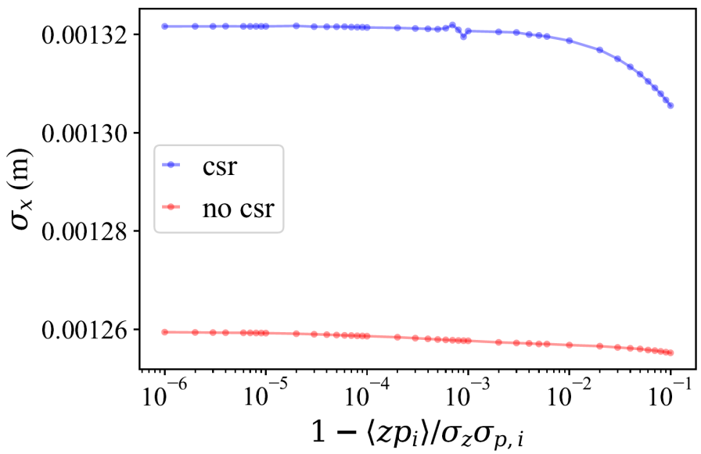
Compression vs Coupling
for 100 pC
p
t
original value

Slide 13
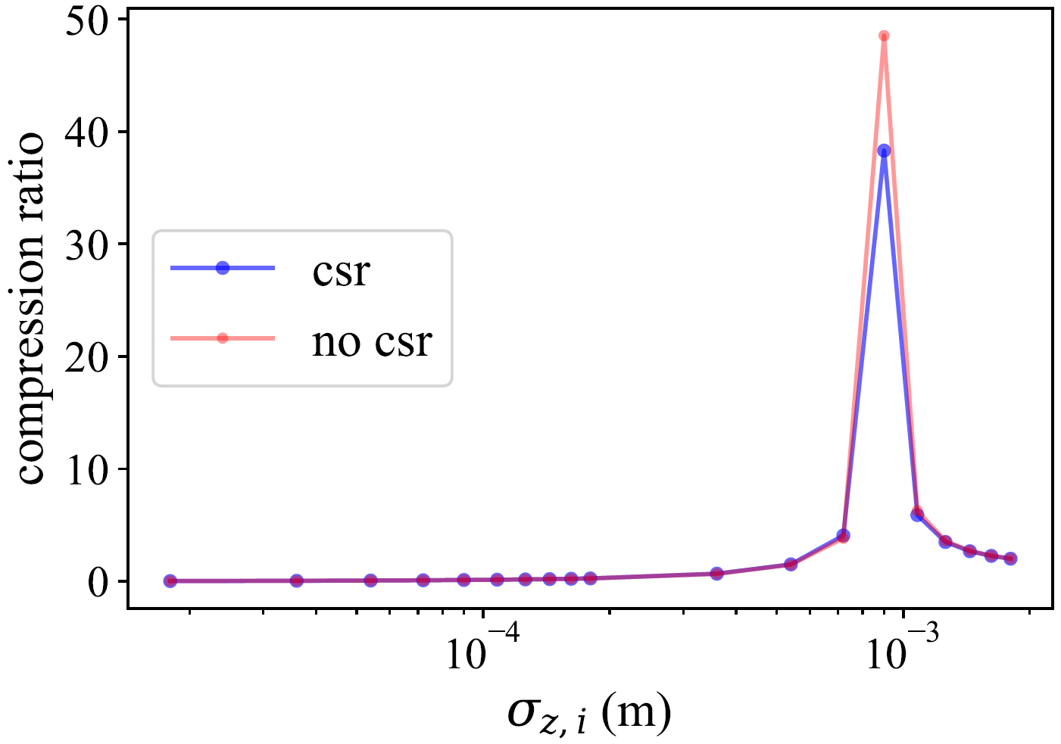
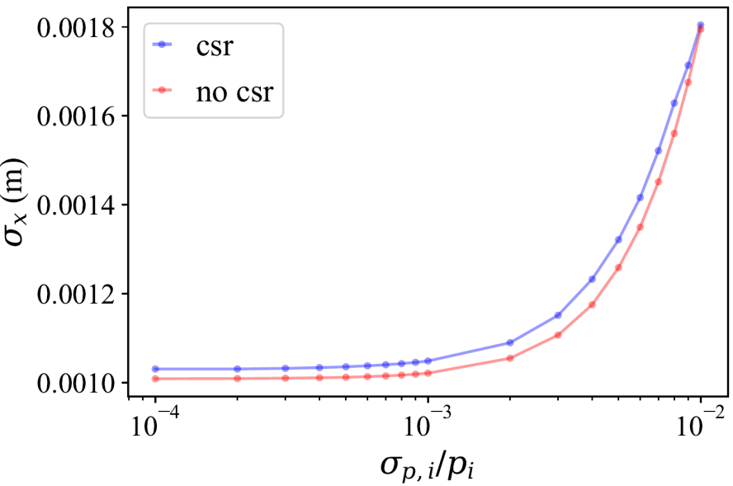
Compression vs Bunch Length
for 100 pC
p
t
original value
Overcompressed
Undercompressed

Slide 14
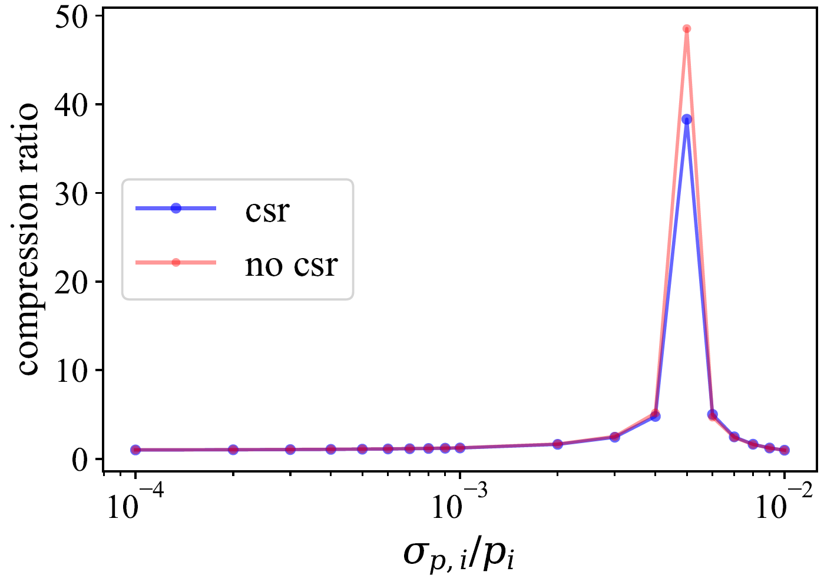
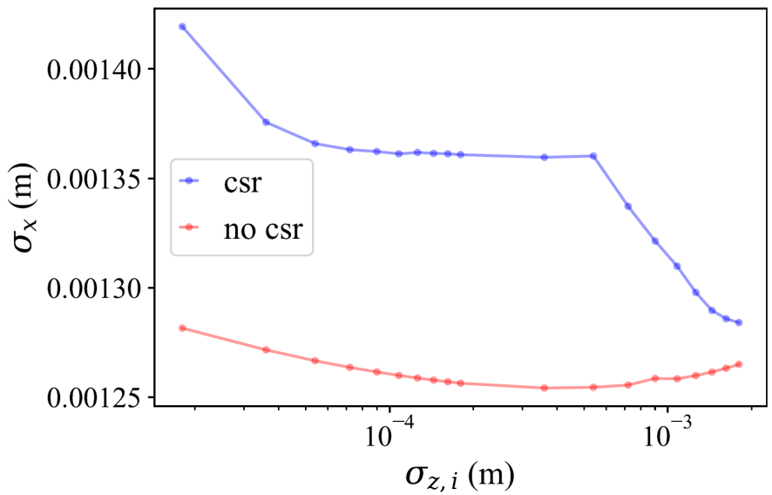
Compression vs Total Energy Spread
for 100 pC
p
t
original value
Undercompressed
Overcompressed

Slide 15
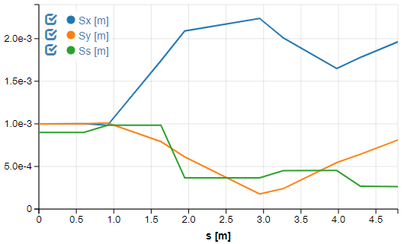
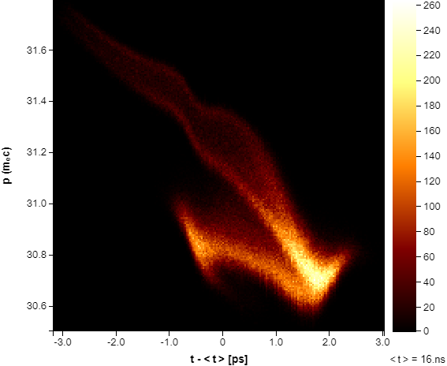
Benchmark with Elegant Results
No space charge and field profile
Beam size in x increases to 2.0 mm
compress bunch length only about 3.4 times
1nC
New shared Sirepo link for benchmarking with Elegant--> https://www.sirepo.com/elegant#/visualization/Qh52wQe0

Slide 16
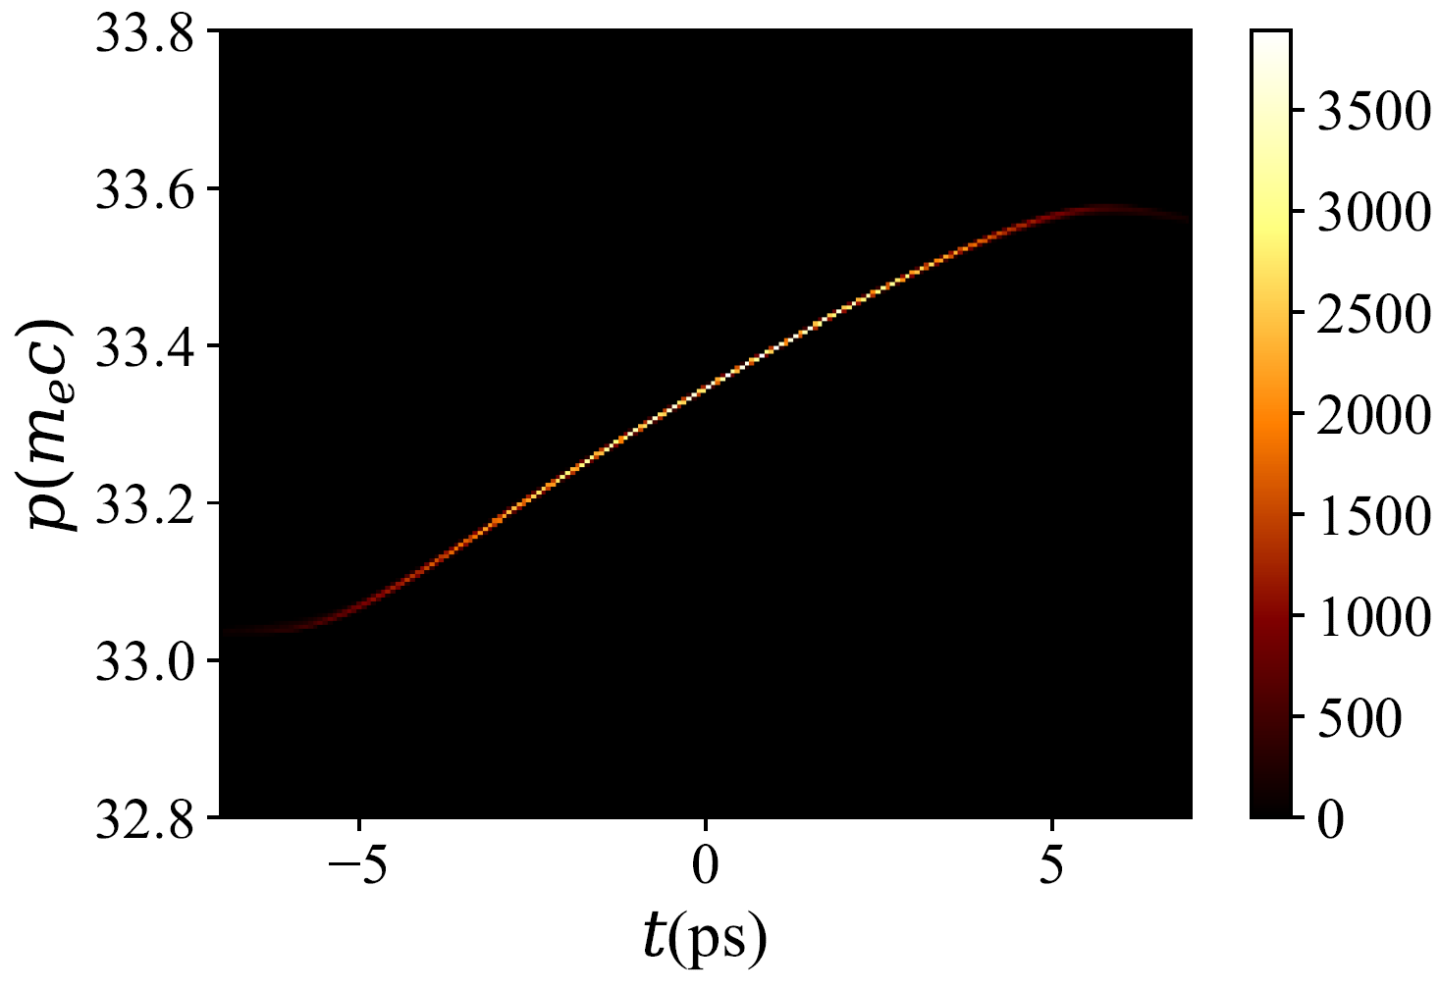
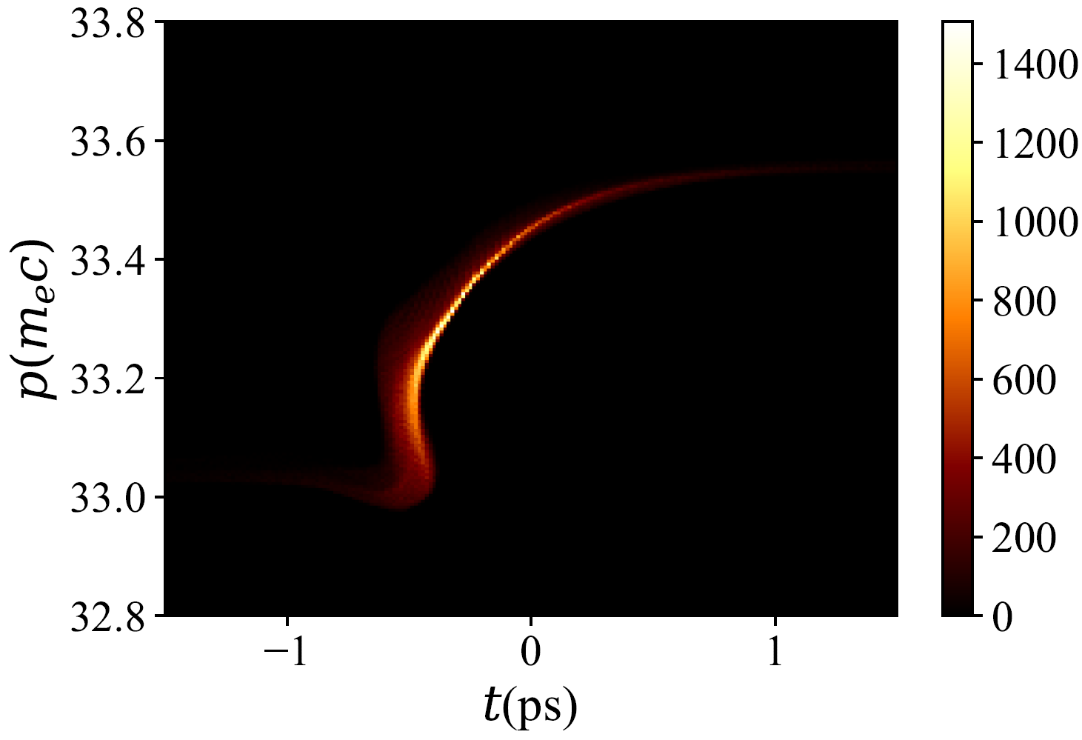
In Progress
use distributions from ASTRA tracking in Gun and Booster
100 pC, Initial
100 pC, Final

Slide 17
Summary
Status
  Design of bunch compressor chicane (no collision with old elements)
  Dipole flat B-profile by CST studio optimizer
CSR study
  IMPACT-t is our first choice but we want to try others as well
  Charge scan : 2 filaments show up at around 100 pC, beam distortion at 1nC
  Longitudinal parameter scan : parameter “coupling” can optimize the beam compression

