Slide 1
Simulation of the radiation in the THz SASE FEL at PITZ with 3D PIC code WARP
Background
Simulation results with Warp
Conclusion
Xiangkun LI
DESY-TEMF winter meeting
DESY, Hamburg, 28.11.2019

Slide 2
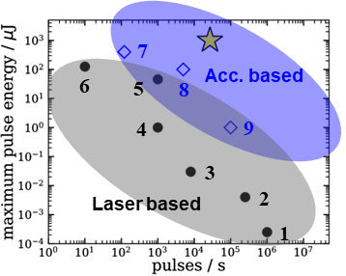
Background
A proof-of-principle experiment on THz SASE FEL is ongoing at PITZ, which is considered as a main option for pump-probe experiments at EuXFEL
Identical pulse train structure as the X-rays with up to mJ level energy
Can be close to XFEL user hall and support all XFEL end stations
SASE@4 nC, 200 A
~mJ
Laser shaping -> Pre-bunching
Chicane -> Short bunch
PITZ tunnel
wall
Tunnel annex
Pulse energy vs. rep. rate
6.6 MeV/c
17-22 MeV/c
THz diag
Gun
CDS booster
collimator
Q₂₈-Q₃₀
# | Mechanism
1,3, 5,6 | Optical rectification ^{[1]}
2 | Photoconductive antenna ^{[1]}
4 | Two-color Laser filamentation ^{[2]}
7 | CTR (LCLS/FACET) ^{[3]}
8 | UR (FLASH) ^{[4]}
9 | UR (TELBE) ^{[5]}
LCLS-I
undulator
Q₃₁-Q₃₂
60 – 100
$$μm$$
Q₂₅-Q₂₇
Y
Y
Y
Y
Vertical
Other app
~ 32 m
Y
BPM
Quadrupole
YAG Screen
Layout of the proof-of-principle THz SASE FEL experiment
Notes:
The advantages include: first, identical pulse train structure with up to mJ level energy; second, small in size, can support all user end stations
PoP experiment enabled by extending the existing beam line with an LCLS-I undulator
Pre-bunching is supported by our laser shaping technique and shorter bunch is reachable with the help of the chicane installed right before the undulator

Slide 3
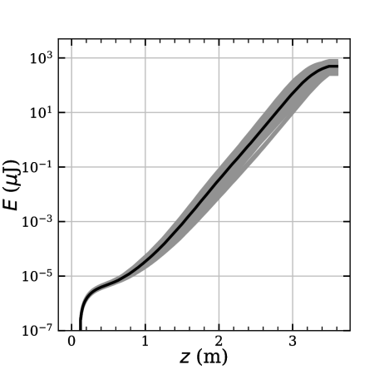
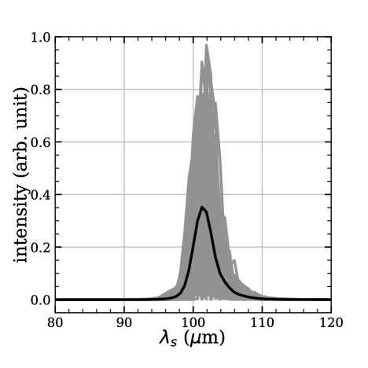
Background
Start–to-end simulations have been carried out with
Astra for the beam dynamics optimization and
Genesis 1.3 for SASE
With the LCLS-I undulator, 0.5 mJ average pulse energy has been generated in Genesis simulations
LCLS-I undulator
Type | planar
Period | 30 | mm
# of periods | 113
Peak B-field | 1.28 | T
Total length | 3.4 | m
Astra simulation w/ flattop laser (FWHM 21.5 ps, 4 nC)
0.5 mJ@100$μm$
Genesis
THz energy
spectrum
Notes:
S2E simulations have employed Astra for beam dynamics and Genesis for SASE generation
Typical simulation results are given here

Slide 4
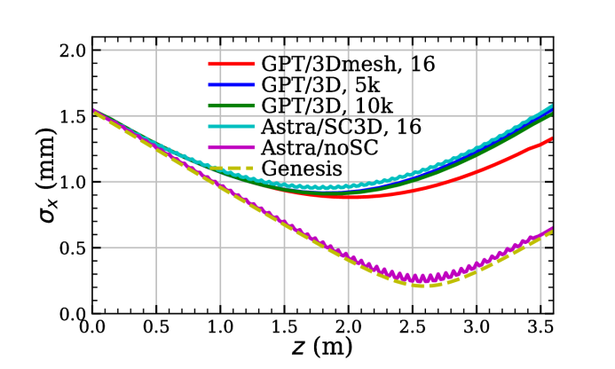
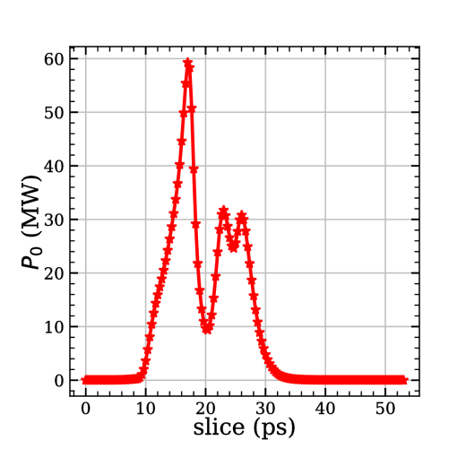
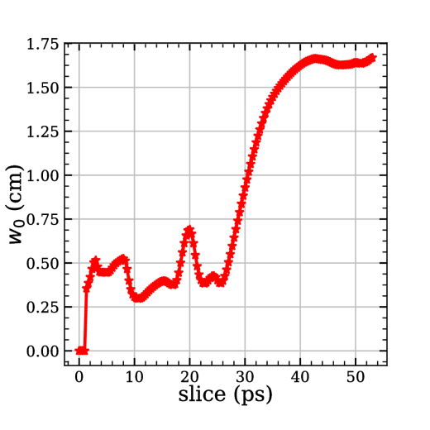
Background
Problems with Genesis 1.3 simulation
No transverse space charge for 4 nC at 16.5 MeV
No waveguide effects
Horizontal beam size in the LCLS-I undulator
Vacuum chamber
1.1 cm
0.5 cm
3.4 m
THz pulse power (left) and spot size (right) by Genesis 1.3
Notes:
Two problems exist for Genesis simulation: first, the space charge is not taken into account, which is not negligible for a 4 nC bunch at 16.5 MeV; second, the THz pulse is much larger than the vacuum chamber, the waveguide effect should be avaible
Crosscheck of space charge with Lienard-Wiechert potential method

Slide 5
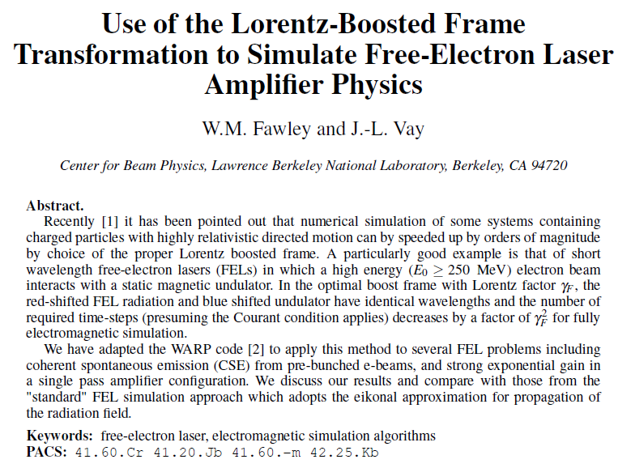
Simulation with Warp
Warp: a PIC framework for accelerator modeling
W. M. Fawley and J.‐L. Vay, AIP Conference Proceedings 1086, 346 (2009)
Jean-Luc Vay, US particle Accelerator School 2016
Notes:
AMR – adaptive mesh refinement
Warp can handle problems in different CS and in two frames. The fully 3D EM solver enables it to simulate the FEL. The boosted frame enables it to simulate the FEL orders of magnitudes faster.
PIC code not considered because of the huge scale of the problem

Slide 6
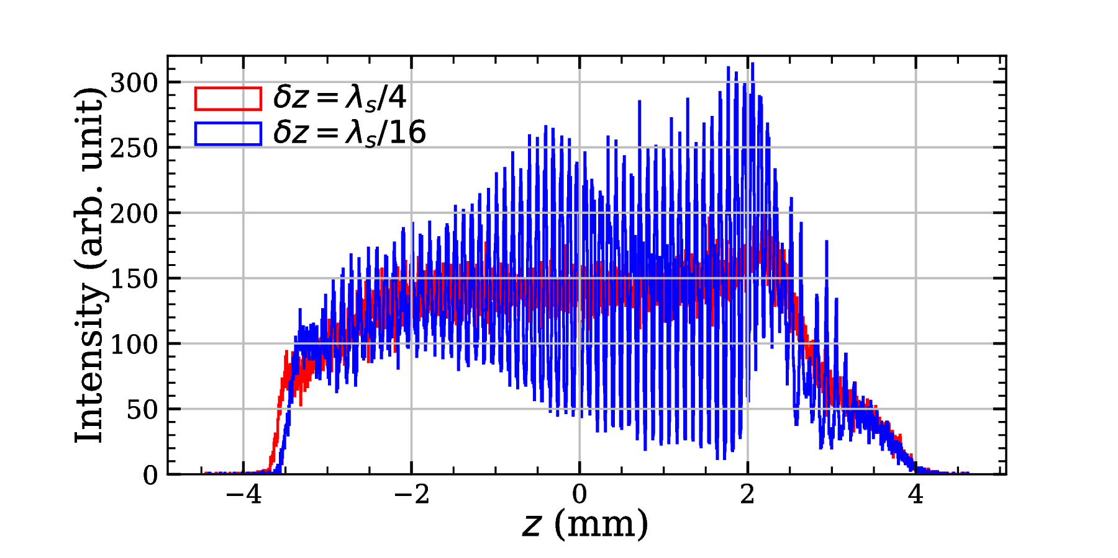
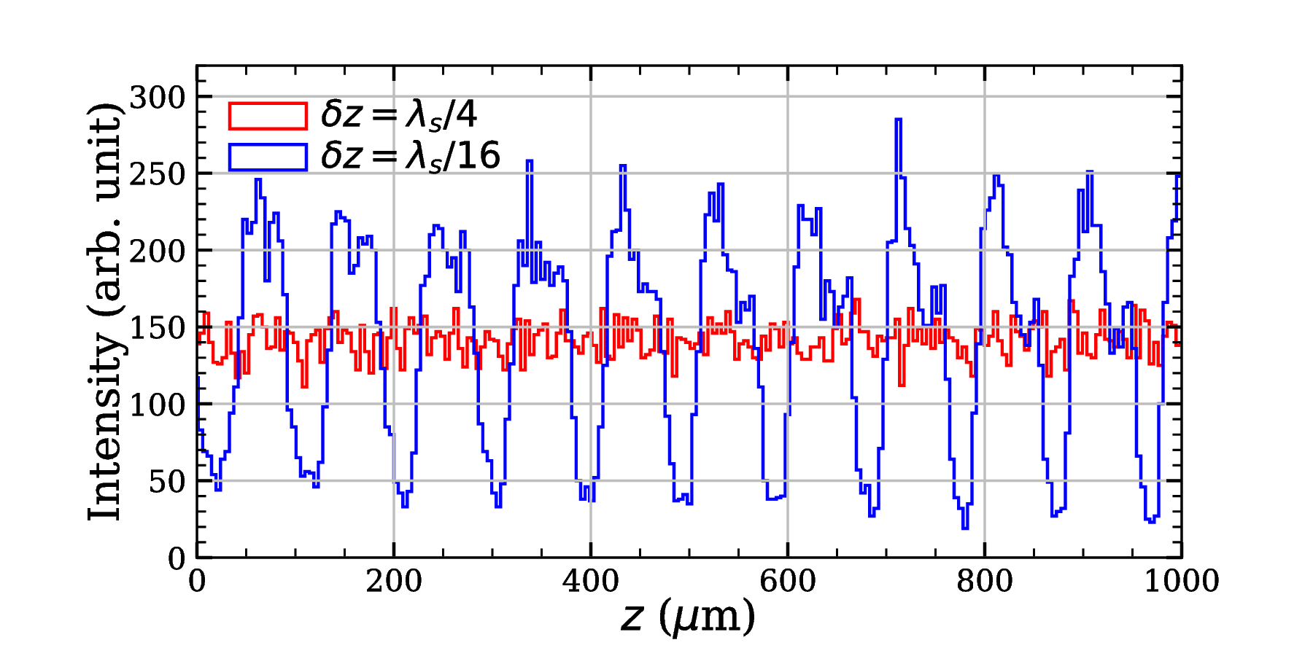
Simulation with Warp
Challenge
Courant condition for time step:
$$δt=\frac{1}{c}\sqrt{\frac{C_{x}}{δx^{2}}+\frac{C_{y}}{δy^{2}}+\frac{C_{z}}{δz^{2}}}$$
$C_{x}, C_{y}, C_{z}$: constants
$δt$ or $δz$ depends on the scale of the physics of interest
For undulator radiation, it is a small fraction of the radiation wavelength or period
3.4 m
1-10 mm
100 um
Taking $δz=λ_{s}/16$, we have $δt\sim 20 fs$ (and a total number of steps of 0.6 M) and a longitudinal mesh cells of 4800
The computation cost is very high
Solution: Parallel simulation + boosted frame
Longitudinal distribution near undulator exit (z~3.6 m)
Notes:
The Courant condition relates the time step with spatial grid sizes for a converged simulation
The time step and grid size depend on the scale of physics of interest
20 fs compared to Astra timestep of 0.5 ps -> more than half a million steps

Slide 7
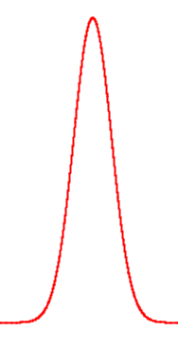
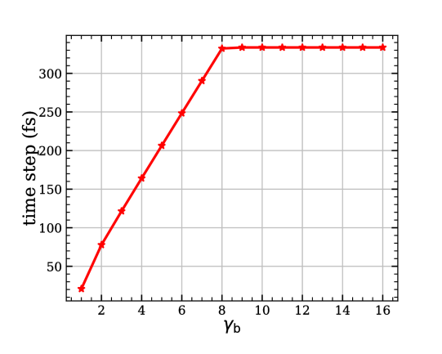
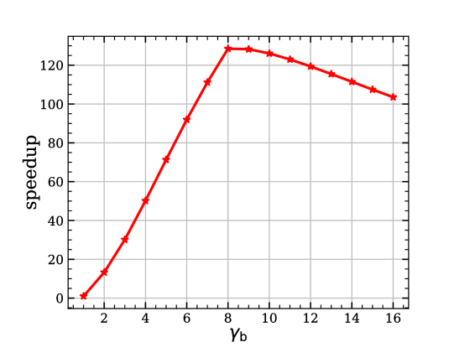
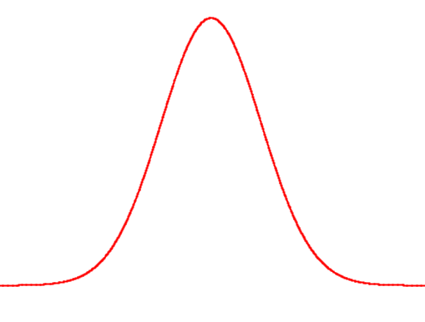
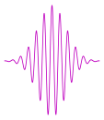
Simulation with Warp
In lab frame
Solution: boosted frame
Moving
window
Courant condition in 1D limit:
Undulator
$$δt=\frac{1}{c}\sqrt{\frac{C_{x}}{δx^{2}}+\frac{C_{y}}{δy^{2}}+\frac{C_{z}}{δz^{2}}}∝δz$$
e beam
$C_{x}, C_{y}, C_{z}$: constants
$$T∝\frac{L_{u}}{cδ_{t}}$$
Parameters in boosted frame (Lorentz transformation):
$$λ_{s}$$
$$γ_{boost}=γ_{b}=\frac{γ_{e}}{\sqrt{1+a_{u}^{2}}}$$
$$L_{0}$$
$$L_{u}$$
$$λ_{u}^{′}=λ_{u}/γ_{b}$$
$$λ_{s}^{′}={γ_{b}(1+β_{b})λ}_{s}≈2{γ_{b}λ}_{s}=λ_{u}^{′}$$
$$δ_{t}^{′}\sim γ_{b}\left(1+β_{b}\right)δ_{t}$$
In boosted frame
$$L_{u}^{′}=L_{u}/γ_{b}$$
$T^{′}∝\frac{L_{u}^{′}}{cδ_{t^{′}}}\sim \frac{T}{2γ_{b}^{2}}$ in 1D limit
Movingwindow
Undulator
$$T^{′}∝\frac{L_{u}^{′}}{cδ_{t^{′}}}$$
e beam
3D
3D
$δx=δy=λ_{s}$, $δz=λ_{s}/16$
$$λ_{s}^{′}$$
$$L_{0}^{′}=γ_{b}\left(1+β_{b}\right)L_{0}$$
$$L_{u}^{′}=L_{u}/γ_{b}$$
Vay, J.-L, et al. Physics of Plasmas, 2011, 18
Notes:
In 1D limit, the time step is proportional to longitudinal grid size
In Lorentz boosted frame, the radiation wavelength is multiplied by a factor of 2 gamma b, therefore making the time step increasing by the same factor; meanwhile, the undulator length is reduced by a factor of gamma b

Slide 8
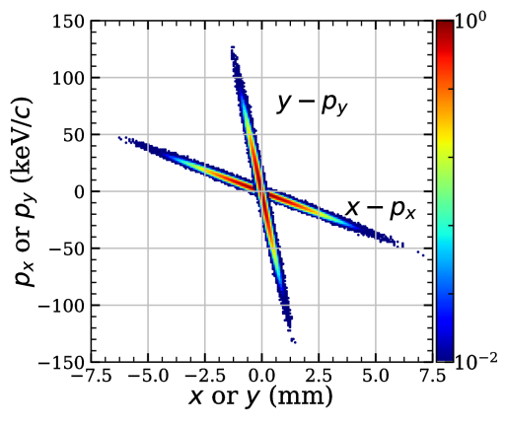
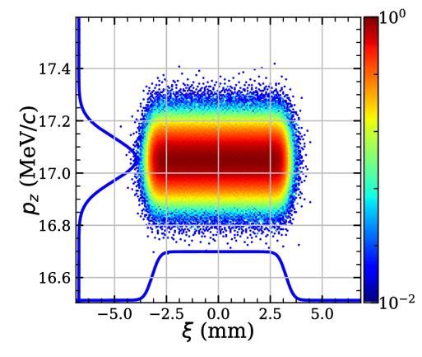
Preliminary results with Warp
Simulation parameters
Parameter | Value
# of particles | 200 k
Bunch charge | 4 nC
Peak current | 186 A
Momentum | 17.05 MeV/c
Undulator center | 1.8 m
Resonant wavelength | 100 $μm$
Moving window | yes
$$δx/λ_{s}$$ | 1
$$δy/λ_{s}$$ | 1
$$δz/λ_{s}$$ | 16
$${ N}_{x}×N_{y}×N_{z}$$ | 200x200x4800
Boosted factor, $γ_{b}$ | 12.25
Boundaries | open
Initial trans. & long. Phase spaces at undulator ent.
Generated by Astra with noise reduction ON
Results:
$δt\sim 215 fs$ with total steps of 8000
~ 5 hours with 96 CPU cores for $δz/λ_{s}=16$
The boosted frame has contributed a speedup of ~ 100
Notes:
The distribution is generated by Astra with the noise reduction ON, which means the Hammersley sequences are involved in the random process
Moving window with an open boundary
Takes ~ 5h with 96 CPU cores for nzplambda = 16 and gamma_b = 12.25, which results in a speedup of ~ 100 in the boosted frame

Slide 9
Preliminary results with Warp
Longitudinal density modulation
Above: Longitudinal distribution
Below: Zoomed view
Strong modulation in the second half of the undulator (from z=1.8 m)
The distance between micro bunches is roughly 100 um -> radiation wavelength
Notes:
The denstiy modulation or micro-bunching is observed here; the bunching period is same as the radiation wavelength

Slide 10
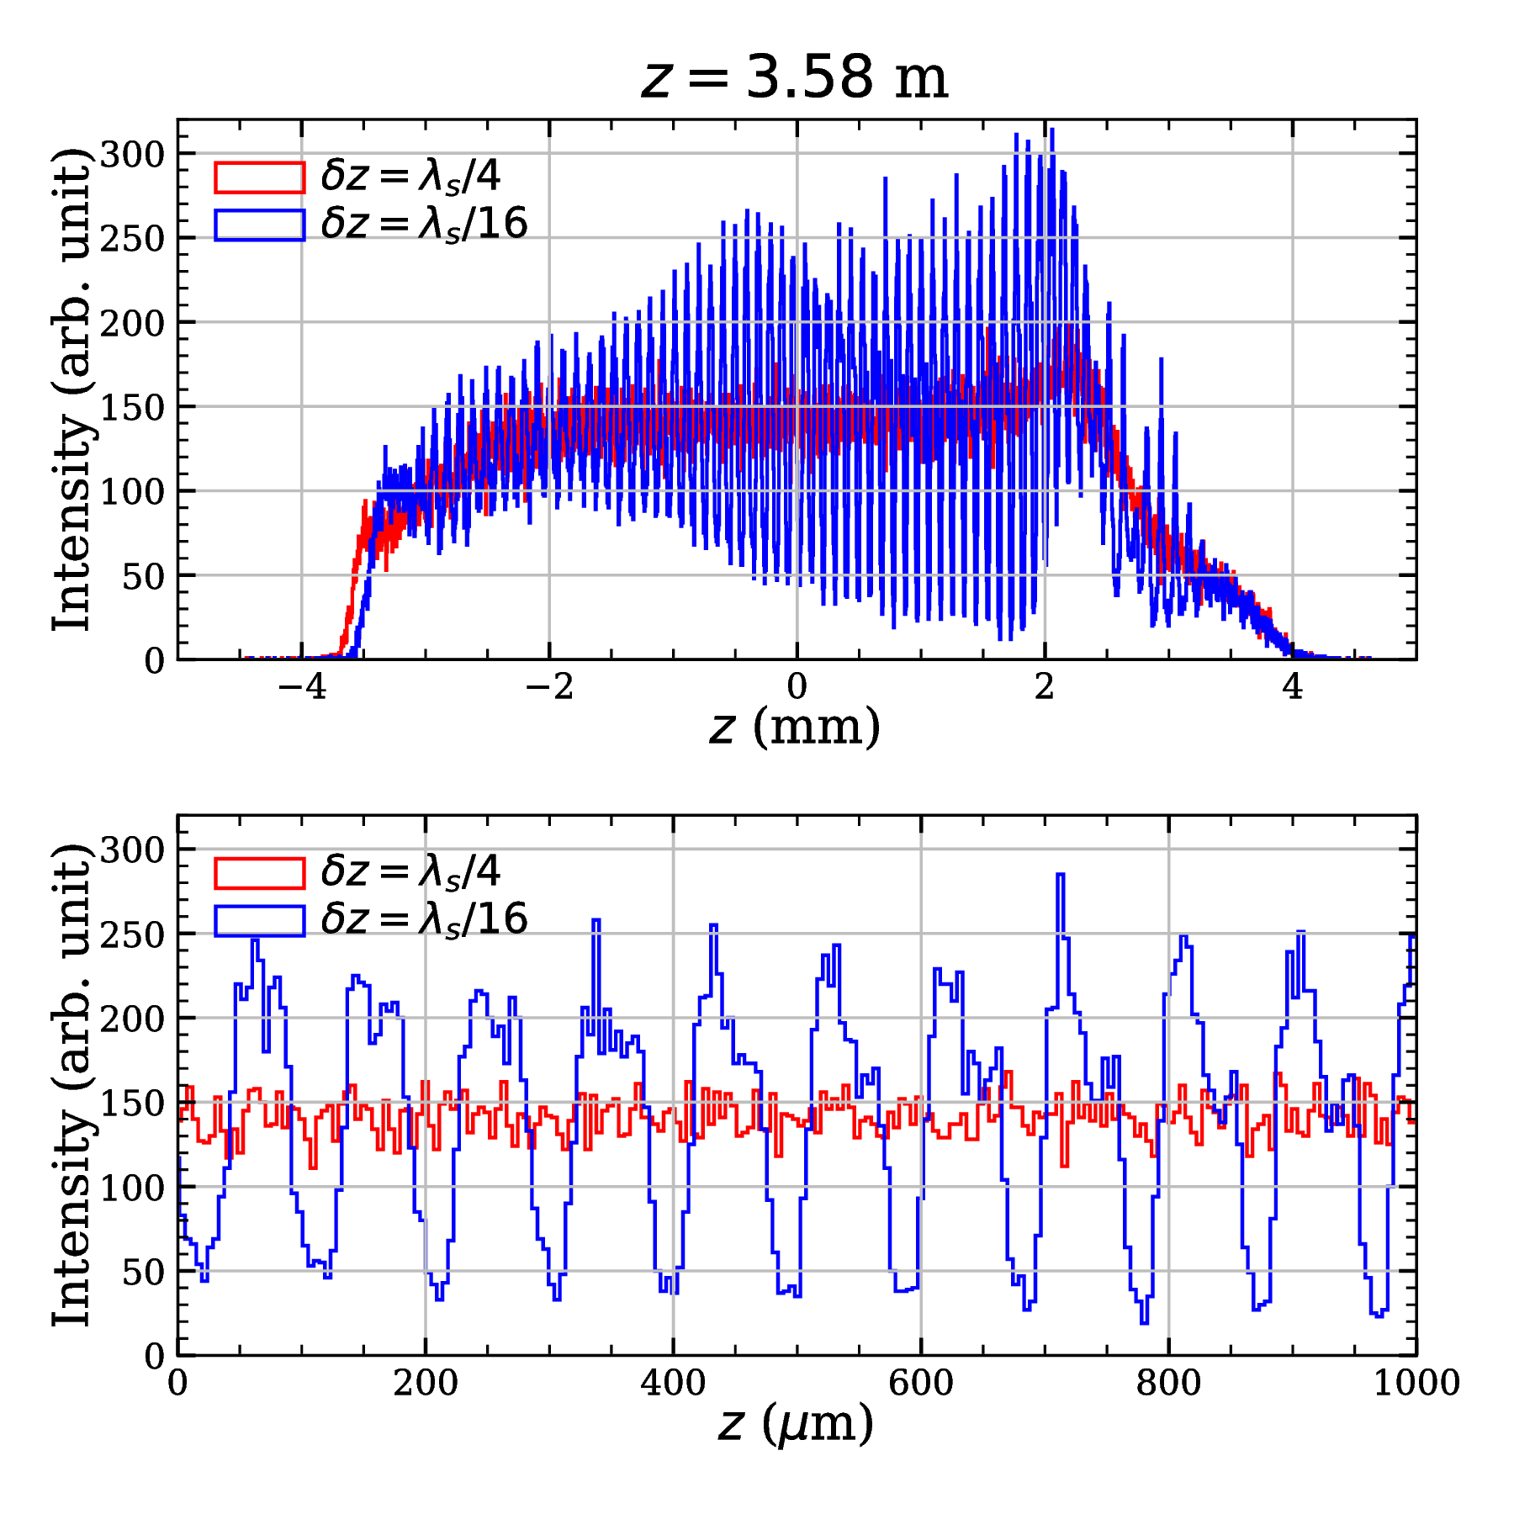
Preliminary results with Warp
Longitudinal density modulation
Above: Longitudinal distribution
Below: Zoomed view
Strong modulation in the second half of the undulator (from z=1.8 m)
The distance between micro bunches is roughly 100 um -> radiation wavelength
$$\sim 100 μm$$

Slide 11
Preliminary results with Warp
Radiation waveform and spectrum
Above: On-axis field profile
Below: Spectrum by FFT
$$E_{x}$$
Linearly polarized in $x$
On-axis field > 30 MV/m
Radiation frequency ~ 3.1 THz
Notes:
The on-axis electric field, which is very strong, is analyzed by FFT, giving a radiation frequency around 3 THz

Slide 12
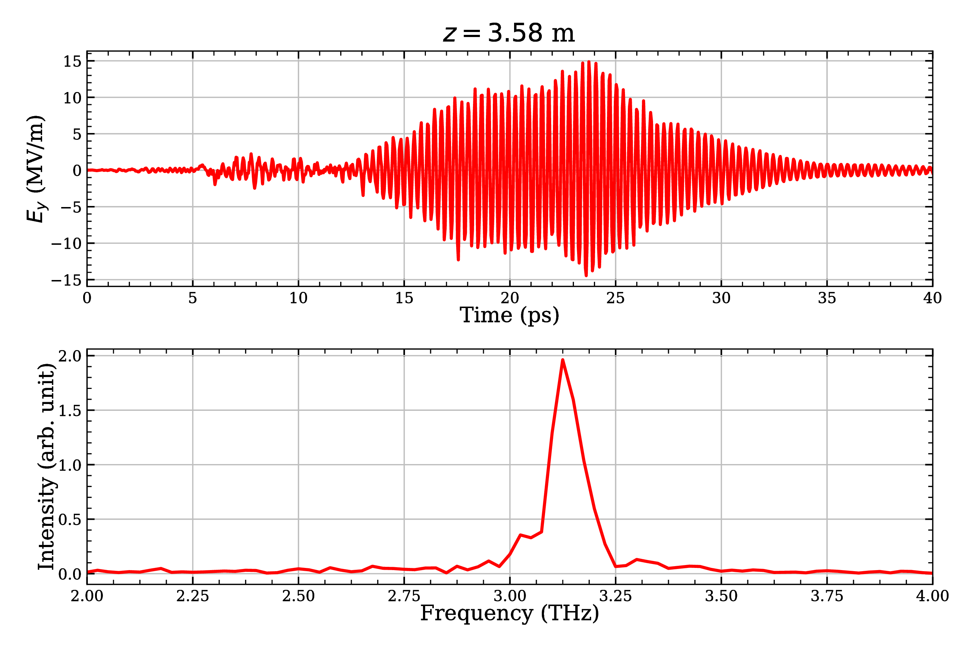
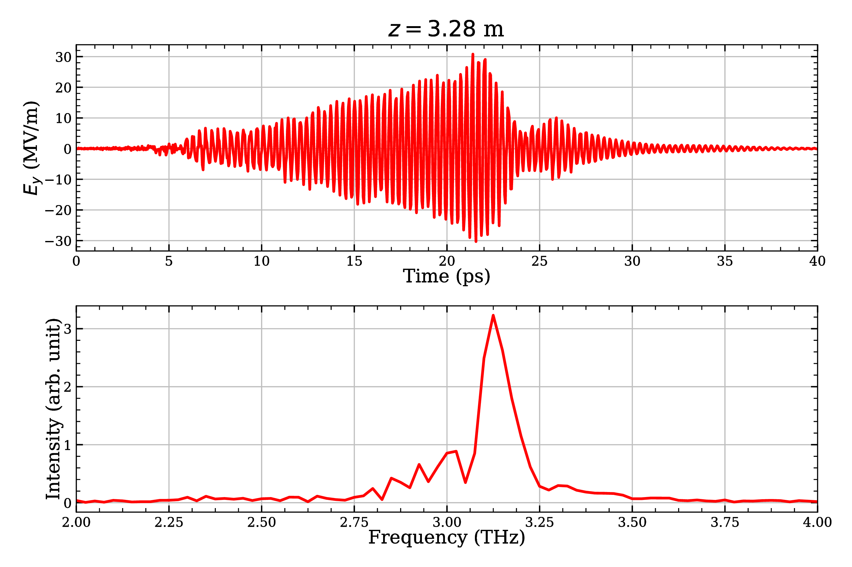
Preliminary results with Warp
Radiation waveform and spectrum
Above: On-axis field profile
Below: Spectrum by FFT
$$E_{x}$$
$$E_{x}$$
Linearly polarized in $x$
On-axis field > 30 MV/m
Radiation frequency ~ 3.1 THz

Slide 13
Preliminary results with Warp
Vacuum chamber size
Radiation distribution
Moving window
Above: THz beam transverse projection
Below: Radiation energy along undulator
The exponential growth starts from z~1.8 m, synchronized with the modulation
Cut by the small chamber/moving window
Radiation energy > 100 uJ
Notes:
The beam size shoots up near the undulator exit (3.5 m)
The THz pulse energy is cut by the moving window, letting alone the vacuum chamber

Slide 14
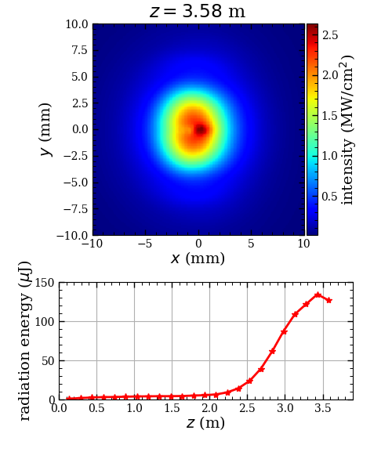
Preliminary results with Warp
Vacuum chamber size
Radiation distribution
Moving window
Above: THz beam transverse projection
Below: Radiation energy along undulator
Genesis
The exponential growth starts from z~1.8 m, synchronized with the modulation
Cut by the small chamber/moving window
Radiation energy > 100 uJ
Cut by moving window

Slide 15
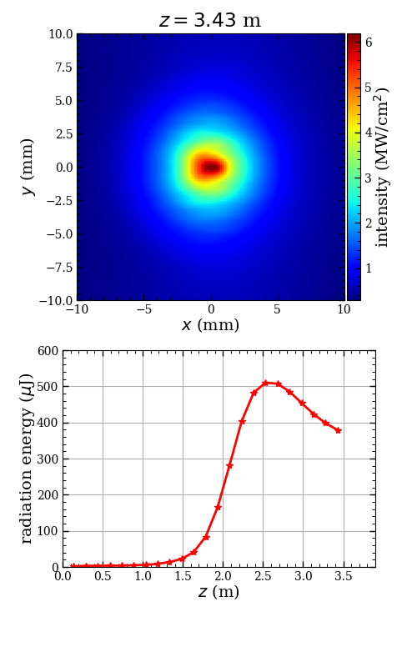
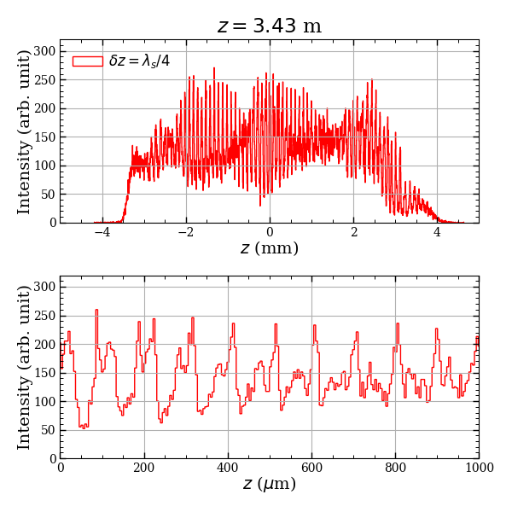
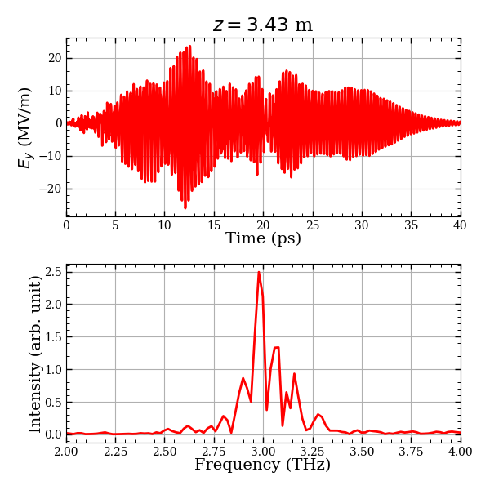
Preliminary results with Warp
Initial distribution without noise reduction
Turning off noise reduction will increase the shot noise from statistical fluctuation of a random process
The modulation happens earlier with fine structures, resulting in multiple spikes in spectrum and much higher radiation energy
$$shot noise\sim 1/N (ON) →N^{−\frac{1}{2}}(OFF)$$
Cut by moving window
Notes:
The noise reduction is realized by using the Hammersley sequences to generate random numbers
When switched off, the shot noise scales inversely with the square root of the macro-particle number
What if shifting the growth curve from the previous slide to match the curve here
The shot noise should be carefully treated

Slide 16
Conclusion
In order to include the space charge and conducting boundary in the simulation of THz generation in a SASE FEL, the 3D PIC code warp is being considered
Preliminary simulations have showed that the simulation can be finished at a reasonably low cost; the micro-bunching of the electron beam and the exponential growth of the THz pulse energy in the undulator have been observed; the radiation energy is relevant with the shot noise
Higher spatial resolution to refine settings; more macro particles for reasonable shot noise level
A conducting boundary will be applied to study the waveguide effect, particularly in the exponential growth stage and to provide an idea on the transport of THz pulse after the undulator
Thank you for your attention

Slide 17
References
[1] B. Green, et al, Sci.Rep.V. 6, Article number: 22256 (2016)
[2] M. Gensch, Proceedings of FEL 2013, 474 (2013)
[3] T. I. Oh et al 2013 New J. Phys. 15 075002
[4] https://flash.desy.de/
[5] https://www.hzdr.de/db/Cms?pOid=34100&pNid=2609&pLang=en
[6] K. Flottmann, ASTRA particle tracking code, http://www.desy.de/~mpyflo/
[7] http://www.pulsar.nl/gpt/
[8] S. Reiche, GENESIS 1.3 code, http://genesis.web.psi.ch/.

Slide 18
Backup

Slide 19
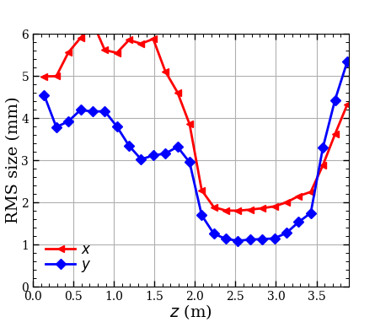
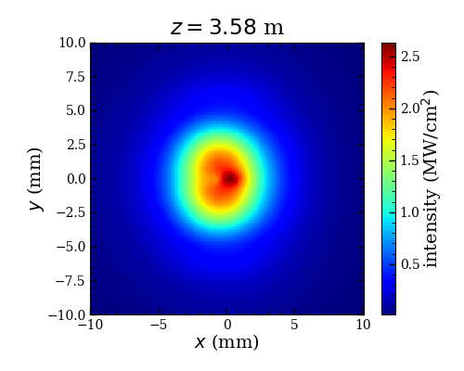
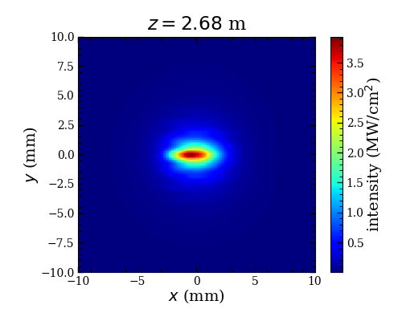
Preliminary results with Warp
Radiation distribution (w/ noise reduction)
Notes:
Beam parameters along the undulator
Modulation of beam
Radiation waveform and spectrum
Discussion

Slide 20
Preliminary results with Warp
Shot noise
Shot noise in Astra and GPT
Shot noise in Genesis 1.3
$$\frac{1}{N} with noise reduction$$
$$N^{−1/2} without noise reduction$$
$N$ is # of macro-particle of the whole bunch
$$\frac{1}{N^{∗}\sqrt{log(N^{∗}/ρ)}}$$
$N^{∗}$ is # of macro-particle per radiation wavelength
$ρ$ is FEL parameter

Slide 21
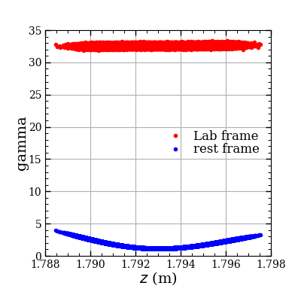
Space charge calculation in undulator
Basic procedures of PIC method:
1. Transform the beam into rest frame
2. Solve Poisson’s equation in the rest frame
3. Transform the fields into lab frame
lab frame
rest frame velocity:
$$\vec{β_{0}}=\frac{∑n_{i}γ_{i}\vec{β_{i}}}{∑n_{i}γ_{i}}$$
All velocities in the rest frame << c, which doesn’t holds when:
1. Energy spread is very large
2. Varying transverse kick applied along the beam
rest frame
 | GPT 3Dmesh | GPT 3D | Astra SC3D
Model | Particle-in-cell | Particle-to-particle | Particle-in-cell
Solver | Multi-grid | Coulomb’s law | FFT
Grids | 16x16x16 | None | 16x16x16
# of particles | 200 k | 5k or 10 k | 200 k

Slide 22
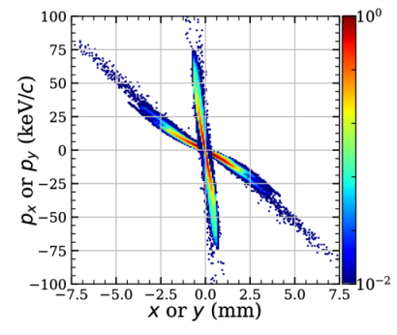
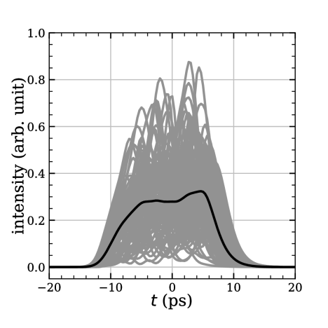
Simulation with Genesis 1.3
$$x−p_{x}$$
Parameter | Value | Unit
Pulse energy | 493.1$±$108.8 | $$μJ$$
Peak power | 52.7$±$11.8 | $$MW$$
Centre wavelength | 101.8$±$0.7 | $$μm$$
Spectrum width | 2.0$±$0.4 | $$μm$$
Arrival time jitter | 1.45 | $$ps$$
$$y−p_{y}$$
Genesis 1.3 simulation with input beam from Astra
No transverse space charge effects
No waveguide effects
Vacuum chamber
11 mm
5 mm
Pulse energy along und.
Spectrum at und. exit
Temporal profile at exit

Slide 23
Lorentz transformation:
Parameters in boosted frame:
$$x^{′}=x$$
$$y^{′}=y$$
$$z^{′}=γ\left(z−vt\right)$$
$$t^{′}=γ\left(t−\frac{vz}{c^{2}}\right)$$
$$γ_{boost}=γ_{b}=\frac{γ_{e}}{\sqrt{1+a_{u}^{2}}}$$
$$λ_{u}^{′}=\frac{λ_{u}}{γ_{b}}$$
$$λ_{s}^{′}={γ_{b}(1+β_{b})λ}_{s}≈2{γ_{b}λ}_{s}=λ_{u}^{′}$$
$$v_{x}^{′}=\frac{v_{x}/γ}{\left(1−βv_{z}/c\right)}$$
$$v_{y}^{′}=\frac{v_{y}/γ}{\left(1−βv_{z}/c\right)}$$
$$v_{z}^{′}=\frac{\left(v_{z}−βc\right)}{\left(1−βv_{z}/c\right)}$$
$$δt=\frac{1}{c}\sqrt{\frac{C_{x}}{δx^{2}}+\frac{C_{y}}{δy^{2}}+\frac{C_{z}}{δz^{2}}}$$
$δt$ or $δz$ depends on the resolution of the radiation wavelength
$$E_{x}^{′}=γE_{x}−βγ{cB}_{y}=−βγcB_{y}$$
$$E_{y}^{′}=γE_{y}+βγcB_{x}=βγ{cB}_{x}$$
$$E_{z}^{′}=E_{z}=0$$
$${cB}_{x}^{′}=γ{cB}_{x}+βγE_{y}=γ{cB}_{x}$$
$${cB}_{y}^{′}=γ{cB}_{y}−βγE_{x}=γ{cB}_{y}$$
$${cB}_{z}^{′}={cB}_{z}=0$$

